Slide 1
Project 2048
Leonie Böhm & Caroline Czapla

Slide 2
Overview
The Vision
The Process
SHOWTIME
Self evaluation

Slide 3
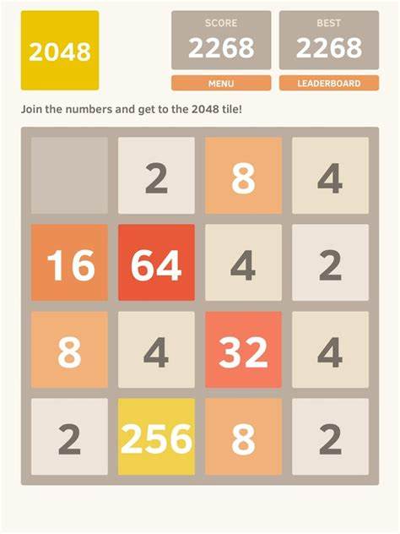
The Vision

Slide 4
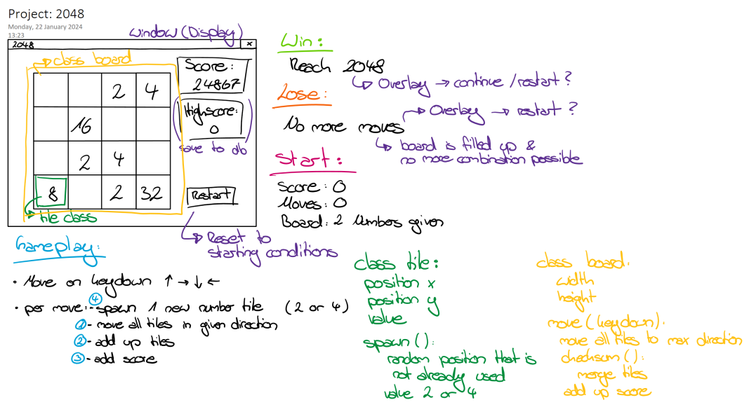
OUr Vision

Slide 5
The process
What was the most fun?
→Working together & learning from each other
What was the most difficult?
→Getting the screen to render the way we wanted it to…
Which function took the longest?
„moveTiles()“ – total 4 hours

Slide 6
The process
17 Issues
14 closed
3 open
→ 82 % „done“

Slide 7
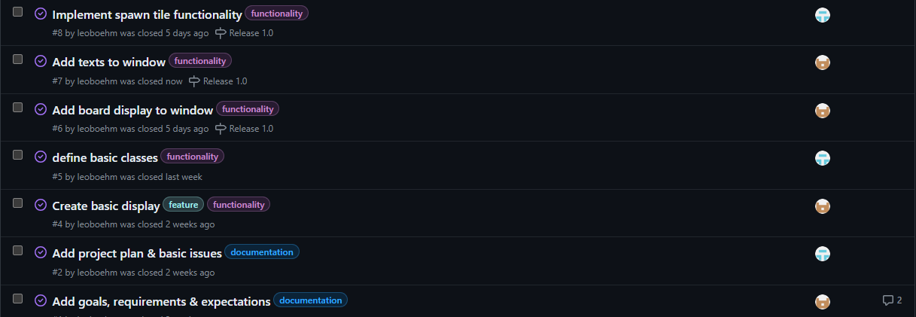

Slide 8
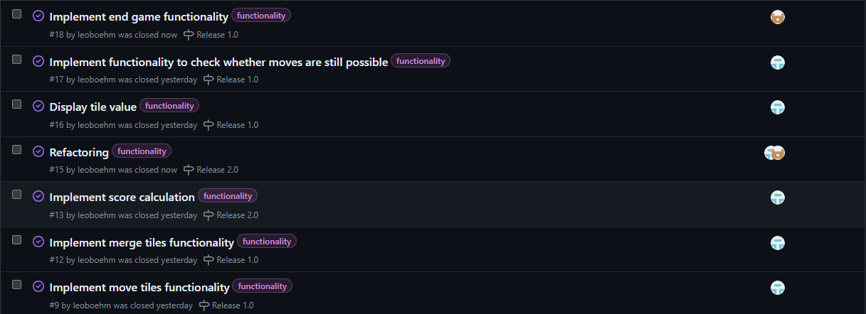

Slide 9
SHOWTIME

Slide 10
Self evaluation
Professional competence
Methodological competence
[TEXT EINFÜGEN]
[TEXT EINFÜGEN]

Slide 11
Self evaluation
Personal/Social competence
Action competence
[TEXT EINFÜGEN]
[TEXT EINFÜGEN]

Slide 12
It takes a lot of hard work to create something simple.
“
”
Steve Jobs

