Slide 1
TRAFFIC SIGN SEGMENTATION AND RECOGNITION IN SCENE IMAGES
Fei Qin1, Bin Fang1, Hengjun Zhao1
1. Department of Computer Science, Chongqing University, Chongqing 400030, China
E-mail: jiemy@cqu.edu.cn, fb@cqu.edu.cn, zhhj@cqu.edu.cn
中原大學 資訊工程學系 9827208 資訊四乙 劉鳳錄

Slide 2
大綱
1. INTRODUCTION
2. TRAFFIC SIGN SEGMENTATION
3. TRAFFIC SIGN RECOGNITION
4. EXPERIMENTAL RESULTS
5. CONCLUSION AND DISCUSSION
6. REFERENCES

Slide 3
1.INTRODUCTION
Automatic traffic sign detection and recognition is important in the development of unmanned vehicles, and is expected to provide information on road signs and guide vehicles during driving. This paper deals with traffic sign detection and recognition from image sequences.

Slide 4



2.TRAFFIC SIGN SEGMENTATION
Red is the basic color for prohibition signs, with background mainly in white.
In the directional signs, blue is the background color, mainly with white-core designs.
As for warning signs, yellow is chosen as the fundamental color, with black border, and the core-based designs are also mainly in black.

Slide 5

I.COLOR DISTANCE
Euclidean distance is one of the most common uses of distances in Bayes Decision Theory and Statistical Pattern Recognition.

Slide 6


COLOR DISTANCE
Therefore, the Color Distance (CD) which denotes the difference between two colors, is defined as:
According to the color distance model given above, the color distance between a pixel and the standard red (255,0,0)
can be written as:

Slide 7
UNFORTUNATELY
Unfortunately, we have to pay attention to the selection of Standard Color (SC). It is assumed that the SC of traffic sign is close to the ideal one. So far, we can do the segmentation as long as the right threshold is selected. How to choose an appropriate threshold remains to be a challenge. We take the red prohibition sign as an example in the subsequent subsections.

Slide 8
II.THRESHOLD SELECTION
The threshold is not an experience threshold but a statistic threshold. The method to search for color segmentation threshold uses consecutive images which includes traffic signs. Using experience threshold roughly segments these consecutive images. After that, positive and negative samples are classified manually. The next task is to do a statistical work both in positive-sample-set and negative-sample-set. Obviously, our threshold parameter is color distance.

Slide 9
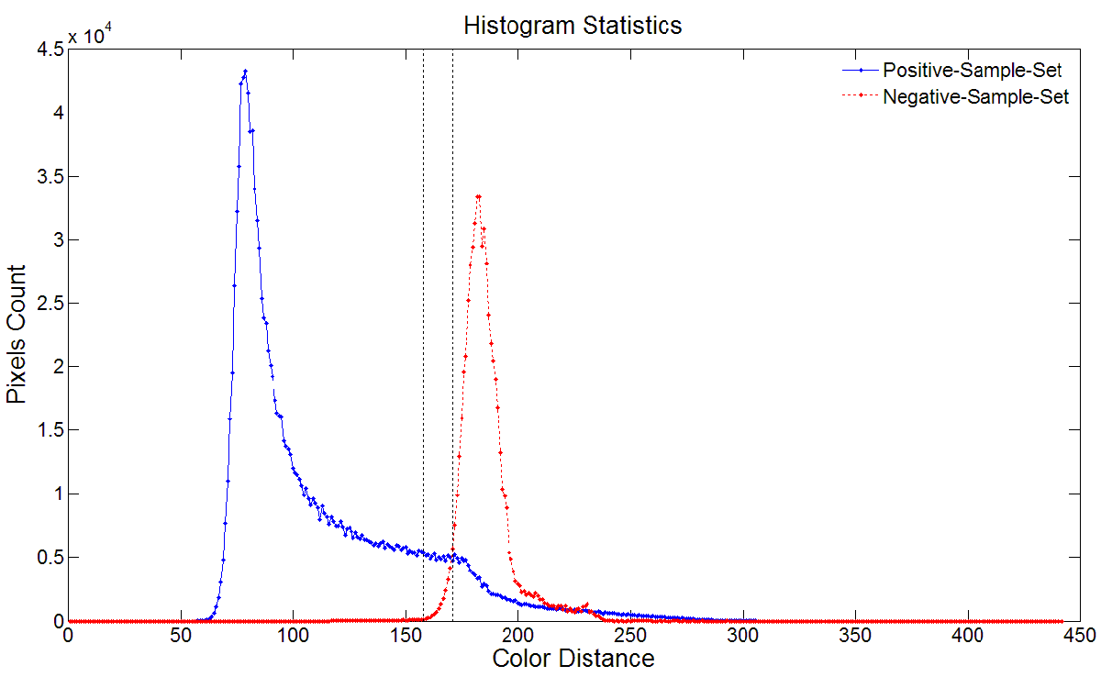
1.positive-sample-set 幾乎都在
second broken line左側
2.negative-sample-set不超過
first broken line
3.區間內越靠近 first broken line
↓
越少雜訊、好檢索出目標

Slide 10
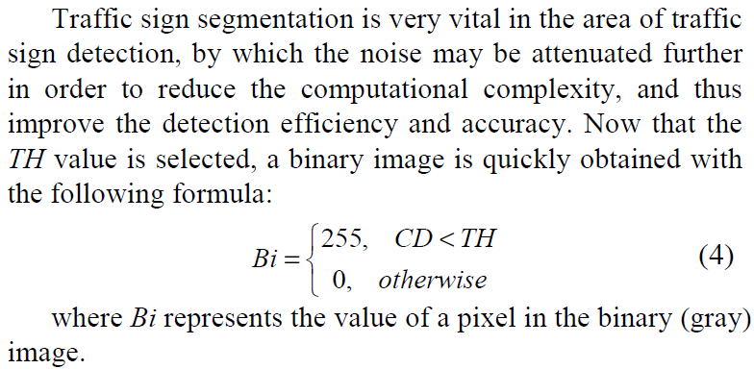
III.TRAFFIC SIGN SEGMENTATION

Slide 11
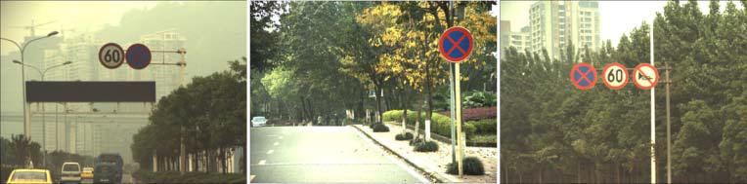

original image
binary image

Slide 12
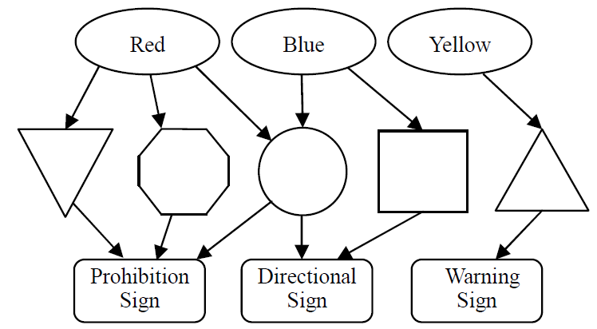
TRAFFIC SIGN RECOGNITION
I.Color-Geometric Model (CGM)

Slide 13

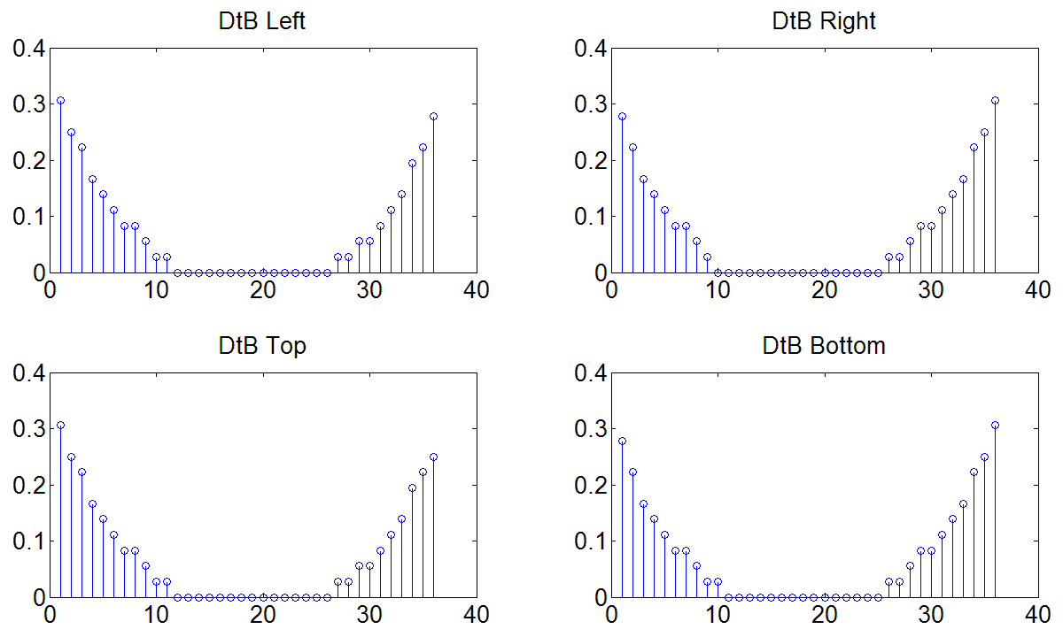

II.DISTANCE TO BORDER (DTB)
DtB is the distance from external edge of the blob to its bounding box.

Slide 14
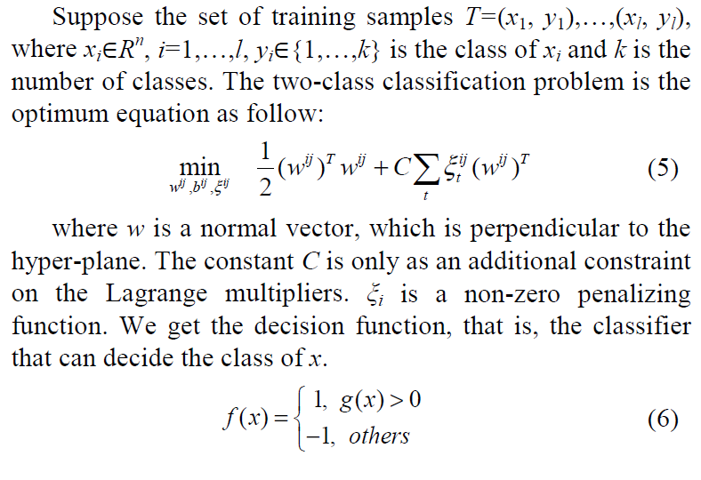

III.SUPPORT VECTOR MACHINE (SVM)
SVM is a set of related supervised learning methods used for classification and regression.

Slide 15
IV.TRAFFIC SIGN CLASSIFICATION
  In the shape classification stage, we need to build a multiclass SVM to classify 5 types of shapes including circle,rectangle, positive triangle, inverse triangle, and octagon.
  Once the shape information is obtained, we can realize rough classification based on CGM. Moreover, it also can be utilized to extract Pixels of Interest (POI) by using a mask image corresponding to the shape of the blob. The shape classified blob is first normalized to a size of 80X80. The masking operation is applied, with only those pixels that arecrucial part of the sign reserved. Then the edge of the masked POI is extracted and used as the feature vector for traffic sign classification.

Slide 16
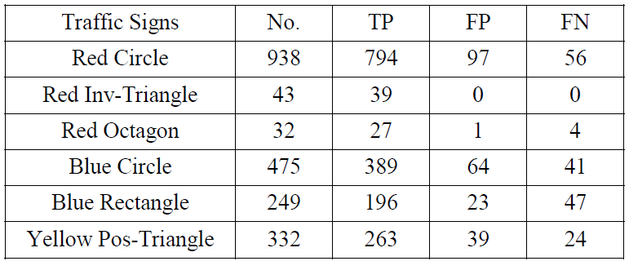
EXPERIMENTAL RESULTS

Slide 17
CONCLUSION AND DISCUSSION
Experiment results show that our algorithm is succinct and conducive to real-time processing. However, the selected TH values in this paper depend on the large number of samples captured in special environment. How to dynamically select the right TH value requires further study, and will be explored in the next research phase.

Slide 18
THANK FOR YOUR ATTENTION!!!!!
肛溫蛤~
中原大學 資訊工程學系 9827208 資訊四乙 劉鳳錄

