Slide 1
Automatic Detection and Segmentation of Brain Tumor Using Random Forest Approach
Bachelor Seminar WS 2020/21
“Medical Image Computing and e-Health”
08.01.2020
Prof. Dr. Heinz Handels, Prof. Dr. Josef Ingenerf, Prof. Dr.-Ing. Marcin Grzegorzek and coworkers
Institute of Medical Informatics
Universität zu Lübeck

Slide 2
Outline
Motivation
Basics
Binary Decision Trees (BDT)
Random Forest (RDF)
Methods
Application in Paper
Results of the Experiment
Conclusion

Slide 3
Motivation
Author: Zoltán Kapás, Release: 2016
Building reliable procedure for tumor detection
Based on supervised machine learning
Primary Goal: Early Detection
Secondary Goal: Segmentation
Currently challenging due to variety of anatomical structures

Slide 4
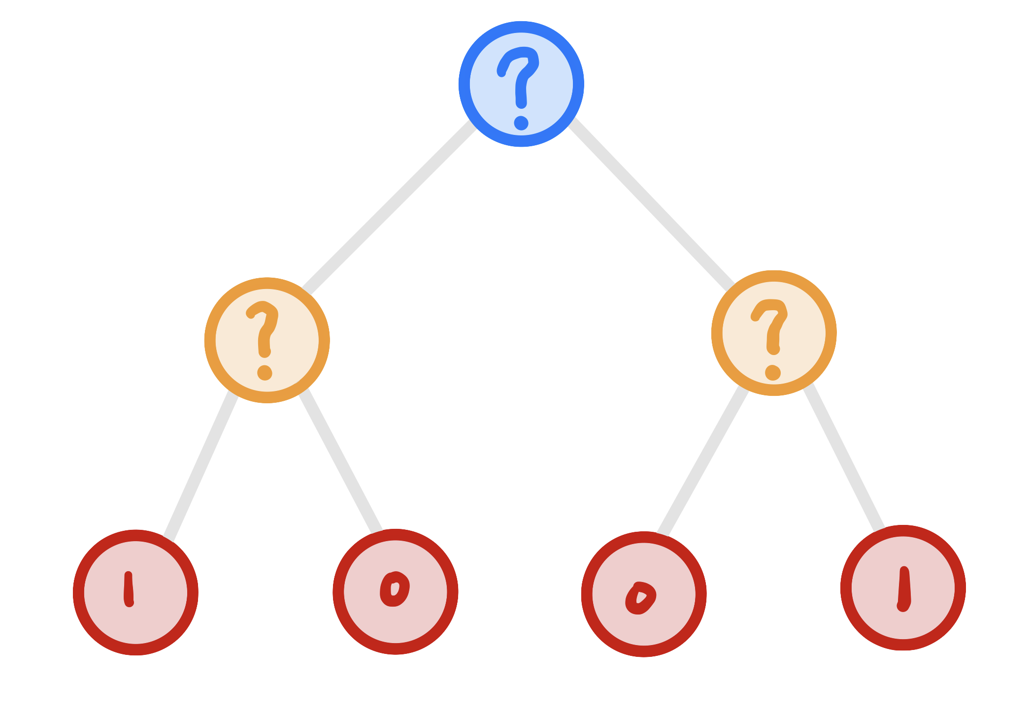
Basics - BINARY DECISION TREE
Hierarchy of two-way decisions
Learn Classification of training set
Decision at leaf node
ROOT
SPLIT
LEAF

Slide 5
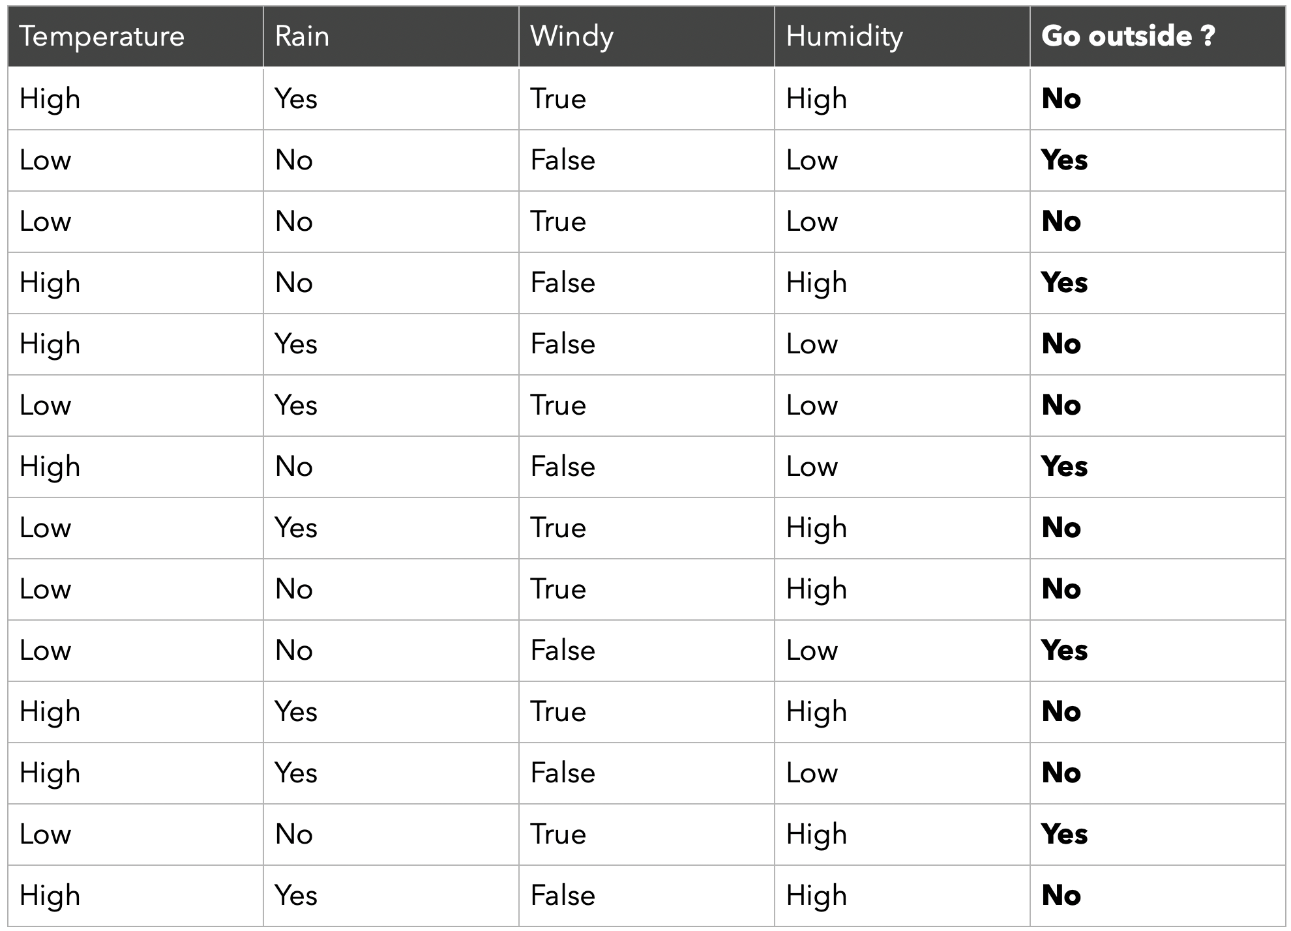
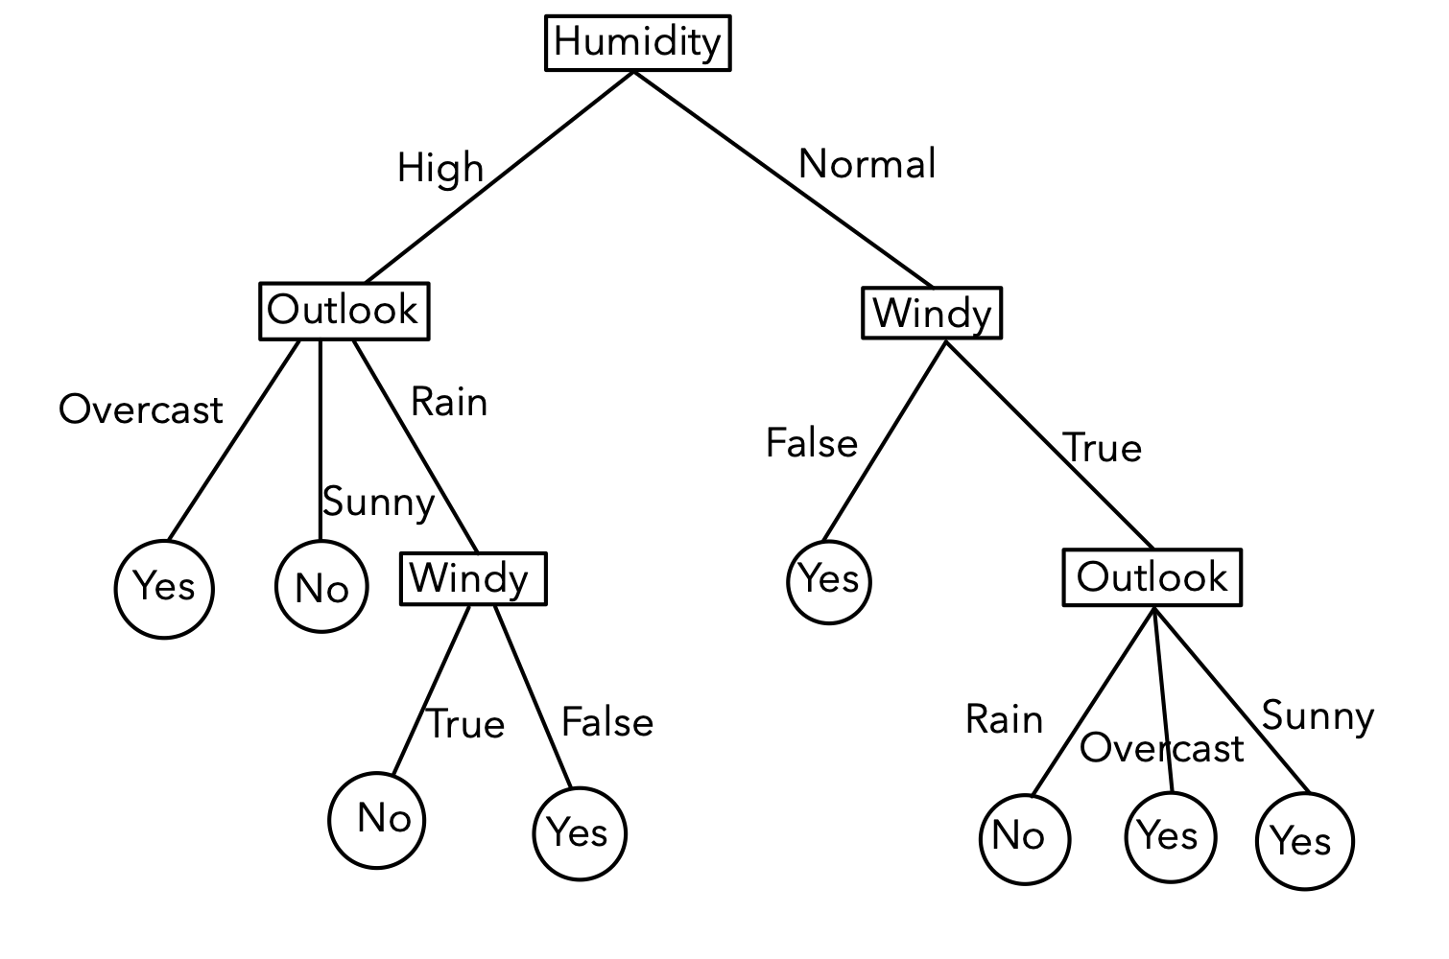
Basics - BINARY DECISION TREE

Slide 6
How to split?

Slide 7
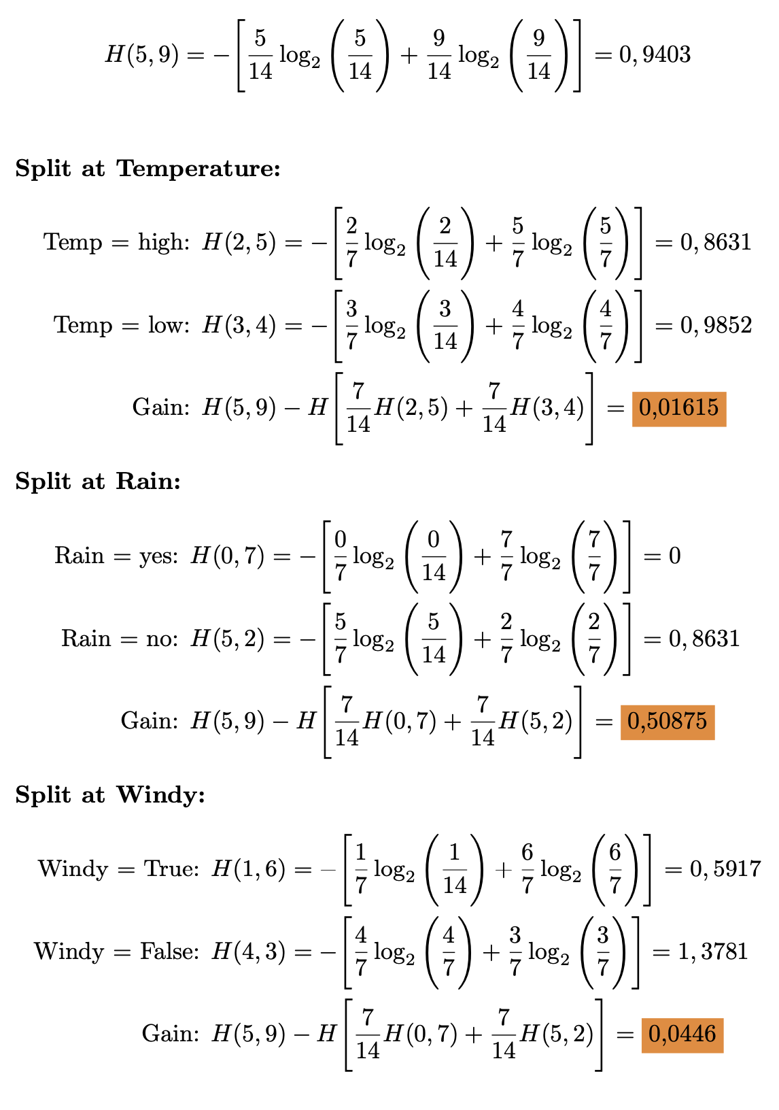
Information Gain

Slide 8
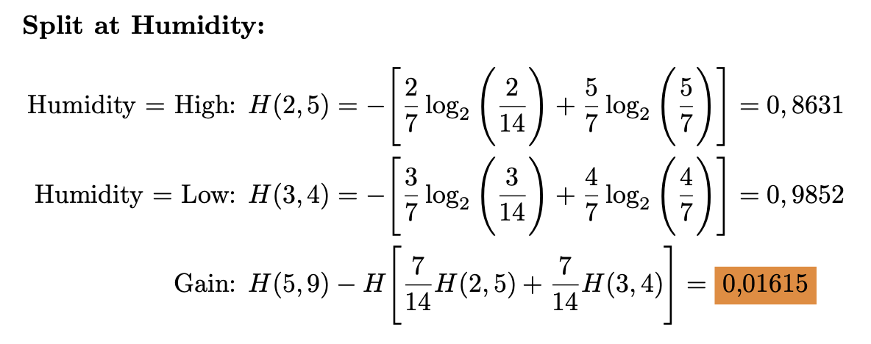
Information Gain

Slide 9
Methods
Now let’s go into details …

Slide 10
Results
Now let’s go into details …

Slide 11
Conclusion
Now let’s go into details …

