Slide 1
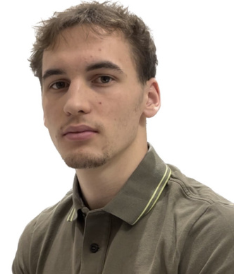


leobtlh@hotmail.com
+41 78 302 50 85
Montreux, Switzerland
LEO BOTELHO
BLOCKCHAIN PROTOCOL ARCHITECT & QUANT DEV
SUMMARY
Now fully engaged in Mathematics studies, I am deepening my expertise in blockchain solutions and DeFi through the EPFL course FIN-413 and the Alyra certification (RS6675).
My goal is to apply this rigorous analytical framework to protocol design and on-chain economic modelling. I am seeking a 40% part-time position that allows me to contribute to innovative decentralized solutions while continuing my academic development.
EDUCATION
PROJECTS
UNIDISTANCE
DEFI PROJECT LEAD
Bachelor of Mathematics
Moeba Protocol, Lausanne | 2025 -
2026 -
Moeba Protocol is a decentralized parametric insurance platform designed to democratize access to Catastrophe Bonds (Cat Bonds). Unlike traditional binary models, it utilizes a "Soft Default" waterfall mechanism to mitigate risk. The architecture segments capital into three layers: an Insurer First Loss buffer, a Junior Tranche (leveraged yield), and a Senior Tranche (capital protection with 70% base APR), making climate risk investment accessible to non-institutional liquidity.
Preview: https://moeba-protocol.vercel.app/
EPFL
FIN-413 - Financial applications . . .
2026 -
ALYRA
RS6675 - Leveraging DeFi in dApps
20.09.2025 - 19.12.2025
HEIG-VD
Computer Science
RETHAGON - QUANT SYSTEM ARCHITECT
2024 - 2026
Alyra, Montreux | 20.09.2025 - 19.12.2025
SKILLS
This project is an autonomous decentralized betting platform for rap battles, designed to ensure artist compensation (15% fee). The betting system features real-time dynamic odds based on ERC-1155 liquidity and stake simulation. Outcomes are secured by a meritocratic oracle using ELO-weighted Soulbound Tokens (SBTs). Governance relies on a veToken model backed by an economic dispute mechanism: the majority captures the minority's staked tokens, making fraud irrational and guaranteeing result integrity.
C language
C++ language
Python3 language
UX development
SPOKEN LANGUAGES
French : native language
English : professional level
Portugese : professional level
German : professional level
EXPERIENCE
EXPERTISE
PYTHON AND WEB DEVELOPER
  Decentralized Finance
  Quantitative Development
  Protocol Architecture
  Algorithmic Design
  DeFi Strategies
Altux SA, Lutry | 2023 - 2026
Broad experience in IT, particularly in Python development for internal tools and automation. Background includes server maintenance, firewall configuration, and basic penetration testing.

