Slide 1
BUDGETING
Group 6:
Leonardo Bunjamin - 00000014225 (Koor)
Octa Wahana Widiwijaya - 00000019399
Rickhen Hermawan - 00000012311
William Citralin - 00000014292

Slide 2
WORK PLAN
 | September | October |  |  |  | November
 | IV | I | II | III | IV | I | II | III | IV
Main Feature
Database Update
Balance
Material Design
Anova, Ttest, Tukey Survey
Documentation

Slide 3
WORK DIVISION
NO | NAME | JOB DESCRIPTION
1. | Leonardo Bunjamin | Main Feature, Slide, Documentation, User Manual, Program Manual, Limitation & Prototype Consideration, Coordinator
2 | Rickhen Hermawan | Slide, Documentation, Design, Main Feature, Questionnaire & Evaluation,T-test, Anova
3 | Williem Citralin | Database Management, Documentation, Schedule and Resource, Main Feature, Design, Slide
4 | Octa Wahana Widiwijaya | Main Feature, Documentation, Slide, User Manual, Program Manual, Design Manual

Slide 4

BRIEF DESCRIPTION
In a Brief, Budgeting Created to manage finance or budgeting that allows users to access and have a simple design that has new innovations such as having some features Today’s Transaction, Transaction Report, Transaction History.
Minimum System Requirement for Budget to run:
Android OS: LOLLIPOP(API 21)

Slide 5
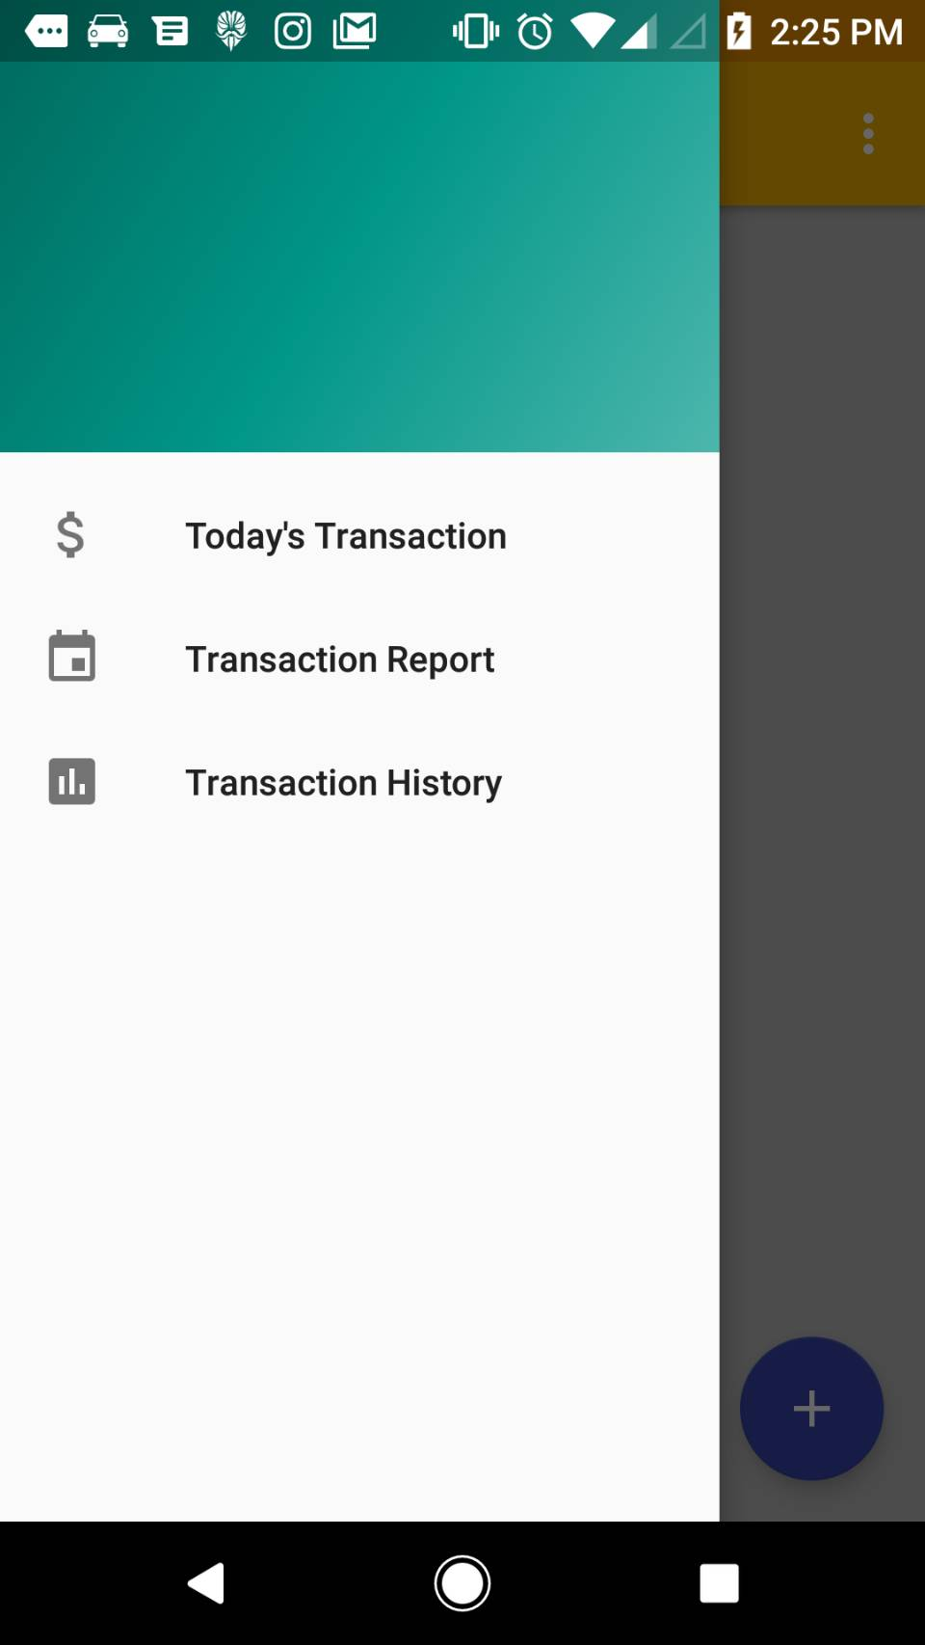
Layout
In general, the layout for main activity Budgeting is given below:
-Navigation drawer: when clicked, it will show Today’s Transaction, Transaction Report, Transaction History.
-Top Bar: shows the title of apps, contains navigation drawer and options menu.
-Options menu: when clicked, options will pop out help file,settings.
-Main Content: all the content for apps will be shown here.
References :
https://material.io/guidelines/material-design/introduction.html
https://material.io/guidelines/layout/structure.html#

Slide 6
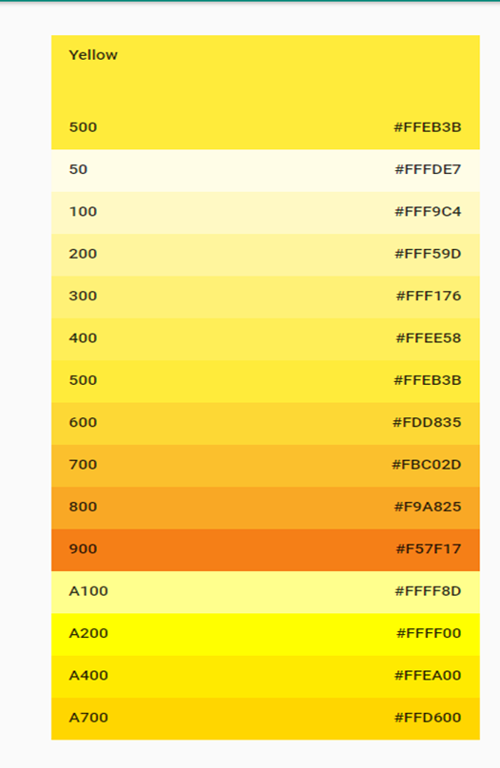
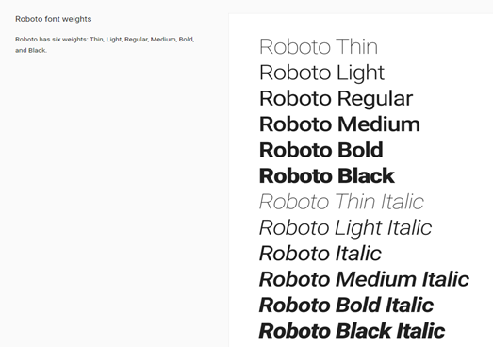
Colors and Fonts
References :
https://developer.android.com/guide/topics/ui/layout/linear.html?hl=id
https://material.io/guidelines/style/color.html

Slide 7
Icons

Slide 8
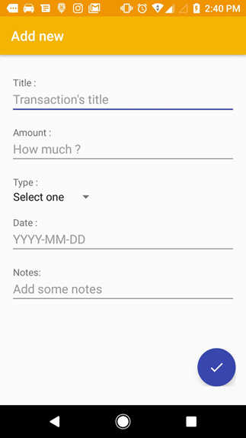
Functionalities 1: ADD NEW
will contain :
Tittle
Amount
Type
Date
Notes

Slide 9
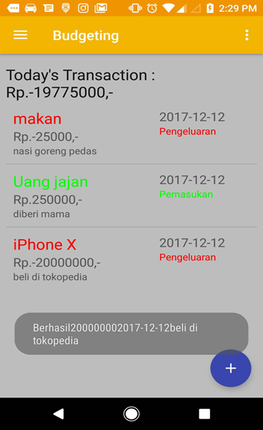
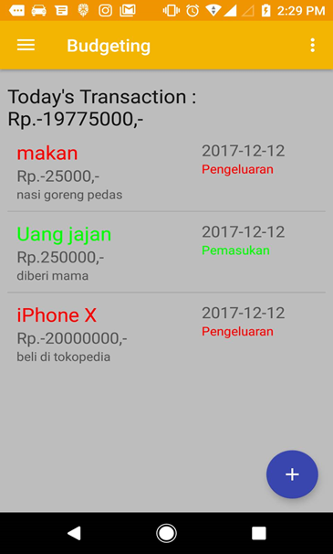
Functionalities 2: Today’s Transaction
This function enables user to view Today’s Transaction and add transaction. The information will contain :
1. Type
2. Amount
3. Note
4. Date
5. Income/expenditure

Slide 10
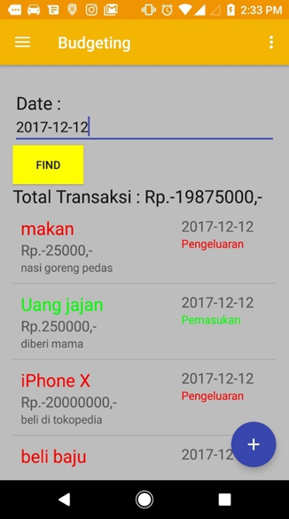
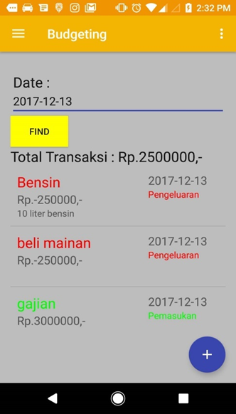
Functionalities 3: Transaction Report
The return results will show transaction by date on search query. All transaction that contain search query will be shown in the screen.

Slide 11
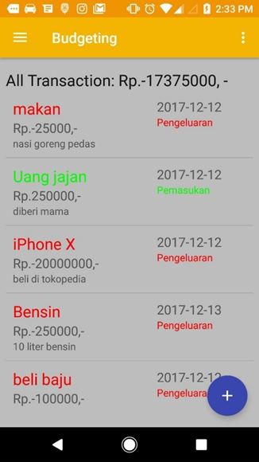
Functionalities 4: Transaction History
Transaction History are list of transaction after submit at add new. This feature allows the user to view the last transaction that has been made and can be known various information such as amount, type, note, date and title.

Slide 12
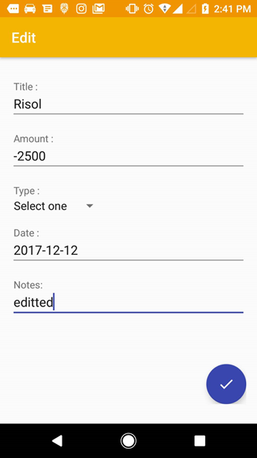
Functionalities 5: Edit
Screenshot shows all the functionalities of edit. Different from add new, edit only change if user want to change transaction information.

Slide 13
Survey Before The Program has been Created
Question:
"Sebutkan nama anda:",
"Apakah anda pengguna Android atau Ios?",
"Apakah sebelumnya anda pernah menggunakan aplikasi budgeting? ",
"Apakah sebelumnya anda pernah menggunakan aplikasi budgeting dalam smartphone anda? ",
"Menurut anda, seberapa pentingkah menggunakan aplikasi budgeting dalam smartphone anda dalam kehidupan sehari-hari?",
"Apakah sebelumnya anda pernah mengetahui tentang fitur-fitur yang ada dalam aplikasi budgeting?",
"Dari 4 fitur dibawah ini, fitur manakah yang sebelumnya pernah anda ketahui?",
"Menurut anda dari skala 1 sampai 10, berapa nilai untuk fitur Income Money untuk ada dalam aplikasi kami:",
"Menurut anda dari skala 1 sampai 10, berapa nilai untuk fitur Expense Money untuk ada dalam aplikasi kami:",
"Menurut anda dari skala 1 sampai 10, berapa nilai untuk fitur Graph untuk ada dalam aplikasi kami:",
"Menurut anda dari skala 1 sampai 10, berapa nilai untuk fitur Schedule & Resource untuk ada dalam aplikasi kami:",
"Dari 4 fitur yang ingin kelompok kami buat untuk aplikasi budgeting, menurut anda fitur mana yang paling anda minati untuk aplikasi budgeting?",
"Kritik dan saran mengenai fitur dalam aplikasi budgeting:"

Slide 14
Survey Before The Program has been Created
Answer:
- "Yan Kristian","Android","Ya","Ya","4","Ya","Fitur Income Money","8","9","7","8","Fitur Schedule & Resource","Buatlah fitur yang lebih simple agar dapat lebih mudah digunakan"
- "Jordy Christopher","Android","Tidak","Tidak","3","Tidak","Tidak Ada","6","7","5","7","Fitur Expense Money","Bagus untuk ditingkatkan lebih lanjut lagi. Tambahkan banyak fitur yang belum ada sebelumnya."
- "Stevan","Android","Ya","Ya","5","Ya","Fitur Expense Money","9","9","10","8","Fitur Graph","Graph menurut saya dapat lebih mudah dipahami"
- "Michael Suryajaya","Android","Tidak","Tidak","2","Tidak","Tidak tau","6","6","9","8","Fitur Graph","Sudah bagus.Dapat dikembangkan lebih baik lagi"
- "Nico Timothy","Android","Ya","Ya","5","Ya","Fitur Expense Money","9","8","9","9","Fitur Expense Money","Dalam aplikasi budgeting, akan lebih baik apabila ditambahkan fitur printout“
Link: https://goo.gl/forms/WG8W0iyBPim7w7if2

Slide 15
Survey After The Program has been Created
Question:
"Siapakah nama anda?",
"Bagaimana tanggapan anda mengenai aplikasi budgeting yang telah kami buat?",
"Berikan nilai anda mengenai manfaat fitur Income Money yang ada dalam aplikasi kami:",
"Berikan nilai anda mengenai manfaat fitur Expense Money yang ada dalam aplikasi kami:",
"Berikan nilai anda mengenai manfaat fitur Graph yang ada dalam aplikasi kami:",
"Berikan nilai anda mengenai manfaat fitur Schedule & Resource yang ada dalam aplikasi kami:",
"Menurut anda dengan adanya fitur-fitur ini banyak membantu atau tidak?",
"Kritik dan saran mengenai program budgeting yang telah dibuat:"

Slide 16
Survey After The Program has been Created
Answer:
-"Yan Kristian","Baik","8","9","7","9","5","Sudah baik. tingkatkan lagi."
- "Jordy Christopher","Biasa Saja","6","7","8","9","4","Perbanyak fitur yang dapat lebih mudah digunakan"
- "Stevan","Sangat Baik","9","10","10","9","5","Good Enough"
- "Michael Suryajaya","Baik","8","9","8","8","4","Tambahkan fitur-fitur lagi"
- "Nico Timothy","Baik","8","8","9","10","5","Perbanyak fitur simple"
Link: https://goo.gl/forms/AAhTB7Y4I4Hlxh543

Slide 17
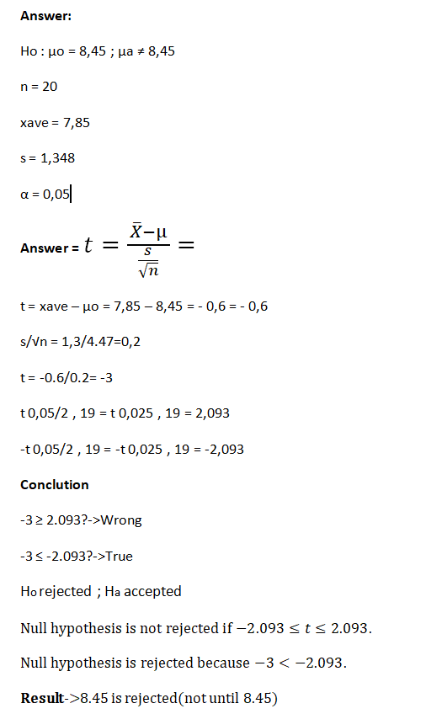
Ttest

Slide 18
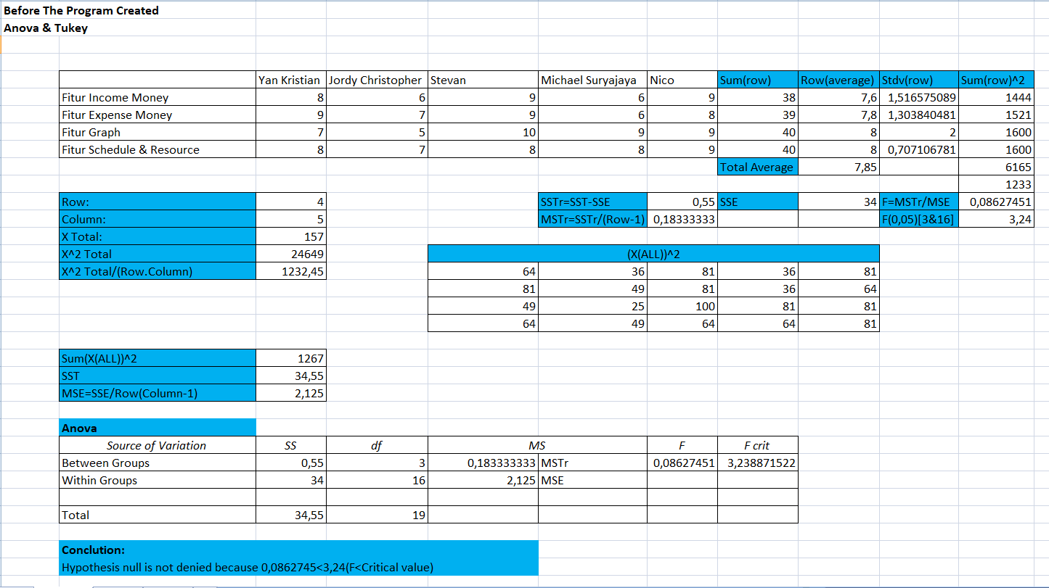
Anova &Tukey Before The Program has been Created

Slide 19
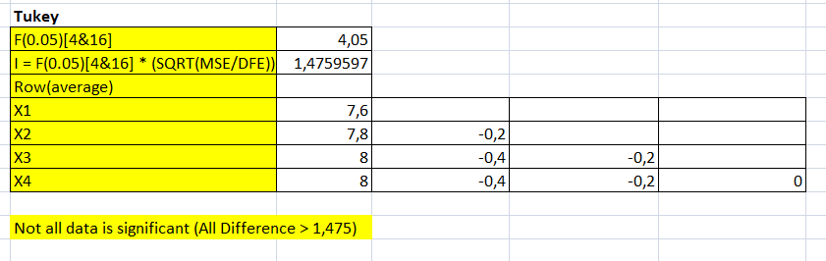
Anova &Tukey Before The Program has been Created

Slide 20
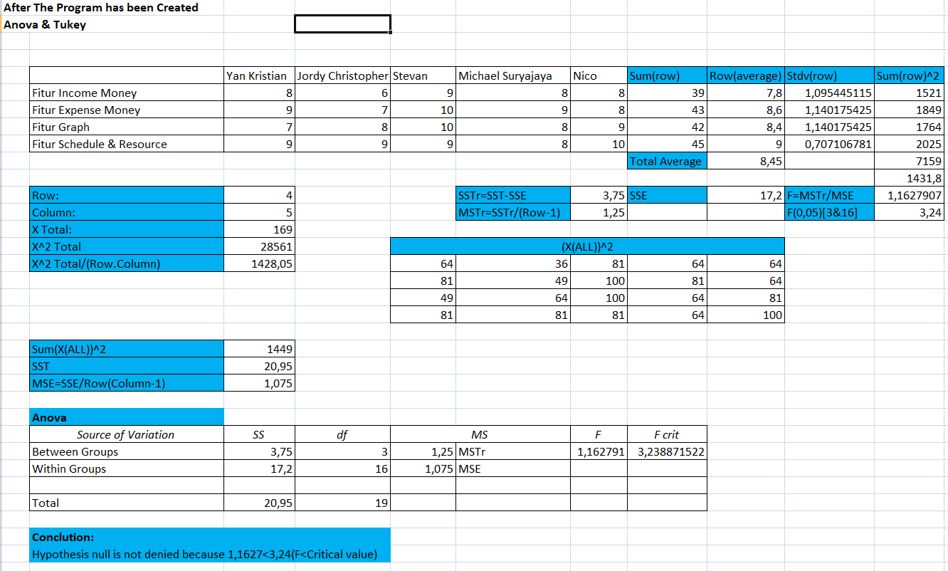
Anova &Tukey After The Program has been Created

Slide 21
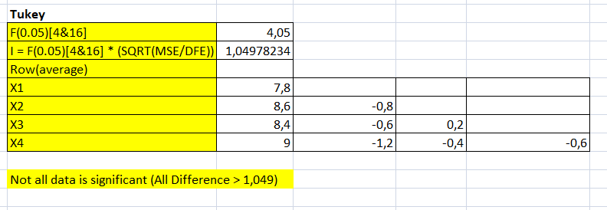
Anova &Tukey After The Program has been Created

Slide 22
Thank You!

