Slide 1
Visualization of population, income, crime and business data in Phoenix
Hong
Lei
Megha
Raghav

Slide 2
Overview
Our project consists of 4 major steps:
Data Extraction
Data Preprocessing
Data Analysis
Data Visualization

Slide 3
Data Extraction
Time range:
2012 – 2013
Geographical range:
Phoenix
Keywords:
Census Tract (Geoid)
BusinessID

Slide 4
Data Extraction
Population and income data:
Downloaded from census.gov
<Geoid> <Value>
535 records
Crime data:
Scraped from spotcrime.com(*)
<Type> <Date Time> <Address>
161434 records
Business and review data:
Download and scraped from yelp.com(*)
<BusinessID> <Name> < Address>
<BusinessID> < Date> <Rating> <Review content>
96689 records
(*) For personal study use only

Slide 5




Data analyzing and preprocessing
Population data
Table1
Geoid based
Income data
Table2
BusinessID based
Crime data
Table3
Time based
Review data

Slide 6
Data preprocessing result
Table1 (Geoid based)
<Income>
<Population>
<Crime for each Month>
<Reviews for each Month>
<Stars for each Month>
Table2 (BusinessID based)
Total stars (rating) and top 20 words count for each month
Table3 (Time based)
Crime and review count for each day

Slide 7
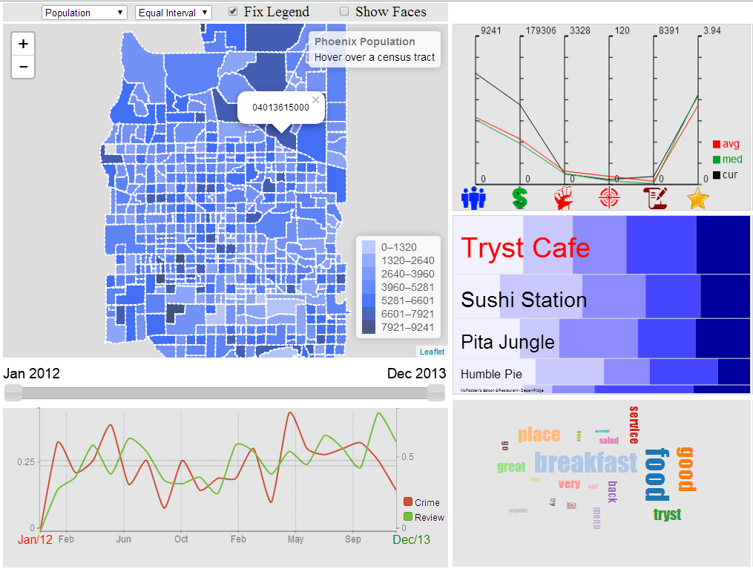
Visuailization
Control flow
Choose data set
Choose time range
Choose census tract
Choose business

Slide 8


Slide 9
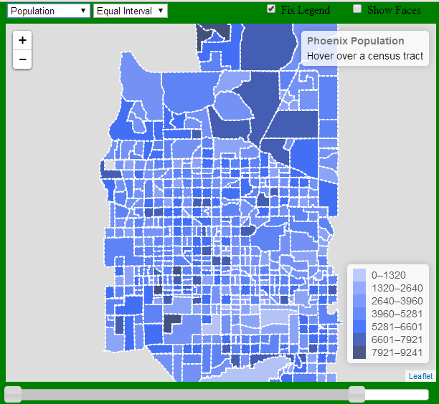
Choropleth Map
The visualization starts with a choropleth map.
Choropleth Map gives an overview of the distribution of population, income, crime number, and review count of restaurant in Phoenix area.
Then we will allow user to select on certain areas of map to get more details of that particular area.

Slide 10


Menu Selection
Use can select one of the 4 data sets:
Population
Income
Crime
Review
User can select one of the 2 classifications:
Equal interval
Quantile interval

Slide 11
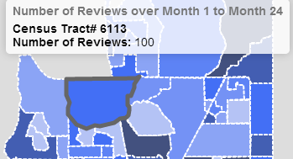
Area Selection
Each tile in the map represents a Census Tract.
When a tile is selected, its information will be displayed in the info panel
Also the Geoid will be sent to other modules.

Slide 12

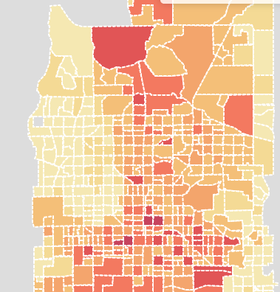
Time Selection
The slide bar will allow user to select a time range between year 2012 and 2013.
We will calculate the sum of crime number and review count in each Census Tract within that time range.
The map then will visualize the data based on the selected classification scheme.

Slide 13
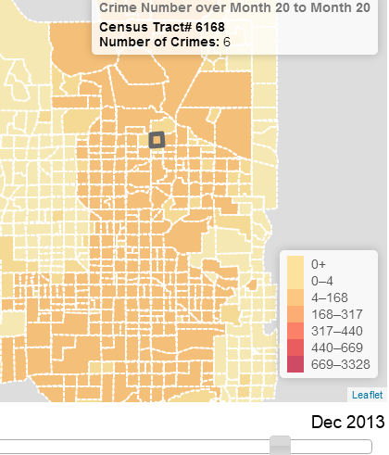
Time Selection Fixed and Dynamic Legend
Initially, we calculated the intervals in the legend based on the full time range.
One problem we encounter is when the selected time range is very small (e.g. 1 month), the original intervals will not work very well anymore.
As shown in the figure, most of the Census Tracts will fall into the lower range in the intervals.

Slide 14
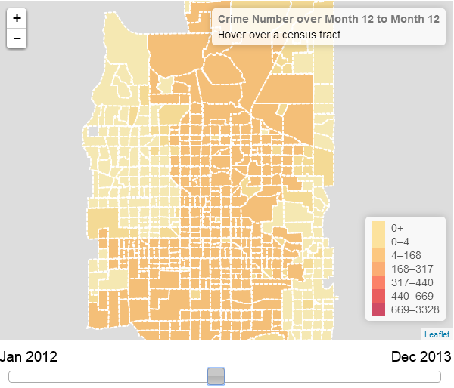
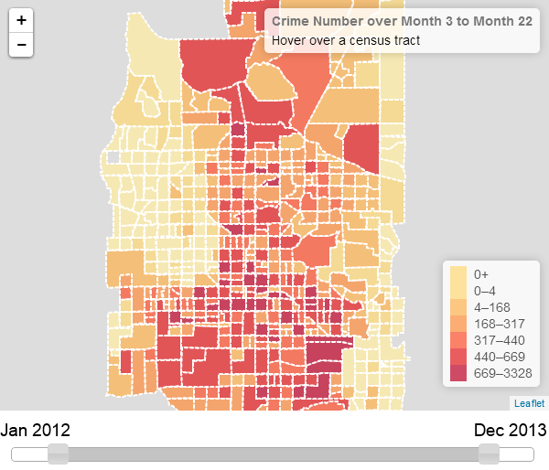
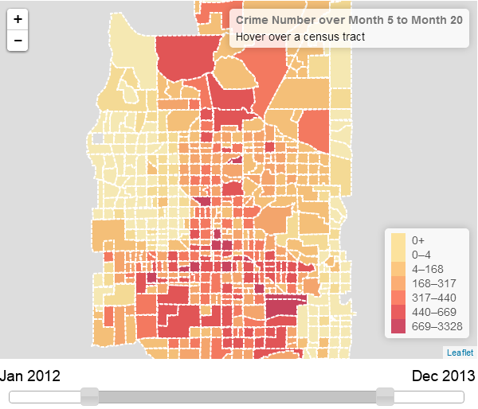
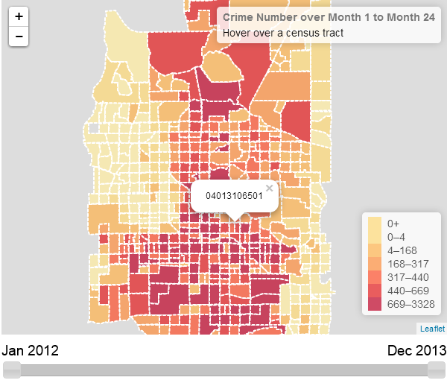
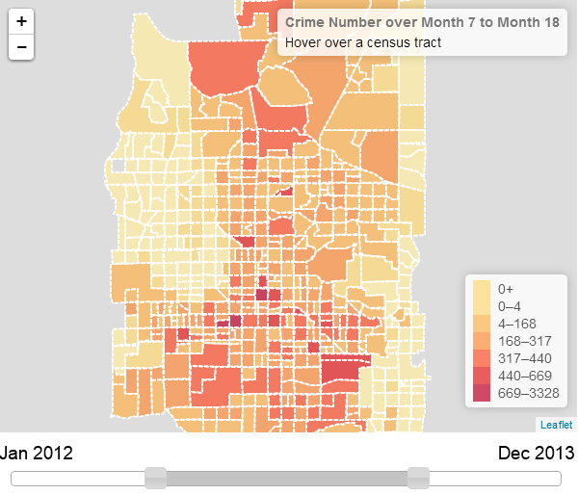
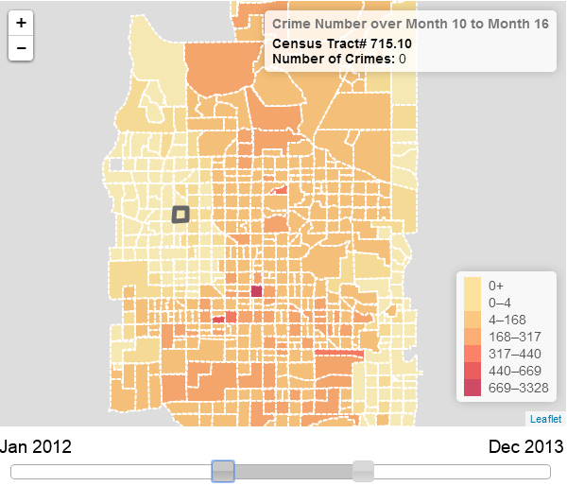
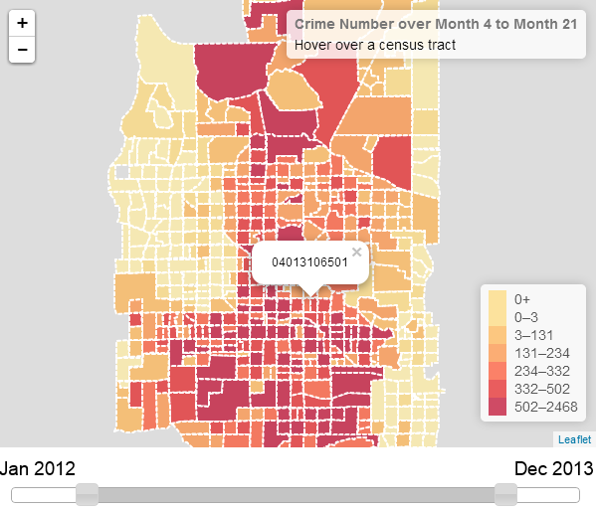
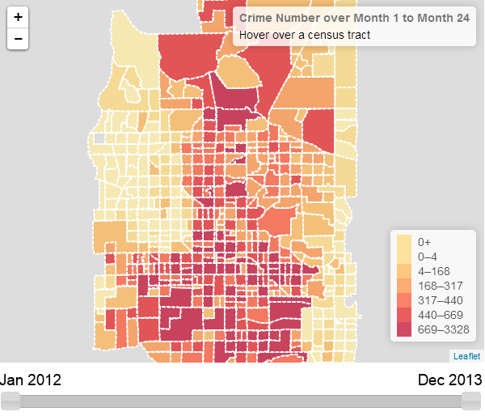
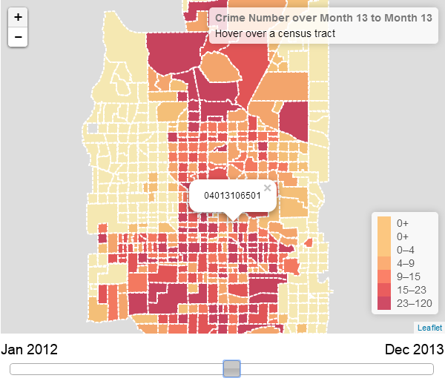
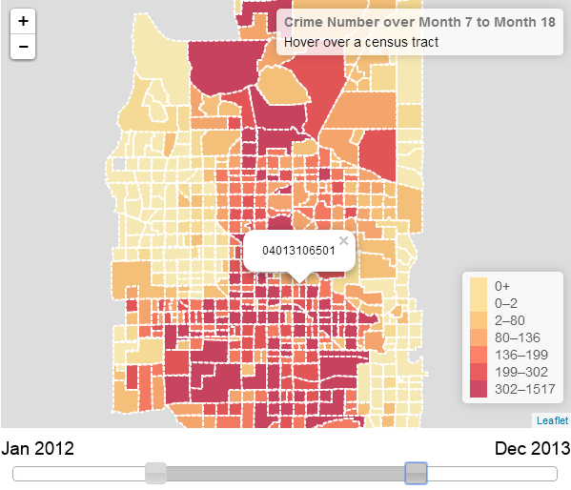
Time Selection Fixed and Dynamic Legend
To fix the problem, we allow user to toggle between fixed and dynamic legend.

Slide 15
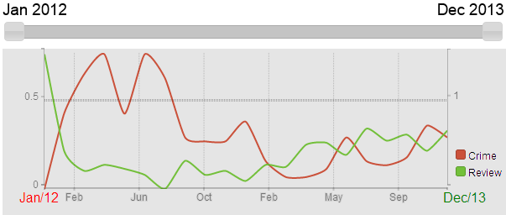
Time Chart
The Time chart will show the change crime number and review count for one particular Census Tract
Red line represents crime number and green line represents review count
User can also use the slide bar to select certain time range. So the time chart will visualize the change within that time range.

Slide 16
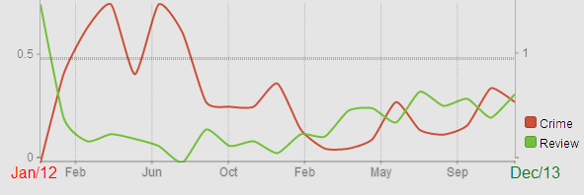
Scaling
We used linear scale for both x and y axis.
In order to always show both lines in the graph, the scale of x and y axis will dynamically change based on user selection.
x-axis will always have 20 sample points within the selected time range, but the interval between each sample point will change dynamically, the value in each sample point is the average of data over that interval.
We use separate y-axis for crime and review lines, the scaling of both y –axis will change based on the min and max value of selected sample points within the time range.

Slide 17
Lei Chen
Chernoff Faces
Proportional Symbol map
Parallel Coordinates Graph

Slide 18
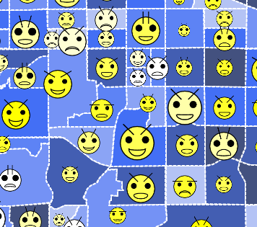
Chernoff Faces
Chernoff Faces are used to show the data of every census tracts
Encoding strategy
Implementation
Proportional symbol map

Slide 19



Chernoff Faces Encoding
Population
Income
Crimes

Slide 20



Chernoff Faces Encoding
Violence Crimes
Reviews
Average Rating

Slide 21


Chernoff Faces Implementation
Use Javascript to draw on html <canvas>
Use Leaflet library to integrate with map

Slide 22
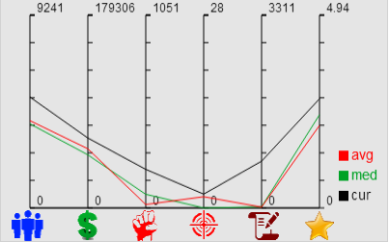
Parallel Coordinates Graph
Show the following 6 numbers of the selected census tract
Population
Income
Total Crimes
Violence Crimes
Total Reviews
Average Rating
Lines:
avg = average
med = median
cur = current selected census tract
The average and median lines are based on all the census tracts.

Slide 23
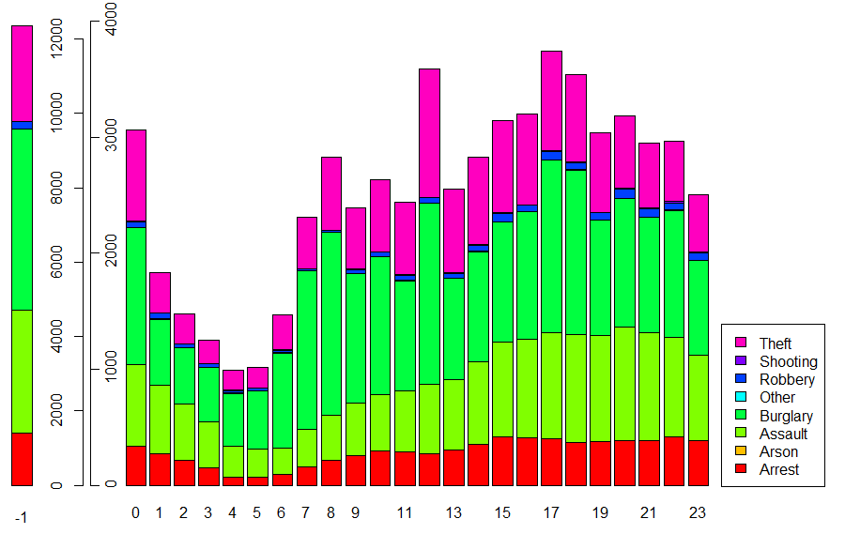
Crime type by hours
NOTE: -1 means no exact time specified

Slide 24
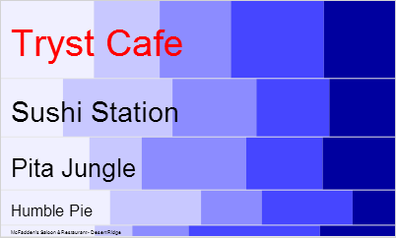
Mosaic Plot
Show the top 5 most reviewed restaurants in the selected census tract
Split:
Vertically split by total reviews
Horizontally split by review ratings
Features:
Single selection
Popup name
Update by time range

Slide 25
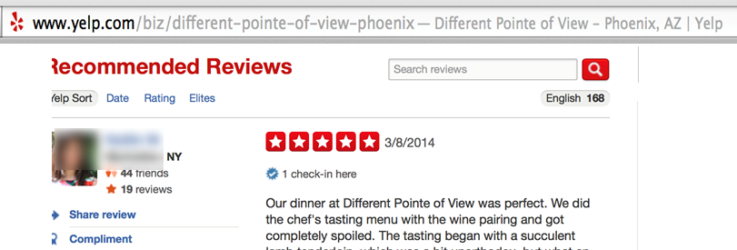
Tag Cloud
Data Extraction:
What data we need ?

Slide 26
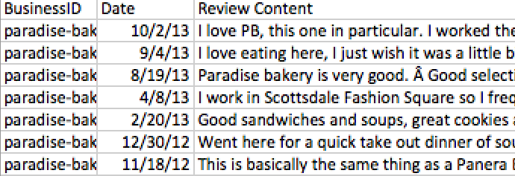
How do we get this data ?
No API support
Use a scraper program (but this is just for personal
use and data is not distributed)
The total reviews now become 99049.

Slide 27
Data Preprocessing
Tag cloud needs only the most frequent words
First, group the reviews together by restaurant for each of 24 months, the format of the data is as follows:
<Business ID> < Date> <Review Content>
We create a total of 24 files in the process
Advantage: Processing each of these files is faster than processing the whole file

Slide 28
Data Preprocessing (contd.,)
Next, group each of these months by business id
The data has business id as the key and review content as the value
<Business ID> <Review Content>
Now, perform a word count on the above file
The data now has business id as the key and top 20 frequently used words as the value
<Business ID> <W1_C1;W2_C2:….>

Slide 29
Data Preprocessing (contd.,)
Merge these files to form one big table
There are a more that 4000 restaurants in Phoenix area
<Business ID> <Month1> <Month2><Month3>……
Convert this file into a .js file to use it in visualization
The data is stored in the form of an array with each element for a business id.
WordCount [“Business ID”] = [“Month1”,”Month2”,…….]

Slide 30
Data Visualization
Inputs
From Mosaic plot (Business ID)
From slider (time range)
Any changes generate a new tag cloud
Visual variable used is the size of the word, which encodes the frequency of the word
Color has no encoding and is random (rainbow color scheme)
Orientation of the word is changed to better utilize the screen space

Slide 31
How we do it ?
Hash Table to get the top 20 words for the given business id and time range
Create a canvas and append these top 20 words with decreasing order of sizes and random colors and orientation
The draw() function from d3.js library is then used to draw the words on to the screen

Slide 32
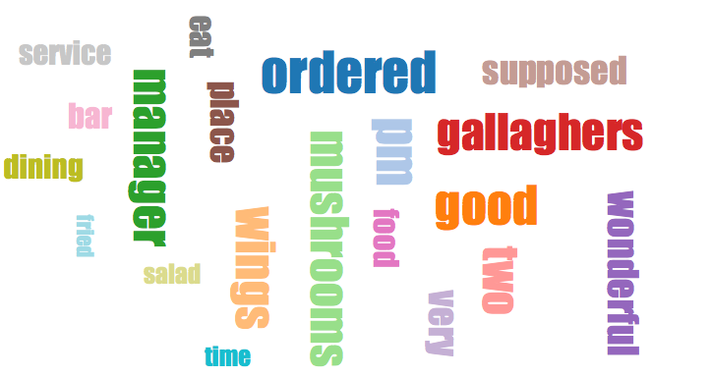
Data Visualization (contd.,)
TAG CLOUD FOR GALLAGHER’S SPORTS GRILL

Slide 33
Uses:
Gives the overview of a particular place
Avoid extensive web search to locate what’s best and trending in a particular restaurant

