Slide 1
Visualizing Population Income Crime And Business Data
Hong
Lei
Megha
Raghav

Slide 2
INTRODUCTION
The goal of the project is to come up with a visualization that can be used to explore income, population, crime and business data.
Data Visualization Process:
Data Extraction
Data Preprocessing
Data Analysis
Data Visualization

Slide 3
INTRODUCTION
DEFINITIONS:
Census Tract
A census tract is a geographic region defined for the purpose of taking a census (from Wikipedia).
GeoId
For each census tract there is a unique id associated to it.
Time Range
Time range selected for the purpose of visualization is from January 2012-Decemeber 2013.
Geographical Range
The geographic range chosen for the purpose of visualization is Phoenix.

Slide 4
Data Extraction
Original Population and Income data
Population and Income data was extracted from factfinder of census.gov in the format of:
<GeoId> <Value>
This data has 535 unique GeoIds
Crime data
Crime data was extracted from spotcrime.com in the format of:
<TYPE> <DATE & TIME> <ADDRESS>
This data has 161434 number of crime records
Yelp Business data
The business data was extracted from yelp in the format of
<ID> <Name> <Street Address>
This data has 4406 number of records.
Yelp Reviews data
The reviews from yelp in the format of:
<BusinessID> <Stars> <Date> <Review_Content>
This data has 96689 number of records.

Slide 5




Table1
Table2
Table3

Slide 6
Final Data
Table1:
Uses <GeoId> as the key and has the following columns
<Income>
<Population>
<Crime for each Month>
<Reviews for each Month>
<Stars for each Month>
Table 2:
Uses <BusinessID> as the key and has the following columns
<Stars for each Month>
<Top 20 Word Count for each Month>
Table 3:
Uses the <Day> as the key and has the following columns
<Crime for each GeoId>
<Review for each GeoId>

Slide 7
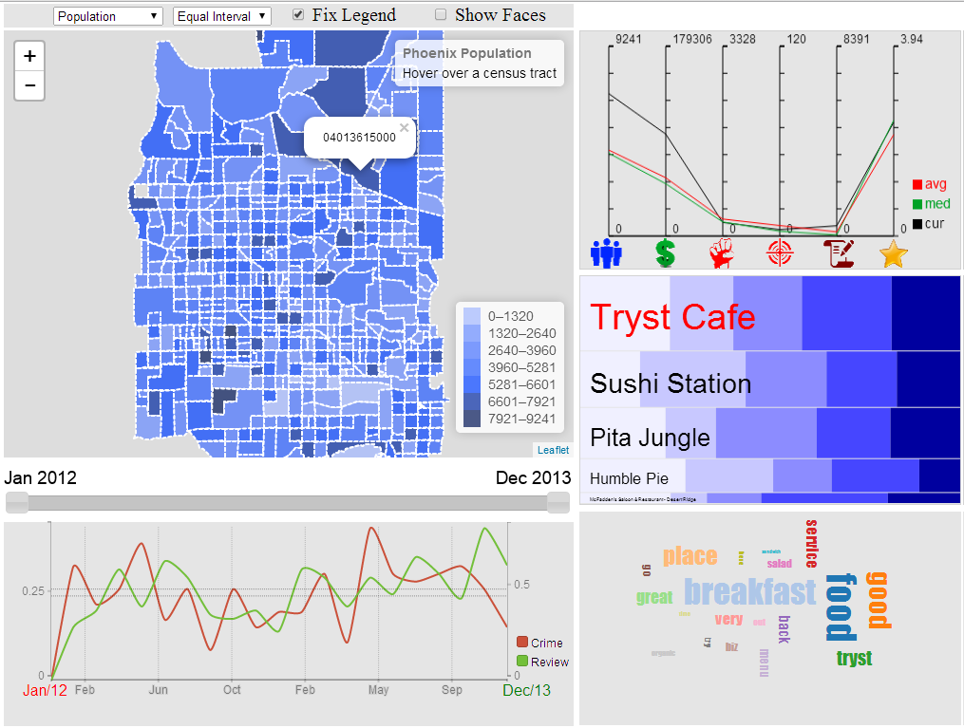
Overview

Slide 8
Hong

Slide 9

Control Flow
The time and area selection is the starting point of the control flow.

Slide 10
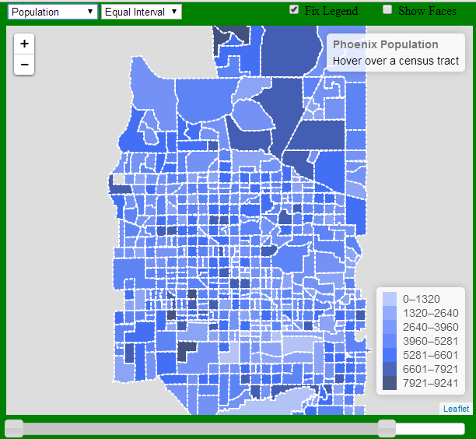
Choropleth Map
The visualization starts with a choropleth map.
Choropleth Map gives an overview of the distribution of population, income, crime number, and review count of restaurant in Phoenix area.
Then we will allow user to select on certain areas of map to get more details of that particular area.

Slide 11


Menu Selection
We allow the user to select 4 sets of data:
Population
Income
Crime Number
Review Count of All Restaurants in one area
We also allow user to switch between equal and quantile color scheme.

Slide 12
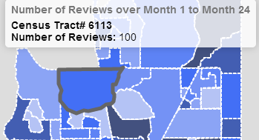
Area Selection
Each tile in the map represents a Census Tract.
Each time when user selects a tile, it will reveal some information about the Census Tract.
Also the Geo Id will be sent to other module for further processing.

Slide 13

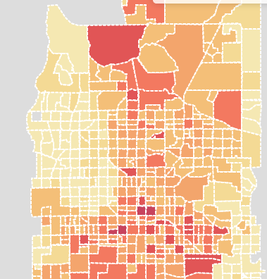
Time Selection
The slide bar will allow user to select a time range between year 2012 and 2013.
We will calculate the sum of crime number and review count in each Census Tract within that time range.
The map then will visualize the data based on the selected classification scheme.

Slide 14
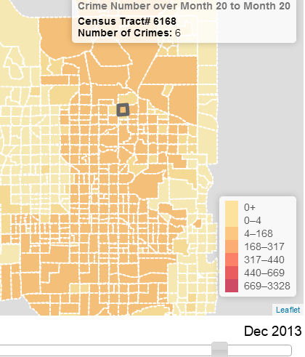
Time Selection Fixed and Dynamic Legend
Initially, we calculated the intervals in the legend based on the full time range.
One problem we encounter is when the selected time range is very small (e.g. 1 month), the original intervals will not work very well anymore.
As shown in the figure, most of the Census Tracts will fall into the lower range in the intervals.

Slide 15
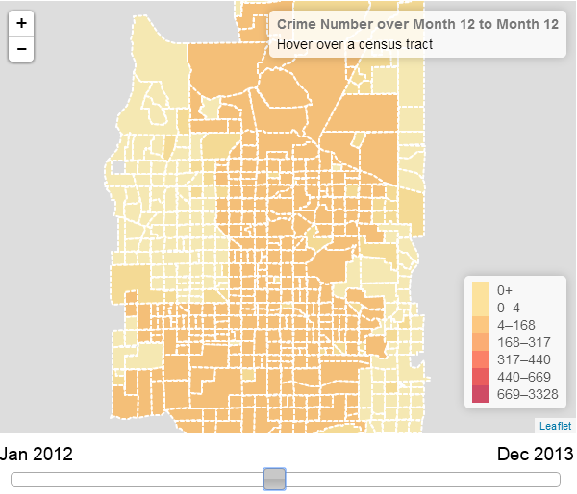
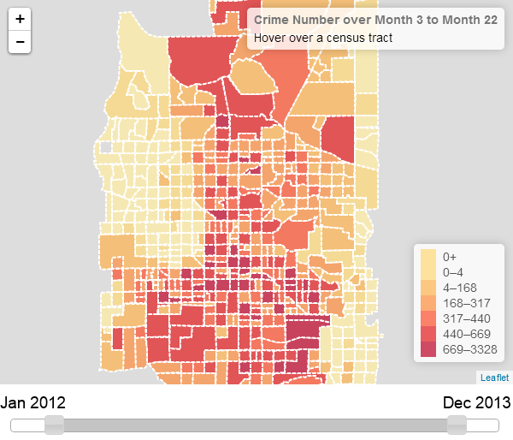
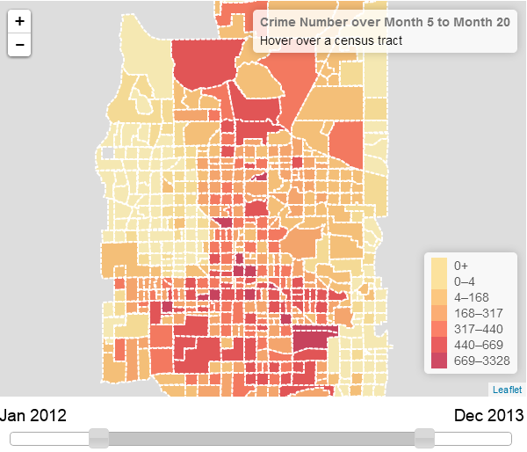
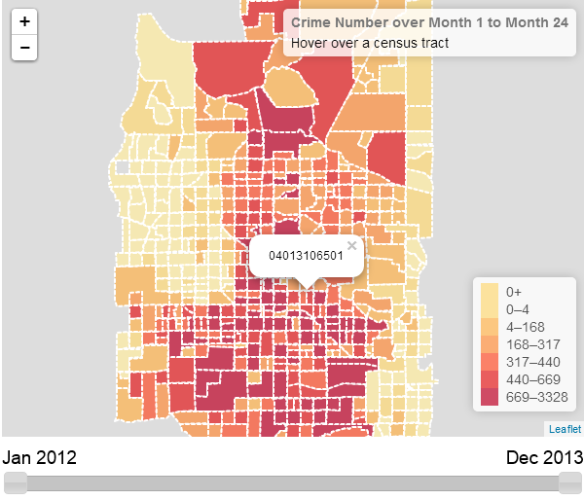
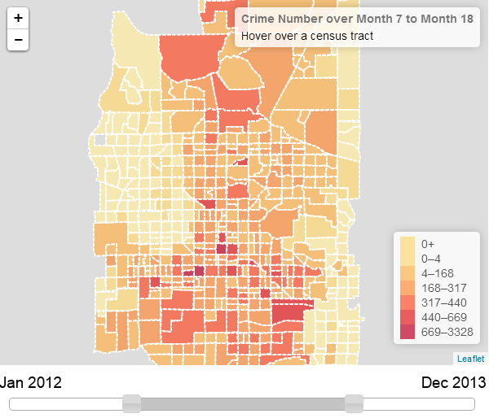
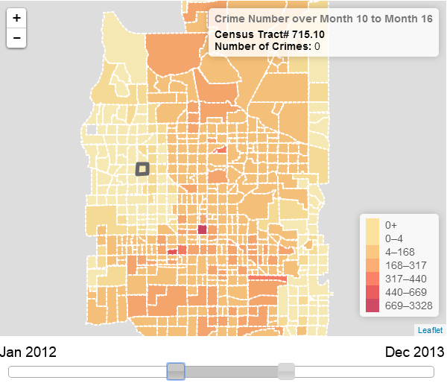
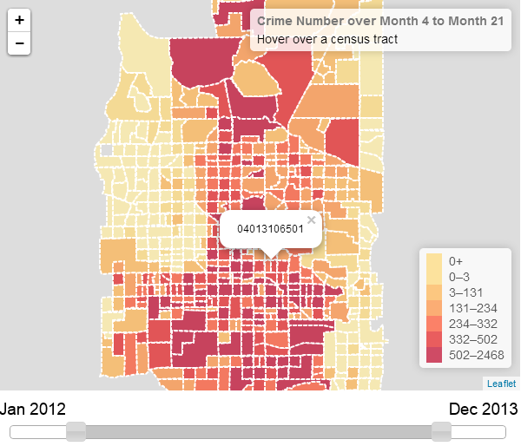
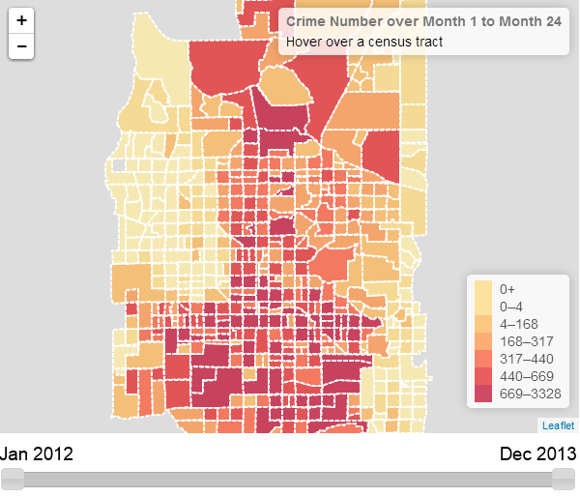
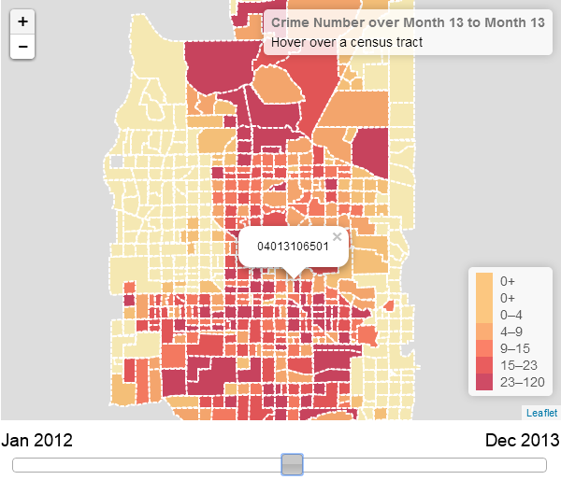
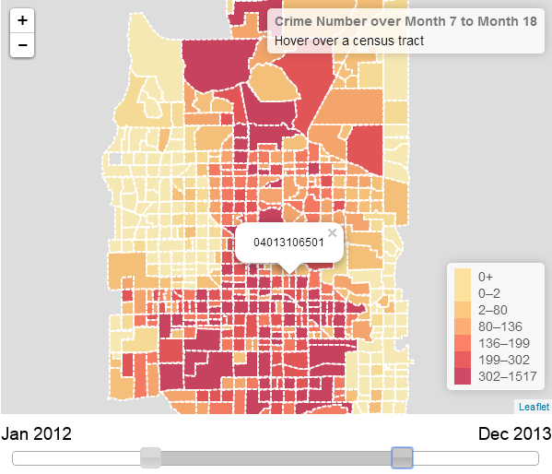
Time Selection Fixed and Dynamic Legend
To fix the problem, we allow user to toggle between fixed and dynamic legend.

Slide 16
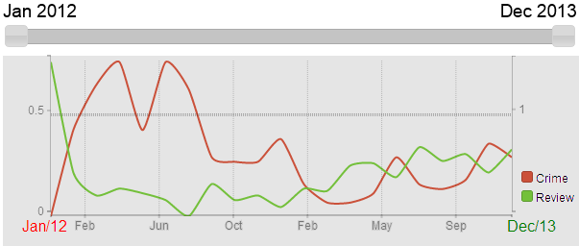
Time Chart
The Time chart will show the change crime number and review count for one particular Census Tract
Red line represents crime number and green line represents review count
User can also use the slide bar to select certain time range. So the time chart will visualize the change within that time range.

Slide 17
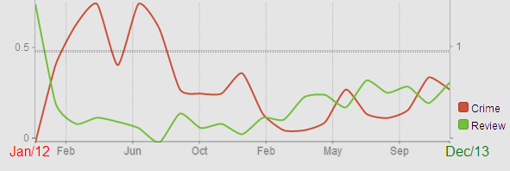
Scaling
We used linear scale for both x and y axis.
In order to always show both lines in the graph, the scale of x and y axis will dynamically change based on user selection.
x-axis will always have 20 sample points within the selected time range, but the interval between each sample point will change dynamically, the value in each sample point is the average of data over that interval.
We use separate y-axis for crime and review lines, the scaling of both y –axis will change based on the min and max value of selected sample points within the time range.

Slide 18
Lei Chen
Chernoff Faces
Proportional Symbol map
Parallel Coordinates Graph

Slide 19
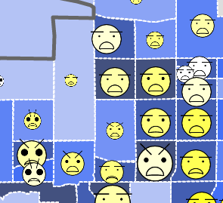
Chernoff Faces
Use Chernoff Faces to show the data of every census tracts
Encoding strategy
Implementation
Proportional symbol map

Slide 20



Chernoff Faces Encoding
Population
Income
Total Crimes

Slide 21



Chernoff Faces Encoding
Violence Crimes
Total Reviews
Average Rating

Slide 22

Chernoff Faces Implementation
Use Javascript to draw on html <canvas>
Use Leaflet library to combine with map

Slide 23
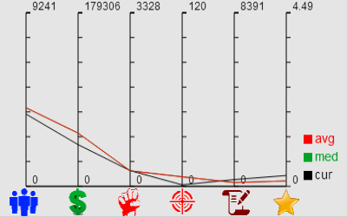
Parallel Coordinates Graph
Show the following 6 numbers of the selected census tract
Population
Income
Total Crimes
Violence Crimes
Total Reviews
Average Rating
Lines:
avg = average
med = median
cur = current selected census tract
The average and median lines are based on all the census tracts.

Slide 24
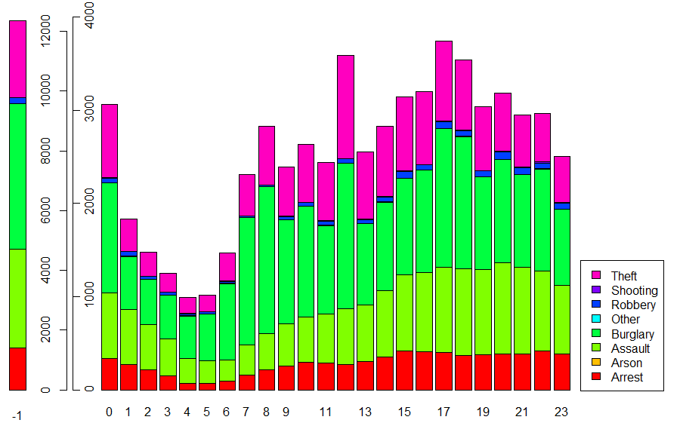
Crime type by hours
NOTE: -1 means no exact time specified

Slide 25
Raghav

Slide 26
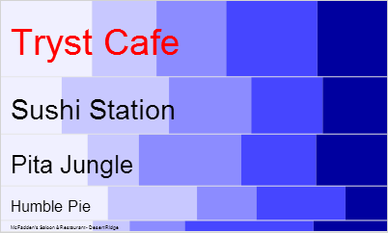
Mosaic Plot
Show the top 5 most reviewed restaurants in the selected census tract
Split:
Vertically split by total reviews
Horizontally split by review ratings
Features:
Single selection
Popup name
Update by time range

Slide 27
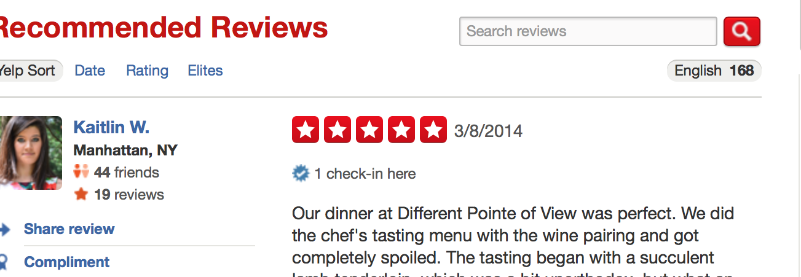
Tag Cloud
Data Extraction:
What data we need ?

Slide 28
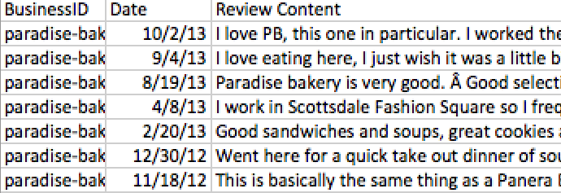
How do we get this data ?
No API support
Use a scraper program (but this is just for personal
use and data is not distributed)
The total reviews now become 99049.

Slide 29
Data Preprocessing
Tag cloud needs only the most frequent words
First, group the reviews together by restaurant for each of 24 months, the format of the data is as follows:
<Business ID> < Date> <Review Content>
We create a total of 24 files in the process
Advantage: Processing each of these files is faster than processing the whole file

Slide 30
Data Preprocessing (contd.,)
Next, group each of these months by business id
The data has business id as the key and review content as the value
<Business ID> <Review Content>
Now, perform a word count on the above file
The data now has business id as the key and top 20 frequently used words as the value
<Business ID> <W1_C1;W2_C2:….>

Slide 31
Data Preprocessing (contd.,)
Merge these files to form one big table
There are a more that 4000 restaurants in Phoenix area
<Business ID> <Month1> <Month2><Month3>……
Convert this file into a .js file to use it in visualization
The data is stored in the form of an array with each element for a business id.
WordCount [“Business ID”] = [“Month1”,”Month2”,…….]

Slide 32
Data Visualization
Inputs
From Mosaic plot (Business ID)
From slider (time range)
Any changes generate a new tag cloud
Visual variable used is the size of the word, which encodes the frequency of the word
Color has no encoding and is random (rainbow color scheme)
Orientation of the word is changed to better utilize the screen space

Slide 33
How we do it ?
Hash Table to get the top 20 words for the given business id and time range
Create a canvas and append these top 20 words with decreasing order of sizes and random colors and orientation
The draw() function from d3.js library is then used to draw the words on to the screen

Slide 34
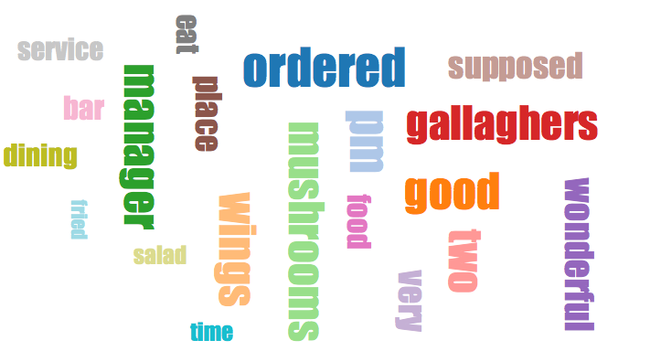
Data Visualization (contd.,)
TAG CLOUD FOR GALLAGHER’S SPORTS GRILL

Slide 35
Uses:
Gives the overview of a particular place
Avoid extensive web search to locate what’s best and trending in a particular restaurant

