Slide 1
Visualization of population, income, crime and business data in Phoenix
Hongxiang Wang
Lei Chen
Megha Tiwari
Raghav Raja

Slide 2
Overview
Our project consists of 4 major steps:
Data Extraction
Data Preprocessing
Data Analysis
Data Visualization

Slide 3
Data Extraction
Time range:
2012 – 2013
Geographical range:
Phoenix
Keys:
Census Tract (Geoid)
BusinessID

Slide 4
Data Extraction
Population and income data:
Downloaded from census.gov
<Geoid> <Value>
535 records
Crime data:
Scraped from spotcrime.com(*)
<Type> <Date Time> <Address>
161434 records
Business and review data:
Downloaded and scraped from yelp.com(*)
<BusinessID> <Name> < Address>
<BusinessID> < Date> <Rating> <Review content>
96689 records
(*) For personal study use only

Slide 5




Data analysis and preprocessing
Population data
Table1
Geoid based
Income data
Table2
BusinessID based
Crime data
Table3
Time based
Review data

Slide 6
Data preprocessing result
Table1 (Geoid based)
<income>
<population>
<crime count for each Month>
<review count for each Month>
<star(rating) count for each Month>
Table2 (BusinessID based)
<star(rating) count for each month>
<top words count for each month>
Table3 (Time based)
<crime count for each day>
<review count for each day>

Slide 7
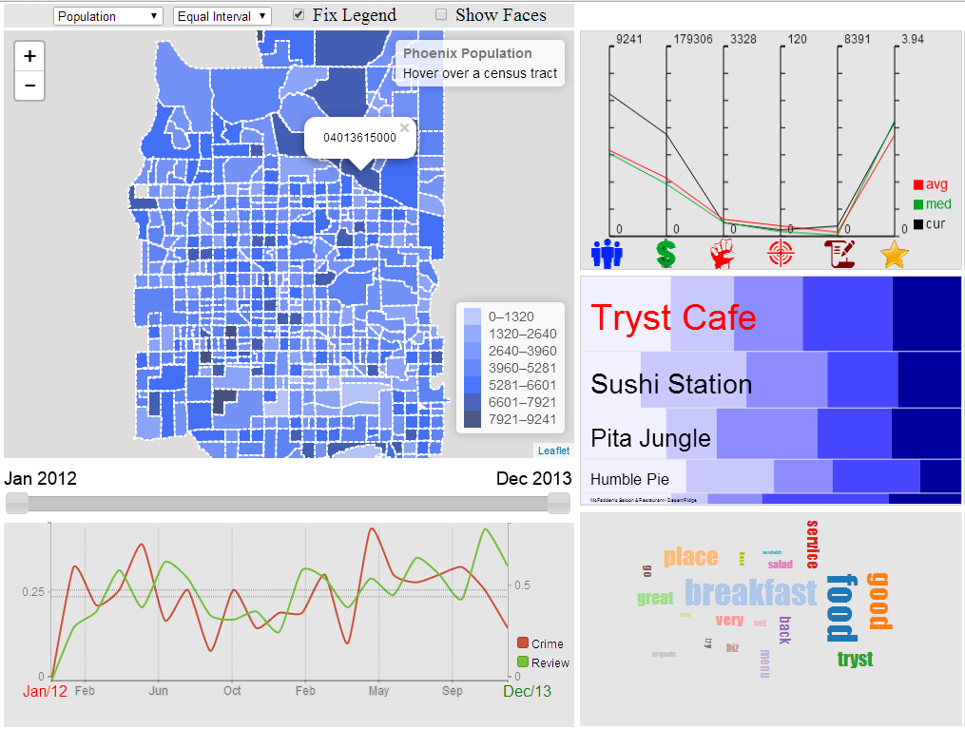
Visualization
Control flow
Choose data set
Choose classification
Choose time range
Choose census tract
Choose business

Slide 8


Slide 9
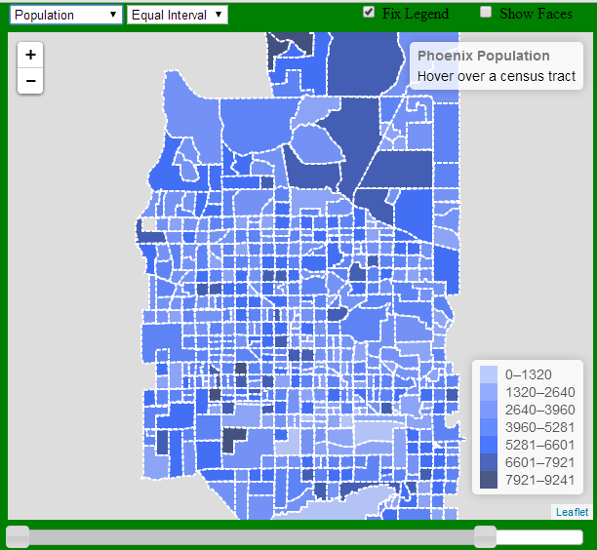
Choropleth Map
The visualization starts with a Choropleth map.
The Choropleth Map gives an overview of the distribution of the population, income, crime, and review count in Phoenix area.
Then we will allow user to select one of the areas to get more details.

Slide 10


Menu Selection
User can select one of the 4 data sets:
Population
Income
Crime
Review
User can select one of the 2 classifications:
Equal interval
Quantile interval

Slide 11
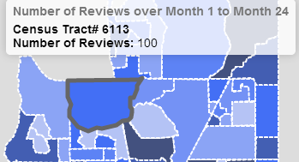
Area Selection
Each tile in the map represents a census tract.
When a tile is selected, its information will be displayed in the info panel
After selection the Geoid will be sent to other modules for synchronization.

Slide 12

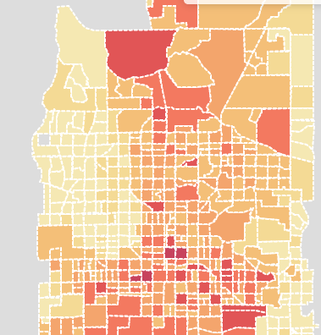
Time Selection
The slide bar will allow user to select a time range.
We will calculate the sum of the crime count and review count in each census tract within the selected time range.
The map then will visualize the data based on the selected classification scheme.

Slide 13
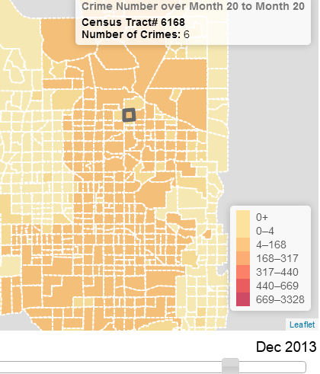
Time Selection Fixed and Dynamic Legend
Initially, we calculated the intervals in the legend based on the full time range as a default.
One problem we encountered was when the selected time range is very small (e.g. 1 month), the default intervals would not work very well.
As shown in the figure, most of the census tracts fall into the lower end of the classification.

Slide 14
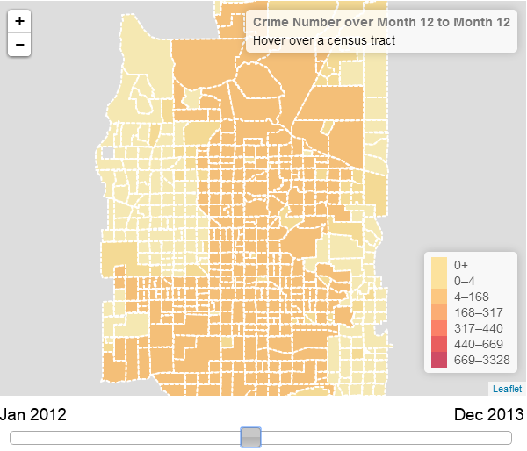
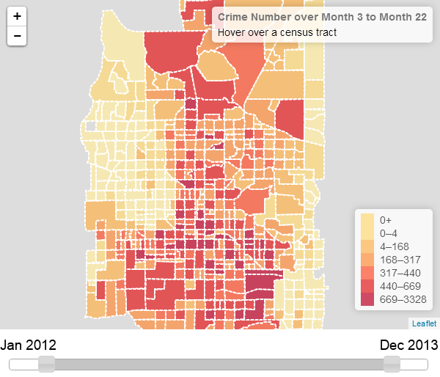
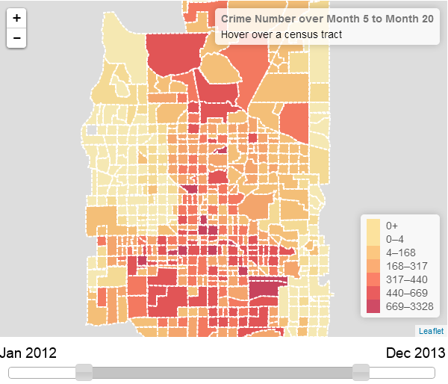
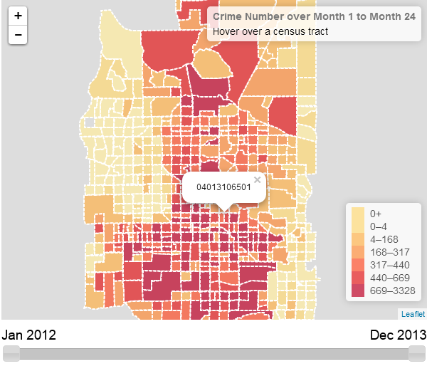
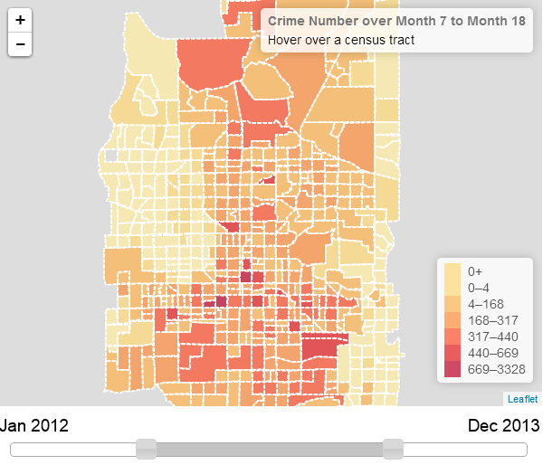
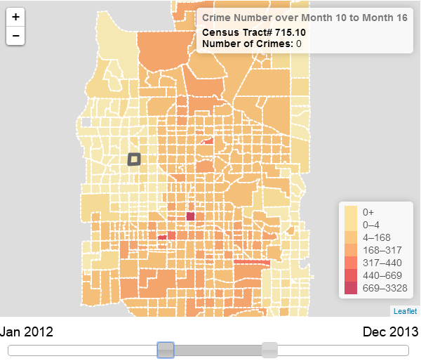
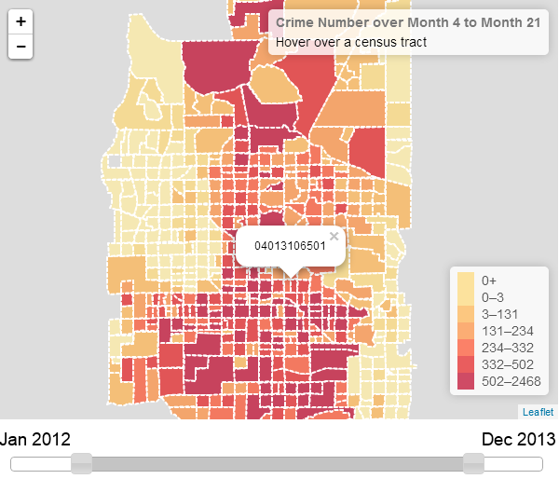
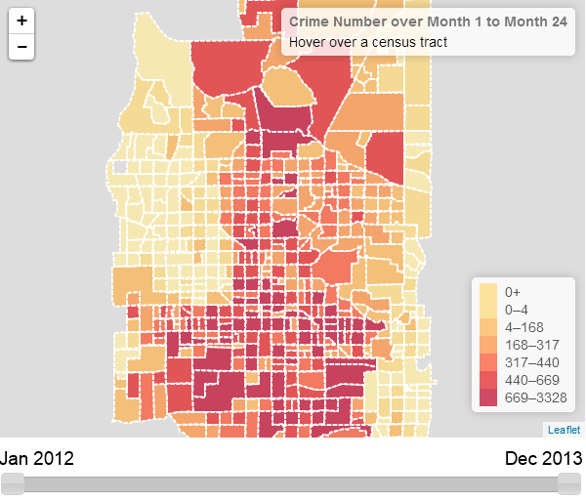
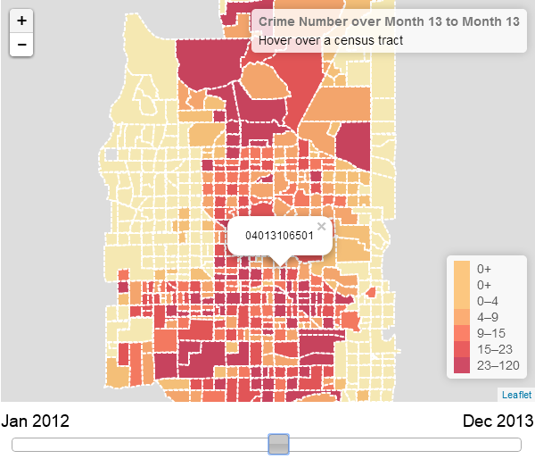
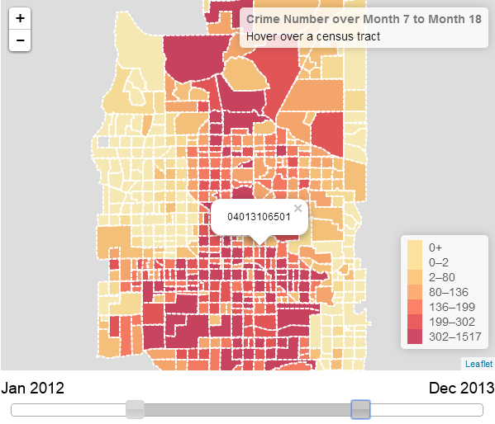
Time Selection Fixed and Dynamic Legend
To fix the problem, we introduced fixed and dynamic classification (legend)

Slide 15
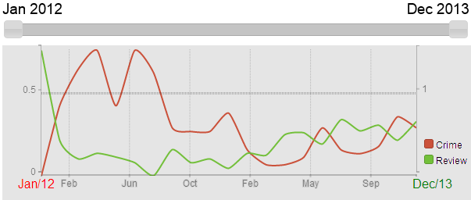
Time Chart
The Time chart will show the change of crime count and review count for the selected census tract.
Red line represents crime count and green line represents review count
User can also use the slide bar to change the time range. The time chart will update accordingly.

Slide 16
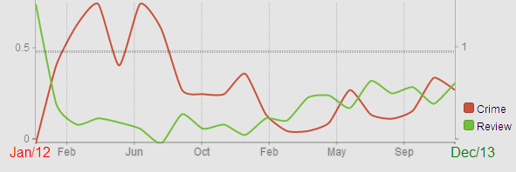
Scaling
We used linear scale for both x and y axis.
In order to always show both lines in the graph, the scale of x and y axis will dynamically change.
x-axis will always have 20 sample points within the selected time range, but the interval between each two sample points will change. The value at each sample point is the average of the value within its interval.
We use separate y-axis for crime and review counts, the scaling of both y –axis will change based on the min and max value of the selected sample points within the time range.

Slide 17

Chernoff Faces
Chernoff Faces are used to show the data of every census tracts
Encoding strategy
Implementation
Proportional symbol map

Slide 18



Chernoff Faces Encoding
Population
Income
Crimes

Slide 19



Chernoff Faces Encoding
Violence Crimes
Reviews
Average Rating

Slide 20


Chernoff Faces Implementation
Use Javascript to draw on html <canvas>
Use Leaflet library to integrate with map

Slide 21
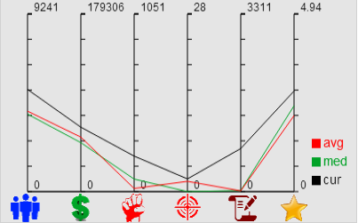
Parallel Coordinates Graph
Show the following 6 numbers of the selected census tract
Population
Income
Total Crimes
Violence Crimes
Total Reviews
Average Rating
Lines:
avg = average
med = median
cur = current selected census tract
The average and median lines are based on all the census tracts.

Slide 22
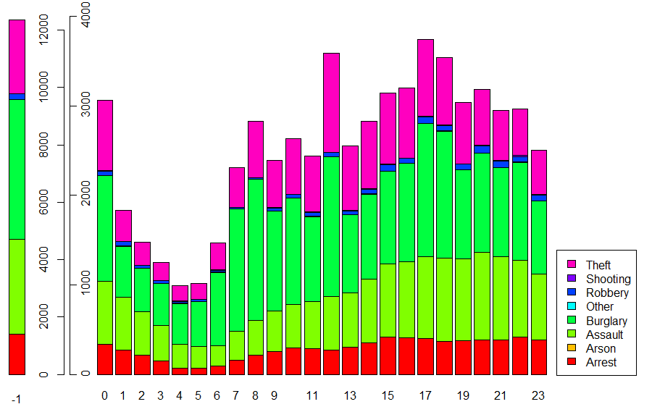
Crime type by hours
NOTE: -1 means no exact time specified

Slide 23
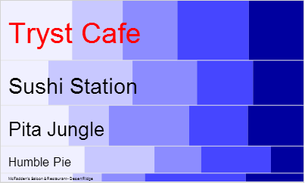
Mosaic Plot
Show the top 5 most reviewed restaurants in the selected census tract
Split:
Vertically split by total review count
Horizontally split by review rating count
Features:
Single selection
Popup name
Update by time range

Slide 24
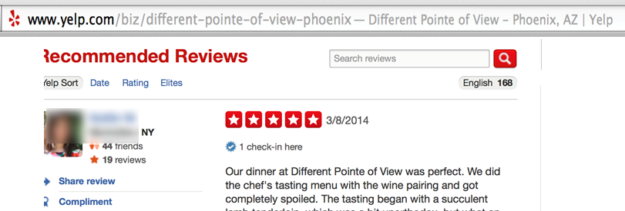
Tag Cloud
Data Extraction:
What data we need ?

Slide 25
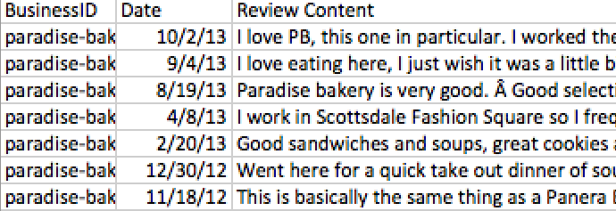
How do we get this data ?
No API support
Use a scraper program (but this is just for personal
use and data is not distributed)
The total reviews now become 99049.

Slide 26
Data Preprocessing
Tag cloud needs only the most frequent words
First, group the reviews together by restaurant for each of 24 months, the format of the data is as follows:
<BusinessID> < Date> <Review Content>
We create a total of 24 files in the process
Advantage: Processing each of these files is faster than processing the whole file

Slide 27
Data Preprocessing (contd.,)
Next, group each of these months by business id
The data has business id as the key and review content as the value
<BusinessID> <Review Content>
Now, perform a word count on the above file
The data now has business id as the key and top 20 frequently used words as the value
<BusinessID> <W1_C1;W2_C2:….>

Slide 28
Data Preprocessing (contd.,)
Merge these files to form a big table
There are a more that 4000 restaurants in Phoenix area
<BusinessID> <Month1> <Month2><Month3>……
Convert this file into a .js file that can be used in web page
The data is stored in the form of an array
WordCount [“BusinessID”] = [“Month1”,”Month2”,…….]

Slide 29
Data Visualization
Inputs
From Mosaic plot (BusinessID)
From slider (time range)
Any changes generate a new tag cloud
Visual variable used is the size of the word, which encodes the frequency of the word
Color has no encoding and is random (rainbow color scheme)
Orientation of the word is changed to better fit the screen space

Slide 30
How we do it ?
Hash Table to get the top 20 words for the given business id and time range
Create a canvas and append these top 20 words with decreasing order of sizes and random colors and orientation
The draw() function from d3.js library is then used to draw the words on to the screen

Slide 31
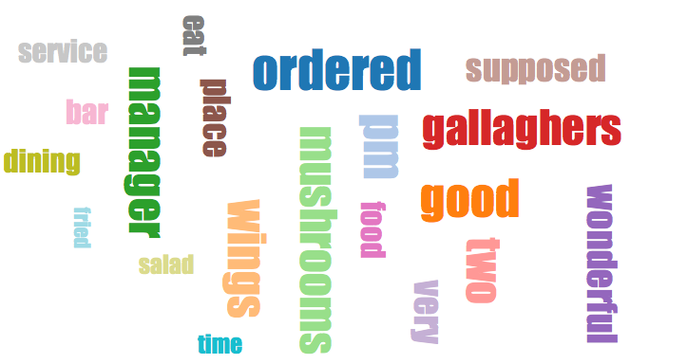
Data Visualization (contd.,)
TAG CLOUD FOR GALLAGHER’S SPORTS GRILL

Slide 32
Uses:
Gives the overview of a particular place
Avoid extensive web search to locate what’s best and trending in a particular restaurant

