Slide 1
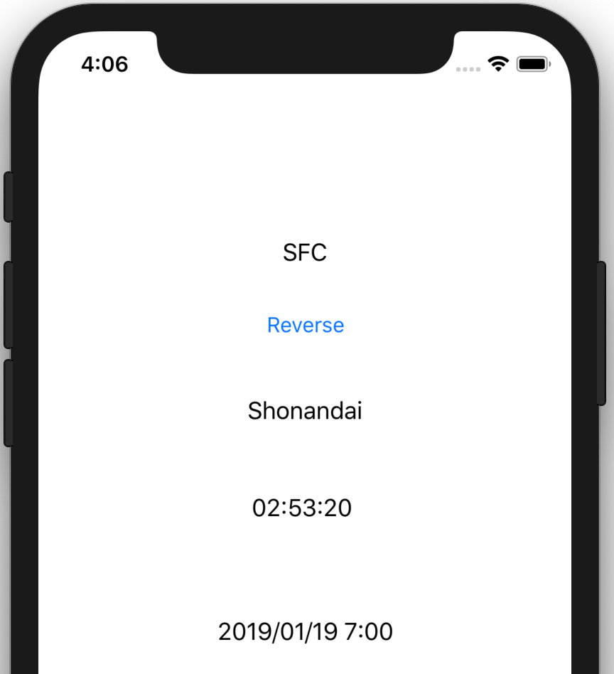
iOS School BusTimer 🚌

Slide 2
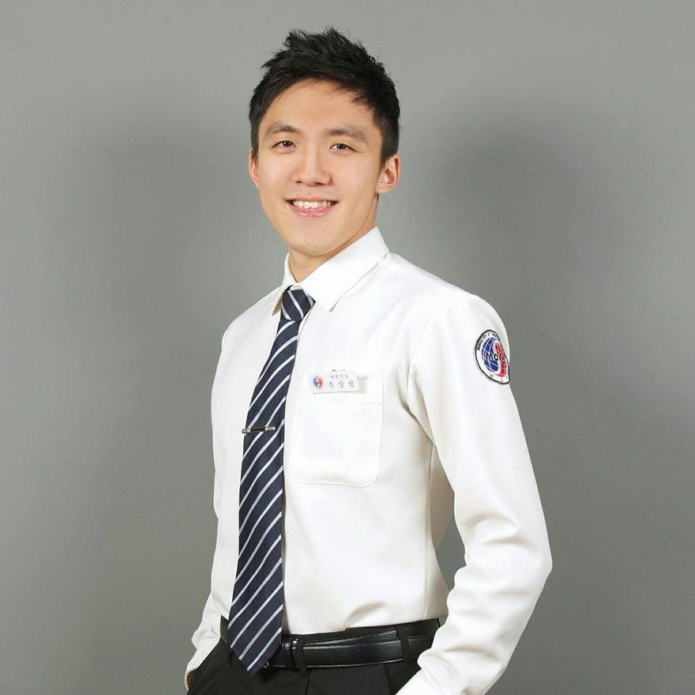
self-introduction
Leonard Sangbuem Choo
2nd year at Keio Univ.
Born in Seoul, 🇰🇷
🇺🇸 (7 years) → 🇰🇷 → 🇯🇵 (2 years ~)
🍎💻 , 🎤🎸 , 🕹,
Notes:
Been learning programming since NYU
But decided to commit to this path only last year.
Before that I focused on being fluent in Japanese and treating my medical condition.

Slide 3
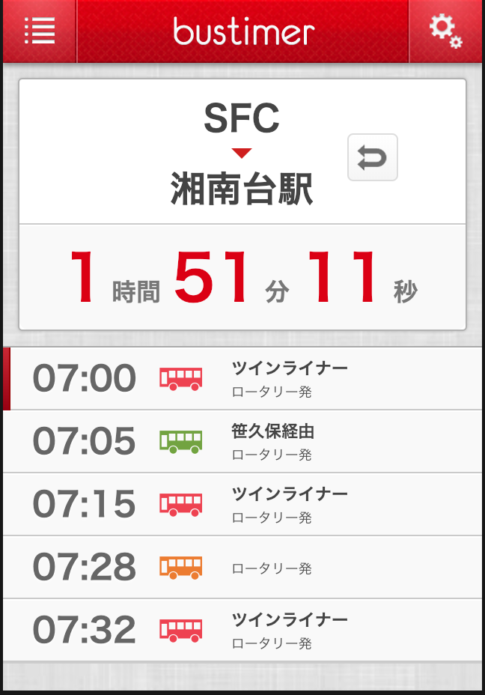
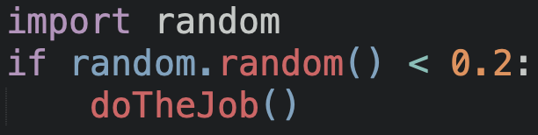
Bustimer (written by someone else)
http://hack.sfc.keioac.jp/bustimer/

Slide 4
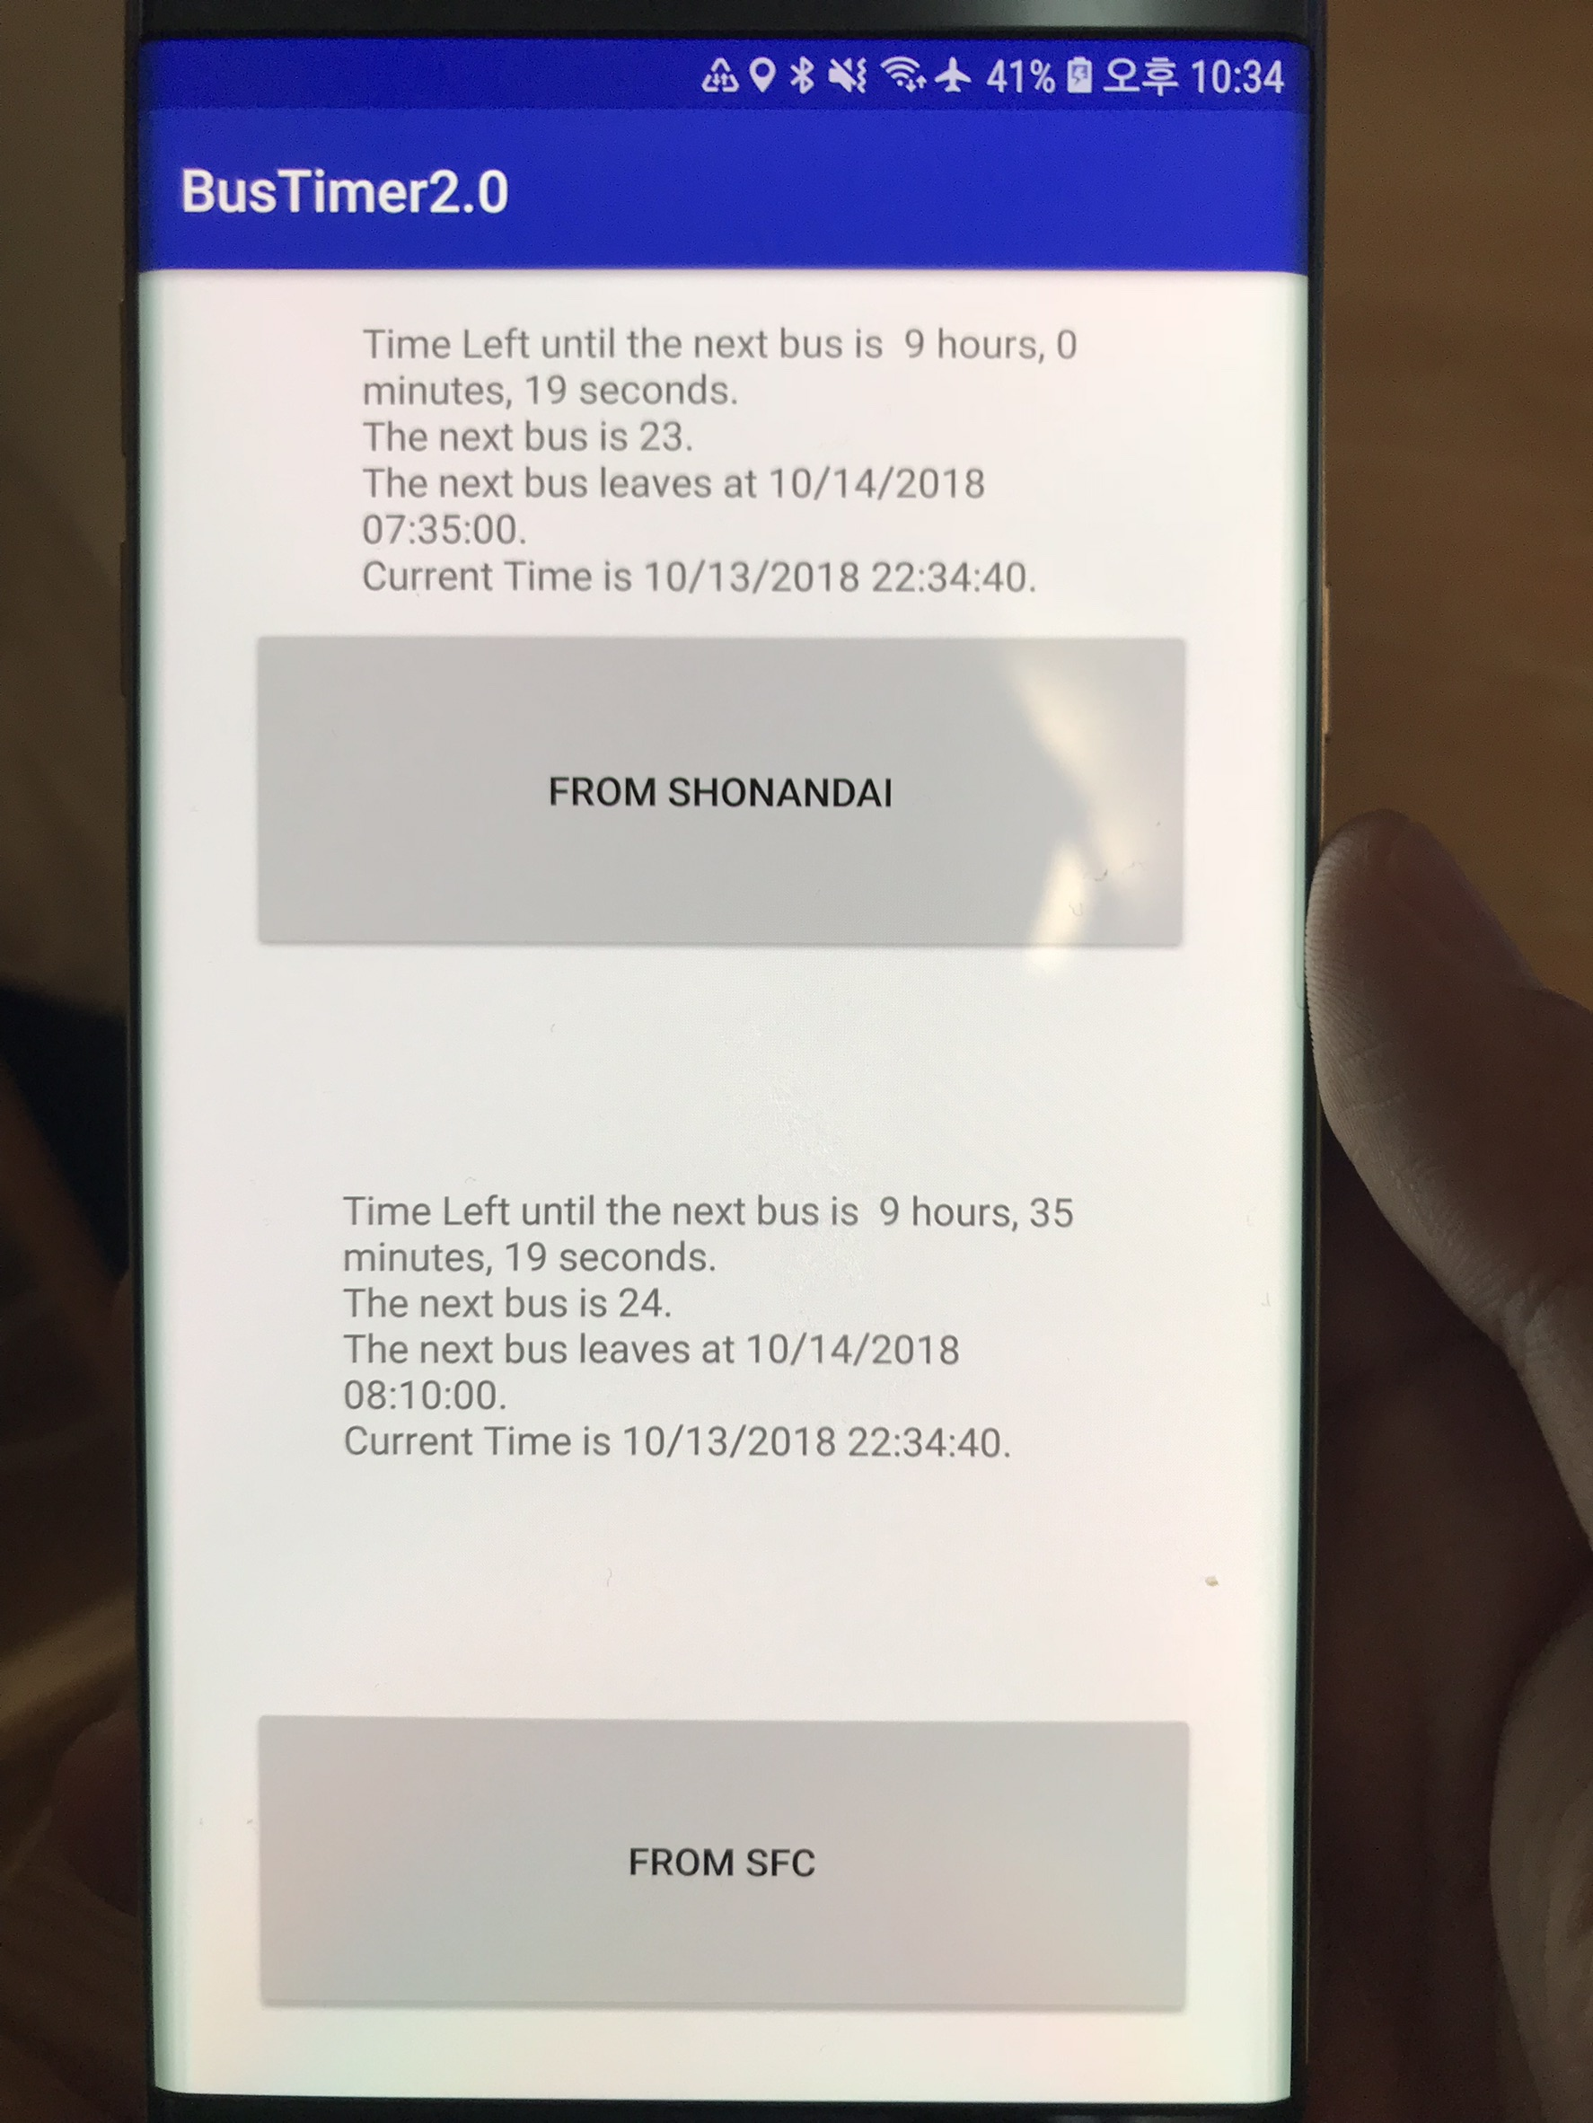
Android version

Slide 5
iOS version

Slide 6




What I thought was going to happen
Parsing Data
Code in Swift
Connecting to UI
Deploy

Slide 7
What actually happened
Parsing JSON
Optional
Callback
Async
DispatchQueue
Connecting to UI
…..
Notes:
UI
ViewController

Slide 8
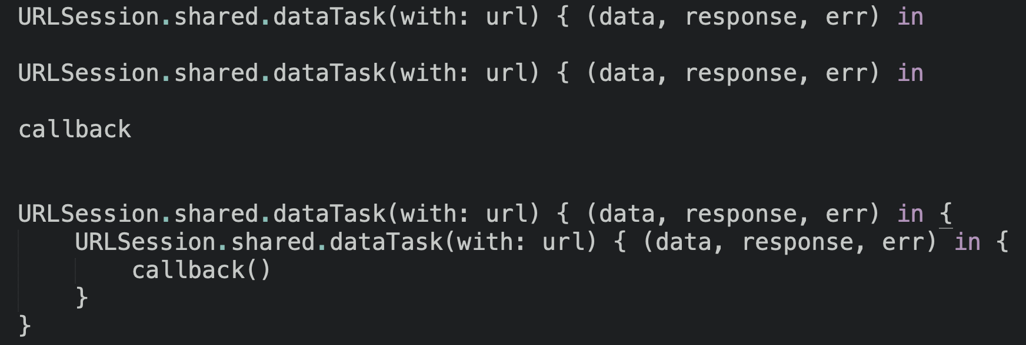
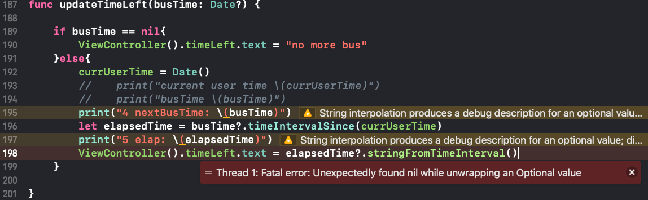

Slide 9
Demo
Notes:
UI
ViewController

Slide 10
Thank you.

