Slide 1
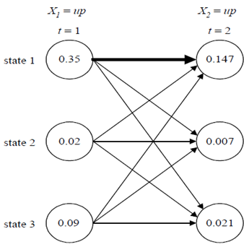
Problems(13/40): Example of Viterbi Algorithm
0.35*0.6*0.7=0.147
0.02*0.5*0.7=0.007
0.09*0.4*0.7=0.0252
0.35*0.2*0.1=0.007
0.02*0.3*0.1=0.0006
0.09*0.1*0.1=0.0009
0.35*0.2*0.3=0.021
0.02*0.2*0.3=0.012
0.09*0.5*0.3=0.0135

Slide 2
Problems(21/40): Example of Forward Algorithm
Assume that each urn has different colored balls, if the observation sequence X is r-g-b-g-r.
How to compute the probability of the observation sequence P(X|Φ) by forward algorithm?
a₁₁=0.4
Urn 1
a₁₃=0.3
a₂₁=0.2
a₃₁=0.1
a₃₃=0.8
a₁₂=0.3
Urn 3
0.7
0.1
0.2
0.1
0.6
0.3
0.3
0.3
0.4
Urn 2
a₃₂=0.1
urn 1:
urn 2:
urn 3:
a₂₂=0.6
a₂₃=0.2

Slide 3
Problems(22/40): Cont.
π= [1/3 1/3 0.3]
S1
S1
S1
S1
S1
S2
S2
S2
S2
S2
S3
S3
S3
S3
S3
t=1
X₁=r
t=2
X₂=g
t=3
X₃=b
t=4
X₄=g
t=5
X₅=r
Complexity: O(N²T)

Slide 4
Problems(36/40): Example of Forward-Backward
Assume that each urn has different colored balls, if the observation sequence X is r-r-r-r-r.
How to adapt the HMM parameters which has the maximum P(X|Φ).
a₁₁=0.4
Urn 1
a₁₃=0.3
a₂₁=0.2
a₃₁=0.1
a₃₃=0.8
a₁₂=0.3
Urn 3
0.7
0.1
0.2
0.1
0.6
0.3
0.3
0.3
0.4
Urn 2
a₃₂=0.1
urn 1:
urn 2:
urn 3:
a₂₂=0.6
a₂₃=0.2

Slide 5
Problems(37/40): Example of Forward-Backward
S1
S1
S1
S1
S1
α₁(S1)
α₂(S1)
α₃(S1)
α₄(S1)
α₅(S1)
0.28
0.0889
0.0298
0.0103
0.0036
β₁(S1)
β₂(S1)
β₃(S1)
β₄(S1)
β₅(S1)
0.0064
0.0179
0.0495
0.1333
0.3333
S2
S2
S2
S2
S2
α₁(S2)
α₂(S2)
α₃(S2)
α₄(S2)
α₅(S2)
0.03
0.0111
0.0038
0.0013
0.0004
β₁(S2)
β₂(S2)
β₃(S2)
β₄(S2)
β₅(S2)
0.0038
0.0108
0.0302
0.0866
0.3333
S3
S3
S3
S3
S3
α₁(S3)
0.09
α₂(S3)
0.0486
α₃(S3)
0.0203
α₄(S3)
0.0078
α₅(S3)
0.0028
β₁(S3)
0.0043
β₂(S3)
0.0123
β₃(S3)
0.0357
β₄(S3)
0.1066
β₅(S3)
0.3333
t=1
X₁=r
t=2
X₂=r
t=3
X₃=r
t=4
X₄=r
t=5
X₅=r

Slide 6

Example of Gaussian Mixture Model (6/12)
為簡化討論，我們引進另一個數學符號：
  β_{j}(x)稱為事後機率

Slide 7
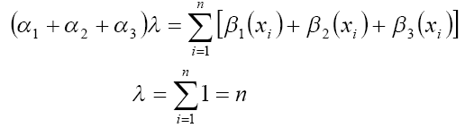
Example of Gaussian Mixture Model (8/12)
接著再針對權重值進行微分，但因權重值總合須為1
  使用Lagrange Multiplier

Slide 8
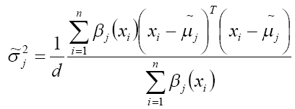
Example of Gaussian Mixture Model (9/12)
藉由調適後的參數值進行疊代，找出觀測機率最大值

Slide 9
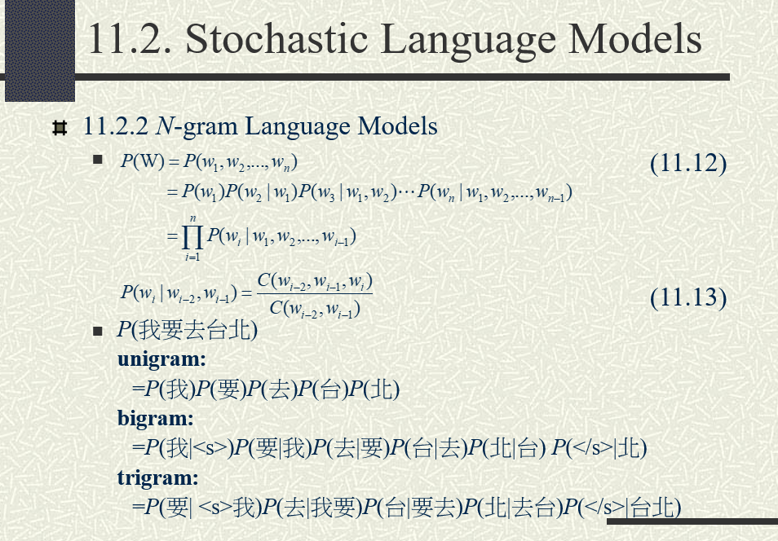

Slide 10
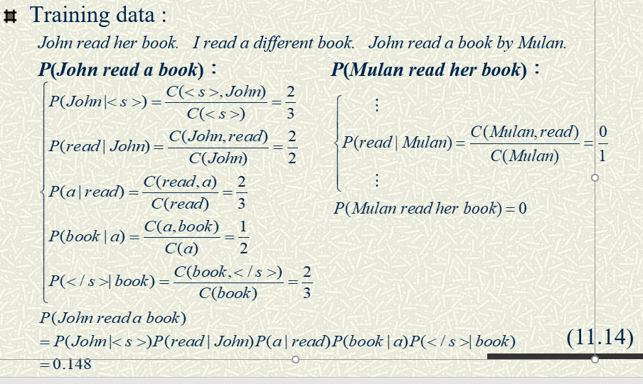

Slide 11
Prediction-based – Training
潮水
Neural
Network
Collect data:
就
潮水 退了 就 知道 誰 …
不爽 不要 買 …
公道價 八萬 一 …
………
退了
退了
Neural
Network
知道
就
就
Neural
Network
Minimizing cross entropy
誰
知道
Notes:
What can it do? Application?

Slide 12
Prediction-based– Various Architectures
Continuous bag of word (CBOW) model
Skip-gram
w_{i-1}
Neural
Network
…… w_{i-1} ____ w_{i+1} ……
w_{i}
w_{i+1}
predicting the word given its context
…… ____ w_{i} ____ ……
Neural
Network
w_{i-1}
w_{i}
w_{i+1}
predicting the context given a word

Slide 13

cos_similarity

