Slide 1
Satisfiability Modulo Theories (SMT): ideas and applications Università Degli Studi Di Milano Scuola di Dottorato in Informatica, 2010
Leonardo de Moura
Microsoft Research

Slide 2
Software development crisis
Software malfunction is a common problem.
Software complexity is increasing.
We need new methods and tools.

Slide 3
Program correctness
I proved my program to be correct.
What does it mean?

Slide 4
Software models
We need models and tools to reason about them?
Does my model/software has property X?

Slide 5
Symbolic Reasoning
Verification/Analysis tools need some form of Symbolic Reasoning

Slide 6
Symbolic Reasoning
Logic is “The Calculus of Computer Science” (Z. Manna).
High computational complexity
Undecidable
(FOL + LA)
Semi-decidable
(First-order logic)
NEXPTime-complete
(EPR)
PSpace-complete
(QBF)
NP-complete
(Propositional logic)
P-time
(Equality)

Slide 7
Applications
Test case generation
Verifying Compilers
Predicate Abstraction
Invariant Generation
Type Checking
Model Based Testing

Slide 8






Some Applications @ Microsoft
HAVOC
Hyper-V
Terminator T-2
VCC
NModel
Vigilante
SpecExplorer
F7
SAGE

Slide 9
Test case generation
unsigned GCD(x, y) {
requires(y > 0);
while (true) {
unsigned m = x % y;
if (m == 0) return y;
x = y;
y = m;
}
}
(y₀ > 0) and
(m₀ = x₀ % y₀) and
not (m₀ = 0) and
(x₁ = y₀) and
(y₁ = m₀) and
(m₁ = x₁ % y₁) and
(m₁ = 0)
x₀ = 2
y₀ = 4
m₀ = 2
x₁ = 4
y₁ = 2
m₁ = 0
SSA
Solver
We want a trace where the loop is executed twice.

Slide 10
Type checking
Signature:
div : int, { x : int | x ≠ 0 } → int
Subtype
Call site:
if a ≤ 1 and a ≤ b then
return div(a, b)
Verification condition
a ≤ 1 and a ≤ b implies b ≠ 0

Slide 11
What is logic?
Logic is the art and science of effective reasoning.
How can we draw general and reliable conclusions from a collection of facts?
Formal logic: Precise, syntactic characterizations of well-formed expressions and valid deductions.
Formal logic makes it possible to calculate consequences at the symbolic level.
Computers can be used to automate such symbolic calculations.

Slide 12
What is logic?
Logic studies the relationship between language, meaning, and (proof) method.
A logic consists of a language in which (well-formed) sentences are expressed.
A semantic that distinguishes the valid sentences from the refutable ones.
A proof system for constructing arguments justifying valid sentences.
Examples of logics include propositional logic, equational logic, first-order logic, higher-order logic, and modal logics.

Slide 13
What is logical language?
A language consists of logical symbols whose interpretations are fixed, and non-logical ones whose interpretations vary.
These symbols are combined together to form well-formed formulas.
In propositional logic PL, the connectives ∧, ∨, and ¬ have a fixed interpretation, whereas the constants p, q, r may be interpreted at will.

Slide 14
Propositional Logic
Formulas: ϕ := p | ϕ₁ ∨ϕ₂ | ϕ₁ ∧ϕ₂ | ¬ϕ₁ | ϕ₁ ⇒ ϕ₂
Examples:
p ∨ q ⇒ q ∨ p
p ∧ ¬q ∧ (¬p ∨ q)
We say p and q are propositional variables.
Exercise: Using a programming language, define a representation for formulas and a checker for well-formed formulas.

Slide 15
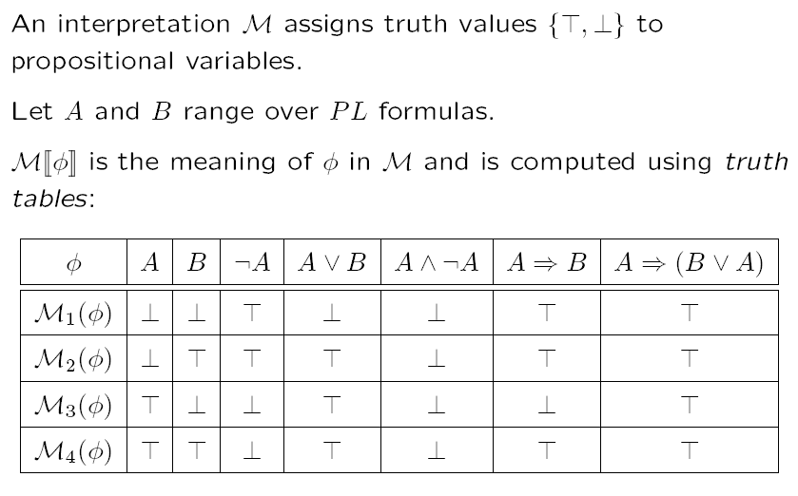
Interpretation

Slide 16
Satisfiability & Validity
A formula is satisfiable if it has an interpretation that makes it logically true.
In this case, we say the interpretation is a model.
A formula is unsatisfiable if it does not have any model.
A formula is valid if it is logically true in any interpretation.
A propositional formula is valid if and only if its negation is unsatisfiable.

Slide 17
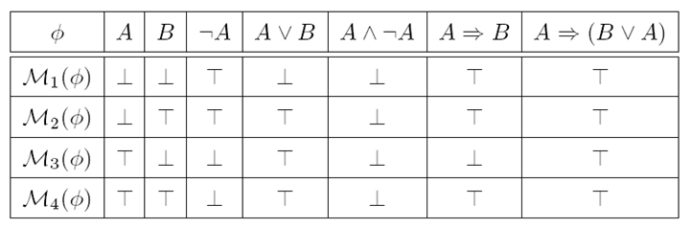
Satisfiability & Validity: examples
p ∨ q ⇒ q ∨ p
p ∨ q ⇒ q
p ∧ ¬q ∧ (¬p ∨ q)

Slide 18
Satisfiability & Validity: examples
p ∨ q ⇒ q ∨ p VALID
p ∨ q ⇒ q SATISFIABLE
p ∧ ¬q ∧ (¬p ∨ q) UNSATISFIABLE

Slide 19
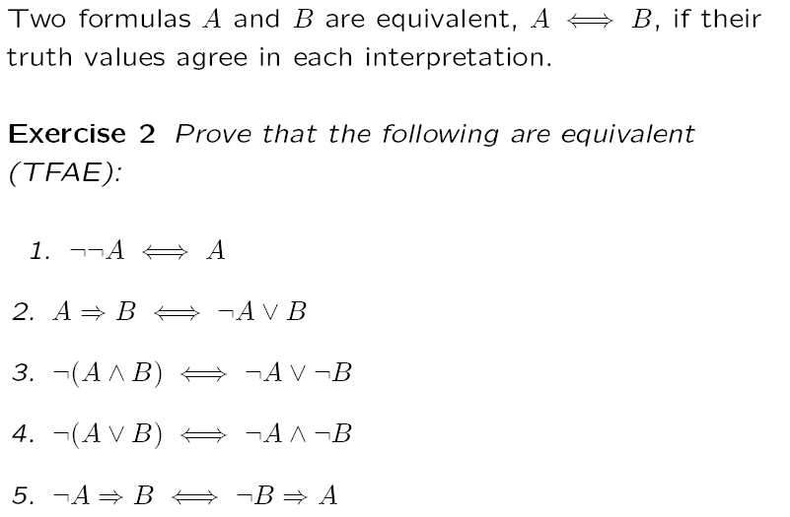
Equivalence

Slide 20
Equisatisfiable
We say formulas A and B are equisatisfiable if and only if A is satisfiable if and only if B is.
During this course, we will describe transformations that preserve equivalence and equisatisfiability.

Slide 21
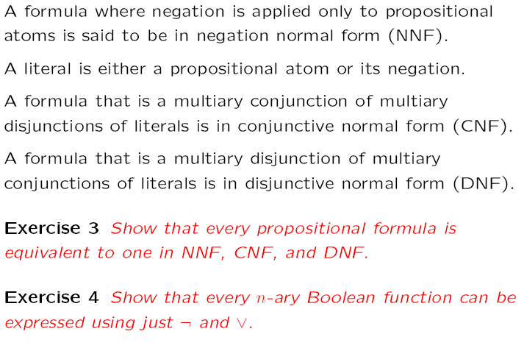
Normal Forms

Slide 22
Normal Forms
NNF?
(p ∨ ¬q) ∧ (q ∨ ¬(r ∧ ¬p))

Slide 23
Normal Forms
NNF? NO
(p ∨ ¬q) ∧ (q ∨ ¬(r ∧ ¬p))

Slide 24
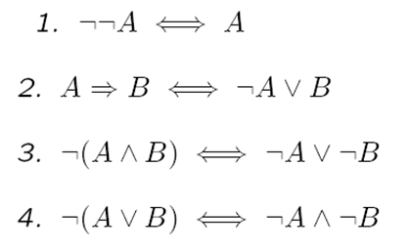
Normal Forms
NNF? NO
(p ∨ ¬q) ∧ (q ∨ ¬(r ∧ ¬p))

Slide 25
Normal Forms
NNF? NO
(p ∨ ¬q) ∧ (q ∨ ¬(r ∧ ¬p))
⇔
(p ∨ ¬q) ∧ (q ∨ (¬r ∨ ¬¬p))

Slide 26
Normal Forms
NNF? NO
(p ∨ ¬q) ∧ (q ∨ ¬(r ∧ ¬p))
⇔
(p ∨ ¬q) ∧ (q ∨ (¬r ∨ ¬¬p))
⇔
(p ∨ ¬q) ∧ (q ∨ (¬r ∨ p))

Slide 27
Normal Forms
CNF?
((p ∧ s) ∨ (¬q ∧ r)) ∧ (q ∨ ¬p ∨ s) ∧ (¬r ∨ s)

Slide 28
Normal Forms
CNF? NO
((p ∧ s) ∨ (¬q ∧ r)) ∧ (q ∨ ¬p ∨ s) ∧ (¬r ∨ s)

Slide 29
Normal Forms
CNF? NO
((p ∧ s) ∨ (¬q ∧ r)) ∧ (q ∨ ¬p ∨ s) ∧ (¬r ∨ s)
Distributivity
1. A∨(B∧C) ⇔ (A∨B)∧(A∨C)
2. A∧(B∨C) ⇔ (A∧B)∨(A∧C)

Slide 30
Normal Forms
CNF? NO
((p ∧ s) ∨ (¬q ∧ r)) ∧ (q ∨ ¬p ∨ s) ∧ (¬r ∨ s)
⇔
((p ∧ s) ∨ ¬q)) ∧ ((p ∧ s) ∨ r)) ∧ (q ∨ ¬p ∨ s) ∧ (¬r ∨ s)
Distributivity
1. A∨(B∧C) ⇔ (A∨B)∧(A∨C)
2. A∧(B∨C) ⇔ (A∧B)∨(A∧C)

Slide 31
Normal Forms
CNF? NO
((p ∧ s) ∨ (¬q ∧ r)) ∧ (q ∨ ¬p ∨ s) ∧ (¬r ∨ s)
⇔
((p ∧ s) ∨ ¬q)) ∧ ((p ∧ s) ∨ r)) ∧ (q ∨ ¬p ∨ s) ∧ (¬r ∨ s)
⇔
(p ∨ ¬q) ∧ (s ∨ ¬q) ∧ ((p ∧ s) ∨ r)) ∧ (q ∨ ¬p ∨ s) ∧ (¬r ∨ s)
Distributivity
1. A∨(B∧C) ⇔ (A∨B)∧(A∨C)
2. A∧(B∨C) ⇔ (A∧B)∨(A∧C)

Slide 32
Normal Forms
CNF? NO
((p ∧ s) ∨ (¬q ∧ r)) ∧ (q ∨ ¬p ∨ s) ∧ (¬r ∨ s)
⇔
((p ∧ s) ∨ ¬q)) ∧ ((p ∧ s) ∨ r)) ∧ (q ∨ ¬p ∨ s) ∧ (¬r ∨ s)
⇔
(p ∨ ¬q) ∧ (s ∨ ¬q) ∧ ((p ∧ s) ∨ r)) ∧ (q ∨ ¬p ∨ s) ∧ (¬r ∨ s)
⇔
(p ∨ ¬q) ∧ (s ∨ ¬q) ∧ (p ∨ r) ∧ (s ∨ r) ∧ (q ∨ ¬p ∨ s) ∧ (¬r ∨ s)

Slide 33
Normal Forms
DNF?
p ∧ (¬p ∨ q) ∧ (¬q ∨ r)

Slide 34
Normal Forms
DNF? NO, actually this formula is in CNF
p ∧ (¬p ∨ q) ∧ (¬q ∨ r)

Slide 35
Normal Forms
DNF? NO, actually this formula is in CNF
p ∧ (¬p ∨ q) ∧ (¬q ∨ r)
Distributivity
1. A∨(B∧C) ⇔ (A∨B)∧(A∨C)
2. A∧(B∨C) ⇔ (A∧B)∨(A∧C)

Slide 36
Normal Forms
DNF? NO, actually this formula is in CNF
p ∧ (¬p ∨ q) ∧ (¬q ∨ r)
⇔
((p ∧ ¬p) ∨ (p ∨ q)) ∧ (¬q ∨ r)
Distributivity
1. A∨(B∧C) ⇔ (A∨B)∧(A∨C)
2. A∧(B∨C) ⇔ (A∧B)∨(A∧C)

Slide 37
Normal Forms
DNF? NO, actually this formula is in CNF
p ∧ (¬p ∨ q) ∧ (¬q ∨ r)
⇔
((p ∧ ¬p) ∨ (p ∨ q)) ∧ (¬q ∨ r)
⇔
(p ∨ q) ∧ (¬q ∨ r)
Distributivity
1. A∨(B∧C) ⇔ (A∨B)∧(A∨C)
2. A∧(B∨C) ⇔ (A∧B)∨(A∧C)
Other Rules
A∧¬A ⇔ ⊥
A∨⊥ ⇔ A

Slide 38
Normal Forms
DNF? NO, actually this formula is in CNF
p ∧ (¬p ∨ q) ∧ (¬q ∨ r)
⇔
((p ∧ ¬p) ∨ (p ∨ q)) ∧ (¬q ∨ r)
⇔
(p ∨ q) ∧ (¬q ∨ r)
⇔
((p ∨ q) ∧ ¬q) ∨ ((p ∨ q) ∧ r)
Distributivity
1. A∨(B∧C) ⇔ (A∨B)∧(A∨C)
2. A∧(B∨C) ⇔ (A∧B)∨(A∧C)
Other Rules
A∧¬A ⇔ ⊥
A∨⊥ ⇔ A

Slide 39
Normal Forms
DNF? NO, actually this formula is in CNF
p ∧ (¬p ∨ q) ∧ (¬q ∨ r)
⇔
((p ∧ ¬p) ∨ (p ∨ q)) ∧ (¬q ∨ r)
⇔
(p ∨ q) ∧ (¬q ∨ r)
⇔
((p ∨ q) ∧ ¬q) ∨ ((p ∨ q) ∧ r)
⇔
(p ∧ ¬q) ∨ (q ∧ ¬q) ∨ ((p ∨ q) ∧ r)
⇔
(p ∧ ¬q) ∨ (p ∧ r) ∨ (q ∧ r)

Slide 40
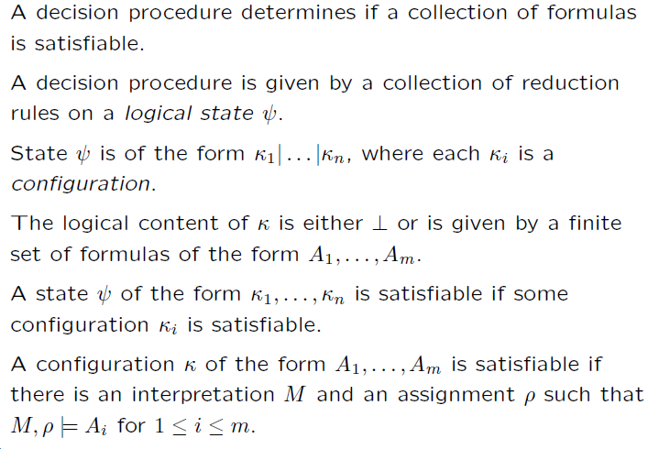

Refutation Decision Procedures

Slide 41
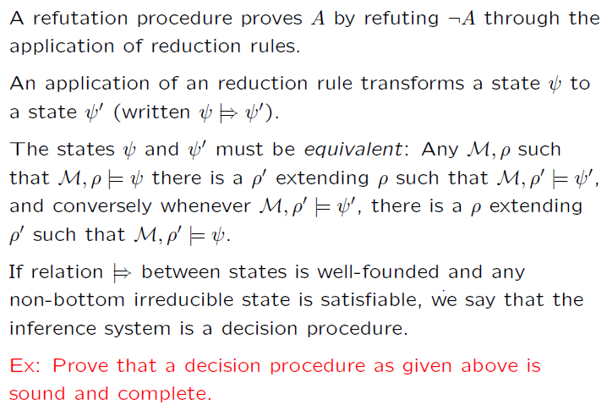
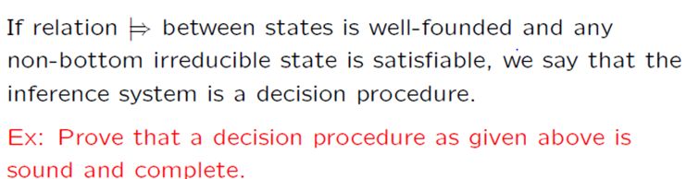
Inference Systems for Decision Procedures
Rules preserve satisfiability.

Slide 42
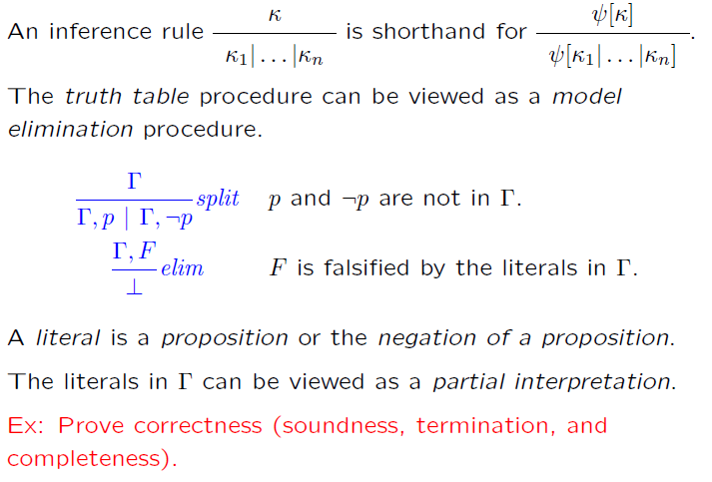
Truth Table

Slide 43
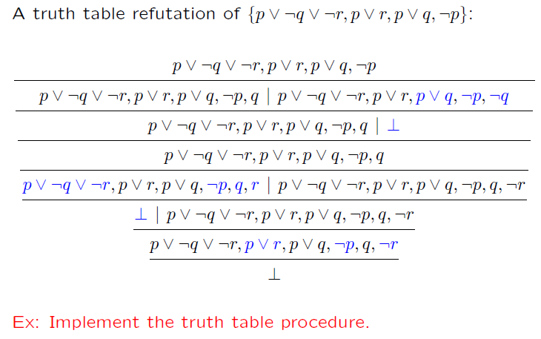
Truth Table (example)

Slide 44
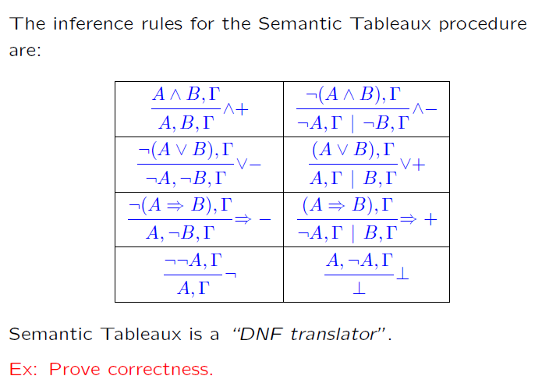
Semantic Tableaux

Slide 45
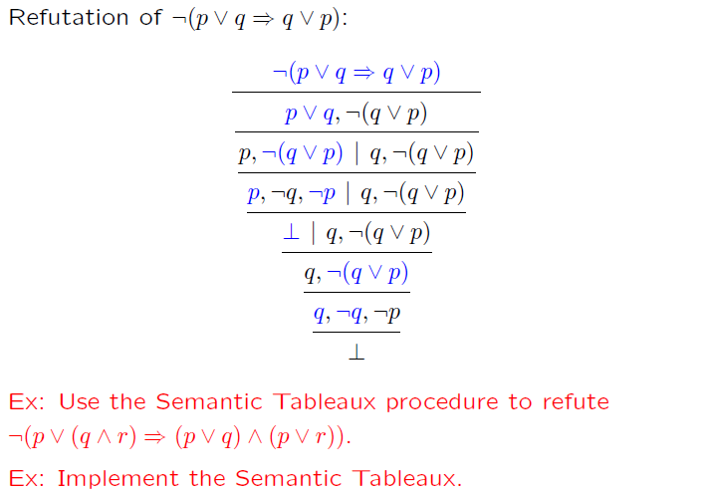
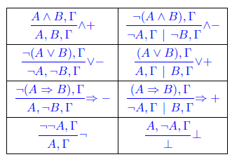
Semantic Tableaux (example)

Slide 46
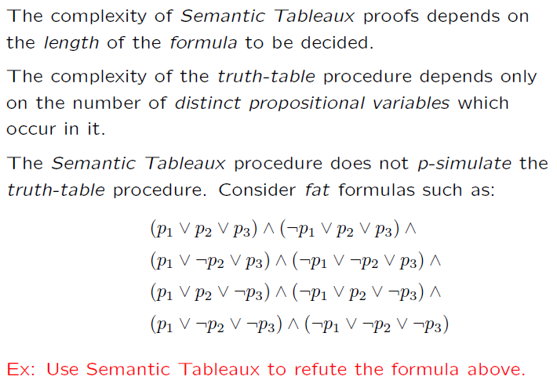
Semantic Tableaux (cont.)

Slide 47
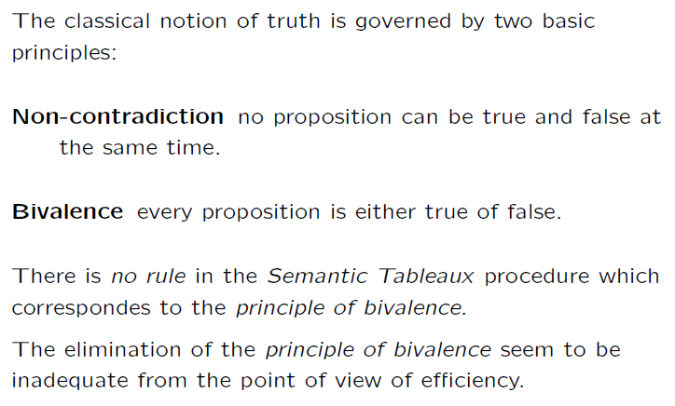
Semantic Tableaux (cont.)

Slide 48
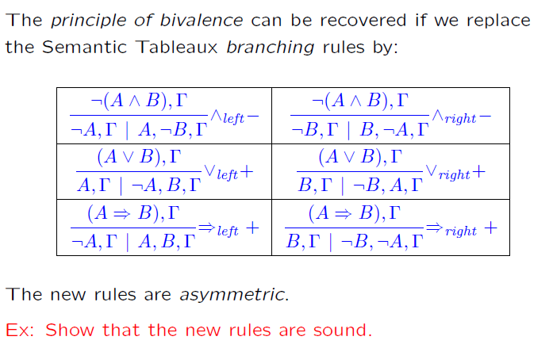
Semantic Tableaux + Bivalence

Slide 49
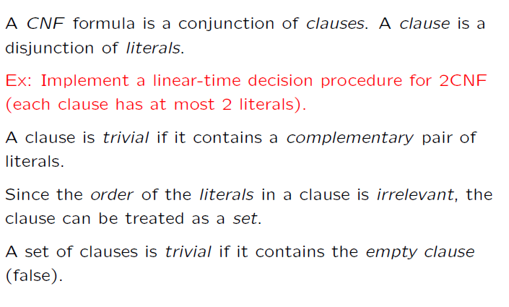
CNF (again)

Slide 50
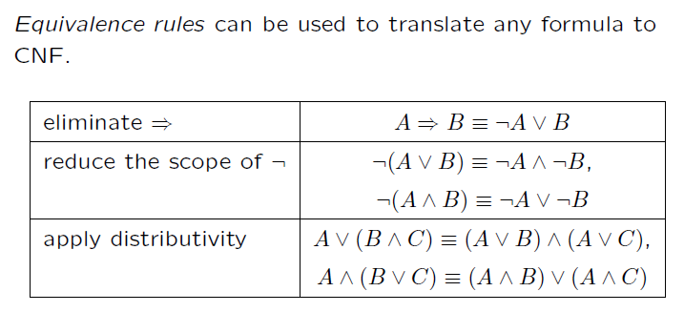
CNF (again)

Slide 51
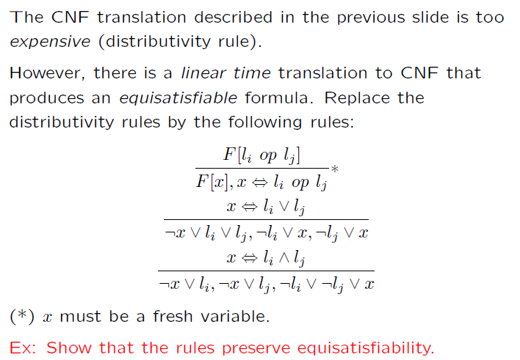
CNF (again)

Slide 52
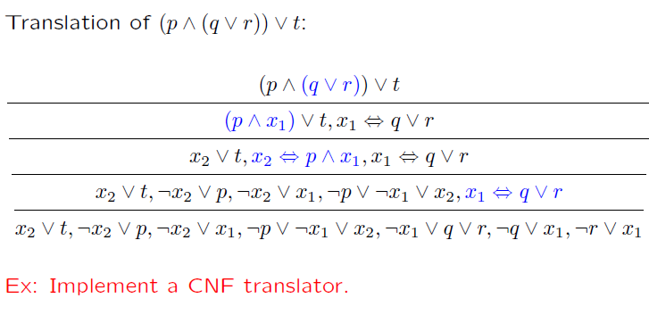
CNF translation (example)

Slide 53
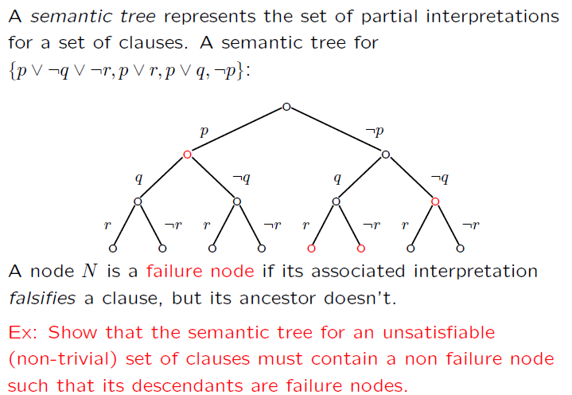
Semantic Trees

Slide 54
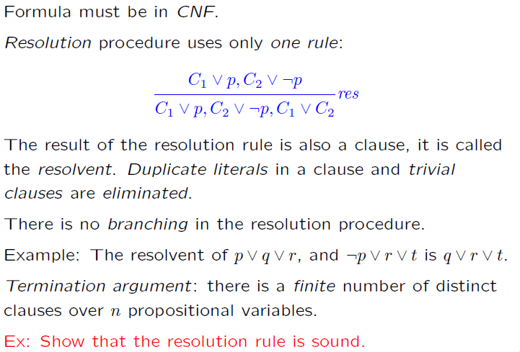
Resolution

Slide 55
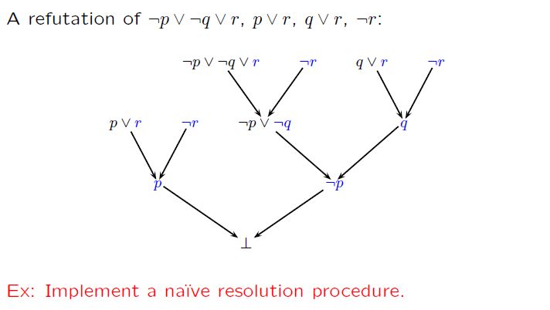
Resolution (example)

Slide 56
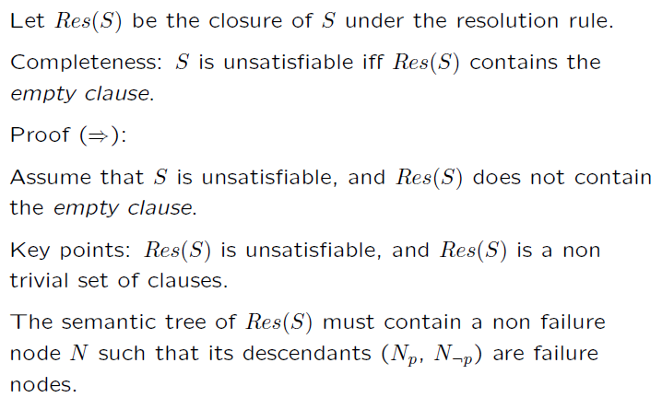
Completeness of Resolution

Slide 57
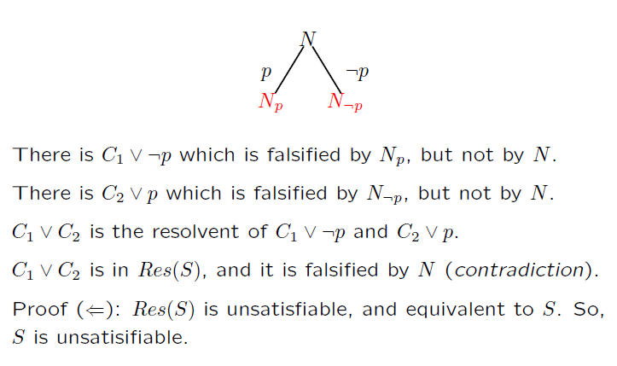
Completeness of Resolution

Slide 58
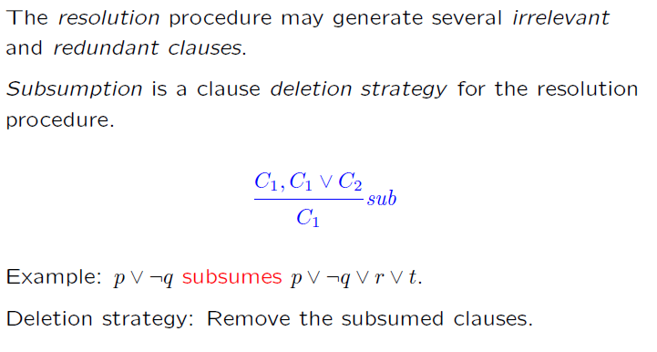
Subsumption

Slide 59
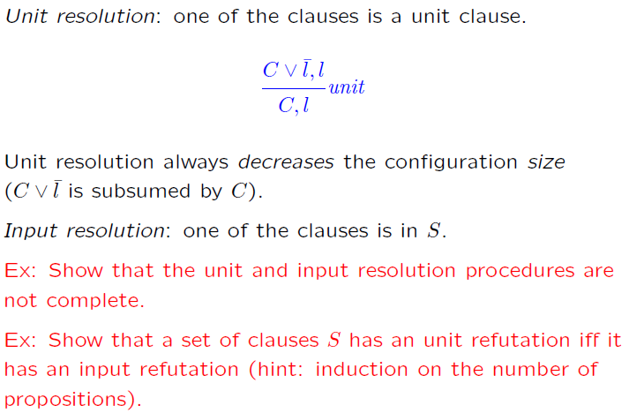
Unit & Input Resolution

Slide 60
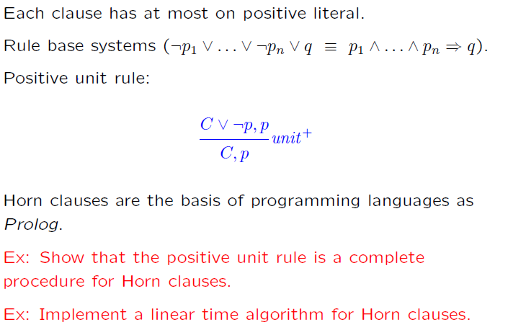
Horn Clauses

Slide 61
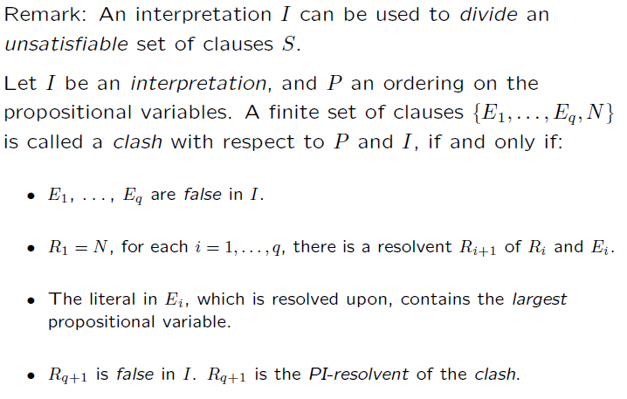
Semantic Resolution

Slide 62
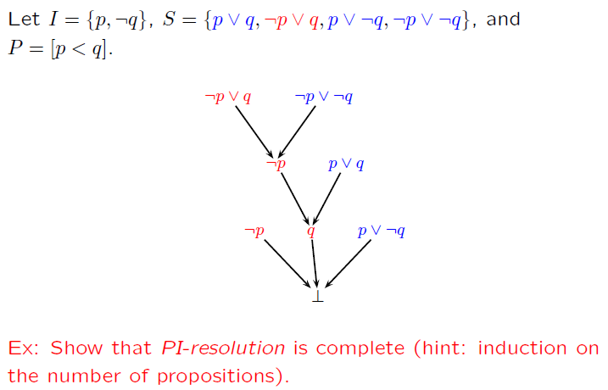
Semantic Resolution (example)

Slide 63
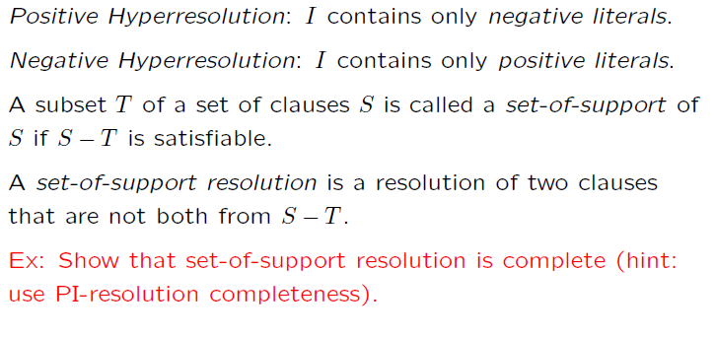
Semantic Resolution (special cases)

Slide 64
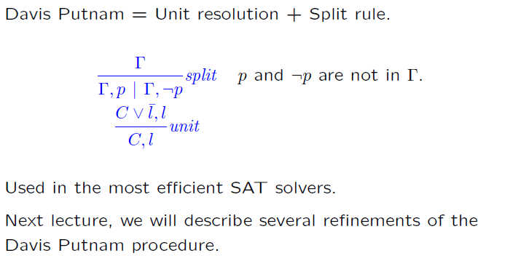
DPLL
DPLL

Slide 65
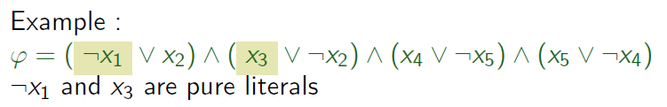
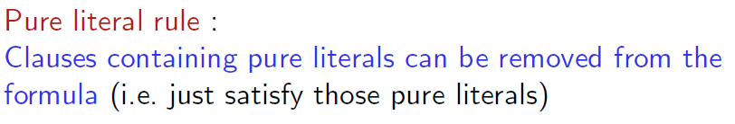

Pure Literals
A literal is pure if only occurs positively or negatively.

Slide 66
Pure Literals
A literal is pure if only occurs positively or negatively.

Slide 67
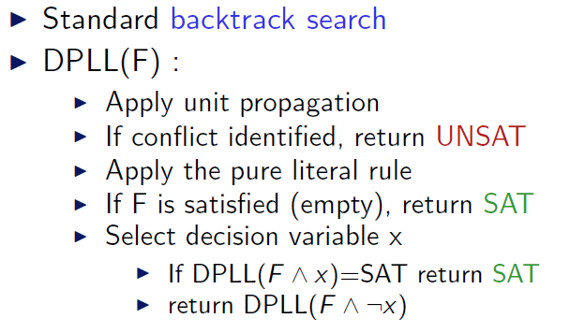
DPLL (as a procedure)

Slide 68
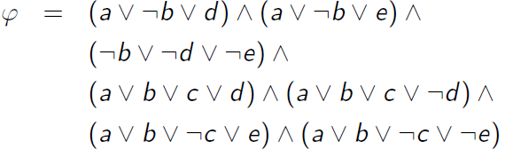
DPLL (example)

Slide 69
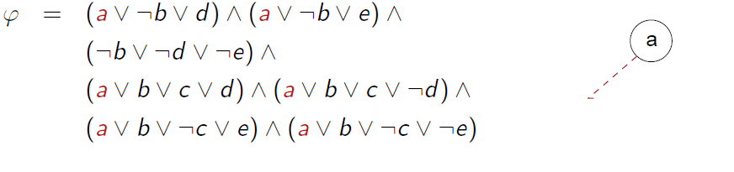
DPLL (example)

Slide 70
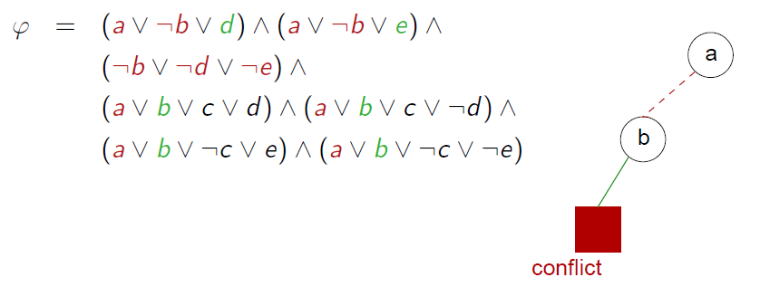
DPLL (example)

Slide 71
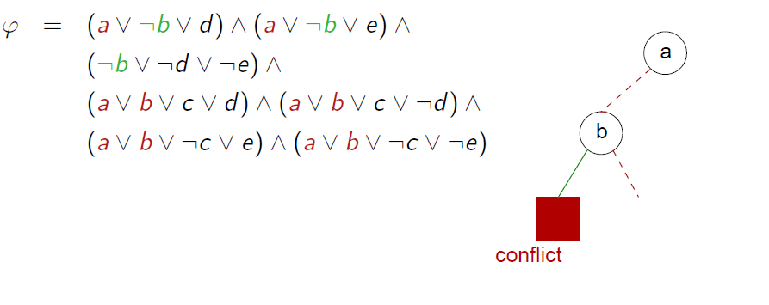
DPLL (example)

Slide 72
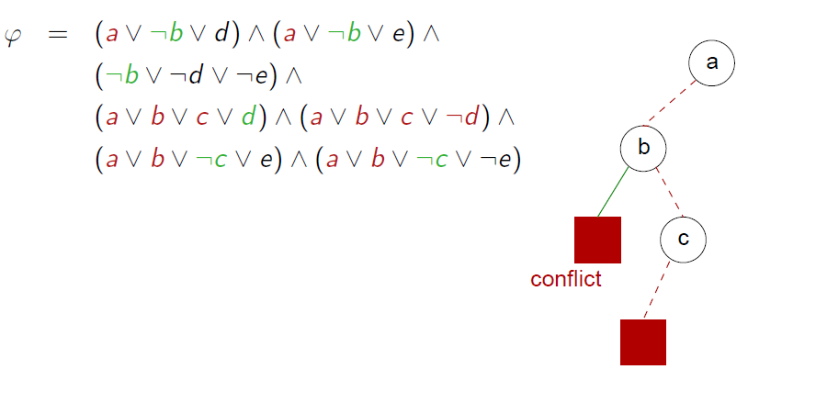
DPLL (example)

Slide 73
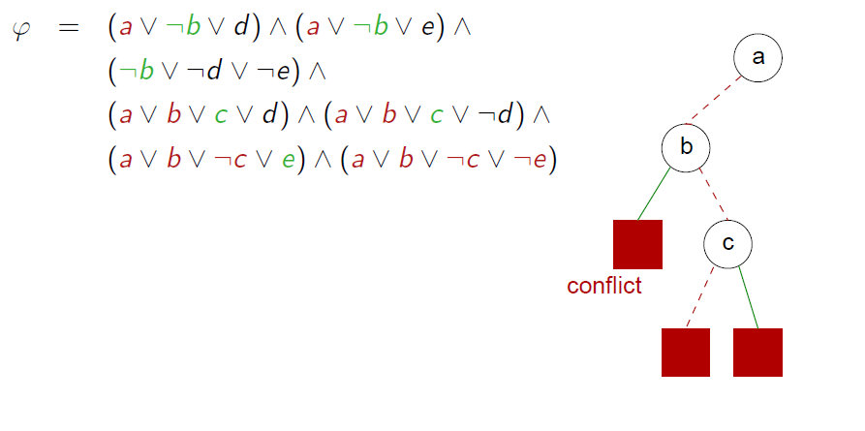
DPLL (example)

Slide 74
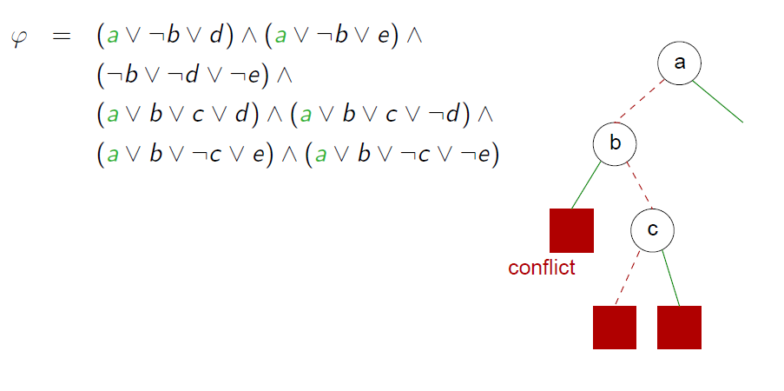
DPLL (example)

Slide 75
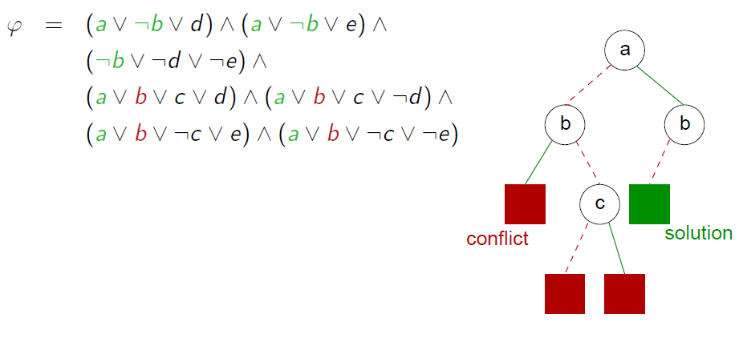
DPLL (example)

Slide 76
Some Applications

Slide 77
Bit-vector / Machine arithmetic
Let x, y and z be 8-bit (unsigned) integers.
Is x > 0 ∧ y > 0 ∧ z = x + y ⇒ z > 0 valid?
Is x > 0 ∧ y > 0 ∧ z = x + y ∧ ¬(z > 0) satisfiable?

Slide 78
Bit-vector / Machine arithmetic
We can encode bit-vector satisfiability problems in propositional logic.
Idea 1:
Use n propositional variables to encode n-bit integers.
x → (x₁, …, x_{n})
Idea 2:
Encode arithmetic operations using hardware circuits.

Slide 79
Encoding equality
p ⇔ q is equivalent to (¬p ∨ q) ∧ (¬q ∨ p)
The bit-vector equation x = y is encoded as:
(x₁ ⇔ y₁) ∧ … ∧ (x_{n} ⇔ y_{n})

Slide 80
Encoding addition
We use (r₁, …, r_{n}) to store the result of x + y
p xor q is defined as ¬(p ⇔ q)
xor is the 1-bit adder
carry
p | q | p xor q | p ∧ q
0 | 0 | 0 | 0
1 | 0 | 1 | 0
0 | 1 | 1 | 0
1 | 1 | 0 | 1

Slide 81
Encoding 1-bit full adder
1-bit full adder
Three inputs: x, y, c_{in}
Two outputs: r, c_{out}
x | y | c_{in} | r = x xor y xor c_{in} | c_{out} = (x ∧ y)∨(x ∧ c_{in})∨(y ∧ c_{in})
0 | 0 | 0 | 0 | 0
1 | 0 | 0 | 1 | 0
0 | 1 | 0 | 1 | 0
1 | 1 | 0 | 0 | 1
0 | 0 | 1 | 1 | 0
1 | 0 | 1 | 0 | 1
0 | 1 | 1 | 0 | 1
1 | 1 | 1 | 1 | 1

Slide 82
Encoding n-bit adder
We use (r₁, …, r_{n}) to store the result of x + y,
and (c₁, …, c_{n})
r₁ ⇔ (x₁ xor y₁)
c₁ ⇔ (x₁ ∧ y₁)
r₂ ⇔ (x₂ xor y₂ xor c₁)
c₂ ⇔ (x₂ ∧ y₂) ∨ (x₂ ∧ c₁) ∨ (y₂ ∧ c₁)
…
r_{n} ⇔ (x_{n} xor y_{n} xor c_{n-1})
c_{n} ⇔ (x_{n} ∧ y_{n}) ∨ (x_{n} ∧ c_{n-1}) ∨ (y_{n} ∧ c_{n-1})

Slide 83
Exercises
Encode x * y
Encode x > y (signed and unsigned versions)

Slide 84
Test case generation (again)
unsigned GCD(x, y) {
requires(y > 0);
while (true) {
unsigned m = x % y;
if (m == 0) return y;
x = y;
y = m;
}
}
(y₀ > 0) and
(m₀ = x₀ % y₀) and
not (m₀ = 0) and
(x₁ = y₀) and
(y₁ = m₀) and
(m₁ = x₁ % y₁) and
(m₁ = 0)
x₀ = 2
y₀ = 4
m₀ = 2
x₁ = 4
y₁ = 2
m₁ = 0
SSA
Solver
We want a trace where the loop is executed twice.

Slide 85
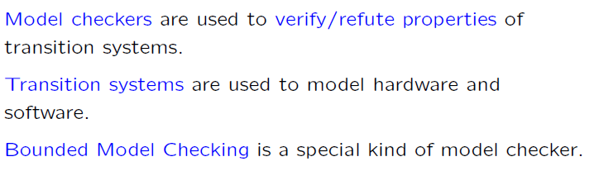
Bounded Model Checkers

Slide 86
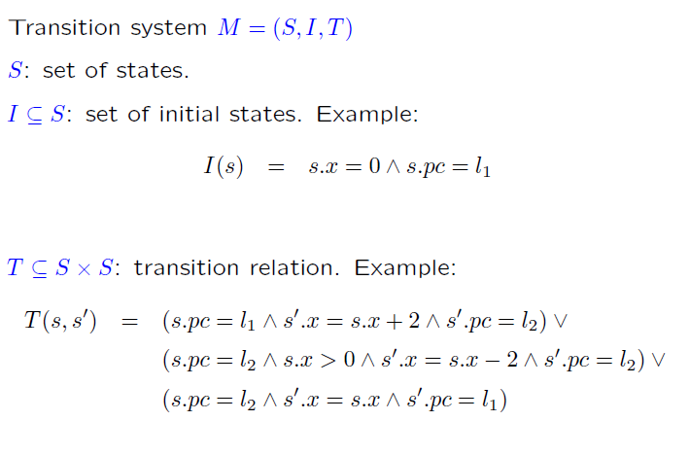
Transition Systems

Slide 87
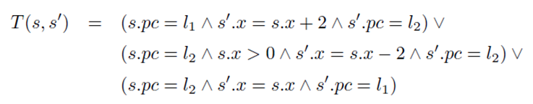
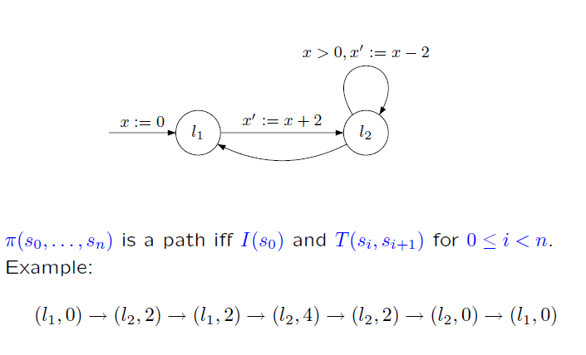
Transition Systems (cont.)

Slide 88
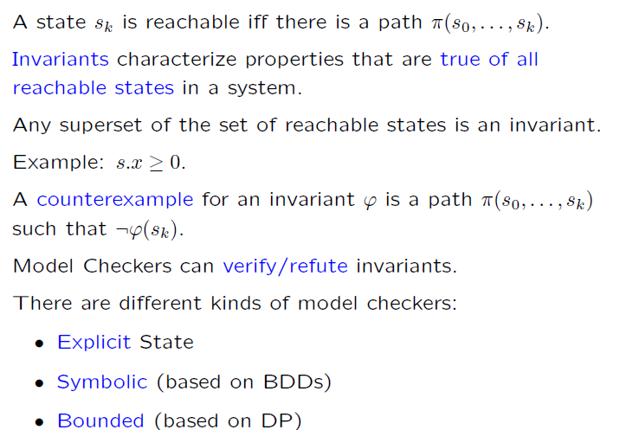
Invariants

Slide 89
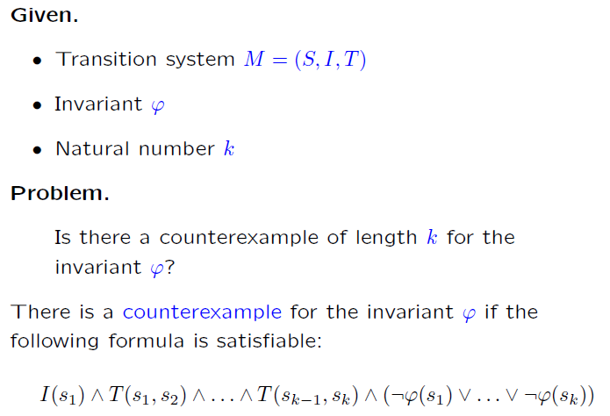
Bounded Model Checking: Invariants

Slide 90
Bounded Model Checking: Invariants

Slide 91
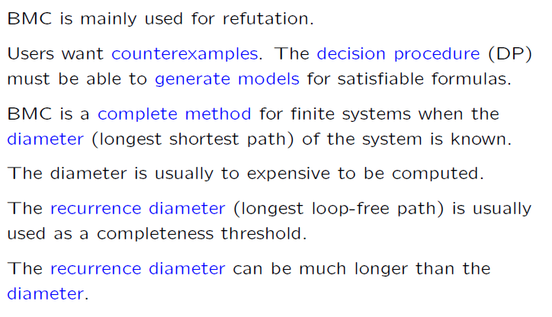
Bounded Model Checking (cont.)

Slide 92

Recurrence diameter

Slide 93

Verifying Invariants

Slide 94

Verifying Invariants: k-induction

Slide 95

Verifying Invariants: k-induction (cont.)

Slide 96

Verifying Invariants: k-induction (cont.)

Slide 97

Experimental Exercises

Slide 98

Available SAT Solvers

Slide 99
Available Examples
Satisfiability library: http://www.satlib.org
The SAT competion: http://www.satcompetition.org
Search the WEB: “SAT benchmarks”

Slide 100

Using SAT solvers

