Slide 1
Satisfiability Modulo Theories (SMT): ideas and applications Università Degli Studi Di Milano Scuola di Dottorato in Informatica, 2010
Leonardo de Moura
Microsoft Research

Slide 2

SMT@Microsoft: Solver
Z3 is a new solver developed at Microsoft Research.
Development/Research driven by internal customers.
Free for academic research.
Interfaces:
http://research.microsoft.com/projects/z3
Z3
Text
C/C++
.NET
OCaml

Slide 3
Test-case generation
Test (correctness + usability) is 95% of the deal:
Dev/Test is 1-1 in products.
Developers are responsible for unit tests.
Tools:
Annotations and static analysis (SAL + ESP)
File Fuzzing
Unit test case generation

Slide 4

Security is critical
Security bugs can be very expensive:
Cost of each MS Security Bulletin: $600k to $Millions.
Cost due to worms: $Billions.
The real victim is the customer.
Most security exploits are initiated via files or packets.
Ex: Internet Explorer parses dozens of file formats.
Security testing: hunting for million dollar bugs
Write A/V
Read A/V
Null pointer dereference
Division by zero

Slide 5

Hunting for Security Bugs.
Two main techniques used by “black hats”:
Code inspection (of binaries).
Black box fuzz testing.
Black box fuzz testing:
A form of black box random testing.
Randomly fuzz (=modify) a well formed input.
Grammar-based fuzzing: rules to encode how to fuzz.
Heavily used in security testing
At MS: several internal tools.
Conceptually simple yet effective in practice

Slide 6

Directed Automated Random Testing ( DART)
Run Test and Monitor
Execution Path
Path Condition
seed
Test Inputs
Known Paths
New input
Constraint System
Solve

Slide 7
DARTish projects at Microsoft
PEX
Implements DART for .NET.
YOGI
Implements DART to check the feasibility of program paths generated statically using a SLAM-like tool.
Vigilante
Partially implements DART to dynamically generate worm filters.
Implements DART for x86 binaries.
SAGE

Slide 8
What is Pex?
Test input generator
Pex starts from parameterized unit tests
Generated tests are emitted as traditional unit tests

Slide 9
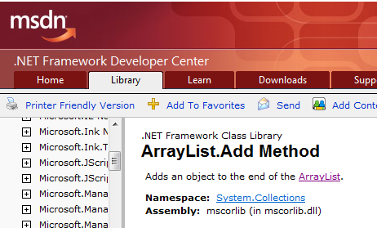
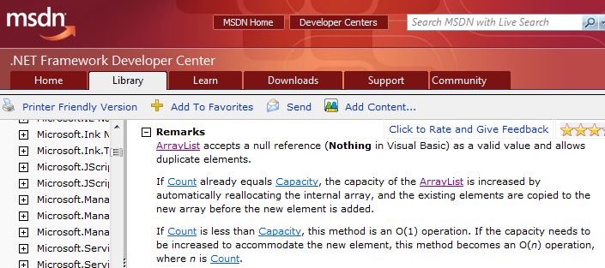
ArrayList: The Spec

Slide 10
ArrayList: AddItem Test
class ArrayListTest { [PexMethod] void AddItem(int c, object item) { var list = new ArrayList(c); list.Add(item);
Assert(list[0] == item); }
}
class ArrayList {
object[] items; int count;
ArrayList(int capacity) {
if (capacity < 0) throw ...;
items = new object[capacity]; }
void Add(object item) {
if (count == items.Length) ResizeArray();
items[this.count++] = item; } ...

Slide 11
ArrayList: Starting Pex…
class ArrayListTest { [PexMethod] void AddItem(int c, object item) { var list = new ArrayList(c); list.Add(item);
Assert(list[0] == item); }
}
 | Inputs
class ArrayList {
object[] items; int count;
ArrayList(int capacity) {
if (capacity < 0) throw ...;
items = new object[capacity]; }
void Add(object item) {
if (count == items.Length) ResizeArray();
items[this.count++] = item; } ...

Slide 12
ArrayList: Run 1, (0,null)
class ArrayListTest { [PexMethod] void AddItem(int c, object item) { var list = new ArrayList(c); list.Add(item);
Assert(list[0] == item); }
}
 | Inputs
 | (0,null)
class ArrayList {
object[] items; int count;
ArrayList(int capacity) {
if (capacity < 0) throw ...;
items = new object[capacity]; }
void Add(object item) {
if (count == items.Length) ResizeArray();
items[this.count++] = item; } ...

Slide 13
ArrayList: Run 1, (0,null)
class ArrayListTest { [PexMethod] void AddItem(int c, object item) { var list = new ArrayList(c); list.Add(item);
Assert(list[0] == item); }
}
 | Inputs | Observed Constraints
 | (0,null) | !(c<0)
class ArrayList {
object[] items; int count;
ArrayList(int capacity) {
if (capacity < 0) throw ...;
items = new object[capacity]; }
void Add(object item) {
if (count == items.Length) ResizeArray();
items[this.count++] = item; } ...
c < 0 → false

Slide 14
ArrayList: Run 1, (0,null)
class ArrayListTest { [PexMethod] void AddItem(int c, object item) { var list = new ArrayList(c); list.Add(item);
Assert(list[0] == item); }
}
 | Inputs | Observed Constraints
 | (0,null) | !(c<0) && 0==c
class ArrayList {
object[] items; int count;
ArrayList(int capacity) {
if (capacity < 0) throw ...;
items = new object[capacity]; }
void Add(object item) {
if (count == items.Length) ResizeArray();
items[this.count++] = item; } ...
0 == c → true

Slide 15
ArrayList: Run 1, (0,null)
class ArrayListTest { [PexMethod] void AddItem(int c, object item) { var list = new ArrayList(c); list.Add(item);
Assert(list[0] == item); }
}
 | Inputs | Observed Constraints
 | (0,null) | !(c<0) && 0==c
item == item → true
class ArrayList {
object[] items; int count;
ArrayList(int capacity) {
if (capacity < 0) throw ...;
items = new object[capacity]; }
void Add(object item) {
if (count == items.Length) ResizeArray();
items[this.count++] = item; } ...
This is a tautology,
i.e. a constraint that is always true,
regardless of the chosen values.
We can ignore such constraints.

Slide 16
ArrayList: Picking the next branch to cover
class ArrayListTest { [PexMethod] void AddItem(int c, object item) { var list = new ArrayList(c); list.Add(item);
Assert(list[0] == item); }
}
Constraints to solve | Inputs | Observed Constraints
 | (0,null) | !(c<0) && 0==c
!(c<0) && 0!=c
class ArrayList {
object[] items; int count;
ArrayList(int capacity) {
if (capacity < 0) throw ...;
items = new object[capacity]; }
void Add(object item) {
if (count == items.Length) ResizeArray();
items[this.count++] = item; } ...

Slide 17
ArrayList: Solve constraints using SMT solver
class ArrayListTest { [PexMethod] void AddItem(int c, object item) { var list = new ArrayList(c); list.Add(item);
Assert(list[0] == item); }
}
Constraints to solve | Inputs | Observed Constraints
 | (0,null) | !(c<0) && 0==c
!(c<0) && 0!=c | (1,null)
class ArrayList {
object[] items; int count;
ArrayList(int capacity) {
if (capacity < 0) throw ...;
items = new object[capacity]; }
void Add(object item) {
if (count == items.Length) ResizeArray();
items[this.count++] = item; } ...

Slide 18
ArrayList: Run 2, (1, null)
class ArrayListTest { [PexMethod] void AddItem(int c, object item) { var list = new ArrayList(c); list.Add(item);
Assert(list[0] == item); }
}
Constraints to solve | Inputs | Observed Constraints
 | (0,null) | !(c<0) && 0==c
!(c<0) && 0!=c | (1,null) | !(c<0) && 0!=c
class ArrayList {
object[] items; int count;
ArrayList(int capacity) {
if (capacity < 0) throw ...;
items = new object[capacity]; }
void Add(object item) {
if (count == items.Length) ResizeArray();
items[this.count++] = item; } ...
0 == c → false

Slide 19
ArrayList: Pick new branch
class ArrayListTest { [PexMethod] void AddItem(int c, object item) { var list = new ArrayList(c); list.Add(item);
Assert(list[0] == item); }
}
Constraints to solve | Inputs | Observed Constraints
 | (0,null) | !(c<0) && 0==c
!(c<0) && 0!=c | (1,null) | !(c<0) && 0!=c
c<0
class ArrayList {
object[] items; int count;
ArrayList(int capacity) {
if (capacity < 0) throw ...;
items = new object[capacity]; }
void Add(object item) {
if (count == items.Length) ResizeArray();
items[this.count++] = item; } ...

Slide 20
ArrayList: Run 3, (-1, null)
class ArrayListTest { [PexMethod] void AddItem(int c, object item) { var list = new ArrayList(c); list.Add(item);
Assert(list[0] == item); }
}
Constraints to solve | Inputs | Observed Constraints
 | (0,null) | !(c<0) && 0==c
!(c<0) && 0!=c | (1,null) | !(c<0) && 0!=c
c<0 | (-1,null)
class ArrayList {
object[] items; int count;
ArrayList(int capacity) {
if (capacity < 0) throw ...;
items = new object[capacity]; }
void Add(object item) {
if (count == items.Length) ResizeArray();
items[this.count++] = item; } ...

Slide 21
ArrayList: Run 3, (-1, null)
class ArrayListTest { [PexMethod] void AddItem(int c, object item) { var list = new ArrayList(c); list.Add(item);
Assert(list[0] == item); }
}
Constraints to solve | Inputs | Observed Constraints
 | (0,null) | !(c<0) && 0==c
!(c<0) && 0!=c | (1,null) | !(c<0) && 0!=c
c<0 | (-1,null) | c<0
class ArrayList {
object[] items; int count;
ArrayList(int capacity) {
if (capacity < 0) throw ...;
items = new object[capacity]; }
void Add(object item) {
if (count == items.Length) ResizeArray();
items[this.count++] = item; } ...
c < 0 → true

Slide 22
ArrayList: Run 3, (-1, null)
class ArrayListTest { [PexMethod] void AddItem(int c, object item) { var list = new ArrayList(c); list.Add(item);
Assert(list[0] == item); }
}
Constraints to solve | Inputs | Observed Constraints
 | (0,null) | !(c<0) && 0==c
!(c<0) && 0!=c | (1,null) | !(c<0) && 0!=c
c<0 | (-1,null) | c<0
class ArrayList {
object[] items; int count;
ArrayList(int capacity) {
if (capacity < 0) throw ...;
items = new object[capacity]; }
void Add(object item) {
if (count == items.Length) ResizeArray();
items[this.count++] = item; } ...

Slide 23
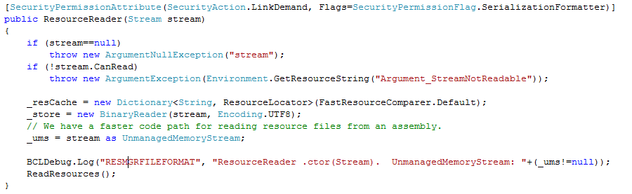
White box testing in practice
How to test this code?
(Real code from .NET base class libraries.)

Slide 24
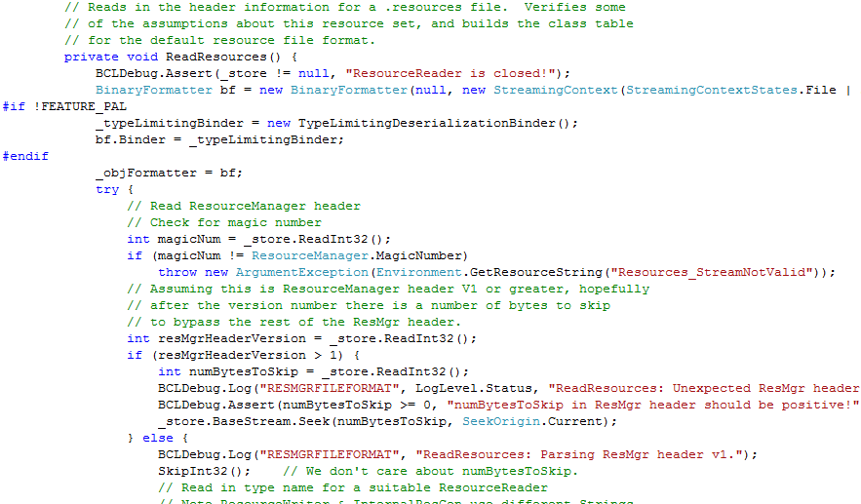
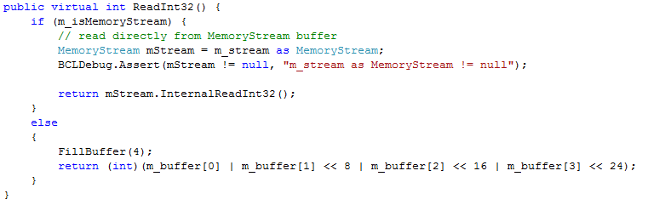
White box testing in practice

Slide 25
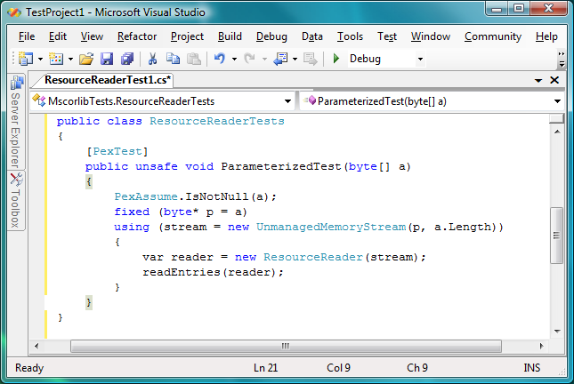
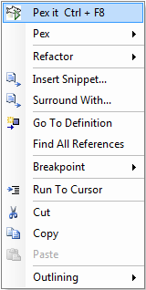
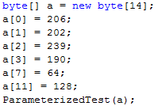
Pex – Test Input Generation tomorrow
Test input, generated by Pex
25

Slide 26
PEX ↔ Z3
Rich Combination
Linear arithmetic
Bitvector
Arrays
Models
∀-Quantifier
API
Huge number of small problems. Textual interface is too inefficient.
Used to model custom theories (e.g., .NET type system)
Model used as test inputs
Free
Functions

Slide 27
PEX ↔ Z3: Incrementality
Pex “sends” several similar formulas to Z3.
Plus: backtracking primitives in the Z3 API.
push
pop
Reuse (some) lemmas.

Slide 28
PEX ↔ Z3: Small models
Given a set of constraints C, find a model M that minimizes the interpretation for x₀, …, x_{n}.
In the ArrayList example:
Why is the model where c = 2147483648 less desirable than the model with c = 1?
!(c<0) && 0!=c
Simple solution:
Assert C
while satisfiable
Peek x_{i} such that M[x_{i}] is big
Assert x_{i} < n, where n is a small constant
Return last found model

Slide 29
PEX ↔ Z3: Small models
Given a set of constraints C, find a model M that minimizes the interpretation for x₀, …, x_{n}.
In the ArrayList example:
Why is the model where c = 2147483648 less desirable than the model with c = 1?
!(c<0) && 0!=c
Refinement:
Eager solution stops as soon as the system becomes unsatisfiable.
A “bad” choice (peek x_{i}) may prevent us from finding a good solution.
Use push and pop to retract “bad” choices.

Slide 30
SAGE
Apply DART to large applications (not units).
Start with well-formed input (not random).
Combine with generational search (not DFS).
Negate 1-by-1 each constraint in a path constraint.
Generate many children for each parent run.
generation 1
parent

Slide 31
Zero to Crash in 10 Generations
Starting with 100 zero bytes …
SAGE generates a crashing test for Media1 parser
00000000h: 00 00 00 00 00 00 00 00 00 00 00 00 00 00 00 00 ; ................
00000010h: 00 00 00 00 00 00 00 00 00 00 00 00 00 00 00 00 ; ................
00000020h: 00 00 00 00 00 00 00 00 00 00 00 00 00 00 00 00 ; ................
00000030h: 00 00 00 00 00 00 00 00 00 00 00 00 00 00 00 00 ; ................
00000040h: 00 00 00 00 00 00 00 00 00 00 00 00 00 00 00 00 ; ................
00000050h: 00 00 00 00 00 00 00 00 00 00 00 00 00 00 00 00 ; ................
00000060h: 00 00 00 00 ; ....
Generation 0 – seed file

Slide 32
Zero to Crash in 10 Generations
Starting with 100 zero bytes …
SAGE generates a crashing test for Media1 parser
00000000h: 52 49 46 46 00 00 00 00 00 00 00 00 00 00 00 00 ; RIFF............
00000010h: 00 00 00 00 00 00 00 00 00 00 00 00 00 00 00 00 ; ................
00000020h: 00 00 00 00 00 00 00 00 00 00 00 00 00 00 00 00 ; ................
00000030h: 00 00 00 00 00 00 00 00 00 00 00 00 00 00 00 00 ; ................
00000040h: 00 00 00 00 00 00 00 00 00 00 00 00 00 00 00 00 ; ................
00000050h: 00 00 00 00 00 00 00 00 00 00 00 00 00 00 00 00 ; ................
00000060h: 00 00 00 00 ; ....
Generation 1

Slide 33
Zero to Crash in 10 Generations
Starting with 100 zero bytes …
SAGE generates a crashing test for Media1 parser
`
00000000h: 52 49 46 46 00 00 00 00 ** ** ** 20 00 00 00 00 ; RIFF....*** ....
00000010h: 00 00 00 00 00 00 00 00 00 00 00 00 00 00 00 00 ; ................
00000020h: 00 00 00 00 00 00 00 00 00 00 00 00 00 00 00 00 ; ................
00000030h: 00 00 00 00 00 00 00 00 00 00 00 00 00 00 00 00 ; ................
00000040h: 00 00 00 00 00 00 00 00 00 00 00 00 00 00 00 00 ; ................
00000050h: 00 00 00 00 00 00 00 00 00 00 00 00 00 00 00 00 ; ................
00000060h: 00 00 00 00 ; ....
Generation 2

Slide 34
Zero to Crash in 10 Generations
Starting with 100 zero bytes …
SAGE generates a crashing test for Media1 parser
00000000h: 52 49 46 46 3D 00 00 00 ** ** ** 20 00 00 00 00 ; RIFF=...*** ....
00000010h: 00 00 00 00 00 00 00 00 00 00 00 00 00 00 00 00 ; ................
00000020h: 00 00 00 00 00 00 00 00 00 00 00 00 00 00 00 00 ; ................
00000030h: 00 00 00 00 00 00 00 00 00 00 00 00 00 00 00 00 ; ................
00000040h: 00 00 00 00 00 00 00 00 00 00 00 00 00 00 00 00 ; ................
00000050h: 00 00 00 00 00 00 00 00 00 00 00 00 00 00 00 00 ; ................
00000060h: 00 00 00 00 ; ....
Generation 3

Slide 35
Zero to Crash in 10 Generations
Starting with 100 zero bytes …
SAGE generates a crashing test for Media1 parser
00000000h: 52 49 46 46 3D 00 00 00 ** ** ** 20 00 00 00 00 ; RIFF=...*** ....
00000010h: 00 00 00 00 00 00 00 00 00 00 00 00 00 00 00 00 ; ................
00000020h: 00 00 00 00 00 00 00 00 00 00 00 00 00 00 00 00 ; ................
00000030h: 00 00 00 00 73 74 72 68 00 00 00 00 00 00 00 00 ; ....strh........
00000040h: 00 00 00 00 00 00 00 00 00 00 00 00 00 00 00 00 ; ................
00000050h: 00 00 00 00 00 00 00 00 00 00 00 00 00 00 00 00 ; ................
00000060h: 00 00 00 00 ; ....
Generation 4

Slide 36
Zero to Crash in 10 Generations
Starting with 100 zero bytes …
SAGE generates a crashing test for Media1 parser
00000000h: 52 49 46 46 3D 00 00 00 ** ** ** 20 00 00 00 00 ; RIFF=...*** ....
00000010h: 00 00 00 00 00 00 00 00 00 00 00 00 00 00 00 00 ; ................
00000020h: 00 00 00 00 00 00 00 00 00 00 00 00 00 00 00 00 ; ................
00000030h: 00 00 00 00 73 74 72 68 00 00 00 00 76 69 64 73 ; ....strh....vids
00000040h: 00 00 00 00 00 00 00 00 00 00 00 00 00 00 00 00 ; ................
00000050h: 00 00 00 00 00 00 00 00 00 00 00 00 00 00 00 00 ; ................
00000060h: 00 00 00 00 ; ....
Generation 5

Slide 37
Zero to Crash in 10 Generations
Starting with 100 zero bytes …
SAGE generates a crashing test for Media1 parser
00000000h: 52 49 46 46 3D 00 00 00 ** ** ** 20 00 00 00 00 ; RIFF=...*** ....
00000010h: 00 00 00 00 00 00 00 00 00 00 00 00 00 00 00 00 ; ................
00000020h: 00 00 00 00 00 00 00 00 00 00 00 00 00 00 00 00 ; ................
00000030h: 00 00 00 00 73 74 72 68 00 00 00 00 76 69 64 73 ; ....strh....vids
00000040h: 00 00 00 00 73 74 72 66 00 00 00 00 00 00 00 00 ; ....strf........
00000050h: 00 00 00 00 00 00 00 00 00 00 00 00 00 00 00 00 ; ................
00000060h: 00 00 00 00 ; ....
Generation 6

Slide 38
Zero to Crash in 10 Generations
Starting with 100 zero bytes …
SAGE generates a crashing test for Media1 parser
00000000h: 52 49 46 46 3D 00 00 00 ** ** ** 20 00 00 00 00 ; RIFF=...*** ....
00000010h: 00 00 00 00 00 00 00 00 00 00 00 00 00 00 00 00 ; ................
00000020h: 00 00 00 00 00 00 00 00 00 00 00 00 00 00 00 00 ; ................
00000030h: 00 00 00 00 73 74 72 68 00 00 00 00 76 69 64 73 ; ....strh....vids
00000040h: 00 00 00 00 73 74 72 66 00 00 00 00 28 00 00 00 ; ....strf....(...
00000050h: 00 00 00 00 00 00 00 00 00 00 00 00 00 00 00 00 ; ................
00000060h: 00 00 00 00 ; ....
Generation 7

Slide 39
Zero to Crash in 10 Generations
Starting with 100 zero bytes …
SAGE generates a crashing test for Media1 parser
00000000h: 52 49 46 46 3D 00 00 00 ** ** ** 20 00 00 00 00 ; RIFF=...*** ....
00000010h: 00 00 00 00 00 00 00 00 00 00 00 00 00 00 00 00 ; ................
00000020h: 00 00 00 00 00 00 00 00 00 00 00 00 00 00 00 00 ; ................
00000030h: 00 00 00 00 73 74 72 68 00 00 00 00 76 69 64 73 ; ....strh....vids
00000040h: 00 00 00 00 73 74 72 66 00 00 00 00 28 00 00 00 ; ....strf....(...
00000050h: 00 00 00 00 00 00 00 00 00 00 00 00 C9 9D E4 4E ; ............ÉäN
00000060h: 00 00 00 00 ; ....
Generation 8

Slide 40
Zero to Crash in 10 Generations
Starting with 100 zero bytes …
SAGE generates a crashing test for Media1 parser
00000000h: 52 49 46 46 3D 00 00 00 ** ** ** 20 00 00 00 00 ; RIFF=...*** ....
00000010h: 00 00 00 00 00 00 00 00 00 00 00 00 00 00 00 00 ; ................
00000020h: 00 00 00 00 00 00 00 00 00 00 00 00 00 00 00 00 ; ................
00000030h: 00 00 00 00 73 74 72 68 00 00 00 00 76 69 64 73 ; ....strh....vids
00000040h: 00 00 00 00 73 74 72 66 00 00 00 00 28 00 00 00 ; ....strf....(...
00000050h: 00 00 00 00 00 00 00 00 00 00 00 00 01 00 00 00 ; ................
00000060h: 00 00 00 00 ; ....
Generation 9

Slide 41
Zero to Crash in 10 Generations
Starting with 100 zero bytes …
SAGE generates a crashing test for Media1 parser
00000000h: 52 49 46 46 3D 00 00 00 ** ** ** 20 00 00 00 00 ; RIFF=...*** ....
00000010h: 00 00 00 00 00 00 00 00 00 00 00 00 00 00 00 00 ; ................
00000020h: 00 00 00 00 00 00 00 00 00 00 00 00 00 00 00 00 ; ................
00000030h: 00 00 00 00 73 74 72 68 00 00 00 00 76 69 64 73 ; ....strh....vids
00000040h: 00 00 00 00 73 74 72 66 B2 75 76 3A 28 00 00 00 ; ....strf²uv:(...
00000050h: 00 00 00 00 00 00 00 00 00 00 00 00 01 00 00 00 ; ................
00000060h: 00 00 00 00 ; ....
Generation 10 – CRASH

Slide 42
SAGE (cont.)
SAGE is very effective at finding bugs.
Works on large applications.
Fully automated
Easy to deploy (x86 analysis – any language)
Used in various groups inside Microsoft
Powered by Z3.

Slide 43
SAGE↔ Z3
Formulas are usually big conjunctions.
SAGE uses only the bitvector and array theories.
Pre-processing step has a huge performance impact.
Eliminate variables.
Simplify formulas.
Early unsat detection.

Slide 44
Predicate Abstraction

Slide 45
Overview
http://research.microsoft.com/slam/
SLAM/SDV is a software model checker.
Application domain: device drivers.
Architecture:
c2bp C program → boolean program (predicate abstraction).
bebop Model checker for boolean programs.
newton Model refinement (check for path feasibility)
SMT solvers are used to perform predicate abstraction and to check path feasibility.
c2bp makes several calls to the SMT solver. The formulas are relatively small.

Slide 46
Example
Do this code obey the looking rule?
do {
KeAcquireSpinLock();
nPacketsOld = nPackets;
if(request){
request = request->Next;
KeReleaseSpinLock();
nPackets++;
}
} while (nPackets != nPacketsOld);
KeReleaseSpinLock();

Slide 47
Example
Model checking Boolean program
U
do {
KeAcquireSpinLock();
if(*){
KeReleaseSpinLock();
}
} while (*);
KeReleaseSpinLock();
L
L
L
U
L
U
L
U
U
E

Slide 48
Example
Is error path feasible?
U
do {
KeAcquireSpinLock();
nPacketsOld = nPackets;
if(request){
request = request->Next;
KeReleaseSpinLock();
nPackets++;
}
} while (nPackets != nPacketsOld);
KeReleaseSpinLock();
L
L
L
U
L
U
L
U
U
E

Slide 49
Example
Add new predicate to
Boolean program
b: (nPacketsOld == nPackets)
U
do {
KeAcquireSpinLock();
nPacketsOld = nPackets;
if(request){
request = request->Next;
KeReleaseSpinLock();
nPackets++;
}
} while (nPackets != nPacketsOld);
KeReleaseSpinLock();
L
b = true;
L
L
U
b = b ? false : *;
L
U
!b
L
U
U
E

Slide 50
Example
Model Checking
Refined Program
b: (nPacketsOld == nPackets)
U
do {
KeAcquireSpinLock();
b = true;
if(*){
KeReleaseSpinLock();
b = b ? false : *;
}
} while (!b);
KeReleaseSpinLock();
L
b
L
L
b
U
b
b
L
U
!b
b
L
U
b
U
E

Slide 51
Example
Model Checking
Refined Program
b: (nPacketsOld == nPackets)
U
do {
KeAcquireSpinLock();
b = true;
if(*){
KeReleaseSpinLock();
b = b ? false : *;
}
} while (!b);
KeReleaseSpinLock();
L
b
L
L
b
U
b
b
L
U
!b
b
L
b
U

Slide 52
Example
Model Checking
Refined Program
b: (nPacketsOld == nPackets)
U
do {
KeAcquireSpinLock();
b = true;
if(*){
KeReleaseSpinLock();
b = b ? false : *;
}
} while (!b);
KeReleaseSpinLock();
L
b
L
L
b
U
b
b
L
U
!b
b
L
b
U

Slide 53
Observations about SLAM
Automatic discovery of invariants
driven by property and a finite set of (false) execution paths
predicates are not invariants, but observations
abstraction + model checking computes inductive invariants (boolean combinations of observations)
A hybrid dynamic/static analysis
newton executes path through C code symbolically
c2bp+bebop explore all paths through abstraction
A new form of program slicing
program code and data not relevant to property are dropped
non-determinism allows slices to have more behaviors

Slide 54
Predicate Abstraction: c2bp
Given a C program P and F = {p₁, … , p_{n}}.
Produce a Boolean program B(P, F)
Same control flow structure as P.
Boolean variables {b₁, … , b_{n}} to match {p₁, … , p_{n}}.
Properties true in B(P, F) are true in P.
Each p_{i} is a pure Boolean expression.
Each p_{i} represents set of states for which p_{i} is true.
Performs modular abstraction.

Slide 55
Abstracting Expressions via F
Implies_{F} (e)
Best Boolean function over F that implies e.
ImpliedBy_{F} (e)
Best Boolean function over F that is implied by e.
ImpliedBy_{F} (e) = not Implies_{F} (not e)

Slide 56
Implies_{F}(e) and ImpliedBy_{F}(e)
e
ImpliedBy_{F}(e)
Implies_{F}(e)

Slide 57
Computing Implies_{F}(e)
minterm m = l₁ ∧ ... ∧ l_{n}, where l_{i} = p_{i}, or l_{i} = not p_{i}.
Implies_{F} (e): disjunction of all minterms that imply e.
Naive approach
Generate all 2^{n} possible minterms.
For each minterm m, use SMT solver to check validity of m ⇒ e.
Many possible optimizations

Slide 58
Computing Implies_{F}(e)
F = { x < y, x = 2}
e : y > 1
Minterms over F
!x<y, !x=2 implies y>1
x<y, !x=2 implies y>1
!x<y, x=2 implies y>1
x<y, x=2 implies y>1
Implies_{F}(y>1) = x<y ∧ x=2

Slide 59
Computing Implies_{F}(e)
F = { x < y, x = 2}
e : y > 1
Minterms over F
!x<y, !x=2 implies y>1
x<y, !x=2 implies y>1
!x<y, x=2 implies y>1
x<y, x=2 implies y>1
Implies_{F}(y>1) = b₁ ∧ b₂

Slide 60
Newton
Given an error path p in the Boolean program B.
Is p a feasible path of the corresponding C program?
Yes: found a bug.
No: find predicates that explain the infeasibility.
Execute path symbolically.
Check conditions for inconsistency using Z3.

Slide 61
SLAM ↔ Z3
All-SAT
Better (more precise) Predicate Abstraction
Unsatisfiable cores
Why the abstract path is not feasible?
Fast Predicate Abstraction

Slide 62
SLAM ↔ Z3: Unsatisfiable cores
Let S be an unsatisfiable set of formulas.
S’ ⊆ S is an unsatisfiable core of S if:
S’ is also unsatisfiable, and
There is not S’’ ⊂ S’ that is also unsatisfiable.
Computing Implies_{F}(e) with F = {p₁, p_{2,} p_{3,} p₄}
Assume p₁, p₂, p₃, p₄ ⇒ e is valid
That is p₁, p₂, p₃, p₄, ¬e is unsat
Now assume p₁, p₃, ¬e is the unsatisfiable core
Then it is unnecessary to check:
p₁, ¬ p₂, p₃, p₄ ⇒ e
p₁, ¬ p₂, p₃, ¬ p₄ ⇒ e
p₁, p₂, p₃, ¬ p₄ ⇒ e

