Slide 1
Satisfiability Modulo Theories (SMT): ideas and applications Università Degli Studi Di Milano Scuola di Dottorato in Informatica, 2010
Leonardo de Moura
Microsoft Research

Slide 2
Verifying Compilers
A verifying compiler uses automated reasoning to check the
correctness of a program that is compiles.
Correctness is specified by types, assertions, . . . and other
redundant annotations that accompany the program.
Tony Hoare 2004

Slide 3
Verifying Compilers
Annotated Program
Verification Condition F
pre/post conditions
invariants
and other annotations

Slide 4
Spec# Approach for a Verifying Compiler
Source Language
C# + goodies = Spec#
Specifications
method contracts,
invariants,
field and type annotations.
Program Logic:
Dijkstra’s weakest preconditions.
Automatic Verification
type checking,
verification condition generation (VCG),
automatic theorem proving Z3
Spec# (annotated C#)
Spec# Compiler
Boogie PL
VC Generator
Formulas
Z3

Slide 5
Basic verifier architecture
Source language
Intermediate verification language
Verification condition (logical formula)

Slide 6
Verification architecture
Spec#
C
C
Dafny
Spec# compiler
Dafny verifier
VCC
HAVOC
MSIL
Bytecode translator
V
Boogie
Inference engine
Boogie
Static program verifier (Boogie)
V.C. generator
Verification condition
Z3
Z3
“correct” or list of errors

Slide 7
Modeling execution traces
terminates
…
diverges
goes wrong

Slide 8
States and execution traces
State
Cartesian product of variables
Execution trace
Nonempty finite sequence of states
Infinite sequence of states
Nonempty finite sequence of states followed by special error state
(x: int, y: int, z: bool)
…

Slide 9
Command language
P
assert P
assume P
x := E
x := x + 1
x := 10
havoc x
¬P
P

Slide 10
Command language
P
x := E
x := x + 1
x := 10
havoc x
S ; T
assert P
assume P
¬P
P
…
…

Slide 11
Command language
P
assert P
assume P
S T
x := E
x := x + 1
x := 10
havoc x
S ; T
¬P
P
…

Slide 12
Reasoning about execution traces
Hoare triple { P } S { Q } says that
every terminating execution trace of S that starts in a state satisfying P
does not go wrong, and
terminates in a state satisfying Q

Slide 13
Reasoning about execution traces
Hoare triple { P } S { Q } says that
every terminating execution trace of S that starts in a state satisfying P
does not go wrong, and
terminates in a state satisfying Q
Given S and Q, what is the weakest P’ satisfying {P’} S {Q} ?
P' is called the weakest precondition of S with respect to Q, written wp(S, Q)
to check {P} S {Q}, check P ⇒ P’

Slide 14
Weakest preconditions
Q[ E / x ]
(∀x • Q )
P ∧ Q
P ⇒ Q
wp( S, wp( T, Q ))
wp( S, Q ) ∧ wp( T, Q )
wp( x := E, Q ) =
wp( havoc x, Q ) =
wp( assert P, Q ) =
wp( assume P, Q ) =
wp( S ; T, Q ) =
wp( S T, Q ) =

Slide 15
Structured if statement
if E then S else T end =
assume E; S
assume ¬E; T

Slide 16
Dijkstra's guarded command
if E → S | F → T fi =
assert E ∨ F;
(
assume E; S
assume F; T
)

Slide 17
Procedures
A procedure is a user-defined command
procedure M(x, y, z) returns (r, s, t) requires P modifies g, h ensures Q

Slide 18
Procedure example
procedure Inc(n) returns (b) requires 0 ≤ n modifies g ensures g = old(g) + n

Slide 19
Verification conditions: Structure
BIG
and-or tree
(ground)
∀ Axioms
(non-ground)
Control & Data Flow

Slide 20
Main Challenge
Quantifiers, quantifiers, quantifiers, …
Modeling the runtime
∀ h,o,f: IsHeap(h) ∧ o ≠ null ∧ read(h, o, alloc) = t ⇒ read(h,o, f) = null ∨ read(h, read(h,o,f),alloc) = t

Slide 21
Main Challenge
Quantifiers, quantifiers, quantifiers, …
Modeling the runtime
Frame axioms
∀ o, f: o ≠ null ∧ read(h₀, o, alloc) = t ⇒ read(h₁,o,f) = read(h₀,o,f) ∨ (o,f) ∈ M

Slide 22
Main Challenge
Quantifiers, quantifiers, quantifiers, …
Modeling the runtime
Frame axioms
User provided assertions
∀ i,j: i ≤ j ⇒ read(a,i) ≤ read(b,j)

Slide 23
Main Challenge
Quantifiers, quantifiers, quantifiers, …
Modeling the runtime
Frame axioms
User provided assertions
Theories
x: p(x,x)
x,y,z: p(x,y), p(y,z) ⇒ p(x,z)
x,y: p(x,y), p(y,x) ⇒ x = y

Slide 24

Main Challenge
Quantifiers, quantifiers, quantifiers, …
Modeling the runtime
Frame axioms
User provided assertions
Theories
Solver must be fast in satisfiable instances.
We want to find bugs!

Slide 25
Some statistics
Grand challenge: Microsoft Hypervisor
70k lines of dense C code
VCs have several Mb
Thousands of non ground clauses
Developers are willing to wait at most 5 min per VC

Slide 26
Many Approaches
Heuristic quantifier instantiation
Combining SMT with Saturation provers
Complete quantifier instantiation
Decidable fragments
Model based quantifier instantiation

Slide 27


E-matching & Quantifier instantiation
SMT solvers use heuristic quantifier instantiation.
E-matching (matching modulo equalities).
Example:
x: f(g(x)) = x { f(g(x)) }
a = g(b),
b = c,
f(a) ≠ c
Trigger

Slide 28
E-matching & Quantifier instantiation
SMT solvers use heuristic quantifier instantiation.
E-matching (matching modulo equalities).
Example:
x: f(g(x)) = x { f(g(x)) }
a = g(b),
b = c,
f(a) ≠ c
x=b
f(g(b)) = b
Equalities and ground terms come from the partial model M

Slide 29
E-matching: why do we use it?
Integrates smoothly with DPLL.
Software verification problems are big & shallow.
Decides useful theories:
Arrays
Partial orders
…

Slide 30
Efficient E-matching
E-matching is NP-Hard.
In practice
Problem | Indexing Technique
Fast retrieval | E-matching code trees
Incremental E-Matching | Inverted path index

Slide 31
E-matching code trees
Trigger:
f(x1, g(x1, a), h(x2), b)
Instructions:
init(f, 2)
check(r4, b, 3)
bind(r2, g, r5, 4)
compare(r1, r5, 5)
check(r6, a, 6)
bind(r3, h, r7, 7)
yield(r1, r7)
Compiler
Similar triggers share several instructions.
Combine code sequences in a code tree

Slide 32
E-matching: Limitations
E-matching needs ground seeds.
∀x: p(x),
∀x: not p(x)

Slide 33
E-matching: Limitations
E-matching needs ground seeds.
Bad user provided triggers:
∀x: f(g(x))=x { f(g(x)) }
g(a) = c,
g(b) = c,
a ≠ b
Trigger is too restrictive

Slide 34
E-matching: Limitations
E-matching needs ground seeds.
Bad user provided triggers:
∀x: f(g(x))=x { g(x) }
g(a) = c,
g(b) = c,
a ≠ b
More “liberal”
trigger

Slide 35
E-matching: Limitations
E-matching needs ground seeds.
Bad user provided triggers:
∀x: f(g(x))=x { g(x) }
g(a) = c,
g(b) = c,
a ≠ b,
f(g(a)) = a,
f(g(b)) = b
a=b

Slide 36

E-matching: Limitations
E-matching needs ground seeds.
Bad user provided triggers.
It is not refutationally complete.
False positives

Slide 37
DPLL(Γ)
Tight integration: DPLL + Saturation solver.
BIG
and-or tree
(ground)
Axioms
(non-ground)
Saturation Solver
DPLL + Theories

Slide 38

DPLL(Γ)
Inference rule:
DPLL(Γ) is parametric.
Examples:
Resolution
Superposition calculus
…

Slide 39
DPLL(Γ)
M | F
Partial model
Set of clauses

Slide 40
DPLL(Γ): Deduce I
p(a) | p(a)∨q(a), ∀x: ¬p(x)∨r(x), ∀x: p(x)∨s(x)

Slide 41
DPLL(Γ): Deduce I
p(a) | p(a)∨q(a), ¬p(x)∨r(x), p(x)∨s(x)

Slide 42
DPLL(Γ): Deduce I
p(a) | p(a)∨q(a), ¬p(x)∨r(x), p(x)∨s(x)
Resolution
p(a) | p(a)∨q(a), ¬p(x)∨r(x), p(x)∨s(x), r(x)∨s(x)

Slide 43
DPLL(Γ): Deduce II
Using ground atoms from M:
M | F
Main issue: backtracking.
Hypothetical clauses:
H  C
Track literals from M used to derive C
(hypothesis)
Ground literals
(regular) Clause

Slide 44
DPLL(Γ): Deduce II
p(a) | p(a)∨q(a), ¬p(x)∨r(x)
p(a), ¬p(x)∨r(x)
r(a)
p(a) | p(a)∨q(a), ¬p(x)∨r(x), p(a)r(a)

Slide 45
DPLL(Γ): Backtracking
p(a), r(a) | p(a)∨q(a), ¬p(a)∨¬r(a), p(a)r(a), …

Slide 46
DPLL(Γ): Backtracking
p(a), r(a) | p(a)∨q(a), ¬p(a)∨¬r(a), p(a)r(a), …
p(a) is removed from M
¬p(a) | p(a)∨q(a), ¬p(a)∨¬r(a), …

Slide 47
DPLL(Γ): Improvement
Saturation solver ignores non-unit ground clauses.
p(a) | p(a)∨q(a), ¬p(x)∨r(x)

Slide 48
DPLL(Γ): Improvement
Saturation solver ignores non-unit ground clauses.
It is still refutanionally complete if:
Γ has the reduction property.
BIG
and-or tree
(ground)
Axioms
(non-ground)
Saturation Solver
DPLL + Theories

Slide 49
DPLL(Γ): Improvement
Saturation solver ignores non-unit ground clauses.
It is still refutanionally complete if:
Γ has the reduction property.
Saturation
Solver
Ground literals
DPLL
+
Theories
Ground clauses

Slide 50
DPLL(Γ): Problem
Interpreted symtbols
¬(f(a) > 2), f(x) > 5
It is refutationally complete if
Interpreted symbols only occur in ground clauses
Non ground clauses are variable inactive
“Good” ordering is used

Slide 51
Notation Remainder
∀x₁, x₂: ¬p(x₁, x₂) ∨ f(x₁) = f(x₂) + 1,
p(a,b), a < b + 1

Slide 52
Notation Remainder
¬p(x₁, x₂) ∨ f(x₁) = f(x₂) + 1,
p(a,b), a < b + 1

Slide 53
Essentially uninterpreted fragment
Variables appear only as arguments of uninterpreted symbols.
f(g(x₁) + a) < g(x₁) ∨ h(f(x₁), x₂) = 0
f(x₁+x₂) ≤ f(x₁) + f(x₂)

Slide 54
Basic Idea
Given a set of formulas F,
build an equisatisfiable set of quantifier-free formulas F*
“Domain” of f is the set of ground terms A_{f}
t ∈ A_{f} if there is a ground term f(t)
Suppose
We have a clause C[f(x)] containing f(x).
We have f(t).
➔
Instantiate x with t: C[f(t)].

Slide 55
Example
F
F*
g(x₁, x₂) = 0 ∨ h(x₂) = 0,
g(f(x₁),b) + 1 ≤ f(x₁),
h(c) = 1,
f(a) = 0

Slide 56
Example
F
F*
g(x₁, x₂) = 0 ∨ h(x₂) = 0,
g(f(x₁),b) + 1 ≤ f(x₁),
h(c) = 1,
f(a) = 0
h(c) = 1,
f(a) = 0
Copy quantifier-free formulas
“Domains”:
A_{f}: { a }
A_{g}: { }
A_{h}: { c }

Slide 57
Example
F
F*
g(x₁, x₂) = 0 ∨ h(x₂) = 0,
g(f(x₁),b) + 1 ≤ f(x₁),
h(c) = 1,
f(a) = 0
h(c) = 1,
f(a) = 0,
“Domains”:
A_{f} : { a }
A_{g} : { }
A_{h} : { c }

Slide 58
Example
F
F*
g(x₁, x₂) = 0 ∨ h(x₂) = 0,
g(f(x₁),b) + 1 ≤ f(x₁),
h(c) = 1,
f(a) = 0
h(c) = 1,
f(a) = 0,
g(f(a),b) + 1 ≤ f(a)
“Domains”:
A_{f} : { a }
A_{g} : { [f(a), b] }
A_{h} : { c }

Slide 59
Example
F
F*
g(x₁, x₂) = 0 ∨ h(x₂) = 0,
g(f(x₁),b) + 1 ≤ f(x₁),
h(c) = 1,
f(a) = 0
h(c) = 1,
f(a) = 0,
g(f(a),b) + 1 ≤ f(a),
“Domains”:
A_{f} : { a }
A_{g} : { [f(a), b] }
A_{h} : { c }

Slide 60
Example
F
F*
g(x₁, x₂) = 0 ∨ h(x₂) = 0,
g(f(x₁),b) + 1 ≤ f(x₁),
h(c) = 1,
f(a) = 0
h(c) = 1,
f(a) = 0,
g(f(a),b) + 1 ≤ f(a),
g(f(a), b) = 0 ∨ h(b) = 0
“Domains”:
A_{f} : { a }
A_{g} : { [f(a), b] }
A_{h} : { c, b }

Slide 61
Example
F
F*
g(x₁, x₂) = 0 ∨ h(x₂) = 0,
g(f(x₁),b) + 1 ≤ f(x₁),
h(c) = 1,
f(a) = 0
h(c) = 1,
f(a) = 0,
g(f(a),b) + 1 ≤ f(a),
g(f(a), b) = 0 ∨ h(b) = 0
“Domains”:
A_{f} : { a }
A_{g} : { [f(a), b]}
A_{h} : { c, b }

Slide 62
Example
F
F*
g(x₁, x₂) = 0 ∨ h(x₂) = 0,
g(f(x₁),b) + 1 ≤ f(x₁),
h(c) = 1,
f(a) = 0
h(c) = 1,
f(a) = 0,
g(f(a),b) + 1 ≤ f(a),
g(f(a), b) = 0 ∨ h(b) = 0,
g(f(a), c) = 0 ∨ h(c) = 0
“Domains”:
A_{f} : { a }
A_{g} : { [f(a), b], [f(a), c] }
A_{h} : { c, b }

Slide 63
Example
F
F*
g(x₁, x₂) = 0 ∨ h(x₂) = 0,
g(f(x₁),b) + 1 ≤ f(x₁),
h(c) = 1,
f(a) = 0
h(c) = 1,
f(a) = 0,
g(f(a),b) + 1 ≤ f(a),
g(f(a), b) = 0 ∨ h(b) = 0,
g(f(a), c) = 0 ∨ h(c) = 0
M
a → 2, b → 2, c → 3
f → { 2 → 0, …}
h → { 2 → 0, 3 → 1, …}
g → { [0,2]→ -1, [0,3]→ 0, …}

Slide 64
Basic Idea (cont.)
Given a model M for F*,
Build a model M^{π} for F
Define a projection function π_{f} s.t.
range of π_{f} is M(A_{f}), and
π_{f} (v) = v if v ∈ M(A_{f})
Then,
M^{π}(f)(v) = M(f)(π_{f}(v))

Slide 65
Basic Idea (cont.)
M(A_{f})
M(f)
M(f(A_{f}))
M^{π}(f)
M(A_{f})
π_{f}
M(f)
M(A_{f})
M(f(A_{f}))

Slide 66
Basic Idea (cont.)
Given a model M for F*,
Build a model M^{π} for F
In our example, we have: h(b) and h(c)
→ A_{h} = { b, c }, and M(A_{h}) = { 2, 3 }
π_{h} = { 2 → 2, 3 → 3, else → 3 }
M(h)
{ 2 → 0, 3 → 1, …}
M^{π}(h)
{ 2 → 0, 3 → 1, else → 1}
M^{π}(h) = λx. if(x=2, 0, 1)

Slide 67
Example
F
F*
g(x₁, x₂) = 0 ∨ h(x₂) = 0,
g(f(x₁),b) + 1 ≤ f(x₁),
h(c) = 1,
f(a) = 0
h(c) = 1,
f(a) = 0,
g(f(a),b) + 1 ≤ f(a),
g(f(a), b) = 0 ∨ h(b) = 0,
g(f(a), c) = 0 ∨ h(c) = 0
M^{π}
M
a → 2, b → 2, c → 3
f → λx. 2
h → λx. if(x=2, 0, 1)
g → λx,y. if(x=0∧y=2,-1, 0)
a → 2, b → 2, c → 3
f → { 2 → 0, …}
h → { 2 → 0, 3 → 1, …}
g → { [0,2]→ -1, [0,3]→ 0, …}

Slide 68
Example: Model Checking
M^{π}
a → 2, b → 2, c → 3
f → λx. 2
h → λx. if(x=2, 0, 1)
g → λx,y. if(x=0∧y=2,-1, 0)
Does M^{π} satisfies?
∀x₁, x₂ : g(x₁, x₂) = 0 ∨ h(x₂) = 0
∀x₁, x₂: if(x₁=0∧x₂=2,-1,0) = 0 ∨ if(x₂=2,0,1) = 0 is valid
∃x₁, x₂: if(x₁=0∧x₂=2,-1,0) ≠ 0 ∧ if(x₂=2,0,1) ≠ 0 is unsat
if(s₁=0∧s₂=2,-1,0) ≠ 0 ∧ if(s₂=2,0,1) ≠ 0 is unsat

Slide 69
Why does it work?
Suppose M^{π} does not satisfy C[f(x)].
Then for some value v,
M^{π}{x →v} falsifies C[f(x)].
M^{π}{x →π_{f}(v)} also falsifies C[f(x)].
But, there is a term t ∈ A_{f} s.t. M(t) = π_{f}(v)
Moreover, we instantiated C[f(x)] with t.
So, M must not satisfy C[f(t)].
Contradiction: M is a model for F*.

Slide 70
Refinement 1: Lazy construction
F* may be very big (or infinite).
Lazy-construction
Build F* incrementally, F* is the limit of the sequence
F⁰ ⊂ F¹ ⊂ … ⊂ F^{k} ⊂ …
If F^{k} is unsat then F is unsat.
If F^{k} is sat, then build (candidate) M^{π}
If M^{π} satisfies all quantifiers in F then return sat.

Slide 71
Refinement 2: Model-based instantiation
Suppose M^{π} does not satisfy a clause C[f(x)] in F.
Add an instance C[f(t)] which “blocks” this spurious model.
Issue: how to find t?
Use model checking,
and the “inverse” mapping π_{f}⁻¹ from values to terms (in A_{f}).
π_{f}⁻¹(v) = t if M^{π}(t) = π_{f}(v)

Slide 72
Model-based instantiation: Example
F
∀x₁: f(x₁) < 0,
f(a) = 1,
f(b) = -1
F⁰
f(a) = 1,
f(b) = -1
M^{π}
a→2, b→3
f →λx. if(x = 2, 1, -1)
Model Checking ∀x₁: f(x₁) < 0
not if(s₁= 2, 1, -1) < 0
F¹
f(a) = 1,
f(b) = -1
f(a) < 0
s₁→ 2
unsat
π_{f}⁻¹(2) = a

Slide 73
Infinite F*
Is our procedure refutationally complete?
FOL Compactness
A set of sentences is unsatisfiable
iff
it contains an unsatisfiable finite subset.
A theory T is a set of sentences, then
apply compactness to F*∪T

Slide 74
Infinite F*: Example
F
∀x₁: f(x₁) < f(f(x₁)),
∀x₁: f(x₁) < a,
1 < f(0).
Unsatisfiable
F*
f(0) < f(f(0)), f(f(0)) < f(f(f(0))), …
f(0) < a, f(f(0)) < a, …
1 < f(0)
Every finite subset of F* is satisfiable.

Slide 75
Infinite F*: What is wrong?
Theory of linear arithmetic T_{Z} is the set of all first-order sentences that are true in the standard structure Z.
T_{z} has non-standard models.
F and F* are satisfiable in a non-standard model.
Alternative: a theory is a class of structures.
Compactness does not hold.
F and F* are still equisatisfiable.

Slide 76
Δ_{F} and Set Constraints
Given a clause C_{k}[x₁, …, x_{n}]
Let
S_{k,i} be the set of ground terms used to instantiate x_{i} in clause C_{k}[x₁, …, x_{n}]
How to characterize S_{k,i}?
F j-th argument of f in C_{k} | Δ_{F} system of set constraints
a ground term t | t ∈ A_{f,j}
t[x₁, …, x_{n}] | t[S_{k,1}, …, S_{k,n}] ⊆ A_{f,j}
x_{i} | S_{k,i} = A_{f,j}

Slide 77
Δ_{F}: Example
F
Δ_{F}
g(x₁, x₂) = 0 ∨ h(x₂) = 0,
g(f(x₁),b) + 1 ≤ f(x₁),
h(c) = 1,
f(a) = 0
S_{1,1} = A_{g,1}, S_{1,2} = A_{g,2}, S_{1,2} = A_{h,1}
S_{2,1} = A_{f,1}, f(S_{2,1}) ⊆ A_{g,1}, b ∈ A_{g,2}
c ∈ A_{h,1}
a ∈ A_{f,1}
Δ_{F}: least solution
S_{1,1} = { f(a) }, S_{1,2} = { b, c }
S_{2,1} = { a }
Use Δ_{F} to generate F*

Slide 78
Complexity
Δ_{F} is stratified then the least solution (and F*) is finite
t[S_{k,1}, …, S_{k,n}] ⊆ A_{f,j} | level(S_{k,i}) < level(A_{f,j})
S_{k,i} = A_{f,j} | level(S_{k,i}) = level(A_{f,j})
New decidable fragment: NEXPTIME-Hard.
The least solution of Δ_{F} is exponential in the worst case.
a∈ S₁, b∈S₁, f₁(S₁, S₁) ⊆ S₂, …, f_{n}(S_{n}, S_{n}) ⊆ S_{n+1}
F* can be doubly exponential in the size of F.

Slide 79
Extensions
Arithmetical literals: π_{f} must be monotonic.
Literal of C_{k} | Δ_{F}
¬(x_{i} ≤x_{j}) | S_{k,i} = S_{k,j}
¬(x_{i} ≤ t), ¬(t ≤x_{i}) | t ∈ S_{k,i}
x_{i} = t | {t+1, t-1} ⊆ S_{k,i}
Offsets:
j-th argument of f in C_{k} | Δ_{F}
x_{i} + r | S_{k,i}+r ⊆ A_{f,j} A_{f,j}+(-r) ⊆ S_{k,i}

Slide 80
Extensions: Example
Shifting
¬(0 ≤ x₁) ∨ ¬(x₁ ≤ n) ∨ f(x₁) = g(x₁+2)

Slide 81
More Extensions
Many-sorted logic
Pseudo-Macros
0 ≤ g(x₁) ∨ f(g(x₁)) = x₁,
0 ≤ g(x₁) ∨ h(g(x₁)) = 2x₁,
g(a) < 0

Slide 82

Conclusion

Slide 83
Books
Bradley & Manna: The Calculus of Computation
Kroening & Strichman: Decision Procedures, An Algorithmic Point of View
Chapter in the Handbook of Satisfiability

Slide 84
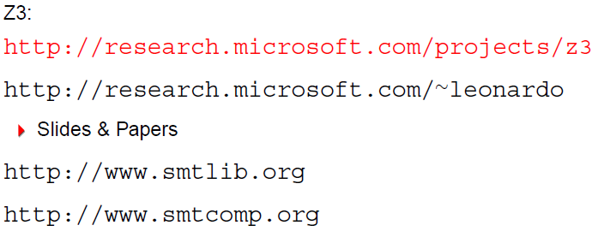
Web Links

Slide 85
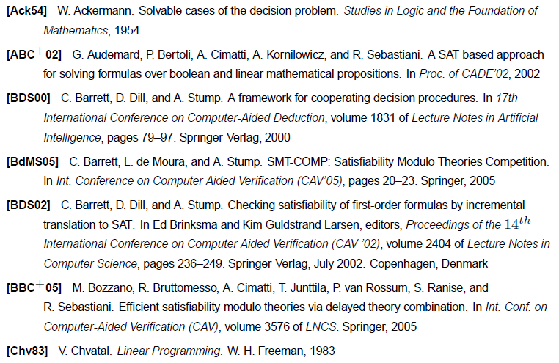
References

Slide 86
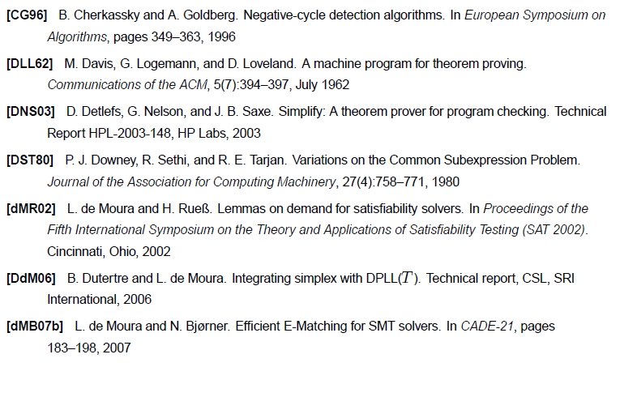
References

Slide 87
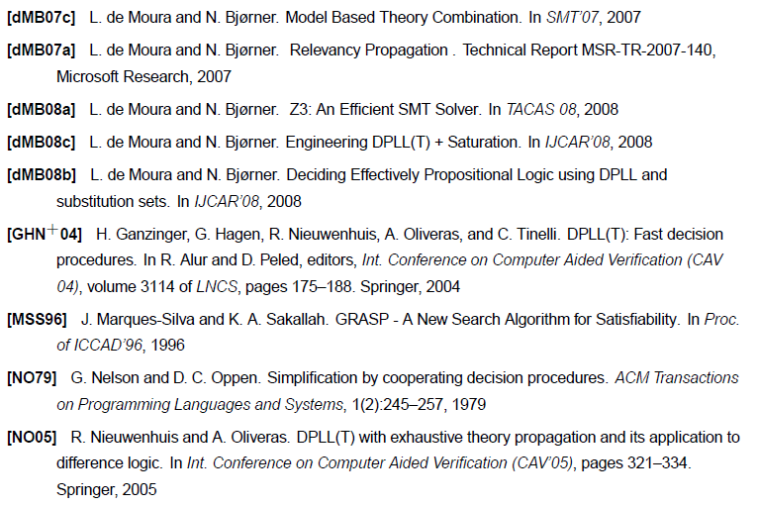
References

Slide 88
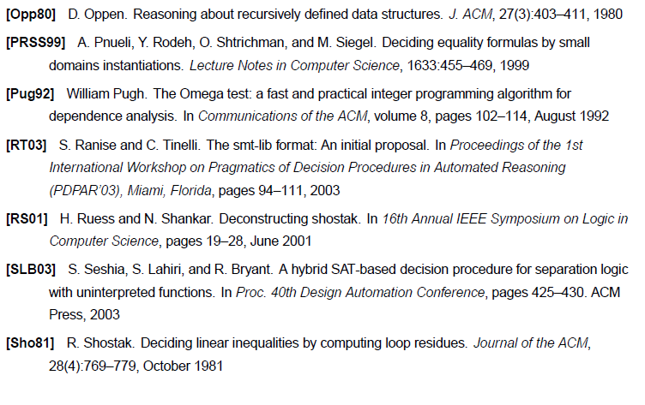
References

Slide 89
References
[dMB09] L. de Moura and N. Bjørner. Generalized and Efficient Array Decision Procedures. FMCAD, 2009.
[GdM09] Y. Ge and L. de Moura. Complete Quantifier Instantiation for quantified SMT formulas, CAV, 2009.

