Slide 1
Computation in Real Closed Infinitesimal and Transcendental Extensions of the Rationals
Leonardo de Moura
Grant Passmore

Slide 2

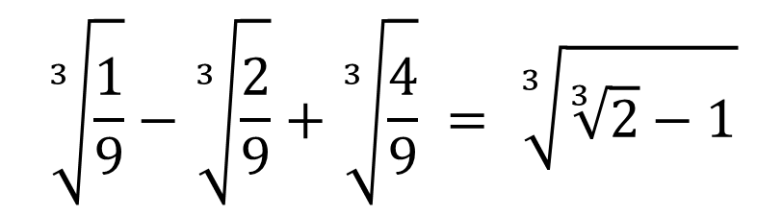

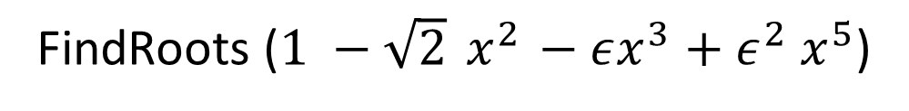
What?
$$\sqrt{2}+\sqrt{3}$$
$$\sqrt[3]{\frac{1}{9}}−\sqrt[3]{\frac{2}{9}}+\sqrt[3]{\frac{4}{9}} = \sqrt[3]{\sqrt[3]{2}−1}$$
$$\frac{1+ε}{ε^{2}}>{10}^{100}$$
Transcendental
Infinitesimal
$$π+ε<π$$
FindRoots (${1 −\sqrt{2}{ x}^{2} −εx^{3}+ε}^{2} x^{5}$)

Slide 3
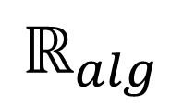

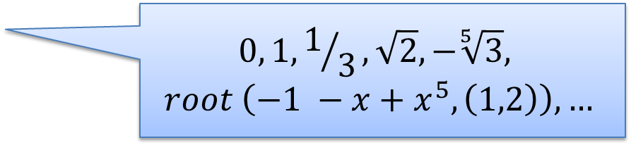
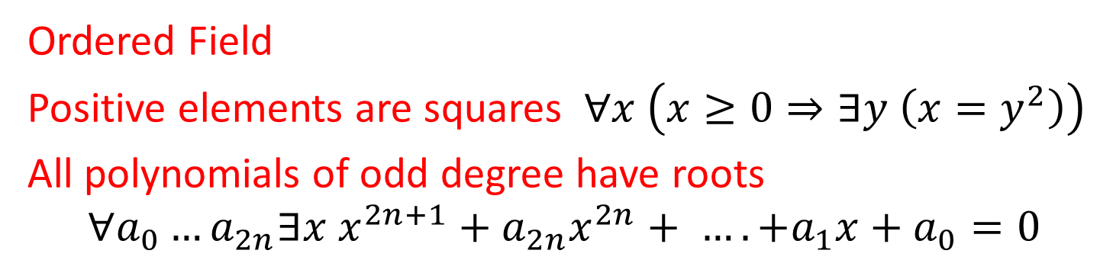

Real Closed Fields
Ordered Field
Positive elements are squares $∀x \left(x≥0⇒∃y \left(x=y^{2}\right)\right)$
All polynomials of odd degree have roots
$$∀a_{0}…a_{2n}∃x x^{2n+1}+a_{2n}x^{2n}+ …. +a_{1}x+a_{0}=0$$
$$ℝ$$
Real Algebraic Numbers
$$⊆$$
$$ℝ_{alg}$$
$$0, 1, 1/3, \sqrt{2}, −\sqrt[5]{3},$$
$$root \left({−1 −x+x}^{5}, \left(1,2\right)\right), …$$

Slide 4



Real Closed Fields
$$ℝ$$
Real Closure of the Rational Numbers
$$⊆$$
$$ℝ_{alg}= \tilde{ℚ}$$

Slide 5
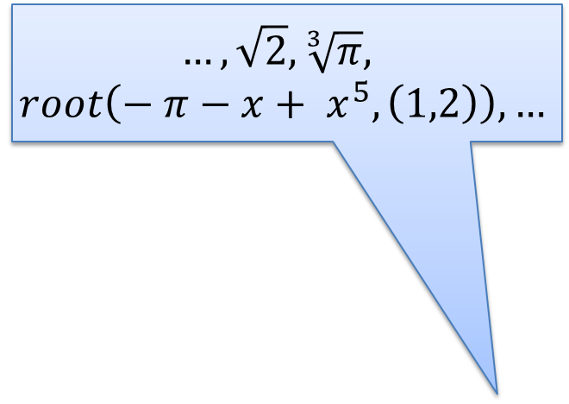

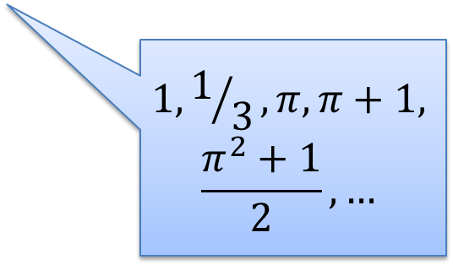


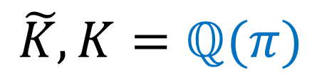

Real Closed Fields
$$…, \sqrt{2}, \sqrt[3]{π},$$
$$root\left({− π−x+ x}^{5}, \left(1,2\right)\right),…$$
$$ℝ$$
Field extension
$$⊆$$
$$\tilde{K}, K=ℚ(π)$$
$$⊆$$
$$1, 1/3,π, π+1,$$
$$\frac{π^{2}+1}{2}, …$$
$$ℝ_{alg}= \tilde{ℚ}$$

Slide 6


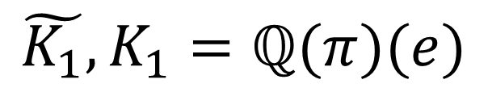


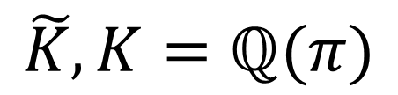


Real Closed Fields
$$ℝ$$
$$⊆$$
$$\tilde{K_{1}},K_{1}=ℚ(π)(e)$$
$$⊆$$
$$1, e, π+e,$$
$$\frac{e^{2}+π}{2}, …$$
$$\tilde{K}, K=ℚ(π)$$
$$⊆$$
$$ℝ_{alg}= \tilde{ℚ}$$

Slide 7


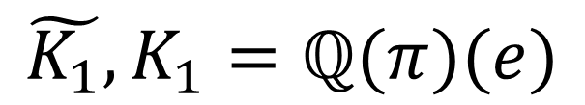
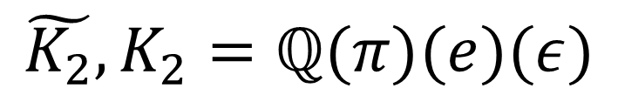



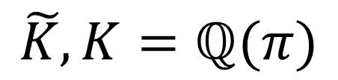



Real Closed Fields
Hyperreals
$$ℍ$$
$$⊆$$
⊇
$$ℝ$$
$$\tilde{K_{2}},K_{2}=ℚ(π)(e)(ε)$$
$$⊆$$
$$⊆$$
$$\tilde{K_{1}},K_{1}=ℚ(π)(e)$$
Infinitesimal
$$⊆$$
$$\tilde{K}, K=ℚ(π)$$
$$⊆$$
$$ℝ_{alg}= \tilde{ℚ}$$

Slide 8

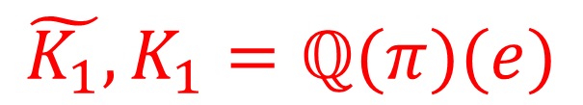
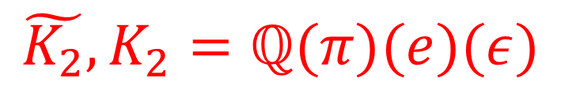


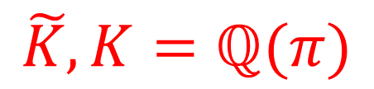

Real Closed Fields
Hyperreals
$$ℍ$$
$$⊆$$
⊇
$$ℝ$$
$$\tilde{K_{2}},K_{2}=ℚ(π)(e)(ε)$$
$$⊆$$
$$⊆$$
$$\tilde{K_{1}},K_{1}=ℚ(π)(e)$$
Infinitesimal
$$⊆$$
$$\tilde{K}, K=ℚ(π)$$
$$⊆$$
$$ℝ_{alg}= \tilde{ℚ}$$

Slide 9
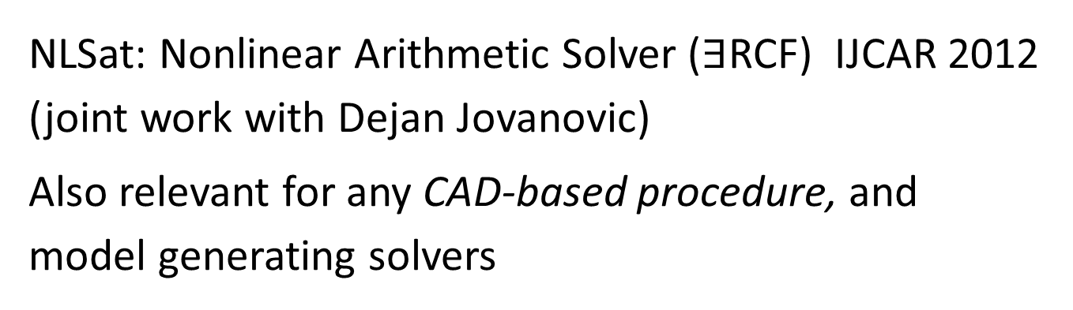
Why?
NLSat: Nonlinear Arithmetic Solver ($∃$RCF) IJCAR 2012
(joint work with Dejan Jovanovic)
Also relevant for any CAD-based procedure, and
model generating solvers
NLSat bottlenecks:
Real algebraic number computations
Subresultant computations

Slide 10

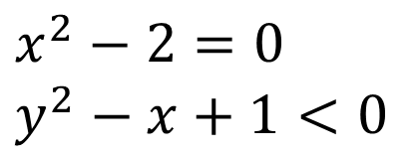
NLSat
$x^{2}−2=0$
$y^{2}−x+1<0$
Decide
$$x→−\sqrt{2}$$

Slide 11
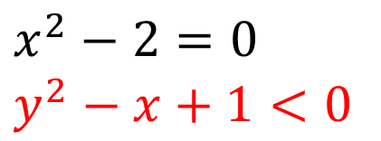

NLSat
$x^{2}−2=0$
$y^{2}−x+1<0$
Decide
$$x→−\sqrt{2}$$
There is no $y$ s.t.$y^{2}+\sqrt{2}+1<0$

Slide 12
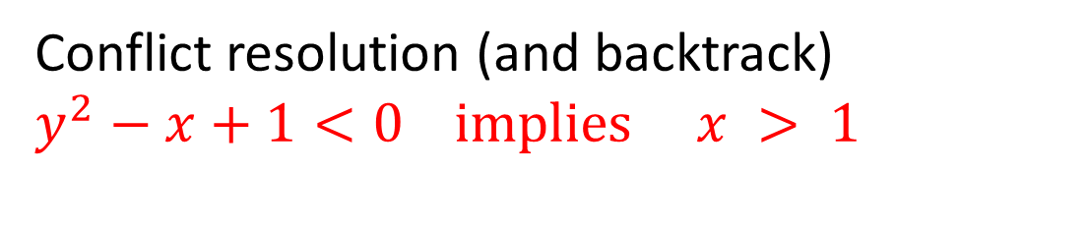

NLSat
$x^{2}−2=0$
$y^{2}−x+1<0$
Decide
$$x→−\sqrt{2}$$
There is no $y$ s.t.$y^{2}+\sqrt{2}+1<0$
Conflict resolution (and backtrack)
$y^{2}−x+1<0$ implies $x > 1$

Slide 13

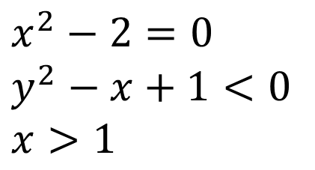

NLSat
$x^{2}−2=0$
$y^{2}−x+1<0$
$x>1$
Decide
$$x→\sqrt{2}$$
Decide
$$y→−1/2$$

Slide 14

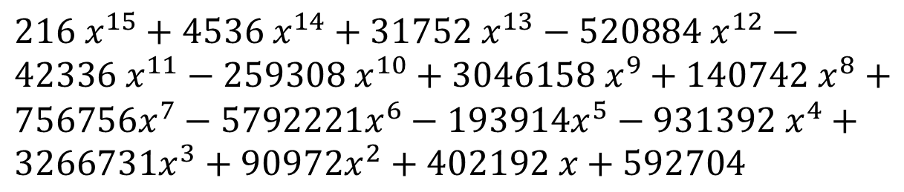
NLSat
Example:
$216 x^{15}+4536 x^{14}+31752 x^{13}−520884 x^{12}−42336 x^{11}−259308 x^{10}+3046158 x^{9}+140742 x^{8}+756756x^{7}−5792221x^{6}−193914x^{5}−931392 x^{4}+3266731x^{3}+90972x^{2}+402192 x+592704$
$$y^{5}−y+{(x}^{3}+1)$$
Before: timeout (old package used Resultant theory)
After: 0.05 secs

Slide 15
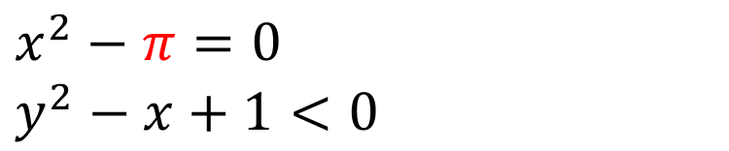
NLSat + Transcendental constants
Nonlinear Arithmetic Solver
Transcendental Constants (e.g., MetiTarski)
$x^{2}−π=0$
$y^{2}−x+1<0$

Slide 16


Exact Nonlinear Optimization (on demand)
Find smallest $y$ s.t. $F\left[y, \vec{x}\right]$
Output:
unsat
unbounded
minimum($a$)
infimum($a$)

Slide 17

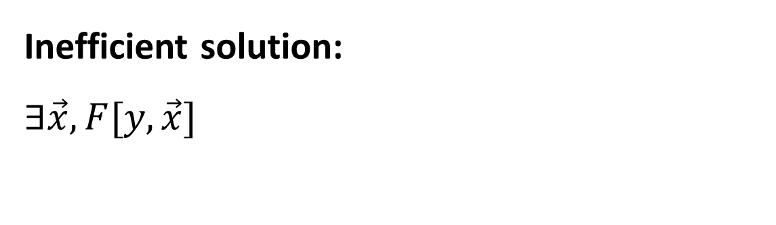
Exact Nonlinear Optimization (on demand)
Find smallest $y$ s.t. $F\left[y,\vec{x}\right]$
Observation 1:
Univariate $F[y]$ case is easy
Inefficient solution:
$$∃\vec{x}, F[y,\vec{x}]$$

Slide 18
Exact Nonlinear Optimization (on demand)
Find smallest $y$ s.t. $F\left[y, \vec{x}\right]$
Observation 2:
Adapt NLSat for solving the
satisfiability modulo assignment problem.

Slide 19
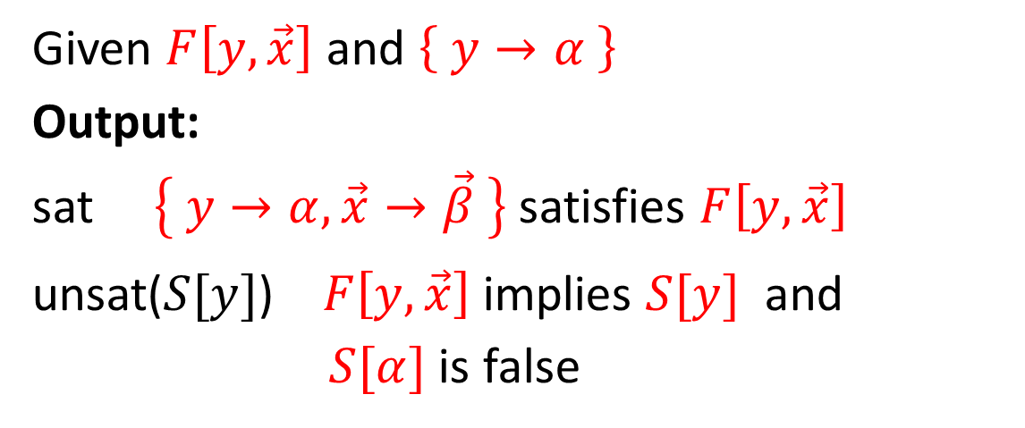
Satisfiability Modulo Assignment (SMA)
Given $F\left[y, \vec{x}\right]$ and $\left\{ y→α \right\}$
Output:
sat $\left\{ y→α, \vec{x}→\vec{β} \right\}$ satisfies $F\left[y, \vec{x}\right]$
unsat($S[y]$) $F\left[y, \vec{x}\right]$ implies $S[y]$ and
$S[α]$ is false

Slide 20
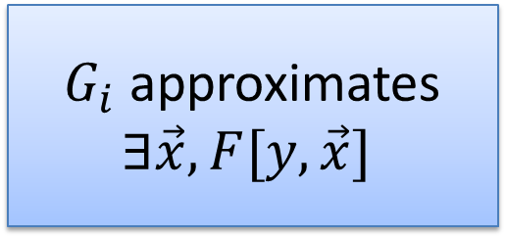
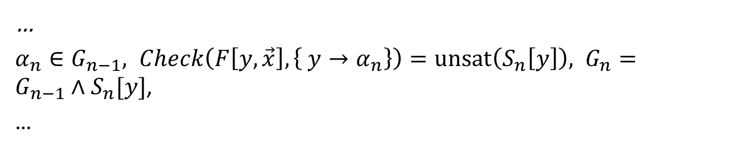
No-good sampling
$Check\left(F\left[y, \vec{x}\right], \left\{ y→α_{1}\right\}\right)=unsat\left(S_{1}\left[y\right]\right), G_{1}=S_{1}[y]$,
$α_{2}∈G_{1}, Check\left(F\left[y, \vec{x}\right], \left\{ y→α_{2}\right\}\right)=unsat\left(S_{2}\left[y\right]\right), G_{2}={G_{1}∧S}_{2}[y]$,
$α_{3}∈G_{2}, Check\left(F\left[y, \vec{x}\right], \left\{ y→α_{3}\right\}\right)=unsat\left(S_{3}\left[y\right]\right), G_{3}={G_{2}∧S}_{3}[y]$,
…
$α_{n}∈G_{n−1}, Check\left(F\left[y, \vec{x}\right], \left\{ y→α_{n}\right\}\right)=unsat\left(S_{n}\left[y\right]\right), G_{n}={G_{n−1}∧S}_{n}[y]$,
…
$G_{i}$ approximates
$∃\vec{x},F[y,\vec{x}]$
Finite decomposition property:
The sequence is finite

Slide 21
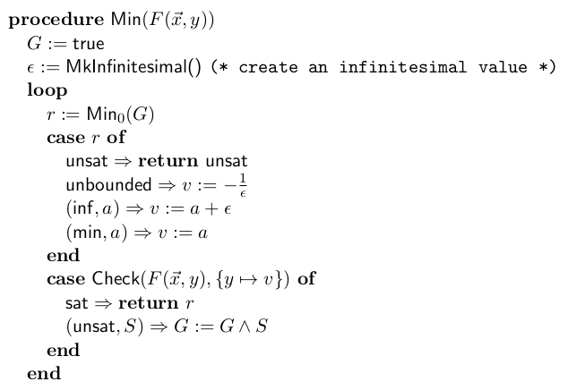

Exact Nonlinear Optimization (on demand)
Univariate minimization
$$−∞$$

Slide 22
Why?
PSPACE procedures

Slide 23
Related Work
Transcendental constants
MetiTarski
Interval Constraint Propagation (ICP)
RealPaver, Rsolver, iSat, dReal
Reasoning with Infinitesimals
ACL2, Isabelle/HOL
Nonstandard analysis
Real Closure of a Single Infinitesimal Extension [Rioboo]
Puiseux series
Coste-Roy: encoding algebraic elements using Thom’s lemma

Slide 24
Our approach
Tower of extensions
Hybrid representation
Interval (arithmetic) + Thom’s lemma
Clean denominators
Non-minimal defining polynomials

Slide 25

Tower of extensions
$$ℚ ⊆$$
$$ℚ\left(ς_{1}\right)⊆$$
$$ℚ\left(ς_{1}\right)\left(ς_{2}\right)⊆$$
$$…$$
$ℚ\left(ς_{1}\right)\left(ς_{2}\right)…\left(ς_{n}\right)⊆$
…
Transcendental, Infinitesimal, or Algebraic extension

Slide 26
Tower of extensions
$$ℚ\left(t_{1}\right)…\left(t_{n}\right)\left(ε_{1}\right)…\left(ε_{m}\right)\left(α_{1}\right)…(α_{k})$$
Transcendental Extensions
Infinitesimal Extensions
Algebraic
Extensions

Slide 27

Tower of extensions
Basic Idea:
Given (computable) ordered field $K$
Implement $K(ς)$

Slide 28
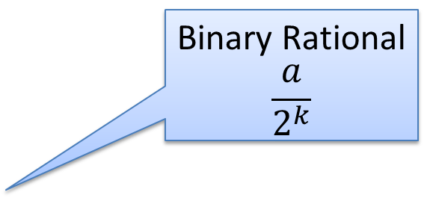
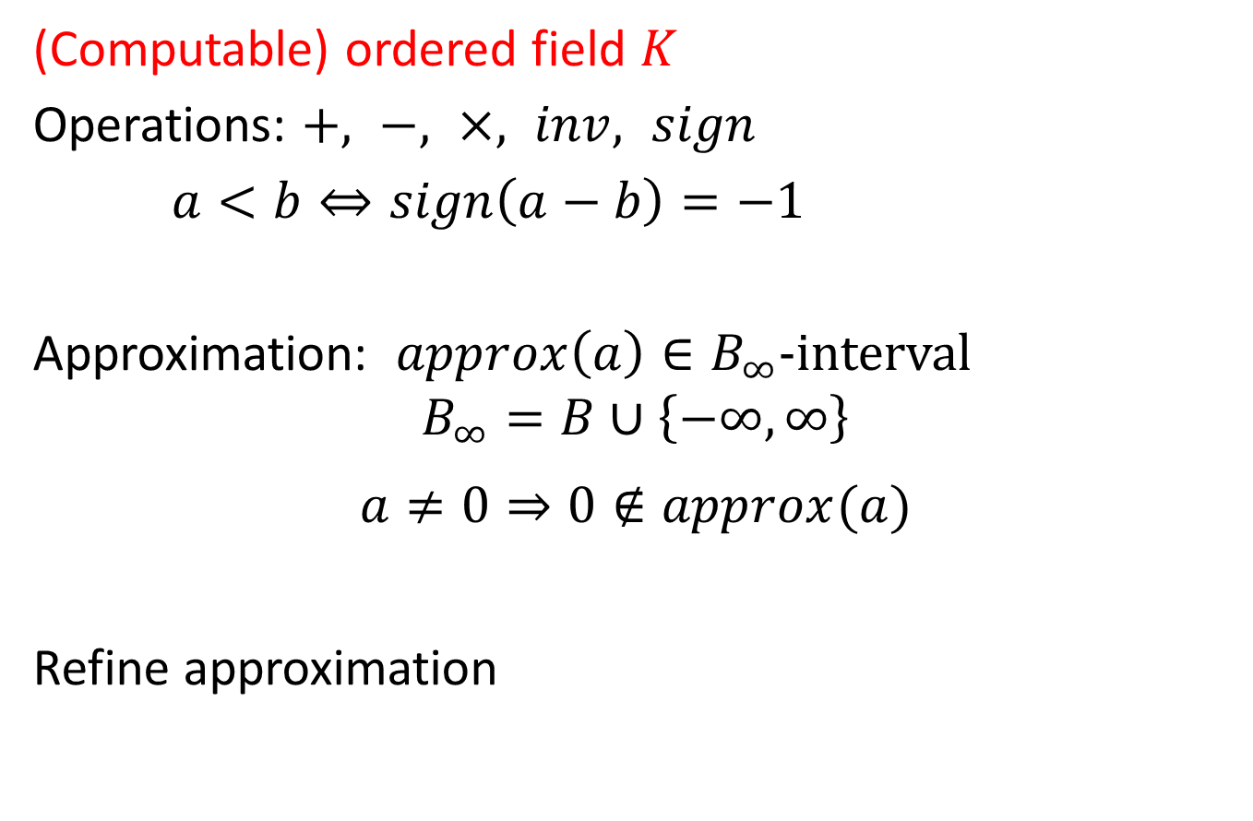
Tower of extensions
(Computable) ordered field $K$
Operations: $+, −, ×, inv, sign$
$a<b⇔sign\left(a−b\right)=−1$
Approximation: $approx\left(a\right)∈B_{∞}$-interval
$$B_{∞}=B∪\left\{−∞, ∞\right\}$$
$$a≠0⇒0∉approx(a)$$
Refine approximation
Binary Rational
$$\frac{a}{2^{k}}$$

Slide 29
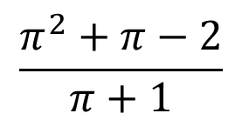
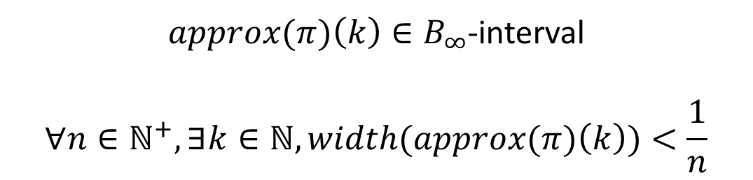
(Computable) Transcendental Extensions
$approx(π)\left(k\right)∈B_{∞}$-interval
$$∀n∈ℕ^{+}, ∃k∈ℕ, width(approx(π)\left(k\right))<\frac{1}{n}$$
Elements of the extension are encoded as rational functions
$$\frac{π^{2}+π−2}{π+1}$$

Slide 30


(Computable) Transcendental Extensions
$$\frac{1}{2}π+ \frac{1}{π+1}= \frac{{\frac{1}{2}π}^{2}+\frac{1}{2}π+1}{π+1}$$
$$\frac{1}{2}π+ \frac{1}{π+1}= \frac{{\frac{1}{2}π}^{2}+\frac{1}{2}π+1}{π+1}$$
Standard normal form for rational functions
GCD(numerator, denominator) = 1
Denominator is a monic polynomial

Slide 31
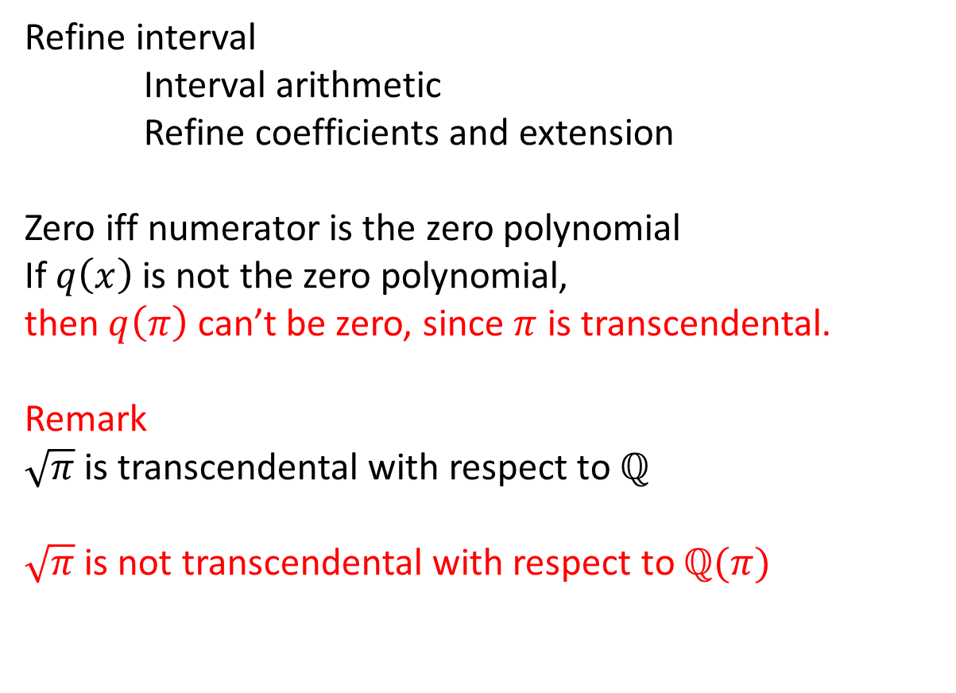
(Computable) Transcendental Extensions
Refine interval
Interval arithmetic
Refine coefficients and extension
Zero iff numerator is the zero polynomial
If $q\left(x\right)$ is not the zero polynomial,
then $q\left(π\right)$ can’t be zero, since $π$ is transcendental.
Remark
$\sqrt{π}$ is transcendental with respect to $ℚ$
$\sqrt{π}$is not transcendental with respect to $ℚ(π)$

Slide 32
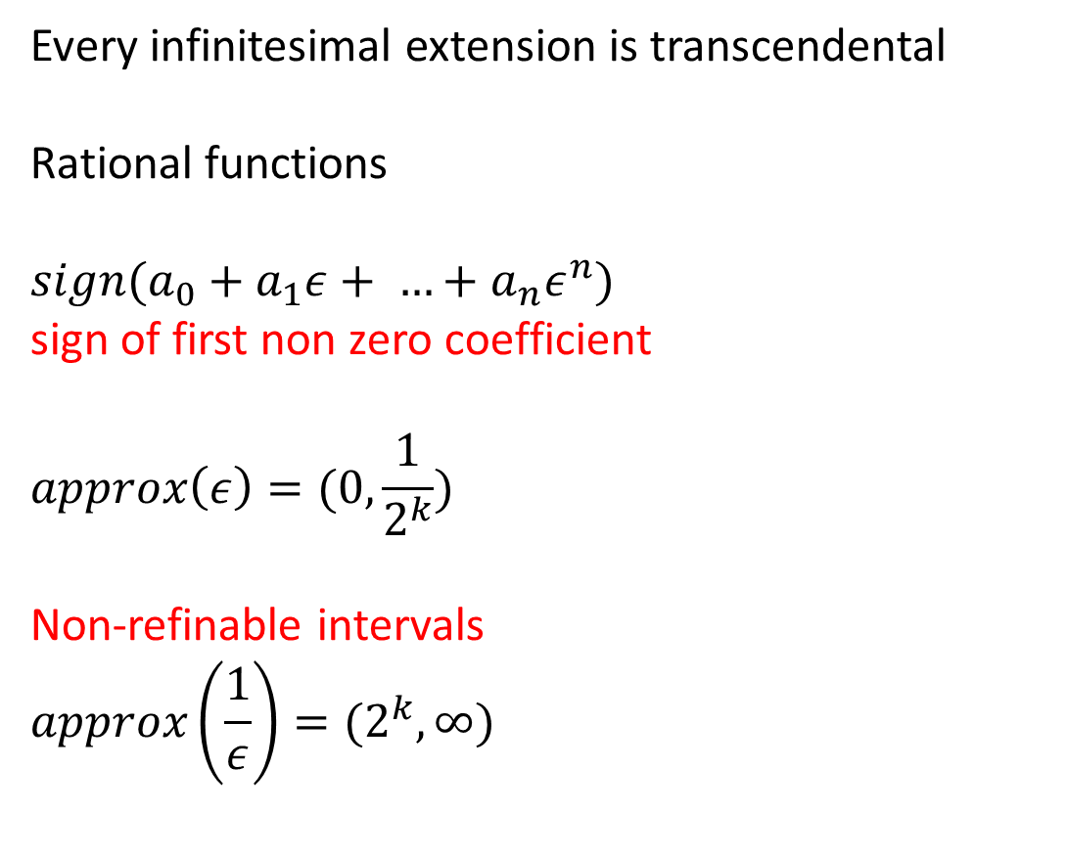
Infinitesimal Extensions
Every infinitesimal extension is transcendental
Rational functions
$sign({{a_{0}+a_{1}ε+ …+a}_{n}ε}^{n})$
sign of first non zero coefficient
$$approx\left(ε\right)=(0, \frac{1}{2^{k}})$$
Non-refinable intervals
$$approx\left(\frac{1}{ε}\right)=(2^{k}, ∞)$$

Slide 33
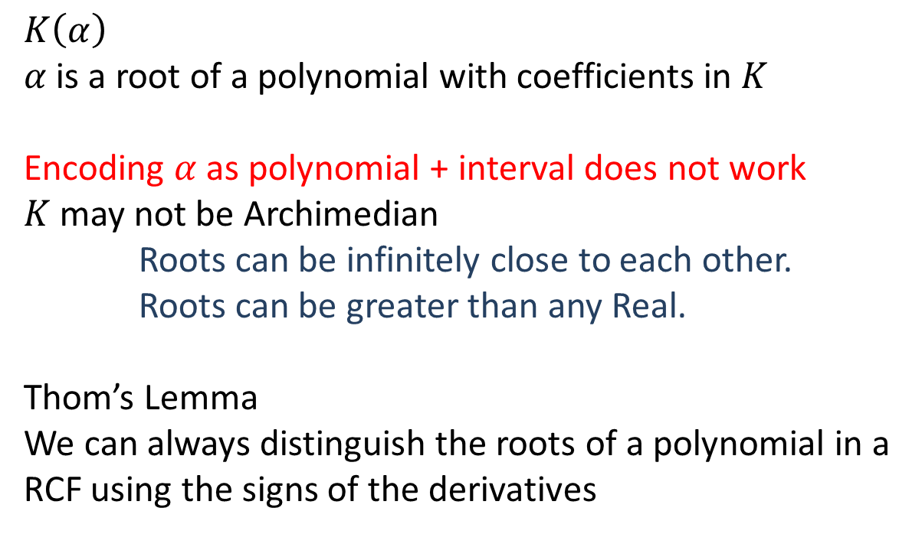
Algebraic Extensions
$K\left(α\right)$
$α$ is a root of a polynomial with coefficients in $K$
Encoding $α$as polynomial + interval does not work
$K$ may not be Archimedian
Roots can be infinitely close to each other.
Roots can be greater than any Real.
Thom’s Lemma
We can always distinguish the roots of a polynomial in a RCF using the signs of the derivatives

Slide 34
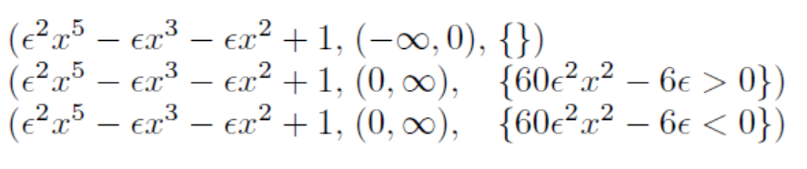
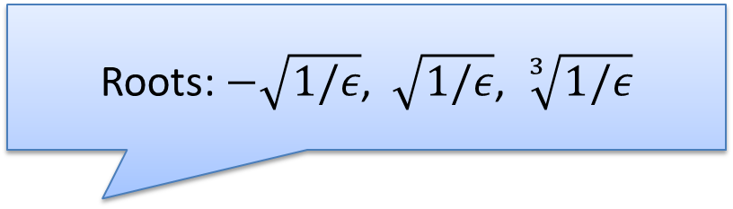
Algebraic Extensions
Roots: $−\sqrt{1/ε}$, $\sqrt{1/ε}$, $\sqrt[3]{1/ε}$
Three roots of

Slide 35
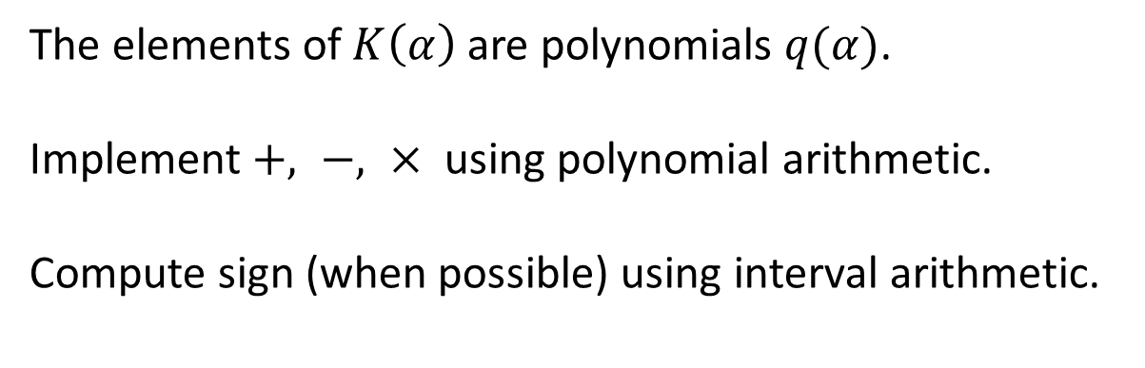
Algebraic Extensions
The elements of $K\left(α\right)$ are polynomials $q(α)$.
Implement $+, −, ×$ using polynomial arithmetic.
Compute sign (when possible) using interval arithmetic.

Slide 36
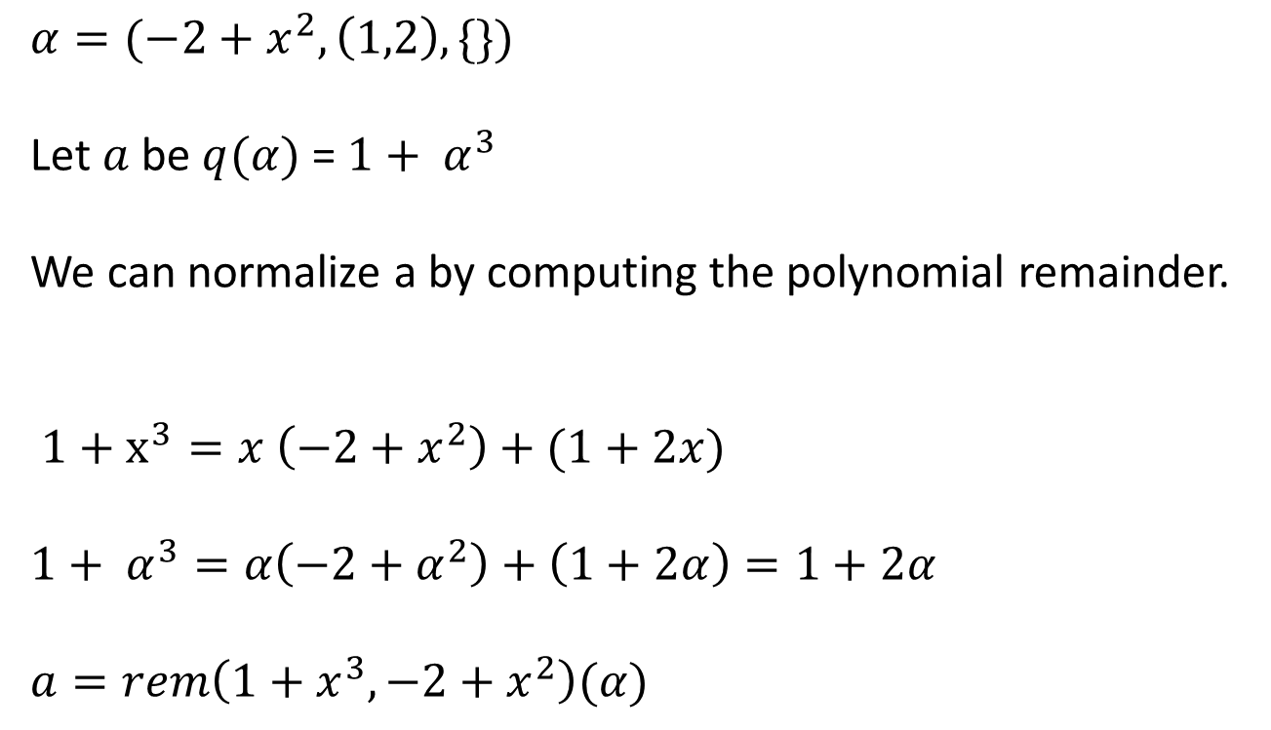
Algebraic Extensions
$$α=(−2+x^{2},\left(1,2\right), \{\})$$
Let $a$ be $q(α)$ = ${1+ α}^{3}$
We can normalize a by computing the polynomial remainder.
$1+x^{3}=x \left(−2+x^{2}\right)+(1+2x)$
$${1+ α}^{3}=α\left(−2+α^{2}\right)+\left(1+2α\right)=1+2α$$
$a=rem\left(1+x^{3}, −2+x^{2}\right)(α)$
Polynomial
Remainder

Slide 37

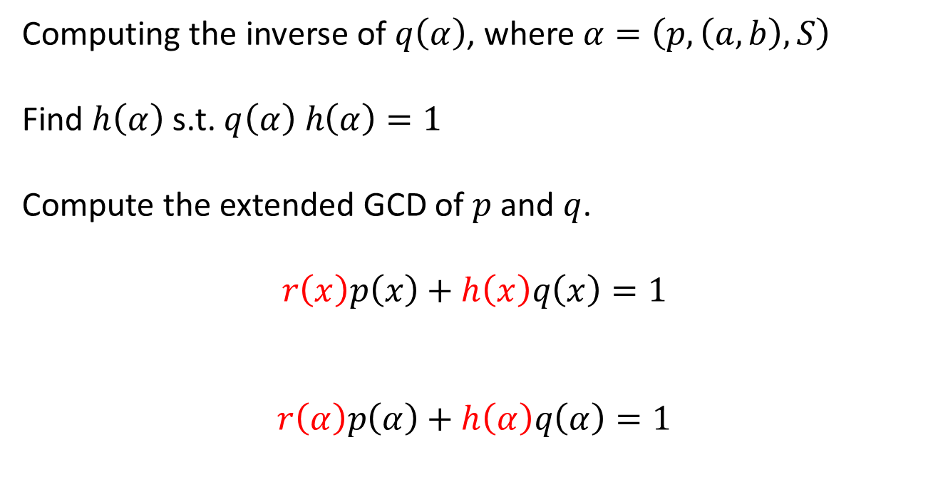
Algebraic Extensions: non-minimal Polynomials
Computing the inverse of $q\left(α\right)$, where $α=\left(p, \left(a,b\right), S\right)$
Find $h\left(α\right)$ s.t. $q\left(α\right) h\left(α\right)=1$
Compute the extended GCD of $p$ and $q$.
$$r\left(x\right)p\left(x\right)+h\left(x\right)q\left(x\right)=1$$
$$r\left(α\right)p\left(α\right)+h\left(α\right)q\left(α\right)=1$$
$$0$$

Slide 38

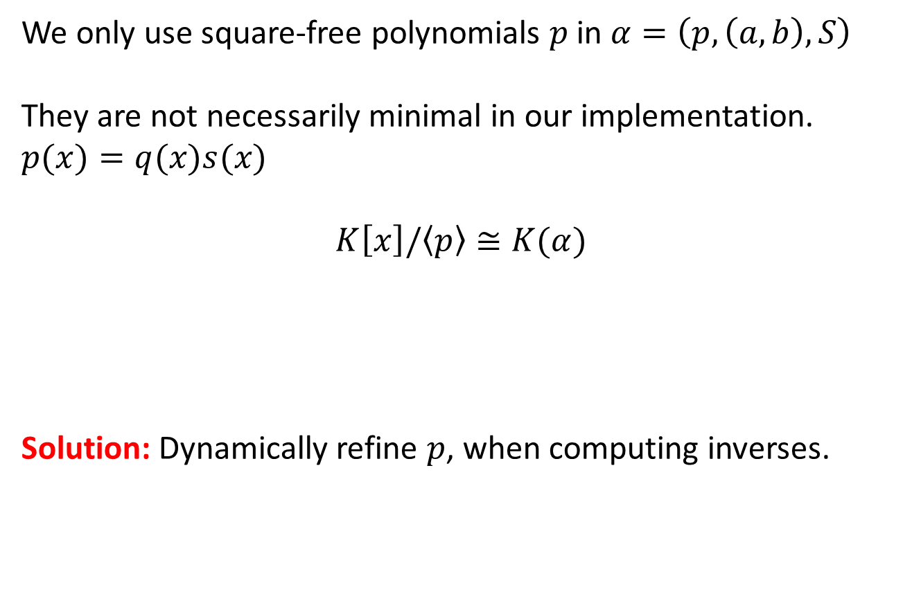
Algebraic Extensions: non-minimal Polynomials
We only use square-free polynomials $p$ in $α=\left(p, \left(a,b\right), S\right)$
They are not necessarily minimal in our implementation.
$$p(x)=q(x)s(x)$$
$$K\left[x\right]/\left\langle p\right\rangle ≅K(α)$$
Solution: Dynamically refine $p$, when computing inverses.
Only is $p$is minimal

Slide 39
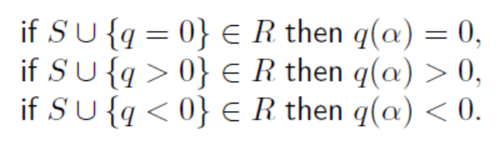
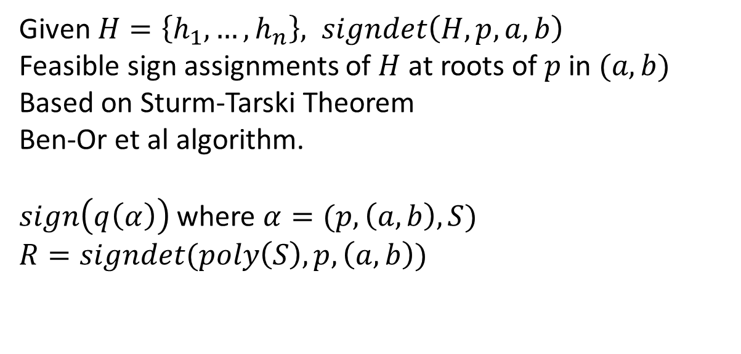
Algebraic Extensions
Given $H=\left\{h_{1}, …, h_{n}\right\}, signdet\left(H, p, a, b\right)$
Feasible sign assignments of $H$ at roots of $p$in $(a, b)$
Based on Sturm-Tarski Theorem
Ben-Or et al algorithm.
$sign\left(q\left(α\right)\right)$ where $α=(p, \left(a,b\right), S)$
$$R=signdet(poly\left(S\right), p, \left(a,b\right))$$

Slide 40
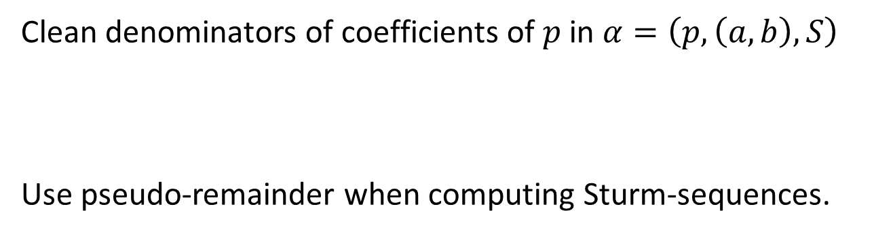
Algebraic Extensions: Clean Representation
Clean denominators of coefficients of $p$ in $α=\left(p, \left(a,b\right), S\right)$
Use pseudo-remainder when computing Sturm-sequences.

Slide 41

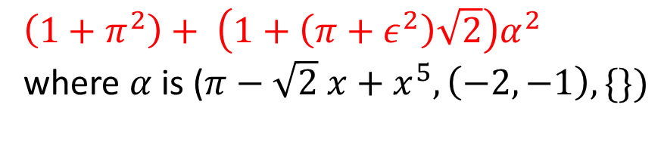
Example
$$\left({1+π}^{2}\right)+ \left(1+\left({π+ε}^{2}\right)\sqrt{2}\right)α^{2}$$
where $α$ is ($π−\sqrt{2} x+x^{5}, \left(−2, −1\right), \{\})$
$$α$$

Slide 42
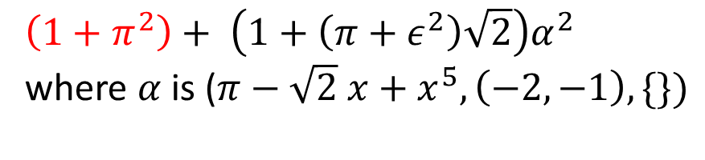



Example
$$\left({1+π}^{2}\right)+ \left(1+\left({π+ε}^{2}\right)\sqrt{2}\right)α^{2}$$
where $α$ is ($π−\sqrt{2} x+x^{5}, \left(−2, −1\right), \{\})$
$$α$$
$$π$$
$$1$$
$$1$$

Slide 43


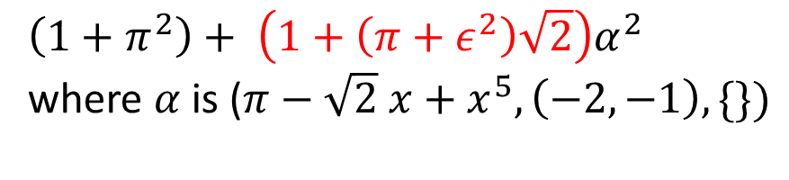
Example
$$\left(1+π^{2}\right)+ \left(1+\left({π+ε}^{2}\right)\sqrt{2}\right)α^{2}$$
where $α$ is ($π−\sqrt{2} x+x^{5}, \left(−2, −1\right), \{\})$
$$α$$
$$π$$
$$\sqrt{2}$$
$$1$$
$$1$$
$$1$$

Slide 44



Example
$$\left(1+π^{2}\right)+ \left(1+\left({π+ε}^{2}\right)\sqrt{2}\right)α^{2}$$
where $α$ is ($π−\sqrt{2} x+x^{5}, \left(−2, −1\right), \{\})$
$$α$$
$$π$$
$$\sqrt{2}$$
$$1$$
$$1$$
$$1$$
$$ε$$
$$1$$

Slide 45



Example
$$\left(1+π^{2}\right)+ \left(1+\left(π{+ ε}^{2}\right)\sqrt{2}\right)α^{2}$$
where $α$ is ($π−\sqrt{2} x+x^{5}, \left(−2, −1\right), \{\})$
$$α$$
$$π$$
$$\sqrt{2}$$
$$1$$
$$1$$
$$1$$
$$ε$$
$$π$$
$$1$$
$$1$$

Slide 46



Examples
$$−2+x^{2}$$
$$−\sqrt{2}$$
$$\sqrt{2}$$
msqrt2, sqrt2 = MkRoots([-2, 0, 1])
print(msqrt2)
>> root(x^2 + -2, (-oo, 0), {})
print(sqrt2)
>> root(x^2 + -2, (0, +oo), {})
print(sqrt2.decimal(10))
>> 1.4142135623?

Slide 47

Examples
$$1−10x^{2}+x^{4}$$
r1,r2,r3,r4 = MkRoots([1, 0, -10, 0, 1])
msqrt2, sqrt2 = MkRoots([-2, 0, 1])
msqrt3, sqrt3 = MkRoots([-3, 0, 1])
print sqrt3 + sqrt2 == r4
>> True
print sqrt3 + sqrt2 > r3
>> True
print sqrt3 + msqrt2 == r3
>> True

Slide 48

Examples
$$π−\sqrt{2} x+x^{5}$$
pi = Pi()
rs = MkRoots([pi, - sqrt2, 0, 0, 0, 1])
print(len(rs))
>> 1
print(rs[0])
>> root(x^5 + -1 root(x^2 + -2, (0, +oo), {}) x + pi, (-oo, 0), {})

Slide 49


Examples
eps = MkInfinitesimal()
print(eps < 0.000000000000001)
>> True
print(1/eps > 10000000000000000000000)
>> True
print(1/eps + 1 > 1/eps)
>> True
[r] = MkRoots([-eps, 0, 0, 1])
print(r > eps)
>> True
Infinity value
$$−ε+x^{3}$$
$$\sqrt[3]{ε}>ε$$

Slide 50

Examples
[x] = MkRoots([-1, -1, 0, 0, 0, 1])
[y] = MkRoots([-197, 3131, -31*x**2, 0, 0, 0, 0, x])
[z] = MkRoots([-735*x*y, 7*y**2, -1231*x**3, 0, 0, y])
print x.decimal(10), y.decimal(10), z.decimal(10)
>> 1.1673039782?, 0.0629726948?, 31.4453571397?
instantaneously solved

Slide 51
Same Example in Mathematica
x = Root[#^5 - # - 1 &, 1]
y = Root[x #^7 - 31 x^2 #^2 + 3131 # - 197 &, 1]
z = Root[y #^5 - 1231 x^3 #^2 + 7 y^2 # - 735 x y &, 1]
10min, $z$ is encoded by a polynomial of degree 175.

Slide 52
Conclusion
Package for computing with transcendental, infinitesimal and algebraic extensions.
Main application: exact nonlinear optimization.
Code is available online.
You can play with it online: http://rise4fun.com/z3rcf
More info: https://z3.codeplex.com/wikipage?title=CADE24
PSPACE-complete procedures

