Slide 1
Internals of SMT Solvers
Leonardo de Moura
Microsoft Research

Slide 2
Acknowledgements
Dejan Jovanovic (SRI International, NYU)
Grant Passmore (Univ. Edinburgh)

Slide 3
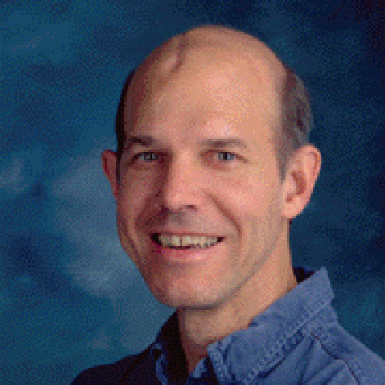
Herbrand Award 2013
Greg Nelson

Slide 4
What is a SMT Solver?

Slide 5

Multiple Approaches
is a portfolio of solvers

Slide 6

Preprocessing
$$F$$
Modular Architecture is a “must have”
Simplify
Variable elimination
if-then-else elimination
…
Solver

Slide 7



Equivalence Preserving Simplifications
$$F$$
Simplify
$$F′$$
Examples:
$$x+y+1−x−2 ↦ y −1$$
$$p∧true∧p↦p$$

Slide 8


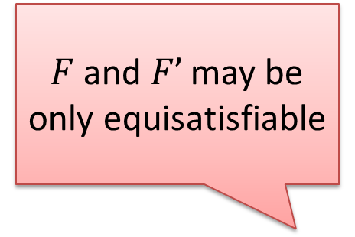
Preprocessor API
$F$and $F’$ may be only equisatisfiable
$$F$$
Preprocessor
$$F′$$
Model
Converter
Proof
Converter

Slide 9


Example
Variable
Elimination
Proof
builder
Model
builder

Slide 10


Example
Variable
Elimination
$$M, M(a) = M(b) + 1$$
Proof
builder
Model
builder
$$M$$

Slide 11


Example
Variable
Elimination
$$b→5, a→6$$
Proof
builder
Model
builder
$$b→5$$

Slide 12


Model Converters
Extension
Filter
$$M, M(a) = M(b) + 1$$
Model
builder
$$M$$

Slide 13
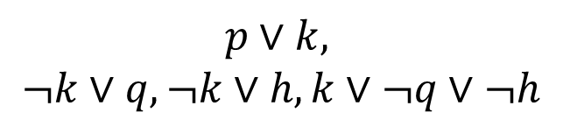



Model Converter: Filter
$$p∨(q∧h)$$
Tseitin
CNF converter
$$M∖k$$
Model
builder
$$p∨k,$$
$$¬k∨q, ¬k∨h, k∨¬q∨¬h$$
$$M$$

Slide 14


Model Converter: Filter
$$p∨(q∧h)$$
Tseitin
CNF converter
$$p→t, q→f, h→t$$
Model
builder
$$p∨k,$$
$$¬k∨q, ¬k∨h, k∨¬q∨¬h$$
$$p→t, k→f, q→f, h→t$$

Slide 15
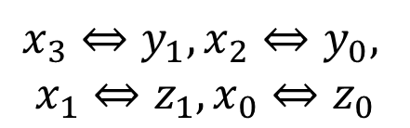
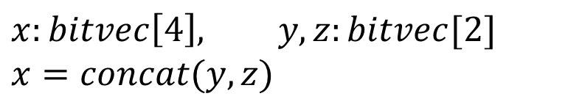


Model Converter: Extension + Filter
$$x:bitvec\left[4\right], y,z:bitvec[2]$$
$$x=concat(y,z)$$
Bit-blaster
$$M′$$
Model
builder
$$x_{3}⇔y_{1}, x_{2}⇔y_{0},$$
$$x_{1}⇔z_{1}, x_{0}⇔z_{0}$$
$$M$$

Slide 16
Preprocessors
1. Produce Equivalent Formula
2. Produce Equisatisfiable Formula
3. Assume “closed world” (non-incremental)
Example: symmetry reduction

Slide 17
Simple QF_BV (bit-vector) solver
$$F$$
Simplify
Variable elimination
Bit-blasting
Tseitin CNF converter
SAT Solver

Slide 18
Under/Over-Approximations
Under-approximation
unsat answers cannot be trusted
Over-approximation
sat answers cannot be trusted

Slide 19
Under/Over-Approximations
Under-approximation
model finders
Over-approximation
proof finders

Slide 20
Under/Over-Approximations
Under-approximation
S → S ∪ S’
Over-approximation
S → S \ S’

Slide 21
Under/Over-Approximations
Under-approximation
Example: QF_NIA model finders
add bounds to unbounded variables (and blast)
Over-approximation
Example: Boolean abstraction

Slide 22
Under/Over-Approximations
Combining under and over is bad!
sat and unsat answers cannot be trusted.

Slide 23
Tracking: under/over-approximations
Proof and Model converters can check if the resultant models and proofs are valid.

Slide 24
CEGAR is your friend Counter-Example Guided Abstract Refinement
Using over-approximation
Model
procedure Solver(F)
F_{p} := Abstract(F)
loop
(R, M) := Solve(F_{p})
if R = UNSAT then return UNSAT
R’ := Check(F, M)
if R’ = SAT then return SAT
F_{p} := Refine(F, F_{p}, M)

Slide 25
CEGAR is your friend Counter-Example Guided Abstract Refinement
Using under-approximation
Proof
procedure Solver(F)
F_{p} := Abstract(F)
loop
(R, Pr) := Solve(F_{p})
if R = SAT then return SAT
R’ := Check(F, Pr)
if R’ = UNSAT then return UNSAT
F_{p} := Refine(F, F_{p}, M)

Slide 26
CEGAR is your friend Counter-Example Guided Abstract Refinement
Refinements:
Incremental Solver
Run over and under-approximation is parallel

Slide 27
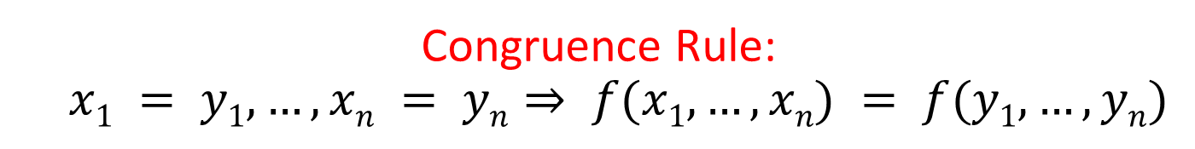
Uninterpreted Functions by CEGAR
Suppose we have a Solver that does not support
uninterpreted functions (example: QF_BV solver)
Congruence Rule:
$$x1 = y1, …, xn = yn⇒ f(x1, …, xn) = f(y1, …, yn)$$

Slide 28
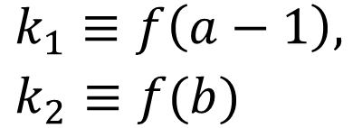

Uninterpreted Functions by CEGAR
Congruence Rule:
$$x1 = y1, …, xn = yn⇒ f(x1, …, xn) = f(y1, …, yn)$$
Abstract: replace each f-application with a fresh variable
(over-approximation)
$$a=b+1, f(a−1)=c, f(b)≠c$$
$k_{1}≡f\left(a−1\right),$
$k_{2}≡f(b)$
$$a=b+1, k_{1}=c, k_{2}≠c$$

Slide 29
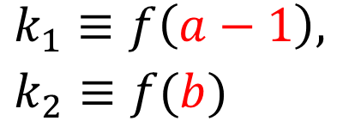
Uninterpreted Functions by CEGAR
Congruence Rule:
$$x1 = y1, …, xn = yn⇒ f(x1, …, xn) = f(y1, …, yn)$$
Check: check if congruence rule is satisfied
$$a=b+1, k_{1}=c, k_{2}≠c$$
$k_{1}≡f\left(a−1\right),$
$k_{2}≡f(b)$
$$a→1, b→0, c→0, k_{1}→0, k_{2}→1$$

Slide 30
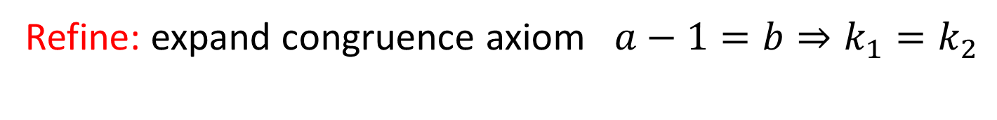
Uninterpreted Functions by CEGAR
Congruence Rule:
$$x1 = y1, …, xn = yn⇒ f(x1, …, xn) = f(y1, …, yn)$$
Refine: expand congruence axiom $a−1=b⇒k_{1}=k_{2}$
$$a=b+1, k_{1}=c, k_{2}≠c$$
$k_{1}≡f\left(a−1\right),$
$k_{2}≡f(b)$
$$a→1, b→0, c→0, k_{1}→0, k_{2}→1$$

Slide 31
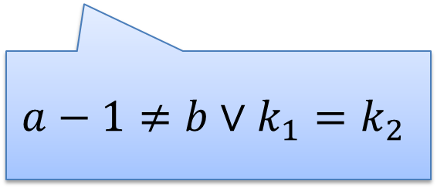
Uninterpreted Functions by CEGAR
Congruence Rule:
$$x1 = y1, …, xn = yn⇒ f(x1, …, xn) = f(y1, …, yn)$$
Refine: expand congruence axiom $a−1=b⇒k_{1}=k_{2}$
$a=b+1, k_{1}=c, k_{2}≠c, (a−1=b⇒k_{1}=k_{2})$
$$a−1≠b∨k_{1}=k_{2}$$
unsat

Slide 32
Simple QF_UFBV Solver
UF by CEGAR
QF_BV
solver

Slide 33
Simple QF_AUFBV Solver arrays on top of UF
AUF by CEGAR
QF_BV
solver
Lemmas on Demand For Theory of Arrays [Brummayer-Biere 2009]

Slide 34
Simple UFBV Solver model-based quantifier instantiation
MBQI
UF by CEGAR
QF_BV
solver
Efficiently solving quantified bit-vector formulas [Wintersteiger at al 2010]

Slide 35
Simple QF_NIA “solver” by CEGAR nonlinear integer arithmetic
Hilbert’s 10th Problem
DPRM theorem: QF_NIA is undecidable
Idea: use (under-approximation) CEGAR
Add lower/upper bounds to all variables, and convert into QF_BV
If SAT → done
Otherwise, refine: increase lower/upper bounds

Slide 36
Lazy SMT as CEGAR
Suppose we have a Solver that can only process a conjunction of literals.
Examples:
Congurence Closure (UF),
Simplex (Linear Real Arithmetic)

Slide 37
Lazy SMT as CEGAR: 1. Abstract
Basic Idea
x ≥ 0, y = x + 1, (y > 2 ∨ y < 1)
p₁, p₂, (p₃ ∨ p₄)
p₁ ≡ (x ≥ 0), p₂ ≡ (y = x + 1),
p₃ ≡ (y > 2), p₄ ≡ (y < 1)
[Audemard et al - 2002], [Barrett et al - 2002], [de Moura et al - 2002]
[Flanagan et al - 2003], …

Slide 38
Lazy SMT as CEGAR: 2. Solve
Basic Idea
x ≥ 0, y = x + 1, (y > 2 ∨ y < 1)
p₁, p₂, (p₃ ∨ p₄)
p₁ ≡ (x ≥ 0), p₂ ≡ (y = x + 1),
p₃ ≡ (y > 2), p₄ ≡ (y < 1)
SAT
Solver

Slide 39
Lazy SMT as CEGAR: 2. Solve
Basic Idea
x ≥ 0, y = x + 1, (y > 2 ∨ y < 1)
p₁, p₂, (p₃ ∨ p₄)
p₁ ≡ (x ≥ 0), p₂ ≡ (y = x + 1),
p₃ ≡ (y > 2), p₄ ≡ (y < 1)
SAT
Solver
Assignment
p₁, p₂, ¬p₃, p₄

Slide 40
Lazy SMT as CEGAR: 3. Check
Basic Idea
x ≥ 0, y = x + 1, (y > 2 ∨ y < 1)
p₁, p₂, (p₃ ∨ p₄)
p₁ ≡ (x ≥ 0), p₂ ≡ (y = x + 1),
p₃ ≡ (y > 2), p₄ ≡ (y < 1)
SAT
Solver
Assignment
p₁, p₂, ¬p₃, p₄
x ≥ 0, y = x + 1,
¬(y > 2), y < 1

Slide 41
Lazy SMT as CEGAR: 3. Check
Basic Idea
x ≥ 0, y = x + 1, (y > 2 ∨ y < 1)
p₁, p₂, (p₃ ∨ p₄)
p₁ ≡ (x ≥ 0), p₂ ≡ (y = x + 1),
p₃ ≡ (y > 2), p₄ ≡ (y < 1)
SAT
Solver
Assignment
p₁, p₂, ¬p₃, p₄
x ≥ 0, y = x + 1,
¬(y > 2), y < 1
Unsatisfiable
x ≥ 0, y = x + 1, y < 1
Theory
Solver

Slide 42
Lazy SMT as CEGAR: 4. Refine
Basic Idea
x ≥ 0, y = x + 1, (y > 2 ∨ y < 1)
p₁, p₂, (p₃ ∨ p₄)
p₁ ≡ (x ≥ 0), p₂ ≡ (y = x + 1),
p₃ ≡ (y > 2), p₄ ≡ (y < 1)
SAT
Solver
Assignment
p₁, p₂, ¬p₃, p₄
x ≥ 0, y = x + 1,
¬(y > 2), y < 1
New Lemma
¬p₁∨¬p₂∨¬p₄
Unsatisfiable
x ≥ 0, y = x + 1, y < 1
Theory
Solver

Slide 43
Lazy SMT as CEGAR: 4. Refine
Basic Idea
New Lemma
¬p₁∨¬p₂∨¬p₄
Unsatisfiable
x ≥ 0, y = x + 1, y < 1
Theory
Solver
AKA
Theory conflict

Slide 44
Lazy SMT as CEGAR: refinements
Many refinements:
Incrementality
Efficient Backtracking
Efficient Lemma Generation
Theory propagation - DPLL(T) [Ganzinger et all – 2004]
Many SMT solvers are based on DPLL(T)

Slide 45
DPLL(T) weakness
Theories are “second-class citizens”.
DPLL(T) is not model-driven (key property of CDCL).
Proofs
Conflict
Resolution
Models

Slide 46
CDCL: Conflict Driven Clause Learning
DPLL
Conflict
Resolution
Resolution
Model
Proof

Slide 47
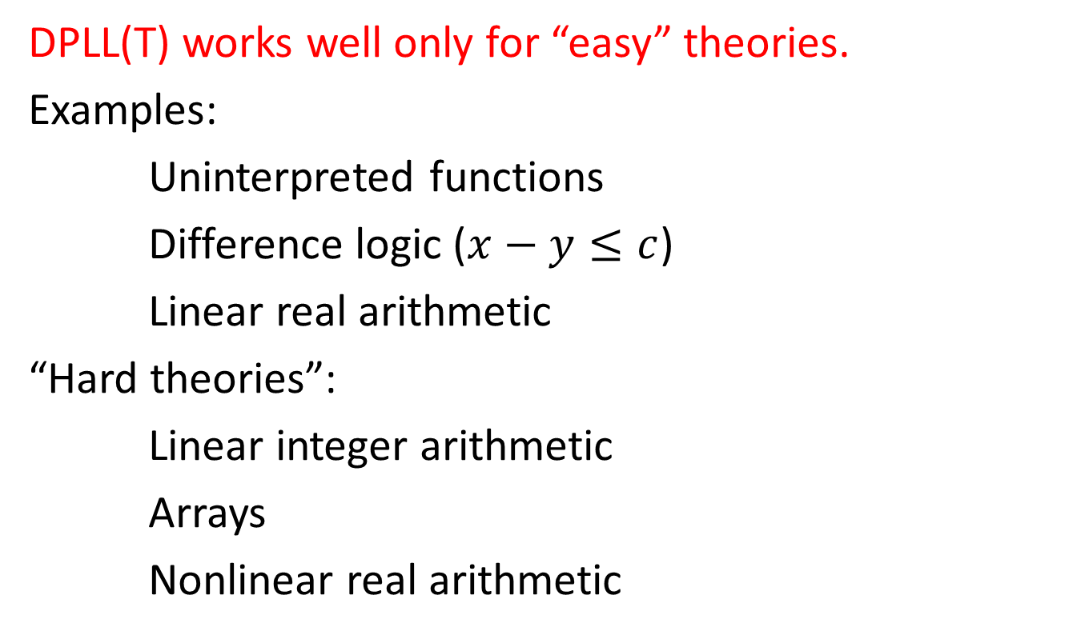
DPLL(T) weakness
DPLL(T) works well only for “easy” theories.
Examples:
Uninterpreted functions
Difference logic ($x−y≤c$)
Linear real arithmetic
“Hard theories”:
Linear integer arithmetic
Arrays
Nonlinear real arithmetic

Slide 48
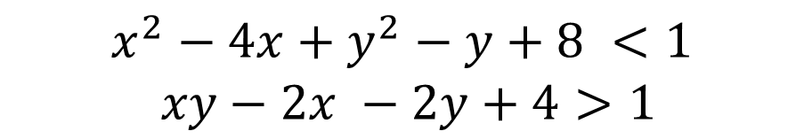
Example: Nonlinear Real Arithmetic
$$x^{2}−4x+y^{2}−y+8 <1$$
$xy−2x −2y+4>1$
PSPACE
PSPACE membership
Canny – 1988,
Grigor’ev – 1988
QF_NRA
NP
NP-hardness
x is “Boolean”→ x (x-1) = 0
x or y or z → x + y + z > 0

Slide 49
The RISE of Model-Driven Techniques in SMT
Notes:
Logic is about deriving irrefutable conclusions from a set of premises.

Slide 50
Saturation x Search
Proof-finding
Model-finding
Proofs
Conflict
Resolution
Models

Slide 51
Two procedures
Resolution | DPLL
Proof-finder | Model-finder
Saturation | Search
CDCL is model-driven proof search

Slide 52
Linear Arithmetic
Fourier-Motzkin | Simplex
Proof-finder | Model-finder
Saturation | Search

Slide 53



Fourier-Motzkin
$$t_{1}≤ax, bx≤t_{2}$$
$$bt_{1}≤abx, abx≤{at}_{2}$$
$$bt_{1}≤{at}_{2}$$
Very similar to Resolution
Exponential time and space

Slide 54

Polynomial Constraints
AKA
Existential Theory of the Reals
∃R
$$x^{2}−4x+y^{2}−y+8 <1$$
$xy−2x −2y+4>1$

Slide 55

CAD “Big Picture”
1. Project/Saturate set of polynomials
2. Lift/Search: Incrementally build assignment$v: x_{k}→$ $α_{k}$
Isolate roots of polynomials $f_{i}(α,x)$
Select a feasible cell $C$, and assign $x_{k}$ some $α_{k}∈C$
If there is no feasible cell, then backtrack

Slide 56
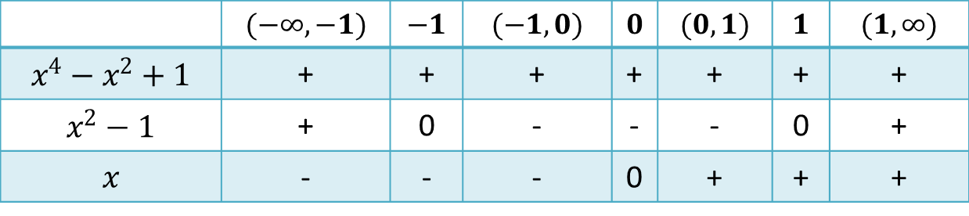





CAD “Big Picture”
$$x^{2}+y^{2} −1<0$$
$$x^{4}−x^{2}+1$$
$$x y −1>0$$
$$x^{2}−1$$
1. Saturate
$$x$$
2. Search
 | $$(−∞, −1)$$ | $$−1$$ | $$(−1, 0)$$ | $$0$$ | $$(0,1)$$ | $$1$$ | $$(1, ∞)$$
$$x^{4}−x^{2}+1$$ | + | + | + | + | + | + | +
$$x^{2}−1$$ | + | 0 | - | - | - | 0 | +
$$x$$ | - | - | - | 0 | + | + | +
Notes:
Backtracking

Slide 57

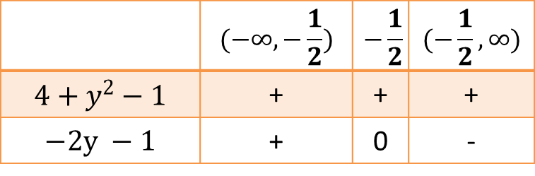


CAD “Big Picture”
$$x^{2}+y^{2} −1<0$$
$$x^{4}−x^{2}+1$$
$$x y −1>0$$
$$x^{2}−1$$
1. Saturate
$$x$$
 | $$(−∞, −\frac{1}{2})$$ | $$−\frac{1}{2}$$ | $$(−\frac{1}{2}, ∞)$$
$$4+y^{2}−1$$ | + | + | +
$$−2y −1$$ | + | 0 | -
$$x−2$$
2. Search
 | $$(−∞, −1)$$ | $$−1$$ | $$(−1, 0)$$ | $$0$$ | $$(0,1)$$ | $$1$$ | $$(1, ∞)$$
$$x^{4}−x^{2}+1$$ | + | + | + | + | + | + | +
$$x^{2}−1$$ | + | 0 | - | - | - | 0 | +
$$x$$ | - | - | - | 0 | + | + | +
Notes:
Backtracking

Slide 58

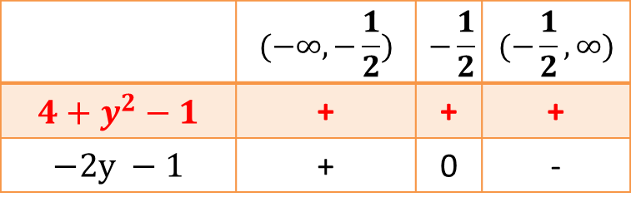

CAD “Big Picture”
$$x^{2}+y^{2} −1<0$$
$$x^{4}−x^{2}+1$$
$$x y −1>0$$
$$x^{2}−1$$
1. Saturate
$$x$$
 | $$(−∞, −\frac{1}{2})$$ | $$−\frac{1}{2}$$ | $$(−\frac{1}{2}, ∞)$$
$$4+y^{2}−1$$ | + | + | +
$$−2y −1$$ | + | 0 | -
CONFLICT
$$x−2$$
2. Search
 | $$(−∞, −1)$$ | $$−1$$ | $$(−1, 0)$$ | $$0$$ | $$(0,1)$$ | $$1$$ | $$(1, ∞)$$
$$x^{4}−x^{2}+1$$ | + | + | + | + | + | + | +
$$x^{2}−1$$ | + | 0 | - | - | - | 0 | +
$$x$$ | - | - | - | 0 | + | + | +
Notes:
Backtracking

Slide 59
NLSat: Model-Driven Search
Static x Dynamic
Optimistic approach
Key ideas
Proofs
Conflict
Resolution
Models
Start the Search before Saturate/Project
We saturate on demand
Model guides the saturation

Slide 60
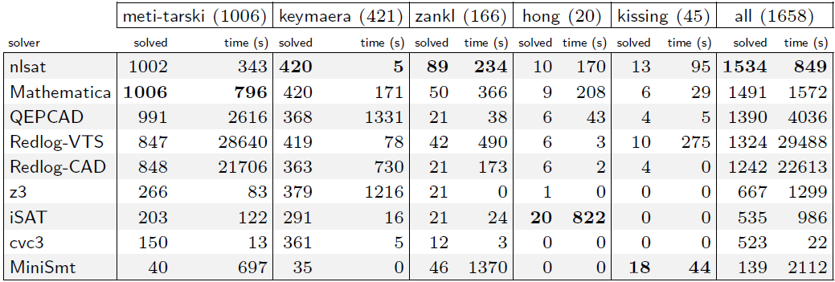
Experimental Results (1)
OUR NEW ENGINE

Slide 61
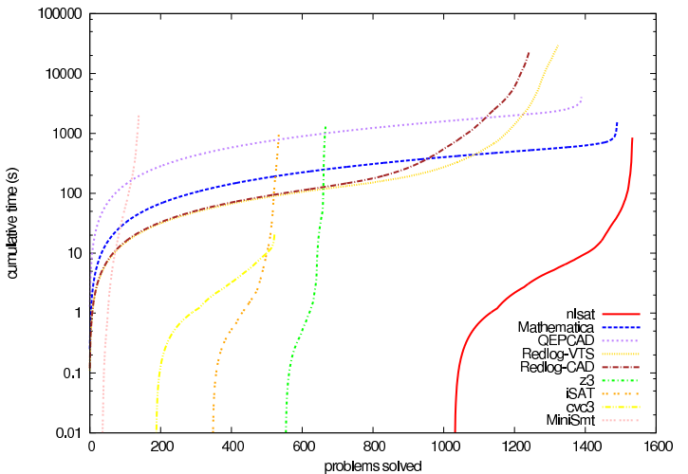
Experimental Results (2)
OUR NEW ENGINE

Slide 62
Other examples
Delayed
Theory Combination
[Bruttomesso et al 2006]
Model-Based
Theory Combination
X

Slide 63
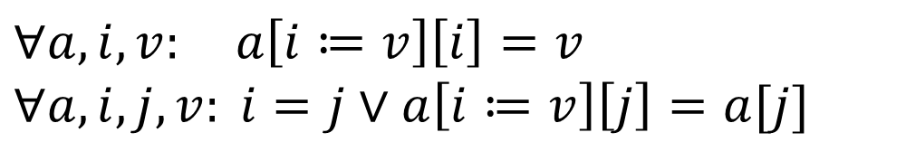
Other examples
Lemmas on Demand
For Theory of Array
[Brummayer-Biere 2009]
Array Theory by
Axiom Instantiation
X
$$∀a,i,v: a\left[i≔v\right]\left[i\right]=v$$
$$∀a,i,j, v: i=j∨a\left[i≔v\right]\left[j\right]=a[j]$$

Slide 64
Other examples (for linear arithmetic)
Generalizing DPLL to richer logics
[McMillan et al 2009]
Fourier-Motzkin
X
Conflict Resolution
[Korovin et al 2009]

Slide 65
Saturation: successful instances
Polynomial time procedures
Gaussian Elimination
Congruence Closure

Slide 66
MCSat
Model-Driven SMT
Lift ideas from CDCL to SMT
Generalize ideas found in model-driven approaches
Easier to implement
Model construction is explicit

Slide 67
MCSat
$$x≥2, \left(¬x≥1∨y≥1\right), (x^{2}+y^{2}≤1∨xy>1)$$

Slide 68

MCSat
$$x≥2, \left(¬x≥1∨y≥1\right), (x^{2}+y^{2}≤1∨xy>1)$$
$$x≥2$$
Propagations

Slide 69

MCSat
$$x≥2, \left(¬x≥1∨y≥1\right), (x^{2}+y^{2}≤1∨xy>1)$$
$$x≥2$$
$$x≥1$$
Propagations

Slide 70

MCSat
$$x≥2, \left(¬x≥1∨y≥1\right), (x^{2}+y^{2}≤1∨xy>1)$$
$$x≥2$$
$$x≥1$$
$$y≥1$$
Propagations

Slide 71

MCSat
$$x≥2, \left(¬x≥1∨y≥1\right), (x^{2}+y^{2}≤1∨xy>1)$$
$$x≥2$$
$$x≥1$$
$$y≥1$$
$$x^{2}+y^{2}≤1$$
Boolean Decisions

Slide 72

MCSat
$$x≥2, \left(¬x≥1∨y≥1\right), (x^{2}+y^{2}≤1∨xy>1)$$
$$x≥2$$
$$x≥1$$
$$y≥1$$
$$x^{2}+y^{2}≤1$$
$$x→2$$
Semantic Decisions

Slide 73
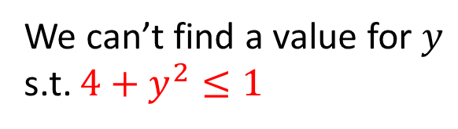


MCSat
$$x≥2, \left(¬x≥1∨y≥1\right), (x^{2}+y^{2}≤1∨xy>1)$$
$$x≥2$$
$$x≥1$$
$$y≥1$$
$$x^{2}+y^{2}≤1$$
$$x→2$$
Conflict
We can’t find a value for $y$ s.t. $4+y^{2}≤1$

Slide 74
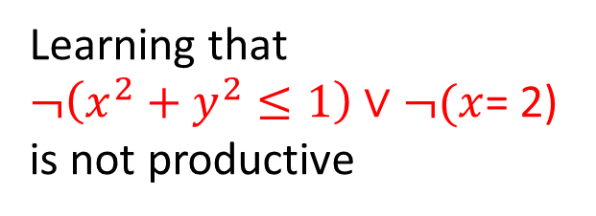
MCSat
$$x≥2, \left(¬x≥1∨y≥1\right), (x^{2}+y^{2}≤1∨xy>1)$$
$$x≥2$$
$$x≥1$$
$$y≥1$$
$$x^{2}+y^{2}≤1$$
$$x→2$$
Conflict
We can’t find a value for $y$ s.t. $4+y^{2}≤1$
Learning that
$¬\left(x^{2}+y^{2}≤1\right)∨¬(x$= 2)
is not productive

Slide 75
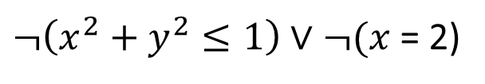

MCSat
$$x≥2, \left(¬x≥1∨y≥1\right), (x^{2}+y^{2}≤1∨xy>1)$$
$$x≥2$$
$$x≥1$$
$$y≥1$$
$$x^{2}+y^{2}≤1$$
$$¬(x=2)$$
$¬\left(x^{2}+y^{2}≤1\right)∨¬(x$= 2)
Learning that
$¬\left(x^{2}+y^{2}≤1\right)∨¬(x$= 2)
is not productive

Slide 76

MCSat
$$x≥2, \left(¬x≥1∨y≥1\right), (x^{2}+y^{2}≤1∨xy>1)$$
$$x≥2$$
$$x≥1$$
$$y≥1$$
$$x^{2}+y^{2}≤1$$
$$¬(x=2)$$
$$x→3$$
$¬\left(x^{2}+y^{2}≤1\right)∨¬(x$= 2)
Learning that
$¬\left(x^{2}+y^{2}≤1\right)∨¬(x$= 2)
is not productive

Slide 77
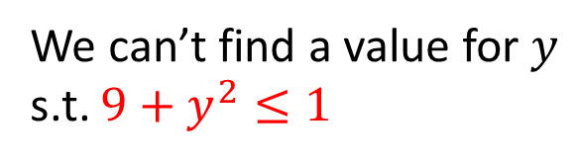

MCSat
$$x≥2, \left(¬x≥1∨y≥1\right), (x^{2}+y^{2}≤1∨xy>1)$$
$$x≥2$$
$$x≥1$$
$$y≥1$$
$$x^{2}+y^{2}≤1$$
$$¬(x=2)$$
$$x→3$$
“Same” Conflict
$¬\left(x^{2}+y^{2}≤1\right)∨¬(x$= 2)
We can’t find a value for $y$ s.t. $9+y^{2}≤1$
Learning that
$¬\left(x^{2}+y^{2}≤1\right)∨¬(x$= 2)
is not productive

Slide 78











$$x≥2, \left(¬x≥1∨y≥1\right), (x^{2}+y^{2}≤1∨xy>1)$$
$$x≥2$$
$$x≥1$$
$$y≥1$$
$$x^{2}+y^{2}≤1$$
$$x→2$$
Conflict
$$y$$
$$x^{2}+y^{2}≤1$$
$$x→2$$
$$x$$
$$−1≤x, x≤1$$
$$¬(x^{2}+y^{2}≤1)∨x≤1$$

Slide 79


MCSat
$$x≥2, \left(¬x≥1∨y≥1\right), (x^{2}+y^{2}≤1∨xy>1)$$
$$x≥2$$
$$x≥1$$
$$y≥1$$
$$x^{2}+y^{2}≤1$$
$$x≤1$$
$$¬(x^{2}+y^{2}≤1)∨x≤1$$

Slide 80




MCSat
$$x≥2, \left(¬x≥1∨y≥1\right), (x^{2}+y^{2}≤1∨xy>1)$$
$$x≥2$$
$$x≥1$$
$$y≥1$$
$$x^{2}+y^{2}≤1$$
$$x≤1$$
$$¬(x^{2}+y^{2}≤1)∨x≤1$$
Conflict
$$¬\left(x≥2\right)∨¬(x≤1)$$

Slide 81

MCSat
$$x≥2, \left(¬x≥1∨y≥1\right), (x^{2}+y^{2}≤1∨xy>1)$$
$$x≥2$$
$$x≥1$$
$$y≥1$$
$$x^{2}+y^{2}≤1$$
$$¬(x^{2}+y^{2}≤1)∨x≤1$$
Learned by resolution
$$¬\left(x≥2\right)∨¬(x^{2}+y^{2}≤1)$$

Slide 82



MCSat
$$x≥2, \left(¬x≥1∨y≥1\right), (x^{2}+y^{2}≤1∨xy>1)$$
$$x≥2$$
$$x≥1$$
$$y≥1$$
$$¬(x^{2}+y^{2}≤1)$$
$$¬\left(x≥2\right)∨¬(x^{2}+y^{2}≤1)$$
$$¬(x^{2}+y^{2}≤1)∨x≤1$$

Slide 83



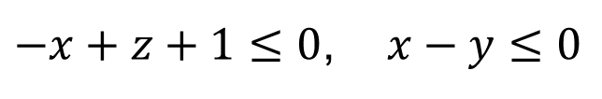
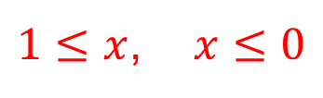
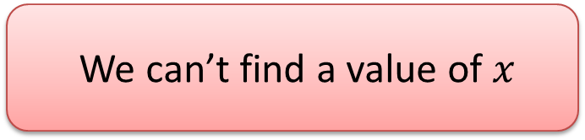


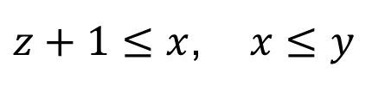

MCSat: FM Example
$$−x+z+1≤0$$
$$z→0$$
$$x−y≤0$$
$$y→0$$
$−x+z+1≤0$, $x−y≤0$
$$z→0, y→0$$
$$≡$$
$z+1≤x$, $x≤y$
$1≤x$, $x≤0$
We can’t find a value of $x$

Slide 84

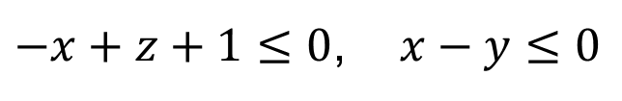


MCSat: FM Example
$$−x+z+1≤0$$
$$z→0$$
$$x−y≤0$$
$$y→0$$
$−x+z+1≤0$, $x−y≤0$
$$z→0, y→0$$
$∃x:−x+z+1≤0 ∧$ $x−y≤0$
Fourier-Motzkin
$$z+1−y≤0$$
$$¬\left(−x+z+1≤0\right)∨¬\left(x−y≤0\right)∨z+1−y≤0$$

Slide 85

MCSat: FM Example
$$−x+z+1≤0$$
$$z→0$$
$$x−y≤0$$
$$z+1−y≤0$$
$$¬\left(−x+z+1≤0\right)∨¬\left(x−y≤0\right)∨z+1−y≤0$$

Slide 86
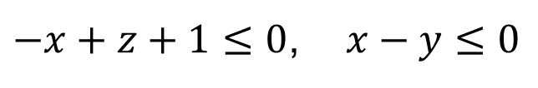

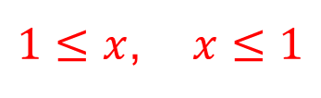

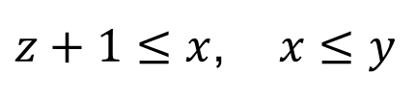

MCSat: FM Example
$$−x+z+1≤0$$
$$z→0$$
$$x−y≤0$$
$$z+1−y≤0$$
$$y→1$$
$$¬\left(−x+z+1≤0\right)∨¬\left(x−y≤0\right)∨z+1−y≤0$$
$−x+z+1≤0$, $x−y≤0$
$$z→0, y→1$$
$$≡$$
$z+1≤x$, $x≤y$
$1≤x$, $x≤1$

Slide 87






MCSat: FM Example
$$−x+z+1≤0$$
$$z→0$$
$$x−y≤0$$
$$z+1−y≤0$$
$$y→1$$
$$x→1$$
$$¬\left(−x+z+1≤0\right)∨¬\left(x−y≤0\right)∨z+1−y≤0$$
$−x+z+1≤0$, $x−y≤0$
$$z→0, y→1$$
$$≡$$
$z+1≤x$, $x≤y$
$1≤x$, $x≤1$

Slide 88
MCSat: Another Example
$$−4xy−4x+y>1, x^{2}+y^{2}<1, x^{3}+2x^{2}+3y^{2}−5<0$$

Slide 89
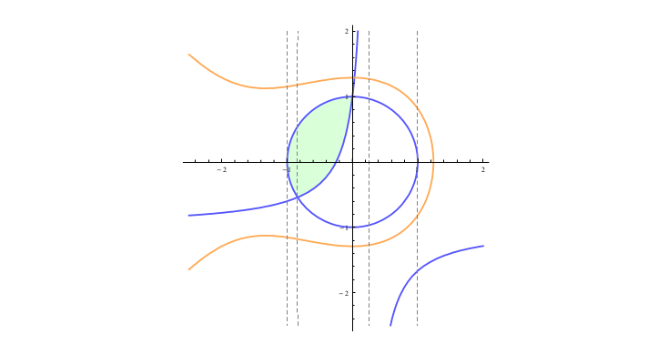


MCSat: Another Example
$$−4xy−4x+y>1, x^{2}+y^{2}<1, x^{3}+2x^{2}+3y^{2}−5<0$$
Feasible Region
$$x^{3}+2x^{2}+3y^{2}−5<0$$
Starting search
Partial solution:
$$x→ 0.5$$
$$−4xy −4x+y>1$$
What is the core?
$$x^{2}+y^{2}<1$$
Can we extend it to $y$?

Slide 90

MCSat: Another Example
$$−4xy−4x+y>1, x^{2}+y^{2}<1, x^{3}+2x^{2}+3y^{2}−5<0$$
Feasible Region
$$x^{3}+2x^{2}+3y^{2}−5<0$$
Starting search
Partial solution:
$$x → 0.5$$
$$−4xy −4x+y>1$$
What is the core?
$$x^{2}+y^{2}<1$$
Can we extend it to $y$?

Slide 91
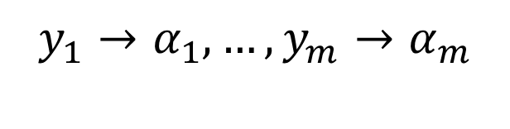



MCSat – Finite Basis
Every theory that admits quantifier elimination has a finite basis (given a fixed assignment order)
$$F[x, y_{1}, …, y_{m}]$$
$$y_{1}→α_{1}, …,y_{m}→α_{m}$$
$$∃x:F[x,y_{1}, …, y_{m}]$$
$$C_{1}[y_{1},…,y_{m}]∧…∧C_{k}[y_{1},…,y_{m}]$$
$$¬F\left[x, y_{1}, …, y_{m}\right]∨C_{k}[y_{1}, …,y_{m}]$$

Slide 92





MCSat – Finite Basis
$$F_{n}[x_{1,}x_{2},…, {x_{n−1},x}_{n}]$$
$$F_{n−1}[x_{1,}x_{2},…,x_{n−1}]$$
$$…$$
$$F_{2}[x_{1,}x_{2}]$$
$$F_{1}[x_{1}]$$

Slide 93

MCSat – Finite Basis
$$F_{n}[x_{1,}x_{2},…, {x_{n−1},x}_{n}]$$
$$F_{n−1}[x_{1,}x_{2},…,x_{n−1}]$$
$$…$$
$$F_{2}[x_{1,}x_{2}]$$
$$F_{1}[x_{1}]$$

Slide 94

MCSat – Finite Basis
$$F_{n}[x_{1,}x_{2},…, {x_{n−1},x}_{n}]$$
$$F_{n−1}[x_{1,}x_{2},…,x_{n−1}]$$
$$…$$
$$F_{2}[x_{1,}x_{2}]$$
$$F_{1}[x_{1}]$$

Slide 95

MCSat – Finite Basis
$$F_{n}[x_{1,}x_{2},…, {x_{n−1},x}_{n}]$$
$$F_{n−1}[x_{1,}x_{2},…,x_{n−1}]$$
$$…$$
$$F_{2}[x_{1,}x_{2}]$$
$$F_{1}[x_{1}]$$

Slide 96
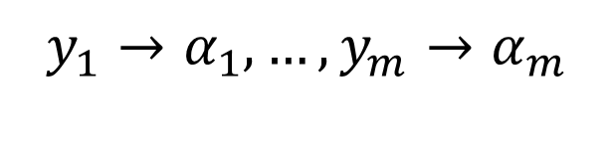

MCSat – Finite Basis
Every “finite” theory has a finite basis
Example: Fixed size Bit-vectors
$$F[x, y_{1}, …, y_{m}]$$
$$y_{1}→α_{1}, …,y_{m}→α_{m}$$
$$¬F\left[x, y_{1}, …, y_{m}\right]∨¬(y_{1}=α_{1})∨…∨{¬(y}_{m}=α_{m})$$

Slide 97
MCSat – Finite Basis
Theory of uninterpreted functions has a finite basis
Theory of arrays has a finite basis [Brummayer- Biere 2009]
In both cases the Finite Basis is essentially composed of equalities between existing terms.

Slide 98
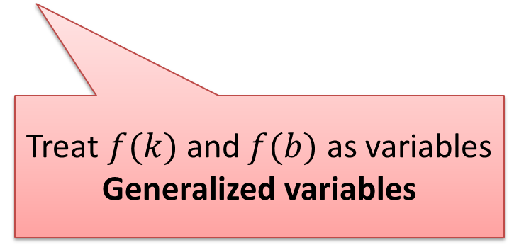
MCSat: Uninterpreted Functions
$$a=b+1, f\left(a−1\right)<c, f\left(b\right)>a$$
$$a=b+1, f\left(k\right)<c, f\left(b\right)>a, k=a −1$$
$$a=b+1, f\left(k\right)<c, f\left(b\right)>a, k=a −1$$
Treat $f(k)$ and $f(b)$ as variables
Generalized variables

Slide 99


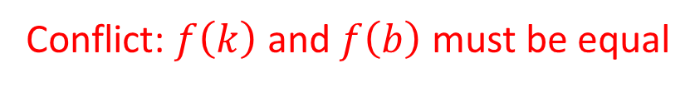



MCSat: Uninterpreted Functions
$$a=b+1, f\left(k\right)<c, f\left(b\right)>a, k=a −1$$
$$k→0$$
$$b→0$$
$$f(k)→0$$
$$f(b)→2$$
Conflict: $f\left(k\right)$ and $f\left(b\right)$ must be equal
$$¬\left(k=b\right)∨f\left(k\right)=f(b)$$

Slide 100


MCSat: Uninterpreted Functions
$$a=b+1, f\left(k\right)<c, f\left(b\right)>a, k=a −1$$
$$k→0$$
$$b→0$$
$$f(k)→0$$
$$k=b$$
(Semantic) Propagation
$$¬\left(k=b\right)∨f\left(k\right)=f(b)$$

Slide 101


MCSat: Uninterpreted Functions
$$a=b+1, f\left(k\right)<c, f\left(b\right)>a, k=a −1$$
$$k→0$$
$$b→0$$
$$f(k)→0$$
$$k=b$$
$$f\left(k\right)=f(b)$$
$$¬\left(k=b\right)∨f\left(k\right)=f(b)$$

Slide 102

MCSat: Uninterpreted Functions
$$a=b+1, f\left(k\right)<c, f\left(b\right)>a, k=a −1$$
$$k→0$$
$$b→0$$
$$f(k)→0$$
$$k=b$$
$$f\left(k\right)=f(b)$$
$$f(b)→0$$
$$¬\left(k=b\right)∨f\left(k\right)=f(b)$$

Slide 103


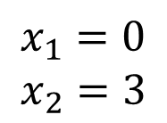

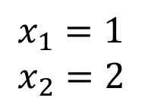


MCSat – Finite Basis
We can also use literals from the finite basis in decisions.
Application: simulate branch&bound for bounded linear integer arithmetic
$$x_{2}$$
6
$$x_{1}=0.8$$
$$x_{2}=2.4$$
5
LP solution:
4
$$x_{1}≤0$$
$$x_{1}≥1$$
3
2
1
$$x_{1}=0$$
$$x_{2}=3$$
$$x_{1}=1$$
$$x_{2}=2$$
0
1
2
3
4
5
6
$$x_{1}$$

Slide 104
MCSat: Termination
Propagations
Boolean Decisions
Semantic Decisions

Slide 105

MCSat
$$≻$$
Propagations
Boolean Decisions
Semantic Decisions

Slide 106

MCSat
$$≻$$
Propagations
Boolean Decisions
Semantic Decisions

Slide 107

MCSat
Maximal Elements
…
…
$$|FiniteBasis|$$

Slide 108







$$x≥2, \left(¬x≥1∨y≥1\right), (x^{2}+y^{2}≤1∨xy>1)$$
$$x≥2$$
$$x≥1$$
$$y≥1$$
$$x^{2}+y^{2}≤1$$
$$x≤1$$
Conflict
$$¬\left(x≥2\right)∨¬(x≤1)$$
$$¬(x^{2}+y^{2}≤1)∨x≤1$$

Slide 109






$$x≥2, \left(¬x≥1∨y≥1\right), (x^{2}+y^{2}≤1∨xy>1)$$
$$x≥2$$
$$x≥1$$
$$y≥1$$
$$x^{2}+y^{2}≤1$$
$$x≤1$$
Conflict
$$¬\left(x≥2\right)∨¬(x≤1)$$
$$¬(x^{2}+y^{2}≤1)∨x≤1$$
$$x≥2, \left(¬x≥1∨y≥1\right), (x^{2}+y^{2}≤1∨xy>1)$$
$$x≥2$$
$$x≥1$$
$$y≥1$$
$$¬(x^{2}+y^{2}≤1)$$
$$¬(x^{2}+y^{2}≤1)∨x≤1$$
$$¬\left(x≥2\right)∨¬(x^{2}+y^{2}≤1)$$

Slide 110
$$x≥2, \left(¬x≥1∨y≥1\right), (x^{2}+y^{2}≤1∨xy>1)$$
$$x≥2$$
$$x≥1$$
$$y≥1$$
$$x^{2}+y^{2}≤1$$
$$x≤1$$
Conflict
$$¬\left(x≥2\right)∨¬(x≤1)$$
$$¬(x^{2}+y^{2}≤1)∨x≤1$$
$$x≥2, \left(¬x≥1∨y≥1\right), (x^{2}+y^{2}≤1∨xy>1)$$
$$x≥2$$
$$x≥1$$
$$y≥1$$
$$¬(x^{2}+y^{2}≤1)$$
$$¬(x^{2}+y^{2}≤1)∨x≤1$$
$$¬\left(x≥2\right)∨¬(x^{2}+y^{2}≤1)$$

Slide 111

MCSat
$$x<1∨p, ¬p∨x=2$$
$$x→1$$

Slide 112


MCSat
$$x<1∨p, ¬p∨x=2$$
$$x→1$$
$$p$$

Slide 113
MCSat
$$x<1∨p, ¬p∨x=2$$
$$x→1$$
$$p$$
Conflict (evaluates to false)

Slide 114
MCSat
$$x<1∨p, ¬p∨x=2$$
$$x→1$$
$$p$$
New clause
$$x<1∨x=2$$

Slide 115

MCSat
$$x<1∨p, ¬p∨x=2$$
$$x→1$$
$$p$$
New clause
$$x<1∨x=2$$
$$x<1$$

Slide 116
MCSat
$$x<1∨p, ¬p∨x=2$$
$$x→1$$
$$p$$
New clause
$$x<1∨x=2$$
$$x<1$$

Slide 117
MCSat: Architecture
Arithmetic
Arrays
Boolean
Lists

Slide 118

MCSat: development

Slide 119




MCSat prototype: 7k lines of code
Deduction Rules
Boolean Resolution
Fourier-Motzkin
Equality Split
Ackermann expansion
aka Congruence
Normalization

Slide 120
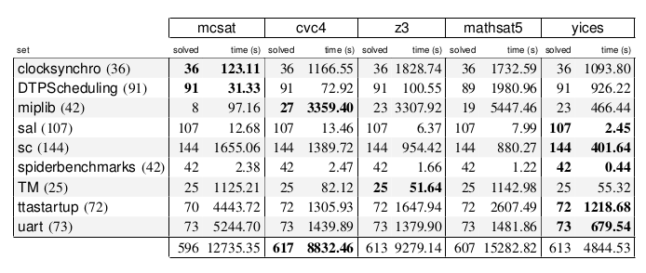
MCSat: preliminary results prototype: 7k lines of code
QF_LRA

Slide 121
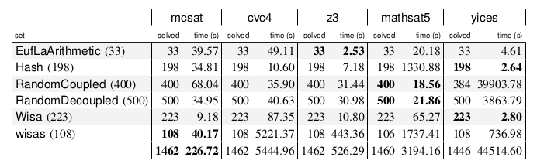
MCSat: preliminary results prototype: 7k lines of code
QF_UFLRA and QF_UFLIA

Slide 122
Conclusion
Mode-driven techniques are very promising
Preprocessing
CEGAR
MCSat: new framework for developing SMT solvers
MCSat generalizes NLSat
Modular architecture

Slide 123
Resources: Papers
The Strategy Challenge in SMT Solving, L. de Moura and G. Passmore.
http://research.microsoft.com/en-us/um/people/leonardo/files/smt-strategy.pdf
Solving non-linear arithmetic, D. Jovanovic and L. de Moura
http://research.microsoft.com/en-us/um/people/leonardo/files/IJCAR2012.pdf
A Model Constructing Satisfiability Calculus, L. de Moura and D. Jovanonic
http://research.microsoft.com/en-us/um/people/leonardo/files/mcsat.pdf
The Design and Implementation of the Model Constructing Satisfiability Calculus,
D. Jovanovic, C. Barrett , L. de Moura
http://research.microsoft.com/en-us/um/people/leonardo/mcsat_design.pdf

Slide 124
Resources: Source Code
nlsat
https://z3.codeplex.com/SourceControl/latest#src/nlsat/
mcsat https://github.com/dddejan/CVC4/tree/mcsat
tactic/preprocessors
https://z3.codeplex.com/SourceControl/latest#src/tactic/

