Slide 1
Decision methods for arithmetic Third summer school on formal methods
Leonardo de Moura
Microsoft Research

Slide 2
Symbolic Reasoning
Software analysis/verification tools
need some form of symbolic reasoning
Logic is “The Calculus of Computer Science”
Zohar Manna

Slide 3
Saturation x Search
Proof-finding
Model-finding
Proofs
Conflict
Resolution
Models

Slide 4
SAT
$$p1∨¬p2, ¬p1∨p2∨p3, p3$$
$$p1=true, p2=true, p3=true$$
CNF is a set (conjunction) set of clauses
Clause is a disjunction of literals
Literal is an atom or the negation of an atom

Slide 5
Two procedures
Resolution | DPLL
Proof-finder | Model-finder
Saturation | Search

Slide 6
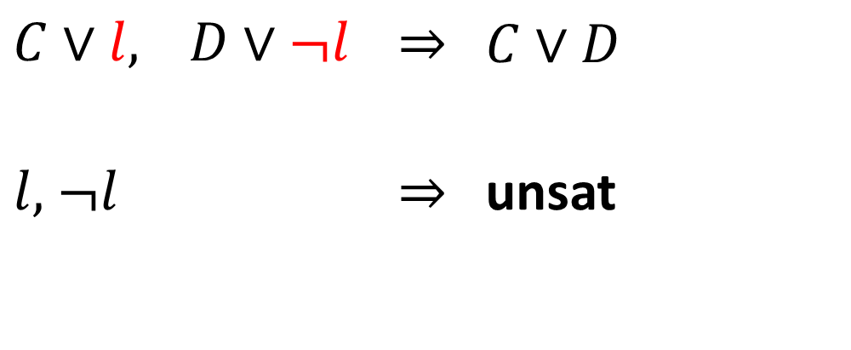
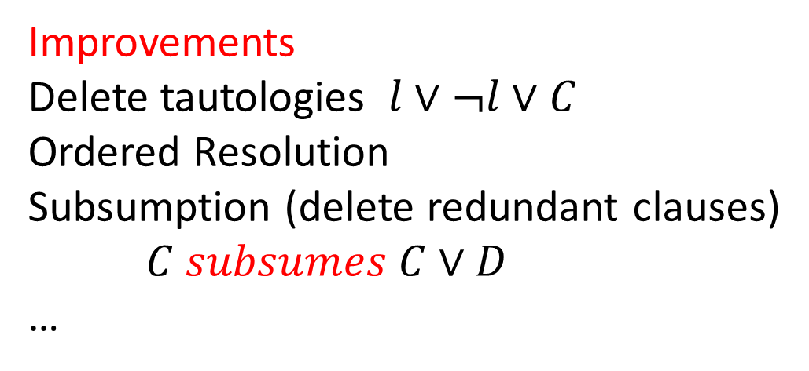
Resolution
$C∨l,$ $D∨¬l$ | $$⇒$$ | $$C∨D$$
$l,$ $¬l$ | $$⇒$$ | unsat
Improvements
Delete tautologies $l∨¬l∨C$
Ordered Resolution
Subsumption (delete redundant clauses)
$C subsumes C∨D$
…

Slide 7

Resolution: Example

Slide 8
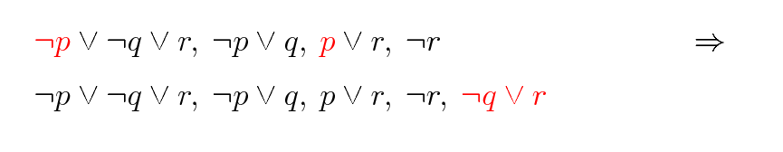
Resolution: Example

Slide 9
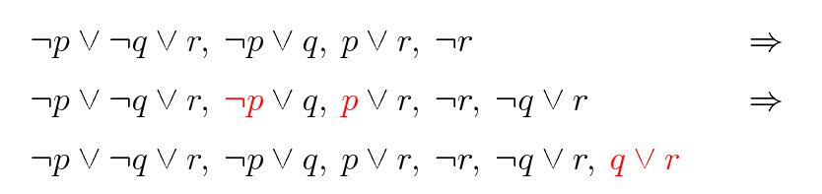
Resolution: Example

Slide 10
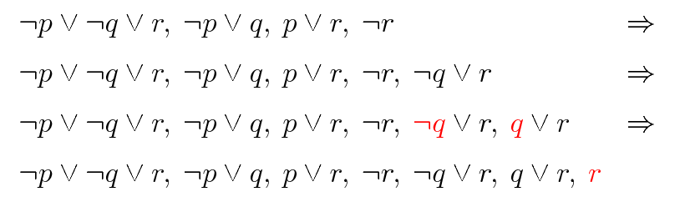
Resolution: Example

Slide 11
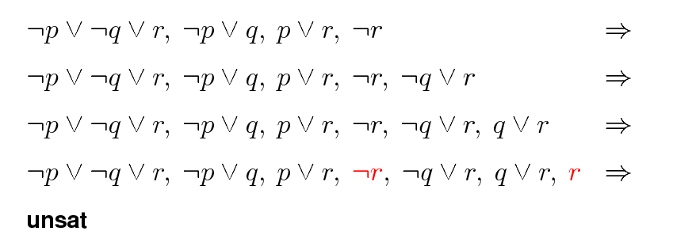
Resolution: Example

Slide 12
Resolution: Problem
Exponential time and space

Slide 13
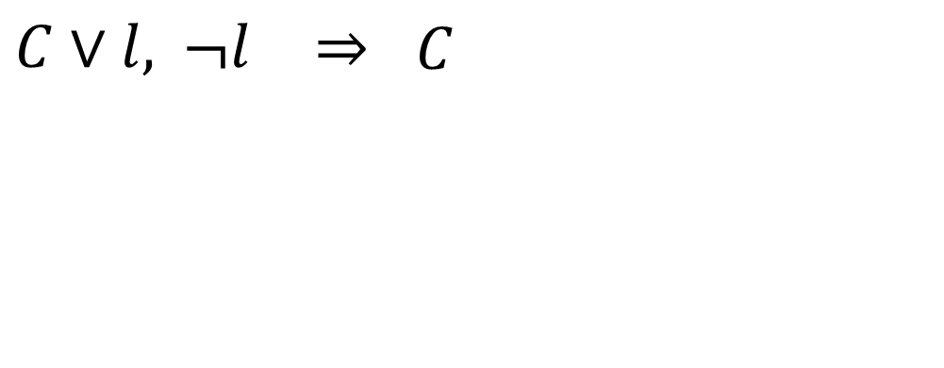
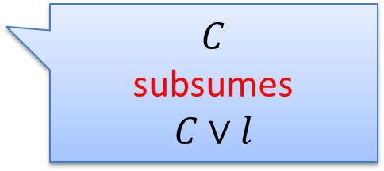

Unit Resolution
$C∨l,$ $¬l$ | $$⇒$$ | $$C$$
$$C$$
subsumes
$$C∨l$$
Complete for Horn Clauses
$$¬q1∨ …∨¬qn∨p$$

Slide 14
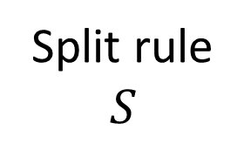


DPLL
Split rule
$$S$$
$$S, p$$
$$S, ¬p$$
DPLL = Unit Resolution + Split rule

Slide 15
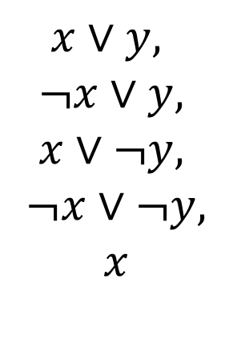
DPLL
$$x∨y, ¬x∨y, x∨¬y, ¬x∨¬y$$
$$x∨y,$$
$$¬x∨y,$$
$$x∨¬y,$$
$$¬x∨¬y,$$
$$x$$

Slide 16
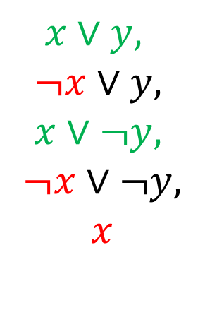
DPLL
$$x∨y, ¬x∨y, x∨¬y, ¬x∨¬y$$
$$x∨y,$$
$$¬x∨y,$$
$$x∨¬y,$$
$$¬x∨¬y,$$
$$x$$

Slide 17
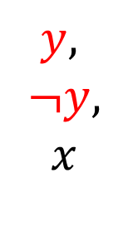
DPLL
$$x∨y, ¬x∨y, x∨¬y, ¬x∨¬y$$
$$y,$$
$$¬y,$$
$$x$$

Slide 18
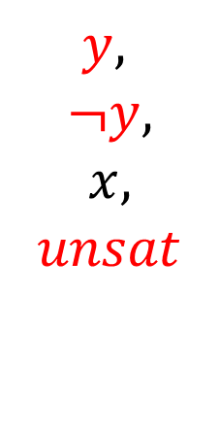
DPLL
$$x∨y, ¬x∨y, x∨¬y, ¬x∨¬y$$
$$y,$$
$$¬y,$$
$$x,$$
$$unsat$$

Slide 19
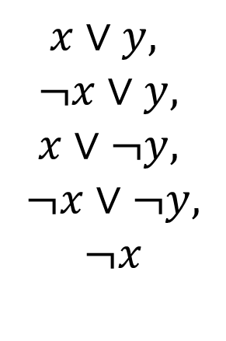
DPLL
$$x∨y, ¬x∨y, x∨¬y, ¬x∨¬y$$
$$y,$$
$$¬y,$$
$$x,$$
$$unsat$$
$$x∨y,$$
$$¬x∨y,$$
$$x∨¬y,$$
$$¬x∨¬y,$$
$$¬x$$

Slide 20
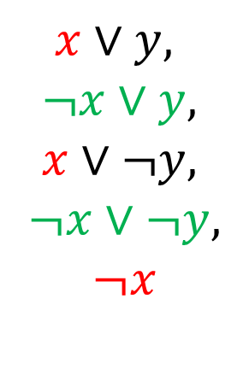
DPLL
$$x∨y, ¬x∨y, x∨¬y, ¬x∨¬y$$
$$y,$$
$$¬y,$$
$$x,$$
$$unsat$$
$$x∨y,$$
$$¬x∨y,$$
$$x∨¬y,$$
$$¬x∨¬y,$$
$$¬x$$

Slide 21
CDCL: Conflict Driven Clause Learning
DPLL
Conflict
Resolution
Resolution
Model
Proof

Slide 22
MCSat
$$x≥2, \left(¬x≥1∨y≥1\right), (x^{2}+y^{2}≤1∨xy>1)$$

Slide 23

MCSat
$$x≥2, \left(¬x≥1∨y≥1\right), (x^{2}+y^{2}≤1∨xy>1)$$
$$x≥2$$
Propagations

Slide 24

MCSat
$$x≥2, \left(¬x≥1∨y≥1\right), (x^{2}+y^{2}≤1∨xy>1)$$
$$x≥2$$
$$x≥1$$
Propagations

Slide 25

MCSat
$$x≥2, \left(¬x≥1∨y≥1\right), (x^{2}+y^{2}≤1∨xy>1)$$
$$x≥2$$
$$x≥1$$
$$y≥1$$
Propagations

Slide 26

MCSat
$$x≥2, \left(¬x≥1∨y≥1\right), (x^{2}+y^{2}≤1∨xy>1)$$
$$x≥2$$
$$x≥1$$
$$y≥1$$
$$x^{2}+y^{2}≤1$$
Decisions

Slide 27

MCSat
$$x≥2, \left(¬x≥1∨y≥1\right), (x^{2}+y^{2}≤1∨xy>1)$$
$$x≥2$$
$$x≥1$$
$$y≥1$$
$$x^{2}+y^{2}≤1$$
$$x→2$$
Model Assignments

Slide 28
MCSat
$$x≥2, \left(¬x≥1∨y≥1\right), (x^{2}+y^{2}≤1∨xy>1)$$
$$x≥2$$
$$x≥1$$
$$y≥1$$
$$x^{2}+y^{2}≤1$$
$$x→2$$
Model Assignments
We can’t falsify any fact in the trail.

Slide 29
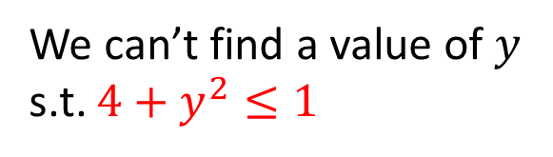


MCSat
$$x≥2, \left(¬x≥1∨y≥1\right), (x^{2}+y^{2}≤1∨xy>1)$$
$$x≥2$$
$$x≥1$$
$$y≥1$$
$$x^{2}+y^{2}≤1$$
$$x→2$$
Conflict
We can’t find a value of $y$ s.t. $4+y^{2}≤1$

Slide 30
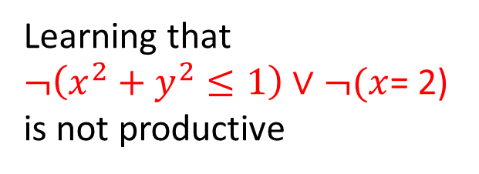
MCSat
$$x≥2, \left(¬x≥1∨y≥1\right), (x^{2}+y^{2}≤1∨xy>1)$$
$$x≥2$$
$$x≥1$$
$$y≥1$$
$$x^{2}+y^{2}≤1$$
$$x→2$$
Conflict
We can’t find a value of $y$ s.t. $4+y^{2}≤1$
Learning that
$¬\left(x^{2}+y^{2}≤1\right)∨¬(x$= 2)
is not productive

Slide 31











$$x≥2, \left(¬x≥1∨y≥1\right), (x^{2}+y^{2}≤1∨xy>1)$$
$$x≥2$$
$$x≥1$$
$$y≥1$$
$$x^{2}+y^{2}≤1$$
$$x→2$$
Conflict
$$y$$
$$x^{2}+y^{2}≤1$$
$$x→2$$
$$x$$
$$−1≤x, x≤1$$
$$¬(x^{2}+y^{2}≤1)∨x≤1$$

Slide 32


MCSat
$$x≥2, \left(¬x≥1∨y≥1\right), (x^{2}+y^{2}≤1∨xy>1)$$
$$x≥2$$
$$x≥1$$
$$y≥1$$
$$x^{2}+y^{2}≤1$$
$$x≤1$$
$$¬(x^{2}+y^{2}≤1)∨x≤1$$

Slide 33




MCSat
$$x≥2, \left(¬x≥1∨y≥1\right), (x^{2}+y^{2}≤1∨xy>1)$$
$$x≥2$$
$$x≥1$$
$$y≥1$$
$$x^{2}+y^{2}≤1$$
$$x≤1$$
$$¬(x^{2}+y^{2}≤1)∨x≤1$$
Conflict
$$¬\left(x≥2\right)∨¬(x≤1)$$

Slide 34

MCSat
$$x≥2, \left(¬x≥1∨y≥1\right), (x^{2}+y^{2}≤1∨xy>1)$$
$$x≥2$$
$$x≥1$$
$$y≥1$$
$$x^{2}+y^{2}≤1$$
$$¬(x^{2}+y^{2}≤1)∨x≤1$$
Learned by resolution
$$¬\left(x≥2\right)∨¬(x^{2}+y^{2}≤1)$$

Slide 35



MCSat
$$x≥2, \left(¬x≥1∨y≥1\right), (x^{2}+y^{2}≤1∨xy>1)$$
$$x≥2$$
$$x≥1$$
$$y≥1$$
$$¬(x^{2}+y^{2}≤1)$$
$$¬\left(x≥2\right)∨¬(x^{2}+y^{2}≤1)$$
$$¬(x^{2}+y^{2}≤1)∨x≤1$$

Slide 36
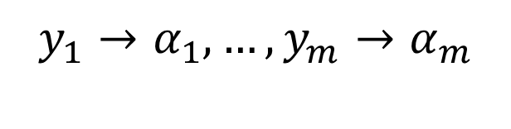


MCSat – Finite Basis
Every theory that admits quantifier elimination has a finite basis (given a fixed assignment order)
$$F[x_{1}, …, x_{n}, y_{1}, …, y_{m}]$$
$$y_{1}→α_{1}, …,y_{m}→α_{m}$$
$$∃x_{1},…,x_{n}:F[x_{1}, …, x_{n}, y]$$
$$C_{1}[y_{1},…,y_{m}]∧…∧C_{k}[y_{1},…,y_{m}]$$
$$¬F\left[x_{1}, …, x_{n}, y_{1}, …, y_{m}\right]∨C_{k}[y_{1}, …,y_{m}]$$

Slide 37





MCSat – Finite Basis
$$F_{n}[x_{1,}x_{2},…, {x_{n−1},x}_{n}]$$
$$F_{n−1}[x_{1,}x_{2},…,x_{n−1}]$$
$$…$$
$$F_{2}[x_{1,}x_{2}]$$
$$F_{1}[x_{1}]$$

Slide 38

MCSat – Finite Basis
$$F_{n}[x_{1,}x_{2},…, {x_{n−1},x}_{n}]$$
$$F_{n−1}[x_{1,}x_{2},…,x_{n−1}]$$
$$…$$
$$F_{2}[x_{1,}x_{2}]$$
$$F_{1}[x_{1}]$$

Slide 39

MCSat – Finite Basis
$$F_{n}[x_{1,}x_{2},…, {x_{n−1},x}_{n}]$$
$$F_{n−1}[x_{1,}x_{2},…,x_{n−1}]$$
$$…$$
$$F_{2}[x_{1,}x_{2}]$$
$$F_{1}[x_{1}]$$

Slide 40

MCSat – Finite Basis
$$F_{n}[x_{1,}x_{2},…, {x_{n−1},x}_{n}]$$
$$F_{n−1}[x_{1,}x_{2},…,x_{n−1}]$$
$$…$$
$$F_{2}[x_{1,}x_{2}]$$
$$F_{1}[x_{1}]$$

Slide 41
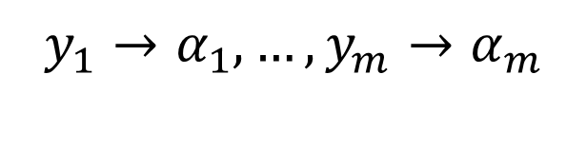

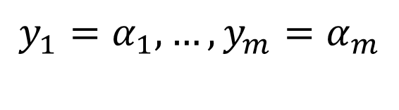
MCSat – Finite Basis
Every “finite” theory has a finite basis
$$F[x_{1}, …, x_{n}, y_{1}, …, y_{m}]$$
$$y_{1}→α_{1}, …,y_{m}→α_{m}$$
$$y_{1}=α_{1}, …,y_{m}=α_{m}$$

Slide 42
MCSat – Finite Basis
Theory of uninterpreted functions has a finite basis
Theory of arrays has a finite basis [Brummayer- Biere 2009]
In both cases the Finite Basis is essentially composed of equalities between existing terms.

Slide 43
MCSat: Termination
Propagations
Decisions
Model Assignments

Slide 44

MCSat
$$≻$$
Propagations
Decisions
Model Assignments

Slide 45
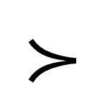
MCSat
$$≻$$
Propagations
Decisions
Model Assignments

Slide 46

MCSat
Maximal Elements
…
$$|FiniteBasis|$$

Slide 47







$$x≥2, \left(¬x≥1∨y≥1\right), (x^{2}+y^{2}≤1∨xy>1)$$
$$x≥2$$
$$x≥1$$
$$y≥1$$
$$x^{2}+y^{2}≤1$$
$$x≤1$$
Conflict
$$¬\left(x≥2\right)∨¬(x≤1)$$
$$¬(x^{2}+y^{2}≤1)∨x≤1$$

Slide 48






$$x≥2, \left(¬x≥1∨y≥1\right), (x^{2}+y^{2}≤1∨xy>1)$$
$$x≥2$$
$$x≥1$$
$$y≥1$$
$$x^{2}+y^{2}≤1$$
$$x≤1$$
Conflict
$$¬\left(x≥2\right)∨¬(x≤1)$$
$$¬(x^{2}+y^{2}≤1)∨x≤1$$
$$x≥2, \left(¬x≥1∨y≥1\right), (x^{2}+y^{2}≤1∨xy>1)$$
$$x≥2$$
$$x≥1$$
$$y≥1$$
$$¬(x^{2}+y^{2}≤1)$$
$$¬(x^{2}+y^{2}≤1)∨x≤1$$
$$¬\left(x≥2\right)∨¬(x^{2}+y^{2}≤1)$$

Slide 49
$$x≥2, \left(¬x≥1∨y≥1\right), (x^{2}+y^{2}≤1∨xy>1)$$
$$x≥2$$
$$x≥1$$
$$y≥1$$
$$x^{2}+y^{2}≤1$$
$$x≤1$$
Conflict
$$¬\left(x≥2\right)∨¬(x≤1)$$
$$¬(x^{2}+y^{2}≤1)∨x≤1$$
$$x≥2, \left(¬x≥1∨y≥1\right), (x^{2}+y^{2}≤1∨xy>1)$$
$$x≥2$$
$$x≥1$$
$$y≥1$$
$$¬(x^{2}+y^{2}≤1)$$
$$¬(x^{2}+y^{2}≤1)∨x≤1$$
$$¬\left(x≥2\right)∨¬(x^{2}+y^{2}≤1)$$

Slide 50

MCSat
$$x<1∨p, ¬p∨x=2$$
$$x→1$$

Slide 51


MCSat
$$x<1∨p, ¬p∨x=2$$
$$x→1$$
$$p$$

Slide 52
MCSat
$$x<1∨p, ¬p∨x=2$$
$$x→1$$
$$p$$
Conflict (evaluates to false)

Slide 53
MCSat
$$x<1∨p, ¬p∨x=2$$
$$x→1$$
$$p$$
New clause
$$x<1∨x=2$$

Slide 54

MCSat
$$x<1∨p, ¬p∨x=2$$
$$x→1$$
$$p$$
New clause
$$x<1∨x=2$$
$$x<1$$

Slide 55
MCSat
$$x<1∨p, ¬p∨x=2$$
$$x→1$$
$$p$$
New clause
$$x<1∨x=2$$
$$x<1$$

Slide 56
MCSat: Architecture
Arithmetic
Arrays
Boolean
Lists

Slide 57


MCSat: development

