Slide 1
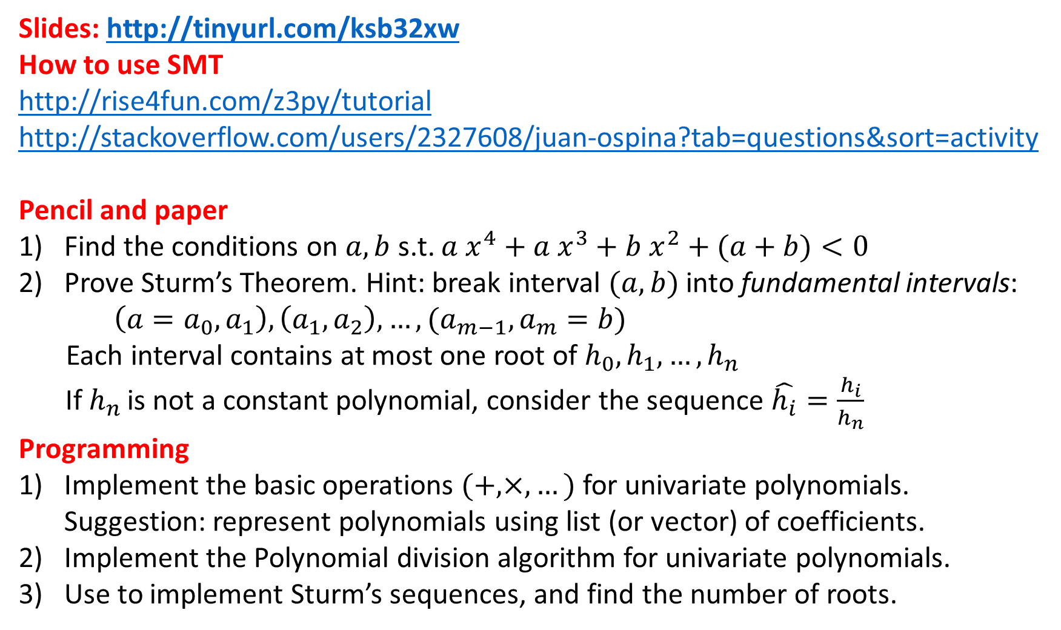
Slides: http://tinyurl.com/ksb32xw
How to use SMT
http://rise4fun.com/z3py/tutorial
http://stackoverflow.com/users/2327608/juan-ospina?tab=questions&sort=activity
Pencil and paper
Find the conditions on $a, b$ s.t. ${a x}^{4}+a x^{3}+b x^{2}+(a+b)<0$
Prove Sturm’s Theorem. Hint: break interval $(a, b)$ into fundamental intervals:
$\left(a=a_{0}, a_{1}\right), \left(a_{1}, a_{2}\right), …, (a_{m−1},a_{m}=b)$
Each interval contains at most one root of $h_{0},h_{1},…, h_{n}$
If $h_{n}$ is not a constant polynomial, consider the sequence $\hat{h_{i}}=\frac{h_{i}}{h_{n}}$
Programming
Implement the basic operations $(+, ×, …)$ for univariate polynomials.
Suggestion: represent polynomials using list (or vector) of coefficients.
Implement the Polynomial division algorithm for univariate polynomials.
Use to implement Sturm’s sequences, and find the number of roots.

