Slide 1
A Model-Constructing Satisfiability Calculus VMCAI 2013
Leonardo de Moura
Microsoft Research
Dejan Jovanović
NYU

Slide 2
Symbolic Reasoning
Software analysis/verification tools
need some form of symbolic reasoning
Logic is “The Calculus of Computer Science”
Zohar Manna

Slide 3
Symbolic Reasoning
Practical problems often have structure that can be exploited.
Undecidable (FOL + LIA)
Semi Decidable (FOL)
NEXPTIME (EPR)
PSPACE (QBF)
NP (SAT)
Notes:
Logic is about deriving irrefutable conclusions from a set of premises.

Slide 4

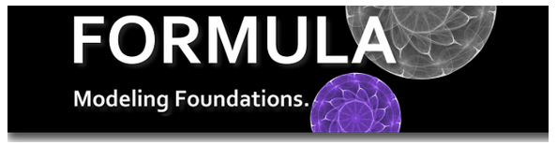


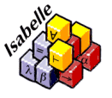







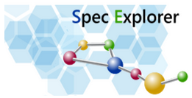



Logic Engines as a Service
$$Scala^{Z3}$$
SAGE
SecGuru
Notes:
Logic is about deriving irrefutable conclusions from a set of premises.

Slide 5
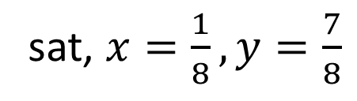
Satisfiability
Solution/Model
sat, $x=\frac{1}{8}, y=\frac{7}{8}$
$x^{2}+y^{2}<1 and xy>0.1$
$x^{2}+y^{2}<1 and xy>1$
unsat, Proof
Is execution path P feasible?
Is assertion X violated?
WI
TNESS
SAGE
Is Formula F Satisfiable?
Notes:
Models are very important.
Classical theorem provers do not produce models

Slide 6
The RISE of Model-Based Techniques in SMT
Notes:
Logic is about deriving irrefutable conclusions from a set of premises.

Slide 7
Saturation x Search
Proof-finding
Model-finding
Proofs
Conflict
Resolution
Models

Slide 8
SAT
$$p1∨¬p2, ¬p1∨p2∨p3, p3$$
$$p1=true, p2=true, p3=true$$
CNF is a set (conjunction) set of clauses
Clause is a disjunction of literals
Literal is an atom or the negation of an atom

Slide 9
Two procedures
Resolution | DPLL
Proof-finder | Model-finder
Saturation | Search

Slide 10
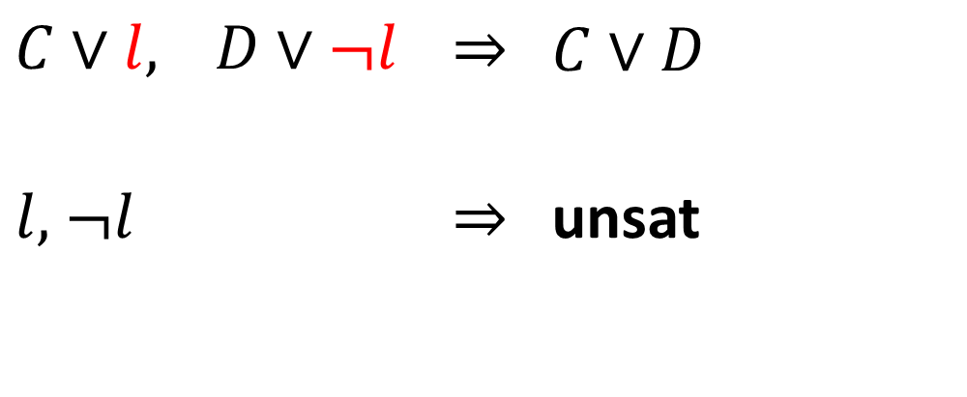
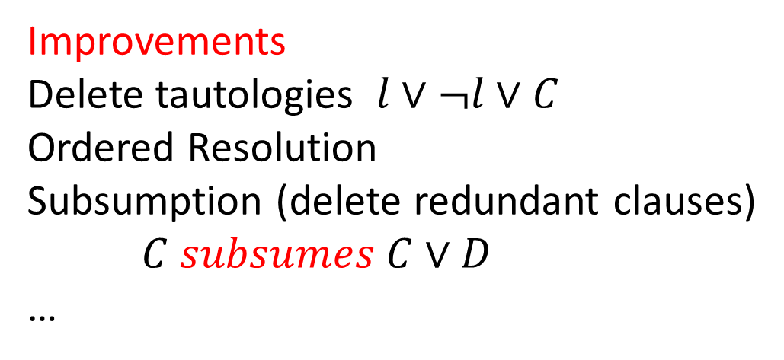
Resolution
$C∨l,$ $D∨¬l$ | $$⇒$$ | $$C∨D$$
$l,$ $¬l$ | $$⇒$$ | unsat
Improvements
Delete tautologies $l∨¬l∨C$
Ordered Resolution
Subsumption (delete redundant clauses)
$C subsumes C∨D$
…

Slide 11

Resolution: Example

Slide 12
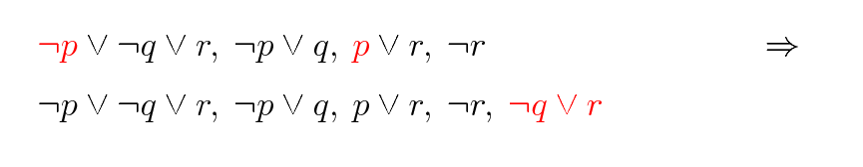
Resolution: Example

Slide 13
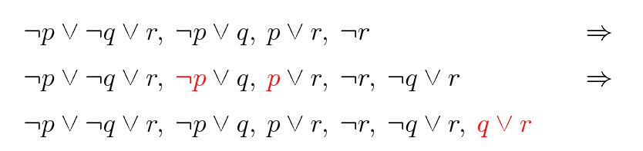
Resolution: Example

Slide 14
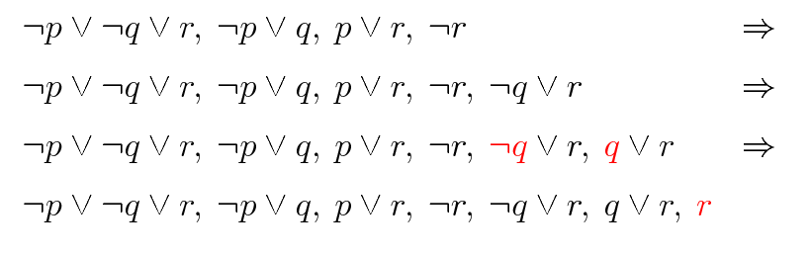
Resolution: Example

Slide 15
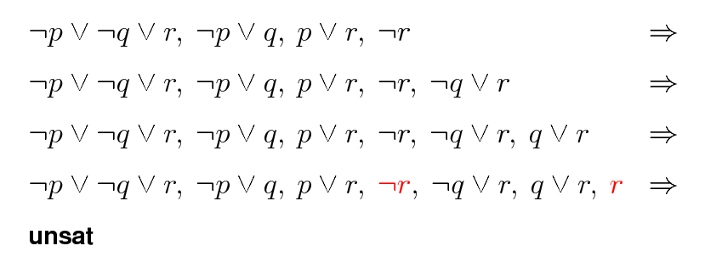
Resolution: Example

Slide 16
Resolution: Problem
Exponential time and space

Slide 17
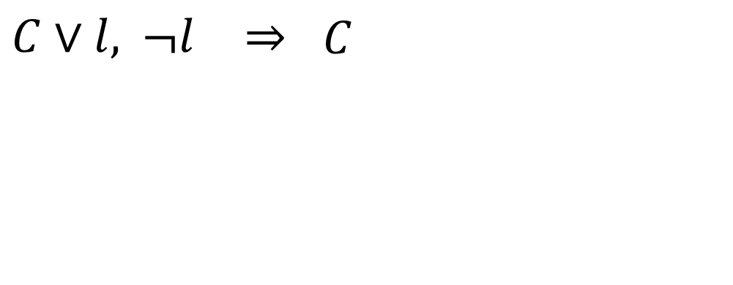
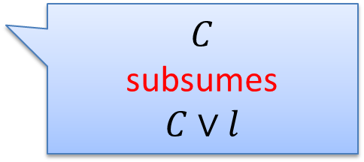
Unit Resolution
$C∨l,$ $¬l$ | $$⇒$$ | $$C$$
$$C$$
subsumes
$$C∨l$$

Slide 18
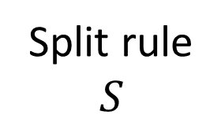


DPLL
Split rule
$$S$$
$$S, p$$
$$S, ¬p$$
DPLL = Unit Resolution + Split rule

Slide 19
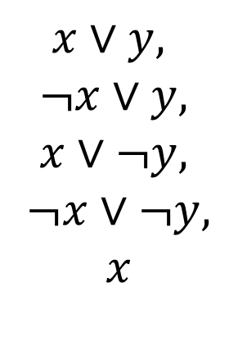
DPLL
$$x∨y, ¬x∨y, x∨¬y, ¬x∨¬y$$
$$x∨y,$$
$$¬x∨y,$$
$$x∨¬y,$$
$$¬x∨¬y,$$
$$x$$

Slide 20
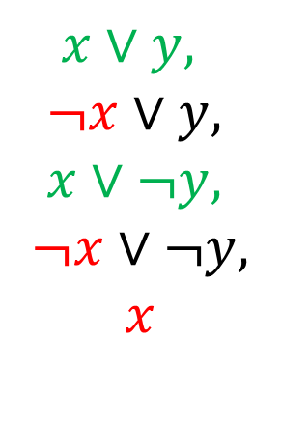
DPLL
$$x∨y, ¬x∨y, x∨¬y, ¬x∨¬y$$
$$x∨y,$$
$$¬x∨y,$$
$$x∨¬y,$$
$$¬x∨¬y,$$
$$x$$

Slide 21
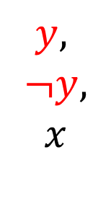
DPLL
$$x∨y, ¬x∨y, x∨¬y, ¬x∨¬y$$
$$y,$$
$$¬y,$$
$$x$$

Slide 22
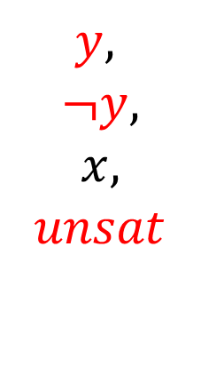
DPLL
$$x∨y, ¬x∨y, x∨¬y, ¬x∨¬y$$
$$y,$$
$$¬y,$$
$$x,$$
$$unsat$$

Slide 23
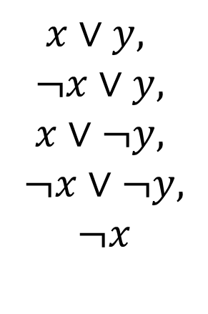
DPLL
$$x∨y, ¬x∨y, x∨¬y, ¬x∨¬y$$
$$y,$$
$$¬y,$$
$$x,$$
$$unsat$$
$$x∨y,$$
$$¬x∨y,$$
$$x∨¬y,$$
$$¬x∨¬y,$$
$$¬x$$

Slide 24
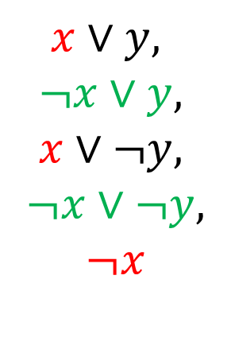
DPLL
$$x∨y, ¬x∨y, x∨¬y, ¬x∨¬y$$
$$y,$$
$$¬y,$$
$$x,$$
$$unsat$$
$$x∨y,$$
$$¬x∨y,$$
$$x∨¬y,$$
$$¬x∨¬y,$$
$$¬x$$

Slide 25
CDCL: Conflict Driven Clause Learning
DPLL
Conflict
Resolution
Resolution
Model
Proof

Slide 26
Linear Arithmetic
Fourier-Motzkin | Simplex
Proof-finder | Model-finder
Saturation | Search

Slide 27



Fourier-Motzkin
$$t_{1}≤ax, bx≤t_{2}$$
$$bt_{1}≤abx, abx≤{at}_{2}$$
$$bt_{1}≤{at}_{2}$$
Very similar to Resolution
Exponential time and space

Slide 28

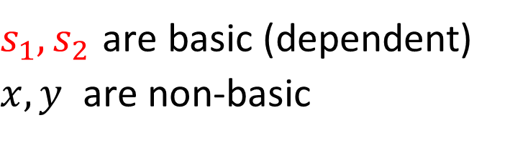
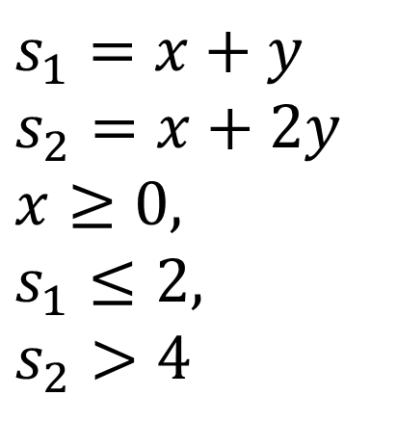

Simplex-based procedure
$$x≥0, x+y≤2, x+2y>4$$
$$s_{1}$$
$$s_{2}$$
$$s_{1}=x+y$$
$$s_{2}=x+2y$$
$$x≥0,$$
$$s_{1}≤2,$$
$$s_{2}>4$$
$s_{1}, s_{2}$ are basic (dependent)
$x, y$ are non-basic

Slide 29
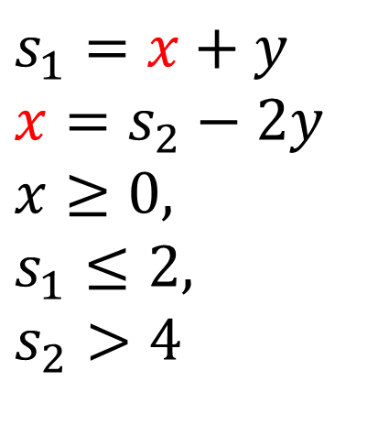
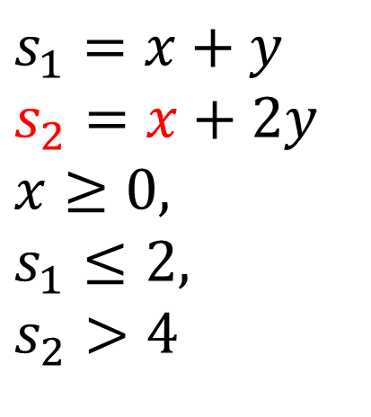
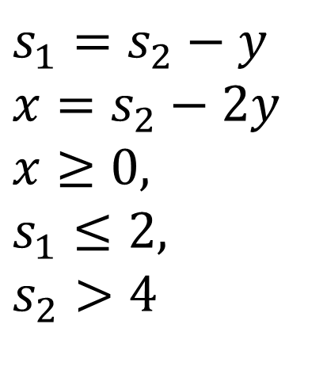
Simplex-based procedure: Pivoting
$$s_{1}=x+y$$
$$s_{2}=x+2y$$
$$x≥0,$$
$$s_{1}≤2,$$
$$s_{2}>4$$
$$s_{1}=x+y$$
$$x=s_{2}−2y$$
$$x≥0,$$
$$s_{1}≤2,$$
$$s_{2}>4$$
$$s_{1}=s_{2}−y$$
$$x=s_{2}−2y$$
$$x≥0,$$
$$s_{1}≤2,$$
$$s_{2}>4$$
Example:
M(x) = 1
M(y) = 1
M(s₁) = 2
M(s₂) = 3
Key Property:
If an assignment satisfies the equations before a pivoting step, then it will also satisfy them after!

Slide 30
Simplex: Repairing Models
If the assignment of a non-basic variable does not satisfy a bound, then fix it and propagate the change to all dependent variables.
a = c – d
b = c + d
M(a) = 0
M(b) = 0
M(c) = 0
M(d) = 0
1 ≤ c
a = c – d
b = c + d
M(a) = 1
M(b) = 1
M(c) = 1
M(d) = 0
1 ≤ c

Slide 31
Simplex: Repairing Models
If the assignment of a basic variable does not satisfy a bound, then pivot it, fix it, and propagate the change to its new dependent variables.
a = c – d
b = c + d
M(a) = 0
M(b) = 0
M(c) = 0
M(d) = 0
1 ≤ a
c = a + d
b = a + 2d
M(a) = 0
M(b) = 0
M(c) = 0
M(d) = 0
1 ≤ a
c = a + d
b = a + 2d
M(a) = 1
M(b) = 1
M(c) = 1
M(d) = 0
1 ≤ a

Slide 32

Polynomial Constraints
AKA
Existential Theory of the Reals
∃R
$$x^{2}−4x+y^{2}−y+8 <1$$
$xy−2x −2y+4>1$

Slide 33

CAD “Big Picture”
1. Project/Saturate set of polynomials
2. Lift/Search: Incrementally build assignment$v: x_{k}→$ $α_{k}$
Isolate roots of polynomials $f_{i}(α,x)$
Select a feasible cell $C$, and assign $x_{k}$ some $α_{k}∈C$
If there is no feasible cell, then backtrack

Slide 34
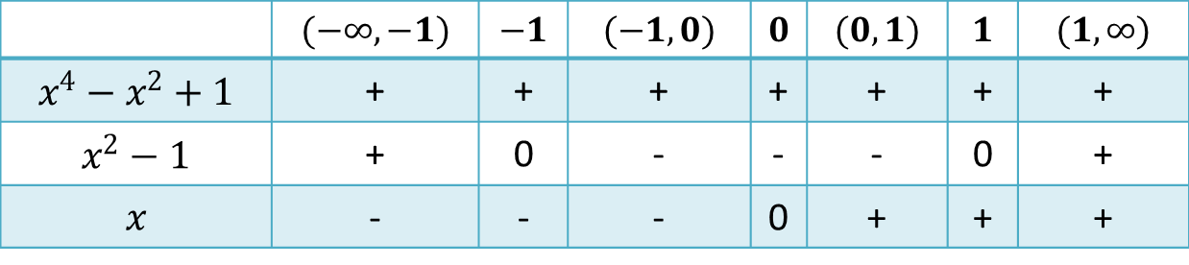





CAD “Big Picture”
$$x^{2}+y^{2} −1<0$$
$$x^{4}−x^{2}+1$$
$$x y −1>0$$
$$x^{2}−1$$
1. Saturate
$$x$$
2. Search
 | $$(−∞, −1)$$ | $$−1$$ | $$(−1, 0)$$ | $$0$$ | $$(0,1)$$ | $$1$$ | $$(1, ∞)$$
$$x^{4}−x^{2}+1$$ | + | + | + | + | + | + | +
$$x^{2}−1$$ | + | 0 | - | - | - | 0 | +
$$x$$ | - | - | - | 0 | + | + | +
Notes:
Backtracking

Slide 35

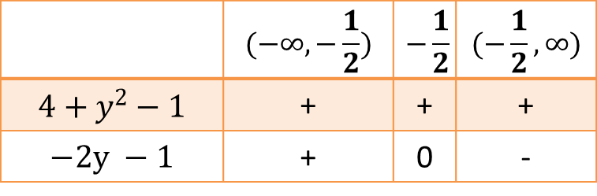


CAD “Big Picture”
$$x^{2}+y^{2} −1<0$$
$$x^{4}−x^{2}+1$$
$$x y −1>0$$
$$x^{2}−1$$
1. Saturate
$$x$$
 | $$(−∞, −\frac{1}{2})$$ | $$−\frac{1}{2}$$ | $$(−\frac{1}{2}, ∞)$$
$$4+y^{2}−1$$ | + | + | +
$$−2y −1$$ | + | 0 | -
$$x−2$$
2. Search
 | $$(−∞, −1)$$ | $$−1$$ | $$(−1, 0)$$ | $$0$$ | $$(0,1)$$ | $$1$$ | $$(1, ∞)$$
$$x^{4}−x^{2}+1$$ | + | + | + | + | + | + | +
$$x^{2}−1$$ | + | 0 | - | - | - | 0 | +
$$x$$ | - | - | - | 0 | + | + | +
Notes:
Backtracking

Slide 36

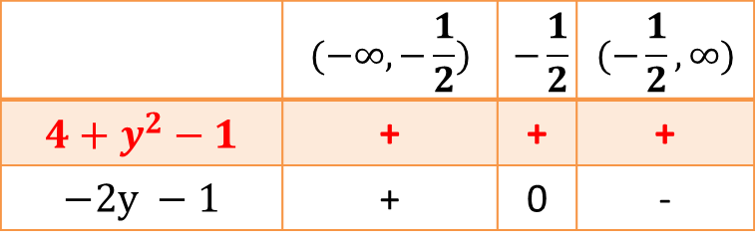

CAD “Big Picture”
$$x^{2}+y^{2} −1<0$$
$$x^{4}−x^{2}+1$$
$$x y −1>0$$
$$x^{2}−1$$
1. Saturate
$$x$$
 | $$(−∞, −\frac{1}{2})$$ | $$−\frac{1}{2}$$ | $$(−\frac{1}{2}, ∞)$$
$$4+y^{2}−1$$ | + | + | +
$$−2y −1$$ | + | 0 | -
CONFLICT
$$x−2$$
2. Search
 | $$(−∞, −1)$$ | $$−1$$ | $$(−1, 0)$$ | $$0$$ | $$(0,1)$$ | $$1$$ | $$(1, ∞)$$
$$x^{4}−x^{2}+1$$ | + | + | + | + | + | + | +
$$x^{2}−1$$ | + | 0 | - | - | - | 0 | +
$$x$$ | - | - | - | 0 | + | + | +
Notes:
Backtracking

Slide 37
NLSAT: Model-Based Search
Static x Dynamic
Optimistic approach
Key ideas
Proofs
Conflict
Resolution
Models
Start the Search before Saturate/Project
We saturate on demand
Model guides the saturation

Slide 38
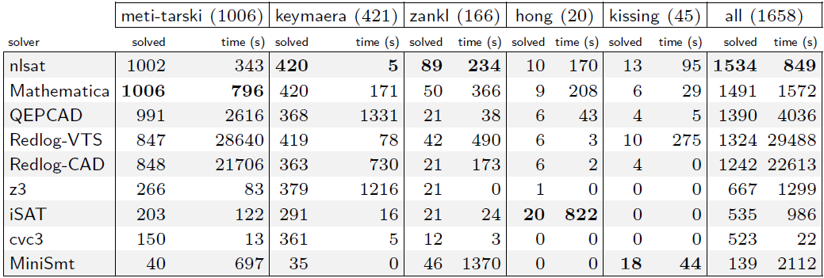
Experimental Results (1)
OUR NEW ENGINE

Slide 39
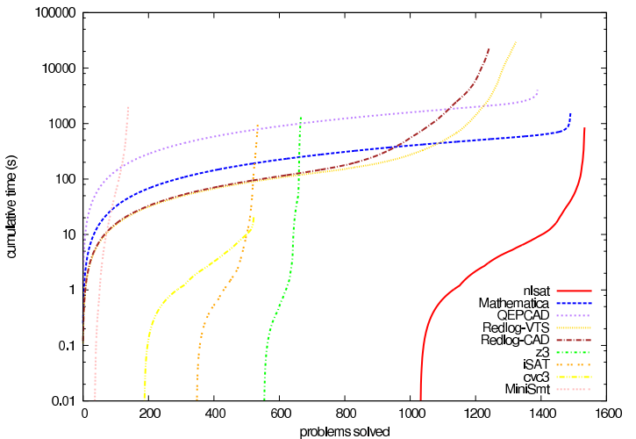
Experimental Results (2)
OUR NEW ENGINE

Slide 40
Other examples
Delayed
Theory Combination
[Bruttomesso et al 2006]
Model-Based
Theory Combination
X

Slide 41
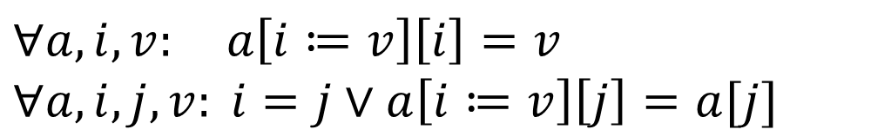
Other examples
Lemmas on Demand
For Theory of Array
[Brummayer-Biere 2009]
Array Theory by
Axiom Instantiation
X
$$∀a,i,v: a\left[i≔v\right]\left[i\right]=v$$
$$∀a,i,j, v: i=j∨a\left[i≔v\right]\left[j\right]=a[j]$$

Slide 42
Other examples (for linear arithmetic)
Generalizing DPLL to richer logics
[McMillan et al 2009]
Fourier-Motzkin
X
Conflict Resolution
[Korovin et al 2009]

Slide 43
Saturation: successful instances
Polynomial time procedures
Gaussian Elimination
Congruence Closure

Slide 44
SAT + Theory Solvers
Basic Idea
x ≥ 0, y = x + 1, (y > 2 ∨ y < 1)
p₁, p₂, (p₃ ∨ p₄)
p₁ ≡ (x ≥ 0), p₂ ≡ (y = x + 1),
p₃ ≡ (y > 2), p₄ ≡ (y < 1)
[Audemard et al - 2002], [Barrett et al - 2002], [de Moura et al - 2002]

Slide 45
SAT + Theory Solvers
Basic Idea
x ≥ 0, y = x + 1, (y > 2 ∨ y < 1)
p₁, p₂, (p₃ ∨ p₄)
p₁ ≡ (x ≥ 0), p₂ ≡ (y = x + 1),
p₃ ≡ (y > 2), p₄ ≡ (y < 1)
SAT
Solver

Slide 46
SAT + Theory Solvers
Basic Idea
x ≥ 0, y = x + 1, (y > 2 ∨ y < 1)
p₁, p₂, (p₃ ∨ p₄)
p₁ ≡ (x ≥ 0), p₂ ≡ (y = x + 1),
p₃ ≡ (y > 2), p₄ ≡ (y < 1)
SAT
Solver
Assignment
p₁, p₂, ¬p₃, p₄

Slide 47
SAT + Theory Solvers
Basic Idea
x ≥ 0, y = x + 1, (y > 2 ∨ y < 1)
p₁, p₂, (p₃ ∨ p₄)
p₁ ≡ (x ≥ 0), p₂ ≡ (y = x + 1),
p₃ ≡ (y > 2), p₄ ≡ (y < 1)
SAT
Solver
Assignment
p₁, p₂, ¬p₃, p₄
x ≥ 0, y = x + 1,
¬(y > 2), y < 1

Slide 48
SAT + Theory Solvers
Basic Idea
x ≥ 0, y = x + 1, (y > 2 ∨ y < 1)
p₁, p₂, (p₃ ∨ p₄)
p₁ ≡ (x ≥ 0), p₂ ≡ (y = x + 1),
p₃ ≡ (y > 2), p₄ ≡ (y < 1)
SAT
Solver
Assignment
p₁, p₂, ¬p₃, p₄
x ≥ 0, y = x + 1,
¬(y > 2), y < 1
Unsatisfiable
x ≥ 0, y = x + 1, y < 1
Theory
Solver

Slide 49
SAT + Theory Solvers
Basic Idea
x ≥ 0, y = x + 1, (y > 2 ∨ y < 1)
p₁, p₂, (p₃ ∨ p₄)
p₁ ≡ (x ≥ 0), p₂ ≡ (y = x + 1),
p₃ ≡ (y > 2), p₄ ≡ (y < 1)
SAT
Solver
Assignment
p₁, p₂, ¬p₃, p₄
x ≥ 0, y = x + 1,
¬(y > 2), y < 1
New Lemma
¬p₁∨¬p₂∨¬p₄
Unsatisfiable
x ≥ 0, y = x + 1, y < 1
Theory
Solver

Slide 50
SAT + Theory Solvers: refinements
Incrementality
Efficient Backtracking
Efficient Lemma Generation
Theory propagation [Ganzinger et all – 2004]

Slide 51
MCSat
$$x≥2, \left(¬x≥1∨y≥1\right), (x^{2}+y^{2}≤1∨xy>1)$$

Slide 52

MCSat
$$x≥2, \left(¬x≥1∨y≥1\right), (x^{2}+y^{2}≤1∨xy>1)$$
$$x≥2$$
Propagations

Slide 53

MCSat
$$x≥2, \left(¬x≥1∨y≥1\right), (x^{2}+y^{2}≤1∨xy>1)$$
$$x≥2$$
$$x≥1$$
Propagations

Slide 54

MCSat
$$x≥2, \left(¬x≥1∨y≥1\right), (x^{2}+y^{2}≤1∨xy>1)$$
$$x≥2$$
$$x≥1$$
$$y≥1$$
Propagations

Slide 55

MCSat
$$x≥2, \left(¬x≥1∨y≥1\right), (x^{2}+y^{2}≤1∨xy>1)$$
$$x≥2$$
$$x≥1$$
$$y≥1$$
$$x^{2}+y^{2}≤1$$
Decisions

Slide 56

MCSat
$$x≥2, \left(¬x≥1∨y≥1\right), (x^{2}+y^{2}≤1∨xy>1)$$
$$x≥2$$
$$x≥1$$
$$y≥1$$
$$x^{2}+y^{2}≤1$$
$$x→2$$
Model Assignments

Slide 57
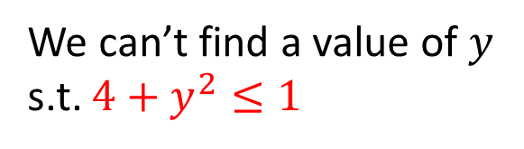


MCSat
$$x≥2, \left(¬x≥1∨y≥1\right), (x^{2}+y^{2}≤1∨xy>1)$$
$$x≥2$$
$$x≥1$$
$$y≥1$$
$$x^{2}+y^{2}≤1$$
$$x→2$$
Conflict
We can’t find a value of $y$ s.t. $4+y^{2}≤1$

Slide 58
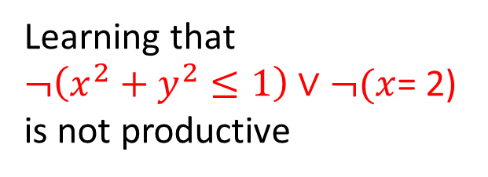
MCSat
$$x≥2, \left(¬x≥1∨y≥1\right), (x^{2}+y^{2}≤1∨xy>1)$$
$$x≥2$$
$$x≥1$$
$$y≥1$$
$$x^{2}+y^{2}≤1$$
$$x→2$$
Conflict
We can’t find a value of $y$ s.t. $4+y^{2}≤1$
Learning that
$¬\left(x^{2}+y^{2}≤1\right)∨¬(x$= 2)
is not productive

Slide 59











$$x≥2, \left(¬x≥1∨y≥1\right), (x^{2}+y^{2}≤1∨xy>1)$$
$$x≥2$$
$$x≥1$$
$$y≥1$$
$$x^{2}+y^{2}≤1$$
$$x→2$$
Conflict
$$y$$
$$x^{2}+y^{2}≤1$$
$$x→2$$
$$x$$
$$−1≤x, x≤1$$
$$¬(x^{2}+y^{2}≤1)∨x≤1$$

Slide 60


MCSat
$$x≥2, \left(¬x≥1∨y≥1\right), (x^{2}+y^{2}≤1∨xy>1)$$
$$x≥2$$
$$x≥1$$
$$y≥1$$
$$x^{2}+y^{2}≤1$$
$$x≤1$$
$$¬(x^{2}+y^{2}≤1)∨x≤1$$

Slide 61




MCSat
$$x≥2, \left(¬x≥1∨y≥1\right), (x^{2}+y^{2}≤1∨xy>1)$$
$$x≥2$$
$$x≥1$$
$$y≥1$$
$$x^{2}+y^{2}≤1$$
$$x≤1$$
$$¬(x^{2}+y^{2}≤1)∨x≤1$$
Conflict
$$¬\left(x≥2\right)∨¬(x≤1)$$

Slide 62

MCSat
$$x≥2, \left(¬x≥1∨y≥1\right), (x^{2}+y^{2}≤1∨xy>1)$$
$$x≥2$$
$$x≥1$$
$$y≥1$$
$$x^{2}+y^{2}≤1$$
$$¬(x^{2}+y^{2}≤1)∨x≤1$$
Learned by resolution
$$¬\left(x≥2\right)∨¬(x^{2}+y^{2}≤1)$$

Slide 63



MCSat
$$x≥2, \left(¬x≥1∨y≥1\right), (x^{2}+y^{2}≤1∨xy>1)$$
$$x≥2$$
$$x≥1$$
$$y≥1$$
$$¬(x^{2}+y^{2}≤1)$$
$$¬\left(x≥2\right)∨¬(x^{2}+y^{2}≤1)$$
$$¬(x^{2}+y^{2}≤1)∨x≤1$$

Slide 64
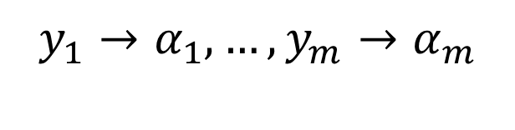


MCSat – Finite Basis
Every theory that admits quantifier elimination has a finite basis (given a fixed assignment order)
$$F[x_{1}, …, x_{n}, y_{1}, …, y_{m}]$$
$$y_{1}→α_{1}, …,y_{m}→α_{m}$$
$$∃x_{1},…,x_{n}:F[x_{1}, …, x_{n}, y]$$
$$C_{1}[y_{1},…,y_{m}]∧…∧C_{k}[y_{1},…,y_{m}]$$
$$¬F\left[x_{1}, …, x_{n}, y_{1}, …, y_{m}\right]∨C_{k}[y_{1}, …,y_{m}]$$

Slide 65





MCSat – Finite Basis
$$F_{n}[x_{1,}x_{2},…, {x_{n−1},x}_{n}]$$
$$F_{n−1}[x_{1,}x_{2},…,x_{n−1}]$$
$$…$$
$$F_{2}[x_{1,}x_{2}]$$
$$F_{1}[x_{1}]$$

Slide 66

MCSat – Finite Basis
$$F_{n}[x_{1,}x_{2},…, {x_{n−1},x}_{n}]$$
$$F_{n−1}[x_{1,}x_{2},…,x_{n−1}]$$
$$…$$
$$F_{2}[x_{1,}x_{2}]$$
$$F_{1}[x_{1}]$$

Slide 67

MCSat – Finite Basis
$$F_{n}[x_{1,}x_{2},…, {x_{n−1},x}_{n}]$$
$$F_{n−1}[x_{1,}x_{2},…,x_{n−1}]$$
$$…$$
$$F_{2}[x_{1,}x_{2}]$$
$$F_{1}[x_{1}]$$

Slide 68

MCSat – Finite Basis
$$F_{n}[x_{1,}x_{2},…, {x_{n−1},x}_{n}]$$
$$F_{n−1}[x_{1,}x_{2},…,x_{n−1}]$$
$$…$$
$$F_{2}[x_{1,}x_{2}]$$
$$F_{1}[x_{1}]$$

Slide 69
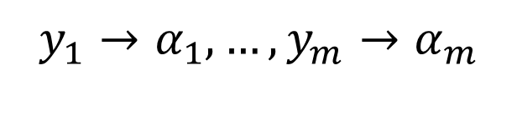

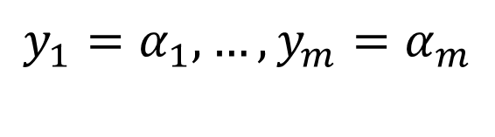
MCSat – Finite Basis
Every “finite” theory has a finite basis
$$F[x_{1}, …, x_{n}, y_{1}, …, y_{m}]$$
$$y_{1}→α_{1}, …,y_{m}→α_{m}$$
$$y_{1}=α_{1}, …,y_{m}=α_{m}$$

Slide 70
MCSat – Finite Basis
Theory of uninterpreted functions has a finite basis
Theory of arrays has a finite basis [Brummayer- Biere 2009]
In both cases the Finite Basis is essentially composed of equalities between existing terms.

Slide 71


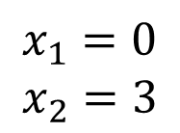

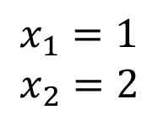


MCSat – Finite Basis
We can also use literals from the finite basis in decisions.
Application: simulate branch&bound for bounded linear integer arithmetic
$$x_{2}$$
6
$$x_{1}=0.8$$
$$x_{2}=2.4$$
5
LP solution:
4
$$x_{1}≤0$$
$$x_{1}≥1$$
3
2
1
$$x_{1}=0$$
$$x_{2}=3$$
$$x_{1}=1$$
$$x_{2}=2$$
0
1
2
3
4
5
6
$$x_{1}$$

Slide 72
MCSat: Termination
Propagations
Decisions
Model Assignments

Slide 73

MCSat
$$≻$$
Propagations
Decisions
Model Assignments

Slide 74

MCSat
$$≻$$
Propagations
Decisions
Model Assignments

Slide 75

MCSat
Maximal Elements
…
$$|FiniteBasis|$$

Slide 76







$$x≥2, \left(¬x≥1∨y≥1\right), (x^{2}+y^{2}≤1∨xy>1)$$
$$x≥2$$
$$x≥1$$
$$y≥1$$
$$x^{2}+y^{2}≤1$$
$$x≤1$$
Conflict
$$¬\left(x≥2\right)∨¬(x≤1)$$
$$¬(x^{2}+y^{2}≤1)∨x≤1$$

Slide 77






$$x≥2, \left(¬x≥1∨y≥1\right), (x^{2}+y^{2}≤1∨xy>1)$$
$$x≥2$$
$$x≥1$$
$$y≥1$$
$$x^{2}+y^{2}≤1$$
$$x≤1$$
Conflict
$$¬\left(x≥2\right)∨¬(x≤1)$$
$$¬(x^{2}+y^{2}≤1)∨x≤1$$
$$x≥2, \left(¬x≥1∨y≥1\right), (x^{2}+y^{2}≤1∨xy>1)$$
$$x≥2$$
$$x≥1$$
$$y≥1$$
$$¬(x^{2}+y^{2}≤1)$$
$$¬(x^{2}+y^{2}≤1)∨x≤1$$
$$¬\left(x≥2\right)∨¬(x^{2}+y^{2}≤1)$$

Slide 78
$$x≥2, \left(¬x≥1∨y≥1\right), (x^{2}+y^{2}≤1∨xy>1)$$
$$x≥2$$
$$x≥1$$
$$y≥1$$
$$x^{2}+y^{2}≤1$$
$$x≤1$$
Conflict
$$¬\left(x≥2\right)∨¬(x≤1)$$
$$¬(x^{2}+y^{2}≤1)∨x≤1$$
$$x≥2, \left(¬x≥1∨y≥1\right), (x^{2}+y^{2}≤1∨xy>1)$$
$$x≥2$$
$$x≥1$$
$$y≥1$$
$$¬(x^{2}+y^{2}≤1)$$
$$¬(x^{2}+y^{2}≤1)∨x≤1$$
$$¬\left(x≥2\right)∨¬(x^{2}+y^{2}≤1)$$

Slide 79

MCSat
$$x<1∨p, ¬p∨x=2$$
$$x→1$$

Slide 80


MCSat
$$x<1∨p, ¬p∨x=2$$
$$x→1$$
$$p$$

Slide 81
MCSat
$$x<1∨p, ¬p∨x=2$$
$$x→1$$
$$p$$
Conflict (evaluates to false)

Slide 82
MCSat
$$x<1∨p, ¬p∨x=2$$
$$x→1$$
$$p$$
New clause
$$x<1∨x=2$$

Slide 83

MCSat
$$x<1∨p, ¬p∨x=2$$
$$x→1$$
$$p$$
New clause
$$x<1∨x=2$$
$$x<1$$

Slide 84
MCSat
$$x<1∨p, ¬p∨x=2$$
$$x→1$$
$$p$$
New clause
$$x<1∨x=2$$
$$x<1$$

Slide 85
MCSat: Architecture
Arithmetic
Arrays
Boolean
Lists

Slide 86


MCSat: development

Slide 87
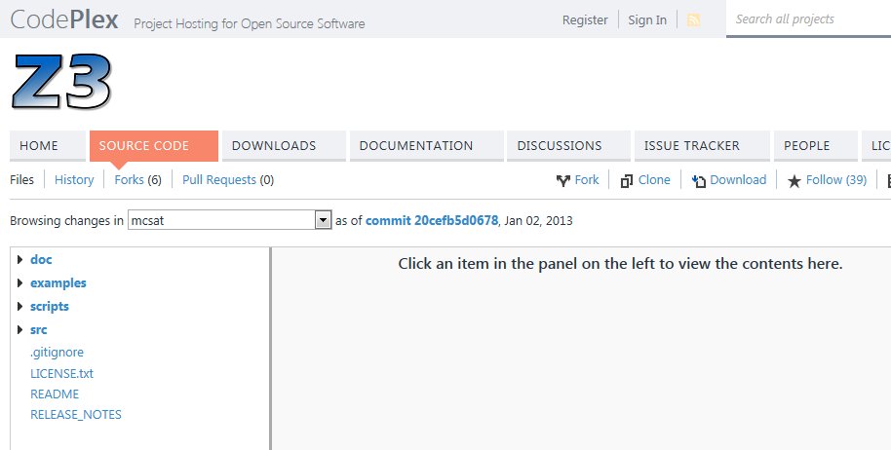
News: Z3 source code is available
http://z3.codeplex.com
Notes:
Logic is about deriving irrefutable conclusions from a set of premises.

Slide 88
Conclusion
Logic as a Service
Model-Based techniques are very promising
MCSat
http://z3.codeplex.com
http://rise4fun.com/z3py

