Slide 1

Logic Engines as a Service
Leonardo de Moura and Nikolaj Bjørner
Microsoft Research

Slide 2

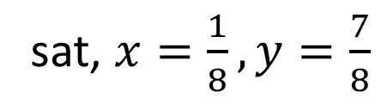
Satisfiability
Solution/Model
sat, $x=\frac{1}{8}, y=\frac{7}{8}$
$x^{2}+y^{2}<1 and xy>0.1$
$x^{2}+y^{2}<1 and xy>1$
unsat, Proof
Is execution path P feasible?
Is assertion X violated?
WI
TNESS
SAGE
Is Formula F Satisfiable?
Notes:
Models are very important.
Classical theorem provers do not produce models

Slide 3

Theorem Prover
Simplex
Rewriting
DPLL
Superposition
Z3 is a collection of
Symbolic Reasoning Engines
Congruence
Closure
Euclidean
Solver
Groebner
Basis
∀∃
elimination

Slide 4
Symbolic Reasoning Engine
Test Case Generation
Verifying Compilers
Invariant Generation
Model Based Testing
Type Checking
Model Checking

Slide 5

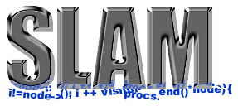
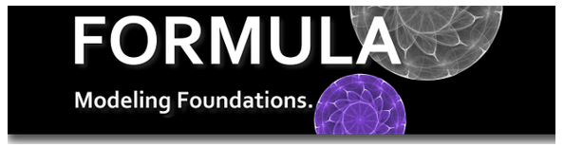


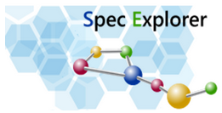





Some Applications at Microsoft
SAGE
HAVOC
Vigilante

Slide 6
Impact
Used by many research groups
TACAS paper (> 1500 citations)
More than 35k downloads
Ships with many popular systems
Isabelle, Pex, SLAM/SDV, …
Solved more than 5 Billion constraints created by SAGE when checking Win8 and Office.

Slide 7
Results and Contributions
Algorithms
Decidable Fragments
Data structures
Heuristics
Notes:
Algorithms: new theory combination, saturation + DPLL(T), abstract GB, cutsat, nlsat
Fragments: Generalized array theory, QBVF, complete instantiation
Data structures: E-matching code trees, Inverted Path index
Heuristics: relevancy propagation, DPLL(Join)

Slide 8
Recent Progress
1. Interpolants
2. Fixed Points
Beyond
Satisfiability
New Engines
3. Strings
4.Nonlinear arith.
Arithmetic, Bit-Vectors,
Booleans, Arrays,
Datatypes, Quantifiers

Slide 9










SMT solvers are popular

Slide 10
Future
Z3 with objective functions (Bjørner)
Leverage progress in MaxSAT for SMT
Stochastic Local Search in Z3 (Wintersteiger)
For hard feasibility problems from symbolic execution, floating points
Lean: new theorem prover (de Moura)
Powerful Dependent Type system, Higher-Order

