Slide 1

Formalizing the Future:
Lean’s Impact on Mathematics, Programming, and AI
Leo de Moura
Senior Principal Applied Scientist, AWS
Chief Architect, Lean FRO
May 6, 2025

Slide 2

Breaking the Cycle of Uncertainty: Math, Software, and AI You Can Trust
Math, software, and AI often rely on manual review or partial testing.
An error in a theorem or critical software system can have massive consequences.
Progress dies where fear of mistakes lives.

Slide 3
Breaking the Cycle of Uncertainty: Math, Software, and AI You Can Trust
Math, software, and AI often rely on manual review or partial testing.
An error in a theorem or critical software system can have massive consequences.
Progress dies where fear of mistakes lives.
Lean: machine-checkable proofs eliminate guesswork and create trust.
If every step is formally verified, we unlock unprecedented confidence and collaboration.

Slide 4
Lean is an open-source programming language and proof assistant that is transforming how we approach mathematics, software verification, and AI.
The Lean project, started in 2013, aimed at merging interactive and automated theorem proving.
Lean provides machine-checkable proofs.
Lean addresses the “trust bottleneck”.
Lean opens up new possibilities for collaboration.

Slide 5
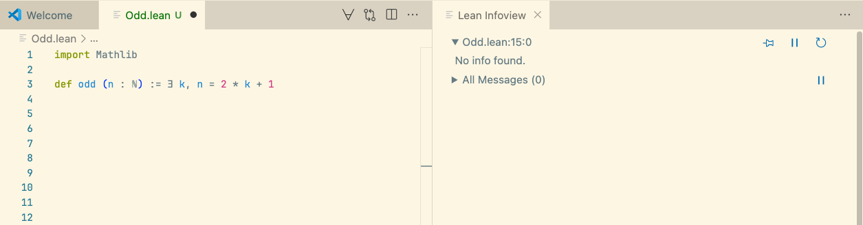
A small example

Slide 6
Mathlib is the Lean Mathematical library
A small example

Slide 7
A small example
Definition of an odd number

Slide 8
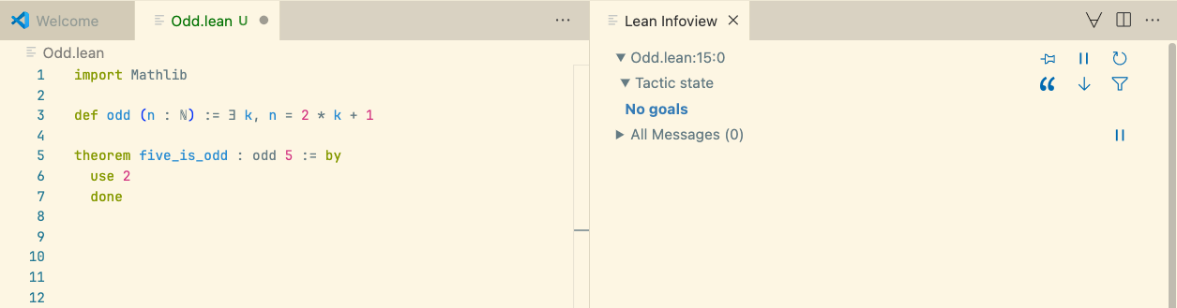
Our first theorem
Theorem statement, i.e., the claim being made

Slide 9
Our first theorem
A proof

Slide 10
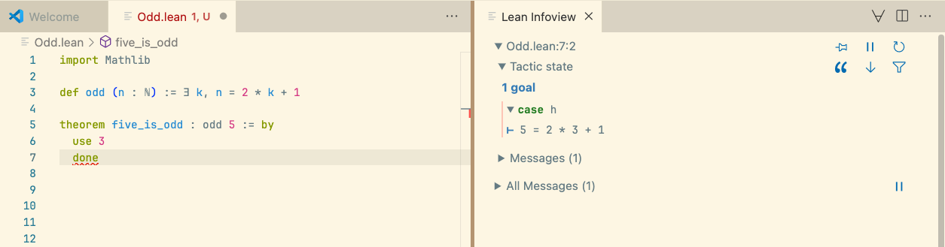
Our first theorem
An incorrect proof

Slide 11
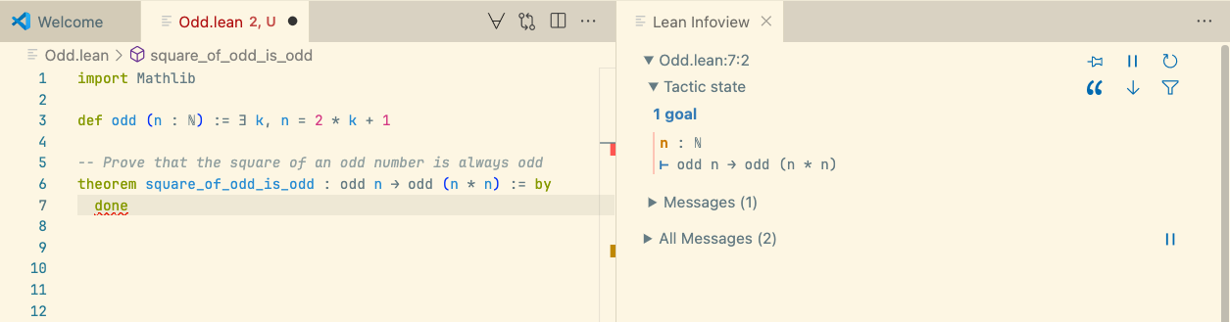
Theorem proving in Lean is an interactive game
The “game board”
“You have written my favorite computer game”, Kevin Buzzard

Slide 12
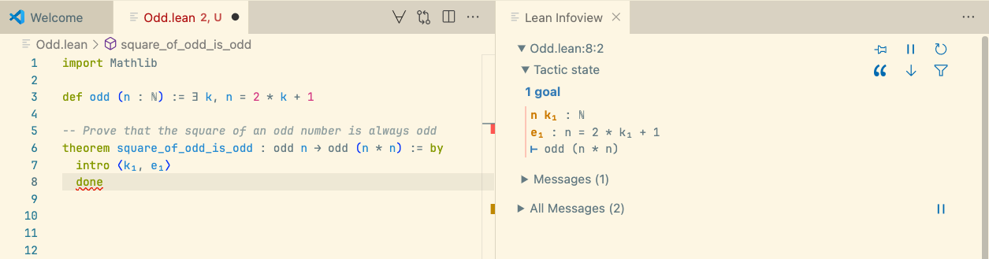
Theorem proving in Lean is an interactive game
A “game move”, aka “tactic”

Slide 13
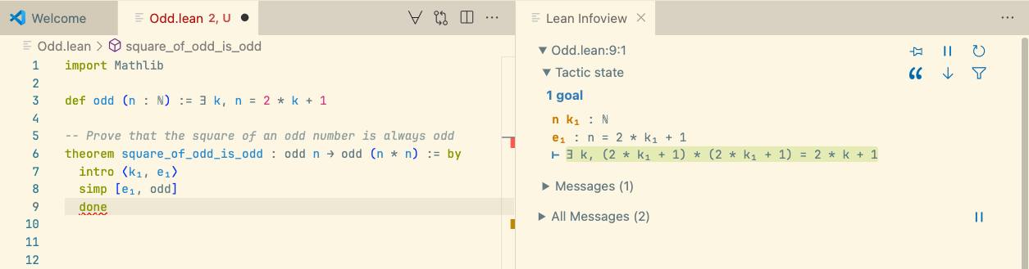
Theorem proving in Lean is an interactive game
The “game move” simp, the simplifier, is one of the most popular moves in our game

Slide 14
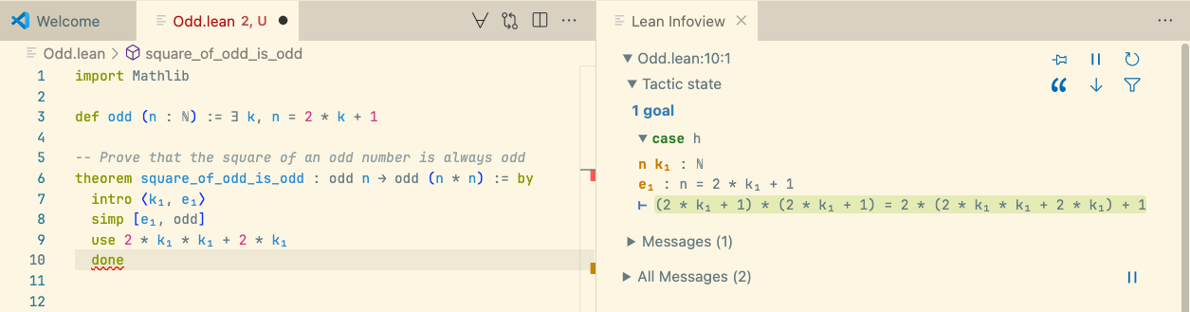
Theorem proving in Lean is an interactive game
The “game move” use is the standard way of proving statements about existentials

Slide 15
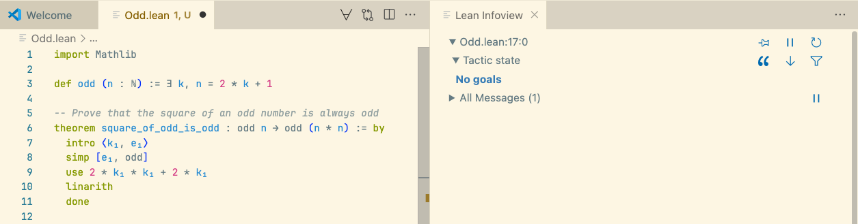
Theorem proving in Lean is an interactive game
We complete this level using linarith, the linear arithmetic, move

Slide 16
Theorem proving in Lean is an interactive and addictive game
“You can do 14 hours a day in it and not get tired and feel kind of high the whole day. You’re constantly getting positive reinforcement”, Amelia Livingston

Slide 17

Mathlib
The Lean Mathematical Library supports a wide range of projects.
It is an open-source collaborative project with over 500 contributors and 1.8M LoC.
“I’m investing time now so that somebody in the future can have that amazing experience”,
Heather Macbeth

Slide 18
Mathematics
Software
AI

Slide 19
Mathematics

Slide 20
Preamble: the Perfectoid Spaces Project
Kevin Buzzard, Patrick Massot, Johan Commelin
Goal: Demonstrate that we can define complex mathematical objects in Lean.
They translated Peter Scholze's definition into a form a computer can understand.
It not only achieved its goals but also demonstrated to the math community that formal objects can be visualized and inspected with computer assistance.
Math is now data that can be processed, transformed, and inspected in various ways.

Slide 21
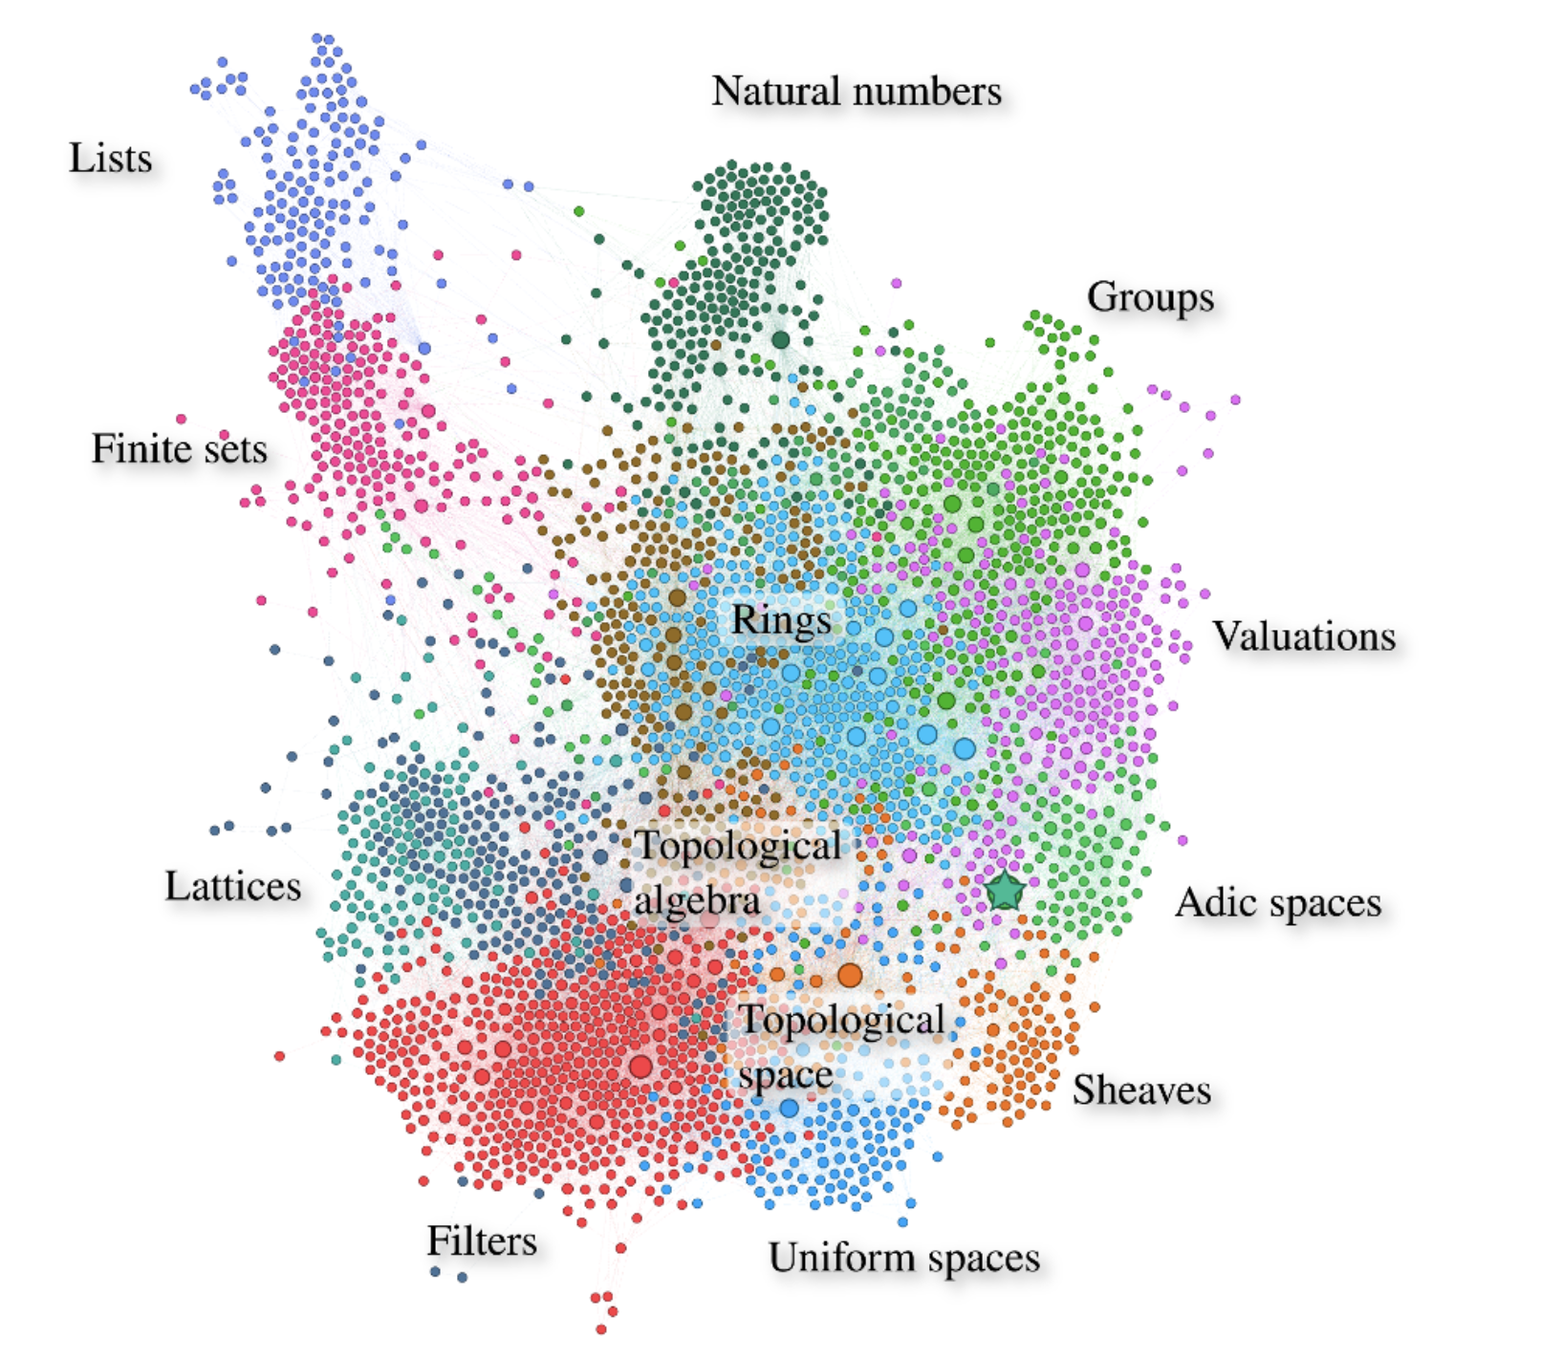
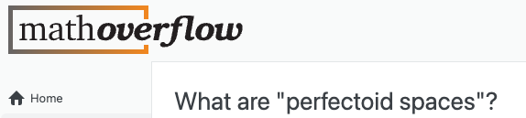
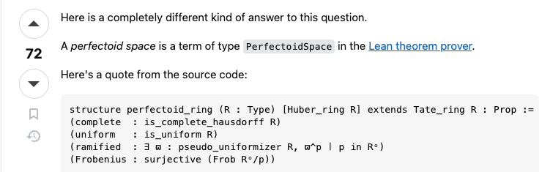
Preamble: the Perfectoid Spaces Project (cont.)
Kevin Buzzard, Patrick Massot, Johan Commelin

Slide 22
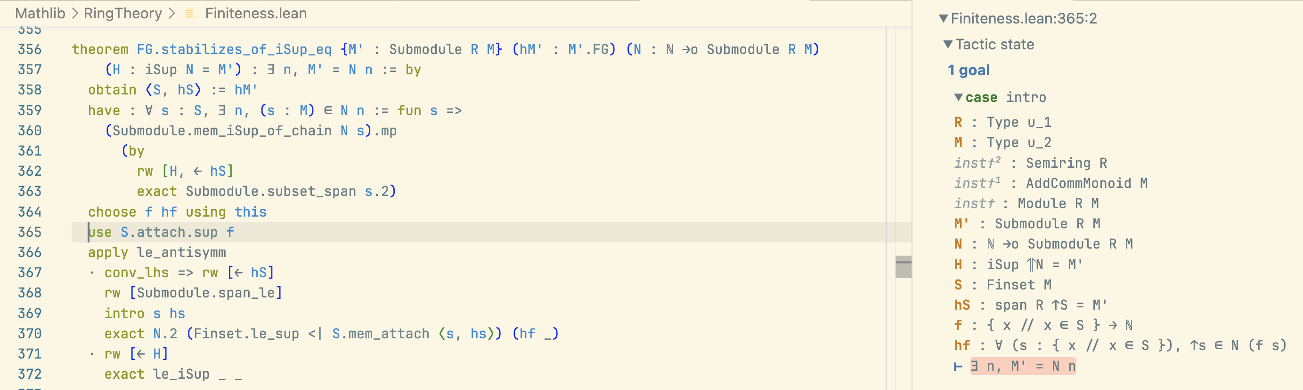

Slide 23
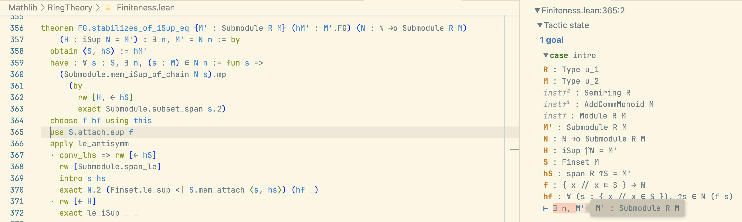

Slide 24
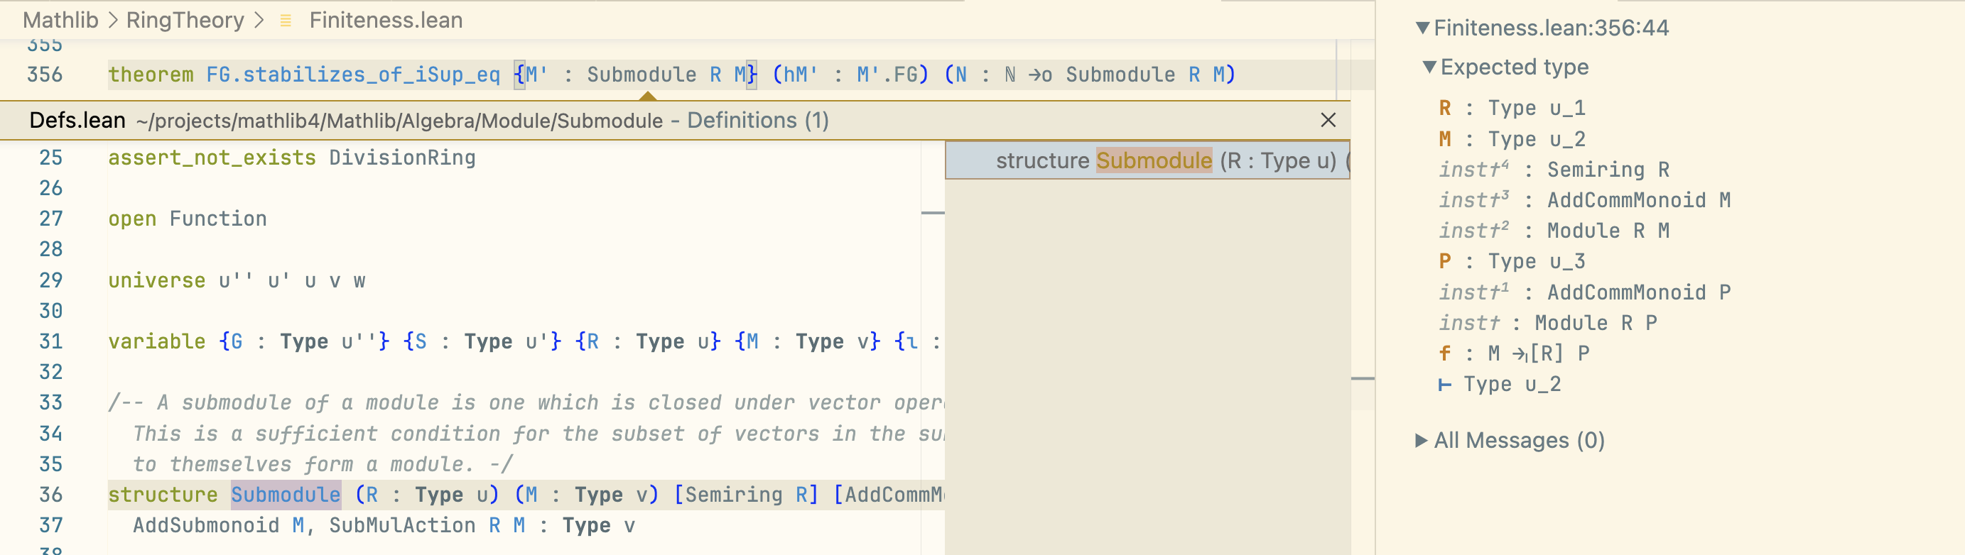

Slide 25
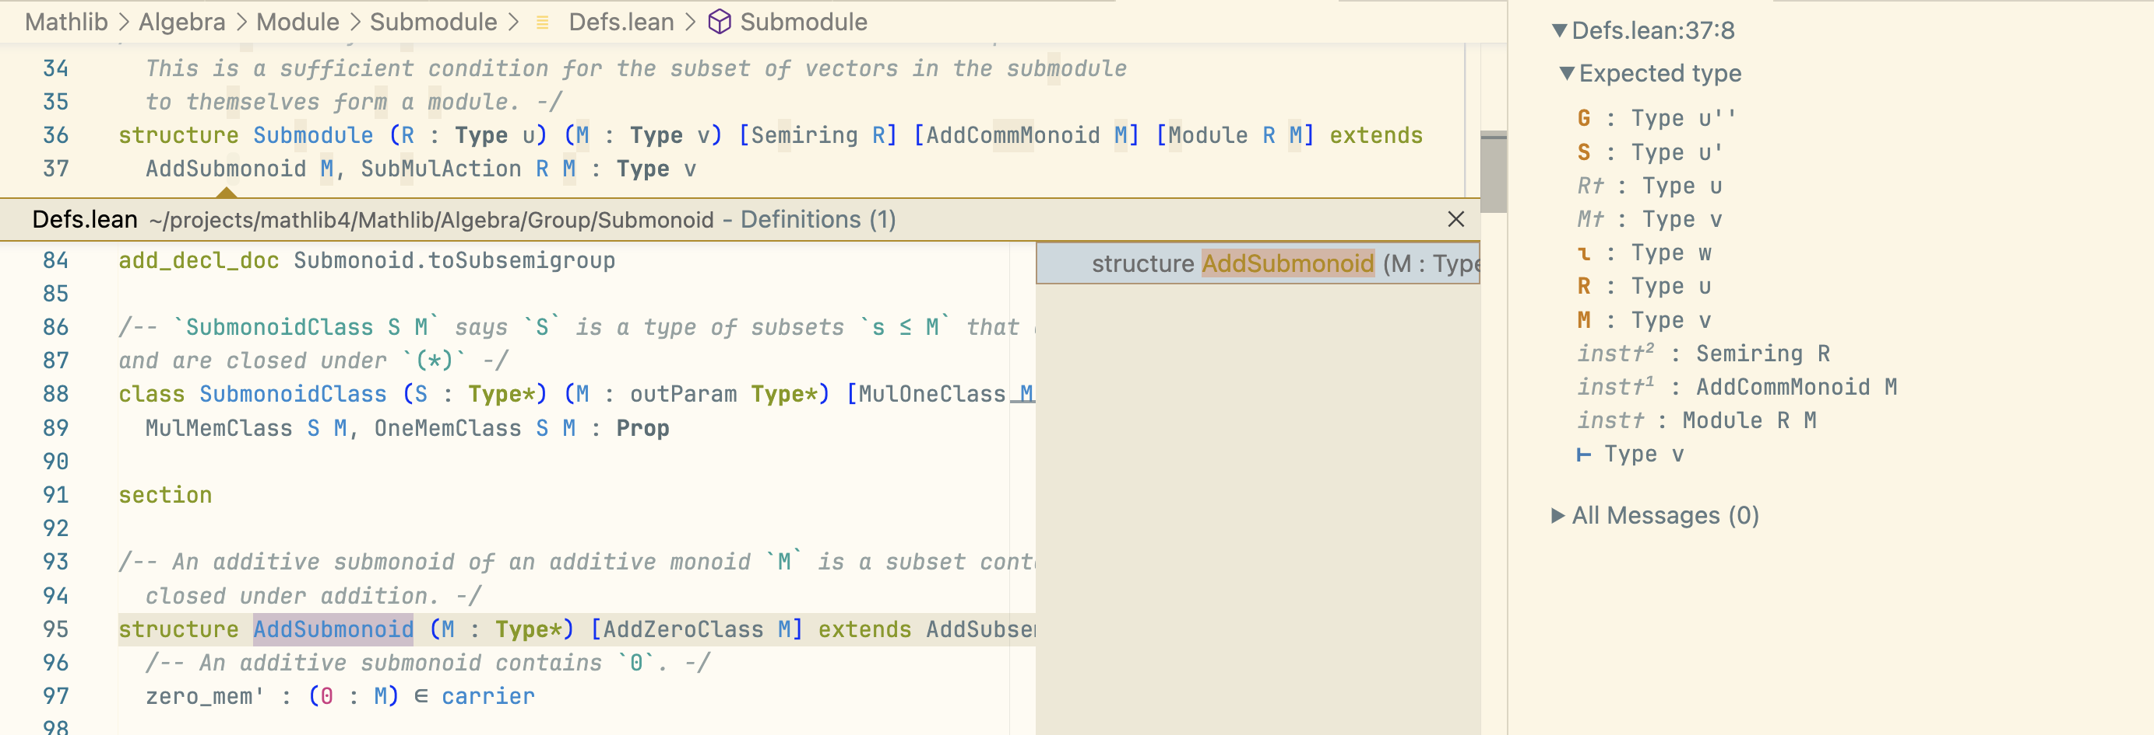

Slide 26
The Challenge
In November of 2020, Peter Scholze posits the Liquid Tensor Experiment (LTE) challenge.
“I spent much of 2019 obsessed with the proof of this theorem, almost getting crazy over it. In the end, we were able to get an argument pinned down on paper, but I think nobody else has dared to look at the details of this, and so I still have some small lingering doubts”,
Peter Scholze

Slide 27
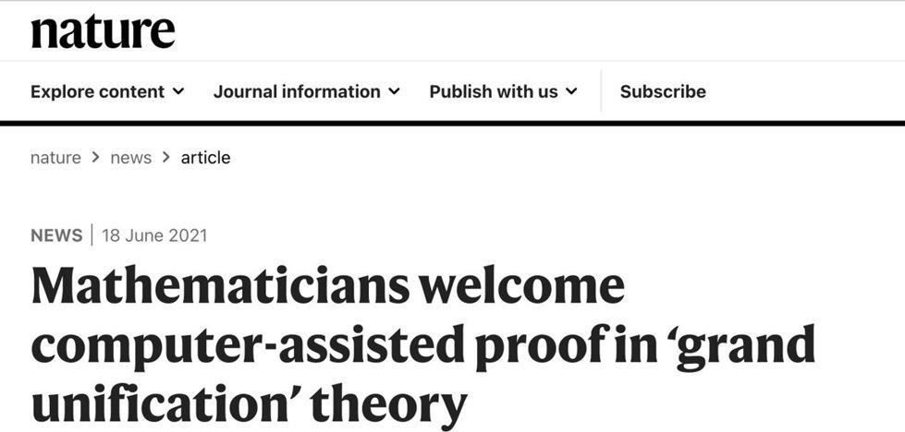
The First Victory
Johan Commelin led a team with several members of the Lean community and announced the formalization of the crucial intermediate lemma that Scholze was unsure about, with only minor corrections, in May 2021.
“[T]his was precisely the kind of oversight I was worried about when I asked for the formal verification. [...] The proof walks a fine line, so if some argument needs constants that are quite a bit different from what I claimed, it might have collapsed”, Peter Scholze

Slide 28
Achieving the Unthinkable
The full challenge was completed in July 2022.
The team not only verified the proof but also simplified it. Moreover, they did this without fully understanding the entire proof.
Johan, the project lead, reported that he could only see two steps ahead. Lean was a guide.
“The Lean Proof Assistant was really that: an assistant in navigating through the thick jungle that this proof is. Really, one key problem I had when I was trying to find this proof was that I was essentially unable to keep all the objects in my RAM, and I think the same problem occurs when trying to read the proof”, Peter Scholze

Slide 29
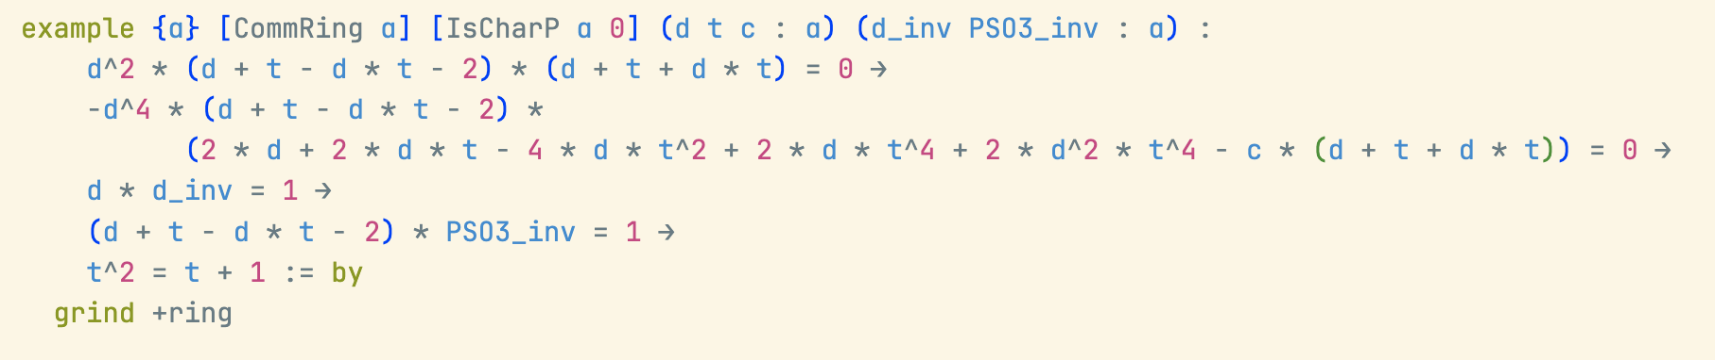
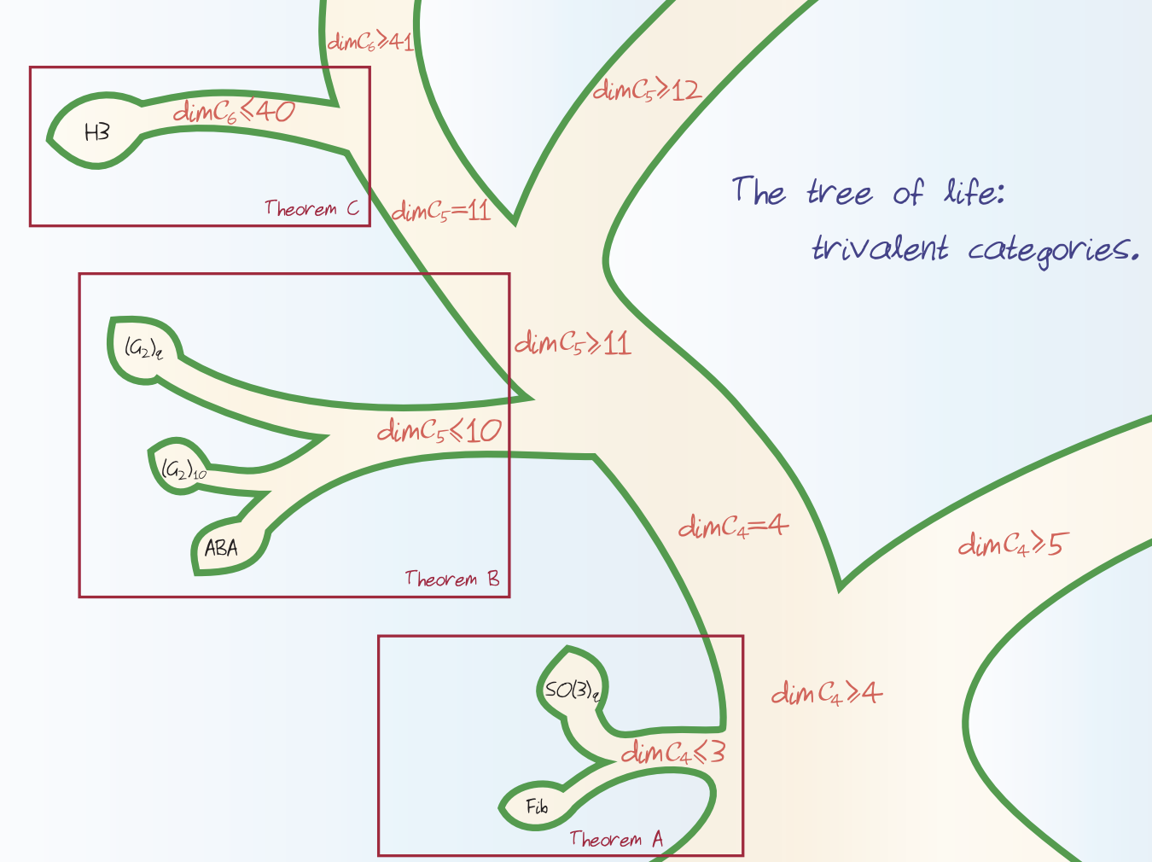
Automating Quantum Algebra
Here is a concrete example from quantum algebra. It comes from a classification result involving quantum SO(3) categories. Specifically, the condition that certain relations among trivalent graphs imply a constraint on the parameters d, t, and c:
From: “Categories generated by a trivalent vertex”, Morrison, Peters, and Snyder

Slide 30
Automating Quantum Algebra
This is not a toy: it encodes a real algebraic constraint derived from relations among diagrams in a pivotal tensor category.
Lean can handle this kind of reasoning automatically, in milliseconds.

Slide 31
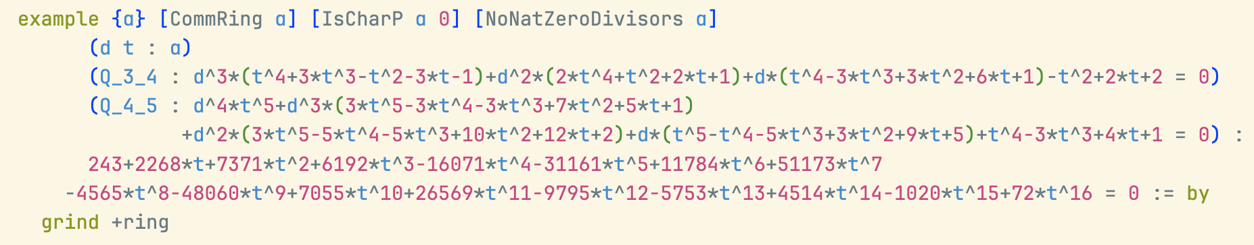
Automating Quantum Algebra
We can explore new mathematical and physical structures, from topological quantum fields theories to fusion categories.
Lean is helping researchers reason reliably about complex symbolic systems that were previously handled only by hand or with unverified computer algebra.
grind +ring is just another move in our interactive game.

Slide 32
Should we trust Lean?
Lean has a small trusted proof checker.
Do I need to trust the checker?
No, you can export your proof, and use external checkers. There are checkers implemented in C/C++, Rust, Lean, etc.
You can implement your own checker.

Slide 33
What did we learn?
Machine-checkable proofs enable a new level of collaboration in mathematics.
The power of the community.
We don’t need to trust our automation/moves.
It is not just about proving but also understanding complex objects and proofs, getting new insights, and navigating through the “thick jungles” that are beyond our cognitive abilities.

Slide 34
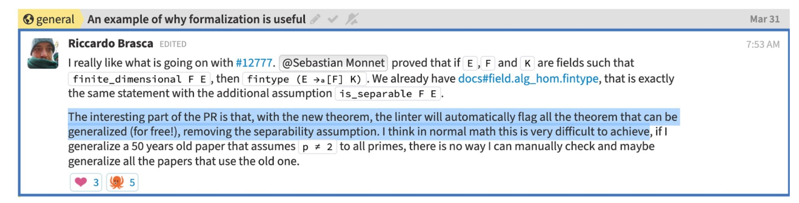
What did we learn?
Another unexpected benefit of formal mathematics: auto refactoring and generalization.

Slide 35
Software

Slide 36
Lean in Software Verification
Lean is a programming language, and is used in many software verification projects.
You can write code and reason about it simultaneously.
You can prove that your code has the properties you expect.
“Testing can show the presence of bugs, but not their absence”, E. Dijkstra

Slide 37
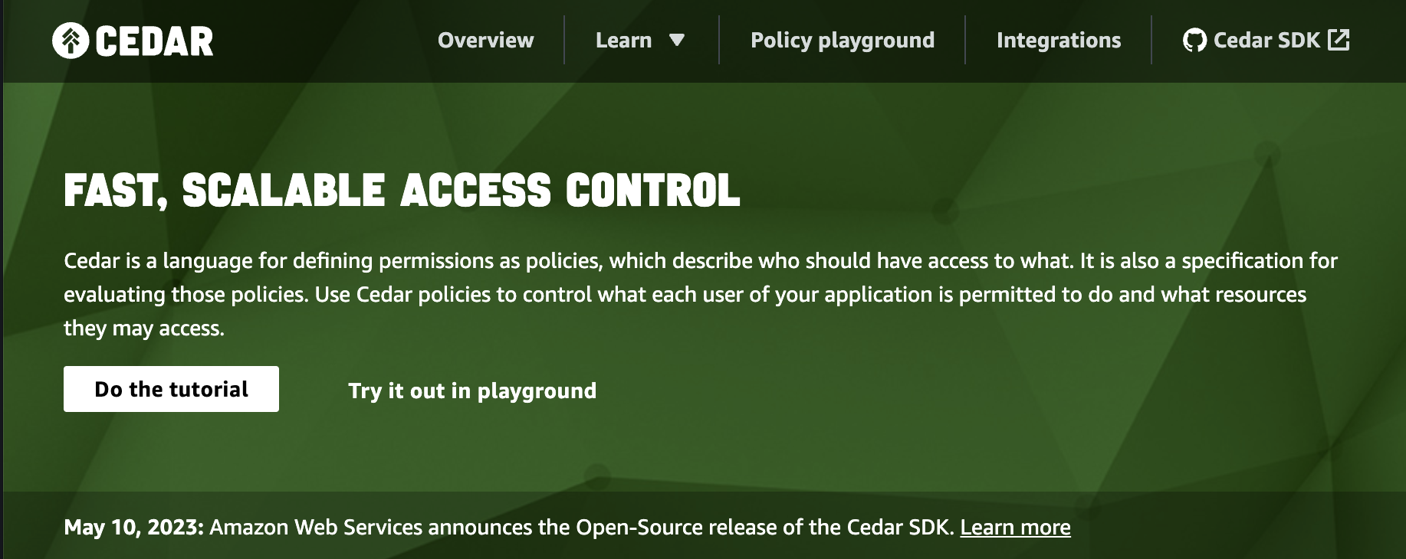
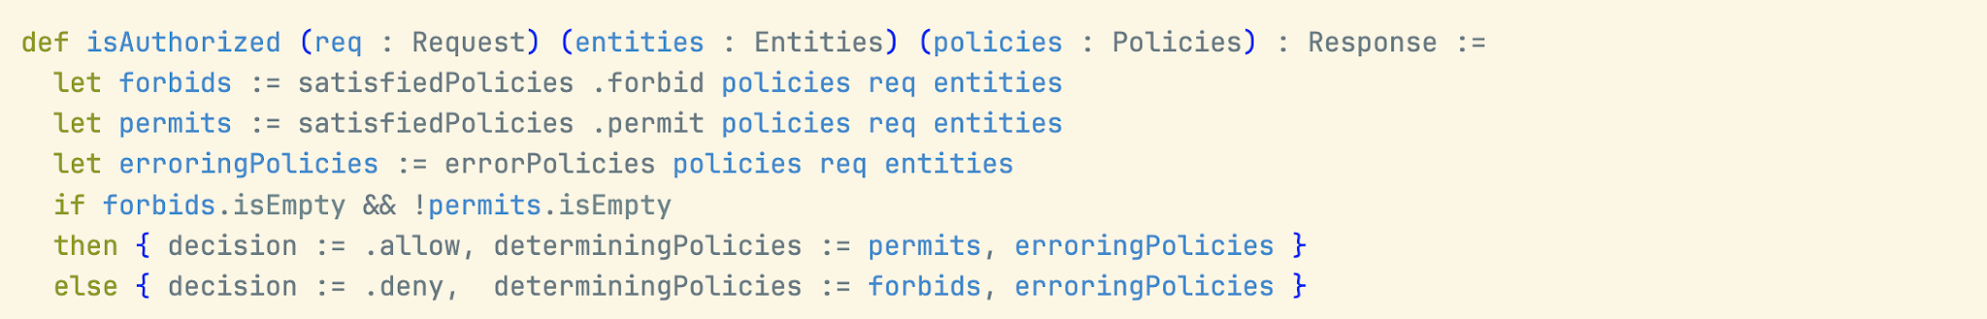
Cedar
https://www.cedarpolicy.com/
https://github.com/cedar-policy/cedar-spec

Slide 38
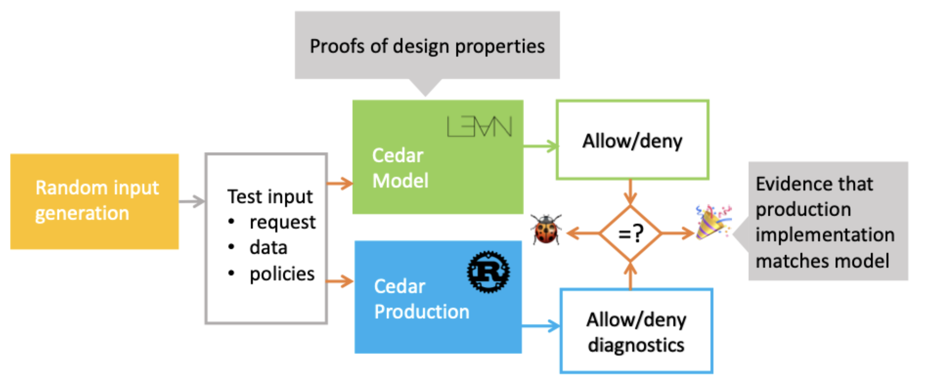
Cedar
Takeaway: “We’ve found Lean to be a great tool for verified software development. You get a full-featured programming language, fast proof checker and runtime, and a familiar way to build both models and proofs”

Slide 39
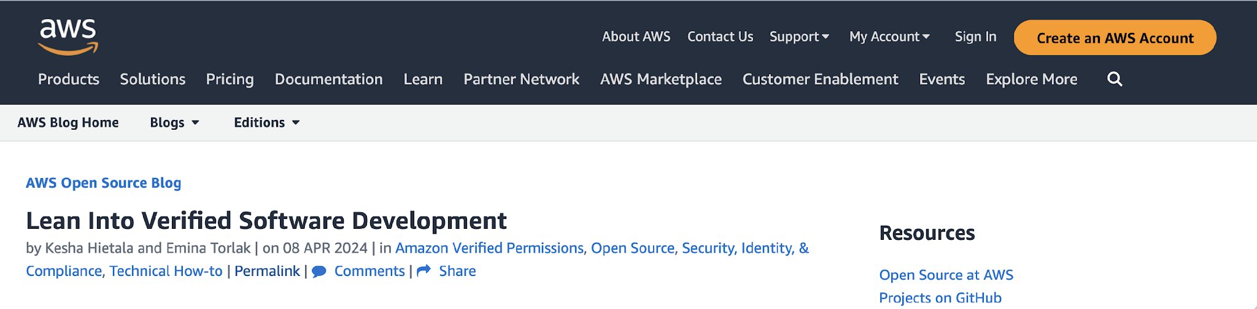
Cedar
To learn more about Cedar:
https://aws.amazon.com/blogs/opensource/lean-into-verified-software-development/

Slide 40
Differential Privacy
A mathematical framework that ensures the privacy of individuals in a dataset by adding controlled random noise to the data.
Discrete sampling algorithms, like the Discrete Gaussian Sampler, are used to add carefully calibrated noise to data.
What may go wrong if a buggy sampler is used?
Privacy Violations: leakage of sensitive information
Incorrect Results: distorted analysis results

Slide 41
SampCert
A project led by Jean-Baptiste Tristan at AWS.
An open-source Lean library of formally verified differential privacy primitives.
Tristan's implementation is not only verified, but it is also twice as fast as the previous one.
He managed to implement aggressive optimizations because Lean served as a guide, ensuring that no bugs were introduced.

Slide 42
SampCert would not exist without Mathlib
SampCert is software, but its verification relies heavily on Mathlib.
The verification of code addressing practical problems in data privacy depends on the formalization of mathematical concepts, from Fourier analysis to number theory and topology.

Slide 43
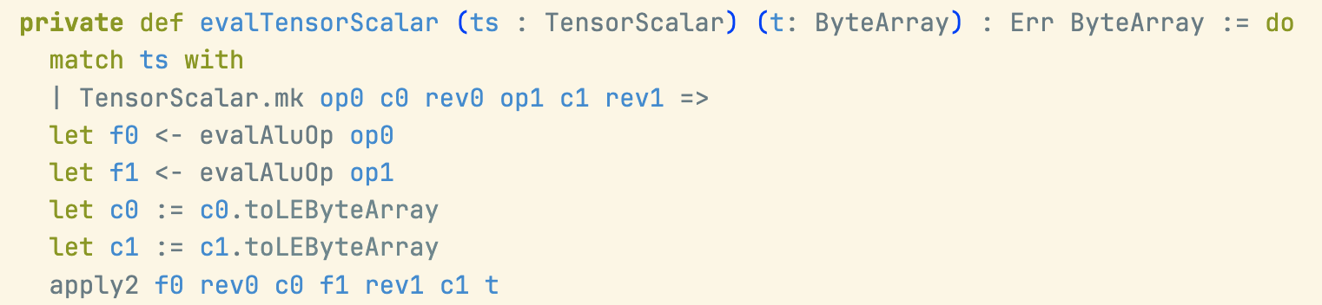
KLR: a language and elaborators for machine learning kernels
Define a common representation for kernel functions with a precise formal semantics along with translations from common kernel languages to the KLR core language.
KLR is also open source.

Slide 44
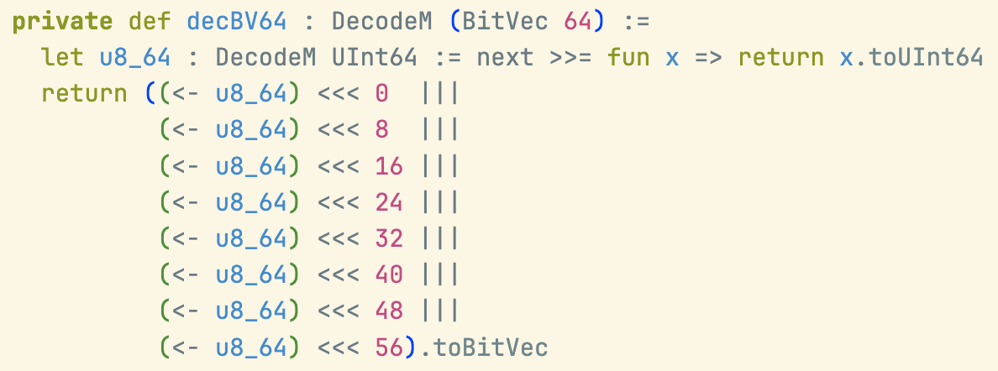
KLR: a language and elaborators for machine learning kernels
KLR uses bit-vectors, fixed integers, etc.

Slide 45
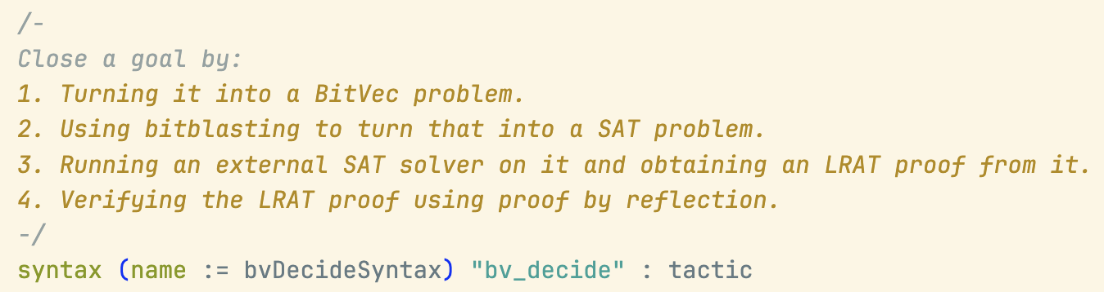
bv_decide: another powerful move
A verified bit-blaster by Henrik Boving, Josh Clune, Siddharth Bhat, and Alex Keizer
Uses LRAT proof producing SAT solvers: Cadical

Slide 46
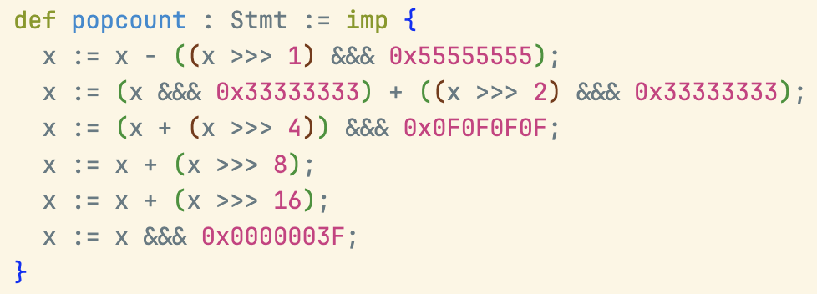
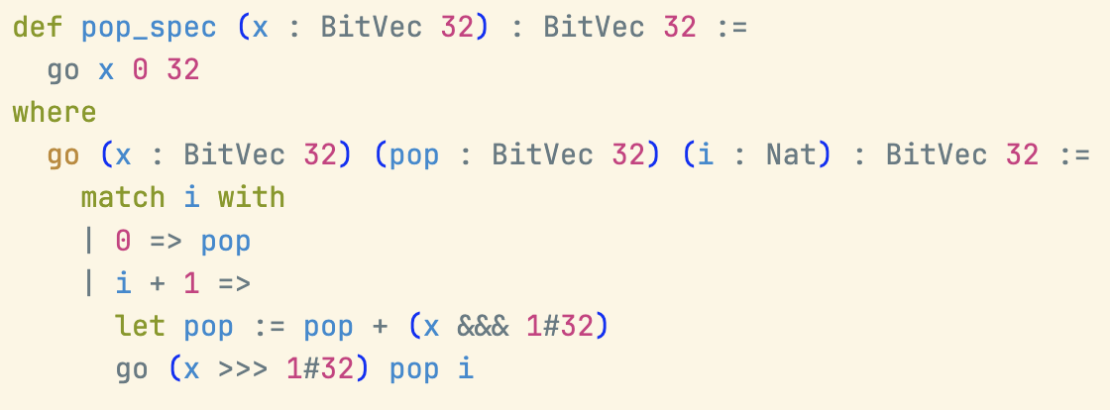
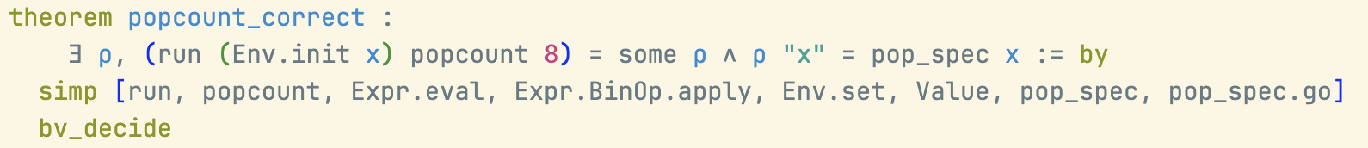
“Blasting” popcount with bv_decide

Slide 47
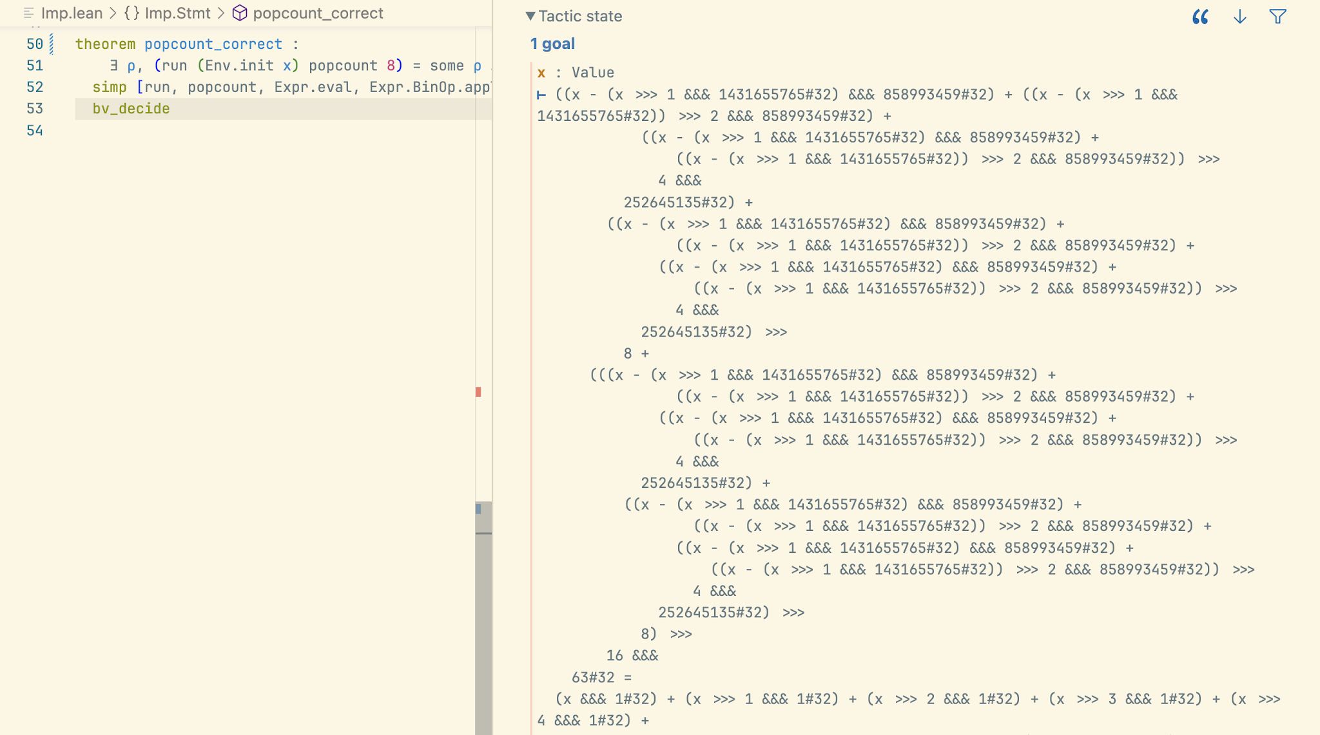
“Blasting” popcount with bv_decide

Slide 48
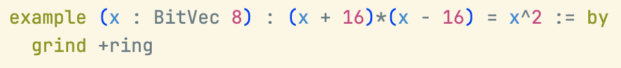
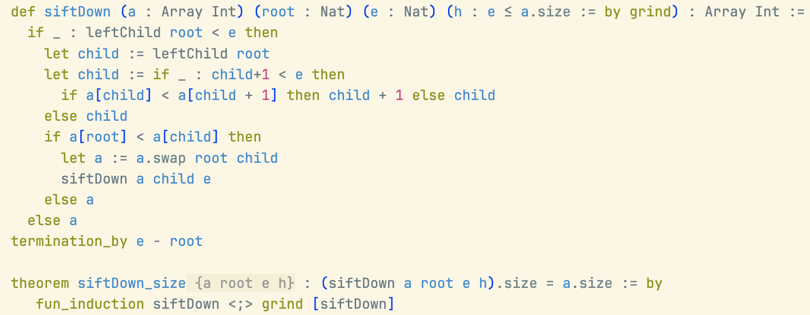
grind in Software Verification

Slide 49

What did we learn?
Machine-checkable proofs enable you to code without fear.
Powerful proof automation.
Industrial projects: Verified compilers, policy languages, cryptographic libraries, etc.
Many more at the Lean Project Registry: https://reservoir.lean-lang.org/

Slide 50
AI

Slide 51
Lean Enables Verified AI for Mathematics and Code
LLMs are powerful tools, but they are prone to hallucinations.
In Math, a small mistake can invalidate the whole proof.
Imagine manually checking an AI-generated proof with the size and complexity of FLT.
The informal proof is over 200 pages.
Buzzard estimates a formal proof will require more than 1M LoC on top of Mathlib.
Machine-checkable proofs are the antidote to hallucinations.

Slide 52
AI Proof Assistants
Several groups are developing AI that suggests the next move(s) in Lean’s interactive proof game.
LeanDojo is an open-source project from Caltech, and everything (model, datasets, code) is open.
OpenAI and Meta AI have also developed AI assistants for Lean.

Slide 53
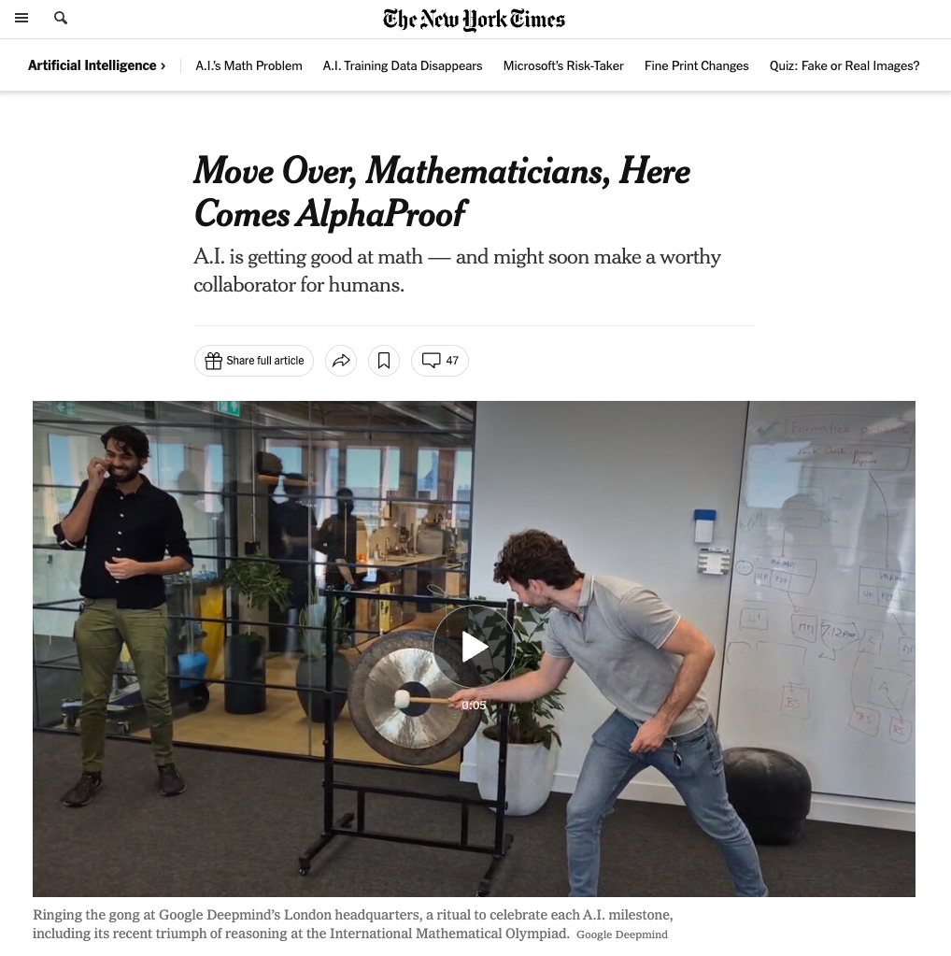

Slide 54
What did we learn?
Machine-checkable proofs enable AI that does not hallucinate.
LLMs are getting better and better at explaining Lean code.
In an era of big data and LLMs, machine-checkable proofs ensure trust in results.
AI systems that prove rather than guess.

Slide 55
Before we wrap up...

Slide 56
Lean Enables Decentralized Collaboration
Lean is Extensible
Users extend Lean using Lean itself.
Lean is implemented in Lean.
You can make it your own.
You can create your own moves.
Machine-Checkable Proofs
You don’t need to trust me to use my proofs.
You don’t need to trust my automation to use it.
Code without fear.

Slide 57
Lean is a game where we can implement your own moves
The linarith “move” was implemented by the Mathlib community in Lean!

Slide 58
Lean is a game where we can implement your own moves
The linarith “move” was implemented by the Mathlib community in Lean!
The bv_decide and grind “moves” are also implemented in Lean!

Slide 59
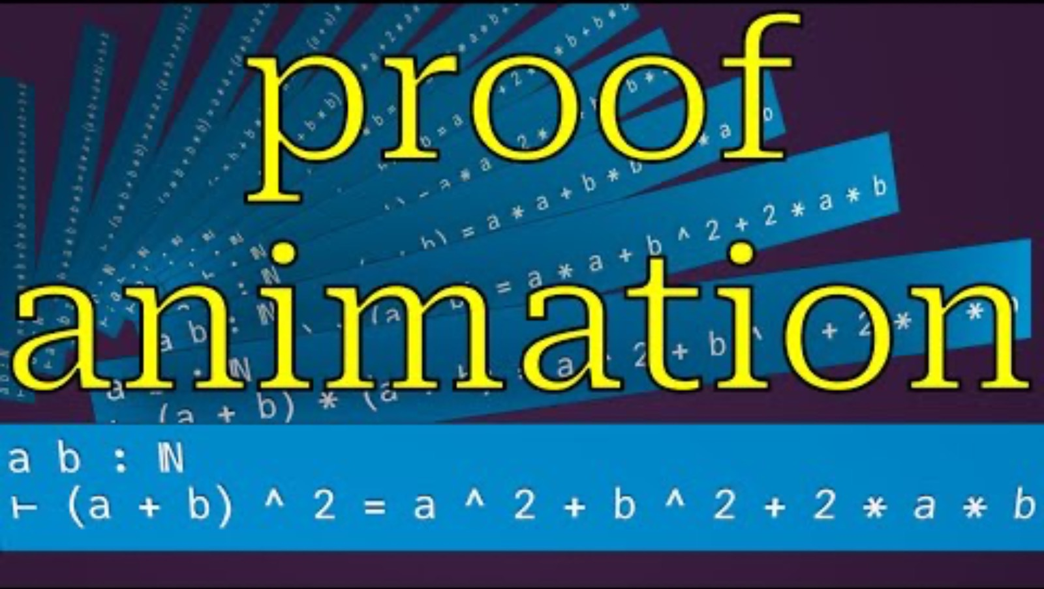
You can use Lean to introspect its internal data
The tool lean-training-data is implemented in Lean itself. It is a Lean package.
A similar approach can be used to automatically generate proof animations.

Slide 60
Lean FRO: Shaping the Future of Lean Development
The Lean Focused Research Organization (FRO) is a non-profit dedicated to Lean’s development.
Founded in August 2023, the organization has 19 members.
Its mission is to enhance critical areas: scalability, usability, documentation, and proof automation.
It must reach self-sustainability in August 2028 and become the Lean Foundation.
Philanthropic support is gratefully acknowledged from the Simons Foundation, the Alfred P. Sloan Foundation, Richard Merkin, and Alex Gerko.

Slide 61
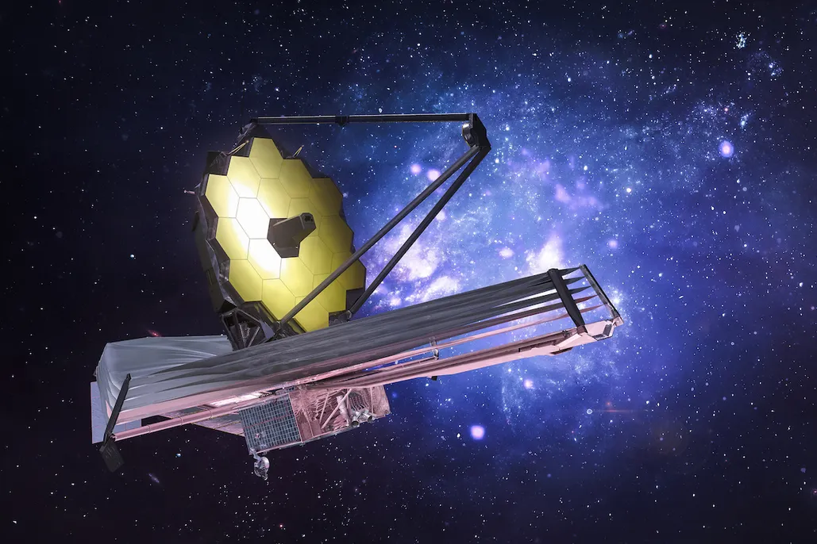
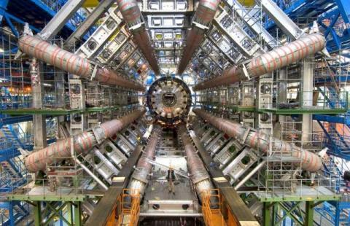
FROs accelerate scientific progress / Lean as a Catalyst
James Webb Telescope and CERN illustrate a common pattern in science: a need for projects that are bigger than an academic lab can undertake, more coordinated than a loose consortium or themed department, and not directly profitable enough to be a venture-backed startup or industrial R&D project.
https://www.convergentresearch.org/about-fros

Slide 62
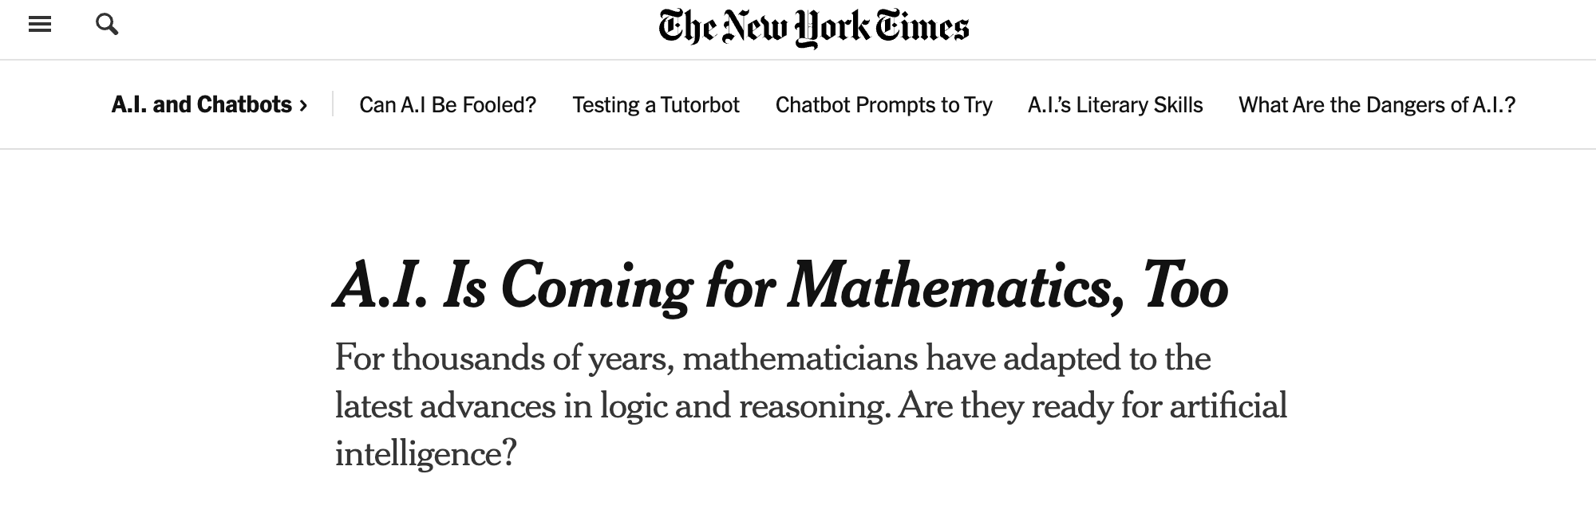
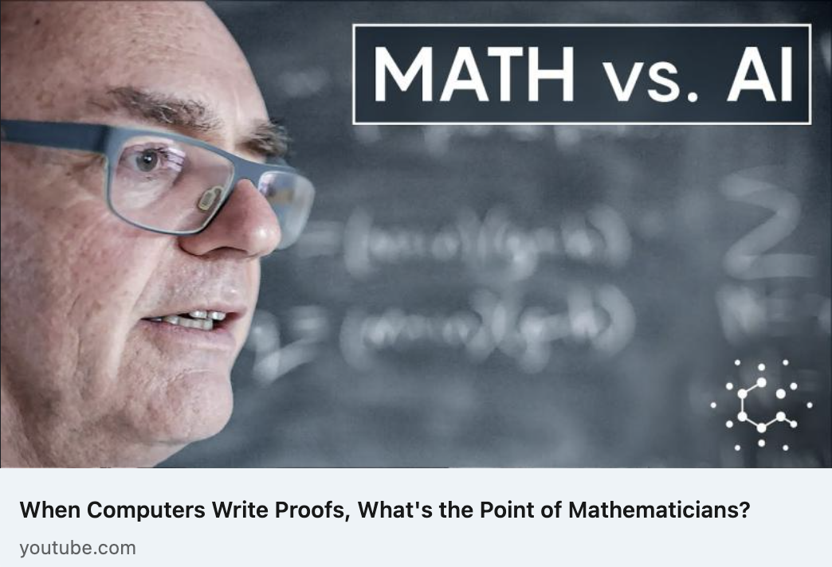
Lean FRO: by numbers
19 releases and 4,047 pull requests merged in the main repository only since its launch in July 2023.
Public roadmaps: https://lean-fro.org/about/roadmap-y2/
Lean project was featured in multiple venues NY Times, Quanta, Scientific American, etc.

Slide 63
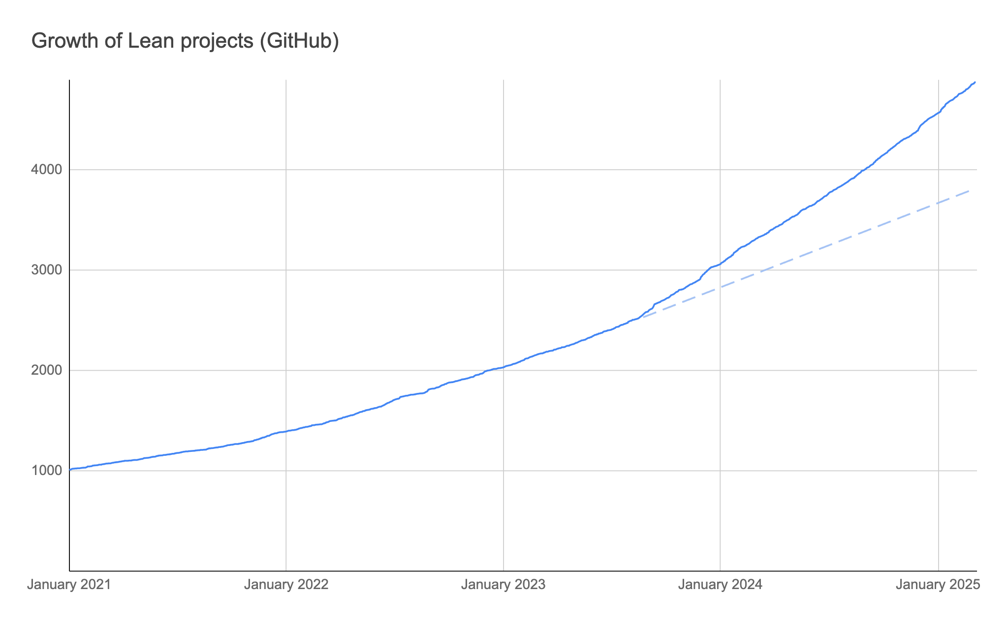
Growth of Lean projects on GitHub
Lean FRO
launched

Slide 64
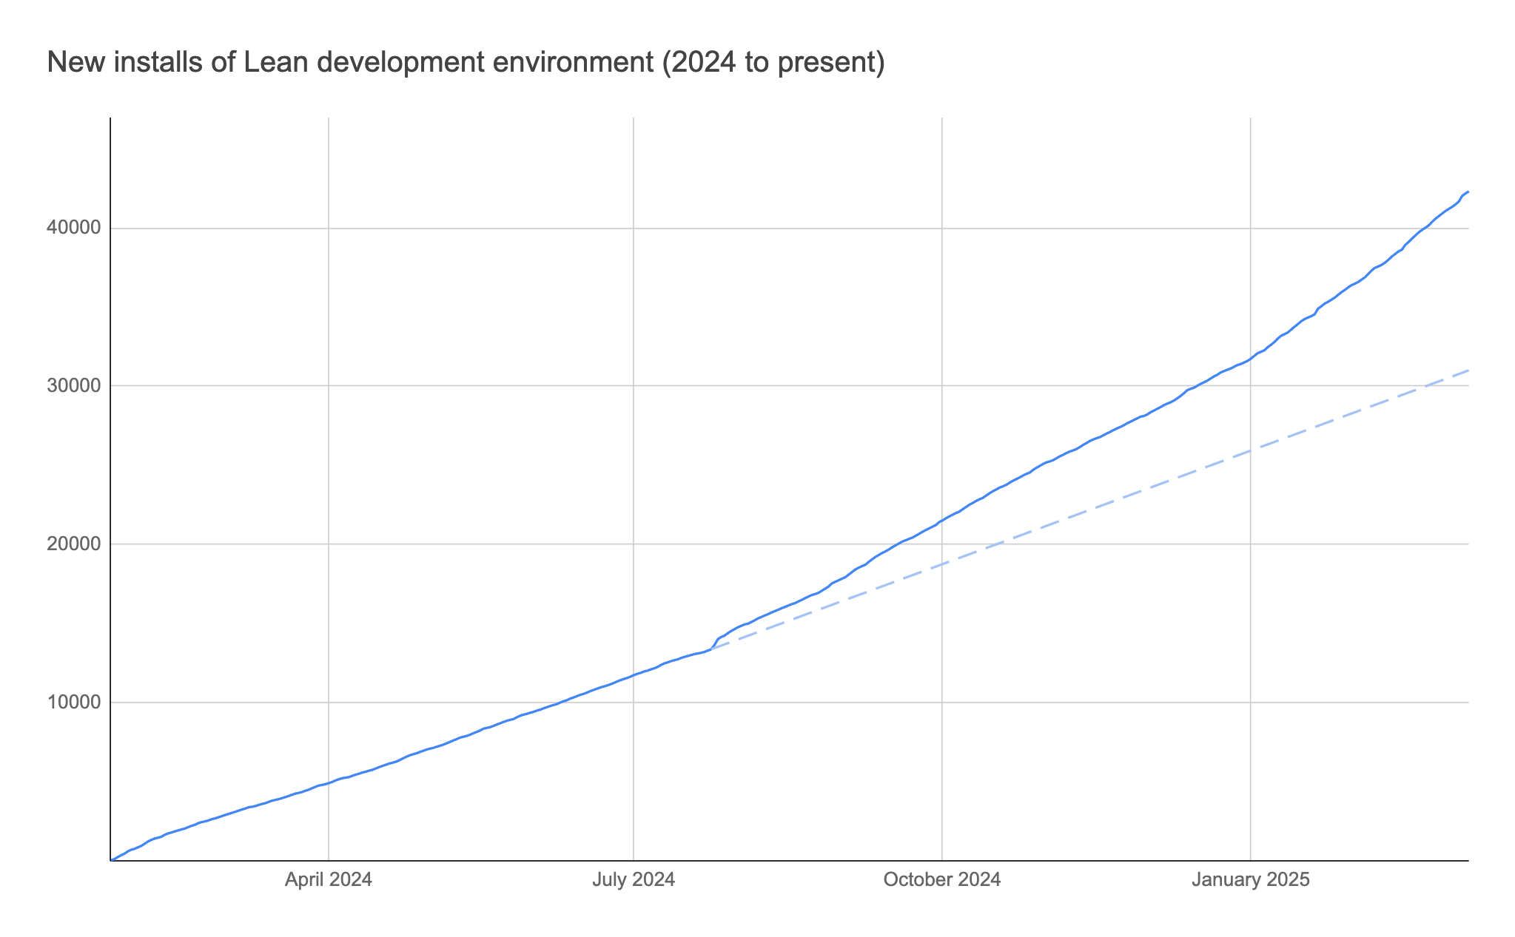
New installations of Lean Development Environment (2024 to present)

Slide 65
How can I contribute?
Help building Mathlib.
Want to engage with the vibrant Lean community? Join our Zulip channel.
Interested in ML kernels? Contribute to the KLR project.
Want to contribute to a large formalization project? Join the FLT formalization project.
Start your own open-source Lean project! Your package will be available on our registry Reservoir.
Start using Lean online: live.lean-lang.org
Support the Lean FRO: Funding, partnerships, or simply advocating the project.

Slide 66
Conclusion
Lean is an efficient programming language and proof assistant.
The Mathlib community is changing how math is done.
It is not just about proving but also understanding complex objects and proofs, getting new insights, and navigating through the “thick jungles” that are beyond our cognitive abilities.
Lean tracks details, so humans focus on big ideas.
Decentralized collaboration with Lean: Large teams can collectively tackle huge proofs without losing track.
The entire discipline thrives when no one has to “take it on faith.”

Slide 67

Thank You
https://leanprover.zulipchat.com/
x: @leanprover
LinkedIn: Lean FRO
Mastodon: @leanprover@functional.cafe
#leanlang, #leanprover
https://www.lean-lang.org/

