Slide 1
Model-Driven Decision Procedures for Arithmetic SYNASC 2013
Leonardo de Moura
Microsoft Research

Slide 2

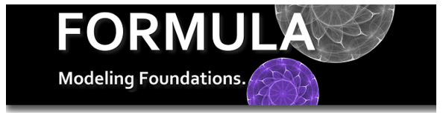


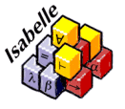











Logic Engines as a Service
$$Scala^{Z3}$$
SAGE
SecGuru
Notes:
Logic is about deriving irrefutable conclusions from a set of premises.

Slide 3
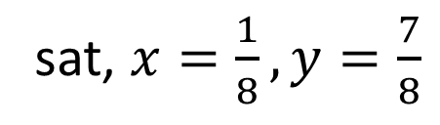
Satisfiability
Solution/Model
sat, $x=\frac{1}{8}, y=\frac{7}{8}$
$x^{2}+y^{2}<1 and xy>0.1$
$x^{2}+y^{2}<1 and xy>1$
unsat, Proof
Is execution path P feasible?
Is assertion X violated?
WI
TNESS
SAGE
Is Formula F Satisfiable?
Notes:
Models are very important.
Classical theorem provers do not produce models

Slide 4
The RISE of Model-Driven Techniques
Notes:
Logic is about deriving irrefutable conclusions from a set of premises.

Slide 5
Saturation x Search
Proof-finding
Model-finding
Proofs
Conflict
Resolution
Models

Slide 6
SAT
$$p1∨¬p2, ¬p1∨p2∨p3, p3$$
$$p1=true, p2=true, p3=true$$
CNF is a set (conjunction) set of clauses
Clause is a disjunction of literals
Literal is an atom or the negation of an atom

Slide 7
Two procedures
Resolution | DPLL
Proof-finder | Model-finder
Saturation | Search

Slide 8
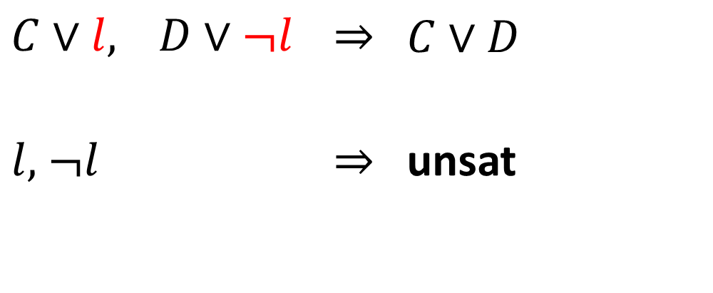
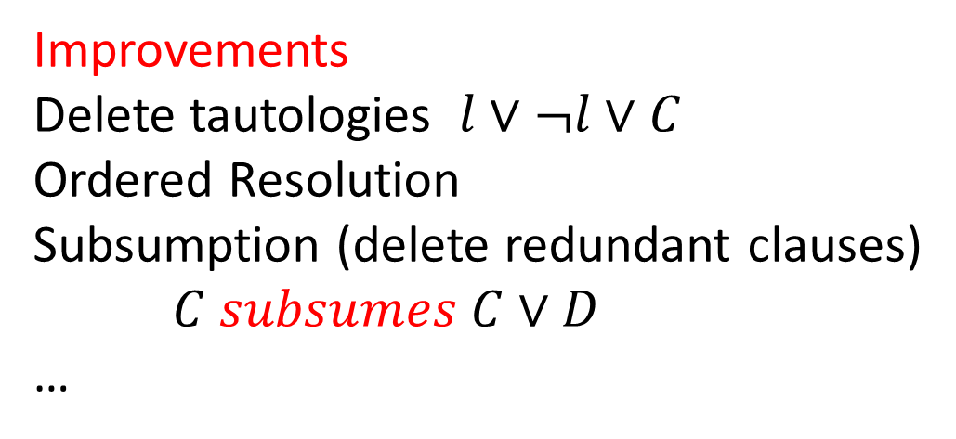
Resolution
$C∨l,$ $D∨¬l$ | $$⇒$$ | $$C∨D$$
$l,$ $¬l$ | $$⇒$$ | unsat
Improvements
Delete tautologies $l∨¬l∨C$
Ordered Resolution
Subsumption (delete redundant clauses)
$C subsumes C∨D$
…

Slide 9

Resolution: Example

Slide 10
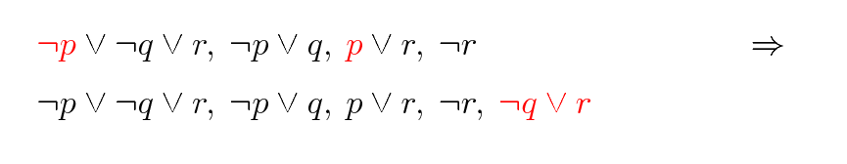
Resolution: Example

Slide 11
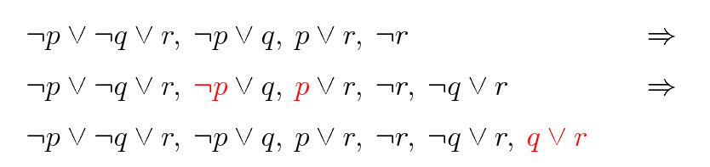
Resolution: Example

Slide 12
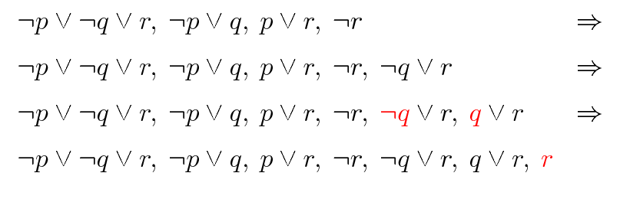
Resolution: Example

Slide 13
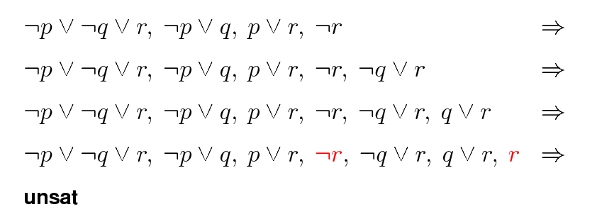
Resolution: Example

Slide 14
Resolution: Problem
Exponential time and space

Slide 15
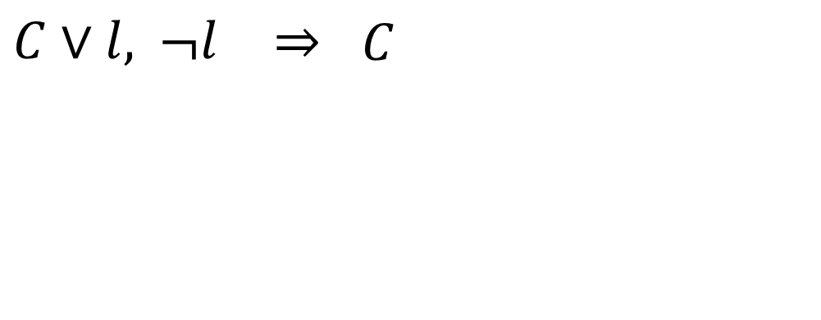
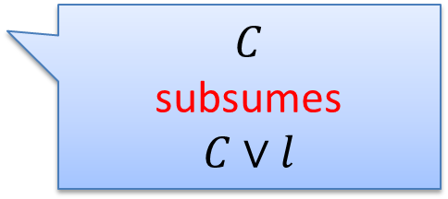
Unit Resolution
$C∨l,$ $¬l$ | $$⇒$$ | $$C$$
$$C$$
subsumes
$$C∨l$$

Slide 16
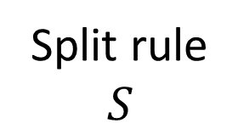


DPLL
Split rule
$$S$$
$$S, p$$
$$S, ¬p$$
DPLL = Unit Resolution + Split rule

Slide 17
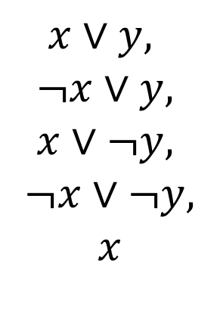
DPLL
$$x∨y, ¬x∨y, x∨¬y, ¬x∨¬y$$
$$x∨y,$$
$$¬x∨y,$$
$$x∨¬y,$$
$$¬x∨¬y,$$
$$x$$

Slide 18
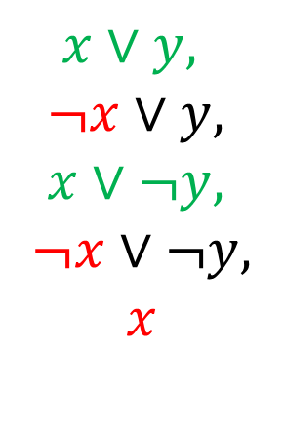
DPLL
$$x∨y, ¬x∨y, x∨¬y, ¬x∨¬y$$
$$x∨y,$$
$$¬x∨y,$$
$$x∨¬y,$$
$$¬x∨¬y,$$
$$x$$

Slide 19
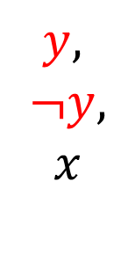
DPLL
$$x∨y, ¬x∨y, x∨¬y, ¬x∨¬y$$
$$y,$$
$$¬y,$$
$$x$$

Slide 20
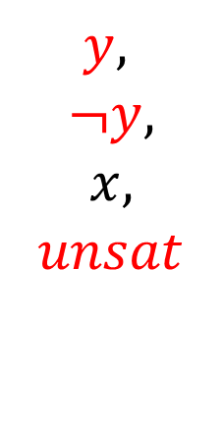
DPLL
$$x∨y, ¬x∨y, x∨¬y, ¬x∨¬y$$
$$y,$$
$$¬y,$$
$$x,$$
$$unsat$$

Slide 21
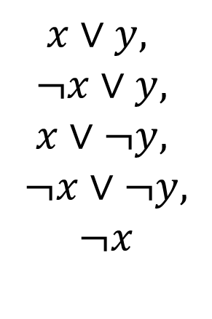
DPLL
$$x∨y, ¬x∨y, x∨¬y, ¬x∨¬y$$
$$y,$$
$$¬y,$$
$$x,$$
$$unsat$$
$$x∨y,$$
$$¬x∨y,$$
$$x∨¬y,$$
$$¬x∨¬y,$$
$$¬x$$

Slide 22
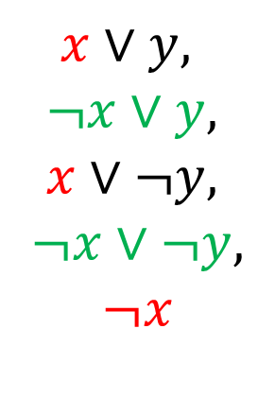
DPLL
$$x∨y, ¬x∨y, x∨¬y, ¬x∨¬y$$
$$y,$$
$$¬y,$$
$$x,$$
$$unsat$$
$$x∨y,$$
$$¬x∨y,$$
$$x∨¬y,$$
$$¬x∨¬y,$$
$$¬x$$

Slide 23
CDCL: Conflict Driven Clause Learning
DPLL
Conflict
Resolution
Resolution
Model
Proof

Slide 24
Linear Arithmetic
Fourier-Motzkin | Simplex
Proof-finder | Model-finder
Saturation | Search

Slide 25



Fourier-Motzkin
$$t_{1}≤ax, bx≤t_{2}$$
$$bt_{1}≤abx, abx≤{at}_{2}$$
$$bt_{1}≤{at}_{2}$$
Very similar to Resolution
Exponential time and space

Slide 26

Polynomial Constraints
AKA
Existential Theory of the Reals
∃R
$$x^{2}−4x+y^{2}−y+8 <1$$
$xy−2x −2y+4>1$

Slide 27
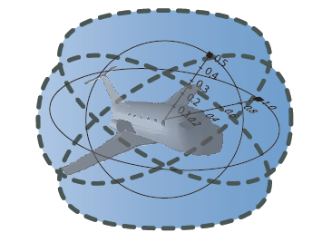
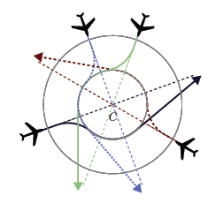
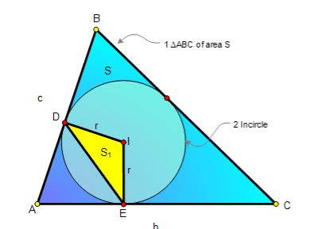

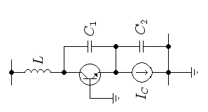

Applications

Slide 28

CAD “Big Picture”
1. Project/Saturate set of polynomials
2. Lift/Search: Incrementally build assignment$v: x_{k}→$ $α_{k}$
Isolate roots of polynomials $f_{i}(α,x)$
Select a feasible cell $C$, and assign $x_{k}$ some $α_{k}∈C$
If there is no feasible cell, then backtrack

Slide 29
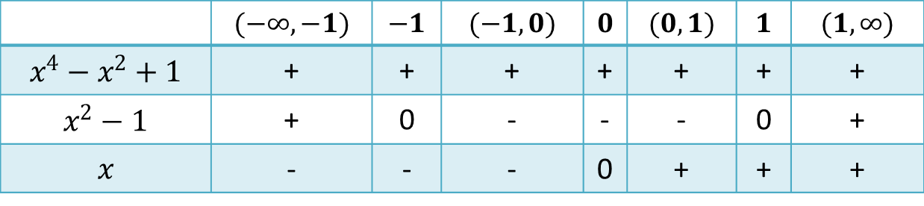





CAD “Big Picture”
$$x^{2}+y^{2} −1<0$$
$$x^{4}−x^{2}+1$$
$$x y −1>0$$
$$x^{2}−1$$
1. Saturate
$$x$$
2. Search
 | $$(−∞, −1)$$ | $$−1$$ | $$(−1, 0)$$ | $$0$$ | $$(0,1)$$ | $$1$$ | $$(1, ∞)$$
$$x^{4}−x^{2}+1$$ | + | + | + | + | + | + | +
$$x^{2}−1$$ | + | 0 | - | - | - | 0 | +
$$x$$ | - | - | - | 0 | + | + | +
Notes:
Backtracking

Slide 30

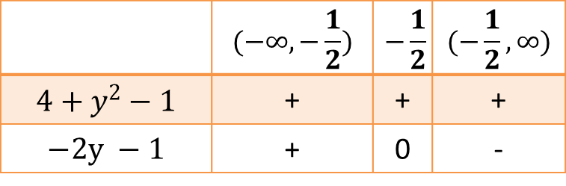


CAD “Big Picture”
$$x^{2}+y^{2} −1<0$$
$$x^{4}−x^{2}+1$$
$$x y −1>0$$
$$x^{2}−1$$
1. Saturate
$$x$$
 | $$(−∞, −\frac{1}{2})$$ | $$−\frac{1}{2}$$ | $$(−\frac{1}{2}, ∞)$$
$$4+y^{2}−1$$ | + | + | +
$$−2y −1$$ | + | 0 | -
$$x−2$$
2. Search
 | $$(−∞, −1)$$ | $$−1$$ | $$(−1, 0)$$ | $$0$$ | $$(0,1)$$ | $$1$$ | $$(1, ∞)$$
$$x^{4}−x^{2}+1$$ | + | + | + | + | + | + | +
$$x^{2}−1$$ | + | 0 | - | - | - | 0 | +
$$x$$ | - | - | - | 0 | + | + | +
Notes:
Backtracking

Slide 31

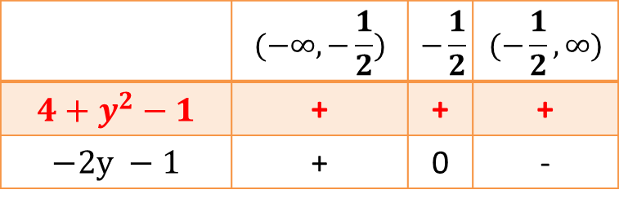

CAD “Big Picture”
$$x^{2}+y^{2} −1<0$$
$$x^{4}−x^{2}+1$$
$$x y −1>0$$
$$x^{2}−1$$
1. Saturate
$$x$$
 | $$(−∞, −\frac{1}{2})$$ | $$−\frac{1}{2}$$ | $$(−\frac{1}{2}, ∞)$$
$$4+y^{2}−1$$ | + | + | +
$$−2y −1$$ | + | 0 | -
CONFLICT
$$x−2$$
2. Search
 | $$(−∞, −1)$$ | $$−1$$ | $$(−1, 0)$$ | $$0$$ | $$(0,1)$$ | $$1$$ | $$(1, ∞)$$
$$x^{4}−x^{2}+1$$ | + | + | + | + | + | + | +
$$x^{2}−1$$ | + | 0 | - | - | - | 0 | +
$$x$$ | - | - | - | 0 | + | + | +
Notes:
Backtracking

Slide 32
NLSAT: Model-Based Search
Static x Dynamic
Optimistic approach
Key ideas
Proofs
Conflict
Resolution
Models
Start the Search before Saturate/Project
We saturate on demand
Model guides the saturation

Slide 33
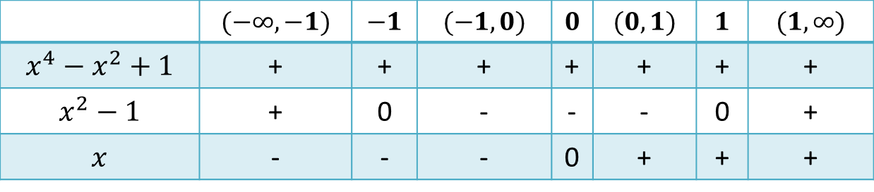

NLSAT (1)
Two kinds of decision
1. case-analysis (Boolean)
$$x^{2}+y^{2}<1∨x<0∨x y>1$$
2. model construction (CAD lifting)
$$x−2$$
 | $$(−∞, −1)$$ | $$−1$$ | $$(−1, 0)$$ | $$0$$ | $$(0,1)$$ | $$1$$ | $$(1, ∞)$$
$$x^{4}−x^{2}+1$$ | + | + | + | + | + | + | +
$$x^{2}−1$$ | + | 0 | - | - | - | 0 | +
$$x$$ | - | - | - | 0 | + | + | +

Slide 34

NLSAT (1)
Two kinds of decision
1. case-analysis (Boolean)
2. model construction (CAD lifting)
Parametric calculus: $explain\left(F, M\right)$
Finite basis explanation function
Explanations may contain new literals
They evaluate to false in the current state

Slide 35
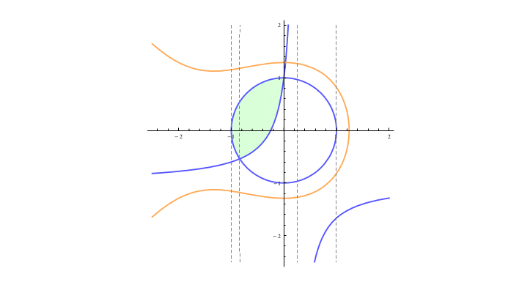

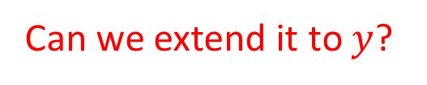

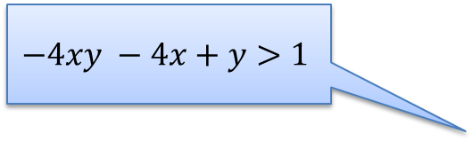
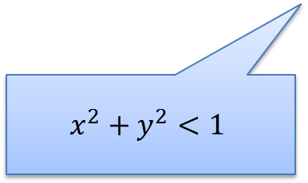
NLSAT (2)
Key ideas: Use partial solution to guide the search
Feasible Region
$$x^{3}+2x^{2}+3y^{2}−5<0$$
Starting search
Partial solution:
$$x←0.5$$
$$−4xy −4x+y>1$$
What is the core?
$$x^{2}+y^{2}<1$$
Can we extend it to $y$?

Slide 36
NLSAT (2)
Key ideas: Use partial solution to guide the search
Feasible Region
$$x^{3}+2x^{2}+3y^{2}−5<0$$
Starting search
Partial solution:
$$x←0.5$$
$$−4xy −4x+y>1$$
What is the core?
$$x^{2}+y^{2}<1$$
Can we extend it to $y$?

Slide 37
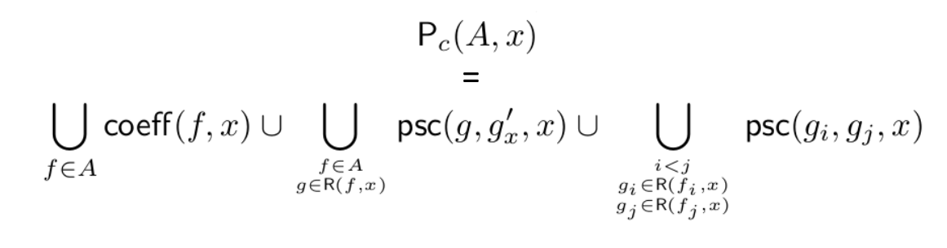
NLSAT (3)
Key ideas: Solution based Project/Saturate
Standard project operators are pessimistic.
Coefficients can vanish!

Slide 38
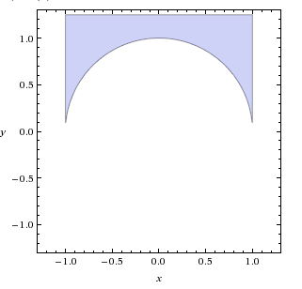

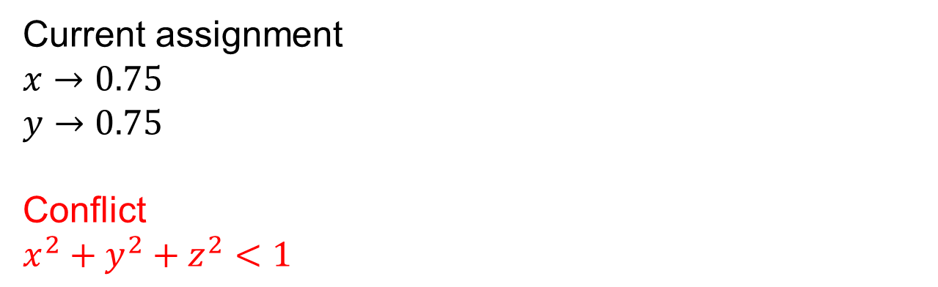
NLSAT (4)
Key ideas: Lemma Learning
Prevent a Conflict from happening again.
Current assignment
$$x→0.75$$
$$y→0.75$$
Conflict
$$x^{2}+y^{2}+z^{2}<1$$
Current assignments does not satisfy new constraint.
Lemma
$−1<x<1 ∧ y>root_{2}\left(1−{ \tilde{y}}^{2}−{ x}^{2}\right) ⇒ ⊥$

Slide 39
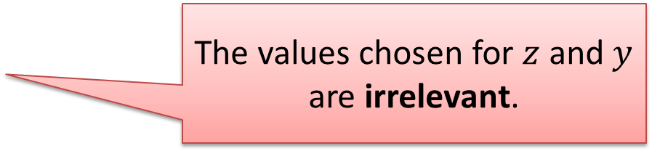
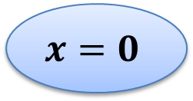
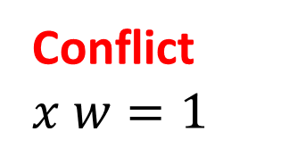

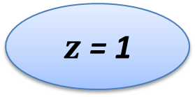
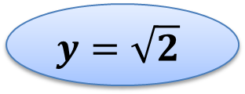
NLSAT (5)
Key ideas: Nonchronological Backtracking
$$w$$
Conflict
$$x w=1$$
$z$ = 1
The values chosen for $z$ and $y$ are irrelevant.
$$y=\sqrt{2}$$
$$x=0$$

Slide 40
Machinery
Multivariate & univariate Polynomials
Basic operations, Pseudo-division,
GCD, Resultant, PSC, Factorization,
Root isolation algorithms, Sturm sequences
Binary rationals $\frac{a}{2^{k}}$
Real Algebraic Numbers

Slide 41
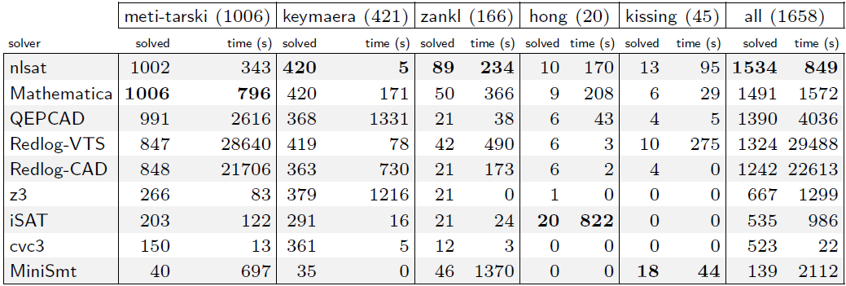
Experimental Results (1)
OUR NEW ENGINE

Slide 42
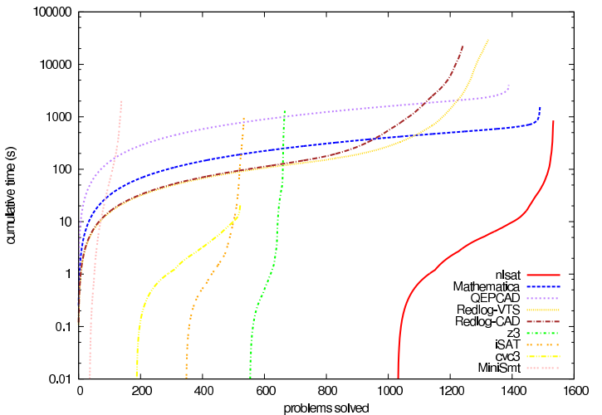
Experimental Results (2)
OUR NEW ENGINE

Slide 43
Other examples (for linear arithmetic)
Generalizing DPLL to richer logics
[McMillan et al 2009]
Fourier-Motzkin
X
Conflict Resolution
[Korovin et al 2009]

Slide 44
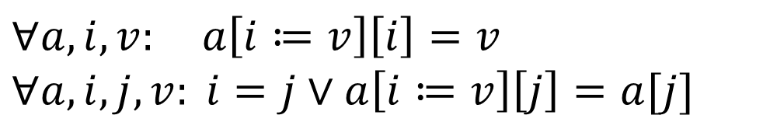
Other examples
Lemmas on Demand
For Theory of Array
[Brummayer-Biere 2009]
Array Theory by
Axiom Instantiation
X
$$∀a,i,v: a\left[i≔v\right]\left[i\right]=v$$
$$∀a,i,j, v: i=j∨a\left[i≔v\right]\left[j\right]=a[j]$$

Slide 45
Saturation: successful instances
Polynomial time procedures
Gaussian Elimination
Congruence Closure

Slide 46
MCSat
Model-Driven SMT
Lift ideas from CDCL to SMT
Generalize ideas found in model-driven approaches
Easier to implement
Model construction is explicit

Slide 47
MCSat
$$x≥2, \left(¬x≥1∨y≥1\right), (x^{2}+y^{2}≤1∨xy>1)$$

Slide 48
MCSat
$$x≥2, \left(¬x≥1∨y≥1\right), (x^{2}+y^{2}≤1∨xy>1)$$
$$x≥2$$
Propagations

Slide 49
MCSat
$$x≥2, \left(¬x≥1∨y≥1\right), (x^{2}+y^{2}≤1∨xy>1)$$
$$x≥2$$
$$x≥1$$
Propagations

Slide 50

MCSat
$$x≥2, \left(¬x≥1∨y≥1\right), (x^{2}+y^{2}≤1∨xy>1)$$
$$x≥2$$
$$x≥1$$
$$y≥1$$
Propagations

Slide 51

MCSat
$$x≥2, \left(¬x≥1∨y≥1\right), (x^{2}+y^{2}≤1∨xy>1)$$
$$x≥2$$
$$x≥1$$
$$y≥1$$
$$x^{2}+y^{2}≤1$$
Boolean Decisions

Slide 52

MCSat
$$x≥2, \left(¬x≥1∨y≥1\right), (x^{2}+y^{2}≤1∨xy>1)$$
$$x≥2$$
$$x≥1$$
$$y≥1$$
$$x^{2}+y^{2}≤1$$
$$x→2$$
Semantic Decisions

Slide 53
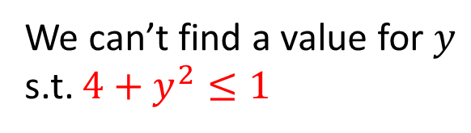


MCSat
$$x≥2, \left(¬x≥1∨y≥1\right), (x^{2}+y^{2}≤1∨xy>1)$$
$$x≥2$$
$$x≥1$$
$$y≥1$$
$$x^{2}+y^{2}≤1$$
$$x→2$$
Conflict
We can’t find a value for $y$ s.t. $4+y^{2}≤1$

Slide 54
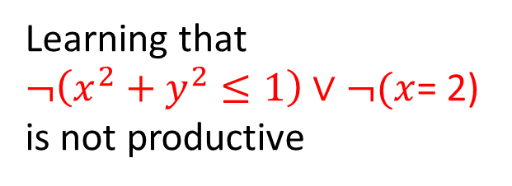
MCSat
$$x≥2, \left(¬x≥1∨y≥1\right), (x^{2}+y^{2}≤1∨xy>1)$$
$$x≥2$$
$$x≥1$$
$$y≥1$$
$$x^{2}+y^{2}≤1$$
$$x→2$$
Conflict
We can’t find a value for $y$ s.t. $4+y^{2}≤1$
Learning that
$¬\left(x^{2}+y^{2}≤1\right)∨¬(x$= 2)
is not productive

Slide 55
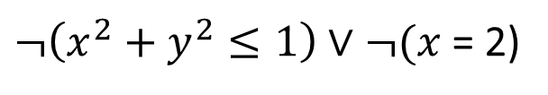

MCSat
$$x≥2, \left(¬x≥1∨y≥1\right), (x^{2}+y^{2}≤1∨xy>1)$$
$$x≥2$$
$$x≥1$$
$$y≥1$$
$$x^{2}+y^{2}≤1$$
$$¬(x=2)$$
$¬\left(x^{2}+y^{2}≤1\right)∨¬(x$= 2)
Learning that
$¬\left(x^{2}+y^{2}≤1\right)∨¬(x$= 2)
is not productive

Slide 56

MCSat
$$x≥2, \left(¬x≥1∨y≥1\right), (x^{2}+y^{2}≤1∨xy>1)$$
$$x≥2$$
$$x≥1$$
$$y≥1$$
$$x^{2}+y^{2}≤1$$
$$¬(x=2)$$
$$x→3$$
$¬\left(x^{2}+y^{2}≤1\right)∨¬(x$= 2)
Learning that
$¬\left(x^{2}+y^{2}≤1\right)∨¬(x$= 2)
is not productive

Slide 57
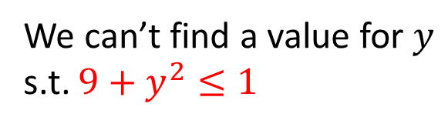

MCSat
$$x≥2, \left(¬x≥1∨y≥1\right), (x^{2}+y^{2}≤1∨xy>1)$$
$$x≥2$$
$$x≥1$$
$$y≥1$$
$$x^{2}+y^{2}≤1$$
$$¬(x=2)$$
$$x→3$$
“Same” Conflict
$¬\left(x^{2}+y^{2}≤1\right)∨¬(x$= 2)
We can’t find a value for $y$ s.t. $9+y^{2}≤1$
Learning that
$¬\left(x^{2}+y^{2}≤1\right)∨¬(x$= 2)
is not productive

Slide 58











$$x≥2, \left(¬x≥1∨y≥1\right), (x^{2}+y^{2}≤1∨xy>1)$$
$$x≥2$$
$$x≥1$$
$$y≥1$$
$$x^{2}+y^{2}≤1$$
$$x→2$$
Conflict
$$y$$
$$x^{2}+y^{2}≤1$$
$$x→2$$
$$x$$
$$−1≤x, x≤1$$
$$¬(x^{2}+y^{2}≤1)∨x≤1$$

Slide 59


MCSat
$$x≥2, \left(¬x≥1∨y≥1\right), (x^{2}+y^{2}≤1∨xy>1)$$
$$x≥2$$
$$x≥1$$
$$y≥1$$
$$x^{2}+y^{2}≤1$$
$$x≤1$$
$$¬(x^{2}+y^{2}≤1)∨x≤1$$

Slide 60

MCSat
$$x≥2, \left(¬x≥1∨y≥1\right), (x^{2}+y^{2}≤1∨xy>1)$$
$$x≥2$$
$$x≥1$$
$$y≥1$$
$$x^{2}+y^{2}≤1$$
$$x≤1$$
$$¬(x^{2}+y^{2}≤1)∨x≤1$$
Conflict
$$¬\left(x≥2\right)∨¬(x≤1)$$

Slide 61

MCSat
$$x≥2, \left(¬x≥1∨y≥1\right), (x^{2}+y^{2}≤1∨xy>1)$$
$$x≥2$$
$$x≥1$$
$$y≥1$$
$$x^{2}+y^{2}≤1$$
$$¬(x^{2}+y^{2}≤1)∨x≤1$$
Learned by resolution
$$¬\left(x≥2\right)∨¬(x^{2}+y^{2}≤1)$$

Slide 62

MCSat
$$x≥2, \left(¬x≥1∨y≥1\right), (x^{2}+y^{2}≤1∨xy>1)$$
$$x≥2$$
$$x≥1$$
$$y≥1$$
$$¬(x^{2}+y^{2}≤1)$$
$$¬\left(x≥2\right)∨¬(x^{2}+y^{2}≤1)$$
$$¬(x^{2}+y^{2}≤1)∨x≤1$$

Slide 63


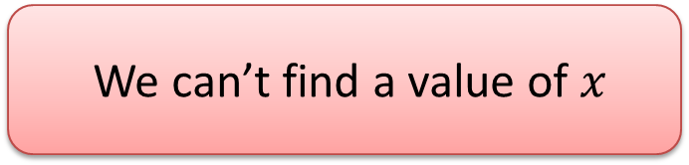


MCSat: FM Example
$$−x+z+1≤0$$
$$z→0$$
$$x−y≤0$$
$$y→0$$
$−x+z+1≤0$, $x−y≤0$
$$z→0, y→0$$
$$≡$$
$z+1≤x$, $x≤y$
$1≤x$, $x≤0$
We can’t find a value of $x$

Slide 64

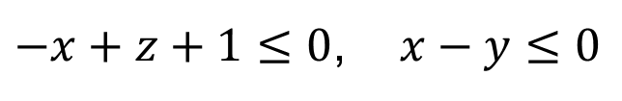


MCSat: FM Example
$$−x+z+1≤0$$
$$z→0$$
$$x−y≤0$$
$$y→0$$
$−x+z+1≤0$, $x−y≤0$
$$z→0, y→0$$
$∃x:−x+z+1≤0 ∧$ $x−y≤0$
Fourier-Motzkin
$$z+1−y≤0$$
$$¬\left(−x+z+1≤0\right)∨¬\left(x−y≤0\right)∨z+1−y≤0$$

Slide 65

MCSat: FM Example
$$−x+z+1≤0$$
$$z→0$$
$$x−y≤0$$
$$z+1−y≤0$$
$$¬\left(−x+z+1≤0\right)∨¬\left(x−y≤0\right)∨z+1−y≤0$$

Slide 66






MCSat: FM Example
$$−x+z+1≤0$$
$$z→0$$
$$x−y≤0$$
$$z+1−y≤0$$
$$y→1$$
$$¬\left(−x+z+1≤0\right)∨¬\left(x−y≤0\right)∨z+1−y≤0$$
$−x+z+1≤0$, $x−y≤0$
$$z→0, y→1$$
$$≡$$
$z+1≤x$, $x≤y$
$1≤x$, $x≤1$

Slide 67






MCSat: FM Example
$$−x+z+1≤0$$
$$z→0$$
$$x−y≤0$$
$$z+1−y≤0$$
$$y→1$$
$$x→1$$
$$¬\left(−x+z+1≤0\right)∨¬\left(x−y≤0\right)∨z+1−y≤0$$
$−x+z+1≤0$, $x−y≤0$
$$z→0, y→1$$
$$≡$$
$z+1≤x$, $x≤y$
$1≤x$, $x≤1$

Slide 68




MCSat – Finite Basis
Every theory that admits quantifier elimination has a finite basis (given a fixed assignment order)
$$F[x, y_{1}, …, y_{m}]$$
$$y_{1}→α_{1}, …,y_{m}→α_{m}$$
$$∃x:F[x,y_{1}, …, y_{m}]$$
$$C_{1}[y_{1},…,y_{m}]∧…∧C_{k}[y_{1},…,y_{m}]$$
$$¬F\left[x, y_{1}, …, y_{m}\right]∨C_{k}[y_{1}, …,y_{m}]$$

Slide 69





MCSat – Finite Basis
$$F_{n}[x_{1,}x_{2},…, {x_{n−1},x}_{n}]$$
$$F_{n−1}[x_{1,}x_{2},…,x_{n−1}]$$
$$…$$
$$F_{2}[x_{1,}x_{2}]$$
$$F_{1}[x_{1}]$$

Slide 70

MCSat – Finite Basis
$$F_{n}[x_{1,}x_{2},…, {x_{n−1},x}_{n}]$$
$$F_{n−1}[x_{1,}x_{2},…,x_{n−1}]$$
$$…$$
$$F_{2}[x_{1,}x_{2}]$$
$$F_{1}[x_{1}]$$

Slide 71

MCSat – Finite Basis
$$F_{n}[x_{1,}x_{2},…, {x_{n−1},x}_{n}]$$
$$F_{n−1}[x_{1,}x_{2},…,x_{n−1}]$$
$$…$$
$$F_{2}[x_{1,}x_{2}]$$
$$F_{1}[x_{1}]$$

Slide 72
MCSat – Finite Basis
$$F_{n}[x_{1,}x_{2},…, {x_{n−1},x}_{n}]$$
$$F_{n−1}[x_{1,}x_{2},…,x_{n−1}]$$
$$…$$
$$F_{2}[x_{1,}x_{2}]$$
$$F_{1}[x_{1}]$$

Slide 73


MCSat – Finite Basis
Every “finite” theory has a finite basis
Example: Fixed size Bit-vectors
$$F[x, y_{1}, …, y_{m}]$$
$$y_{1}→α_{1}, …,y_{m}→α_{m}$$
$$¬F\left[x, y_{1}, …, y_{m}\right]∨¬(y_{1}=α_{1})∨…∨{¬(y}_{m}=α_{m})$$

Slide 74
MCSat – Finite Basis
Theory of uninterpreted functions has a finite basis
Theory of arrays has a finite basis [Brummayer- Biere 2009]
In both cases the Finite Basis is essentially composed of equalities between existing terms.

Slide 75

MCSat: Uninterpreted Functions
$$a=b+1, f\left(a−1\right)<c, f\left(b\right)>a$$
$$a=b+1, f\left(k\right)<c, f\left(b\right)>a, k=a −1$$
$$a=b+1, f\left(k\right)<c, f\left(b\right)>a, k=a −1$$
Treat $f(k)$ and $f(b)$ as variables
Generalized variables

Slide 76






MCSat: Uninterpreted Functions
$$a=b+1, f\left(k\right)<c, f\left(b\right)>a, k=a −1$$
$$k→0$$
$$b→0$$
$$f(k)→0$$
$$f(b)→2$$
Conflict: $f\left(k\right)$ and $f\left(b\right)$ must be equal
$$¬\left(k=b\right)∨f\left(k\right)=f(b)$$

Slide 77


MCSat: Uninterpreted Functions
$$a=b+1, f\left(k\right)<c, f\left(b\right)>a, k=a −1$$
$$k→0$$
$$b→0$$
$$f(k)→0$$
$$k=b$$
(Semantic) Propagation
$$¬\left(k=b\right)∨f\left(k\right)=f(b)$$

Slide 78


MCSat: Uninterpreted Functions
$$a=b+1, f\left(k\right)<c, f\left(b\right)>a, k=a −1$$
$$k→0$$
$$b→0$$
$$f(k)→0$$
$$k=b$$
$$f\left(k\right)=f(b)$$
$$¬\left(k=b\right)∨f\left(k\right)=f(b)$$

Slide 79

MCSat: Uninterpreted Functions
$$a=b+1, f\left(k\right)<c, f\left(b\right)>a, k=a −1$$
$$k→0$$
$$b→0$$
$$f(k)→0$$
$$k=b$$
$$f\left(k\right)=f(b)$$
$$f(b)→0$$
$$¬\left(k=b\right)∨f\left(k\right)=f(b)$$

Slide 80







MCSat – Finite Basis
We can also use literals from the finite basis in decisions.
Application: simulate branch&bound for bounded linear integer arithmetic
$$x_{2}$$
6
$$x_{1}=0.8$$
$$x_{2}=2.4$$
5
LP solution:
4
$$x_{1}≤0$$
$$x_{1}≥1$$
3
2
1
$$x_{1}=0$$
$$x_{2}=3$$
$$x_{1}=1$$
$$x_{2}=2$$
0
1
2
3
4
5
6
$$x_{1}$$

Slide 81
MCSat: Termination
Propagations
Boolean Decisions
Semantic Decisions

Slide 82

MCSat
$$≻$$
Propagations
Boolean Decisions
Semantic Decisions

Slide 83

MCSat
$$≻$$
Propagations
Boolean Decisions
Semantic Decisions

Slide 84

MCSat
Maximal Elements
…
…
$$|FiniteBasis|$$

Slide 85







$$x≥2, \left(¬x≥1∨y≥1\right), (x^{2}+y^{2}≤1∨xy>1)$$
$$x≥2$$
$$x≥1$$
$$y≥1$$
$$x^{2}+y^{2}≤1$$
$$x≤1$$
Conflict
$$¬\left(x≥2\right)∨¬(x≤1)$$
$$¬(x^{2}+y^{2}≤1)∨x≤1$$

Slide 86






$$x≥2, \left(¬x≥1∨y≥1\right), (x^{2}+y^{2}≤1∨xy>1)$$
$$x≥2$$
$$x≥1$$
$$y≥1$$
$$x^{2}+y^{2}≤1$$
$$x≤1$$
Conflict
$$¬\left(x≥2\right)∨¬(x≤1)$$
$$¬(x^{2}+y^{2}≤1)∨x≤1$$
$$x≥2, \left(¬x≥1∨y≥1\right), (x^{2}+y^{2}≤1∨xy>1)$$
$$x≥2$$
$$x≥1$$
$$y≥1$$
$$¬(x^{2}+y^{2}≤1)$$
$$¬(x^{2}+y^{2}≤1)∨x≤1$$
$$¬\left(x≥2\right)∨¬(x^{2}+y^{2}≤1)$$

Slide 87
$$x≥2, \left(¬x≥1∨y≥1\right), (x^{2}+y^{2}≤1∨xy>1)$$
$$x≥2$$
$$x≥1$$
$$y≥1$$
$$x^{2}+y^{2}≤1$$
$$x≤1$$
Conflict
$$¬\left(x≥2\right)∨¬(x≤1)$$
$$¬(x^{2}+y^{2}≤1)∨x≤1$$
$$x≥2, \left(¬x≥1∨y≥1\right), (x^{2}+y^{2}≤1∨xy>1)$$
$$x≥2$$
$$x≥1$$
$$y≥1$$
$$¬(x^{2}+y^{2}≤1)$$
$$¬(x^{2}+y^{2}≤1)∨x≤1$$
$$¬\left(x≥2\right)∨¬(x^{2}+y^{2}≤1)$$

Slide 88

MCSat
$$x<1∨p, ¬p∨x=2$$
$$x→1$$

Slide 89


MCSat
$$x<1∨p, ¬p∨x=2$$
$$x→1$$
$$p$$

Slide 90
MCSat
$$x<1∨p, ¬p∨x=2$$
$$x→1$$
$$p$$
Conflict (evaluates to false)

Slide 91
MCSat
$$x<1∨p, ¬p∨x=2$$
$$x→1$$
$$p$$
New clause
$$x<1∨x=2$$

Slide 92

MCSat
$$x<1∨p, ¬p∨x=2$$
$$x→1$$
$$p$$
New clause
$$x<1∨x=2$$
$$x<1$$

Slide 93
MCSat
$$x<1∨p, ¬p∨x=2$$
$$x→1$$
$$p$$
New clause
$$x<1∨x=2$$
$$x<1$$

Slide 94
MCSat: Architecture
Arithmetic
Arrays
Boolean
Lists

Slide 95




MCSat prototype: 7k lines of code
Deduction Rules
Boolean Resolution
Fourier-Motzkin
Equality Split
Ackermann expansion
aka Congruence
Normalization

Slide 96

MCSat: preliminary results prototype: 7k lines of code
QF_LRA

Slide 97

MCSat: preliminary results prototype: 7k lines of code
QF_UFLRA and QF_UFLIA

Slide 98
Conclusion
Logic as a Service
Model-Based techniques are very promising
MCSat
http://z3.codeplex.com
http://rise4fun.com/z3

