Slide 1
Arithmetic and Optimization @ MCSat
Leonardo de Moura
Joint work with
Dejan Jovanović and Grant Passmore

Slide 2
Arithmetic and Optimization @ MCSat (random remarks)
Leonardo de Moura
Joint work with
Dejan Jovanović and Grant Passmore

Slide 3

Polynomial Constraints
AKA
Existential Theory of the Reals
∃R
$$x^{2}−4x+y^{2}−y+8 <1$$
$xy−2x −2y+4>1$

Slide 4

CAD “Big Picture”
1. Project/Saturate set of polynomials
2. Lift/Search: Incrementally build assignment$v: x_{k}→$ $α_{k}$
Isolate roots of polynomials $f_{i}(α,x)$
Select a feasible cell $C$, and assign $x_{k}$ some $α_{k}∈C$
If there is no feasible cell, then backtrack

Slide 5
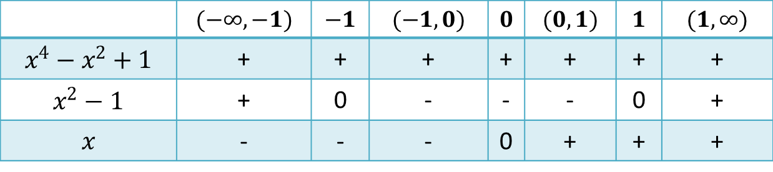





CAD “Big Picture”
$$x^{2}+y^{2} −1<0$$
$$x^{4}−x^{2}+1$$
$$x y −1>0$$
$$x^{2}−1$$
1. Saturate
$$x$$
2. Search
 | $$(−∞, −1)$$ | $$−1$$ | $$(−1, 0)$$ | $$0$$ | $$(0,1)$$ | $$1$$ | $$(1, ∞)$$
$$x^{4}−x^{2}+1$$ | + | + | + | + | + | + | +
$$x^{2}−1$$ | + | 0 | - | - | - | 0 | +
$$x$$ | - | - | - | 0 | + | + | +
Notes:
Backtracking

Slide 6

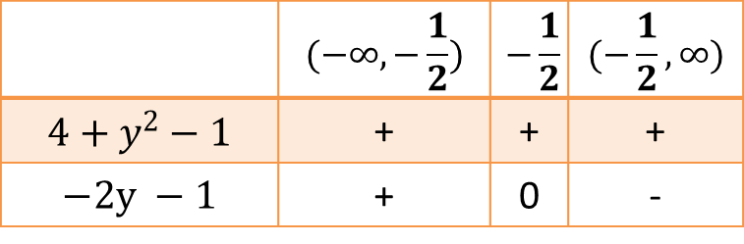


CAD “Big Picture”
$$x^{2}+y^{2} −1<0$$
$$x^{4}−x^{2}+1$$
$$x y −1>0$$
$$x^{2}−1$$
1. Saturate
$$x$$
 | $$(−∞, −\frac{1}{2})$$ | $$−\frac{1}{2}$$ | $$(−\frac{1}{2}, ∞)$$
$$4+y^{2}−1$$ | + | + | +
$$−2y −1$$ | + | 0 | -
$$x−2$$
2. Search
 | $$(−∞, −1)$$ | $$−1$$ | $$(−1, 0)$$ | $$0$$ | $$(0,1)$$ | $$1$$ | $$(1, ∞)$$
$$x^{4}−x^{2}+1$$ | + | + | + | + | + | + | +
$$x^{2}−1$$ | + | 0 | - | - | - | 0 | +
$$x$$ | - | - | - | 0 | + | + | +
Notes:
Backtracking

Slide 7

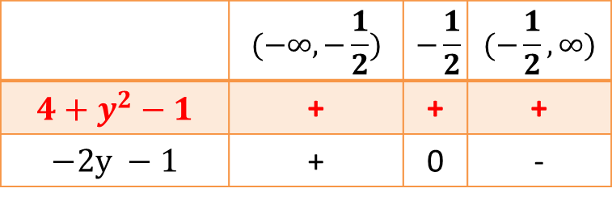

CAD “Big Picture”
$$x^{2}+y^{2} −1<0$$
$$x^{4}−x^{2}+1$$
$$x y −1>0$$
$$x^{2}−1$$
1. Saturate
$$x$$
 | $$(−∞, −\frac{1}{2})$$ | $$−\frac{1}{2}$$ | $$(−\frac{1}{2}, ∞)$$
$$4+y^{2}−1$$ | + | + | +
$$−2y −1$$ | + | 0 | -
CONFLICT
$$x−2$$
2. Search
 | $$(−∞, −1)$$ | $$−1$$ | $$(−1, 0)$$ | $$0$$ | $$(0,1)$$ | $$1$$ | $$(1, ∞)$$
$$x^{4}−x^{2}+1$$ | + | + | + | + | + | + | +
$$x^{2}−1$$ | + | 0 | - | - | - | 0 | +
$$x$$ | - | - | - | 0 | + | + | +
Notes:
Backtracking

Slide 8
NLSAT: MCSAT for Nonlinear Arithmetic
Static x Dynamic
Optimistic approach
Key ideas
Proofs
Conflict
Resolution
Models
Start the Search before Saturate/Project
We saturate on demand
Model guides the saturation

Slide 9
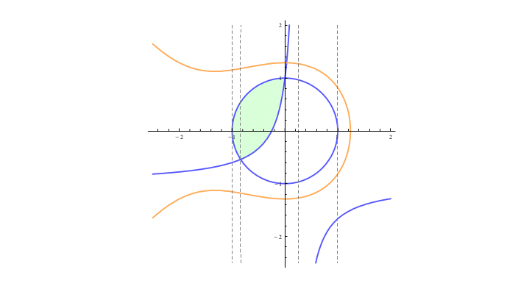



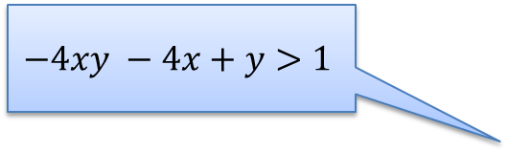
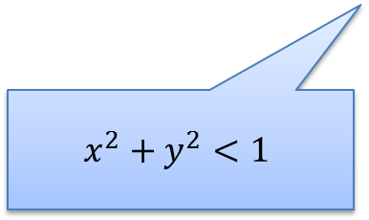
NLSAT/MCSAT
Key ideas: Use partial solution to guide the search
Feasible Region
$$x^{3}+2x^{2}+3y^{2}−5<0$$
Starting search
Partial solution:
$$x←0.5$$
$$−4xy −4x+y>1$$
What is the core?
$$x^{2}+y^{2}<1$$
Can we extend it to $y$?

Slide 10
NLSAT/MCSAT
Key ideas: Use partial solution to guide the search
Feasible Region
$$x^{3}+2x^{2}+3y^{2}−5<0$$
Starting search
Partial solution:
$$x←0.5$$
$$−4xy −4x+y>1$$
What is the core?
$$x^{2}+y^{2}<1$$
Can we extend it to $y$?

Slide 11
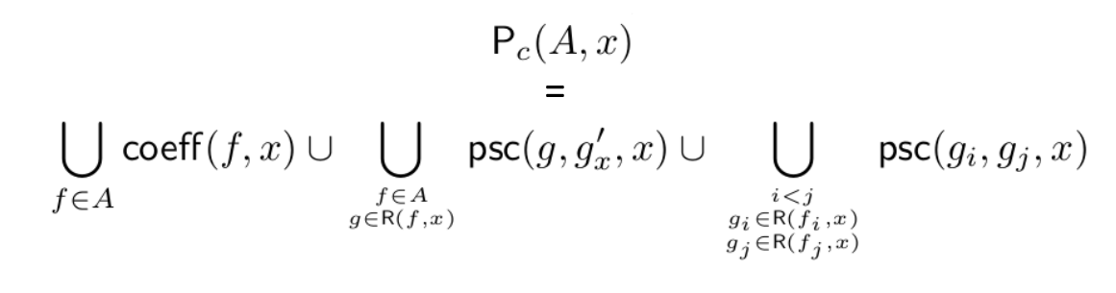
NLSAT/MCSAT
Key ideas: Solution based Project/Saturate
Standard project operators are pessimistic.
Coefficients can vanish!

Slide 12
NLSAT/MCSAT
$$x≥2, \left(¬x≥1∨y≥1\right), (x^{2}+y^{2}≤1∨xy>1)$$

Slide 13

NLSAT/MCSAT
$$x≥2, \left(¬x≥1∨y≥1\right), (x^{2}+y^{2}≤1∨xy>1)$$
$$x≥2$$
Propagations

Slide 14

NLSAT/MCSAT
$$x≥2, \left(¬x≥1∨y≥1\right), (x^{2}+y^{2}≤1∨xy>1)$$
$$x≥2$$
$$x≥1$$
Propagations

Slide 15

NLSAT/MCSAT
$$x≥2, \left(¬x≥1∨y≥1\right), (x^{2}+y^{2}≤1∨xy>1)$$
$$x≥2$$
$$x≥1$$
$$y≥1$$
Propagations

Slide 16

NLSAT/MCSAT
$$x≥2, \left(¬x≥1∨y≥1\right), (x^{2}+y^{2}≤1∨xy>1)$$
$$x≥2$$
$$x≥1$$
$$y≥1$$
$$x^{2}+y^{2}≤1$$
Boolean Decisions

Slide 17

NLSAT/MCSAT
$$x≥2, \left(¬x≥1∨y≥1\right), (x^{2}+y^{2}≤1∨xy>1)$$
$$x≥2$$
$$x≥1$$
$$y≥1$$
$$x^{2}+y^{2}≤1$$
$$x→2$$
Semantic Decisions

Slide 18
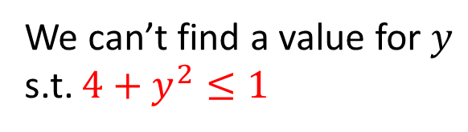


NLSAT/MCSAT
$$x≥2, \left(¬x≥1∨y≥1\right), (x^{2}+y^{2}≤1∨xy>1)$$
$$x≥2$$
$$x≥1$$
$$y≥1$$
$$x^{2}+y^{2}≤1$$
$$x→2$$
Conflict
We can’t find a value for $y$ s.t. $4+y^{2}≤1$

Slide 19
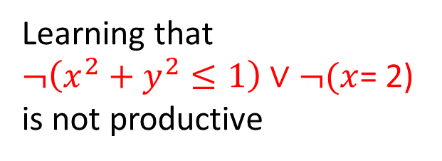
NLSAT/MCSAT
$$x≥2, \left(¬x≥1∨y≥1\right), (x^{2}+y^{2}≤1∨xy>1)$$
$$x≥2$$
$$x≥1$$
$$y≥1$$
$$x^{2}+y^{2}≤1$$
$$x→2$$
Conflict
We can’t find a value for $y$ s.t. $4+y^{2}≤1$
Learning that
$¬\left(x^{2}+y^{2}≤1\right)∨¬(x$= 2)
is not productive

Slide 20
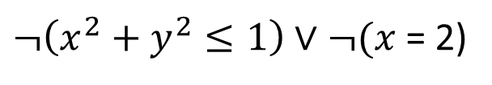

NLSAT/MCSAT
$$x≥2, \left(¬x≥1∨y≥1\right), (x^{2}+y^{2}≤1∨xy>1)$$
$$x≥2$$
$$x≥1$$
$$y≥1$$
$$x^{2}+y^{2}≤1$$
$$¬(x=2)$$
$¬\left(x^{2}+y^{2}≤1\right)∨¬(x$= 2)
Learning that
$¬\left(x^{2}+y^{2}≤1\right)∨¬(x$= 2)
is not productive

Slide 21

NLSAT/MCSAT
$$x≥2, \left(¬x≥1∨y≥1\right), (x^{2}+y^{2}≤1∨xy>1)$$
$$x≥2$$
$$x≥1$$
$$y≥1$$
$$x^{2}+y^{2}≤1$$
$$¬(x=2)$$
$$x→3$$
$¬\left(x^{2}+y^{2}≤1\right)∨¬(x$= 2)
Learning that
$¬\left(x^{2}+y^{2}≤1\right)∨¬(x$= 2)
is not productive

Slide 22


NLSAT/MCSAT
$$x≥2, \left(¬x≥1∨y≥1\right), (x^{2}+y^{2}≤1∨xy>1)$$
$$x≥2$$
$$x≥1$$
$$y≥1$$
$$x^{2}+y^{2}≤1$$
$$¬(x=2)$$
$$x→3$$
“Same” Conflict
$¬\left(x^{2}+y^{2}≤1\right)∨¬(x$= 2)
We can’t find a value for $y$ s.t. $9+y^{2}≤1$
Learning that
$¬\left(x^{2}+y^{2}≤1\right)∨¬(x$= 2)
is not productive

Slide 23











$$x≥2, \left(¬x≥1∨y≥1\right), (x^{2}+y^{2}≤1∨xy>1)$$
$$x≥2$$
$$x≥1$$
$$y≥1$$
$$x^{2}+y^{2}≤1$$
$$x→2$$
Conflict
$$y$$
$$x^{2}+y^{2}≤1$$
$$x→2$$
THIS IS AN INTERPOLANT
$$x$$
$$−1≤x, x≤1$$
$$¬(x^{2}+y^{2}≤1)∨x≤1$$

Slide 24


NLSAT/MCSAT
$$x≥2, \left(¬x≥1∨y≥1\right), (x^{2}+y^{2}≤1∨xy>1)$$
$$x≥2$$
$$x≥1$$
$$y≥1$$
$$x^{2}+y^{2}≤1$$
$$x≤1$$
$$¬(x^{2}+y^{2}≤1)∨x≤1$$

Slide 25

NLSAT/MCSAT
$$x≥2, \left(¬x≥1∨y≥1\right), (x^{2}+y^{2}≤1∨xy>1)$$
$$x≥2$$
$$x≥1$$
$$y≥1$$
$$x^{2}+y^{2}≤1$$
$$x≤1$$
$$¬(x^{2}+y^{2}≤1)∨x≤1$$
Conflict
$$¬\left(x≥2\right)∨¬(x≤1)$$

Slide 26

NLSAT/MCSAT
$$x≥2, \left(¬x≥1∨y≥1\right), (x^{2}+y^{2}≤1∨xy>1)$$
$$x≥2$$
$$x≥1$$
$$y≥1$$
$$x^{2}+y^{2}≤1$$
$$¬(x^{2}+y^{2}≤1)∨x≤1$$
Learned by resolution
$$¬\left(x≥2\right)∨¬(x^{2}+y^{2}≤1)$$

Slide 27
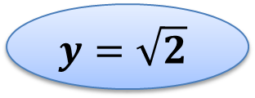
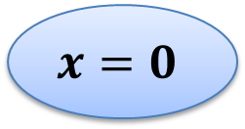

NLSAT/MCSAT
$$x≥2, \left(¬x≥1∨y≥1\right), (x^{2}+y^{2}≤1∨xy>1)$$
$$x≥2$$
$$x≥1$$
$$y≥1$$
$$¬(x^{2}+y^{2}≤1)$$
$$¬\left(x≥2\right)∨¬(x^{2}+y^{2}≤1)$$
$$¬(x^{2}+y^{2}≤1)∨x≤1$$

Slide 28
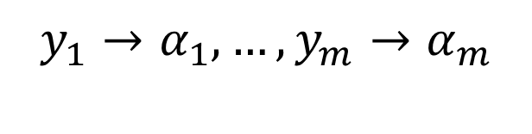



NLSAT/MCSAT – Finite Basis
Every theory that admits quantifier elimination has a finite basis (given a fixed assignment order)
$$F[x, y_{1}, …, y_{m}]$$
$$y_{1}→α_{1}, …,y_{m}→α_{m}$$
$$∃x:F[x,y_{1}, …, y_{m}]$$
$$C_{1}[y_{1},…,y_{m}]∧…∧C_{k}[y_{1},…,y_{m}]$$
$$¬F\left[x, y_{1}, …, y_{m}\right]∨C_{k}[y_{1}, …,y_{m}]$$

Slide 29





NLSAT/MCSAT – Finite Basis
$$F_{n}[x_{1,}x_{2},…, {x_{n−1},x}_{n}]$$
$$F_{n−1}[x_{1,}x_{2},…,x_{n−1}]$$
$$…$$
$$F_{2}[x_{1,}x_{2}]$$
$$F_{1}[x_{1}]$$

Slide 30

NLSAT/MCSAT – Finite Basis
$$F_{n}[x_{1,}x_{2},…, {x_{n−1},x}_{n}]$$
$$F_{n−1}[x_{1,}x_{2},…,x_{n−1}]$$
$$…$$
$$F_{2}[x_{1,}x_{2}]$$
$$F_{1}[x_{1}]$$

Slide 31

NLSAT/MCSAT – Finite Basis
$$F_{n}[x_{1,}x_{2},…, {x_{n−1},x}_{n}]$$
$$F_{n−1}[x_{1,}x_{2},…,x_{n−1}]$$
$$…$$
$$F_{2}[x_{1,}x_{2}]$$
$$F_{1}[x_{1}]$$

Slide 32
NLSAT/MCSAT – Finite Basis
$$F_{n}[x_{1,}x_{2},…, {x_{n−1},x}_{n}]$$
$$F_{n−1}[x_{1,}x_{2},…,x_{n−1}]$$
$$…$$
$$F_{2}[x_{1,}x_{2}]$$
$$F_{1}[x_{1}]$$

Slide 33
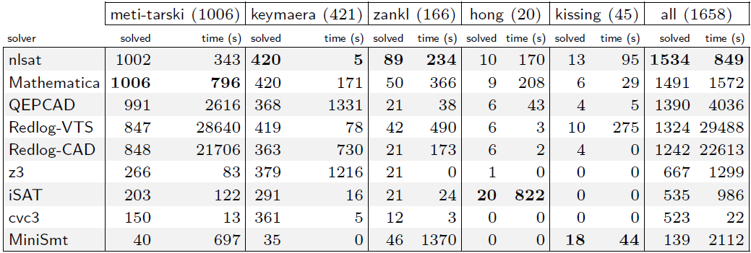
Experimental Results (1)
OUR NEW ENGINE

Slide 34
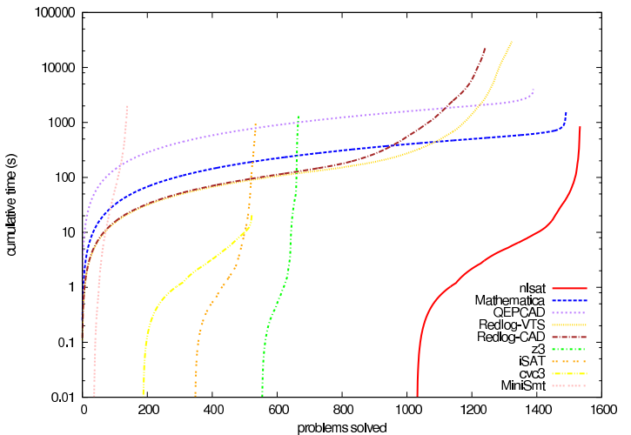
Experimental Results (2)
OUR NEW ENGINE

Slide 35

NLSAT Bootlenecks
Real Algebraic Computations
$$x^{5}−x −1=0$$
$$y^{3}−x^{2}−1=0$$

Slide 36
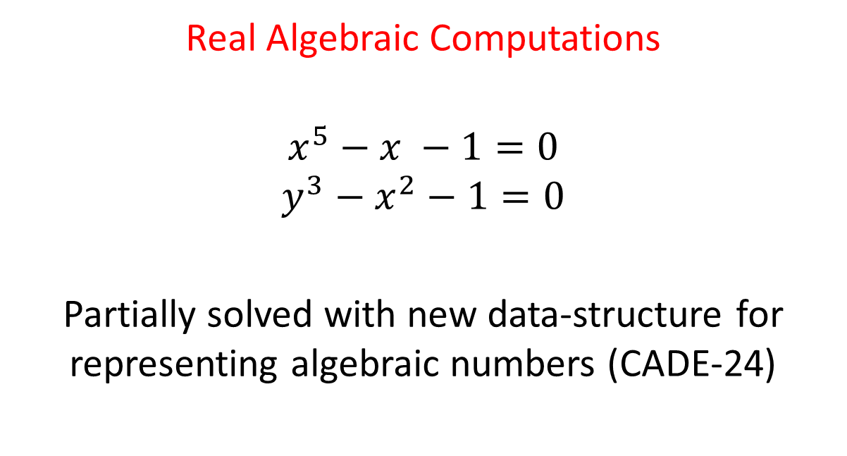
NLSAT Bootlenecks
Real Algebraic Computations
$$x^{5}−x −1=0$$
$$y^{3}−x^{2}−1=0$$
Partially solved with new data-structure for representing algebraic numbers (CADE-24)

Slide 37
NLSAT Bootlenecks
PSCs (aka Subresultants)
used in the projection operation

Slide 38
NLSAT Bootlenecks
17775151118729246135103863388881244617666660995187997666751969361497959600261429526762965024955216280099712289835808749268353553329553408 x^532 + 14473361351917674942786915532863722010517729893029084002260132795724226061515042219666395922056072037155588196471401681986578474461376811173412864 x^528 + 7229264998313939499755285902335926519307056597551651381146753511646047738146905415067477398888861711230373693449992379893747438459329806626598158336 x^524 + 158784827446222308921979727635817054235991980842353022538396492548153626499565364208853722786019478985969496682581884114140587007076140978185518972928 x^520 - 4410563168927154959307787280809148373010154156649833978256064036376437001542687429034576933638931815534105275826969416747569750785179602103271342211072 x^516 + 275981604809658125488926381199985855193552775515144632223023339400572704101030486623630265311259465820514249485787529521385167557247179634103204576231424 x^512 + 6005496113851709232159189387155432129186124262387022345374062107799536035700179566807919823125222614801401602675421835585186474612352437820625632425410560 x^508 + 9868516235764070332516671284250750538717740924705210798820147280258964925351014753466294425389789490898418284195320252535878334248758178877215099657912320 x^504 - 378028159474387237425783924562370206464801541899173138738283448214552506310481207722925933354771900671555660223317431714107705017411150737102305045174550528 x^500 - 1780873010623107319187865823676132892028239900785276876846096000498430603157244248300141910519071293157553116918309609948528141784332572969485575969088471040 x^496 + 4990560428467654860196604597453324843559087963276481697899863219725446559769492367522989640788543220219661578754114055194399798491910857107607723810620440576 x^492 + 59251181672059584077424535291209687078232953829881306760118723543670560648034779432845164225459730400245051751104340753741284859922353854611675214692701175808 x^488 + 109201751920878554152069678524782287046297971035994332930305162162683589782245643126391186807395573850358394453020368632207346082500403862320477315199250989056 x^484 - 543635472379893925360505124247110498770961588622964318091251368183582212798004391152930087582383621190153681363319204281535655046706194540731277164848615522304 x^480 - 3194670956856507038170782804869266802725402645284102679037145501374352436793117406480681198776756731038477784720721031162710801645757232905349994812022863167488 x^476 - 4389542999616648631176896862140482496025180570204160606868604052851952038383252327224402153694876499471391261384385978794867468485931764498796997297217185251328 x^472 + 15524463640477929342623012689068443238906921917318414901015667570651210157882543051008270507122059363243821913470981377270906967132756811349600993710391290757120 x^468 + 80230430018834186054096672189233096308237228378515144056129280360834909794336559434803359466411692112541882365896166210172878178922236773486199994866195813629952 x^464 + 130783283430011592992525937688271291747950864033011823499122097623311139311871055468781357776468264400549786532527216932407625418075352376349853019068119472144384 x^460 - 60351536353188030534762927297367399984025488595096075263659285538732087664513596914391741526578214246339915348904989182771248594080446910993435975372364947914752 x^456 - 673737188260475498982932420729791402429356609686364569053248570809232723474624874495372845950372093438174034642659688327168552160083094705613444283604882272813056 x^452 - 1318117509927793506162380225228023990287741912478720066809245992271712421491009133459969206543489785652231766194877671560048021548398906486339442301290611380060160 x^448 - 1205772902296624353525064468229731294159952402826502407966957243712474044871756863977220867339445619958882709535542116624268994947095099000601401794543891557384192 x^444 - 498147540139927868371121123193544793997390792351584158209270507443166229317102963234758051076664986272012629263789383825333809441919597343891557884342482707152896 x^440 - 42518316035687815029500437329049753144853170778074503722857356709783483039433964598020662789393811356984055296482888805350497766068131792648011052930362953957376 x^436 + 2167996804993158163001181995783226793635123598671754662727385112374477494375636416301609442111303553129819996897856795247956675815003699183308595660549691310866432 x^432 + 9240121069267051295045417000851608693216707145106865888222118073936078384812617095103340753185561818646400333469464298879016638319832506639469499496502215581892608 x^428 + 14142674873965714441086369293263351081598953483434978452220946251634405490570039165341647880486182030947941853112320373639351925117748260464648116616807160519589888 x^424 + 4804392316217169298797299552280517149141556371101110118079706175749819893456084330834213192017152592033652756465196002644939544131707849914986554956068418796650496 x^420 - 6134328651047789328297594265911322867983176776828417042204526328352800710210496869027446316063433853708134399584229350095830205627581054793407103214275303368032256 x^416 + 3667090053094090945313756073105630333582362976190542753984041052543074833064572525231477454196982964134256021905924763753701259287857721495779112184940262523404288 x^412 - 478182019810480876776906563099285241550749306282930585205816495097862179710089377342887742428258115095797444186389272755327507836131206425026140456005328418373632 x^408 - 50186901855213154855455322673164185696026971617543598141599919460301704348994047769553919666699488469505760925100359426459292729938602691732233804713882945039892480 x^404 - 49783192919360672941965836922796102255831339676036749735719193270699604144117615499151399963603838515014307866633369426721337772113987367017962230781939280563404800 x^400
….
1389385726272139827600391787516457146404057581084159628129387959867904441533378882732656681024381855322448 x^24 + 6206288177615149058112826996188212177598396346403337279651424778662193245748575347946115209485426265049 x^20 + 367427074610454070056469795165580196050000194113672530558928364635826090406030636905429257496922636544 x^16 + 703328874179918846589526631439210541602625801684456856171748313001635386337165809959342810385612800 x^12 - 68999097046917627889169552420353798555453476109616123008816364722270432052018874285536216875008 x^8 - 140432623903101758790898107887718053467061472637614549187228994429864721538224739784429911670784 x^4 + 272654874565539049477735920513220412248759995742372057602216372063084536679766701870415872000

Slide 39
Preamble for Grant’s talk

Slide 40

Check Modulo Assignment
Given a CNF formula $F$and a set of literals $S$
$$check(F,S)$$

Slide 41
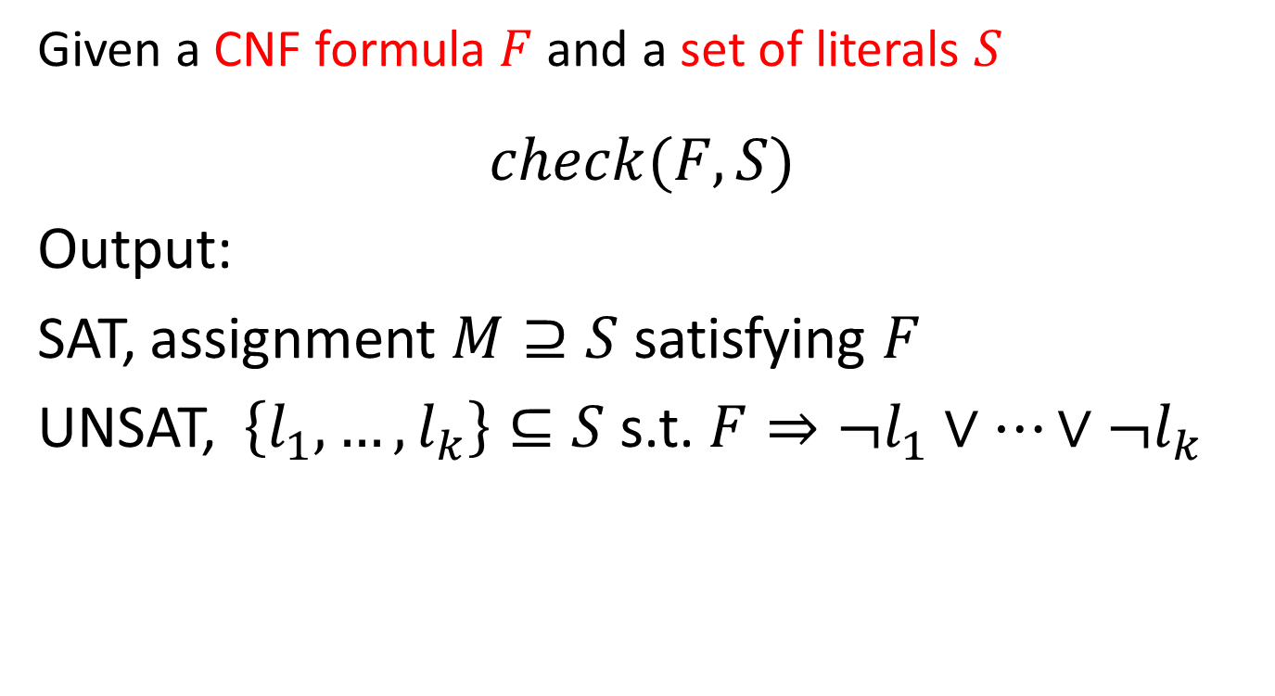
Check Modulo Assignment
Given a CNF formula $F$and a set of literals $S$
$$check(F,S)$$
Output:
SAT, assignment $M⊇S$ satisfying $F$
UNSAT, $\left\{l_{1}, …, l_{k}\right\}⊆S$ s.t. $F⇒{¬l}_{1}∨…∨¬l_{k}$

Slide 42
Check Modulo Assignment
Given a CNF formula $F$and a set of literals $S$
$$check(F,S)$$
Output:
SAT, assignment $M⊇S$ satisfying $F$
UNSAT, $\left\{l_{1}, …, l_{k}\right\}⊆S$ s.t. $F⇒{¬l}_{1}∨…∨¬l_{k}$

Slide 43

Check Modulo Assignment
$$F≡p∨q∨r, ¬p∨q, p∨q$$
$$check(F,\{¬q, r\})$$

Slide 44

Check Modulo Assignment
$$F≡p∨q∨r, ¬p∨q, p∨q$$
$$check(F,\{¬q, r\})$$
UNSAT, $\{¬q\}$

Slide 45
Check Modulo Assignment
Many Applications:
UNSAT Core generation
MaxSAT
Interpolant generation
Introduced in MiniSAT
Implemented in many SMT solvers

Slide 46

Extending Check Modulo Assignment for MCSAT
$$F\left[\overline{x},\overline{y}\right] \overline{y}→\overline{v}$$

Slide 47

Extending Check Modulo Assignment for MCSAT
$$F\left[\overline{x},\overline{y}\right] \overline{y}→\overline{v}$$
SAT, $\overline{x}→\overline{w},$ $F\left[\overline{w},\overline{v}\right]$ is true

Slide 48

Extending Check Modulo Assignment for MCSAT
$$F\left[\overline{x},\overline{y}\right] \overline{y}→\overline{v}$$
SAT, $\overline{x}→\overline{w}$, $F\left[\overline{w},\overline{v}\right]$ is true
UNSAT, $S[\overline{y}]$ s.t. $F\left[\overline{x},\overline{y}\right]⇒S[\overline{y}]$, $S[\overline{v}]$ is false

Slide 49


NLSAT/MCSAT
$$F\left[\overline{x},\overline{y}\right]$$
$$y_{1}→w_{1}$$
…
$$y_{k}→w_{k}$$

Slide 50
NLSAT/MCSAT
$$Check(x^{2}+y^{2}<1, \left\{y→−2\right\})$$

Slide 51
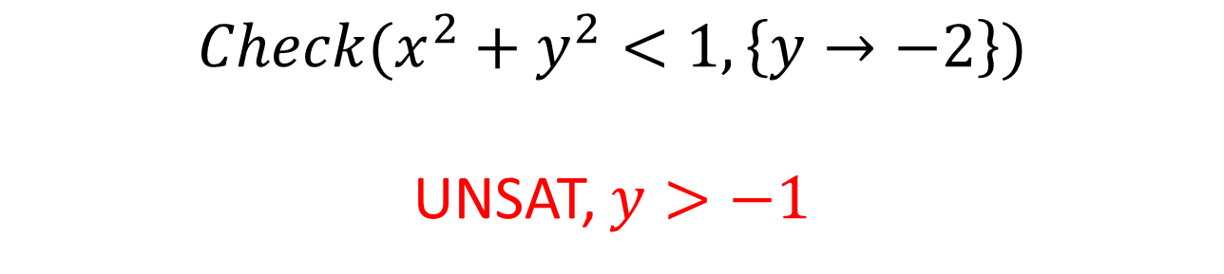
NLSAT/MCSAT
$$Check(x^{2}+y^{2}<1, \left\{y→−2\right\})$$
UNSAT, $y>−1$

Slide 52
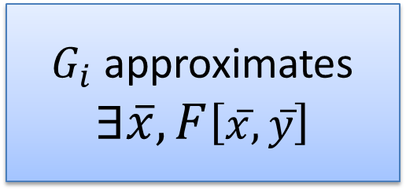
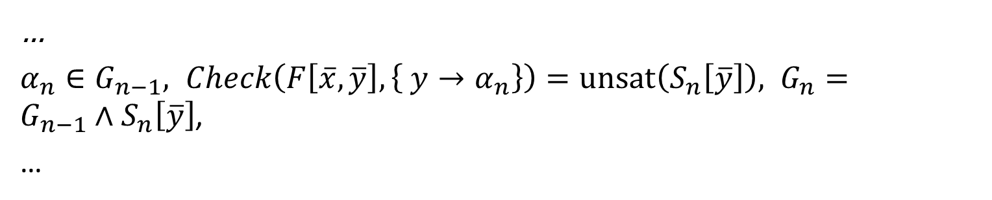
No-good sampling
$Check\left(F\left[\overline{x},\overline{y}\right], \left\{ y→α_{1}\right\}\right)=unsat\left(S_{1}\left[\overline{y}\right]\right), G_{1}=S_{1}\left[\overline{y}\right]$,
$α_{2}∈G_{1}, Check\left(F\left[\overline{x},\overline{y}\right], \left\{ y→α_{2}\right\}\right)=unsat\left(S_{2}\left[\overline{y}\right]\right), G_{2}={G_{1}∧S}_{2}\left[\overline{y}\right]$,
$α_{3}∈G_{2}, Check\left(F\left[\overline{x},\overline{y}\right], \left\{ y→α_{3}\right\}\right)=unsat\left(S_{3}\left[\overline{y}\right]\right), G_{3}={G_{2}∧S}_{3}\left[\overline{y}\right]$,
…
$α_{n}∈G_{n−1}, Check\left(F\left[\overline{x},\overline{y}\right], \left\{ y→α_{n}\right\}\right)=unsat\left(S_{n}\left[\overline{y}\right]\right), G_{n}={G_{n−1}∧S}_{n}\left[\overline{y}\right]$,
…
$G_{i}$ approximates
$$∃\overline{x},F\left[\overline{x},\overline{y}\right]$$
Finite decomposition property:
The sequence is finite

Slide 53

Computing Interpolants using Extended Check Modulo Assignment
Given: $A\left[\overline{x},\overline{y}\right]∧B[\overline{y}$, $\overline{z}]$
Ouput: $I\left[\overline{y}\right]$ s.t.
$B[\overline{y}$, $\overline{z}]⇒I\left[\overline{y}\right]$,
$A\left[\overline{x},\overline{y}\right]∧I\left[\overline{y}\right]$ is unsat

Slide 54
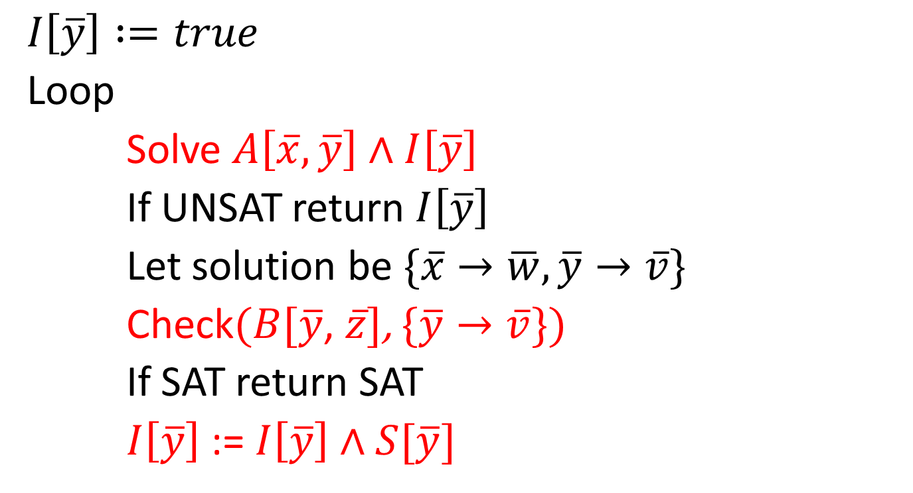
Computing Interpolants using Extended Check Modulo Assignment
$$I\left[\overline{y}\right] :=true$$
Loop
Solve $A\left[\overline{x},\overline{y}\right]∧I\left[\overline{y}\right]$
If UNSAT return $I\left[\overline{y}\right]$
Let solution be $\{\overline{x}→\overline{w}, \overline{y}→\overline{v}\}$
Check$(B[\overline{y}$, $\overline{z}]$, $\{\overline{y}→\overline{v}\})$
If SAT return SAT
$I\left[\overline{y}\right]$ := $I\left[\overline{y}\right]∧S[\overline{y}]$

Slide 55
Conclusion
Model-Based techniques are very promising
NLSAT source code is available in Z3
http://z3.codeplex.com
Extended Check Modulo Assignment
Grant’s talk: nonlinear optimization
New version coming soon

