Slide 1
Key Challenges in Brake Caliper Supply
15%+ cost-down target amid inflationary input costs and tight capacity.
Geopolitical volatility (USMCA compliance, Section 301 tariffs, CBAM fees) reshaping landed cost baselines.
Fragmented supplier footprint complicates logistics, PPAP timing, and quality alignment across regions.
Technology readiness gaps for brake-by-wire, smart sensing, and copper-free systems increase validation load.
Premium freight and inventory buffers erode working capital while Ford seeks tighter delivery windows.

Slide 2
Contract-Led Solutions & Actions
Sequence joint productivity roadmap milestones with VA/VE, automation, and packaging upgrades baked into contracts.
Deploy capital co-investment clauses for casting automation and in-line inspection tied to OEE & scrap KPIs.
Adopt open-book cost baselines with indexed raw-material clauses to reset pricing each quarter.
Implement performance rebates/penalties (1–2% of annual value) and volume/mix protection to stabilize supply.
Launch Phase 2A agile tech sprints with suppliers to evaluate EMB, smart calipers, lightweight monoblocs, and copper-free friction.

Slide 3
Expected Impact on Cost, Efficiency & Customer Outcomes
Joint roadmap + capital clauses forecast 15–17% unit cost reduction once automation and VA/VE savings flow.
Regionalized finishing, milk-runs, and reusable packaging deliver 8–12% freight savings and $0.20–0.30 per unit packaging reduction.
Indexed pricing and tariff triggers protect margins against 25% Section 301 surcharges and CBAM carbon fees.
Performance governance lifts OTIF to >98% and cuts premium freight events by ~50%, boosting Ford plant satisfaction.

Slide 4
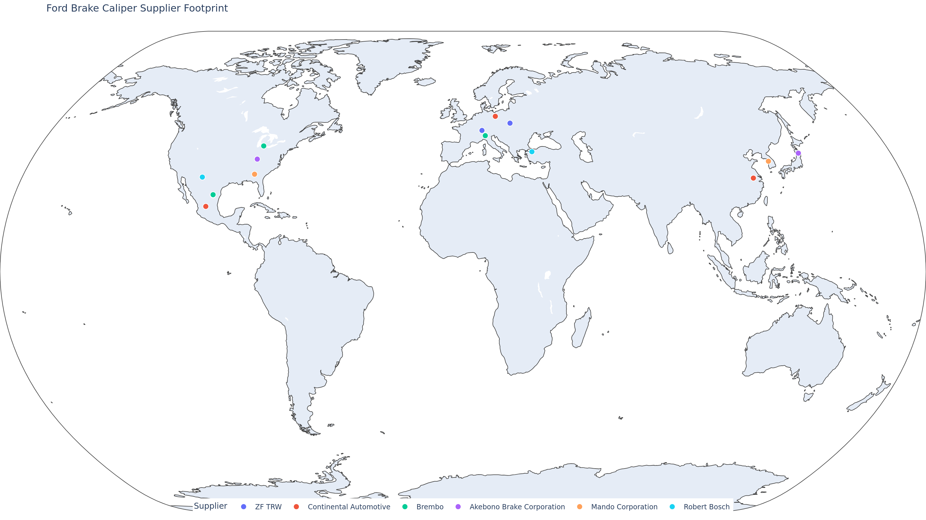
Supplier Footprint & Supporting Data
Map shows 15 Ford caliper supplier sites clustered in NA/EU/APAC, highlighting dual-source resilience.
Largest volumes: ZF TRW (Poland/Mexico), Continental (Germany/Mexico/China), Brembo (US/Italy/Mexico).
Map data sourced from 2025 supplier landscape analysis; see additional information for detailed tables.

Slide 5
Additional Information
Detailed supplier ranking tables (Ford vs. other OEM suppliers with plant locations and notes).
New brake caliper technology evaluation backlog covering EMB, smart sensing, lightweight monobloc, copper-free friction, EPB units.
Geopolitical & tariff matrix (USMCA, Section 301, CBAM, Russia/Ukraine, Mexico energy, China mineral controls, India duties, FX).
Tariff management checklist for HS 870830/870839, bonded warehousing, origin certificates, and 25% escalation scenarios.
Interactive folium map available at ford-brake-caliper-suppliers-map.html for deeper site-by-site analysis.

