Slide 1
Hexagonal keyboard: QWERTY vs. Typewise vs. Custom
Leo Domitrović

Slide 2
Research goal
Test the text entry efficiency with Hexagonal keyboard (developed for one-thumb typing context)
text entry (standard) metrics, usability attributes, design considerations, etc.

Slide 3
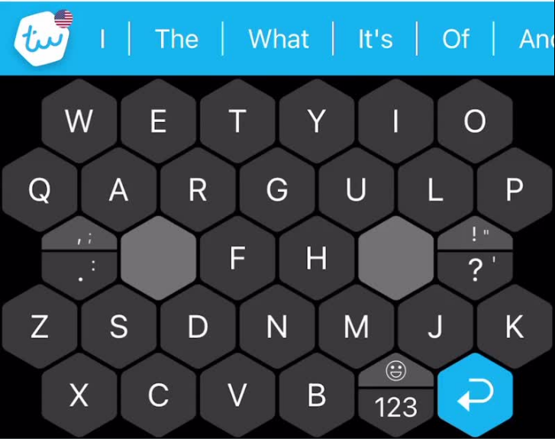
Motivation
Existent Typewise keyboard: https://www.typewise.app/

Slide 4
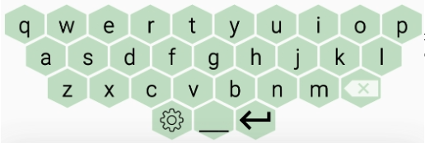
Hexagonal QWERTY layout

Slide 5
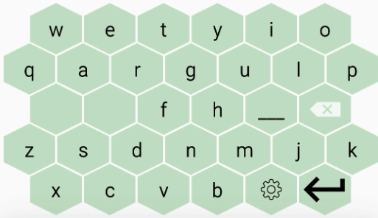
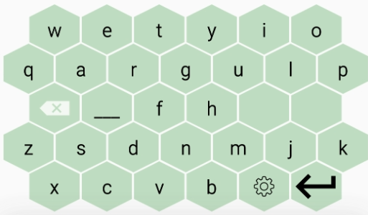
Hexagonal Typewise layout
Right-handed layout: Left-handed layout:

Slide 6
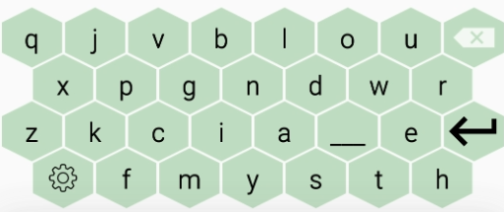
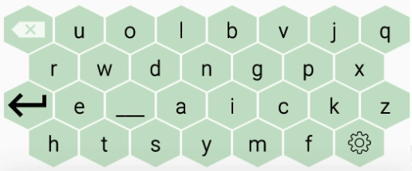
Hexagonal Custom layout
Right-handed layout: Left-handed layout:

Slide 7
Experiment procedure
Questionnaire before experiment
10-15 min training before experiment
Text entry tasks [Default vs. Hexagonal QWERTY vs. Hexagonal Typewise vs. Hexagonal Custom] in Text Input Logger
20 different phrases from English language
Errors are allowed
As fast as possible, as accurate as possible
Questionnaire before experiment
Design (7-point Likert scale)
Usability attributes (7-point Likert scale)
NASA-TLX (mental demand, physical demand, performance, effort and frustration)

Slide 8
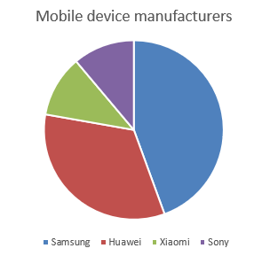
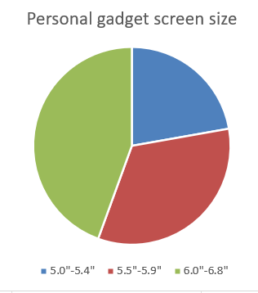
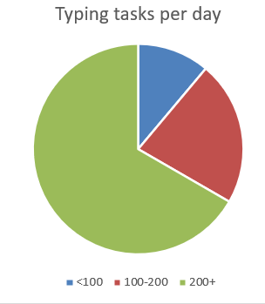
Participants and apparatus
9 Users: 8M + 1F
Age: Mean=25.1, STDEV=
Dominant hand: Right=9
Preferred texting style: Two-handed portrait

Slide 9
Performance estimation of Hexagonal keyboard layouts
Fitts coefficients from literature: a = 0.1154, b = 0.1098
Fitts coefficients from FittsTouch experiment: a = 0.3887, b = 0.0639
QWERTY
Based on literature: 36.485 WPM
Based on FittsTouch: 23.39 WPM
Typewise
Based on literature: 39.314 WPM (right) and 41.256 WPM (left)
Based on FittsTouch: 24.447 WPM (right) and 24.037 WPM ()left
Custom
Based on literature: 44.274 WPM
Based on FittsTouch: 25.036 WPM

Slide 10
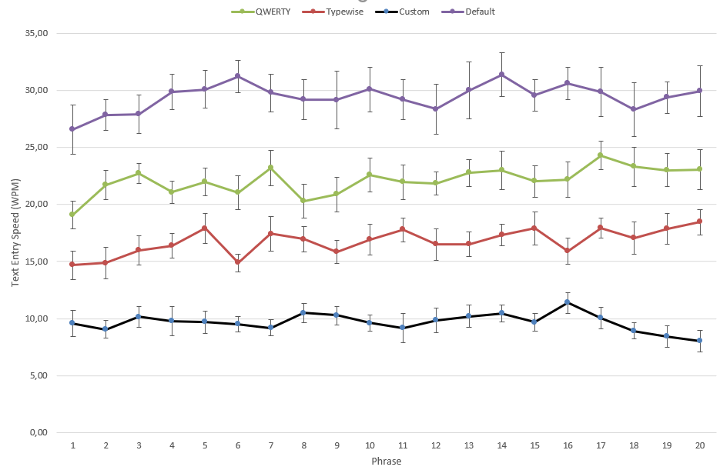
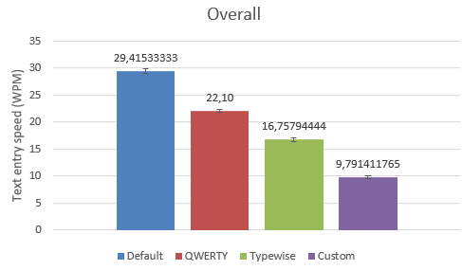
Results: WPM

Slide 11
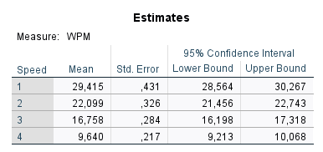
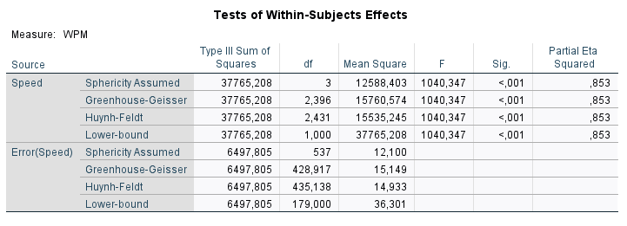
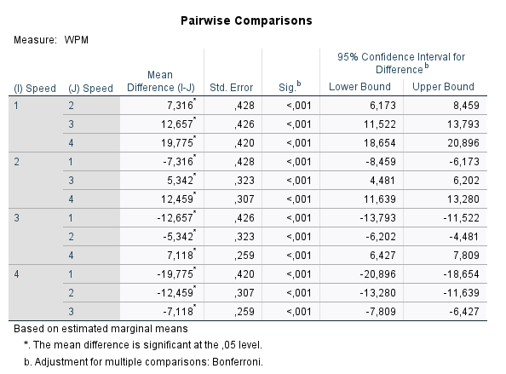
Results: WPM

Slide 12
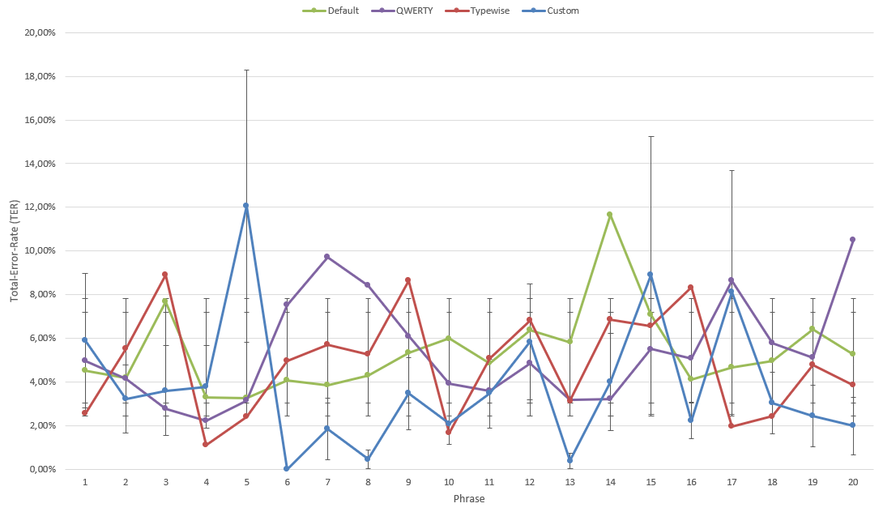
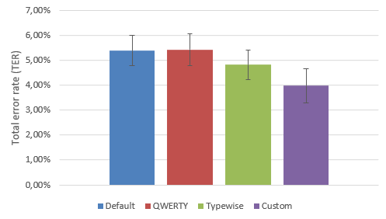
Results: TER

Slide 13
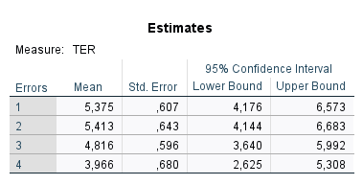
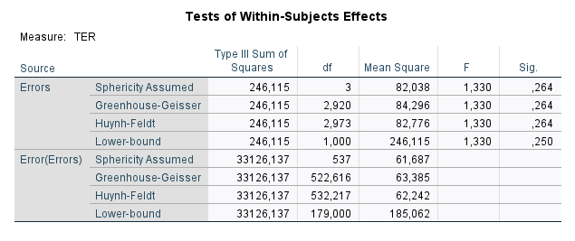
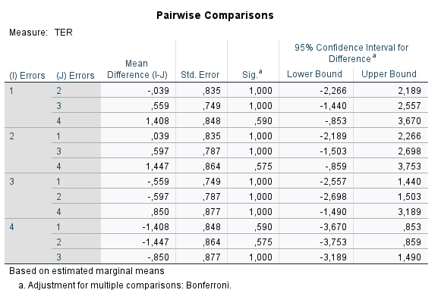
Results: TER

Slide 14
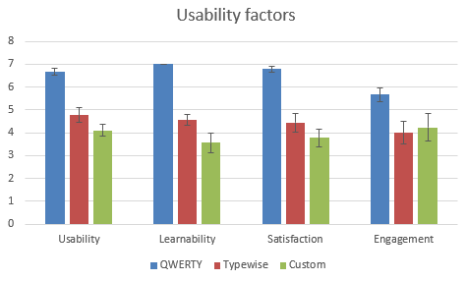
Results: Usability attributes

Slide 15
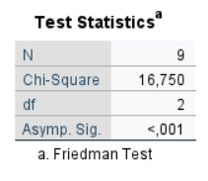
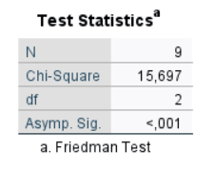
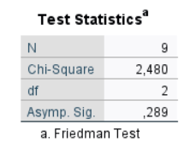
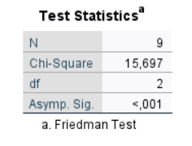
Results: Usability attributes
Usability test Learnability test
Engagement test Satisfaction test

Slide 16
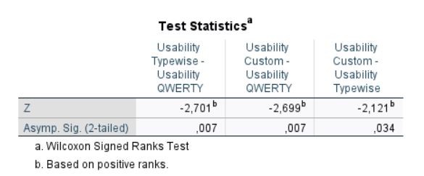
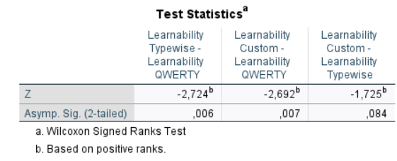
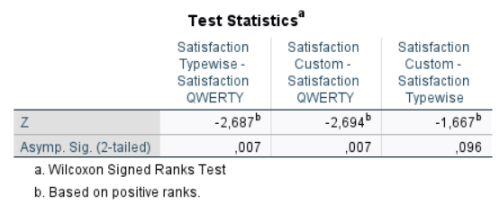
Results: Usability attributes

Slide 17
Results: Usability attributes
Usability Learnability
Engagement Satisfaction

Slide 18
Results: Usability attributes

Slide 19
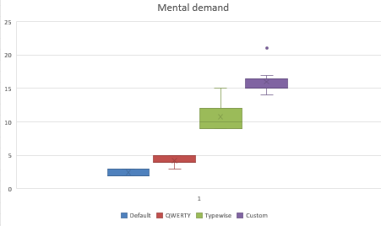
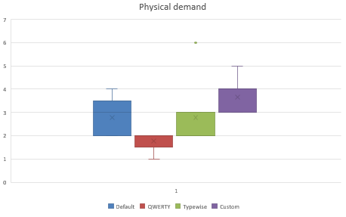
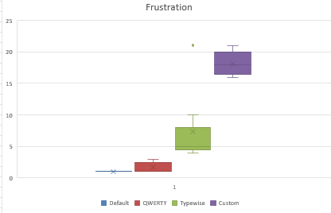
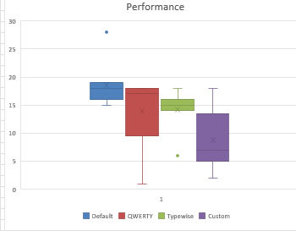
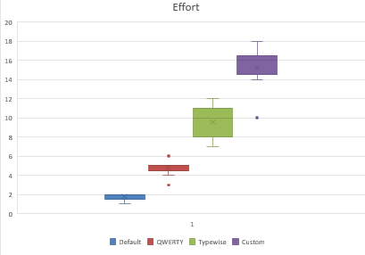
Results: TLX factors

Slide 20
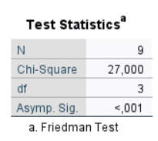
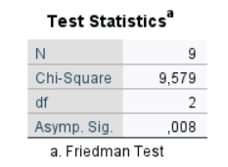
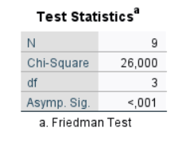
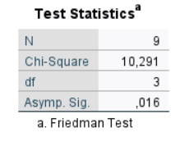
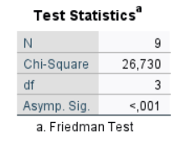
Results: TLX factors
Mental demand Physical demand Frustration
Performance Effort

Slide 21
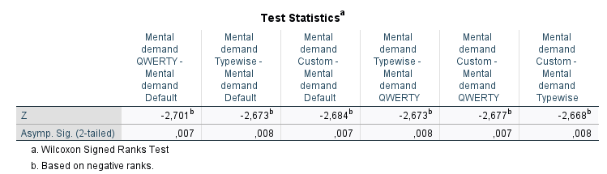
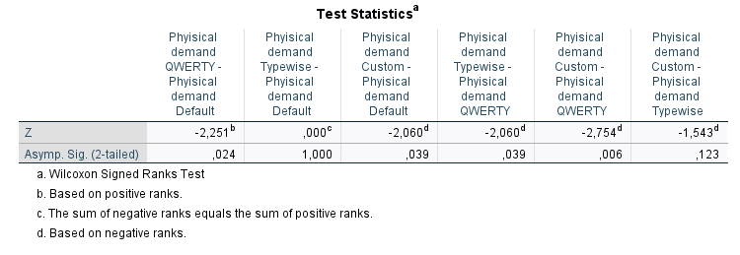
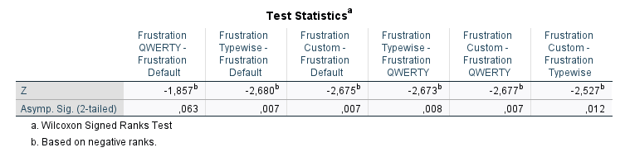
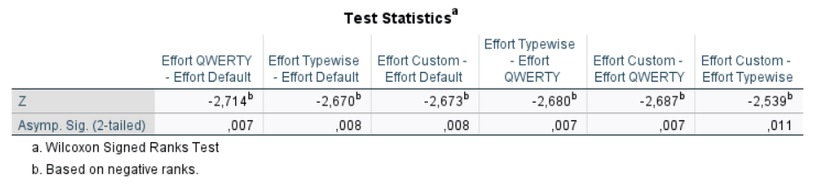
Results: TLX factors

Slide 22
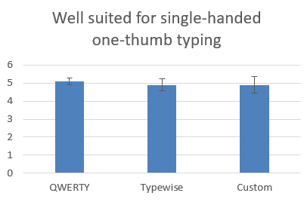
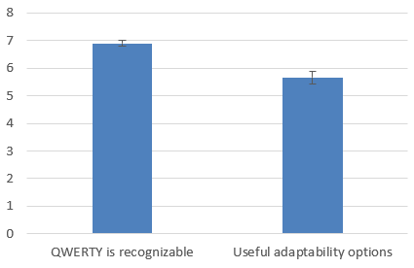
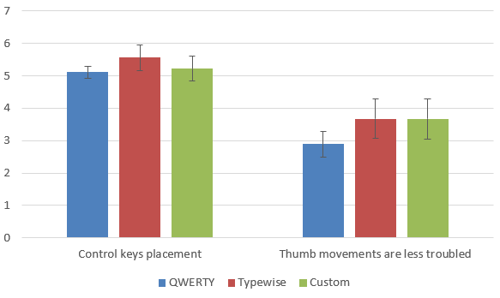
Result: Design considerations

Slide 23
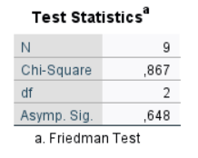
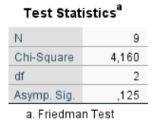
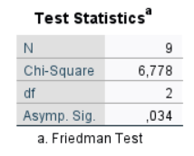
Result: Design considerations
Well-suited Control keys placement
Movements

Slide 24
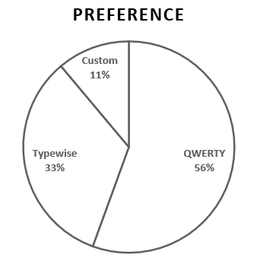
Results: Overall preference

Slide 25
HVALA NA PAŽNJI!

