Slide 1
MOTORWAY
M31
Leo Wong

Slide 4


Slide 6

ENGINE
START
STOP

Slide 7

About Me
Work
Portfolio
Resume
Other projects
Resume
Contact me
About Me
Big project

Slide 8
MOTORWAY
M31
Leo Wong

Slide 9
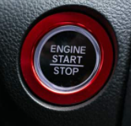
About Me
Work
Portfolio
Resume
Resume
Contact me
Other projects
ENGINE
START
STOP
About Me
Big project

Slide 10

Resume
Contact me
Other projects
About Me
Big project

Slide 11
About Me
Resume
Contact me
Other projects
About Me
Big project

Slide 12
Big project
Resume
Contact me
Other projects
About Me
Big project

Slide 13
Other projects
Resume
Contact me
Other projects
About Me
Big project

Slide 14

Resume
Resume
Contact me
Other projects
About Me
Big project

Slide 15
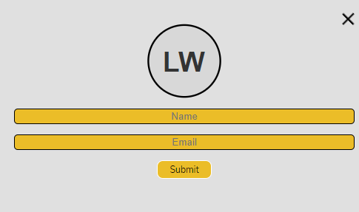

Leo Wong
Resume
Contact me
Other projects
About Me
Big project

