Slide 1





About Me
Work
M1
Portfolio
Resume
Resume
Contact me
Other projects
About Me
Big project

Slide 2

Resume
Contact me
Other projects
About Me
Big project

Slide 3
About Me
Resume
Contact me
Other projects
About Me
Big project

Slide 4
Big project
Resume
Contact me
Other projects
About Me
Big project

Slide 5
Other projects
Resume
Contact me
Other projects
About Me
Big project

Slide 6

Resume
Resume
Contact me
Other projects
About Me
Big project

Slide 7
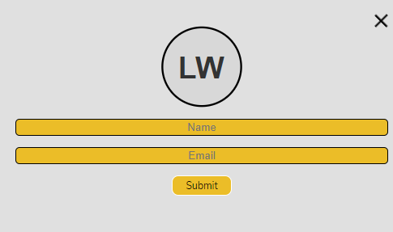
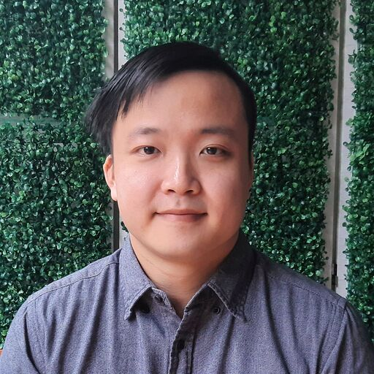
Leo Wong
Resume
Contact me
Other projects
About Me
Big project

