Slide 1
An Optimized Last-level TLB Replacement Policy for Graph Processing Workloads
M.Tech Project
By
P J Leo Evenss
20111038
Supervised By,
Prof. Mainak Chaudhuri,
IIT, Kanpur

Slide 2
Outline
Introduction
Related Works
Problem Statement
Implementation details
Results
Conclusion

Slide 3
Introduction
Graph applications and their properties (sparsity & huge memory footprints)
Representation of the Graph Applications - Irregular memory accesses
Compressed Sparse Row(CSR)
Compressed Sparse Column(CSC)
TLB and its importance

Slide 4
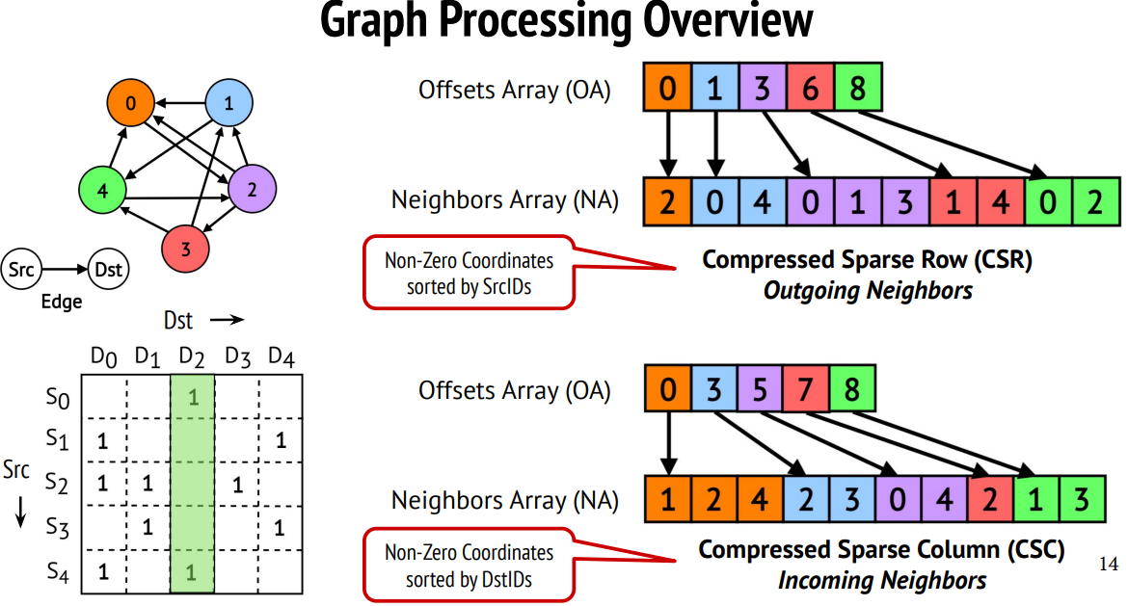
Graph Representation types
Typical graphs are extremely sparse

Slide 5
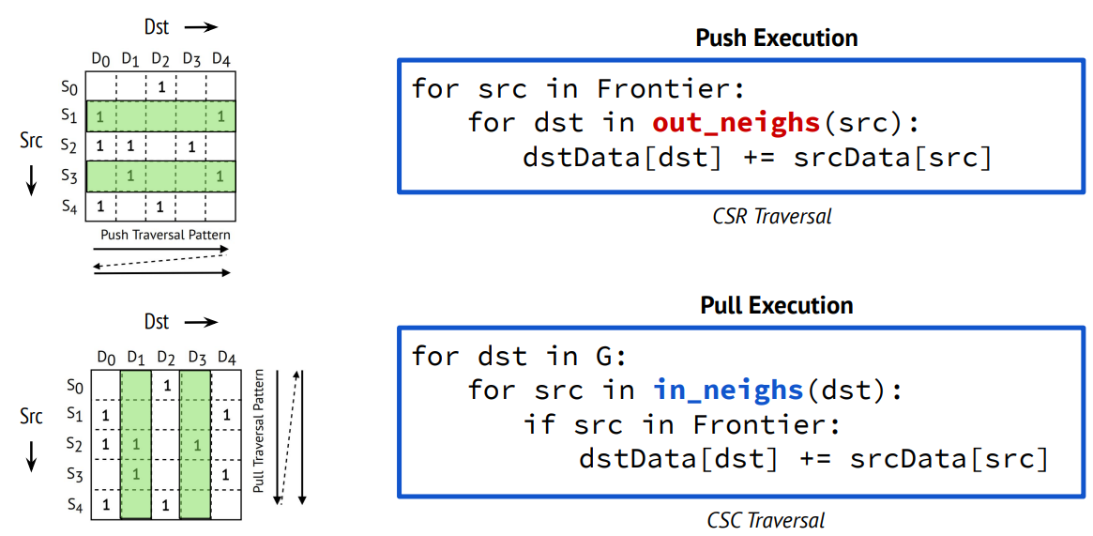
Graph Kernel Traversal Types

Slide 6
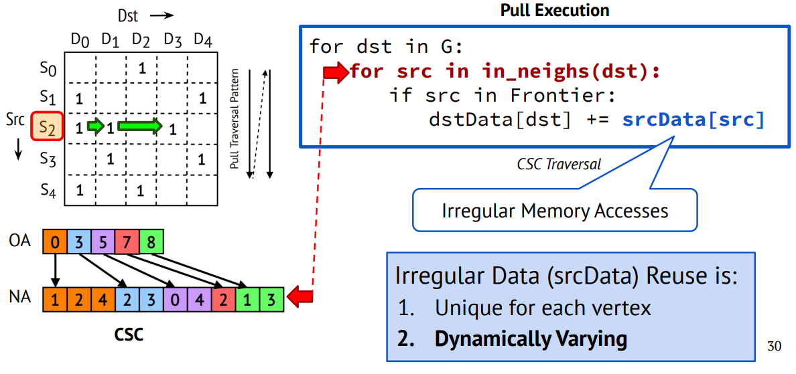
Capturing (irregular) Graph Data reuse is Challenging

Slide 7
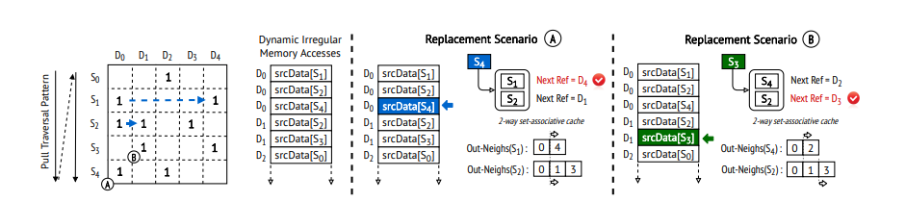
Related Work-Overview of TOPT
Picture from the paper

Slide 8
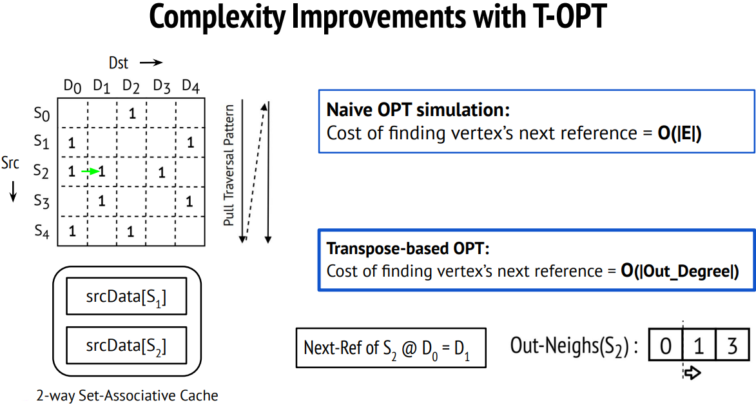

Slide 9
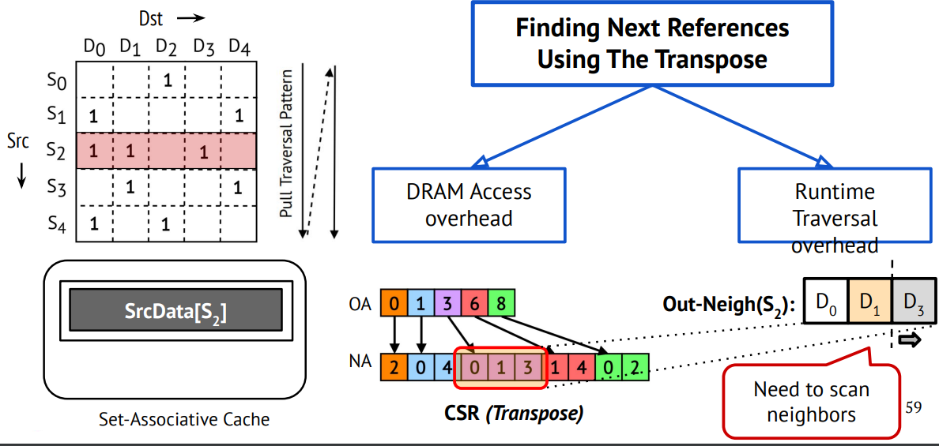
Transpose based opt replacement incurs overhead

Slide 10
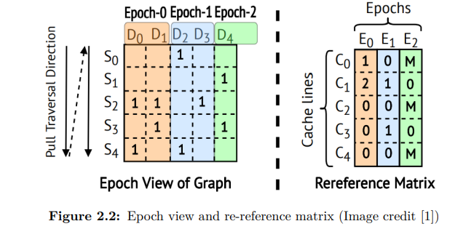
Related Work – Quantized Rereference matrix

Slide 11
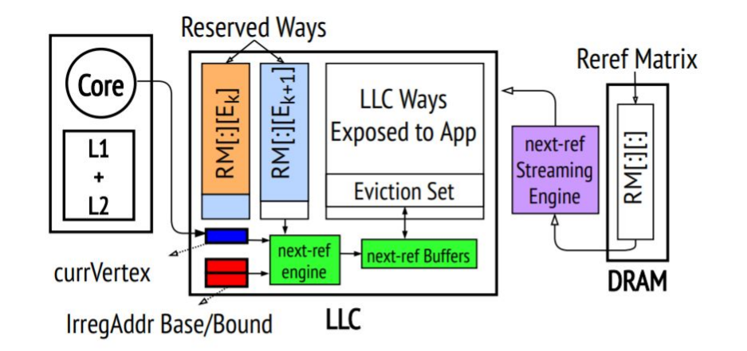
POPT Architecture

Slide 12

Variations of POPT
POPT-INTER
1 MSB , 1 column stored on chip
POPT-INTER-INTRA
1 MSB , 2 columns stored on chip
POPT-INTER-INTRA-SE
2 bits of MSB, 1 column stored on chip

Slide 13
Advantages over TOPT
Single lookup per cache line into rereference matrix
No lookups for every vertex in cache , but require offline building of rereference matrix.
No need to store entire rereference matrix at any point in time.
Only 1 column , or 2 columns of rereference matrix needed for replacement decisions.

Slide 14
Shortcomings of POPT
The P-OPT policy assumes that the entire irregular data is allocated in the physical memory contiguously.
Does not discuss the impact of paging and translation overhead in the graph processing workloads.

Slide 15
Problem Statement
Since the TLB access is on the critical path for every access to the memory, performance improvement of the TLB is the primary motivation of our work.
POPT and its variations on TLB for practical optimal replacement.

Slide 16
Modifications Needed for POPT in TLB
We do not require entire irregular data to be stored in a contiguous manner in physical memory as TLB works on virtual addresses and these are generally in contiguous manner.
Size of the re-reference matrix is reduced compared to that of cache level , because the number of rows correspond to number of pages.
16 bits per re-reference entry needed for encoding because of coarser granularity.

Slide 17
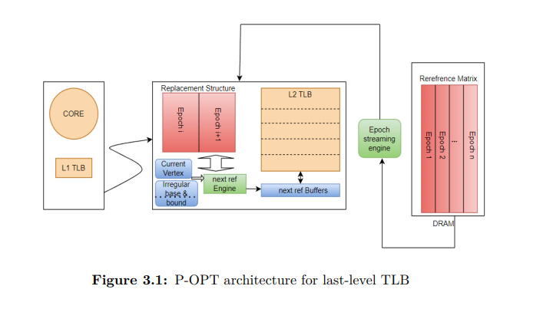
TLB - Architecture

Slide 18
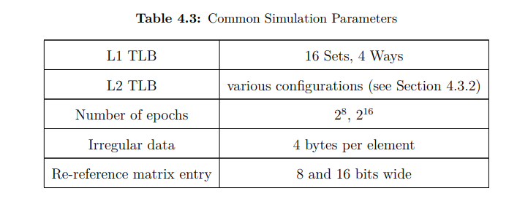
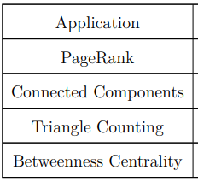
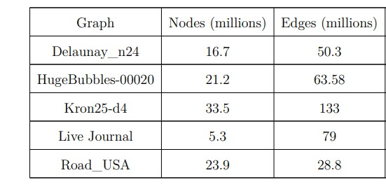
Evaluation Parameters

Slide 19
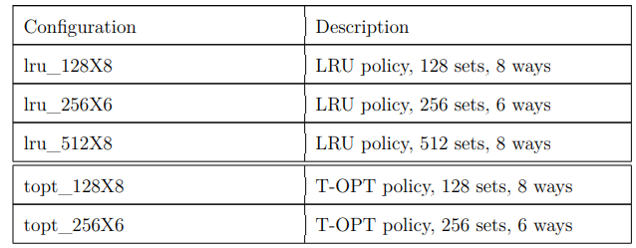
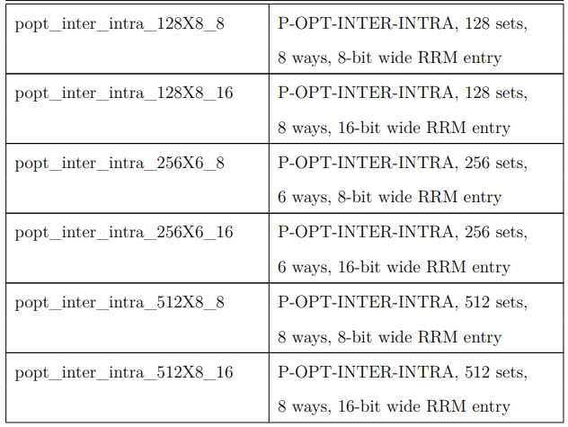
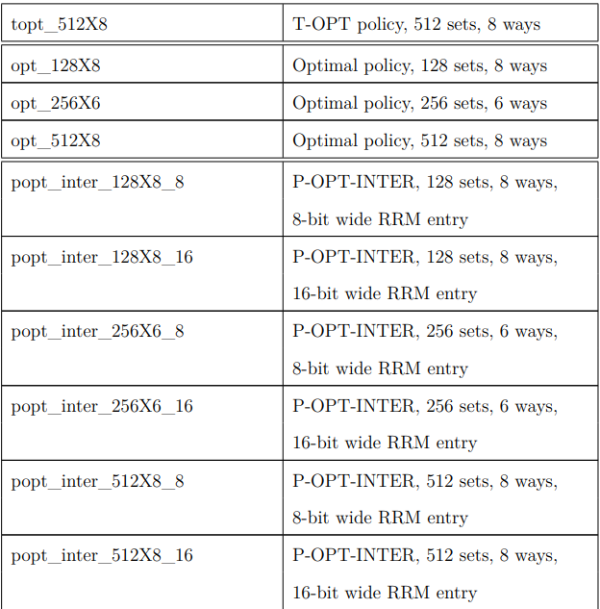
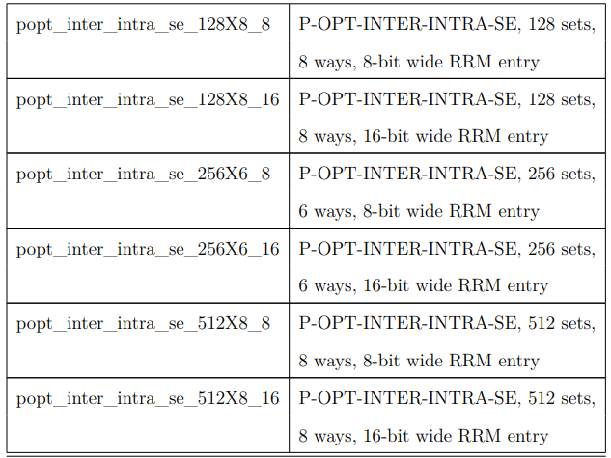
Last Level TLB designs

Slide 20
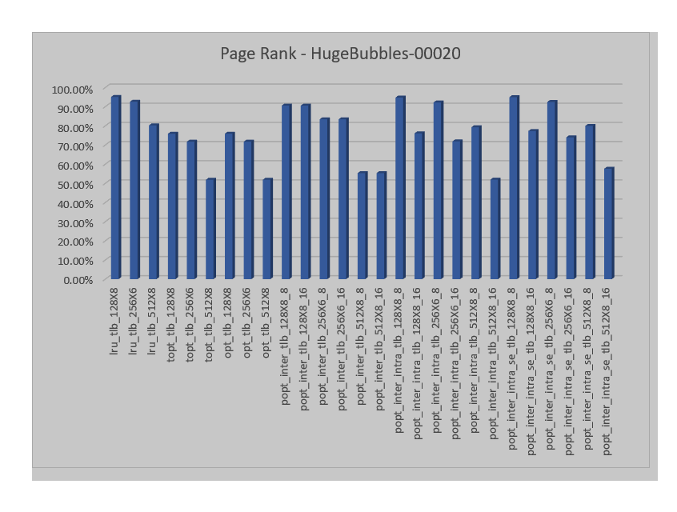
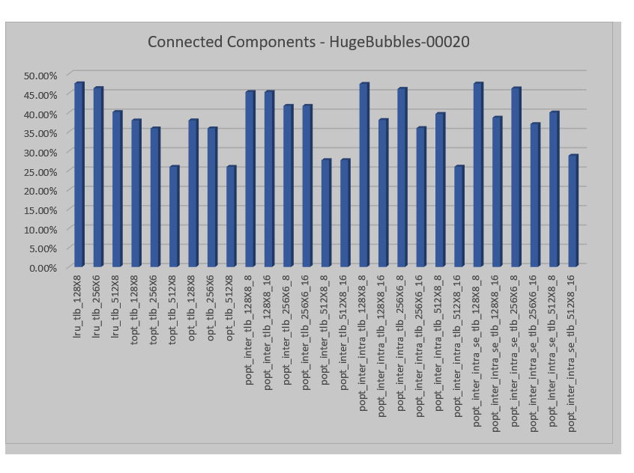
Results

Slide 21
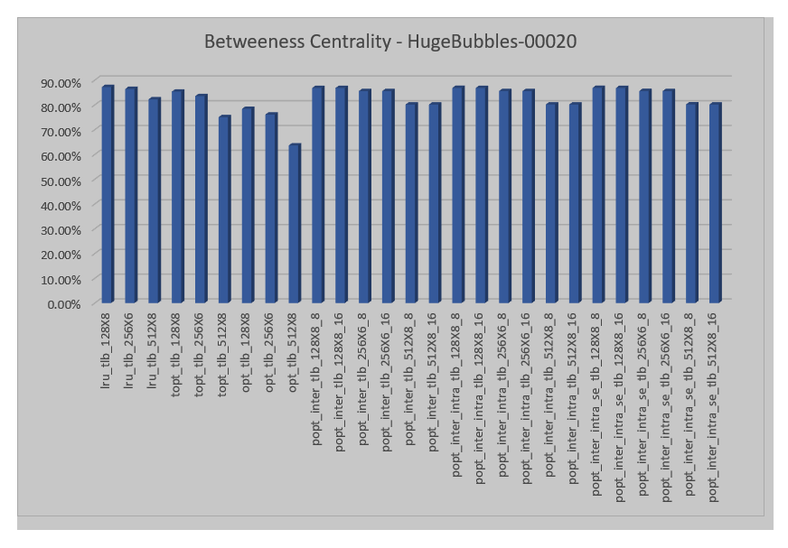
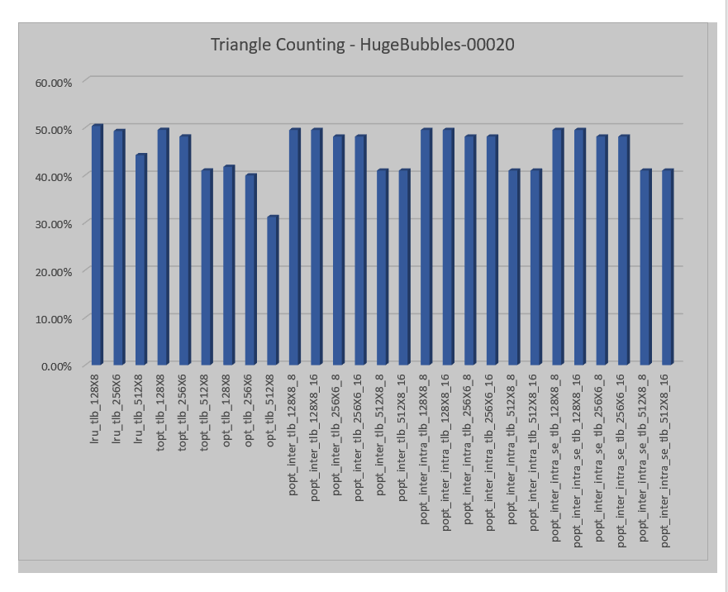
Results(contd)

Slide 22
Conclusion
Improved the miss rate of the last-level TLB via design of replacement policies.
The future work can include cycle-level simulation and estimation of the speedup arising from the implemented replacement policy optimizations.
Comparison with transparent huge pages is an also an relevant study.

Slide 23
THANK YOU

