Slide 1
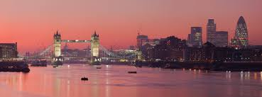
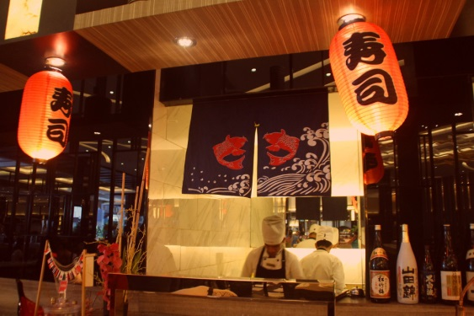
Finding an optimal location for a new Japanese restaurant in London
Coursera\IBM Capstone Project
Fabrizio Leo

Slide 2
Introduction
There are about 18110 restaurants in London
A first selection of candidate areas to open a new Japanese restaurant based on density might be based on these constraints:
With very few restaurants
With no Japanese restaurants
Close to the city center

Slide 3
Data
791 circular areas (radius = 350 m) defined by a grid of locations spaced by 500 m and centered around the city center of London with a limit of 8000 m distance from it.
1315 restaurants data retrieved with Foursquare API including their location and category (removing duplicates)

Slide 4
Methodology
Exploratory data analysis on the number of restaurants and Japanese restaurants for different concentric areas around the city center
K-means cluster analysis of the neighborhoods with distance from city center, n° of restaurants and n° of Japanese restaurants as input

Slide 5
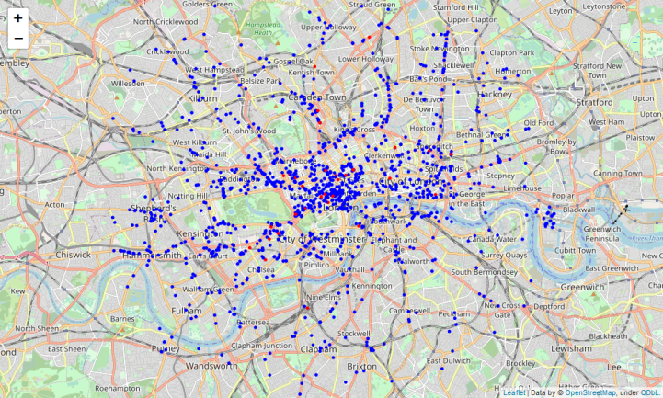
Distribution of restaurants in London
Not Japanese
Japanese

Slide 6
Distribution of restaurants in three different concentric areas
Area | N° restaurants | N° Japanese restaurants | % Japanese restaurants
0-2667 meters | 522 | 21 | 0.04
2667-5333 meters | 477 | 10 | 0.02
5333-8000 meters | 316 | 2 | 0.006

Slide 7
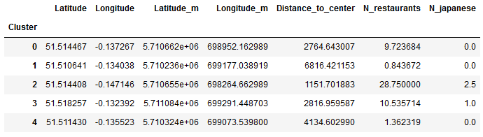
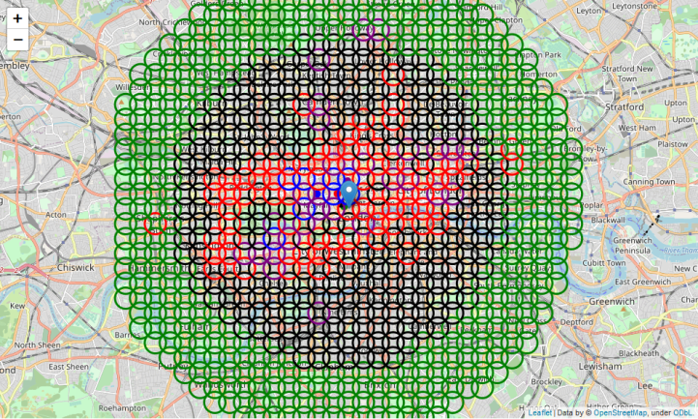
K-means Cluster analysis
CENTROIDS

Slide 8
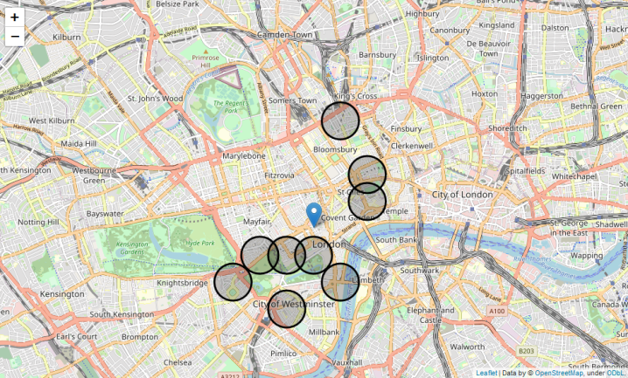
K-means Cluster analysis
Black cluster is promising since it does not include Japanese restaurants and it has little other restaurants (mean=1.4)
I selected areas from black cluster that are closest to city center to satisfy the third criterion

Slide 9
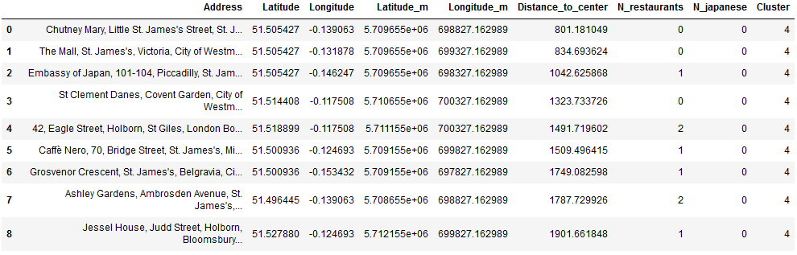
Final Candidate Areas
I identified potentially interesting areas in the City of Westminster and between Covent Garden and King's Cross

Slide 10
Conclusions
Identified 9 potential area candidates based on distance to center and density of restaurants
Future investigations might want to include other variables to find out the best location. These variables might include:
Population density
Level of traffic
Real estate prices
…

