Slide 1
Objective
Give an overview of programming and the C programming language.

Slide 2
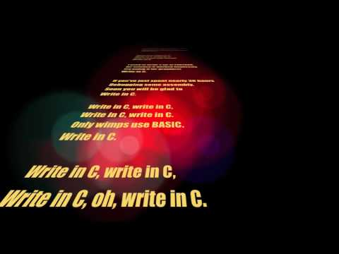

Why C?!
Old (and...?)
Hard
  Manual memory mgmt
  Pointers
  Subtle bugs
    Stack, int overflow, out of
    bounds, NUL-terminated strings,
    implicit conversions, dangling
    pointers, and !many! others...
  Low-level = super insecure
No modularity (namespaces...)
Super basic
https://youtu.be/1S1fISh-pag

Slide 3
Why learn C
Popularity [see next 2 slides]
Low level (hm? wasn't this bad just now?)
  Learn concepts that other languages hide
Portability
Lean, mean, fast
Many more years of C left
And yet all this, even C, is secondary...

Slide 4
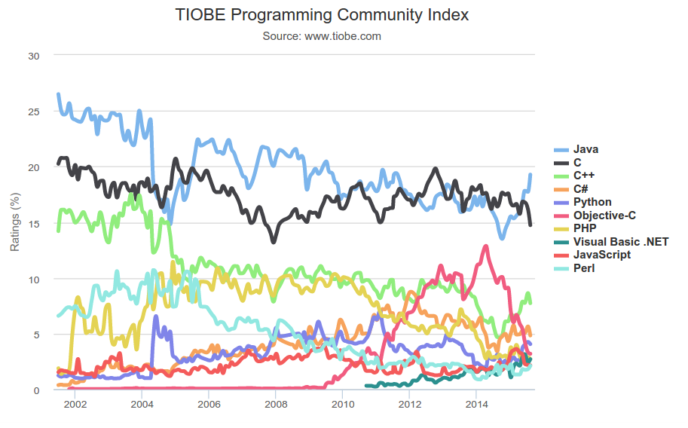
The Ranking of C [handle with care]
http://www.tiobe.com/index.php/content/paperinfo/tpci/index.html

Slide 5
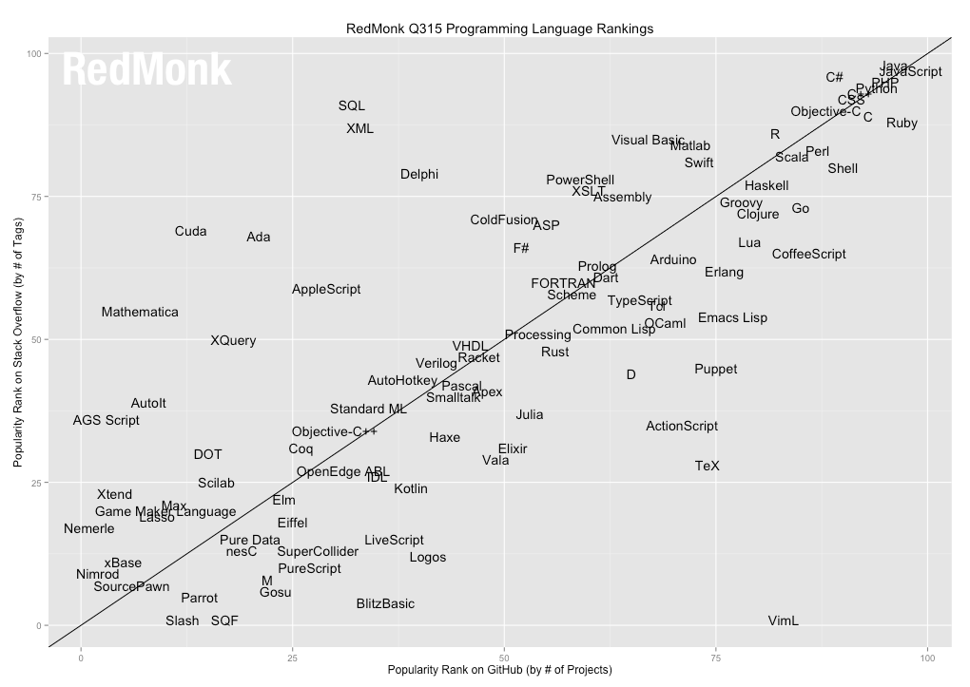
The Ranking of C [handle with care]

