Slide 1
Tools
Linux
The terminal (or console)
irssi
git
Emacs
C
gcc
LaTeX

Slide 2

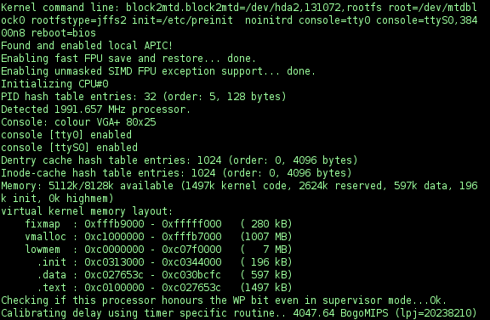
Linux
This is how you code...

Slide 3
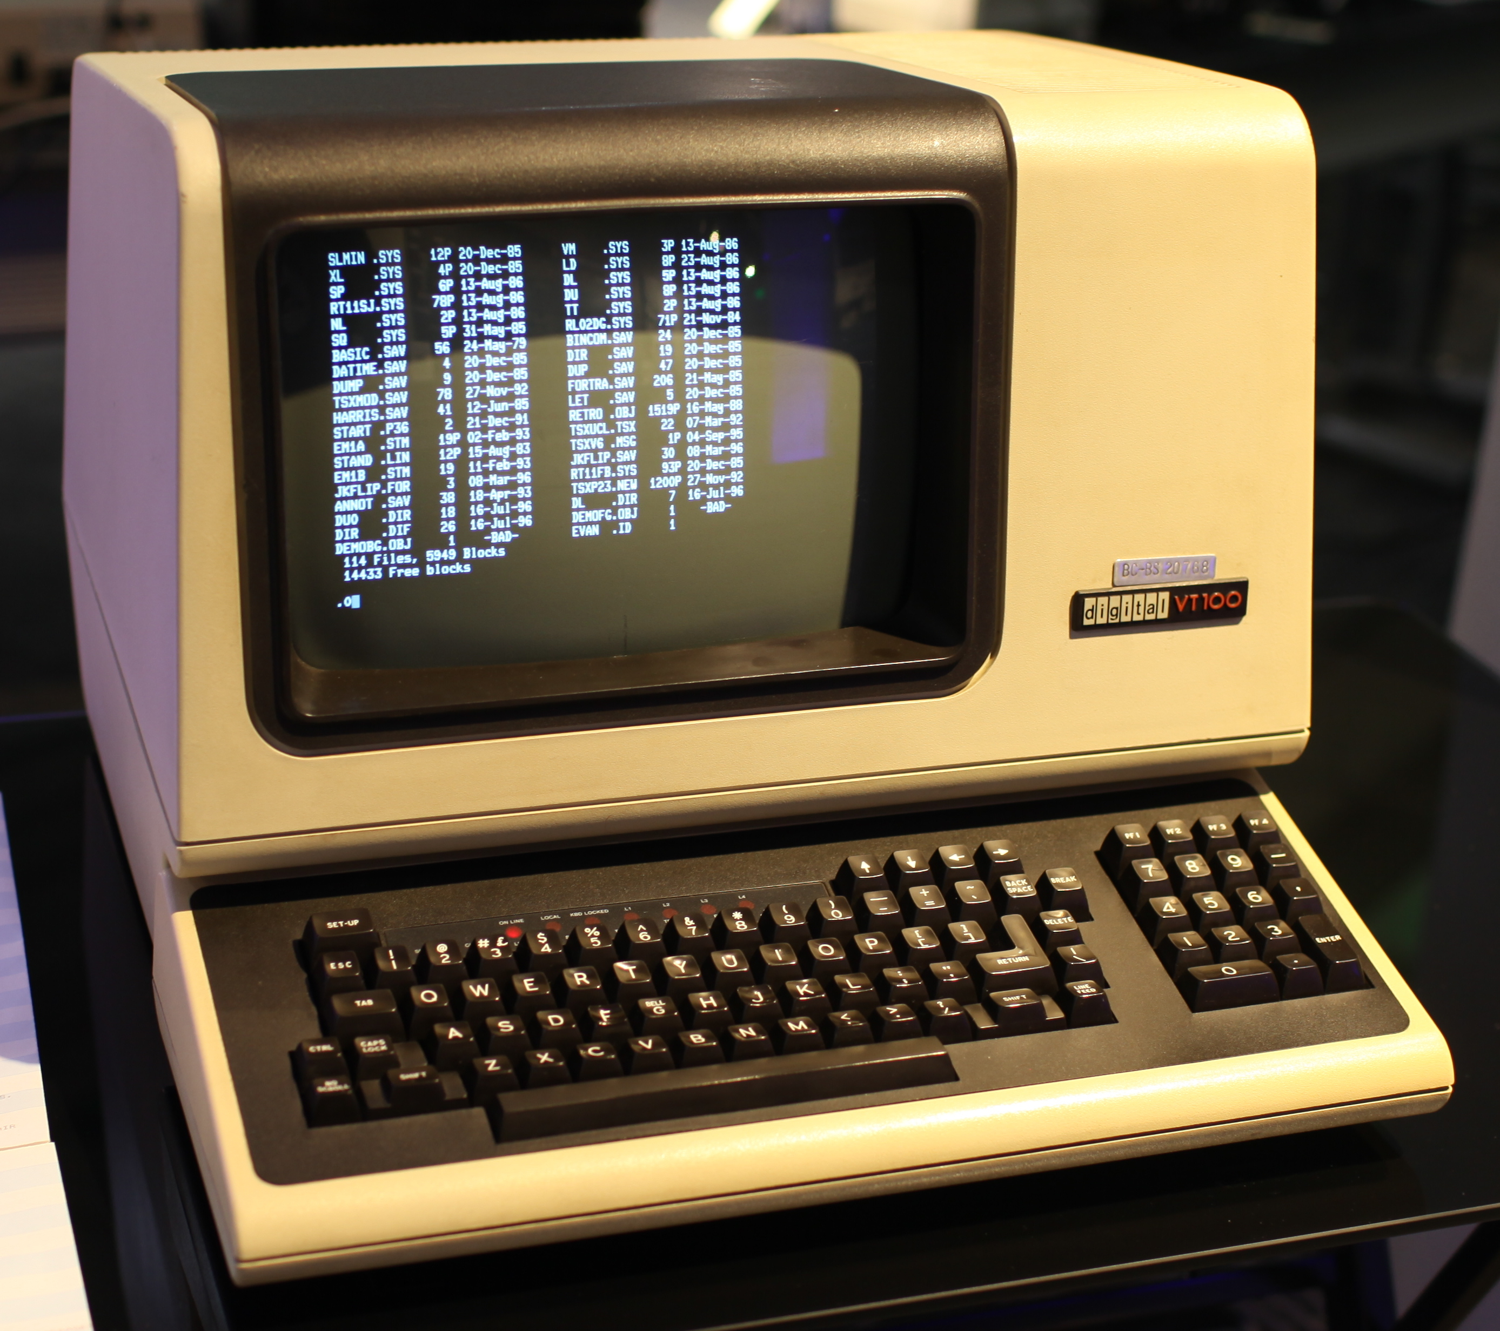
The DEC VT100 terminal
video terminal, introduced in August 1978 by Digital Equipment Corporation (DEC) – Wikipedia

Slide 4
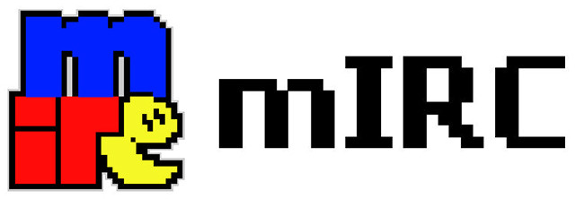
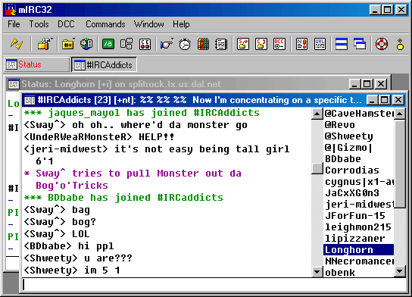
irssi
1990s... mostly

Slide 5


git/github
Initially designed and developed by Linus Torvalds for Linux kernel development in 2005 – Wikipedia
Web-based Git repository hosting service, 2015, GitHub reports having over 9 million users and over 21.1 million repositories (largest repo in the world)
– Wikipedia

Slide 6

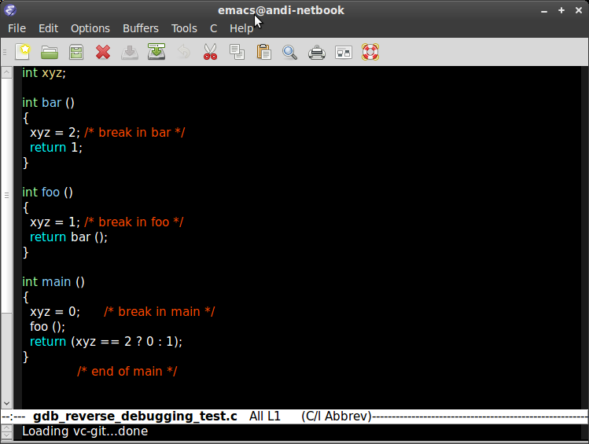
Emacs!
GNU Emacs, describes it as "the extensible, customizable, self-documenting, real-time display editor",
since the 70s!!!

Slide 7
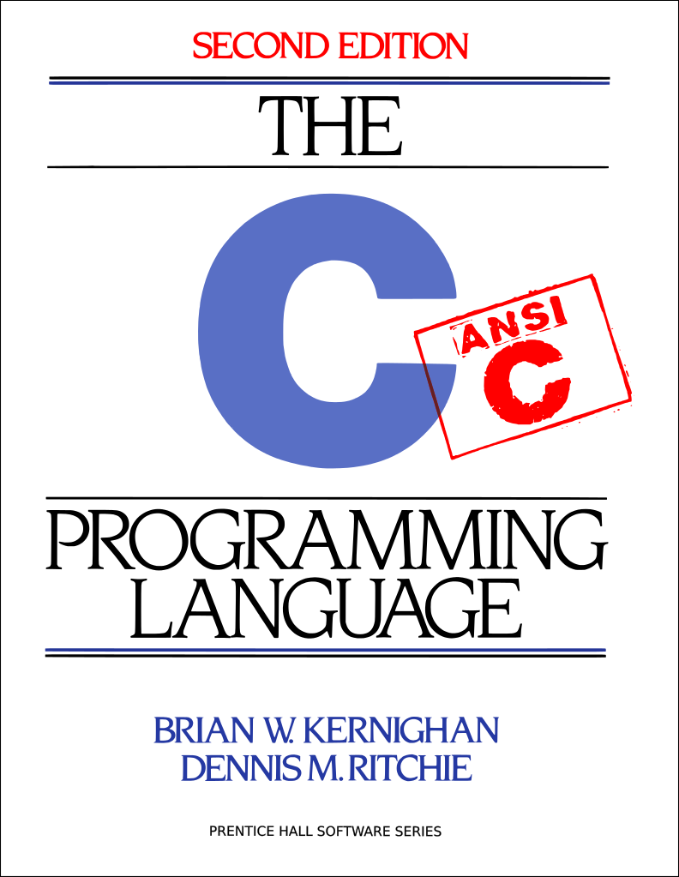

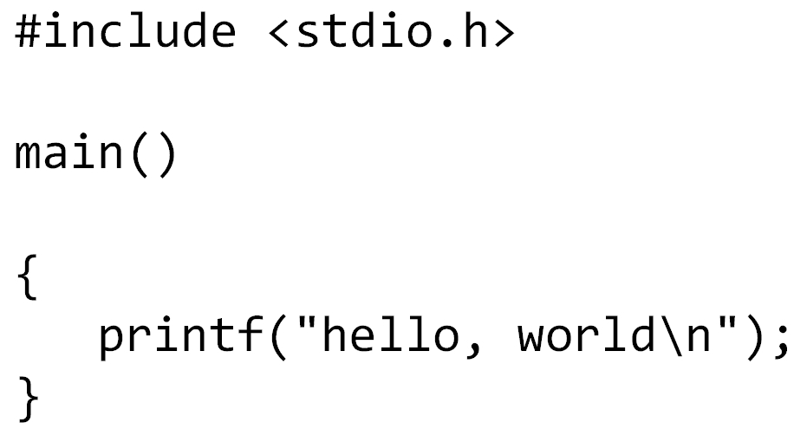
C
C was originally developed by Dennis Ritchie between 1969 and 1973
“Errors” aside... :)

Slide 8

gcc
GNU C Compiler, when it only handled the C programming language, GCC 1.0 was released in 1987

Slide 9
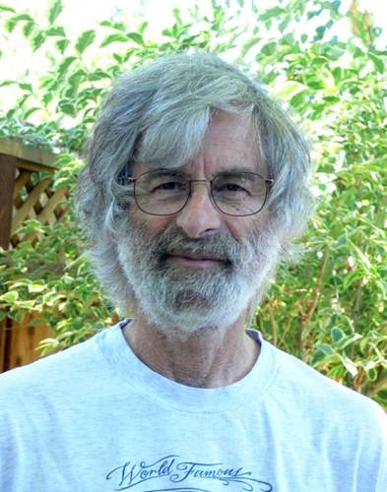

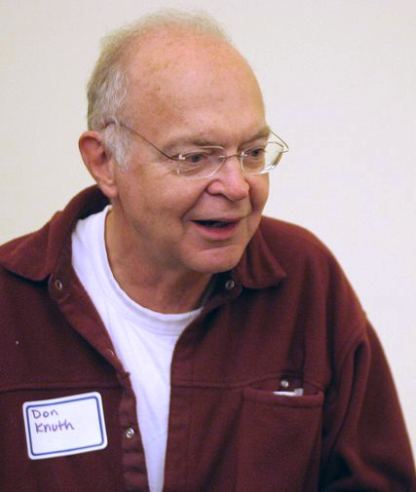
LaTeX
A document markup language, LaTeX was originally written in the early 1980s, released in 1984 by Leslie Lamport at SRI International, using D Knuth TeX language, released in 1978.

