Slide 1
LP 1
Nerdiness
Introduction
  About Leo
Administration
  Staff
  Class schedule
  Evaluation
Tools (surely next class)
  Linux, console, emacs, gcc, gdb, irc, and more!

Slide 2
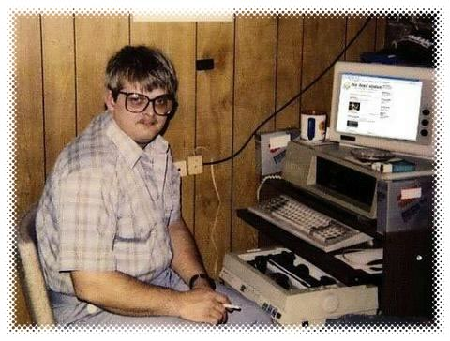
We are not like this...

Slide 3
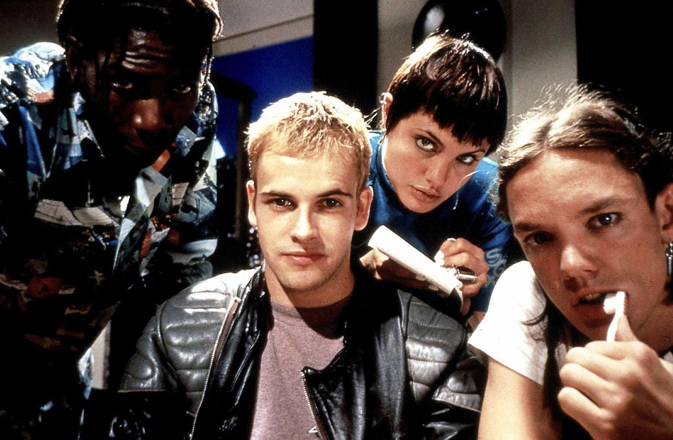
We (you) are like this...

Slide 4
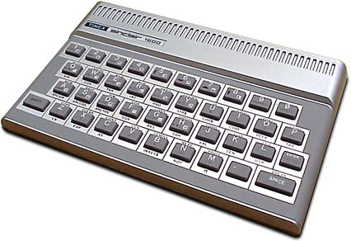
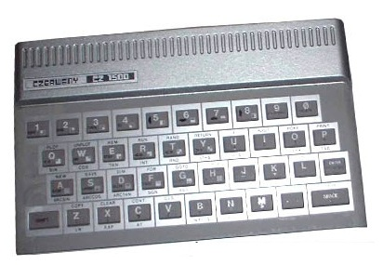
Introduction
Czerweny CZ 1500
Timex Sinclair 1500

Slide 5
Introduction
Objectives
  Understand how computers do things
  Understand and use programming concepts
    Not a great programmer, but good enough.
  “Learn” C
    Small syntax/Awesome expressivity
    But... caveats!
  Problem solving, teamwork, prog history, etc.
  New tools! (we'll see later, h4x0r!)

Slide 6
Administration
Boring, but important! (our contract)
Staff:
  Leo (prof), <lferres@inf.udec.cl>
  TAs: Anibal Tolosa <atolosa@udec.cl>, Meraioth Ulloa <meraulloa@udec.cl>, Diego Gatica <dgatica@udec.cl>
Course information
  Website:
  https://piazza.com/udec.cl/fall2015/503208/home
  Time:
    Recitation: Tue 3-5 (TAs)
    Classes: TBD (now)

Slide 7
Adminstration
Evaluation
  2 exams: 50%
    (40% E1, 60% E2, simple avg >= 4 to pass)
    (make up exam available, regular period)
  3 assignments: 30%
    (10% each, simple avg >= 4 to pass)
    (no bonus assignment available!)
  1 lab exam (note!): 18%
  Class participation: 2%
  Class transcription: 1%, only if you've passed

Slide 8
There's more admin, but...
Full handout (in Spanish!) is coming soon (this aft)
PLEASE READ!!!
  Evaluation dates
  Topics of the course (in general)
  Guide for assignments
  Guide for scribes
  Collaboration policies
  Resources
  Video recording
  Extra help
I forgot the file at home... Dropbox, anyone?

Slide 9
ToDo for today!
Register on infoda!
  You have one job!

Slide 10
Next class: Tools!
Check out:
  Linux (Xubuntu distro)
  The terminal (Ctrl+Alt t)
  Emacs
  Git/github
  Irssi (this is sooo old school)

