Slide 1
期中報告
M103040069簡志軒

Slide 2
簡介
黑洞演算法在2013年提出，演算法的靈感來自於黑洞現象，並試圖模仿其吸引空間中其他恆星的特性。

Slide 3
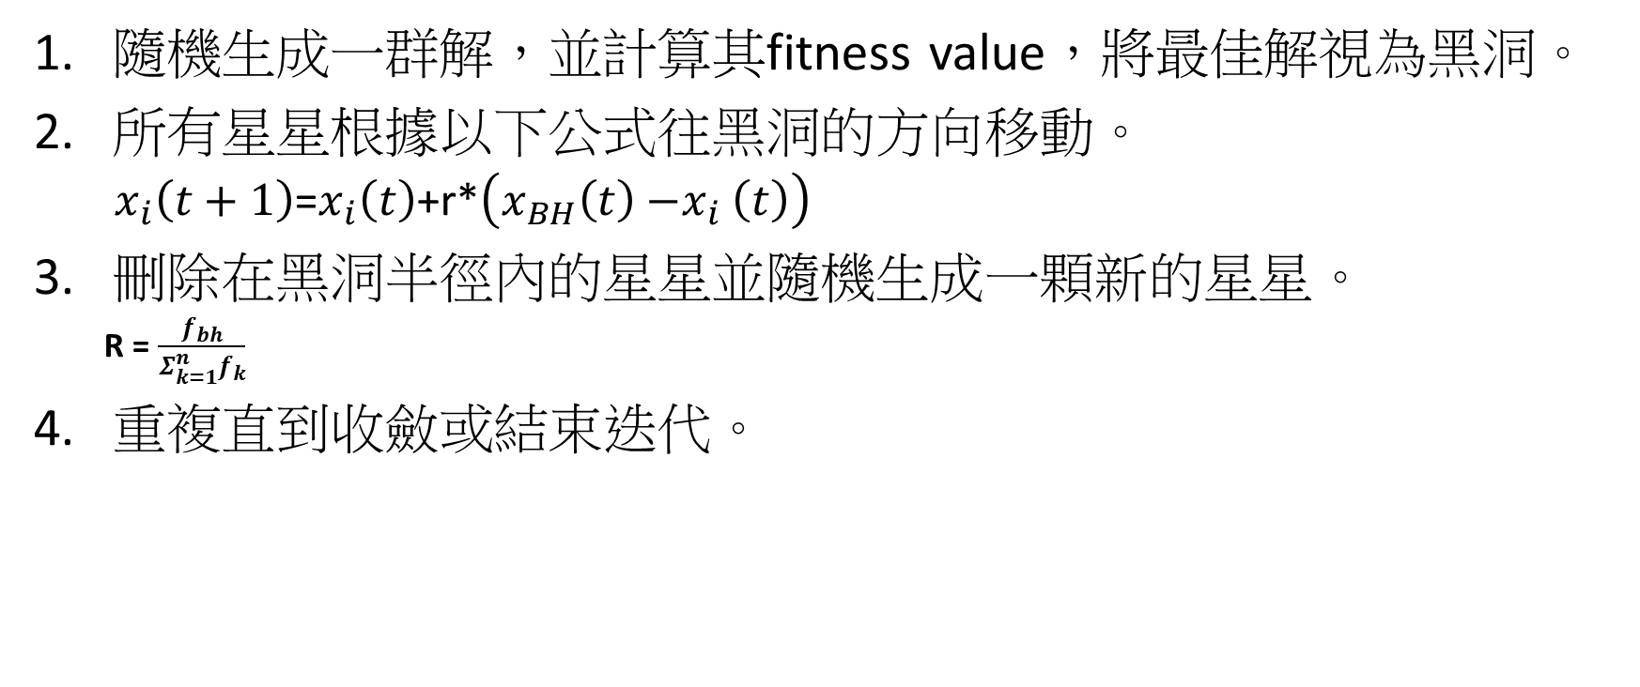
黑洞演算法
隨機生成一群解，並計算其fitness value，將最佳解視為黑洞。
所有星星根據以下公式往黑洞的方向移動。
$x_{i}\left(t+1\right)$=$x_{i}\left(t\right)$+r*$\left(x_{BH}\left(t\right){−x}_{i}\left(t\right)\right)$
刪除在黑洞半徑內的星星並隨機生成一顆新的星星。
R =$\frac{f_{bh}}{Σ_{k=1}^{n}f_{k}}$
重複直到收斂或結束迭代。

Slide 4
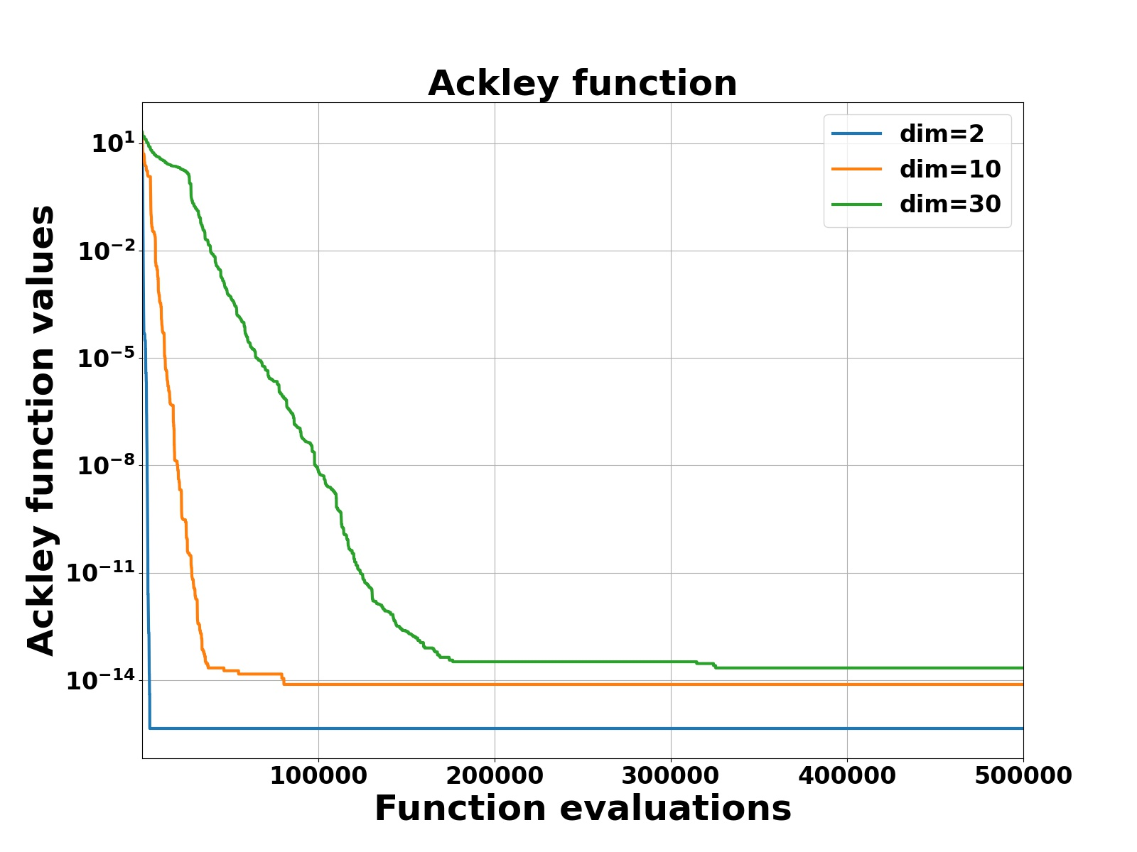
實驗數據
Ackley | dim=2 | dim=10 | dim=30
min | 4.44E-16 | 7.55E-15 | 2.18E-14

Slide 5
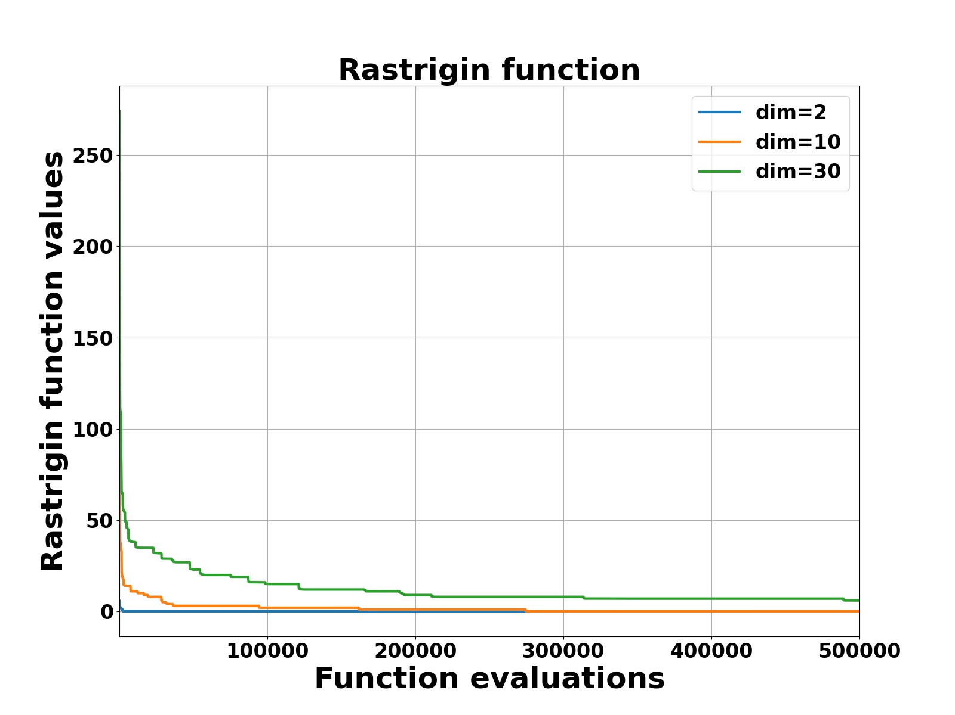
Rastrigin | dim=2 | dim=10 | dim=30
min | 6.01E-308 | 3.10E-68 | 5.96978

Slide 6
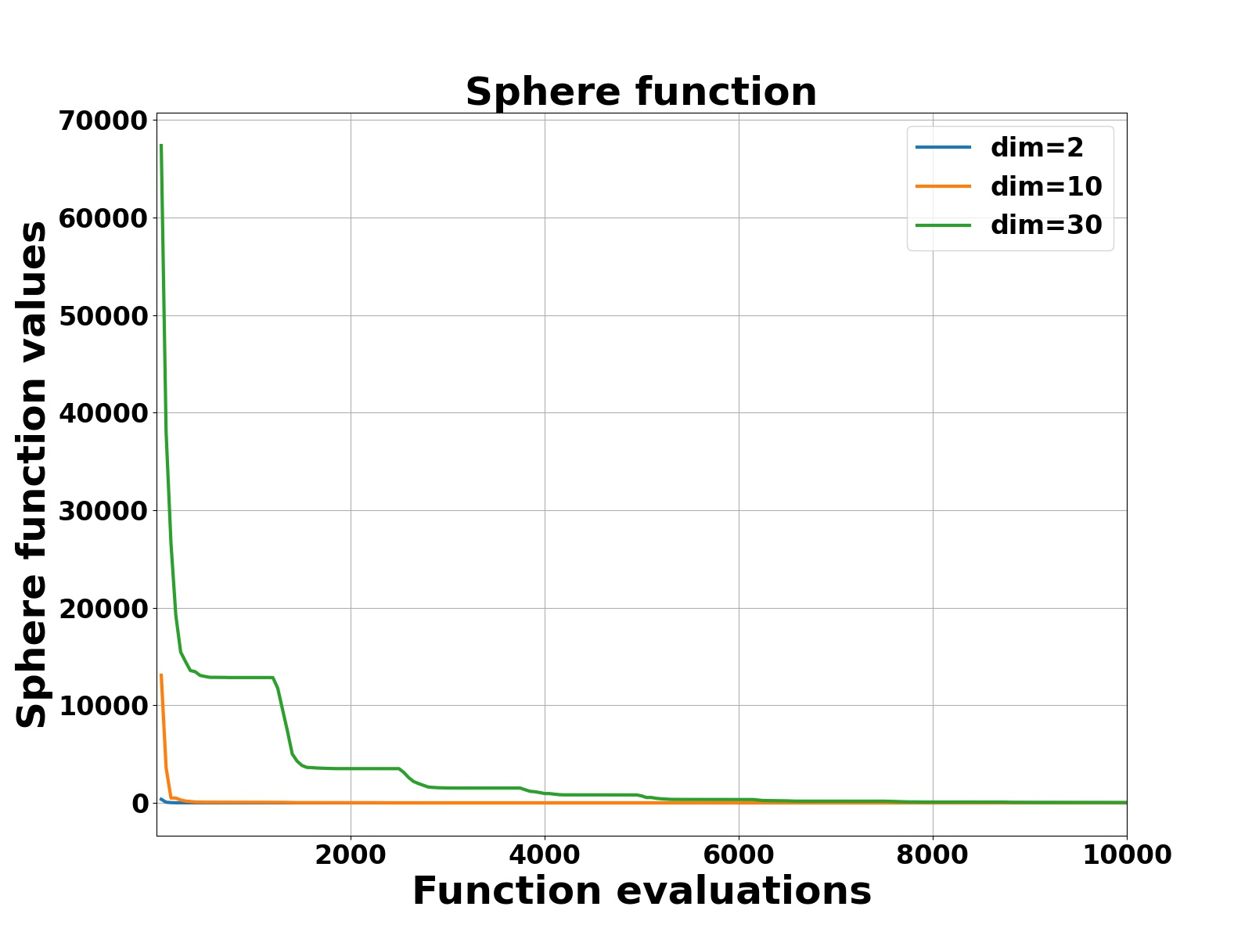
Sphere | dim=2 | dim=10 | dim=30
min | 4.94066e-324 | 7.81E-116 | 2.71E-45

Slide 7
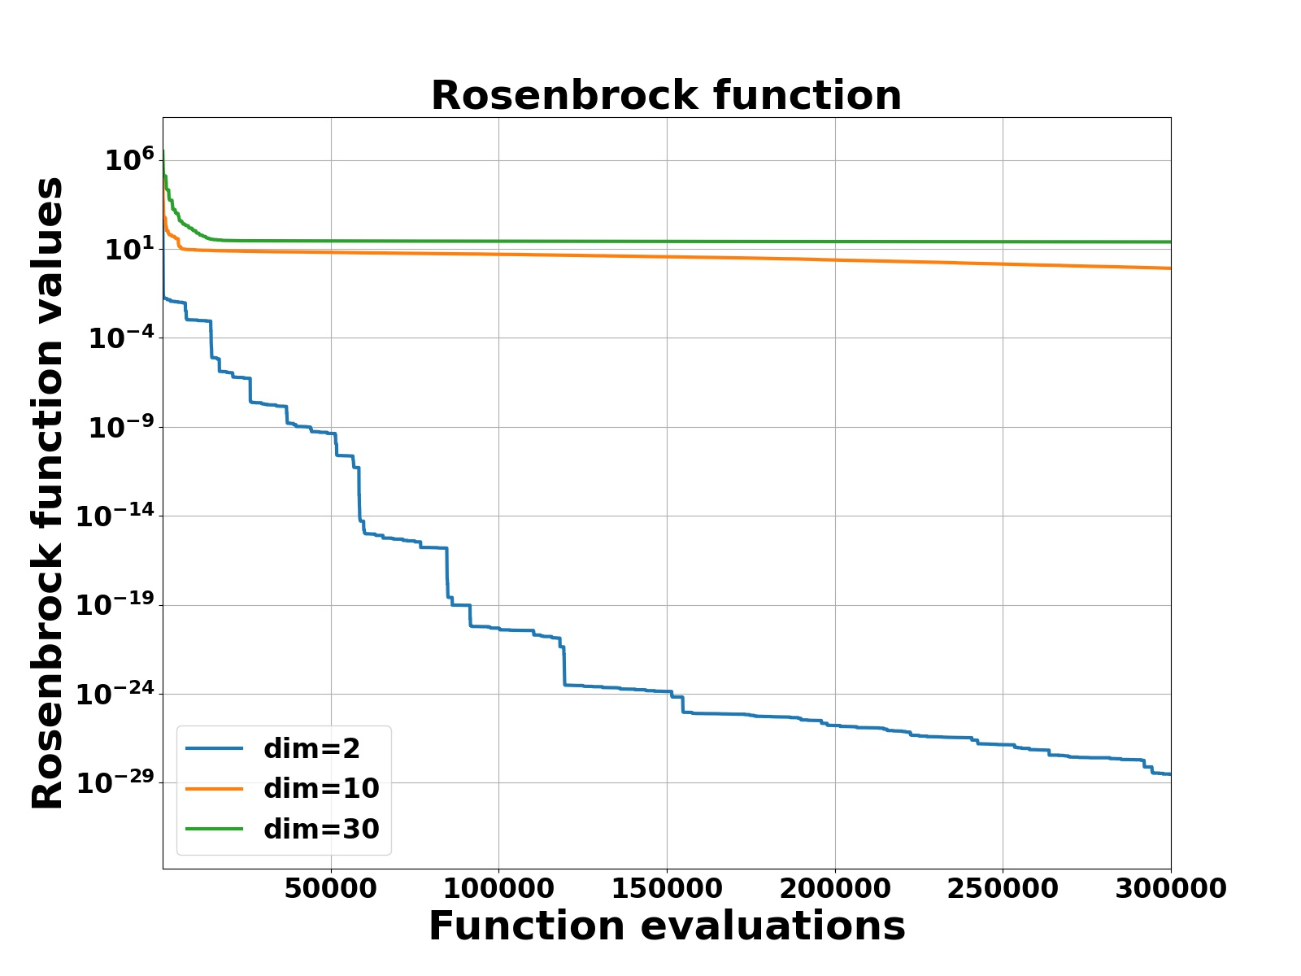
Rosenbrock | dim=2 | dim=10 | dim=30
min | 1.23E-32 | 0.172062 | 22.395

Slide 8
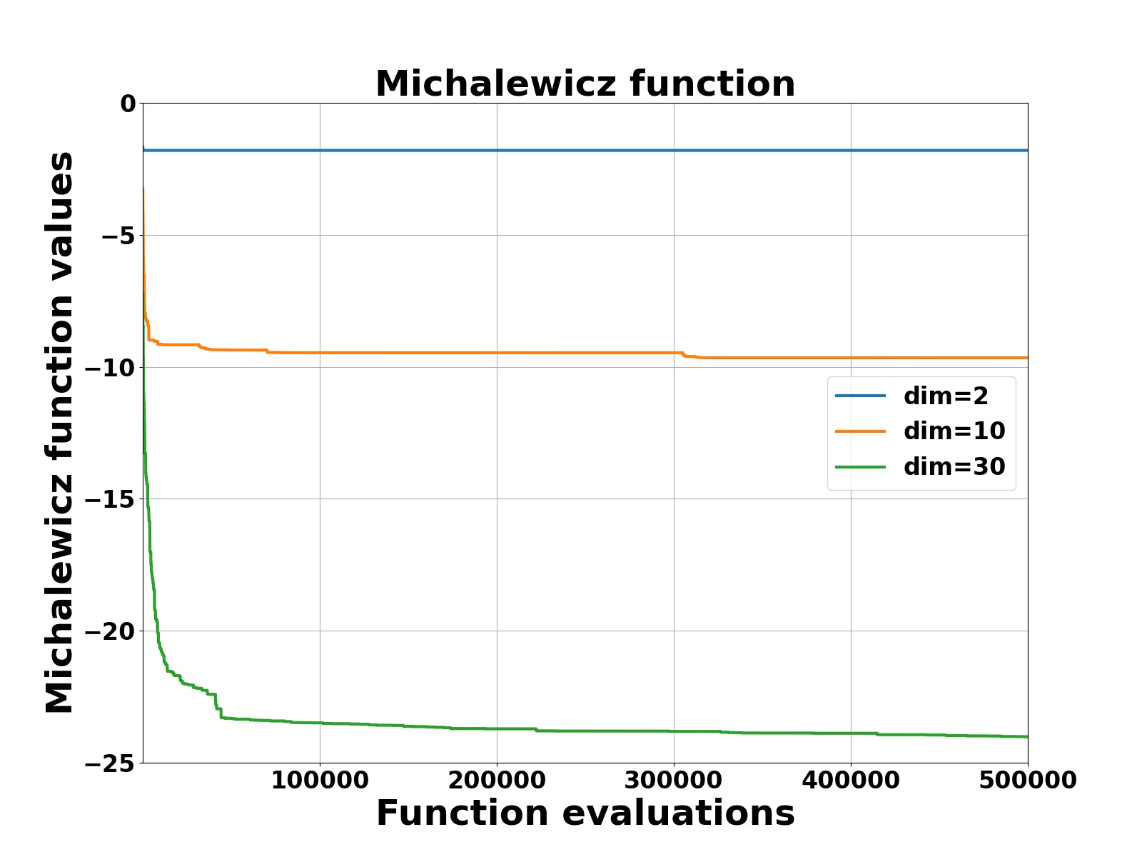
Michalewicz | dim=2 | dim=10 | dim=30
min | -1.8013 | -9.6598 | -24.0135

Slide 9
期末改進
採用多個黑洞的方法去改進。

Slide 10
Black Hole Algorithm
1. Black hole algorithm starts with an initial population of candidate solutions.
2. At each iteration of the Black Hole, the best candidate is selected to be the black hole and the rest form the normal stars. After the initialization process, the black hole starts pulling stars around it.
3. If a star gets too close to the black hole it will be swallowed by the black hole. In such a case, a new star is randomly generated and placed in the search space and starts a new search.

