Slide 1

Business Analytics and Data Science
Assignment 2
Leonardo gonnelli

Slide 2
Data Preprocessing & Feature Engineering
Feature Engineering
Derived features : car_age, mileage_per_year, engine_efficiency, power_index
Interaction features : brand_model (brand + model combination)
Tax-based features : 5 features capturing tax relationships (e.g. tax_mileage and tax_per_mpg)
Polynomial features : 8 polynomial terms (squared terms and interactions)
Encoding Strategy
Target encoding : applied to all categorical variables (including brand_model) with smoothing = 10 to reduce overfitting
One-hot encoding (for XGBoost) : replace categorical variables with binary columns
Frequency encoding : model and brand_model frequency added as additional features
Data Cleaning and Target Transformation
Dropped columns : ID (non-informative), year (we used car_age instead)
Outlier handling : IQR-based clipping to manage extreme values
Target transformation : price distribution being skewed, we applied log1p(price), which improves models performance,

Slide 3
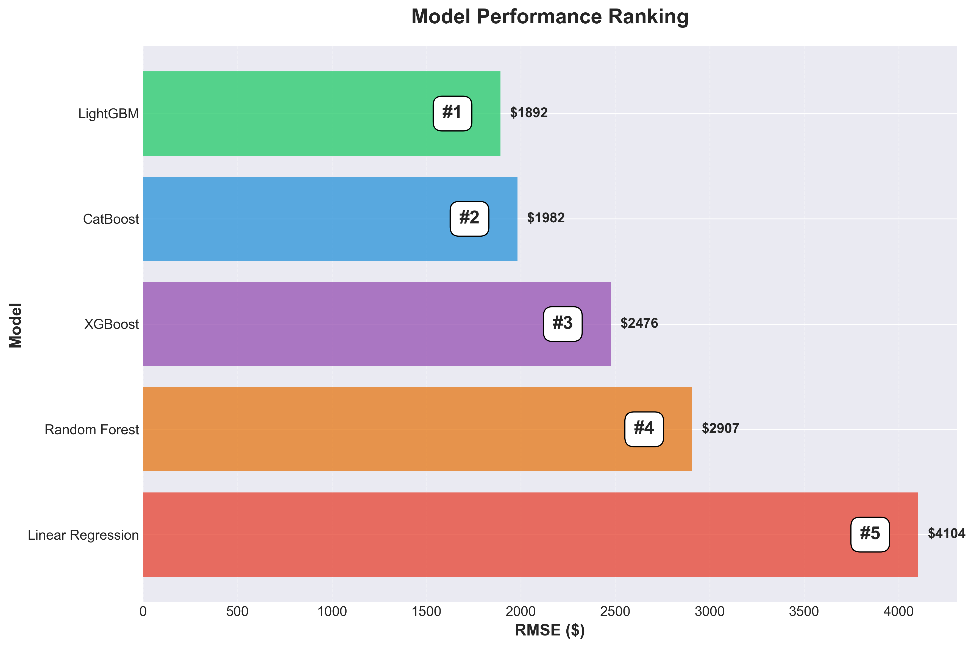
Model Comparison
Key Findings
LightGBM outperforms all other tested models, achieving a significant improvement over the baseline Linear Regression model (54% improvement).
Gradient boosting models outperform the tree-based model (random forest) and linear model.
LightGBM and CatBoost models outperform XGBoost as they handle categorical variables natively.

Slide 4
Conclusion and Further Improvements
Best model – LightGBM
Final test rmse (on the available half of the test set on Kaggle) : 1892.37
Achieves the best performance and good generalization.
Key success factors
Feature engineering, log transformation and target encoding significantly improved models performance (e.g. LightGBM’s rmse : 1953 before target encoding -> 1892 after — ↓61).
Further Improvements Ideas
Advanced feature engineering (feature aggregation, combination target encoding...), experiment ensemble methods (model blending, stacking).

