Slide 1
MSc DATA ANALYSIS & AI · EDHEC BUSINESS SCHOOL · MASTER THESIS DEFENSE
The Role of Weather in French Day-Ahead
Electricity Price Forecasting
A Random Forest Approach
Leo Cambreleng Lyam Oumedjeber
Supervisor: Prof. Milos Vulanovic
June 2026

Slide 2
CONTEXT & MOTIVATION
LÉO
Why forecast French day-ahead prices?
Electricity cannot be stored at scale
supply & demand clear instantaneously every hour → extreme volatility, spikes up to several 000s EUR/MWh
France is a special market
~63 GW nuclear (~70% of output); electric heating → ~2.4 GW/°C winter thermosensitivity — the highest in Europe
Forecasts have real economic stakes
a 1 EUR/MWh accuracy gain on a 100 MW book ≈ 876,000 EUR/year
So: does weather actually help?
temperature & wind drive demand and renewable supply — but is that signal already priced in elsewhere?
Weather in French Day-Ahead Electricity Price Forecasting
2

Slide 3
RESEARCH QUESTION
LÉO
What we set out to answer
“Do weather variables significantly improve the accuracy of French day-ahead electricity price forecasts — and does their contribution depend on the market regime?”
1
Can ML (Random Forest, XGBoost) beat a naïve statistical benchmark?
2
Do weather features add statistically significant value over fundamentals alone?
3
Does that value differ between a stable regime (2024–25) and the 2022 crisis — and why?
4
Can the forecasts be turned into real trading profit under realistic costs?
Weather in French Day-Ahead Electricity Price Forecasting
3

Slide 4
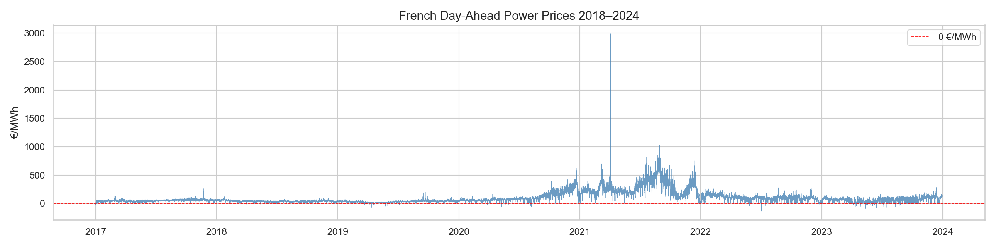
DATA
LÉO
A reproducible French dataset, 2018–2025
~64,000 hourly observations · 4 public sources
ENTSO-E
Prices, load forecast, generation by source, cross-border flows
ERA5 (ECMWF)
Temperature, wind, solar irradiance, precipitation — spatial mean France
Fuel prices
TTF natural gas (EUR/MWh), ARA coal (EUR/t)
Engineered
35 features: calendar, price lags, fundamentals, flows, weather, derived
Three regimes: pre-crisis (2018–21), the 2022 energy crisis (>1,000 EUR/MWh), and normalisation (2023+).
Weather in French Day-Ahead Electricity Price Forecasting
4

Slide 5
METHODOLOGY
LÉO
A nested four-model ablation design
A
Naïve benchmark
price 168h ago (same hour, last week)
The bar to beat
B
RF without weather
27 features — no meteorology
Ablation baseline
C
RF with weather
35 features — full meteorology
Main model
D
XGBoost with weather
same 35 features, boosted trees
More expressive?
Key comparison: C vs B isolates the marginal value of weather. Evaluated out-of-sample with the Diebold-Mariano test (HLN-corrected).
Weather in French Day-Ahead Electricity Price Forecasting
5

Slide 6
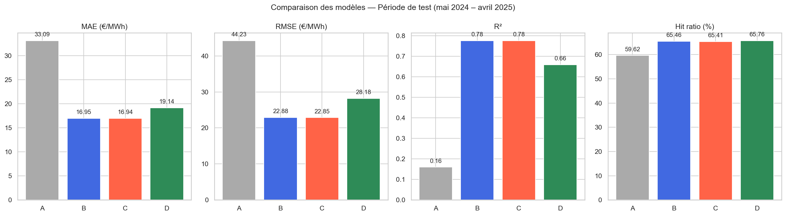
RESULTS — STABLE REGIME (MAY 2024–APR 2025)
LÉO
Machine learning works; weather barely moves the needle
Model
MAE
RMSE
R²
Hit %
A — Naïve
33.09
44.23
0.160
59.6
B — RF no weather
16.95
22.88
0.775
65.5
C — RF weather
16.94
22.85
0.776
65.4
D — XGBoost
19.14
28.18
0.659
65.8
− 49% MAE vs naïve (33.1 → 16.9 EUR/MWh), R² 0.16 → 0.78
Weather C vs B: MAE −20.01 EUR/MWh — negligible
XGBoost underperforms RF here
Weather in French Day-Ahead Electricity Price Forecasting
6

Slide 7
CENTRAL FINDING
LÉO
Weather is not statistically significant — in the stable regime
Diebold-Mariano C vs B: p = 0.572 (DM = −0.565) → fail to reject equal accuracy
Comparison
DM stat
p-value
Sig.
C vs B — does weather add value?
−0.565
0.572
n.s.
C vs A — RF-weather beats naïve?
−53.53
<0.001
***
B vs A — RF-no-weather beats naïve?
−53.44
<0.001
***
D vs C — XGBoost vs RF-weather?
+10.88
<0.001
***
ML adds robust value; weather does not — yet. Why? And is this always true? → over to Lyam.
Weather in French Day-Ahead Electricity Price Forecasting
7

Slide 8
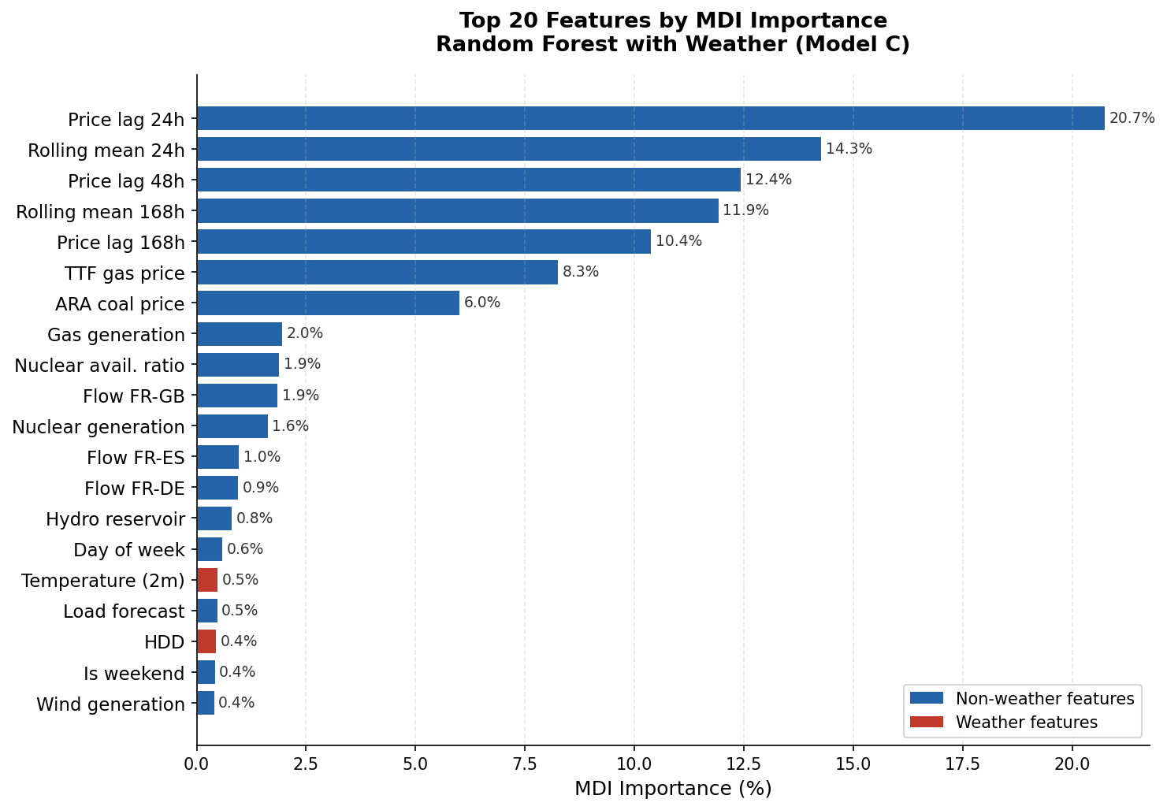
FEATURE IMPORTANCE
LYAM
Where does the predictive power come from?
Price lags dominate
lag-24h alone = 20.7% of importance; lags + rolling means ≈ 70%
Fuel prices matter
TTF gas 8.3%, ARA coal 6.0%, nuclear availability ~1.9%
Weather is small
all weather features combined ≈ 2.2% of total importance
→ consistent with the DM test: weather signal is already captured by load forecast & TTF.
Weather in French Day-Ahead Electricity Price Forecasting
8

Slide 9
INTERPRETATION
LYAM
The Information Redundancy Hypothesis
Weather looks redundant because its signal is already encoded in other features:
Load forecast ≡ temperature
RTE's published load forecast is built on temperature forecasts — including it implicitly conditions on weather-driven demand.
TTF gas ≡ European weather
Gas prices rise with pan-European heating demand — the commodity market aggregates the weather signal.
Nuclear dominance
The nuclear availability ratio explains a large share of price variance independently of weather.
Weather in French Day-Ahead Electricity Price Forecasting
9

Slide 10
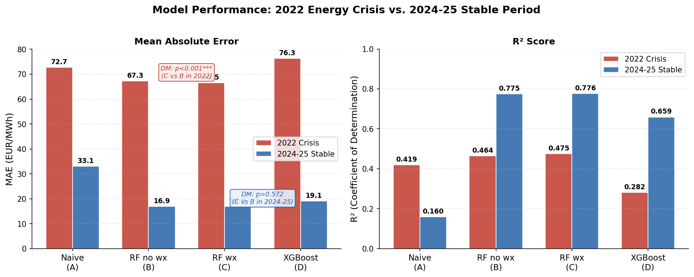
ROBUSTNESS — 2022 ENERGY CRISIS
LYAM
The result reverses: weather becomes highly significant
Models retrained on 2018–2021, tested on full-year 2022 (strict temporal split).
Stable 2024–25
p = 0.572
DM = −0.565 · n.s.
Crisis 2022
p < 0.001
DM = −13.27 · ***
What happens in 2022:
All models degrade sharply — MAE 16.9 → 66.6 EUR/MWh (~4×)
But C now beats B by 0.73 EUR/MWh, highly significant
XGBoost degrades most (+14.6% vs RF) — RF is the robust choice
Weather in French Day-Ahead Electricity Price Forecasting
10

Slide 11
INTERPRETATION
LYAM
Why the crisis breaks the redundancy
The same three channels that made weather redundant break down in 2022:
1
TTF decouples from local weather
The Russian gas supply shock drove TTF by geopolitics, not French temperature — the gas–weather link snaps.
2
Nuclear constraints amplify demand
With availability ~40%, there is no headroom to absorb cold-driven demand surges → temperature feeds straight into price.
3
Signal-to-noise rises
When prices swing by hundreds of EUR/MWh, the direct temperature–demand effect becomes large enough to measure.
Takeaway: the value of weather is regime-dependent — a dynamic, not a permanent, modelling choice.
Weather in French Day-Ahead Electricity Price Forecasting
11

Slide 12
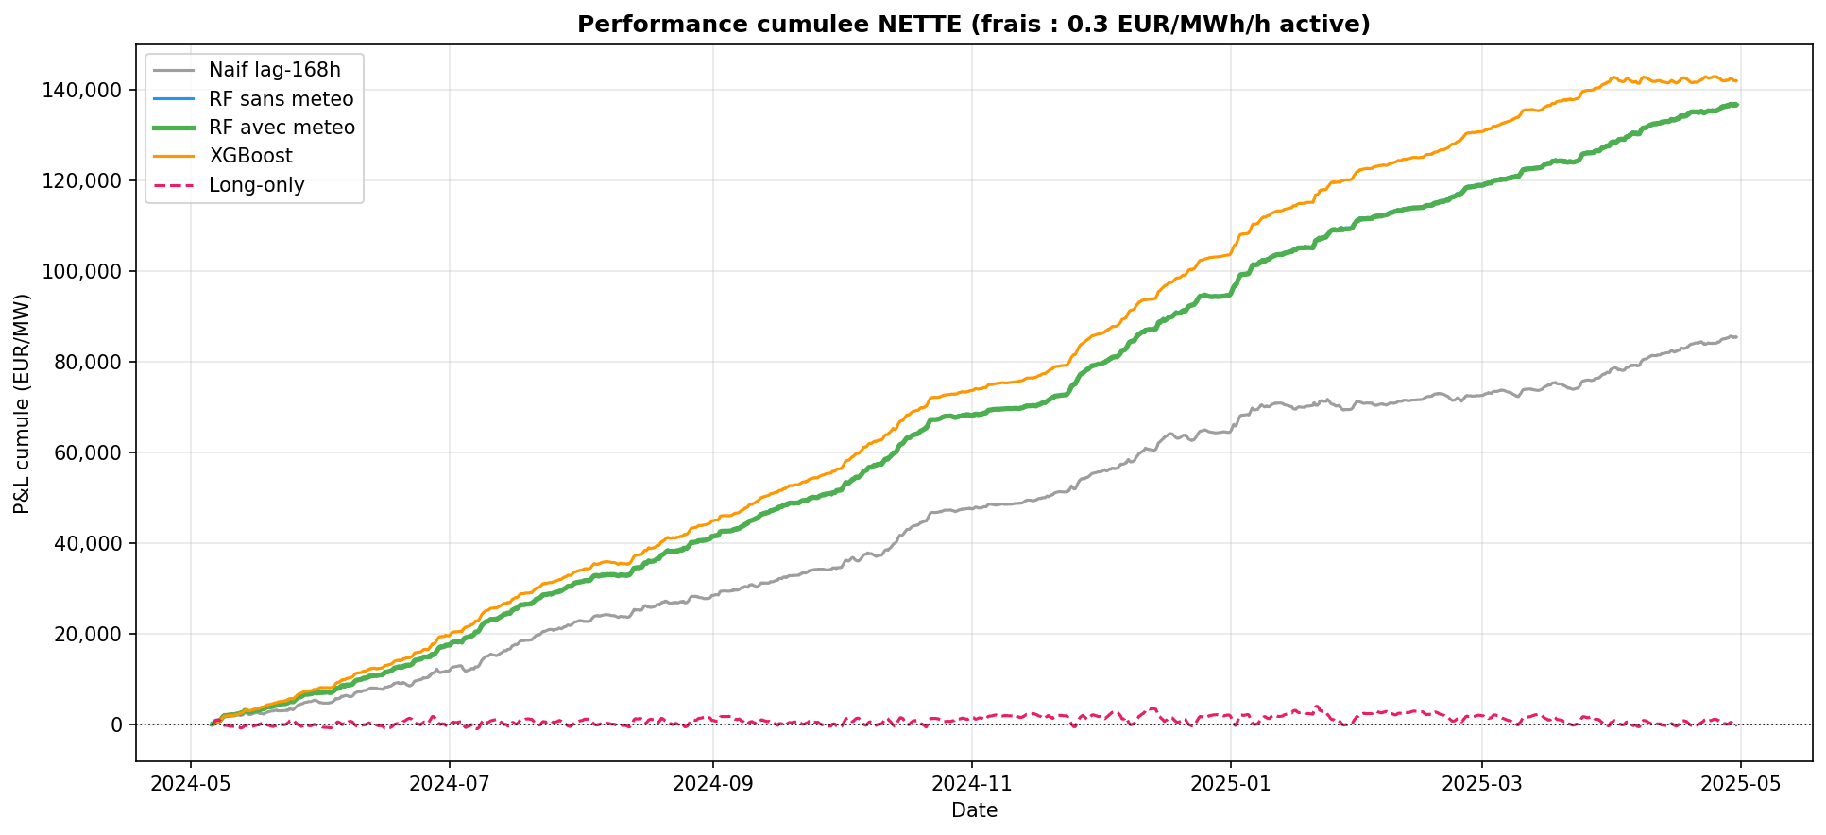
ECONOMIC VALUE — TRADING BACKTEST
LYAM
Do better forecasts make money?
Day-ahead directional strategy, central cost 0.30 EUR/MWh, 1 MW position.
Model
Net P&L
Sharpe
MaxDD
Calmar
A — Naïve
85,482
10.5
2,367
37
B — RF no wx
136,884
19.4
433
321
C — RF wx
136,711
19.5
422
328
D — XGBoost
142,012
18.8
1,351
107
RF ≈ 137k EUR/MW vs 85k naïve; long-only ≈ 0 → real skill, not trend
RF drawdown 5.6× smaller than naïve; positive Sharpe every single month
Weather in French Day-Ahead Electricity Price Forecasting
12

Slide 13
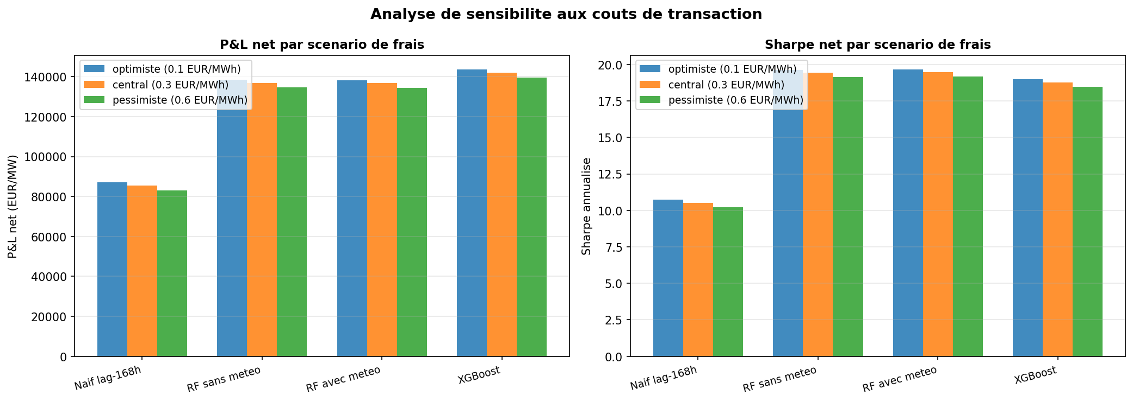
ROBUSTNESS CHECKS
LYAM
The result holds under different assumptions
Cost sensitivity — Net P&L (EUR/MW)
Model
0.10 EUR/MWh
0.30 EUR/MWh
0.60 EUR/MWh
A — Naïve
88,340
85,482
81,195
B — RF no wx
139,742
136,884
132,597
C — RF wx
139,569
136,711
132,424
D — XGBoost
144,870
142,012
137,725
RF Sharpe: 19.51 → 19.46 → 19.16 across all three cost scenarios
Positive Sharpe in all 12 months of the test period
DM result stable: p = 0.572 n.s. confirmed across multiple sub-periods
Weather in French Day-Ahead Electricity Price Forecasting
13

Slide 14
LIMITATIONS & FUTURE WORK
LYAM
What we would do differently
1
ERA5 = upper bound
Reanalysis gives perfect hindsight weather — production would use NWP forecasts with 10–30% error. Our result is a ceiling on weather value.
2
No walk-forward retraining
Single batch training; monthly retraining on an expanding window would better reflect real trading conditions.
3
Carbon prices (EUA) excluded
EUA correlates with TTF/coal — partly absorbed — but should be tested explicitly as an additional feature.
4
XGBoost not fully tuned
Default hyperparameters; Bayesian optimisation could close or reverse the RF vs XGBoost gap.
5
France only
The redundancy mechanism is specific to France's nuclear-dominant, high-thermosensitivity structure. Germany, Spain or UK may differ substantially.
6
No market impact
Transaction costs modelled as flat fee; large positions (>10 MW) would face liquidity constraints not captured here.
Weather in French Day-Ahead Electricity Price Forecasting
14

Slide 15
CONCLUSIONS
LYAM
Four takeaways
1
ML beats naïve, decisively
−49% MAE, R² 0.78, p < 0.001 — robust across all 12 months.
2
Weather is regime-dependent
n.s. in the stable regime (redundancy), but significant in the 2022 crisis (redundancy breaks). The core contribution.
3
Random Forest > XGBoost
RF wins on risk-adjusted metrics (Calmar 328 vs 107) and degrades less under stress.
4
Forecasts create real value
~137k EUR/MW net, Sharpe ~19.5, tiny drawdown — robust to transaction costs.
Weather in French Day-Ahead Electricity Price Forecasting
15

Slide 16
Thank you
Questions & Discussion
Leo Cambreleng · Lyam Oumedjeber
Supervisor: Prof. Milos Vulanovic · EDHEC MSc Data Analysis & AI

