Slide 1
HYDeep
09/2026 • Overview
Hybrid Deep modelling of CHO processes for biotherapeutics production optimization
Goal
Develop a hybrid deep modelling (HYDeep) platform for CHO cell processes towards the production of a single mAb.
Part I: Regularization and Selection
  Develop metabolic model for the generation of synthetic datasets of CHO-based processes for mAb production;
  Evaluate deep learning and regularization algorithms for selection methods (Akaike Information Criteria and Validation loss) of hybrid models;
  Tune hyperparameters using Optuna and evaluate model performance.
Part II: PCA Implementation
  Perform PCA on synthetic dataset to incorporate eigenvectors (loadings) in the inputs of the Neural Network;
  Tune hyperparameters using Optuna and evaluate optimal number of Principal Components.
Part III: Glycosylation
  Develop glycosylation model and incorporate it into previous structure;
  Evaluate impact of glycosylation.
L. Gündersen

Slide 2
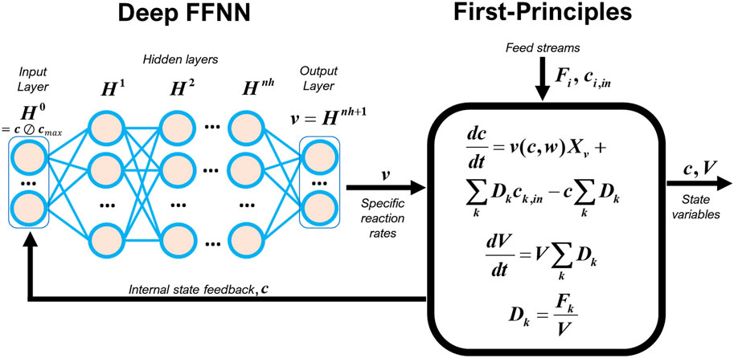
Hybrid Deep Modelling
09/2026 • Introduction to Part I
Part I: Regularization and Selection
empirical versus probabilistic model selection
Synthetic data:
  DoE framework based on induction time, and pre/post feed rates;
  Metabolic network generates intra and extracellular concentrations of species;
  Gaussian noise is added to the dataset at 10% the measured value;
  DoE 15 total batches; 1 for testing (max mAB production);
  (72 commercial mAbs/ 15 total batches for each);
  No glycosylation.
Hybrid model:
  Mechanist part: ODEs system of 25 extracellular species;
  Machine learning part: Neural network with 26 inputs (concentrations + feed state) and 25 outputs (reaction rates);
Figure 1 Example of deep hybrid model structure^{[1]} .
3 Stochastic Regularization s(SR):
No k-fold;
With k-fold (k = 5);
With LOOCV.
2 selection methods:
Probabilistic (AICc);
Empirical (Valloss).
Empirical (Valloss).
Objectives
Discriminate best hybrid model structure, regularization and selection methodology to describe independent CHO experiments.
[1] J. Pinto, J. R. C. Ramos, R. S. Costa, S. Rossell, P. Dumas, and R. Oliveira, “Hybrid deep modeling of a CHO-K1 fed-batch process: combining first-principles with deep neural networks,” Frontiers in Bioengineering and Biotechnology, vol. 11, Sep. 2023, doi: https://doi.org/10.3389/fbioe.2023.1237963.
‌
L. Gündersen

Slide 3
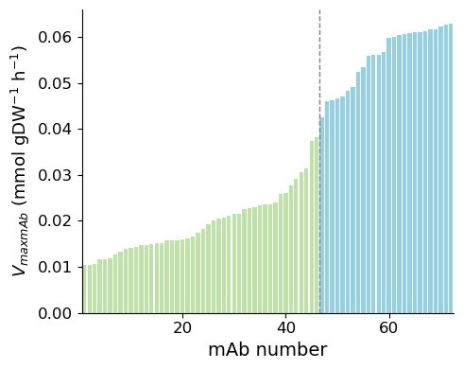
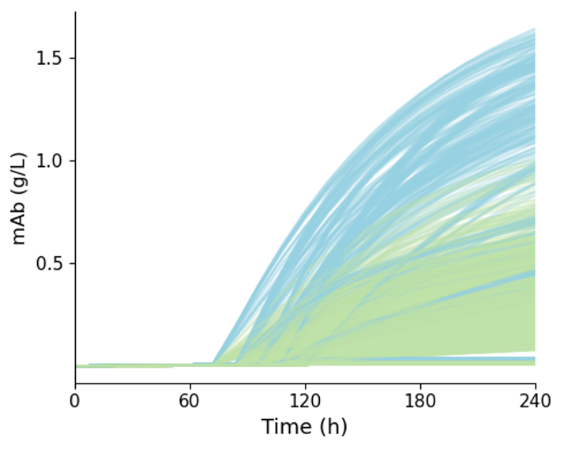
09/2026 • Synthetic Dataset
Part I: Regularization and Selection
  Data-generation code adapted from Robitaille et al. (2015) ^{[2]} ;
  DoE with varying induction time and pre and post induction feed rate (Table 1);
  Data generated for 72 commercial mAbs with different maximum velocities (Figure 2);
  The different batch conditions and metabolic differences between mAbs lead to different productions of antibody across the 15 batches of the 72 mAbs (Figure 3);
Table 1 DoE conditions of the 15 batches generated for each mAb, where the induction time (T_ind), the feed rate pre induction (F_pre_ind) and pos induction (F_pos_ind) are varied.
T_ind | F_pre_ind | F_pos_ind
72 | 0.2 | 1.5
84 | 0.081 | 0.61
84 | 0.081 | 2.39
84 | 0.319 | 0.61
84 | 0.082 | 0.4235
96 | 0.2 | 0
96 | 0 | 1.5
96 | 0.4 | 1.5
96 | 0.2 | 3.0
96 | 0.2 | 1.50
108 | 0.081 | 0.61
108 | 0.081 | 2.39
108 | 0.319 | 0.61
108 | 0.319 | 2.39
120 | 0.2 | 1.5
Figure 2 Variation of the maximum velocity of the 72, with the red line at V_{max} = 0.04, diving the mAbs classified into High or Low productivity mAbs. .
Figure 3 Evolution over time of the concentration of monoclonal antibody over time. All batches of all mAbs are represented, with High productivity mAbs represented in blue and Low productivity in green.
[2] J. Robitaille, J. Chen, and M. Jolicoeur, “A Single Dynamic Metabolic Model Can Describe mAb Producing CHO Cell Batch and Fed-Batch Cultures on Different Culture Media,” PLOS ONE, vol. 10, no. 9, p. e0136815, Sept. 2015, doi: 10.1371/journal.pone.0136815.
‌‌
L. Gündersen

Slide 4
09/2026 • Glycosylation hybrid model (29 ODEs)
Part I: Regularization and Selection
Intracellular mAb [mg/Mcell] material balance:
$$\frac{d[mAb]}{dt }=v_{mAb}−K_{M3}\left[mAb\right]−K_{FM3}\left[mAb\right]−K_{A1}\left[mAb\right]−K_{M4}\left[mAb\right]−K_{FA1}\left[mAb\right]−K_{A2}\left[mAb\right]−K_{HT1}\left[mAb\right]−K_{FA2}\left[mAb\right]−K_{M5}\left[mAb\right]−K_{FA1G1}\left[mAb\right]−K_{A2G1}\left[mAb\right]−K_{FA3}\left[mAb\right]−K_{FA2G1(a)}\left[mAb\right]−K_{FA2G1(b)}\left[mAb\right]−K_{M6(a)}\left[mAb\right]−K_{M6(b)}\left[mAb\right]−K_{M6(c)}\left[mAb\right]−K_{FA1G1S1}\left[mAb\right]−K_{FA3G1}\left[mAb\right]−K_{FA2G2}\left[mAb\right]−K_{FA2G1S1}\left[mAb\right]−K_{M7}\left[mAb\right]−K_{FA2G2S1}\left[mAb\right]−K_{M8(a)}\left[mAb\right]−K_{M8(b)}\left[mAb\right]−K_{FA2G2S2}\left[mAb\right]−K_{M9}\left[mAb\right]−K_{Unkown}\left[mAb\right]$$
Acronym | Complete name
M3 | Man3GlcNAc2 w/o Fuc
FM3 | Man3GlcNAc2 w Fuc
A1 | Diantennary w/o 2 ß-Gal w/o 1 GlcNAc w/o Fuc
M4 | Man4GlcNAc2
FA1 | Diantennary w/o 2 ß-Gal w/o 1 GlcNAc w Fuc
A2 | Diantennary w/o 2 ß-Gal w/o Fuc
HT1 | Gal1GlcNAc1Man1+Corewith fucose
FA2 | Diantennary w/o 2 ß-Gal w Fuc
M5 | Man5GlcNAc2
FA1G1 | Diantennary w/o 1 ß-Gal w/o 1 GlcNAc w Fuc
A2G1 | Diantennary w/o 1 ß-Gal w/o Fuc
FA3 | Triantennary w/o 3 ß-Gal w Fuc
FA2G1(a) | Diantennary w/o 1 ß-Gal w Fuc
FA2G1(b) | Diantennary w/o 1 ß-Gal w Fuc
M6 | Man6GlcNAc2
FA1G1S1 | Monosialylated (Neu5Ac), diantennary w/o 1 ß-Gal w/o 1 GlcNAc w Fuc
FA3G1 | Triantennary w/o 2 ß-Gal w Fuc
FA2G2 | Diantennary w Fuc
FA2G1S1 | Monosialylated (Neu5Ac), diantennary w/o 1 ß-Gal w Fuc
M7 | Man7GlcNAc2
FA2G2S1 | Monosialylated (Neu5Ac), diantennary w Fuc
M8 | Man8GlcNAc2
FA2G2S2 | Disialylated (Neu5Ac), diantennary w Fuc
M9 | Man9GlcNAc3
Extracellular mAb-glycoform [mg/L] material balances:
$$\frac{d{[mAb]}_{Glycoform(n)}}{dt}=K_{Glycoform(n)}\left[mAb\right]X_{v}−D{\left[mAb\right]}_{Glycoform(n)}$$
$$\left[mAb\right](\frac{mg}{L})= \sum_{n=1}^{nGlycoforms}{{[mAb]}_{Glycoform(n)}}$$
L. Gündersen

Slide 5
09/2026 • Regularization Method
Part I: Regularization and Selection
Empirical Selection relies on multiple train/validation splits, where training is repeated and models are selected based on minimum validation error (Valloss); it is very robust but computationally expensive. It is being compared with Probabilistic Selection, a no-fold training optimized for lowest AICc.
Parameters
Probabilistic (AICc)
Empirical (Valloss)
K-fold
LOOCV
Constant Parameters
Inputs ANN: 26 (25 [C] + state)
Outputs ANN: 25 (25 reaction rates)
5000 epochs
15 total batches, 1 for Test: Max mAb
Folds
Single fold
K-fold
LOOCV
Data Splitting
14 for Train
10:4 (Train/Val)
13:1 (Train/Val)
Final Model
Ensemble (Average prediction)
Optimizes for
AICc
Valloss
Optimizer
ADAMw (weight decay)
Optimization of hyperparameters:
Establish ranges for hyperparameters;
Use Optuna to determine optimum;
Use different test batch for selected models;
Determine best Regularization method.
Structural Hyperparameters
Number of hidden layers
Number of nodes per layer
General Hyperparameters
Weight decay
Learning rate
Activation function
SR - specific Hyperparameters
Mini batch rate
Weight dropout rate
Activation function
‘tanh’ if only 1 hidden layer, else ‘relu’
L. Gündersen

Slide 6
09/2026 • Implementing Optuna
Part I: Regularization and Selection
1) Establish ranges for hyperparameters
Parameter
Default
Range
Step
Number of hidden layers
Number of nodes per layer
NA
NA
1 to 5
1 to 25
1
1
Weight decay
Learning rate
1e-4
1e-3
1e-7 to 1e-3
1e-5 to 1e-2
logarithmic
logarithmic
ρ = 6
Mini batch rate
Weight dropout rate
0.80
0.20
0.30 to 0.90
0.10 to 0.70
0.05
0.05
Hyperparameters to optimize = ρ ; Min number of trials > 2^{ρ} ; 2^{ρ} = 64 ; Number of trials = 65
2) Use Optuna to determine optimum
Change code to receive hyperparameters values instead of using global hyperparameters (functions train_Hyb_pytorch (Cell 11) and weight_dropout_with_precalculated_values (Cell 9) and, and class definition FFNN (Cell 5));
Create objective function with hyperparameter ranges and steps;
Run study for optimization of training results (AICc for Probabilistic method, Validation error for Empirical method).
L. Gündersen

Slide 7
09/2026 • Results Optuna
Part I: Regularization and Selection
Parameters
Probabilistic (AICc)
Empirical (k-fold)
Empirical (LOOCV)
Noisy vs True - Top
Number of hidden layers
Number of nodes per layer
1
2
1
12
1
24
Training and Validation batches
WMSE – 0.4696 | R2 - 0.9622
Test batch (Top)
Weight decay
Learning rate
Activation function
1.3464700407939077e-07
7.160247325944843E-03
tanh
2.174678917296539e-07
3.661483220556779e-03
tanh
1.0039691935944614e-07
8.701116100036337e-03
tanh
WMSE – 0.6363 | R2 - 0.9591
Mini batch rate
Weight dropout rate
0.85
0.10
0.90
0.20
0.70
0.30
Computational time
742 min (13.4 h)
2740 min (45.7 h)
6848 min (114.1 h)
The methods obtained comparable results during training (AICc being slightly better), but the test results are better using the AICc as a Selection Method.
Trainvalloss
WMSE – 0.5095 | R2 - 0.9450
WMSE – 0.5041 | R2 - 0.9459
WMSE – 0.5338 | R2 - 0.9388
Noisy
Testloss
WMSE – 2.0368 | R2 - 0.9193
WMSE – 2.1210 | R2 - 0.8970
WMSE – 2.2104 | R2 - 0.8967
Trainvalloss
WMSE – 0.0908 | R2 - 0.9802
WMSE – 0.0984 | R2 - 0.9804
WMSE – 0.1108 | R2 - 0.9731
True
Testloss
WMSE – 0.9234 | R2 - 0.9567
WMSE – 0.9125 | R2 - 0.9308
WMSE – 1.0170 | R2 - 0.9290
L. Gündersen

Slide 8
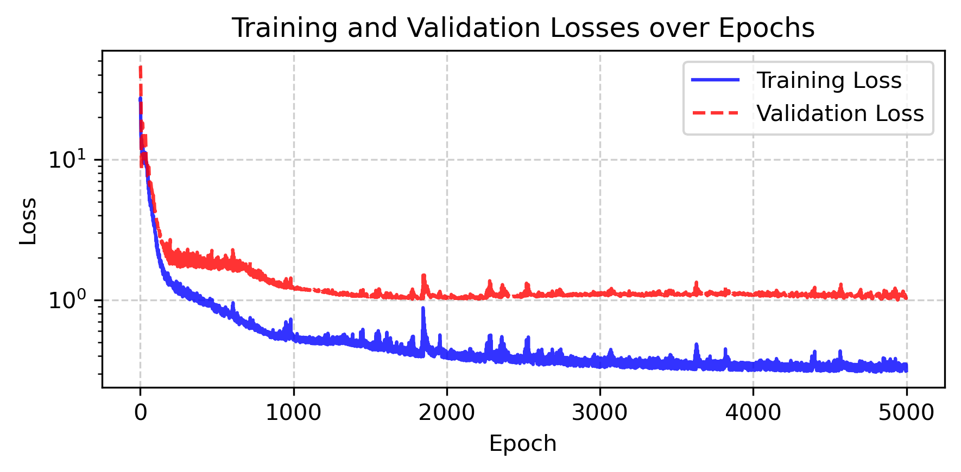
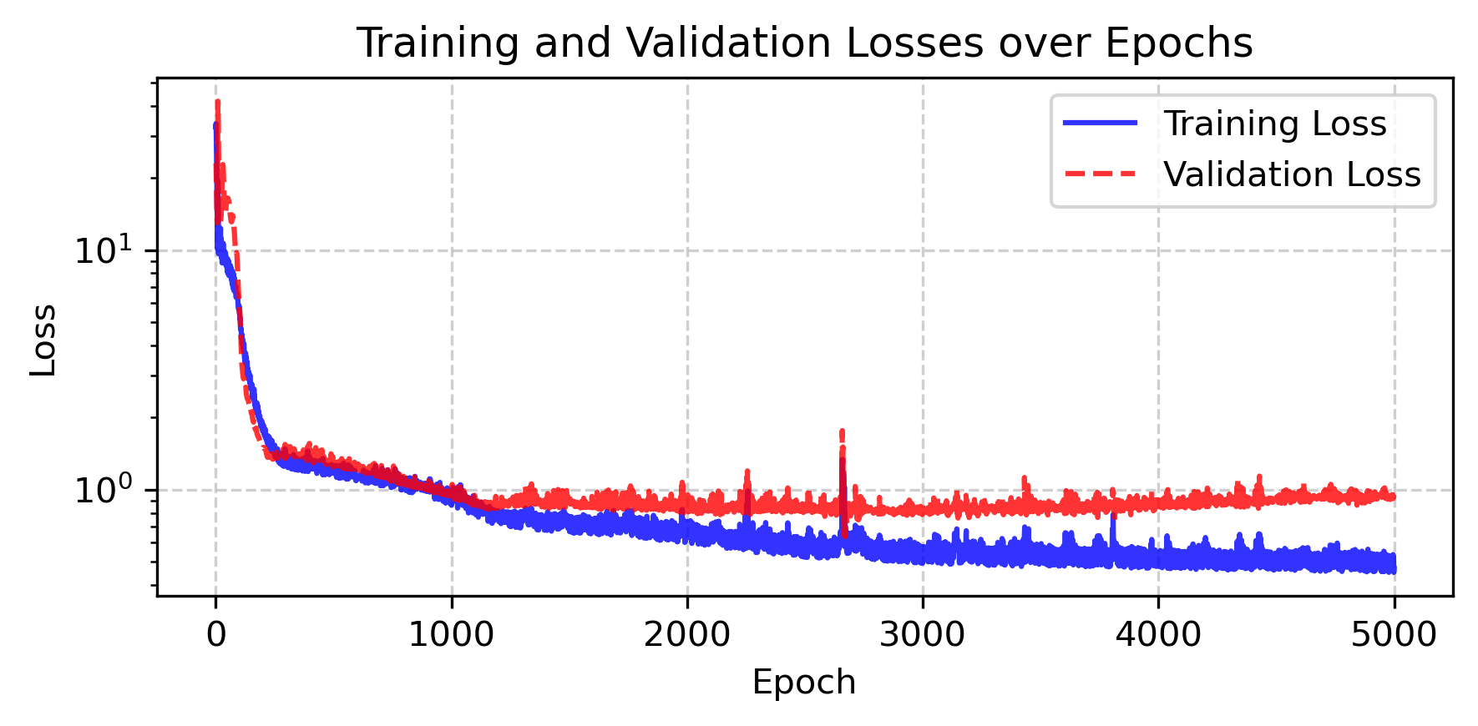
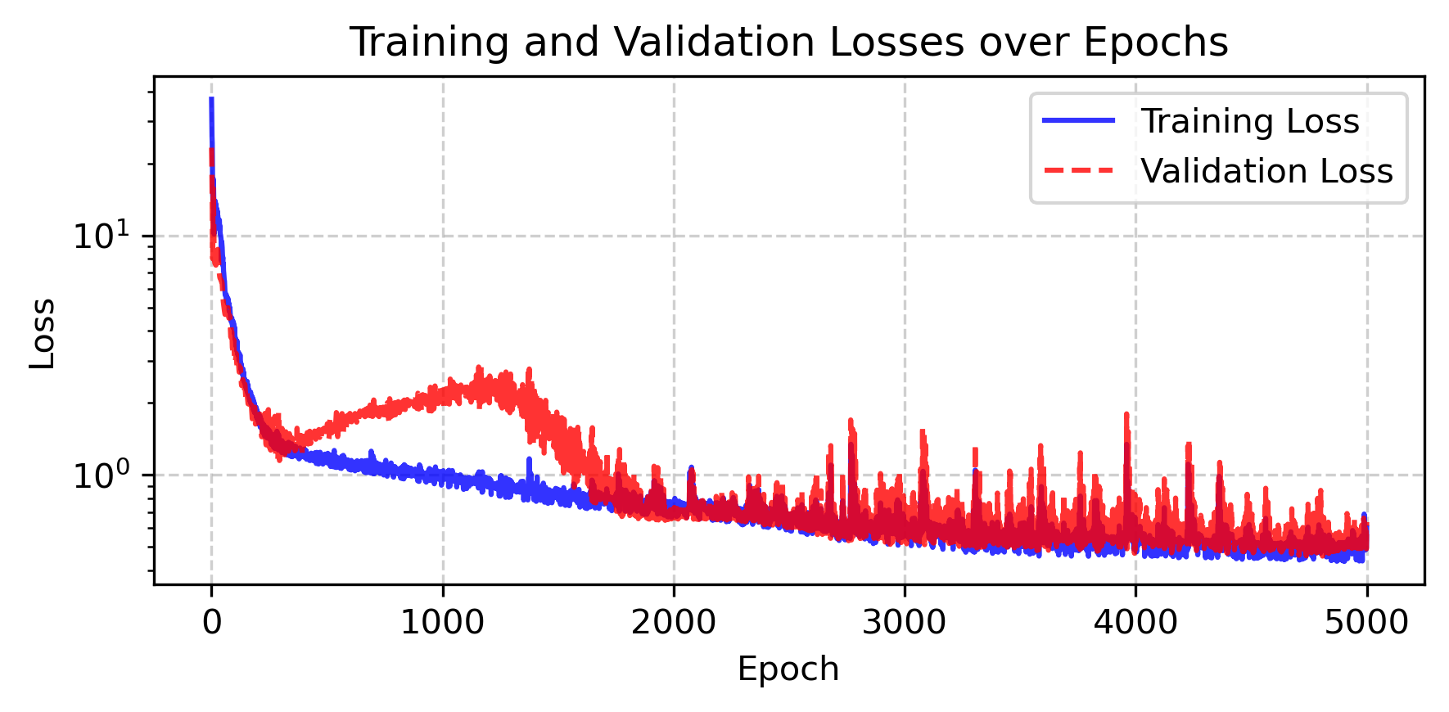
09/2026 • Results Optuna
Part I: Regularization and Selection
Convergence
Probabilistic (AICc)
Empirical (k-fold)
L. Gündersen

Slide 9
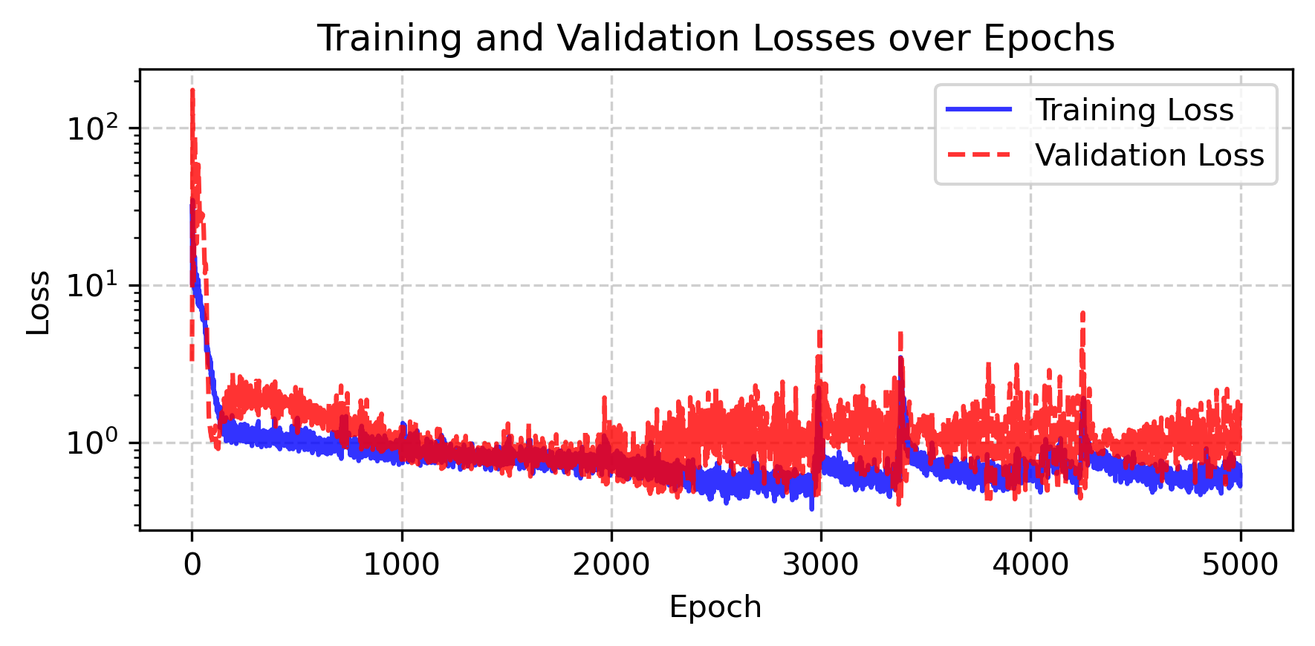
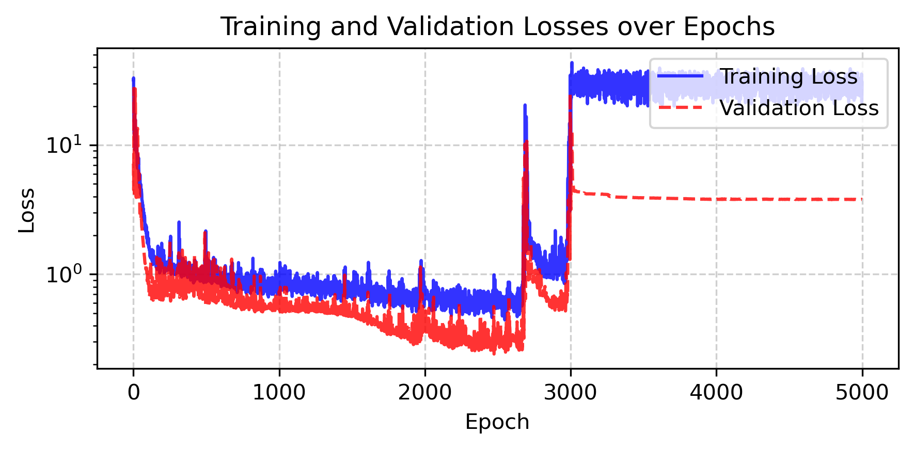
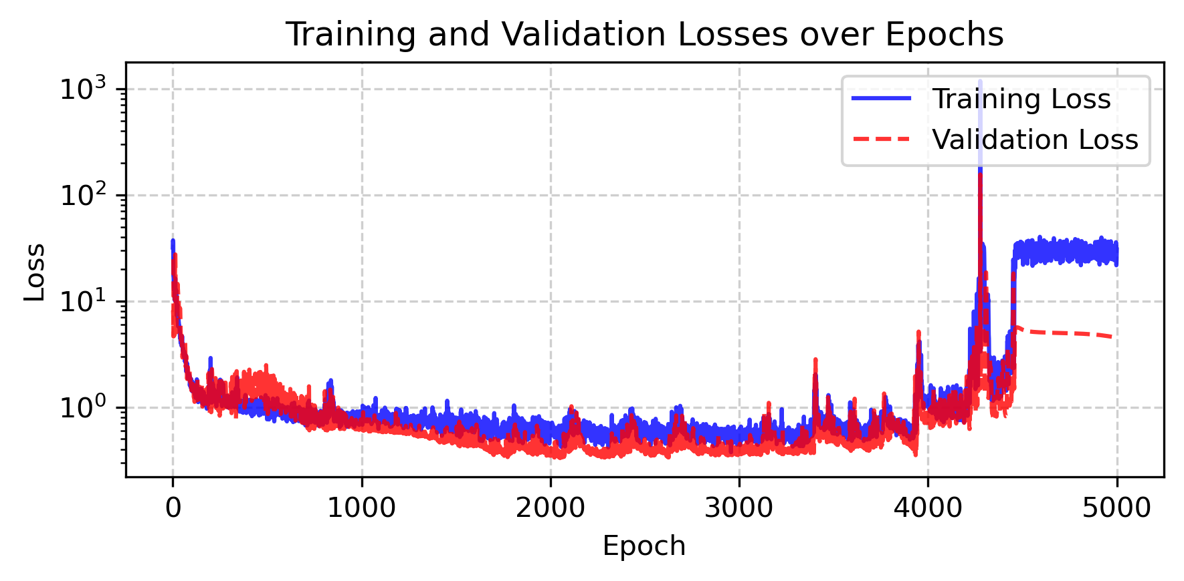
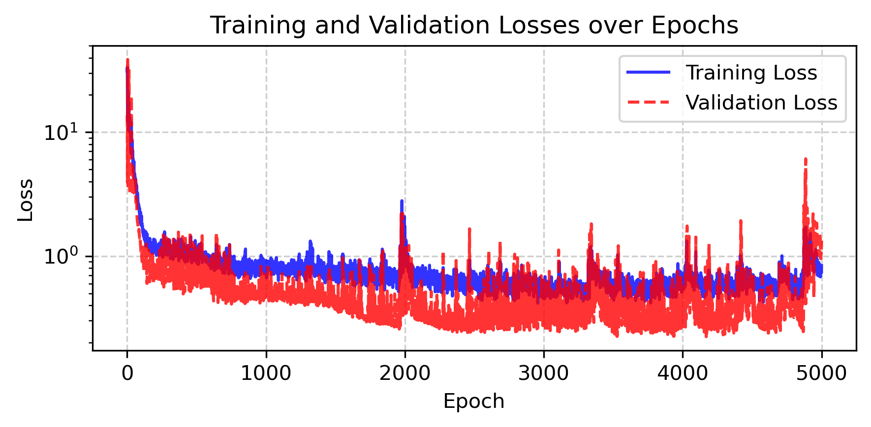
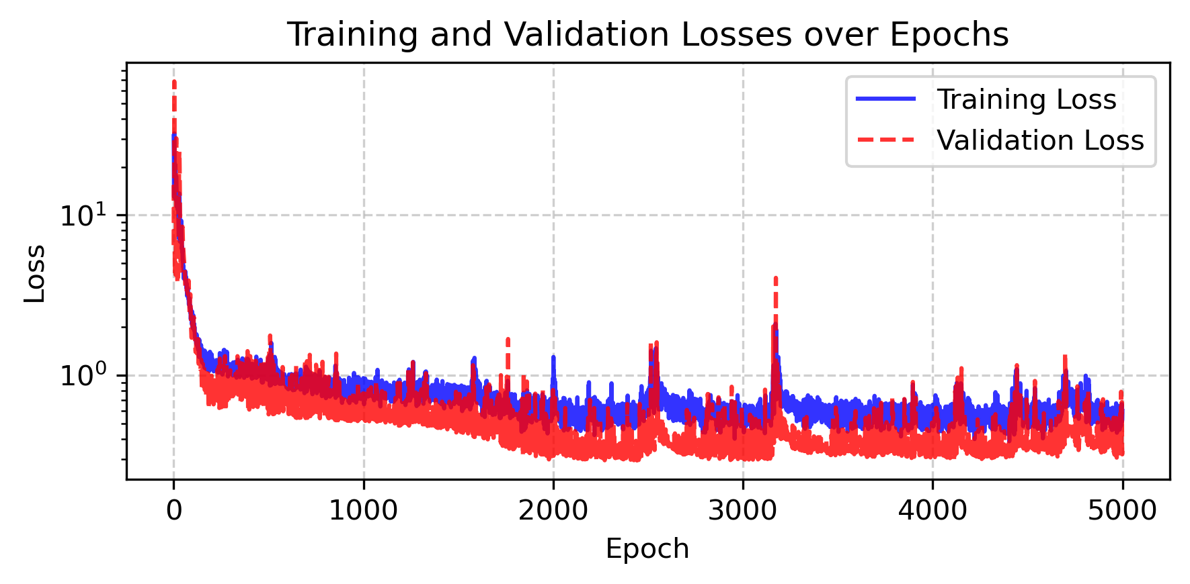
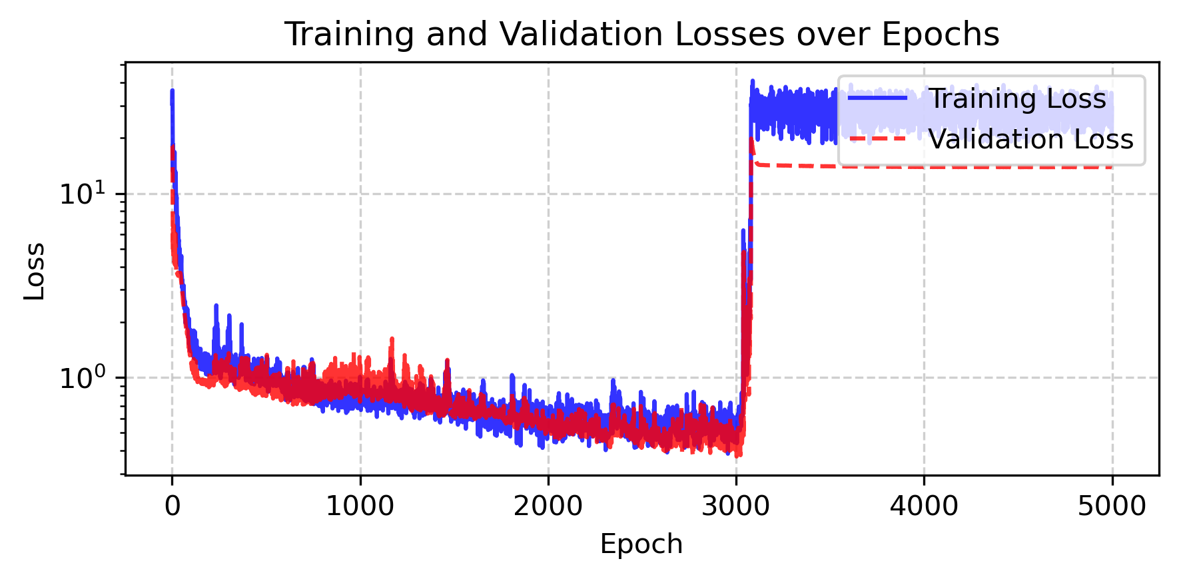
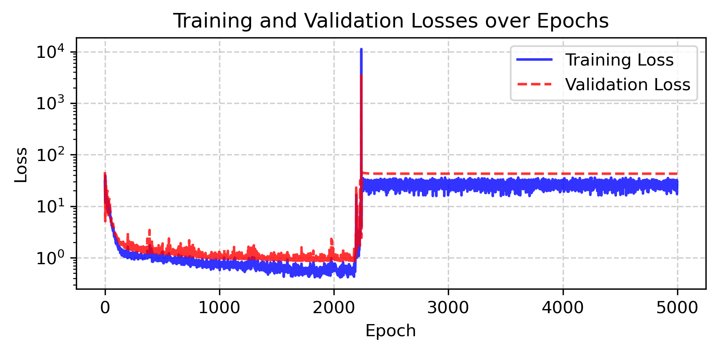
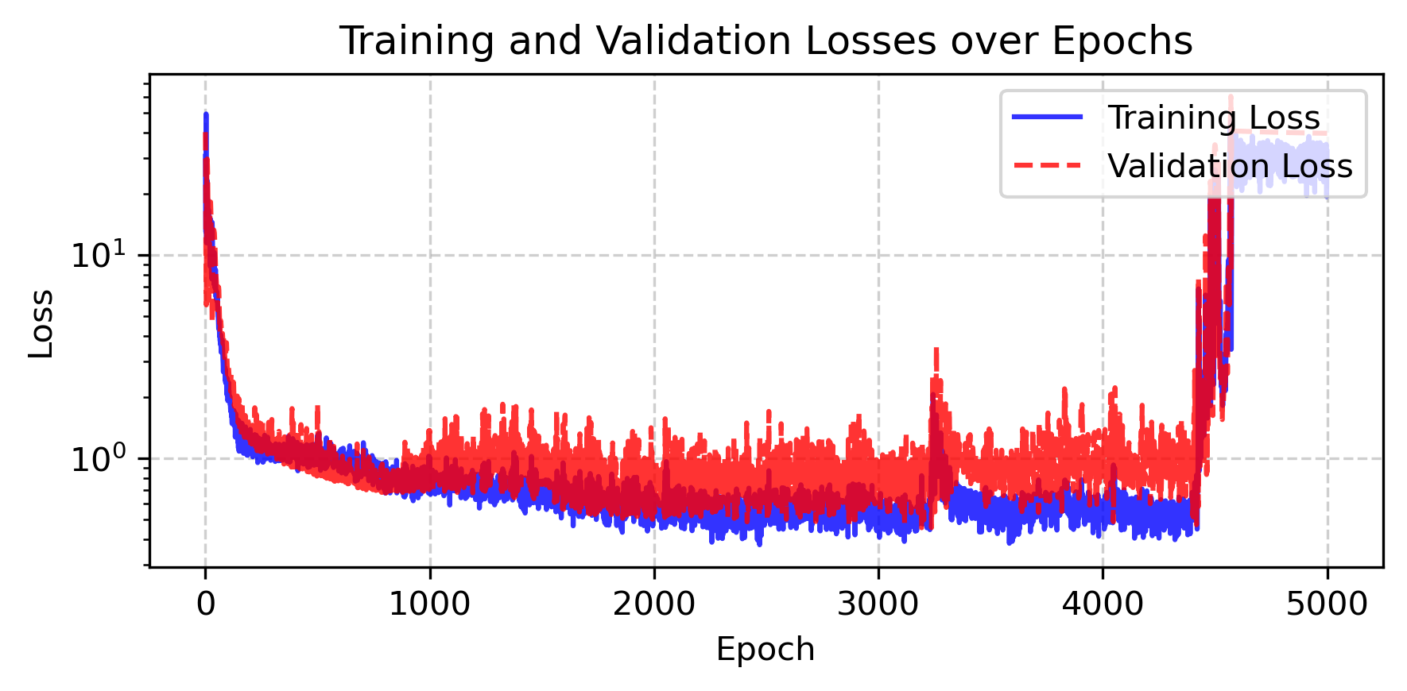
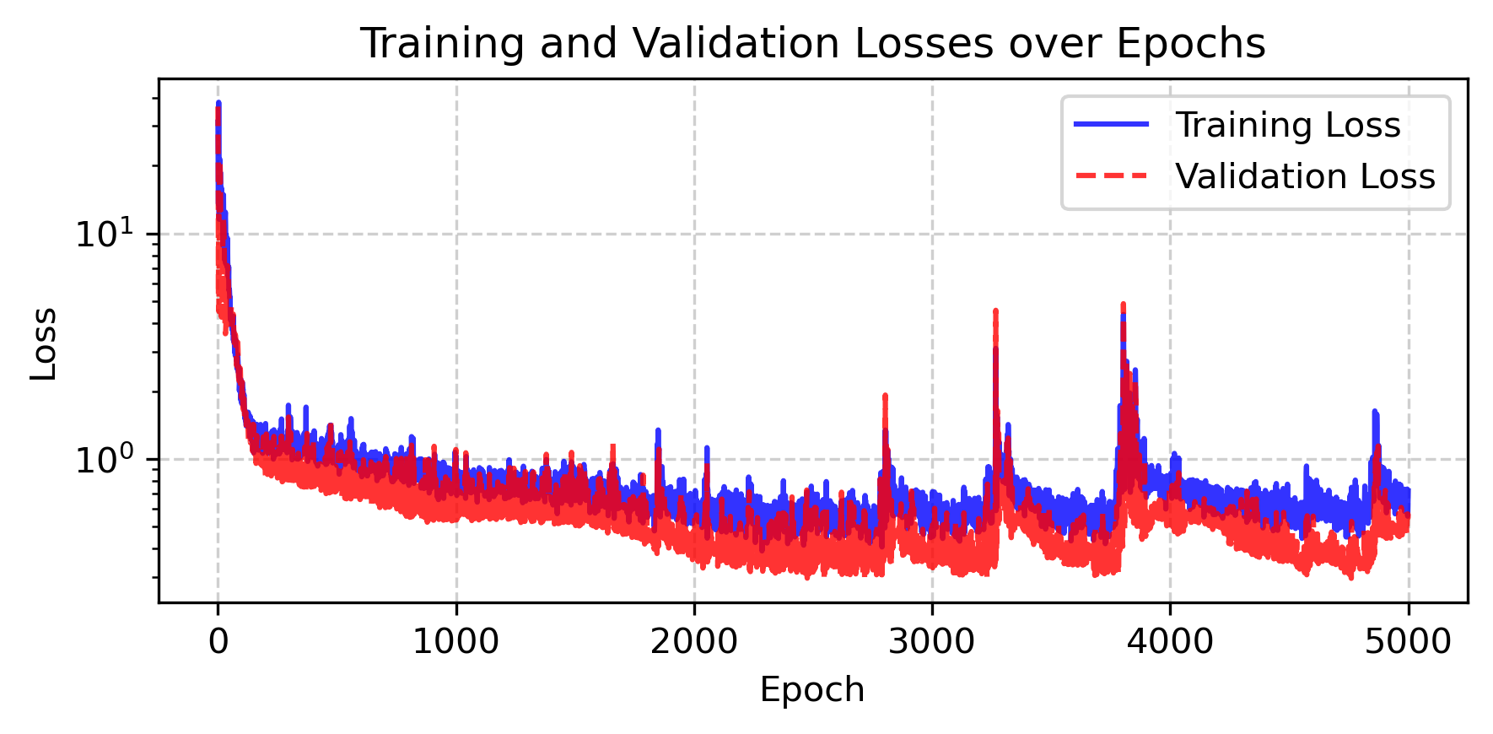
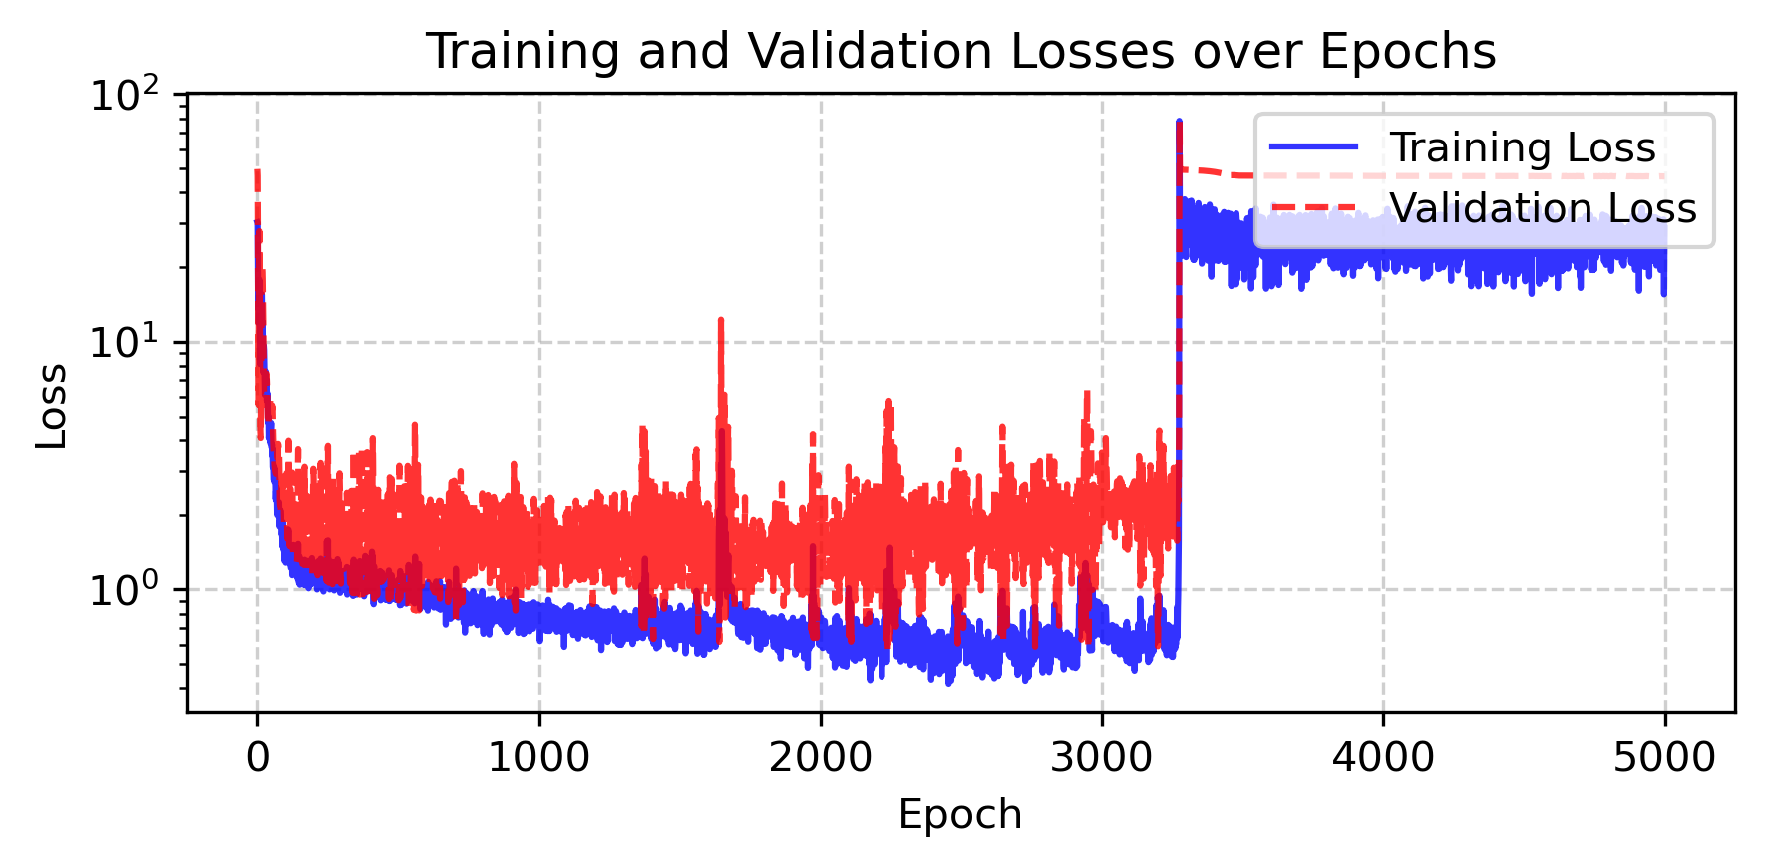
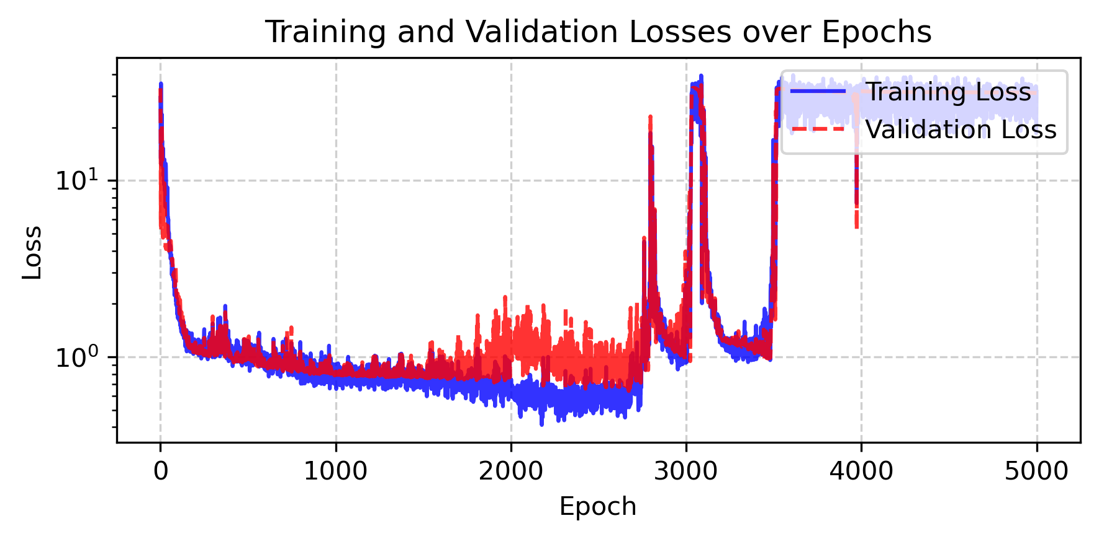
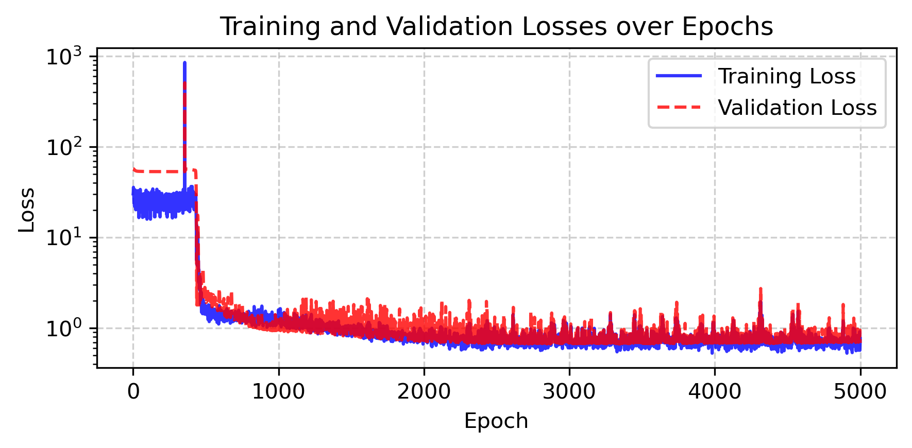
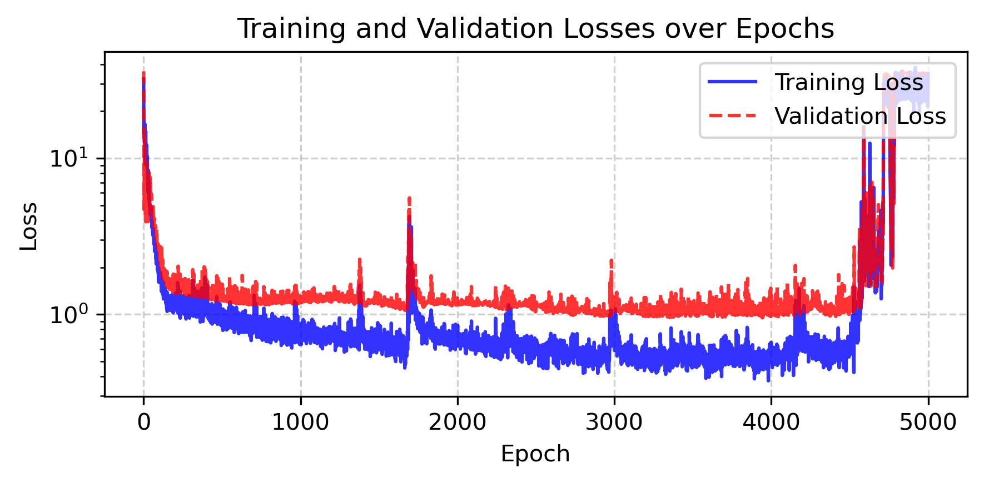
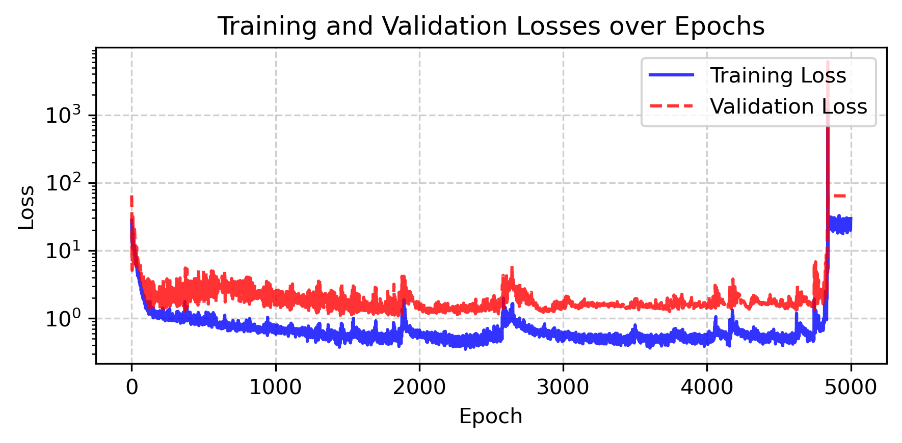
09/2026 • Results Optuna
Part I: Regularization and Selection
Convergence
Empirical (LOOCV)
L. Gündersen

Slide 10
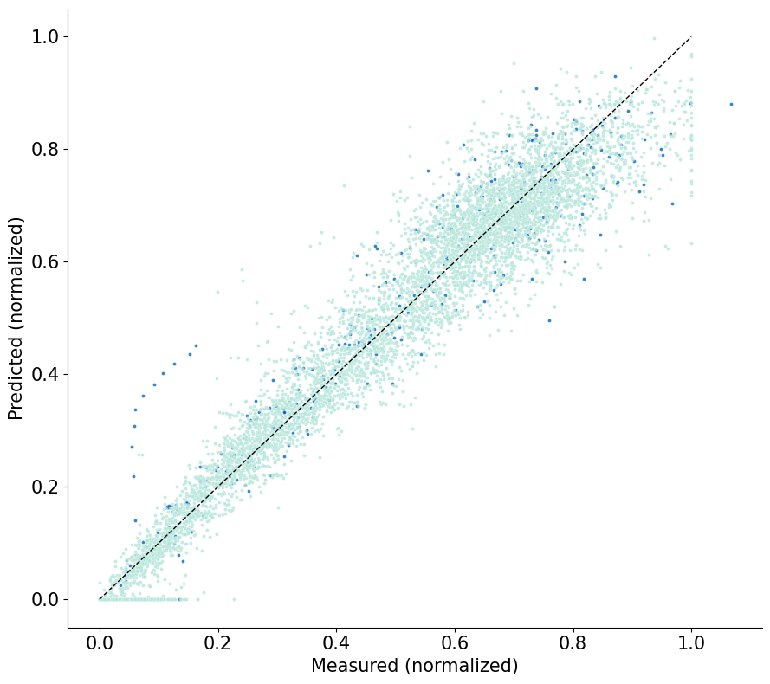
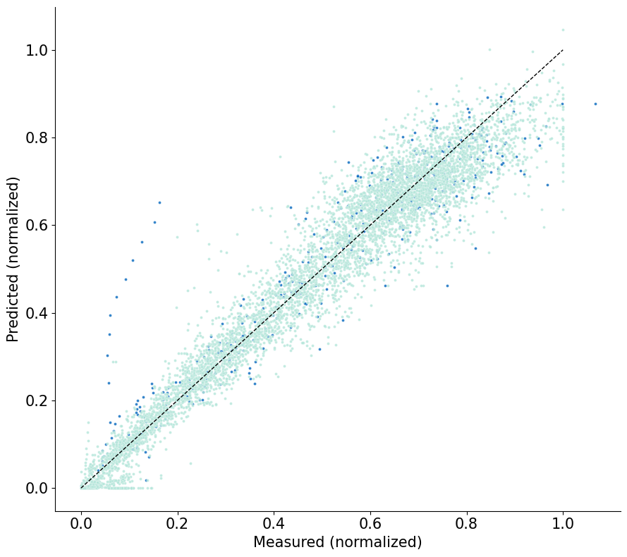

09/2026 • Results Optuna
Part I: Regularization and Selection
Parity Plots
Probabilistic (AICc)
Empirical (k-fold)
Empirical (LOOCV)
L. Gündersen

Slide 11
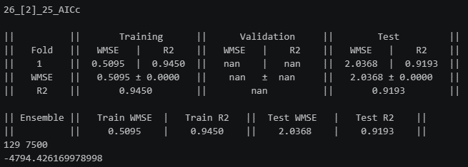
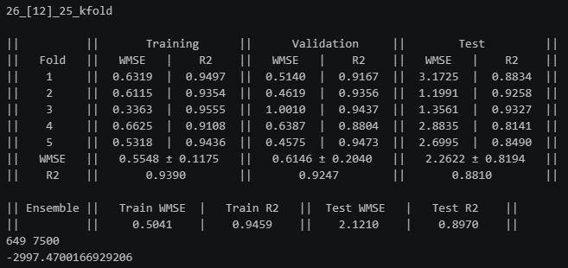
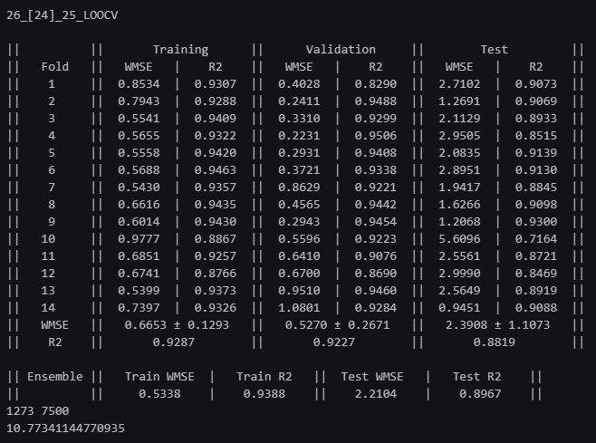
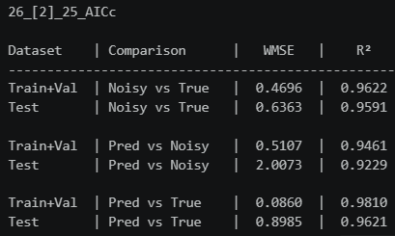
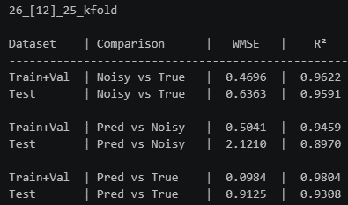
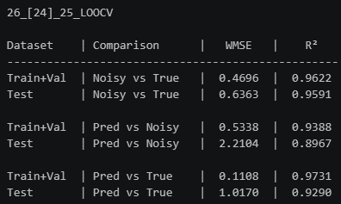
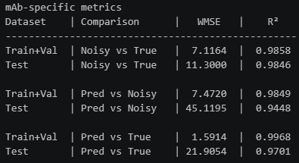
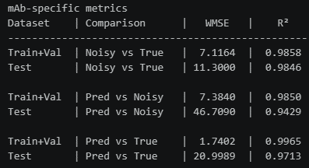
09/2026 • Results Optuna
Part I: Regularization and Selection
Results
Probabilistic (AICc)
Empirical (k-fold)
Empirical (LOOCV)
L. Gündersen

Slide 12
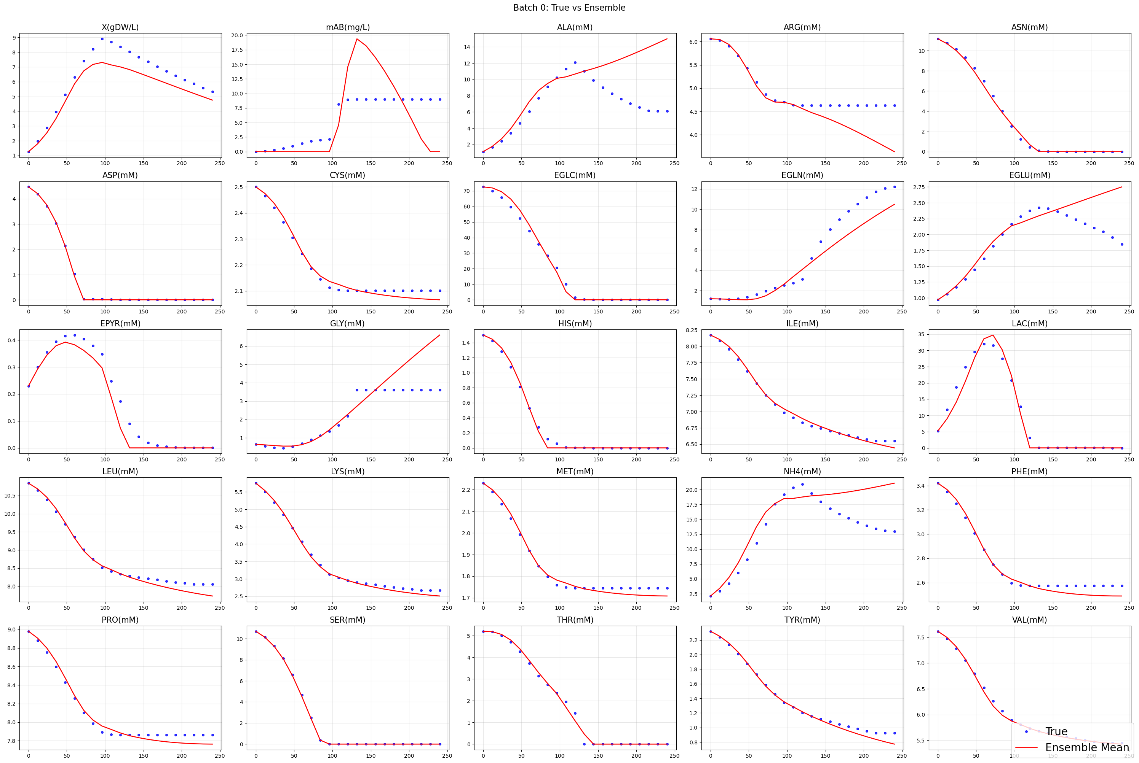
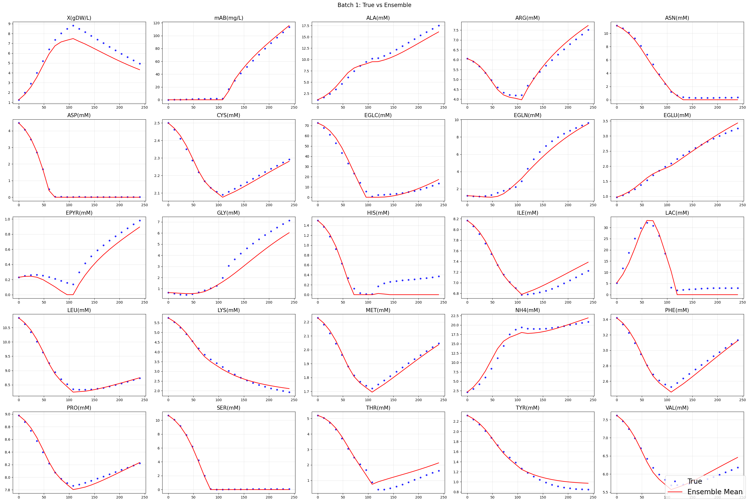
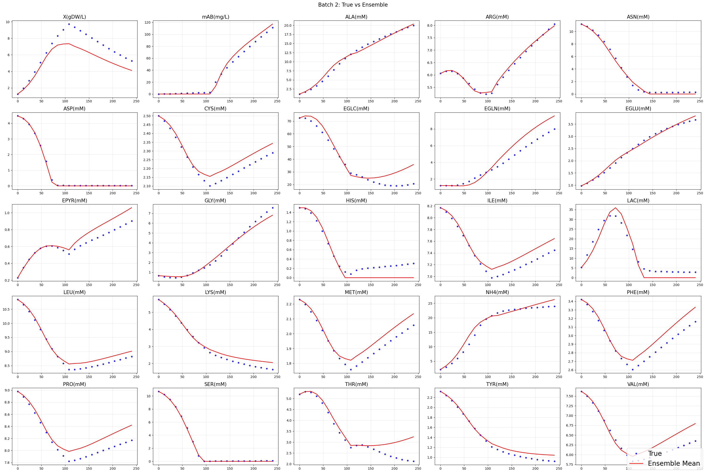
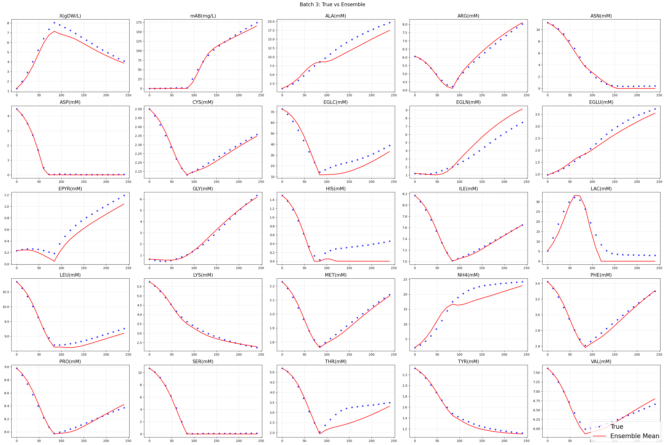
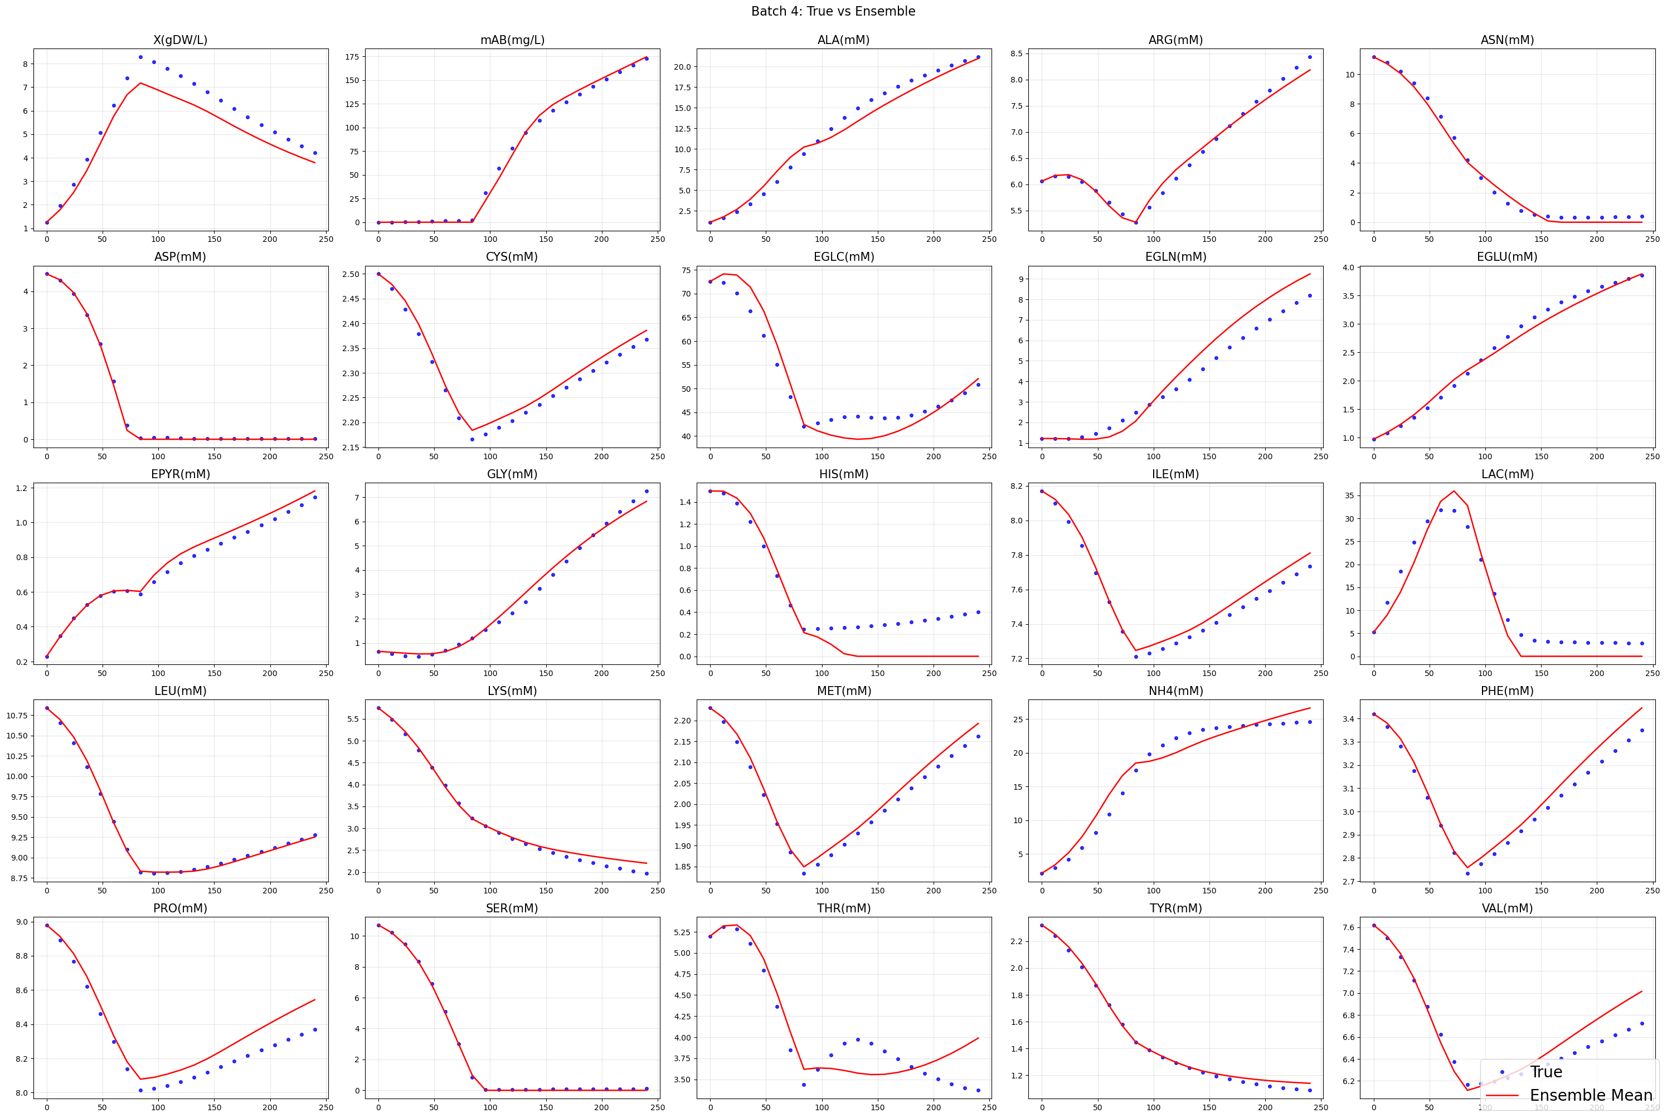
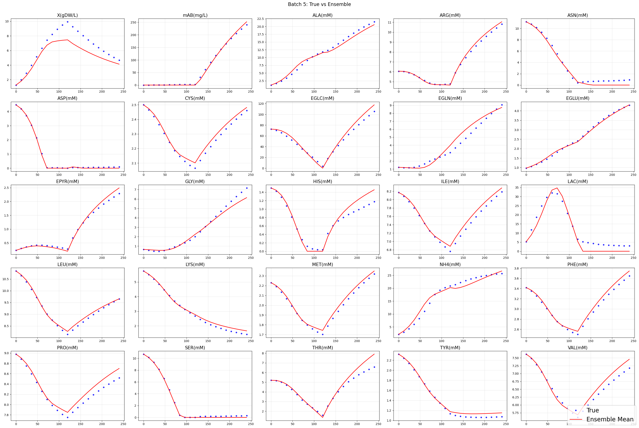
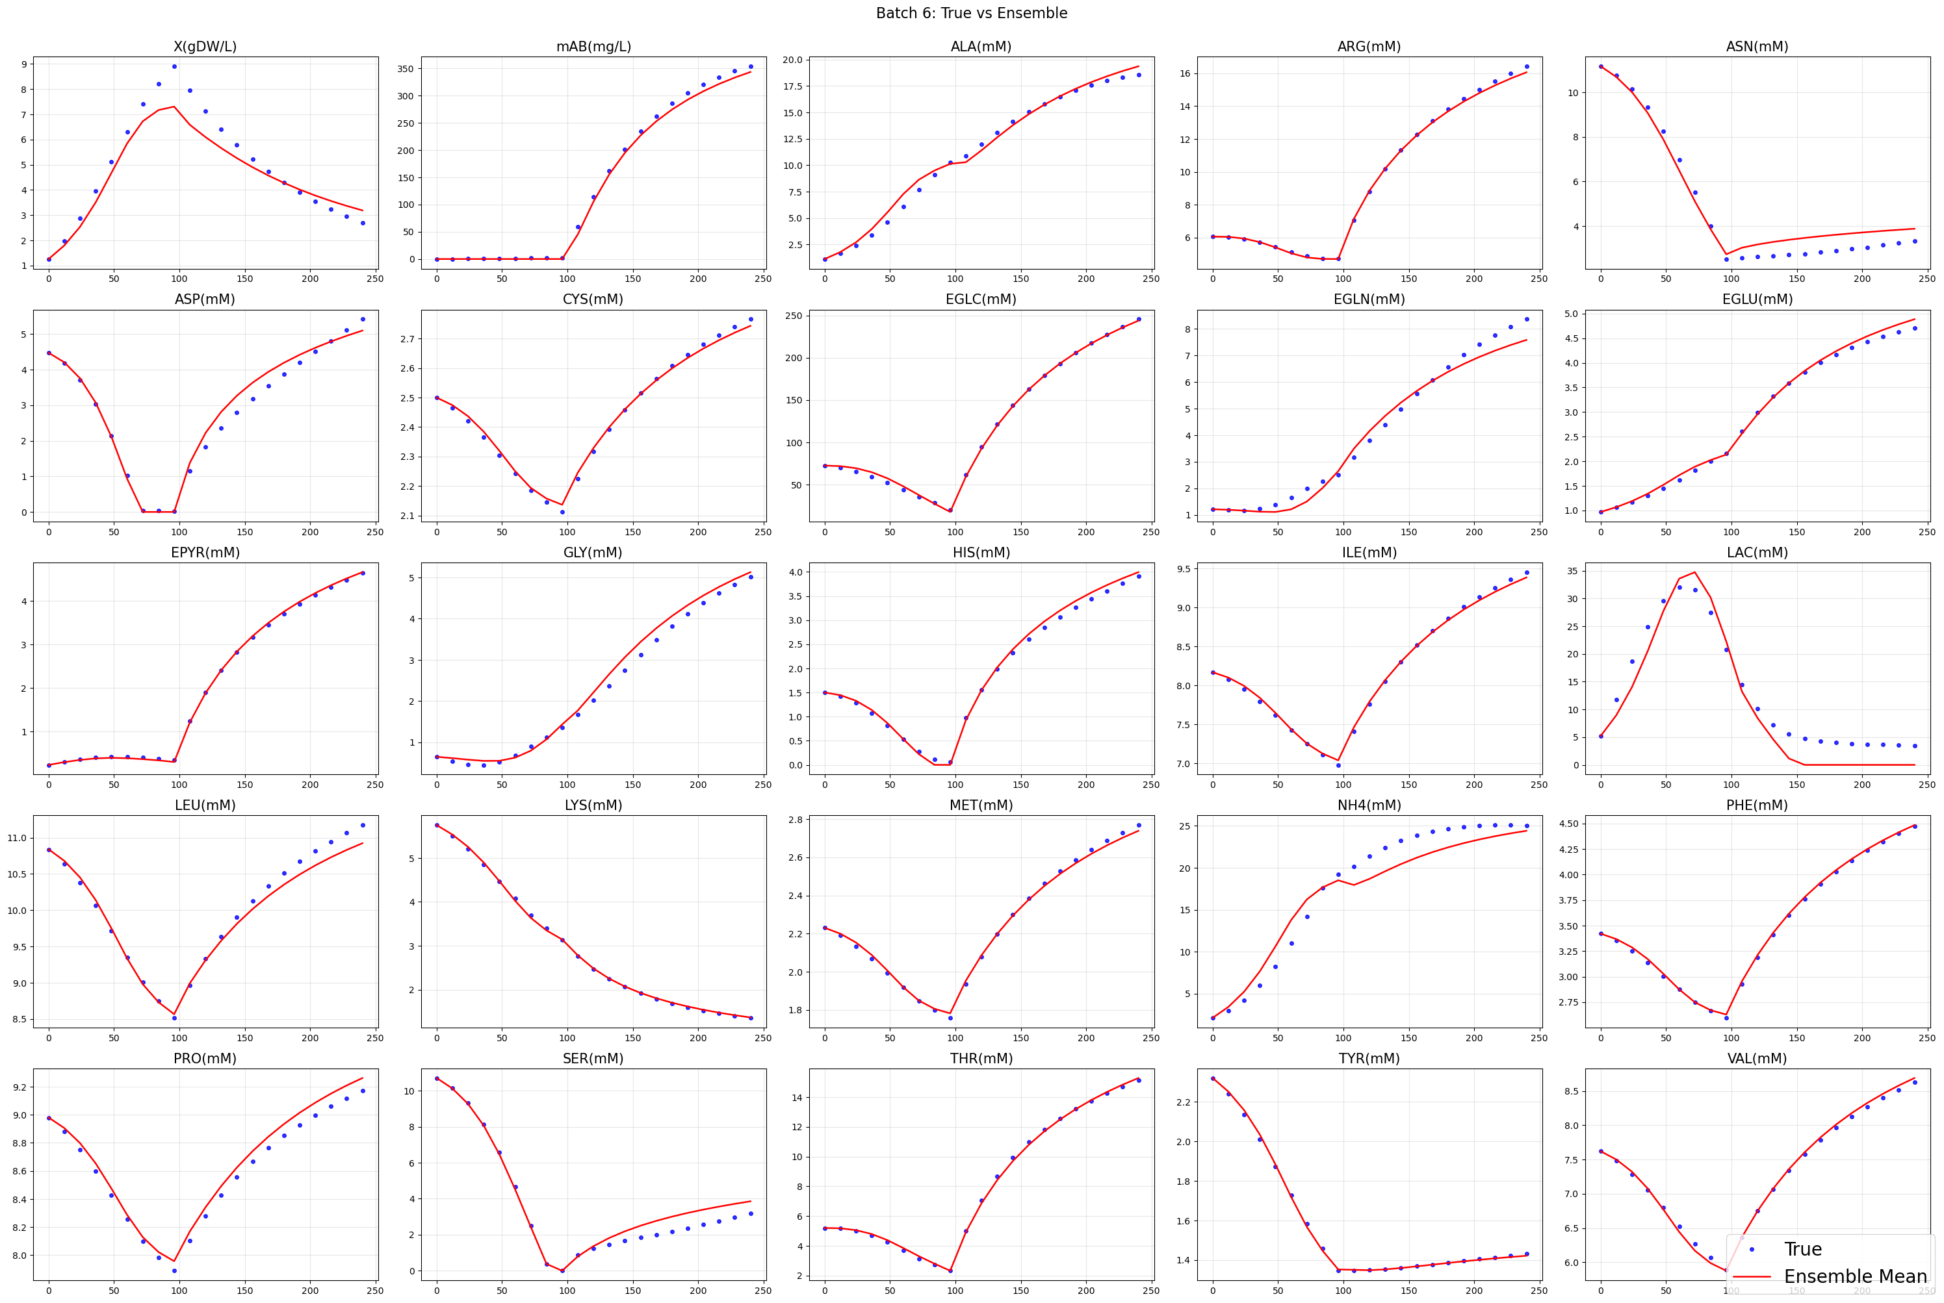
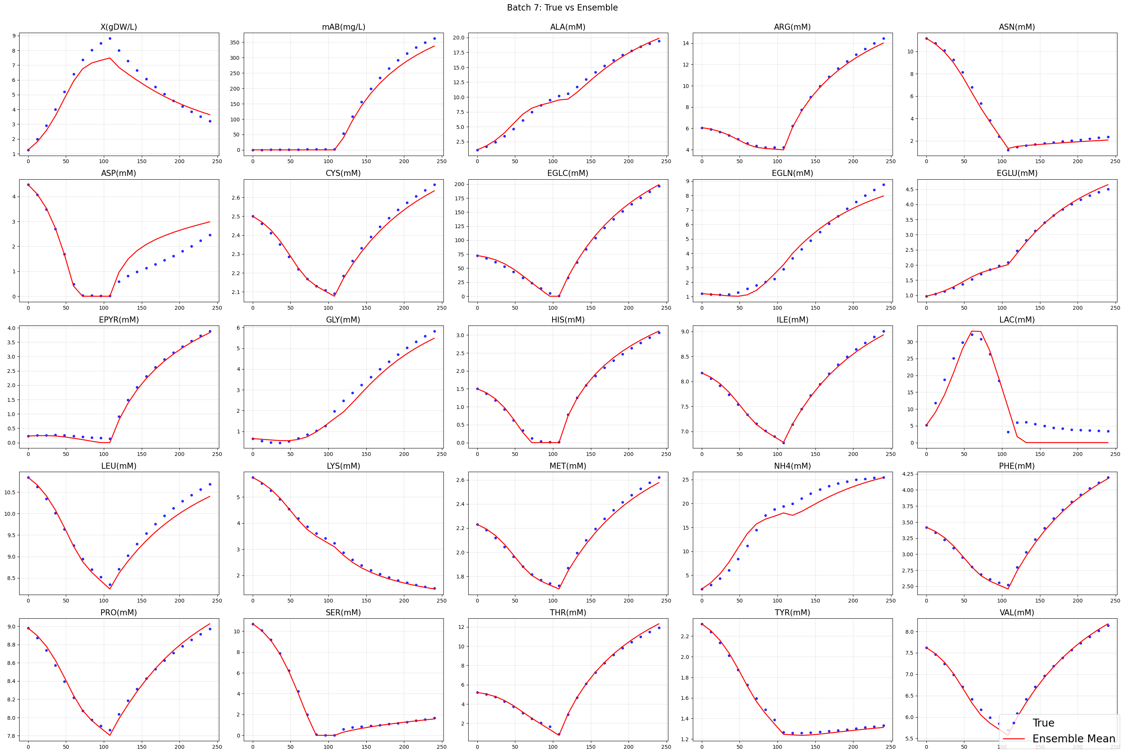
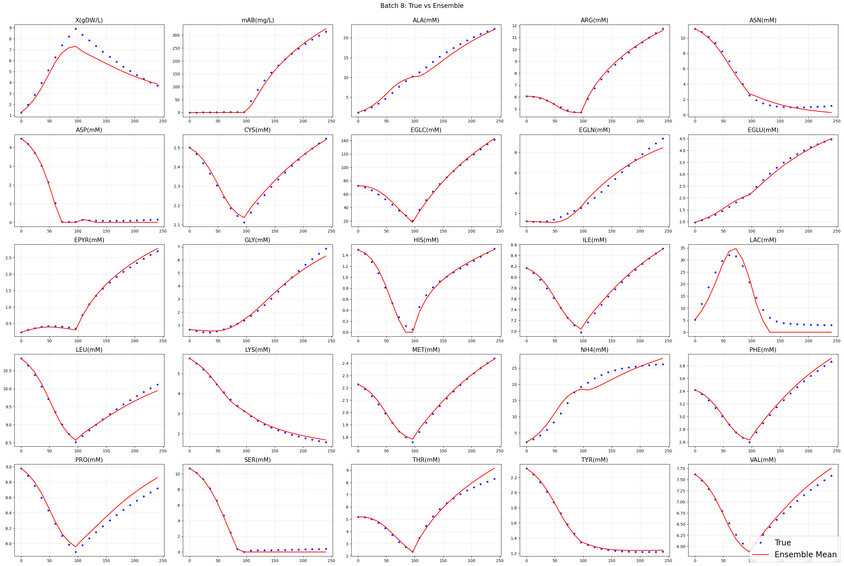
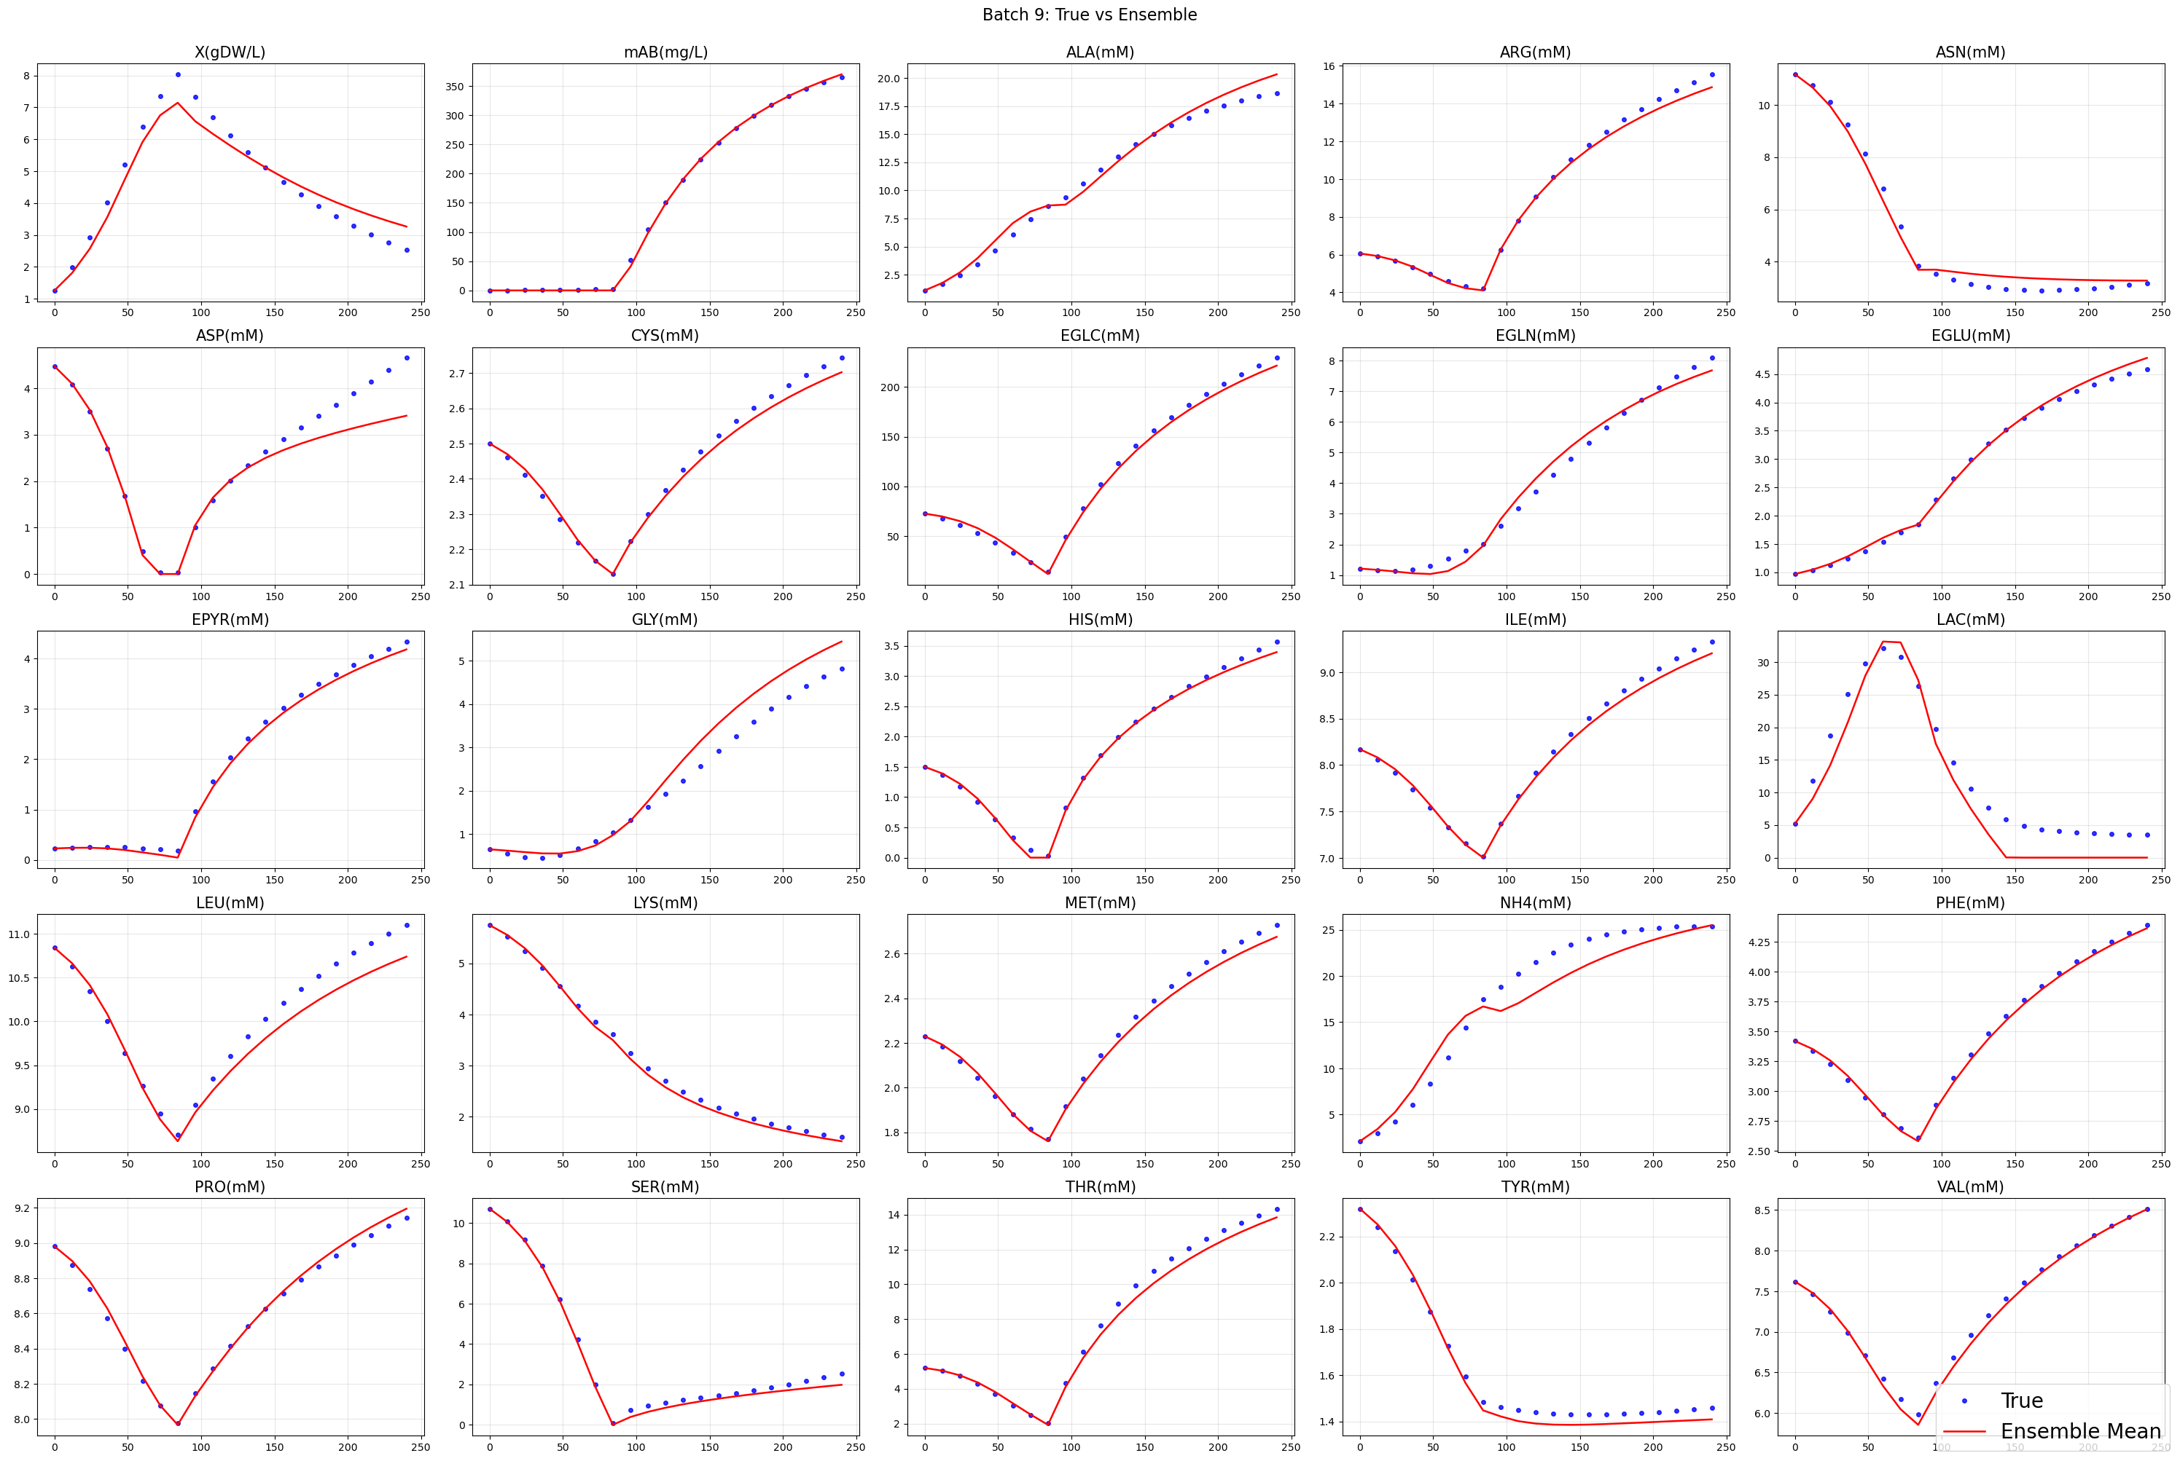
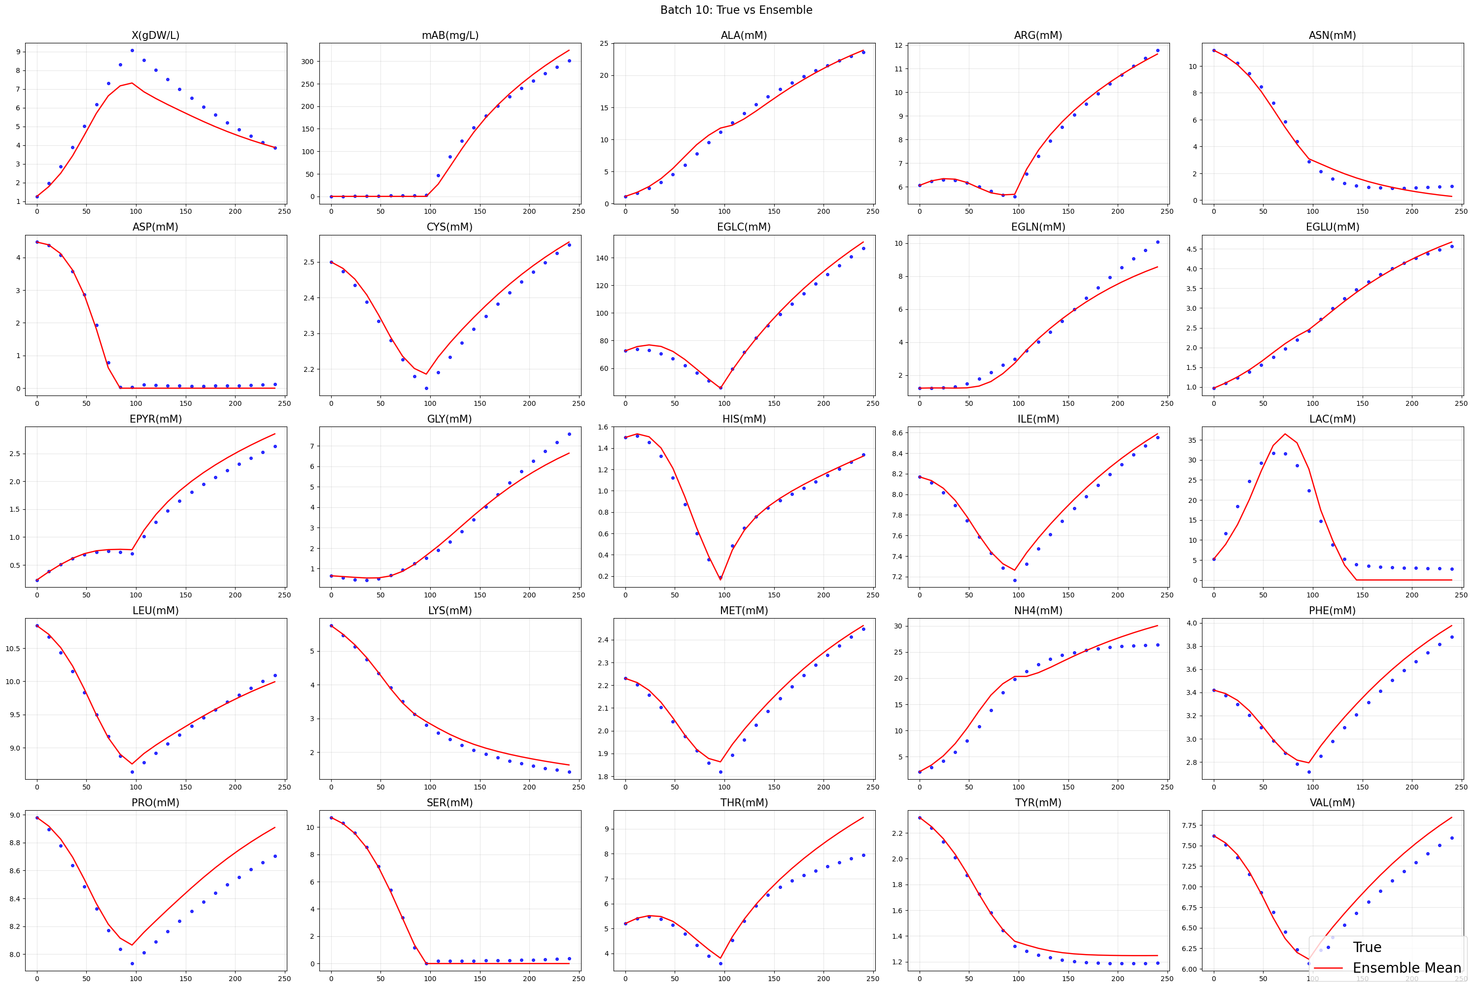
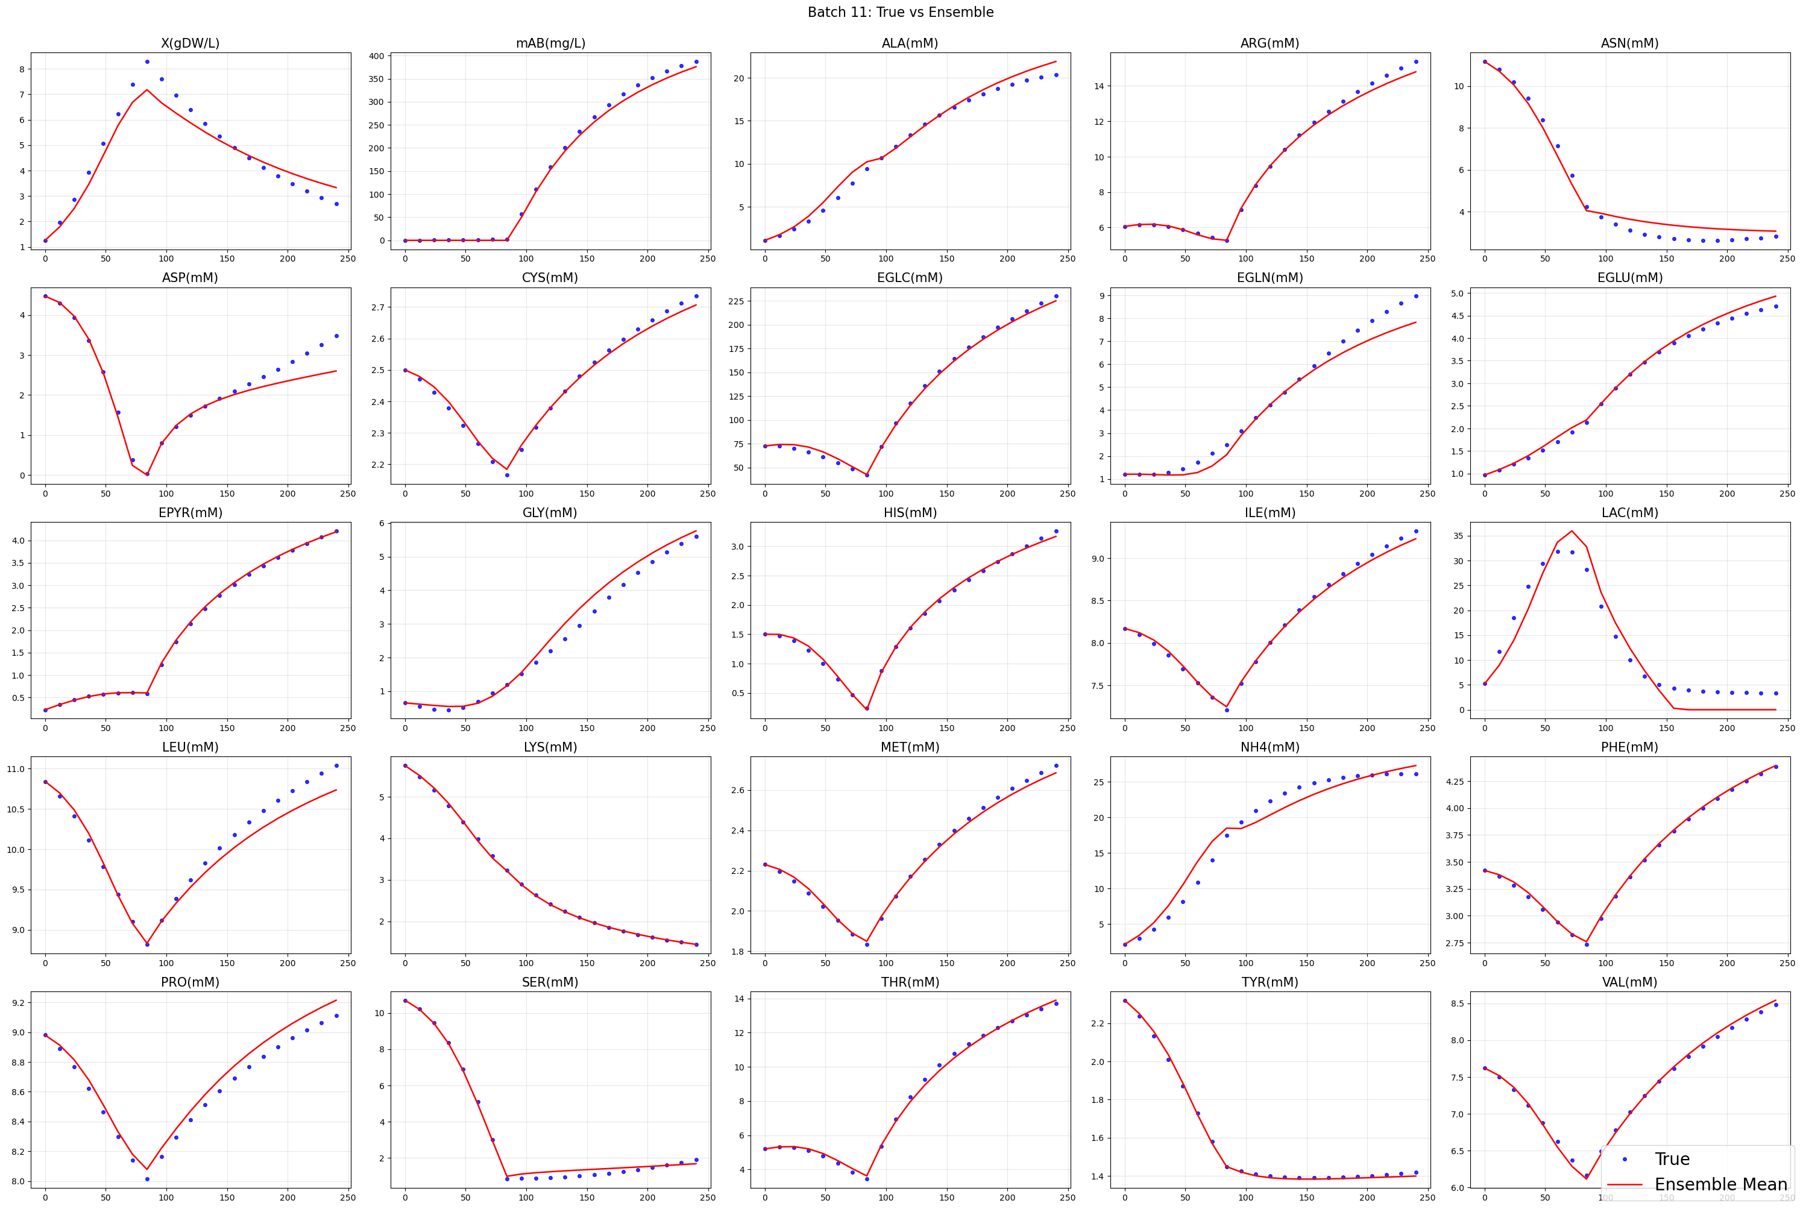
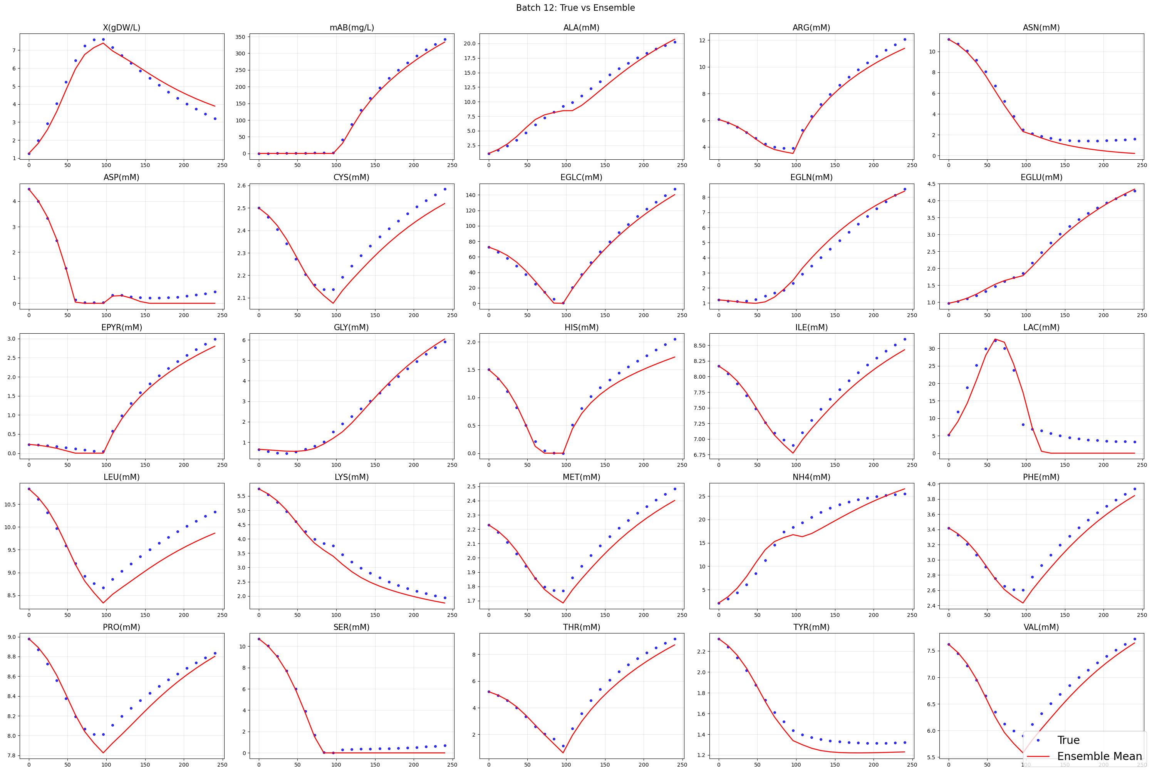
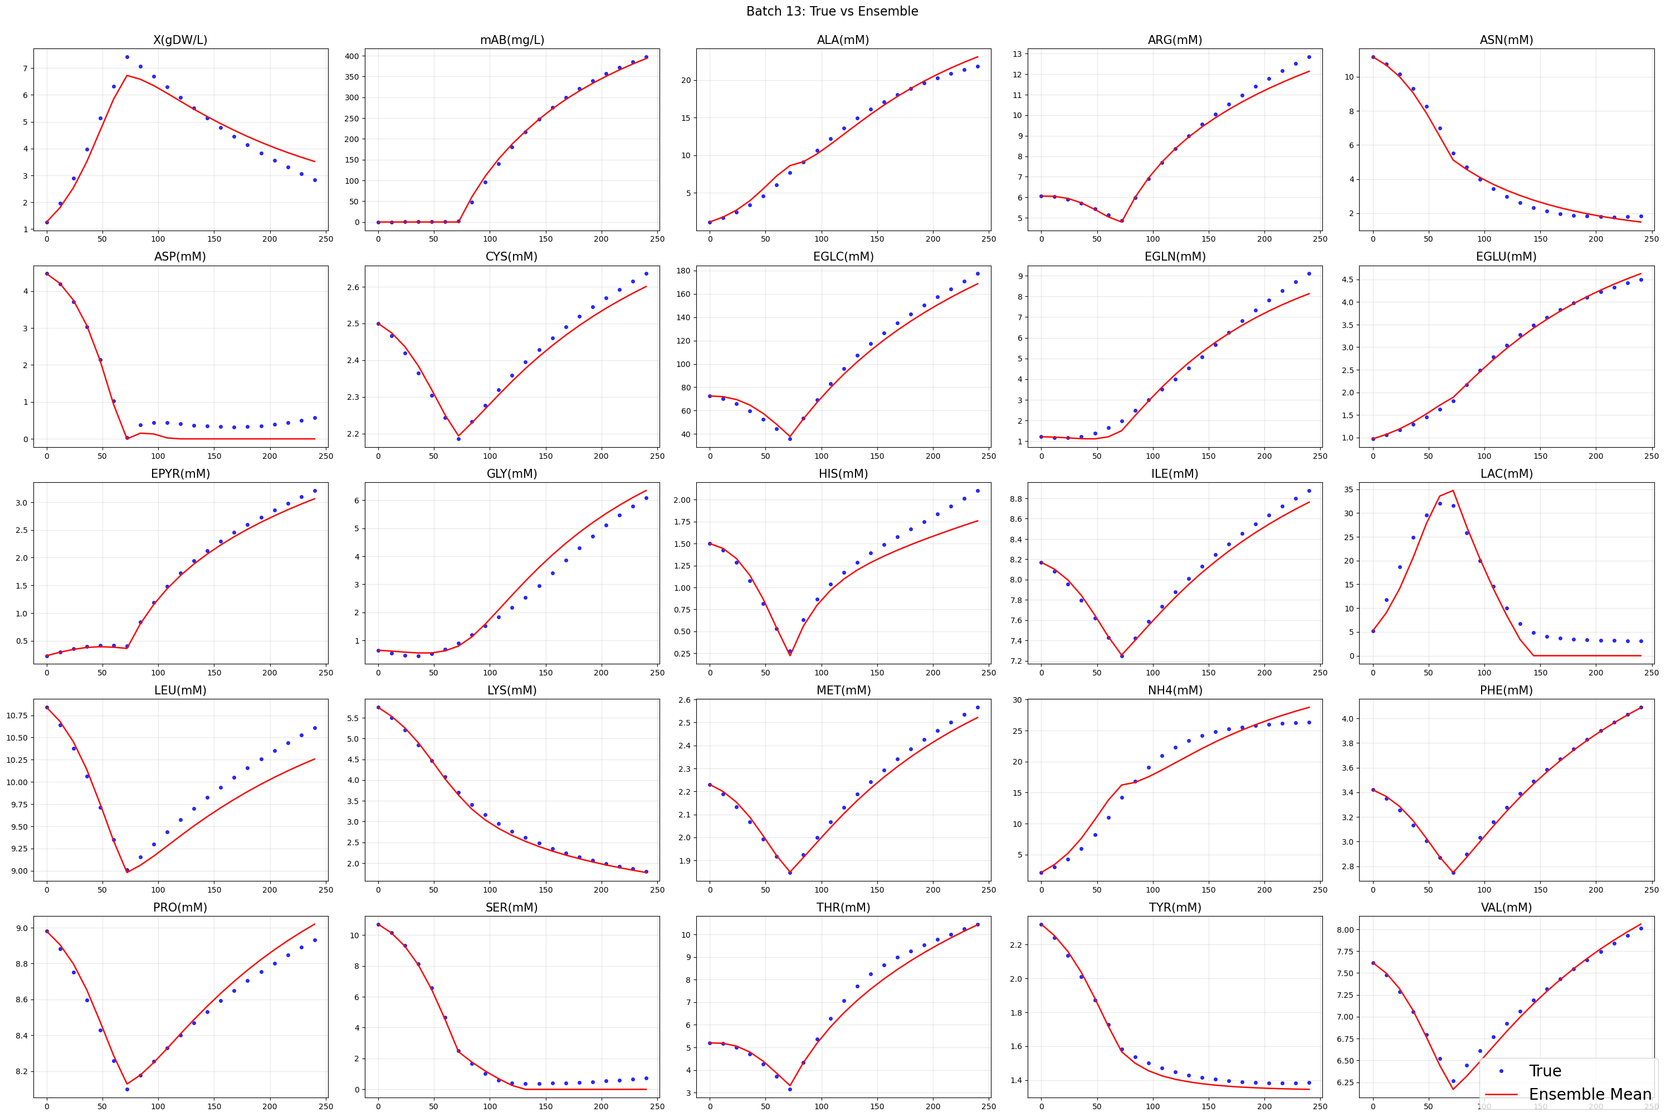
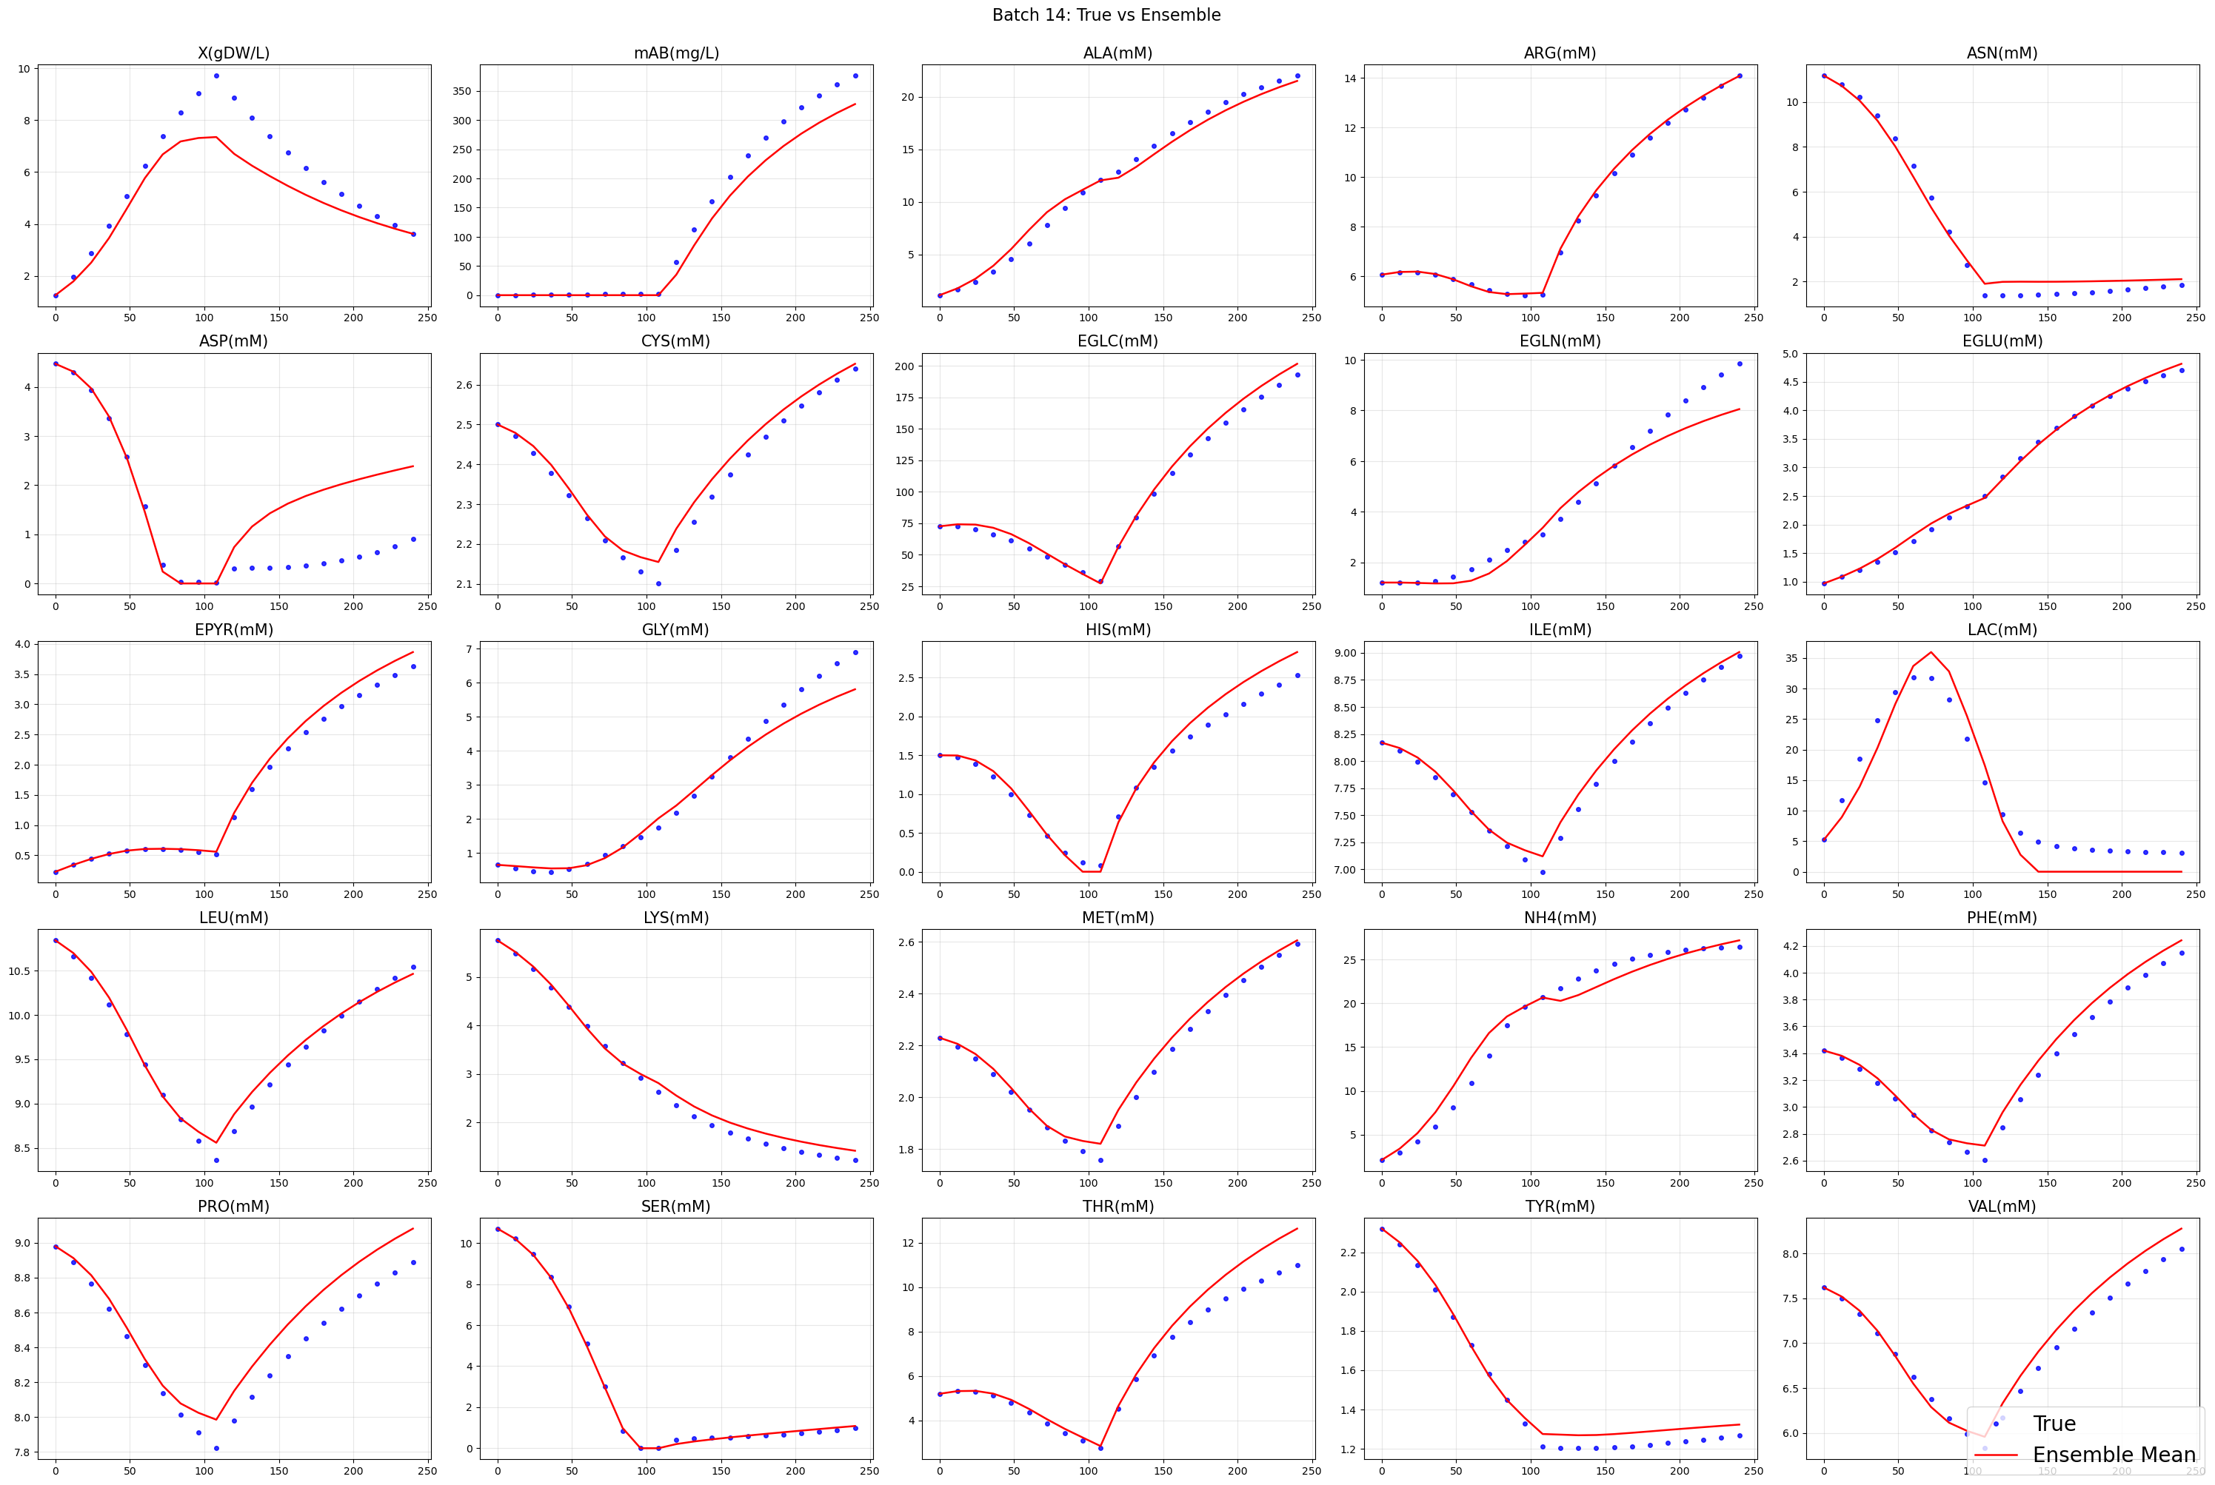
09/2026 • Results Optuna
Part I: Regularization and Selection
All batches
Probabilistic (AICc)
L. Gündersen

Slide 13
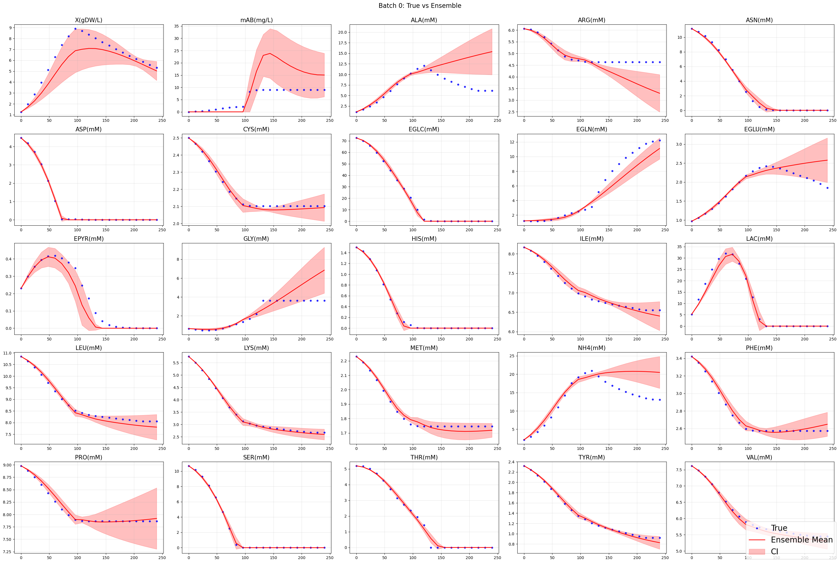
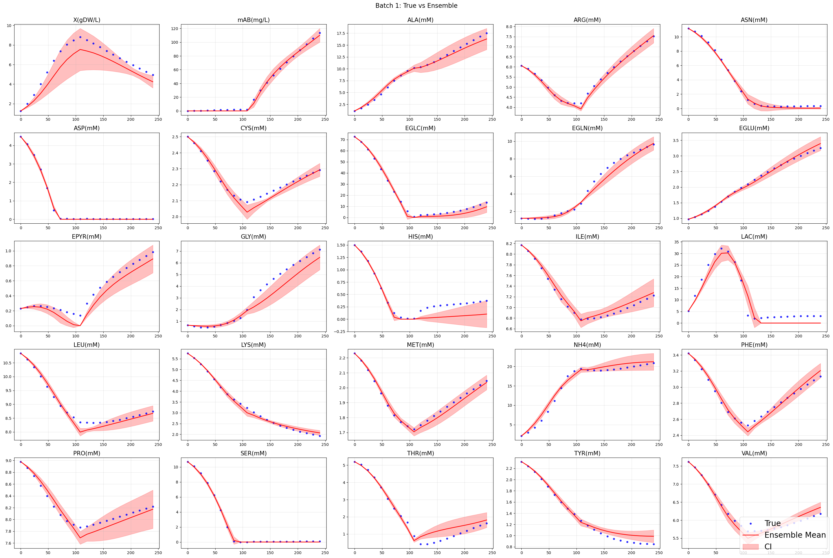
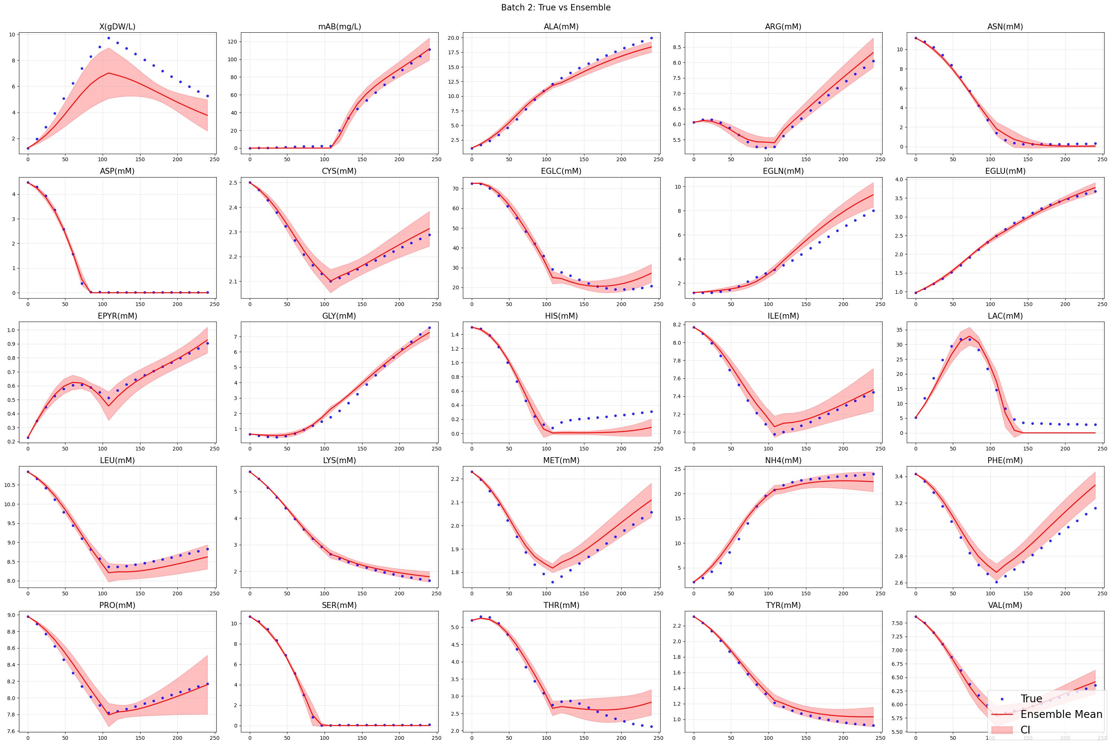
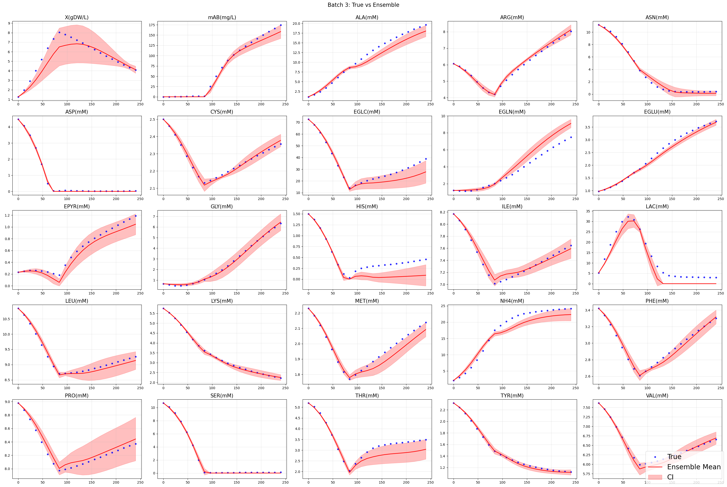
09/2026 • Results Optuna
Part I: Regularization and Selection
All batches
Empirical (k-fold)
L. Gündersen

Slide 14
09/2026 • Results Optuna
Part I: Regularization and Selection
All batches
Empirical (LOOCV)
L. Gündersen

Slide 15
09/2026 • Results with different Test batch
Part I: Regularization and Selection
3) Use different test batch for selected models (middle and bottom batch)
Noisy vs True - Middle
Parameters
Probabilistic (AICc)
Empirical (k-fold)
Empirical (LOOCV)
Training and Validation batches
WMSE – 0.4860 | R2 - 0.9624
Middle batch as Test
Test batch (Middle)
WMSE – 0.4070 | R2 - 0.9583
Trainvalloss
WMSE – 0.5426| R2 – 0.9401
WMSE – 0.5426| R2 – 0.9401
WMSE – 0.5426| R2 – 0.9401
Not updated!!
Noisy
Noisy vs True - Bottom
Testloss
WMSE – 0.5351| R2 – 0.9278
WMSE – 0.5351| R2 – 0.9278
WMSE – 0.5351| R2 – 0.9278
Training and Validation batches
Trainvalloss
WMSE – 0.0821| R2 – 0.9746
WMSE – 0.0821| R2 – 0.9746
WMSE – 0.0821| R2 – 0.9746
WMSE – 0.5036 | R2 – 0.9608
True
Testloss
WMSE – 0.0761| R2 – 0.9680
Test batch (Bottom)
WMSE – 0.0761| R2 – 0.9680
WMSE – 0.0761| R2 – 0.9680
WMSE – 0.1612| R2 – 0.9725
Bottom batch as Test
Trainvalloss
WMSE – 0.5585 | R2 – 0.9417
WMSE – 0.5585 | R2 – 0.9417
WMSE – 0.5585 | R2 – 0.9417
Noisy
Not updated!!
Testloss
WMSE – 1.1517| R2 – 0.8529
WMSE – 1.1517| R2 – 0.8529
WMSE – 1.1517| R2 – 0.8529
Trainvalloss
WMSE – 0.0843 | R2 – 0.9776
WMSE – 0.0843 | R2 – 0.9776
WMSE – 0.0843 | R2 – 0.9776
True
Testloss
WMSE – 0.9812 | R2 – 0.8759
WMSE – 0.9812 | R2 – 0.8759
WMSE – 0.9812 | R2 – 0.8759
L. Gündersen

Slide 16
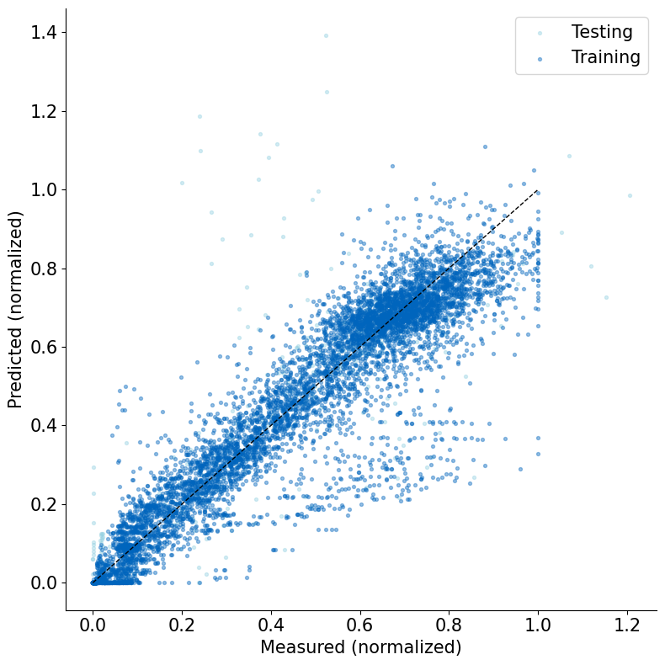


09/2026 • Results of different test batches
Part I: Regularization and Selection
Probabilistic (AICc)
Parity Plots
Bottom batch as Test
Middle batch as Test
Top batch as Test
Not updated!!
L. Gündersen

Slide 17



09/2026 • Results of different test batches
Part I: Regularization and Selection
Empirical (k-fold)
Parity Plots
Bottom batch as Test
Middle batch as Test
Top batch as Test
Not updated!!
L. Gündersen

Slide 18



09/2026 • Results of different test batches
Part I: Regularization and Selection
Probabilistic (AICc)
mAb prediction
Bottom batch as Test
Middle batch as Test
Top batch as Test
Not updated!!
Not updated!!
L. Gündersen

Slide 19



09/2026 • Results of different test batches
Part I: Regularization and Selection
Empirical (k-fold)
mAb prediction
Bottom batch as Test
Middle batch as Test
Top batch as Test
Not updated!!
Bottom batch
Middle batch
Not updated!!
Top
batch
L. Gündersen

Slide 20

09/2026 • Results of different test batches
Part I: Regularization and Selection
Empirical (LOOCV)
mAb prediction
Bottom batch as Test
Middle batch as Test
Top batch as Test
Not updated!!
Bottom batch
Middle batch
Not updated!!
Top
batch
L. Gündersen

Slide 21








09/2026 • Results of different test batches
Part I: Regularization and Selection
Probabilistic (AICc)
Prediction curves for all species
Bottom batch as Test
Middle batch as Test
Top batch as Test
Bottom batch
Not updated!!
Not updated!!
Middle batch
Top
batch
L. Gündersen

Slide 22
09/2026 • Results of different test batches
Part I: Regularization and Selection
Empirical (k-fold)
Prediction curves for all species
Bottom batch as Test
Middle batch as Test
Top batch as Test
Bottom batch
Not updated!!
Not updated!!
Middle batch
Top
batch
L. Gündersen

Slide 23
09/2026 • Results of different test batches
Part I: Regularization and Selection
Empirical (LOOCV)
Prediction curves for all species
Bottom batch as Test
Middle batch as Test
Top batch as Test
Bottom batch
Not updated!!
Not updated!!
Middle batch
Top
batch
L. Gündersen

Slide 24
Hybrid Deep Modelling
09/2026 • Conclusions to Part I
Part I: Regularization and Selection
empirical versus probabilistic model selection
Regarding Optuna:
  The probabilistic selection criteria (Valloss) resulted in significantly larger computation times (about 4.3x larger) compared to empirical selection criteria (AICc);
  The AICc criteria selected a small single hidden layer ( [2] ), while Valloss selected a deep model ( [11 11 ] ).
Regarding regularization/selection criteria:
  The empirical selection criteria (AICc) resulted in significantly better results (both testing and training) compared to the probabilistic selection;
  It was observed that the empirical selection criteria was faster and better performing than the probabilistic criteria.
Regarding Test batch:
  No consistent differences in the WMSE and R2 were observed by changing the test batch, but it showed a definitive impact.
  This highlighted the need to better understand how different data splits impact model performance.
Not updated!!
L. Gündersen

