Slide 1

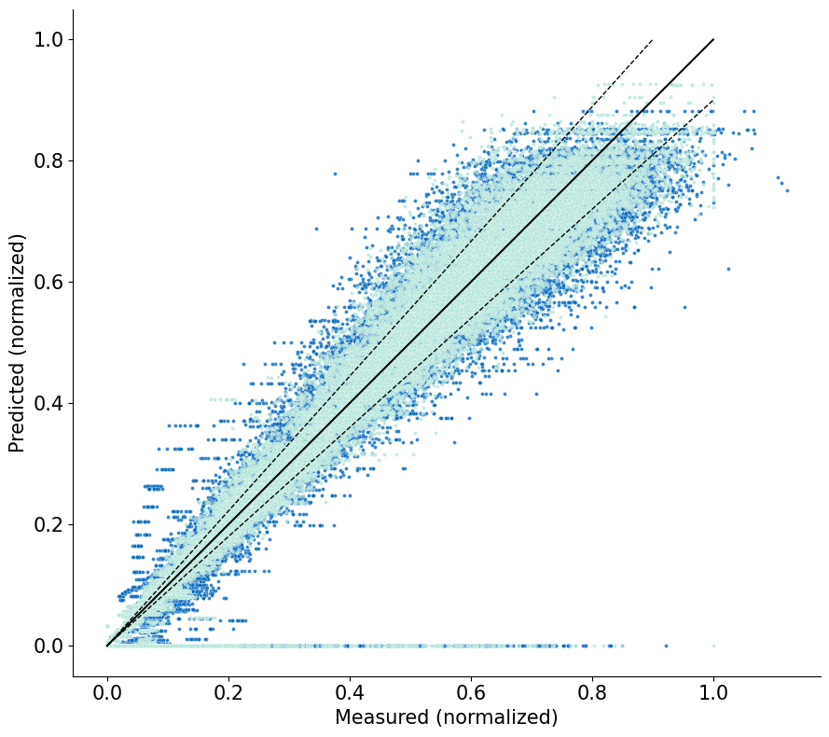

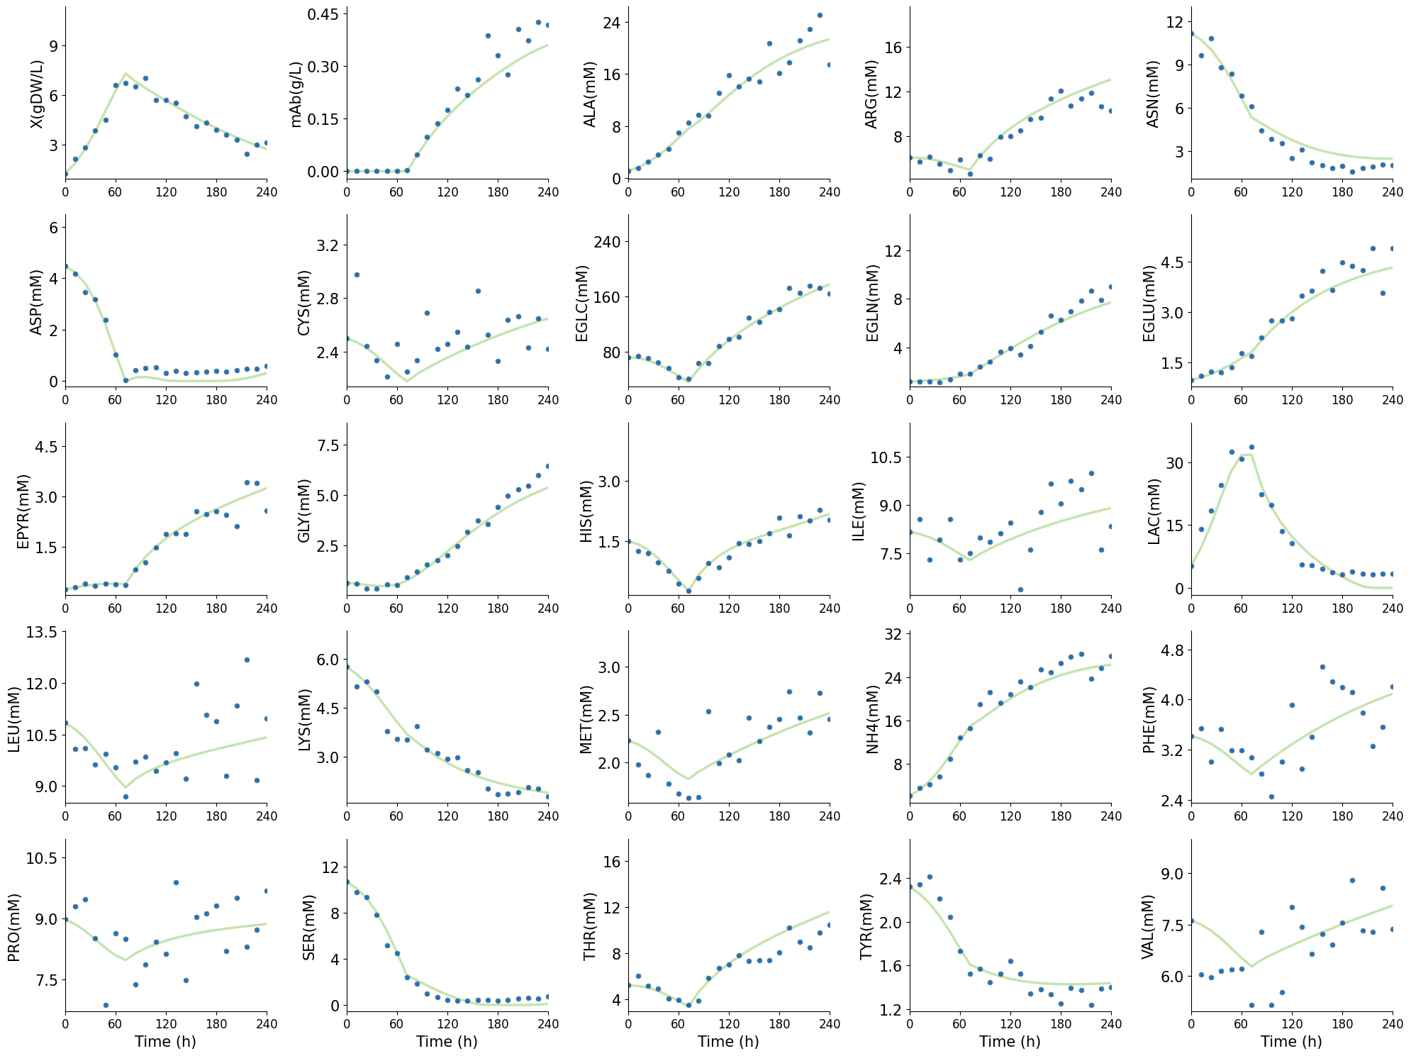
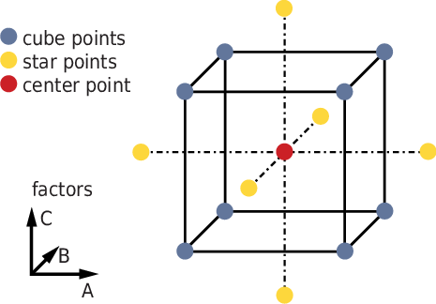
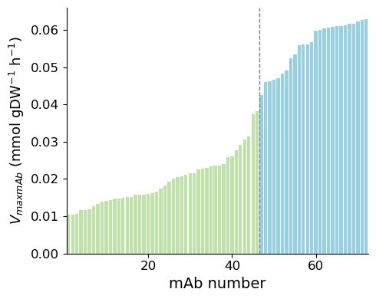
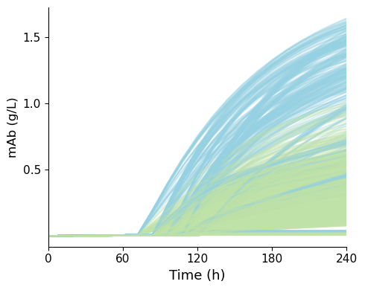
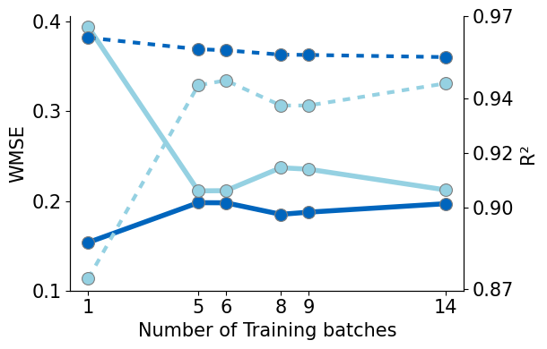
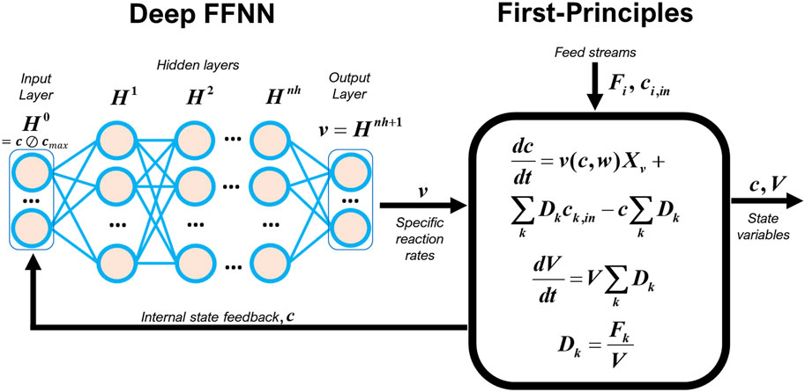




Deep hybrid modelling of CHO platforms: addressing multiple development campaigns across different antibody products
Leonor Gündersen^{α,1, 2}, José Pinto^{1,2,3}, Rui Oliveira^{1,2,3}
XII International Forum on Industrial Bioprocesses
Braga, Portugal • 9th - 12th September, 2026
(α) Presenting author: leonorgundersen@gmail.com
(1) Systems Biology & Engineering group, Chemistry Department, School of Sciences and Technology, NOVA School of Science and Technology, Lisbon, Portugal
(2) UCIBIO - Applied Molecular Biosciences Unit, Department of Chemistry, NOVA School of Science and Technology, Universidade NOVA de Lisboa, 2829-516 Caparica, Portugal
(3) Associate Laboratory i4HB - Institute for Health and Bioeconomy, NOVA School of Science and Technology, Universidade NOVA de Lisboa, 2829-516 Caparica, Portugal
Introduction
Model Selection
These results are explained by the significant differences in mAb production across the 10 mAbs data set. While the behaviour of the other species is largely dictated by the batch conditions, the production of mAb differs heavily across the different products.
Hybrid models combine mechanistic and data-driven methods, leveraging on prior knowledge and data availability. The mechanistic component reduces data needs, while the data-driven component fills knowledge gaps. This flexibility makes hybrid modeling the method of choice for digital twins in Biopharma 4.0.
Phase I assesses different structures of hidden layers:
[5], [10], [20]; [5 5], [10 10], [20 20]
Phase I compares models based on the test loss.
Selected model is used in Phase II (train set reduction).
Selected model/test set is used in Phase III (multiple mAb).
CHO cells are the preferred host system for biotherapeutic production, but establishing and optimizing each new biotherapeutic is costly and slow. Hybrid models that can minimize experimental burden and leverage knowledge transferability are a key tool for bioprocess digitalization towards efficient development of new biotherapeutics.
Data Splitting
1 mAb. 14 train batches. 1 for test (maximum mAb (b_{M})).
1 mAb. 6 test sets assed: {b_{M} +b_{s}}, {b_{M} +b_{C} +b_{s}}, {b_{M} +b_{c}}, {b_{M} +b_{C} +b_{c}}, {b_{M} +b_{s} +b_{c}}, with 9, 8, 6, 5 or 1 training batches, respectively.
10 randomly chosen mAbs are used.
Objectives
Results and Discussion
Develop a hybrid model for single-mAb prediction;
Assess impact of training dataset size on model performance;
Implement multiple-mAb prediction and evaluate performance;
I. Single mAb prediction
The 6 model structures were validated using a single mAb.
The selected model had a single 20-node hidden layer ([20]). The training WMSE and R² corresponded to 0.1970 and 0.9550. The results for the test batch are shown in Figure 4.
Framework
Figure 6: Parity plot for training (light blue) and test data (dark blue) for Phase III.
Synthetic Data
The model lacks this information and therefore cannot learn or predict mAb behavior based solely on batch conditions.
These results indicate that it is necessary to provide the model with further information regarding mAb features.
Data-generation code was adapted from Robitaille et al. (2015). A 3-factor Design of Experiments (DoE) was used: induction time (T_{ind}) and pre (F_{Pre}) and post induction feed rate (F_{Pre}) (Figure 1).
Cube points: 8 batches (b_{c})
Star points: 6 batches (b_{s})
Central point (b_{C})
Conclusions
Best performing structure was shallows, [20], with a test WMSE and R² of 0.2123 and 0.9454, respectively;
Training set was reduced by adding the cube and central DoE points to the test set. This reduced training CPU and maintained predictive capability.
Multiple-mAb prediction was not achieved. The mAb output collapsed to zero across all 10 mAbs tested. This resulted from hybrid model structure limitations to address different mAbs.
Total: 15 batches
Figure 1: DoE schematic with 3 varying factors (T_{ind}, F_{Pre} , and F_{Pre}).
Data was generated for 72 commercial monoclonal antibodies (mAbs), with different maximum production velocities (V_{maxmAb}) (Figure 2.A). The different metabolic profiles and batch conditions lead to distinct productions of antibody (Figure 2.B).
Figure 4: Predicted (green line) vs Measured (blue circles) concentrations for test batch in Phase I model (all species). The WMSE and R² corresponded to 0.2123 and 0.9454. For mAb, these values were 0.1313 and 0.9460, respectively.
(A)
(B)
Deeper architectures did not improve performance. [20 20] showed clear overfitting, obtaining highest test error. This indicates that shallow models can accurately capture the system’s dynamics.
Hybrid model can achieve strong predictive performance for a single mAb with a reduced dataset, supporting a lower experimental burden for new biotherapeutics development. Overall, objectives I and II were met; knowledge transfer in objective III highlighted a key limitation to address in future work.
II. Single mAb prediction: Test Sets
Using the previously selected structure, the model performance was assed using 6 different data partitions.
Both {b_{M} + b_{c}} and {b_{M} + b_{C} + b_{c}} obtained lower test errors than the original set, {bM}. {b_{M} + b_{C} + b_{c}} had the lowest test WSME (0.2113), and a R² of 0.9447, but the highest training error. The worst results occurred in {b_{M} + b_{s} + b_{c}}, attributed again to overfitting (Figure 5).
Future Work
Figure 2: (A) V_{maxmAb} variation of for 72 mAbs, divided into high (blue) or low productivity (green); (B) mAb concentration evolution over time (all batches/mAbs).
Evaluate hybrid model structures allowing distinction between production profiles;
Evaluate whether the training-set reduction strategy from Phase II also holds for multiple-mAb models;
Test the extended model structure on the full set of 72 mAbs to assess generalization.
The concentration of 25 state variables (including mAb), as well as the volume and feed state (0 if t < T_{ind}, 1 afterwards) were tracked.
Hybrid Model
The selected split also resulted in a 25.9% reduction in training time compared to Phase I.
These results evidenced how reducing the training data size can improve efficiency without compromising the model’s predictive capability.
The hybrid model was adapted from Pinto et al. (2022), composed by a deep FFNN and an ODE system. The FFNN inputs are the state variables and outputs are reaction rates (ν). Rates are fed to the ODE system that outputs state variables (Figure 3).
References
[1] J. Pinto, J. R. C. Ramos, R. S. Costa, S. Rossell, P. Dumas, and R. Oliveira, “Hybrid deep modeling of a CHO-K1 fed-batch process: combining first-principles with deep neural networks,” Frontiers in Bioengineering and Biotechnology, vol. 11, Sep. 2023.
[2] H. Hetzner, C. Schmid, S. Tremmel, K. Durst, and S. Wartzack, “Empirical-Statistical Study on the Relationship between Deposition Parameters, Process Variables, Deposition Rate and Mechanical Properties of a-C:H:W Coatings,” Coatings, vol. 4, no. 4, pp. 772–795, Dec. 2014
‌[3] J. Robitaille, J. Chen, and M. Jolicoeur, “A Single Dynamic Metabolic Model Can Describe mAb Producing CHO Cell Batch and Fed-Batch Cultures on Different Culture Media,” PLOS ONE, vol. 10, no. 9, p. e0136815, Sept. 2015.
[4] J. Pinto, M. Mestre, J. Ramos, R. S. Costa, G. Striedner, and R. Oliveira, “A general deep hybrid model for bioreactor systems: Combining first principles with deep neural networks,” Computers & Chemical Engineering, vol. 165, p. 107952, Sept. 2022.
26 inputs
1 feed state +
25 state variables
25 outputs
25 state variables
Figure 5: WMSE (solid line) and R² (dashed line) for train (dark blue) and test (light blue) per batches for training.
III. Multiple mAb prediction
The structure selected in Phase I and the data split selected in Phase II are used to train 10 mAbs (6 high titer + 4 low titer). 56 batches were used for training + regularization and 104 for testing.
The model showed some agreement with the training and test data, with WMSE values corresponding to 0.2665 and 0.2830. However, it was unable to describe mAbs dynamics, predicting null mAb in both training and testing sets, evidenced in the parity plot in Figure 6.
Figure 3: Example of deep hybrid model structure.
Uses ADAMw as an optimizer and stochastic regularization with mini-batch and weight dropout. The hyperparameter values were based on the work of Pinto et al. (2022), including the use of ‘tanh’ activation function for shallow NNs and ‘relu’ for deep NNs.

