Slide 1

Image Classification using PyTorch
Leo Hermansson

Slide 2
Contents
Data processing
Create the model
Train the model
Visualizations & Analysis

Slide 3
Data Processing
Download data
Split data
Resize images to same size
Create dataloaders

Slide 4
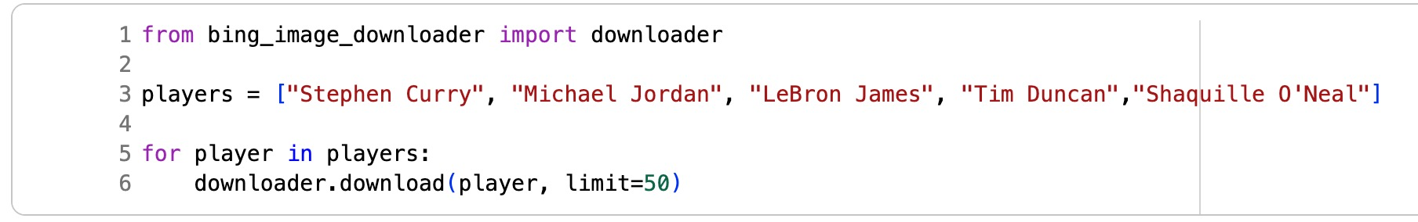
Download data

Slide 5
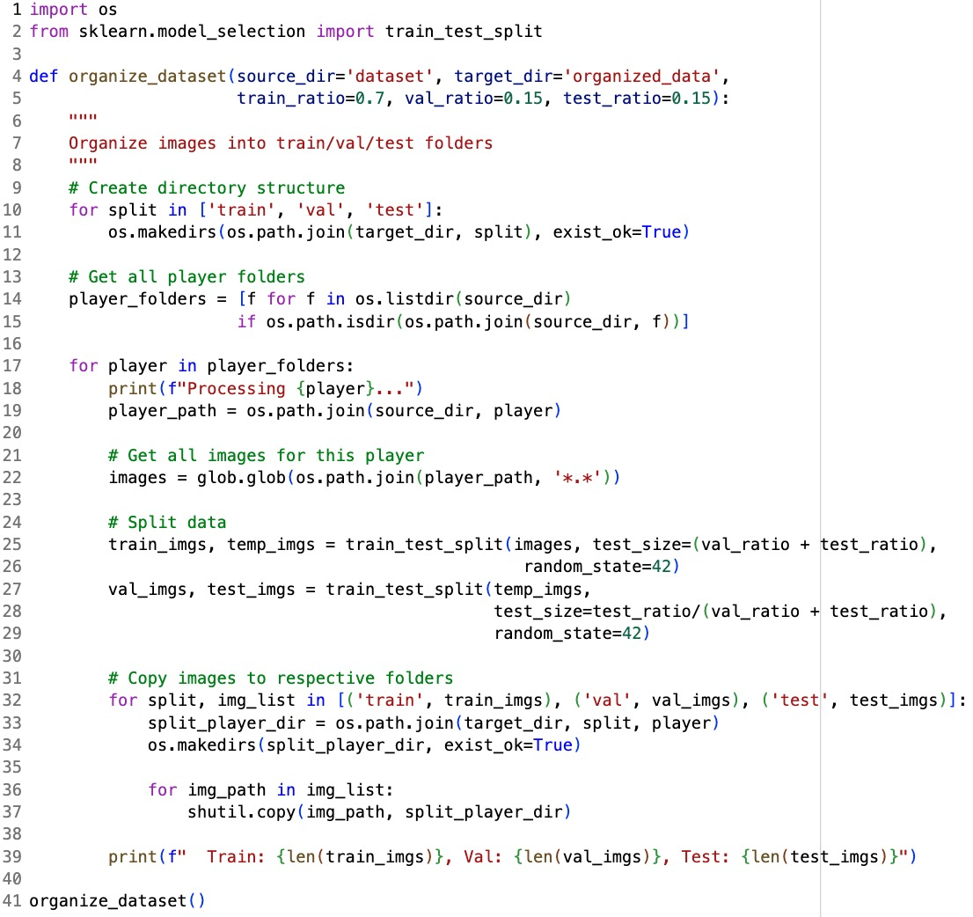
Split data

Slide 6
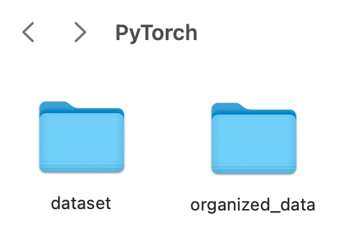
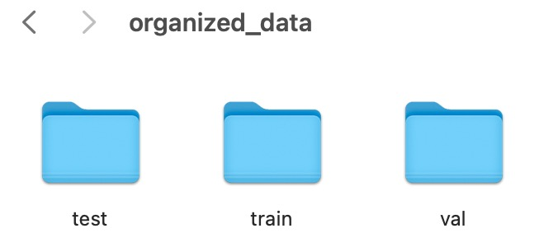
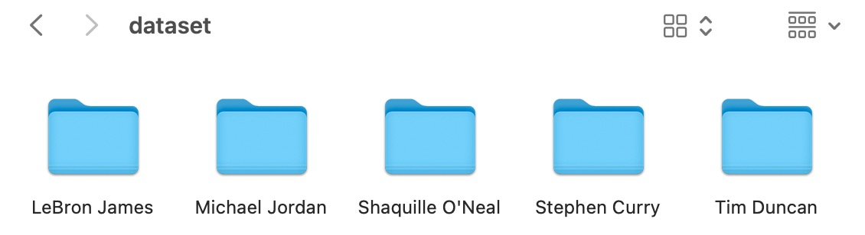
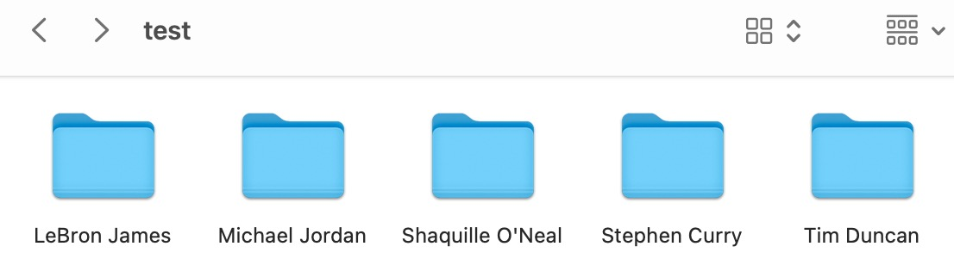
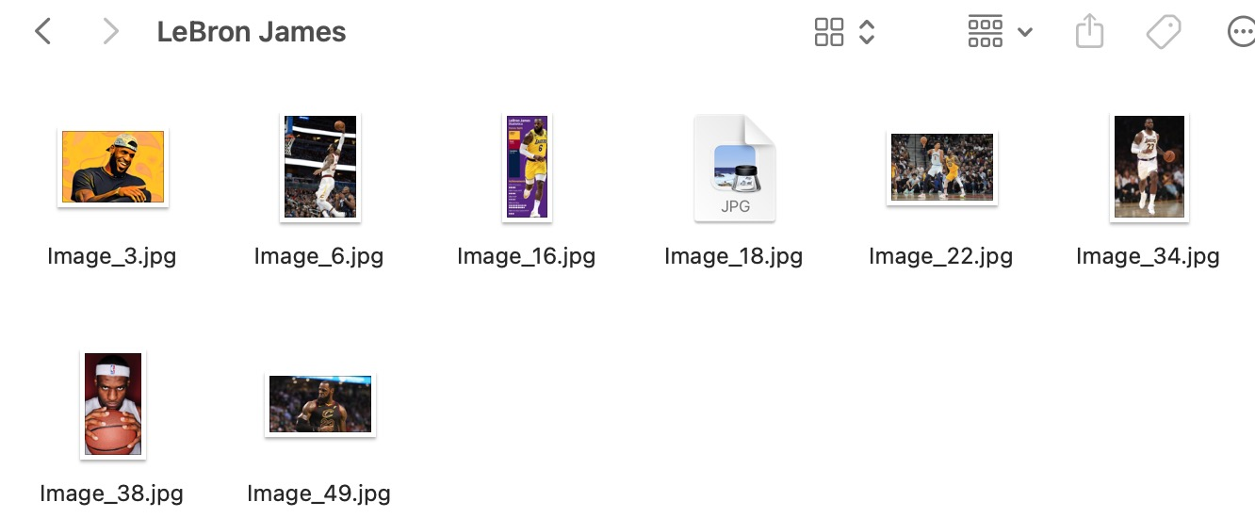
Split data

Slide 7
Create the model
Define number of classes
Define input layers
Define output layer
Define forward pass
Define loss function
Define learning rate

Slide 8
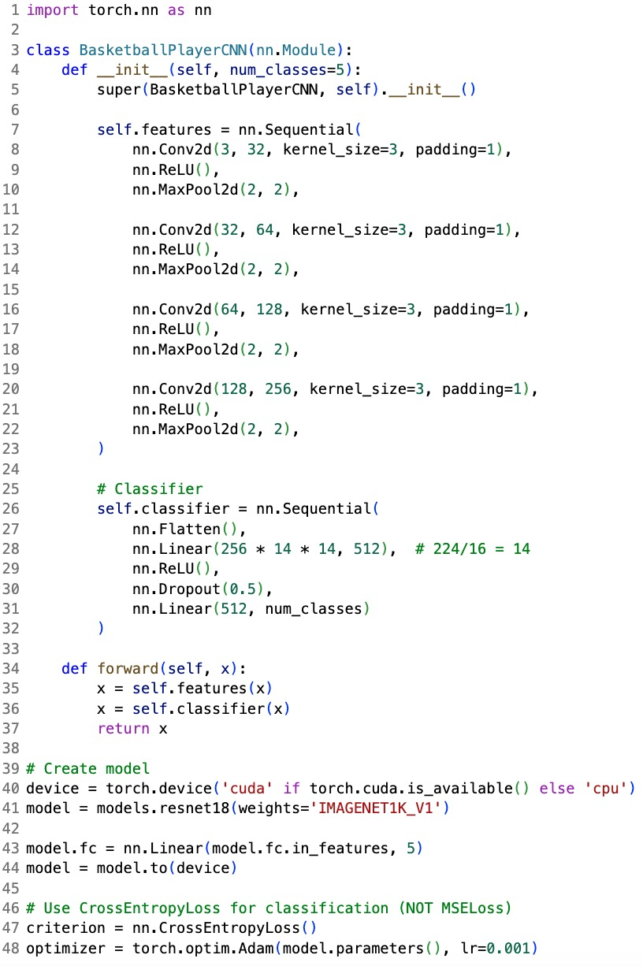
Create the model

Slide 9
Train the model
LOOP TRAINING DATA
FORWARD PASS
BACKWARD PASS
STORE LOSSES & ACCURACIES

Slide 10
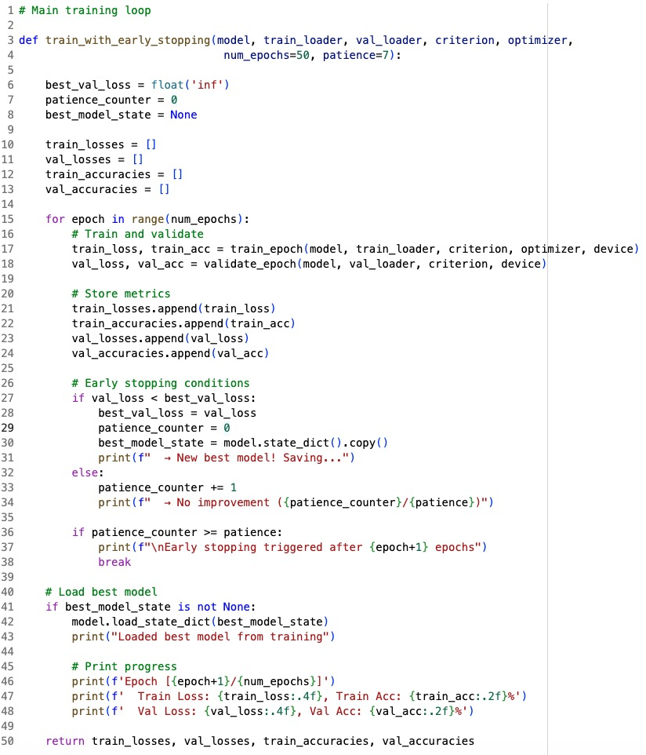
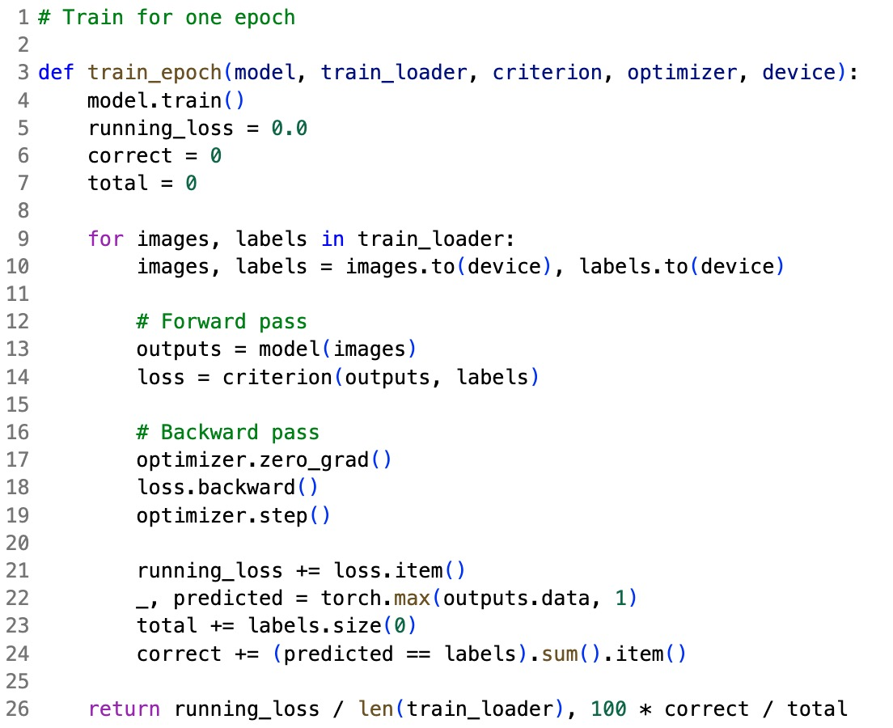
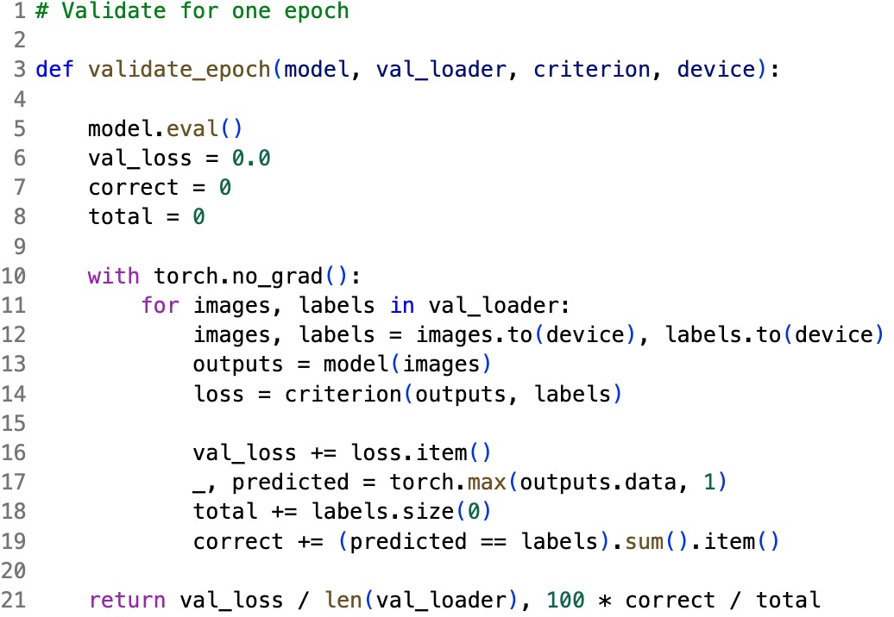
Train the model

Slide 11
Visualizations & Analysis
True LABELS VS PREDICTED LABELS
COMPARE RESULTS FOR DIFFERENT LABELS

Slide 12
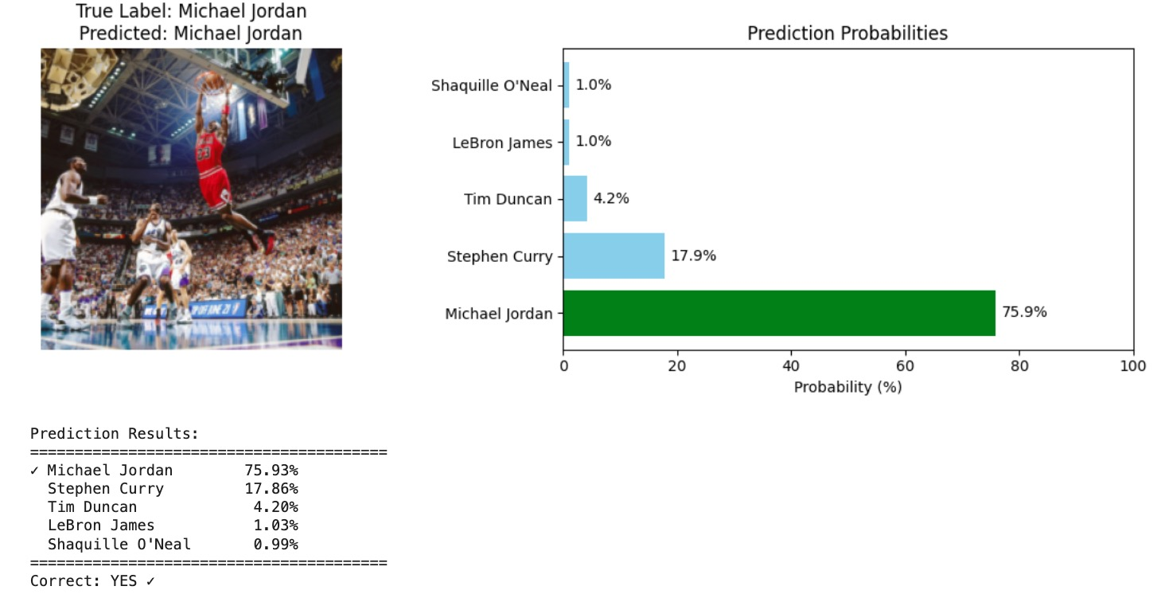
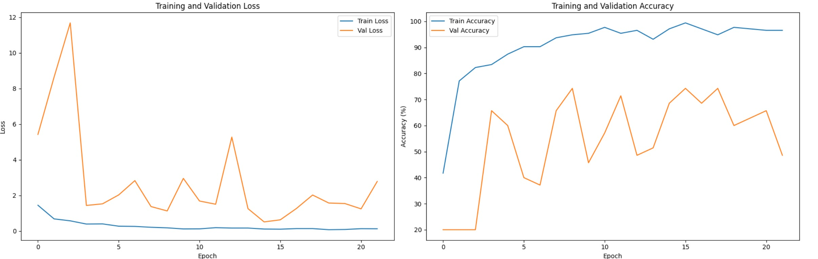
Visualizations & Analysis

Slide 13
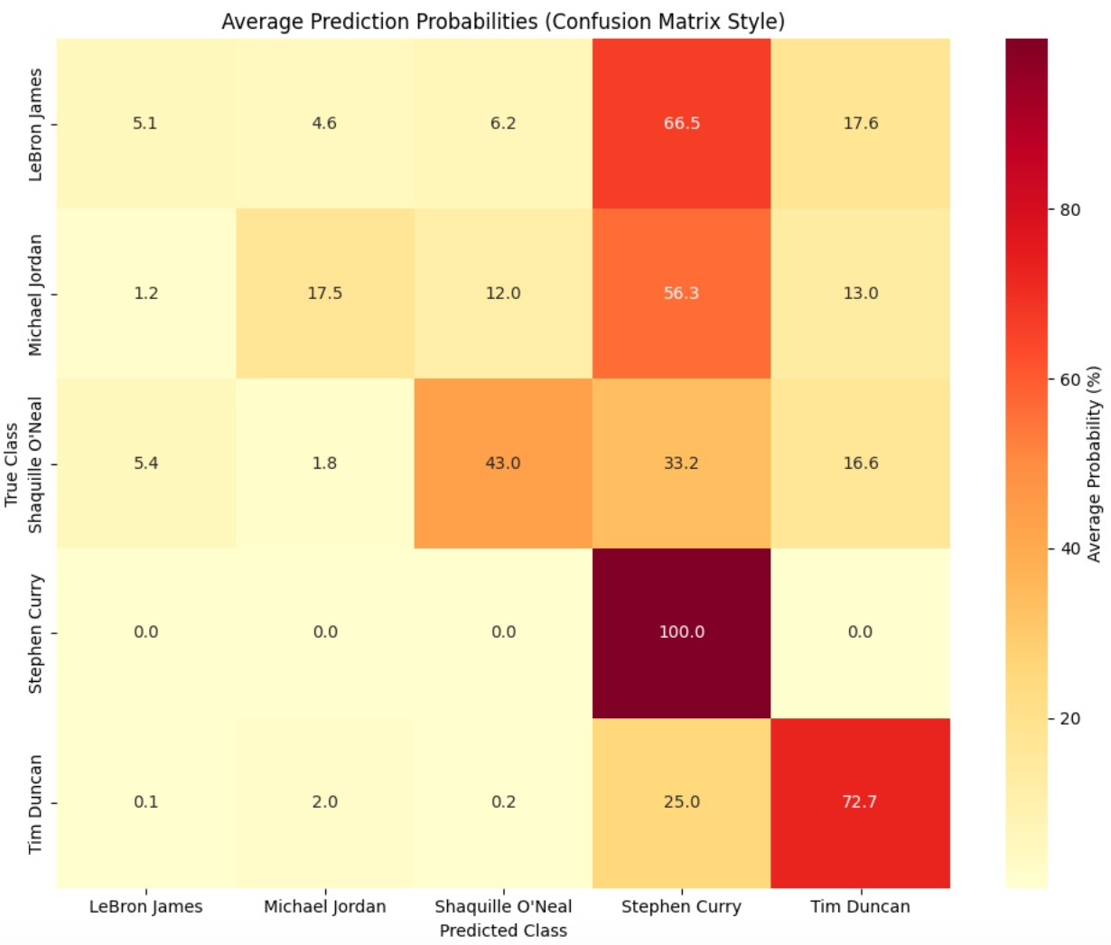
Visualizations & Analysis

