Slide 1
Accessibility Framework & JAWS
Apr 4th 2014

Slide 2
What is Accessibility Framework
Overview
How to enable Accessibility Framework
Building Accessible Applications
Guidelines and design tips for accessible applications
Accessibility requirements in composite portals
Accessibility Report
How to use JAWS for Accessibility Framework

Slide 3
Accessibility Framework Overview
It supports keyboard navigation and follows a semantic markup which is understood by the screen readers like JAWS.
Accessibility - Supported features
Work User Portal Only Features
Harness Only Features
Adding browser plug-ins to accessible applications
Building Accessible Applications
Notes:
Accessibility features first became available with PRPC 5.3 SP1. PRPC 5.5 and 6.1 of PegaRULES Process Commander enhanced these capabilities and added new functions. Reporting features display a chart detailing the level of accessibility compliance in an application by Rule Type and % of accessibility. Drill down displays additional levels of detail about individual accessible elements within the rules. The accessibility report checks the value set in the Accessibility option for all harness, flow action, HTML fragment, and HTML property reference objects in your application. UI components using automatically-generated HTML are verified as accessible. When HTML is generated manually by a developer, the developer tests the code for accessibility, and sets the Accessibility option manually. A broad range of features are provided as default behaviours that are immediately available to the accessible-enabled user.
Since 6.1 Accessibility support was extended to Composite portals, Work Area Gadget and AJAX is now supported for accessible screens.
The Accessibility Framework:
Improves accessibility for people with disabilities.
Addresses the needs of both users with disabilities and authors of accessible content.
Enables people with disabilities to access, read, and act in PRPC applications, using both Web-based and PDF-based forms and content.
Lets developers quickly assess accessibility of applications based on accessibility of screens and content.
Provides keyboard commands and popup windows to improve navigation.
Includes alternative text for graphics and icons.
Accessibility is enabled for an Application simply by adding the PegaWAI RuleSet for developers and users needing accessibility features and controls.
Semantic Markup
semantic markup is markup that is descriptive enough to allow us and the machines we program to recognize it and make decisions about it. In other words, markup means something when we can identify it and do useful things with it. In this way, semantic markup becomes more than merely descriptive. It becomes a brilliant mechanism that allows both humans and machines to “understand” the same information.
Accessibility - Supported features
Work User Portal Only Features
Accessible work list
OnChange selection lists replaced with buttons
Title attribute for left navigation panel
Visual focus indicator for bars in the left navigation panel
Harness Only Features
Visual focus indicator
Form controls explicitly associated with labels
Accessible action frame
Accessible take action drop down box
Tabbed displays
Accessible history/attachment window
Custom plug-ins
Accessible URLs
Accessible parties section
Accessible style sheet
Date and DateTime formatting controls
Locale-specific date formatting
TextArea control
Accessible required field indicator
Shortcut keys
Shortcut key to the first control in the tabbing sequence
Error handling
Warnings when changing the current window
To add a custom plug-in:
Open the CustomInclude section rule and save it to your RuleSet.
On the Layout tab, select the custom plug-ins HTML fragment and click on magnifying lens icon. The Cell properties pop-up window displays.
Building Accessible Applications
For an application upgraded to Version 5.3 SP1:
If you have an application built on a previous release that you want to make accessible, it is necessary to use the Revalidate and Save tool to update your harness, section, flow action, and list view rules. This process re-generates the HTML to include additional markup language to support accessibility requirements.
From the Tools menu, select the Revalidate and Save option for the following rule types:
Rule-HTML-Harness Rule-HTML-Section Rule-Obj-FlowAction Rule-Obj-ListView
For more information about how to use the Revalidate and Save tool, see the Administration and Security Guide section on Revalidating Rules

Slide 4
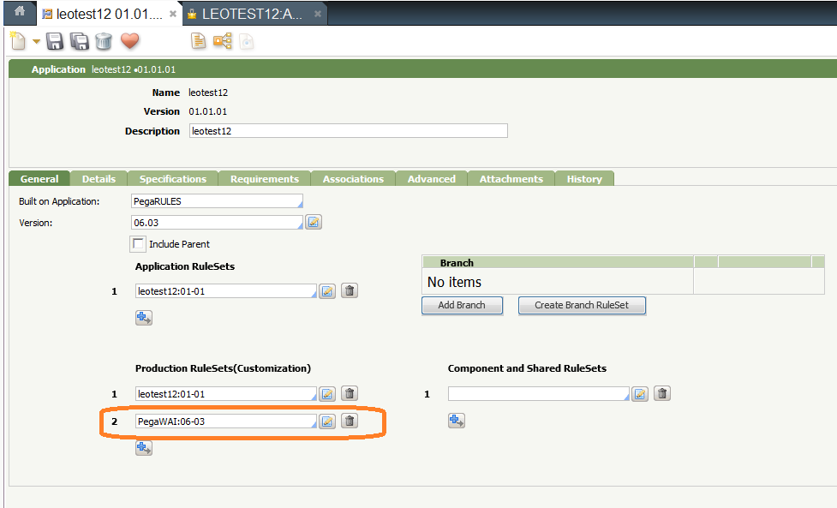
How to enable Accessibility Framework
Accessibility features and controls are enabled through access to the PegaWAI RuleSet.
To Enable Access
Notes:
In the Production RuleSets section of the Access tab, add the PegaWAIRuleSet to the access groups of developers and users needing accessibility features and controls

Slide 5
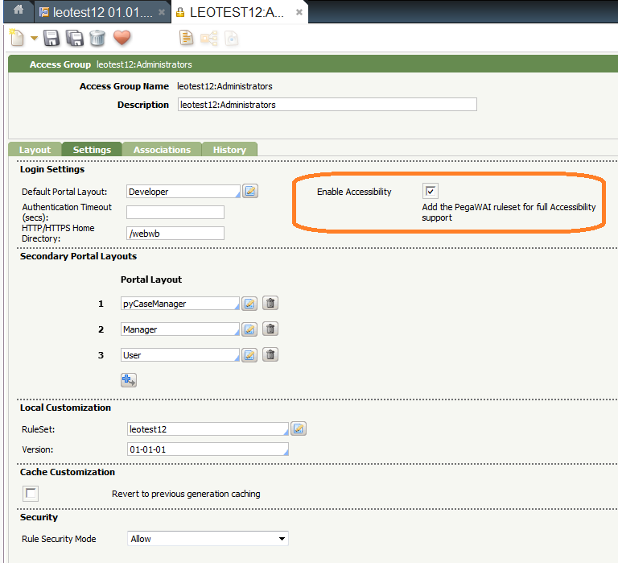
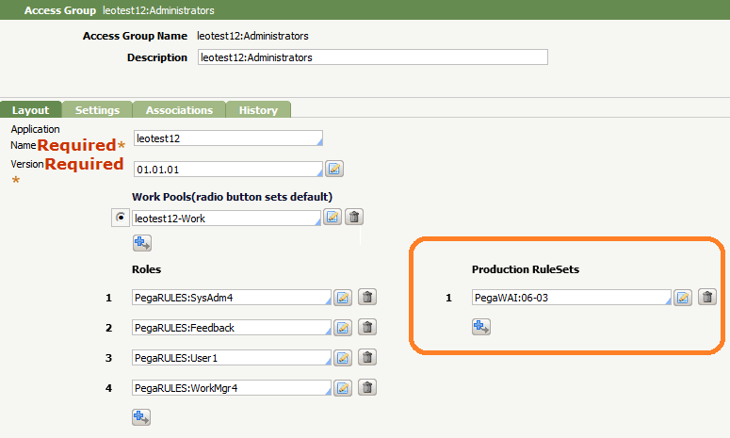
Cont.…

Slide 6
Guidelines and design tips for accessible applications
Do not use px or px-fixed layouts
Do not use inline styles
Do not use the deferred load feature
Avoid the use of AJAX-based displays
Avoid using multiple icons
Provide shortcut keys for frequently used buttons, fields, and actions
Notes:
The following list contains configuration guidelines and design tips developers should follow when building applications using existing Process Commander functionality intended to comply with accessibility standards.
Do not use px or px-fixed layouts — these layouts fix the width of windows and forms
Do not use inline styles — these styles fix fonts, colours and other style attributes
Do not use the deferred load feature
Avoid the use of AJAX-based displays — these typically require use of the mouse. Features to avoid include: conditional hide and show displays, onscreen calculations, and hover-over displays on worklists and harnesses
Avoid using multiple icons — initial focus will be placed on them and not on the first input field
Provide shortcut keys for frequently used buttons, fields, and actions

Slide 7
Accessibility requirements in composite portals
Simplified navigation
Automated labelling
Update warnings
Reports
Accessible style sheets
Alternative controls
Notes:
The PegaWAI RuleSet provides accessibility features for access groups that need them, without changing the portal experience for other groups.
Example
Composite portals, as well as being simpler to maintain, adapt, and deploy than traditional portals, provide many features that simplify the creation of accessible programs. These features include:
Simplified navigation. Users can proceed from field to field and link to link by tabbing, and can move from section to section in the portal using the shortcut keys provided by their assistive device, or by using the keyboard arrow keys.
Automated labeling. Standard portal components automatically have label fields that can be read by assistive devices.
Update warnings. The portal warns a user for whom accessibility features are activated whenever an action will cause a major change to the current screen, or will require the user to refresh the screen.
Reports in accessible composite portals appear in tabular form, rather than graphically, for those using assistive devices.
Accessible style sheets. Composite portals use a style sheet with color schemes and fonts that enhance reading for color-blind users or those needing very large fonts.
Alternative controls enable those using the accessibility features to "drag and drop" from list to list, select items in a drop-down list, or delete items from a list.

Slide 8
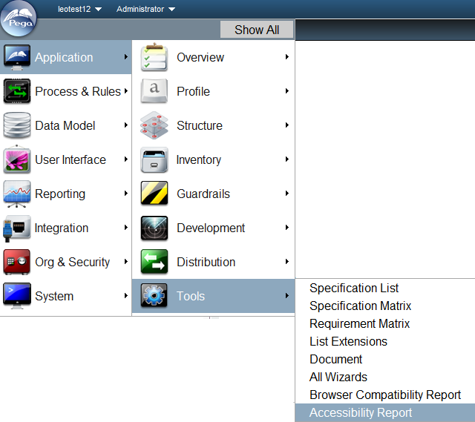
Accessibility Report

Slide 9

JAWS
JAWS (Job Access With Speech) is a computer screen reader program for Microsoft Windows that allows blind and visually impaired users to read the screen either with a text-to-speech output or by a Refreshable Braille display.
JAWS is produced by the Blind and Low Vision Group of Freedom Scientific, St. Petersburg, Florida, USA.

Slide 10
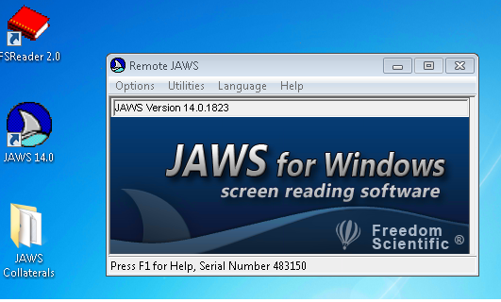
Machine Name- wgcsblrw7-2

Slide 11
QA
Questions ?
Thanks.

