Slide 1
VB Script - QTP
For QTP training
By Leo
Notes:
Restricted

Slide 2
VB Script Fundamentals
  What Is VB Script?
  VBScript Data Types
  VBScript Variables
  VBScript Constants
  VBScript Operators
  Using Conditional Statements
  Looping Through Code
  VBScript Procedures
  VBScript Coding Conventions

Slide 3
Basic Windows Script Host Tasks
Accessing Networks
Creating an Automated Login Script
Driving Applications
Executing File Management Operations
Managing Shortcuts
Manipulating the System Registry
Running Scripts Remotely
Signing a Script
WSH and Windows Management Instrumentation (WMI)

Slide 4
Scripting Technique in Live Project
Automated Scripts
Data Sheets
Error Recovery
Re-Usable methods
Import and Export the Data Value

Slide 5

Framework

Slide 6



Slide 7

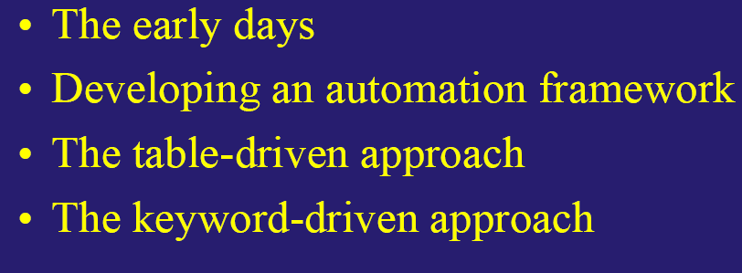

Slide 8

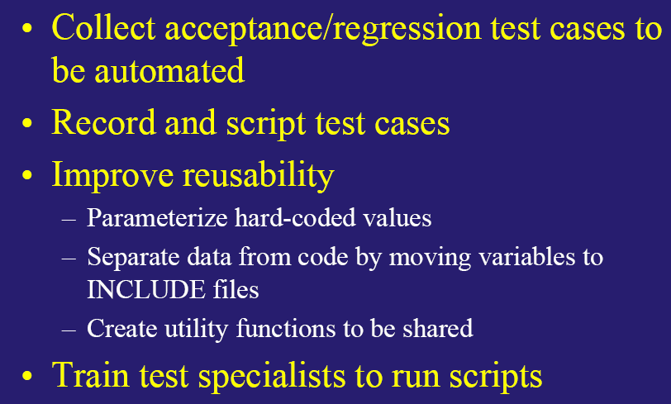
Configuration file supporting Application needs to be updated supporting Unicode char set
VenvUnicodeFormat to be set as “UTF-8”
VenvNLSLang to be set specific to locale.
Ex: <Language>.<Territory>.<character set>
AMERICAN.AMERICA.WE8MSWIN1252
VenvEmailMIMECharset has to be set to “utf-8”
VenvEmailMIMEBits has to be set to 8
VenvJavaActivatorSettings has to be set with
-Dfile.encodeing=“UTF-8”, with which delivered SMS appears in configured locale.

Slide 9

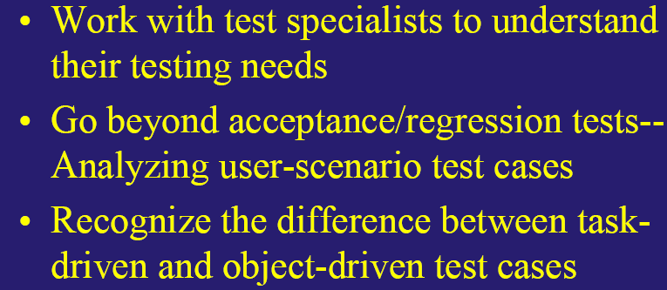

Slide 10
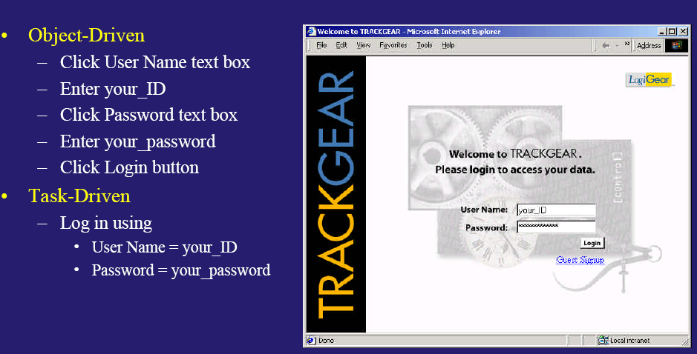
Number Groupings
  amount per group, separator
Decimal Point
  correct character
Date/Time
  order of day, month, year, separator, short & long form, Abbreviations
Currency
  symbol, 3-letter ID, expansion room, # of digits after decimal
Measure
  proper units
Telephone numbers
  no restriction on format, allowance for certain non-numeric characters
Addresses
  generic address lines, state/province optional, postal code, country field

Slide 11

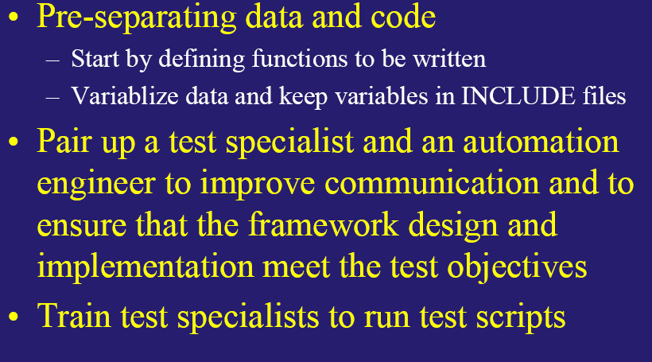

Slide 12

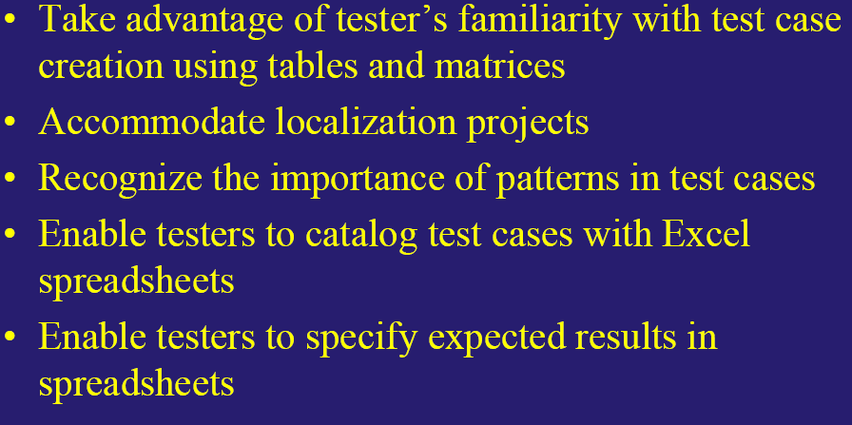

Slide 13
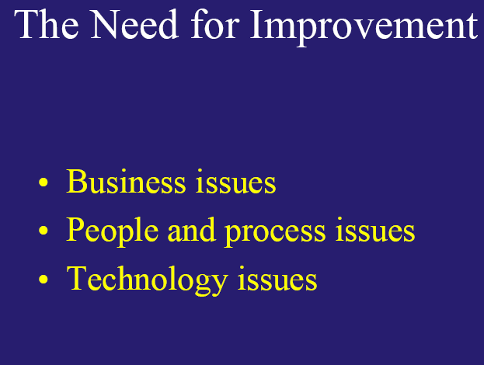
What are the platforms on which the software product is supported?
Should date, time, and calendar formats be localized?
Should decimal be localized?
Should currency format's be localized? What about units of measurements?
Are there keyboard accelerators that must be localized?
Should address and phone number formats be localized?
Should URLs be localized?
Should graphics be localized?
Are there any special screen layout requirements (vertical text, bi-directional text, etc.)?

Slide 14

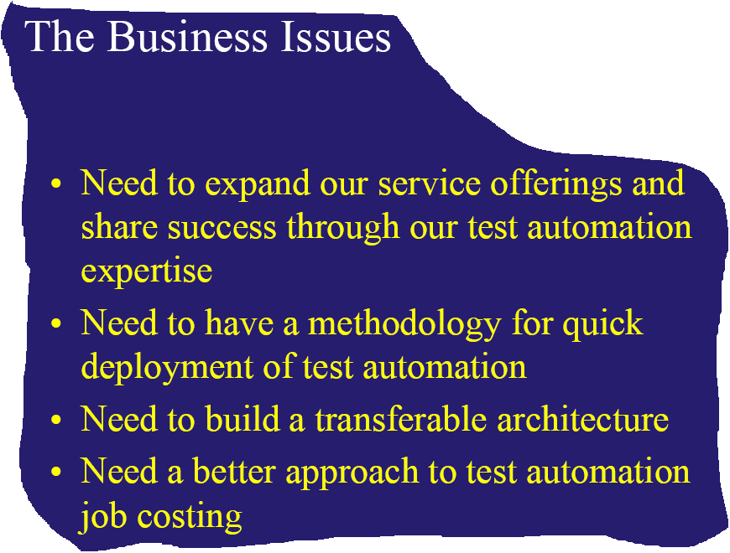
Strategy

Slide 15

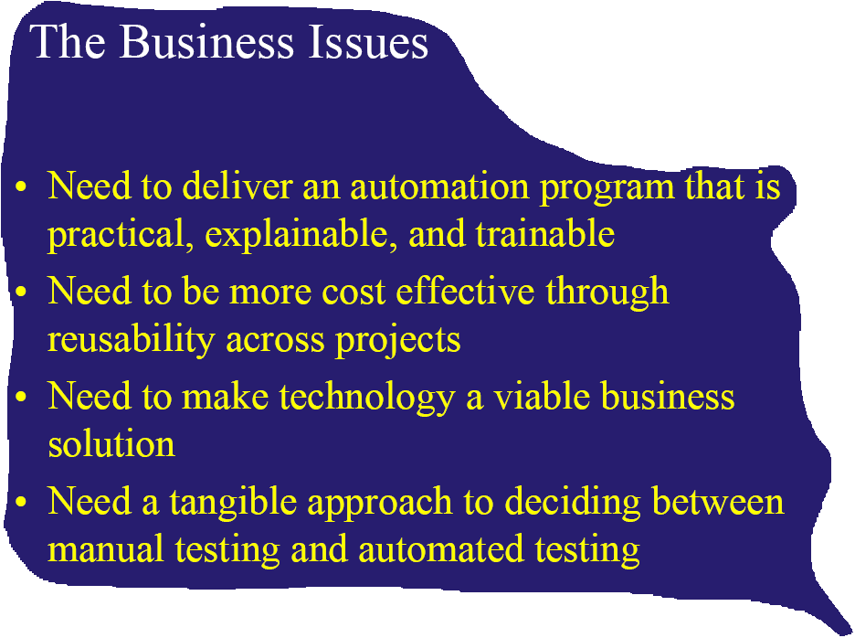

Slide 16
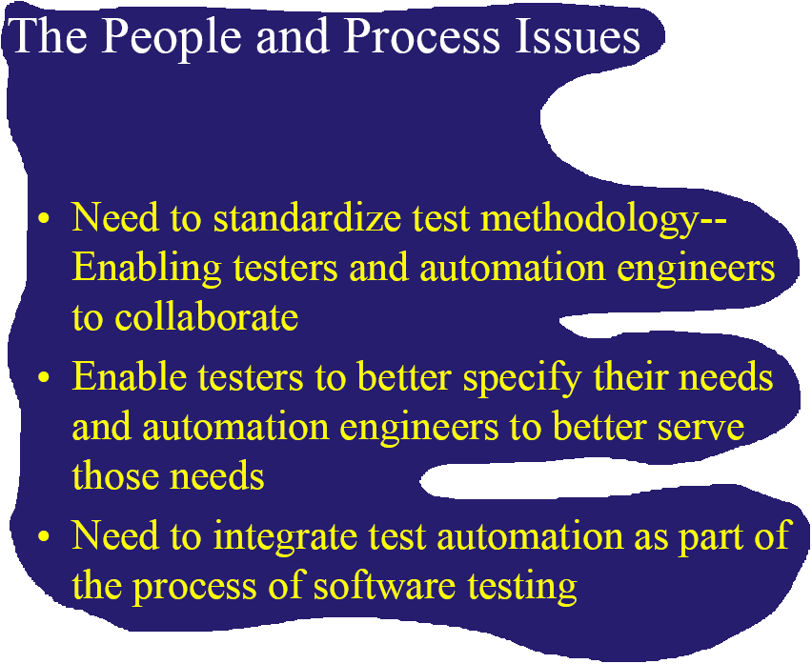
Challenges

Slide 17

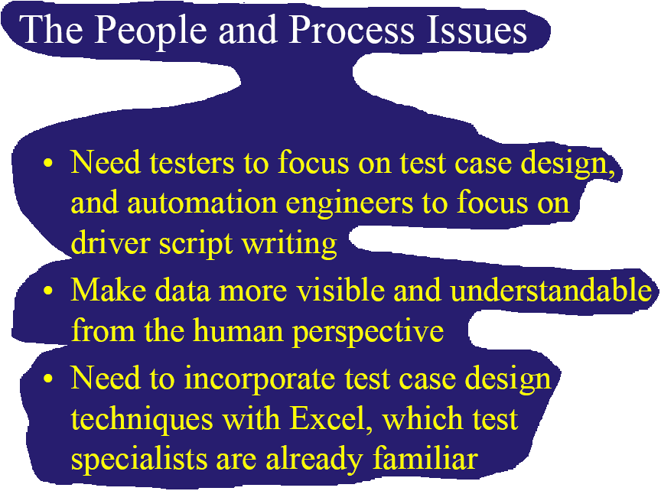

Slide 18

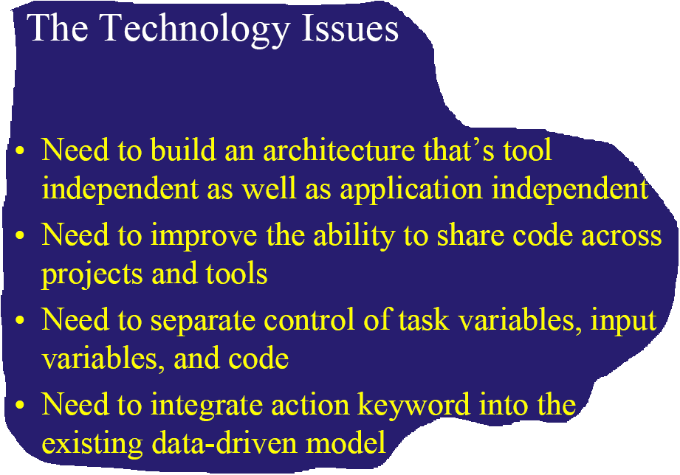

Slide 19
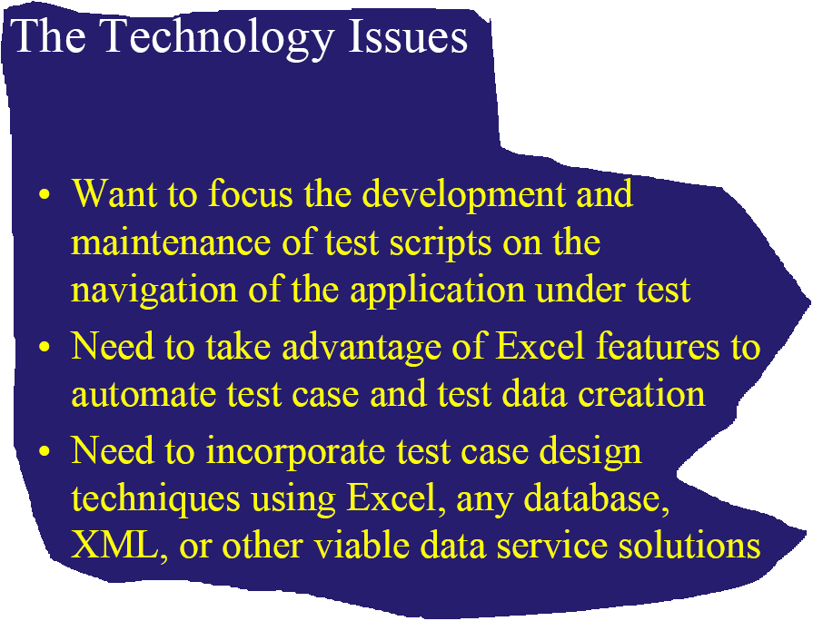

Slide 20
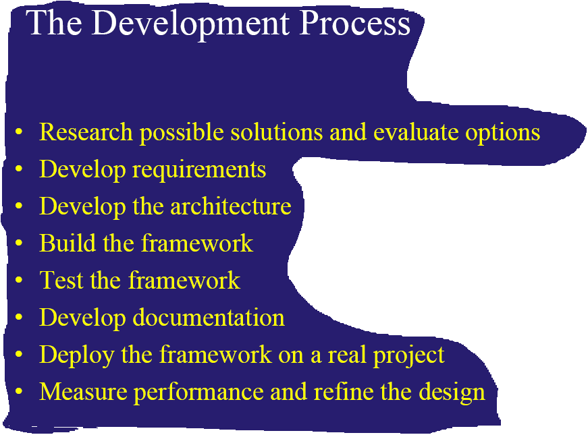


Slide 21
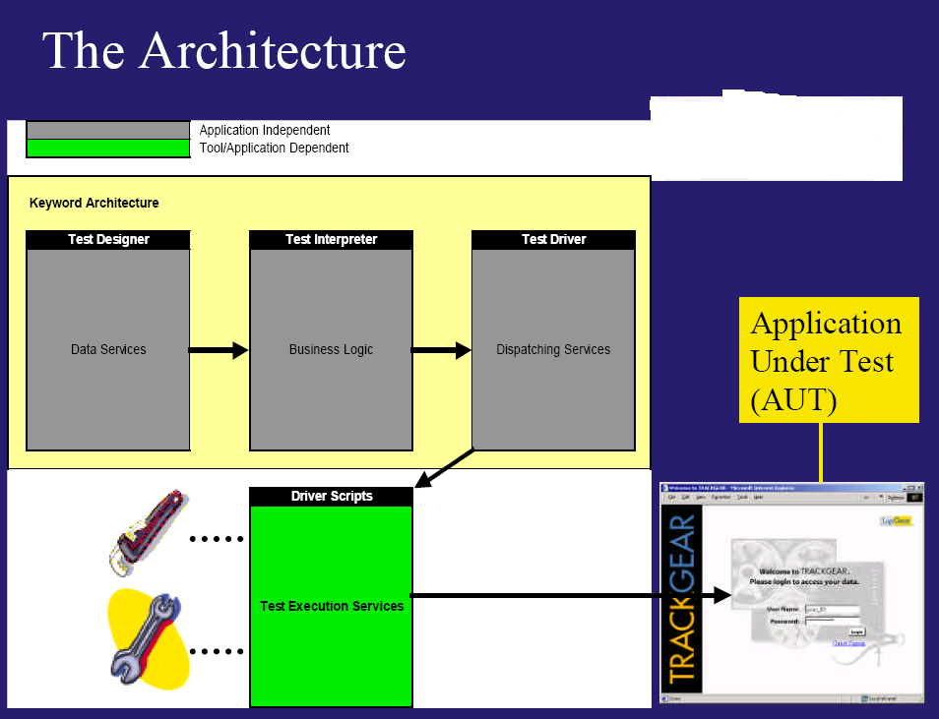

Slide 22
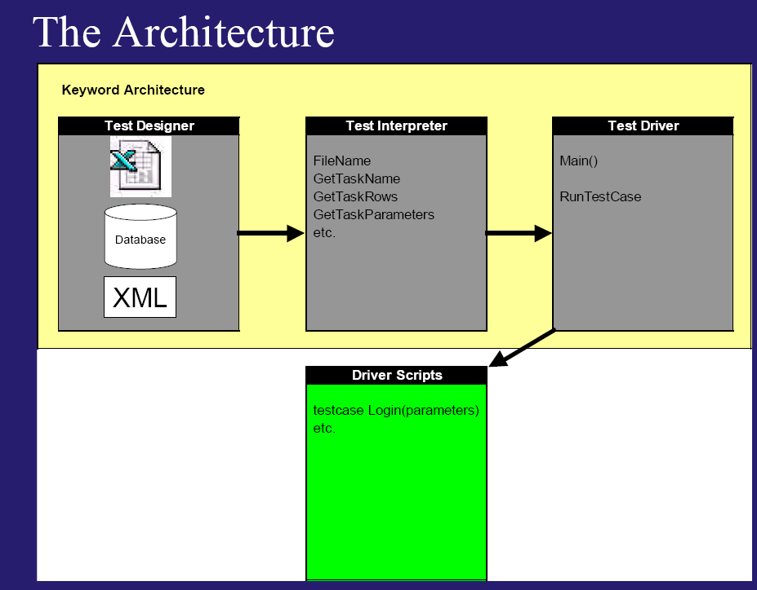

Slide 23
