Slide 1
MCHP E5x/D5x CCL
Leo Li

Slide 2
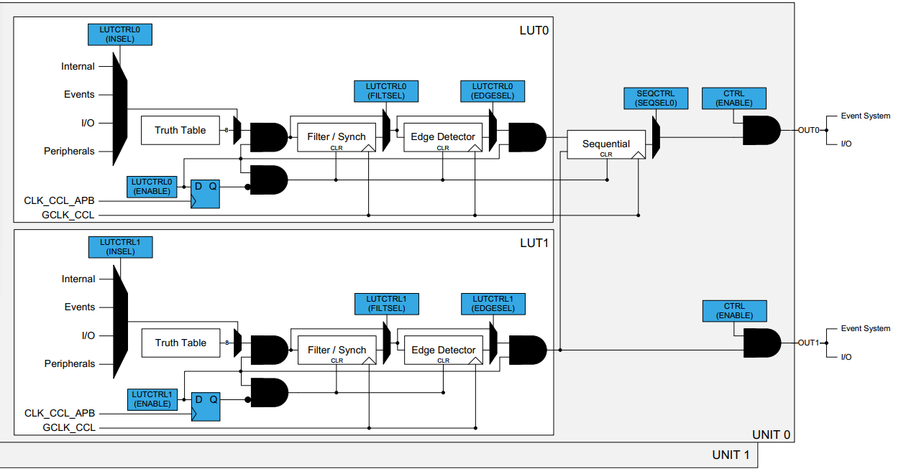
Over View

Slide 3
LUTx
LUTCTRLn.INSEL0[3:0]
LUTCTRLn.INSEL1[3:0]
LUTCTRLn.INSEL2[3:0]
LUTCTRLn.FILSEL[1:0]
LUTCTRLn.EDGESEL
IN[2:0]
TRUTH | BIT0
 | BIT1
 | BIT2
 | BIT3
 | BIT4
 | BIT5
 | BIT6
 | BIT7
8bits
Filter/Synch
Edge Detector
CLR
LUTCTRLn.EN
D Q
>C
CLK_CCL_APB
GCLK_CCL

Slide 4
UNIT0
SEQCTRL.Seqsel0
LUTCTRL.EN
Event Sys
OUT0
LUT0
Sequential
I/O
CLR
CLK
LUTCTRL.EN
LUT1
Event Sys
OUT1
I/O

Slide 5
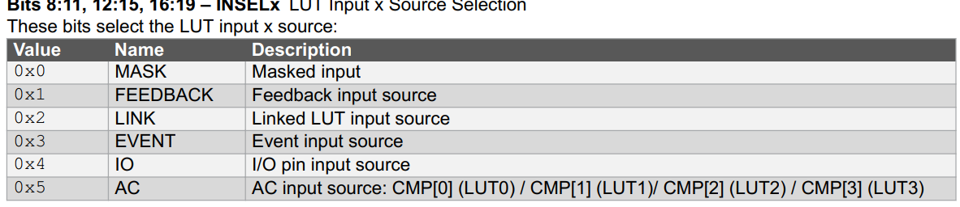
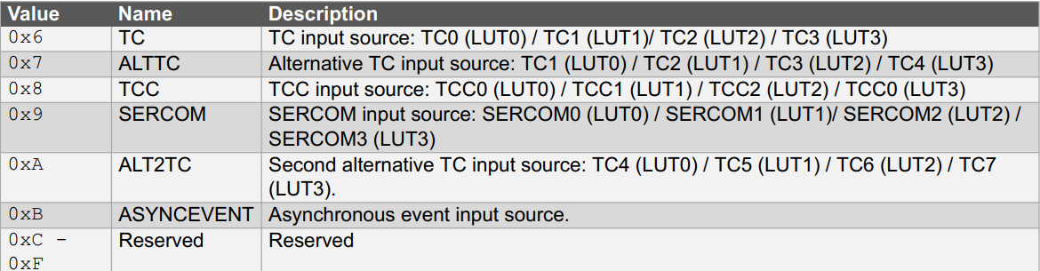
INSEL[2:0]

Slide 6
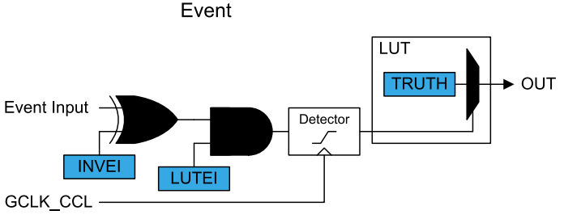
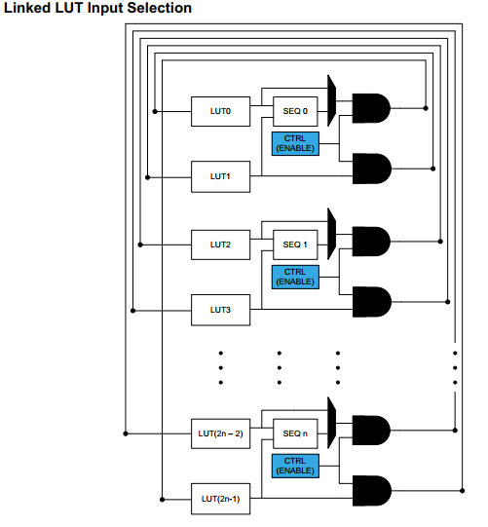
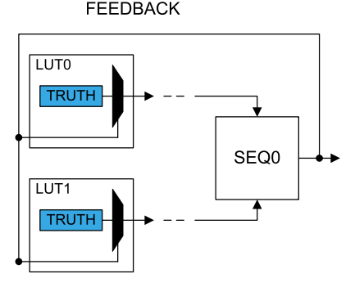
INSEL[2:0]

Slide 7
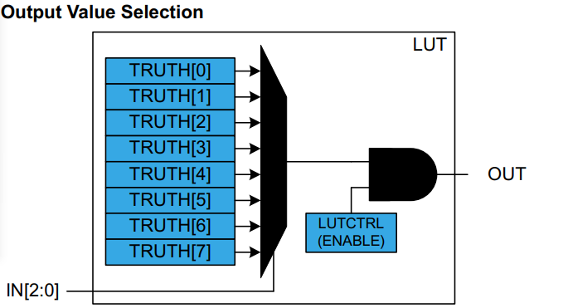
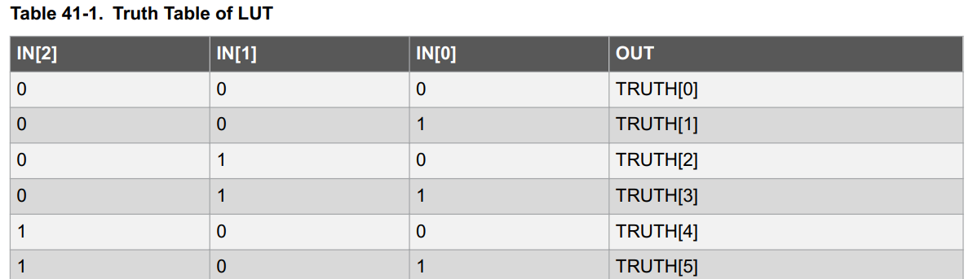
TRUTH

Slide 8
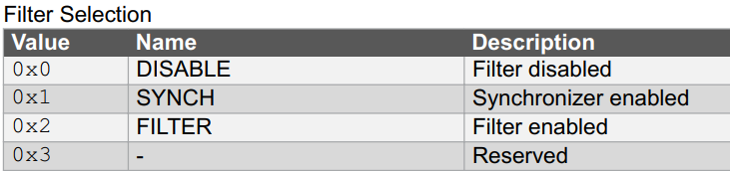
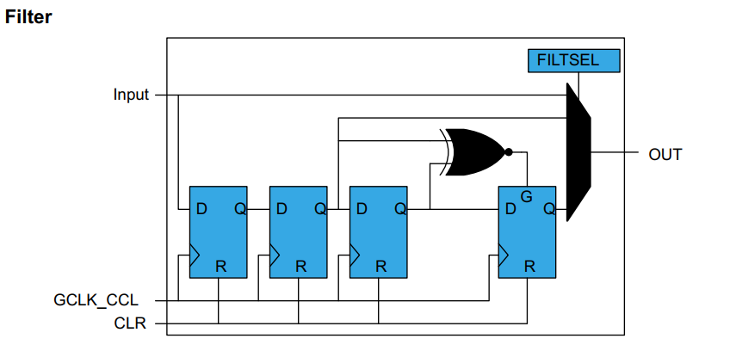
FILTER[1:0]

Slide 9
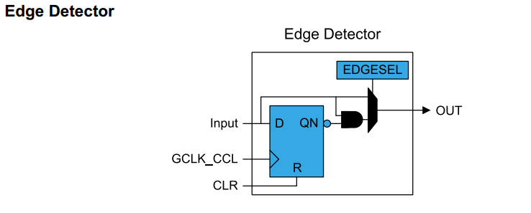
EDGSEL
The edge detector can be used to generate a pulse when detecting a rising edge on its input. To detect a falling edge, the TRUTH table should be inverted

Slide 10
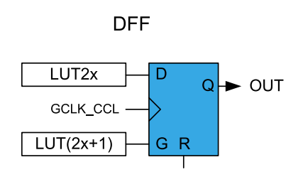
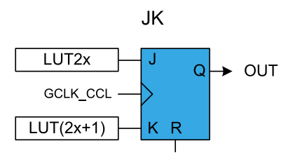
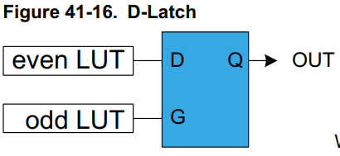
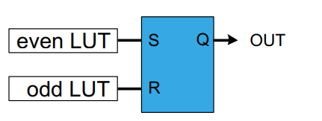
Sequential

Slide 11
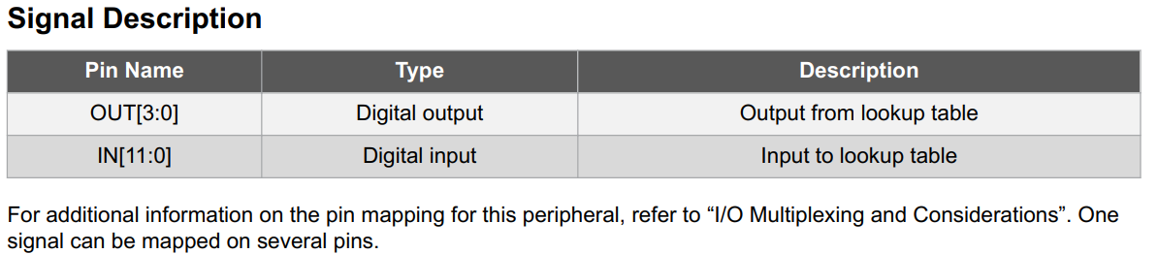
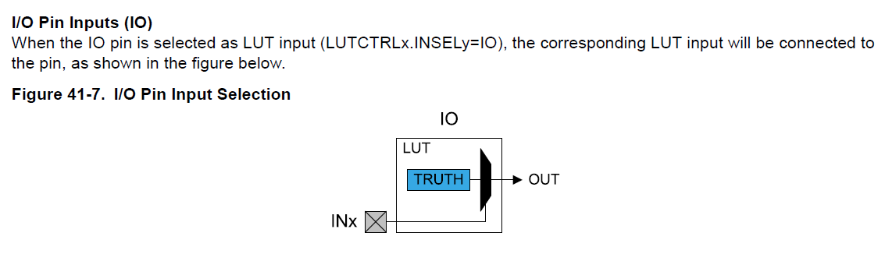
Q1: CCL IO configurate（IN）
Which IO will be introduced to LUT? There are 12 INx, but only 3 SEL.
??????
2:0 -> LUT0 SELIN[2:0]
5:3 -> LUT1 SELIN[2:0]
8:6 -> LUT2 SELIN[2:0]
11:9 -> LUT3 SELIN[2:0]

Slide 12
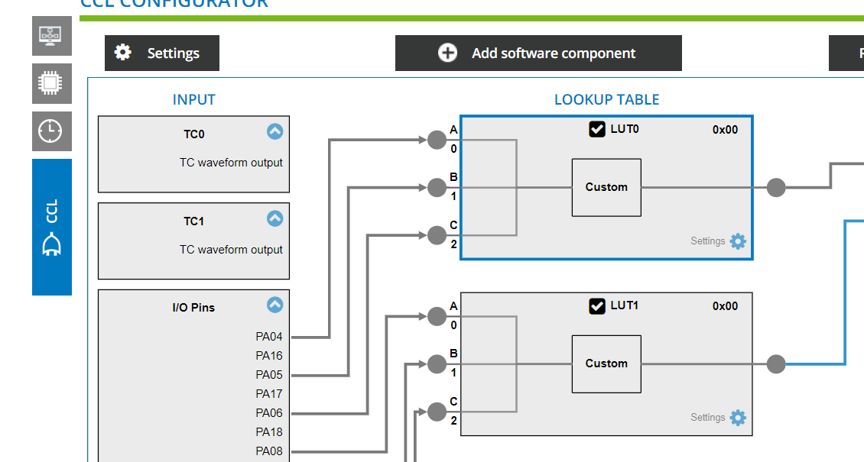
Answer 1: CCL IO configurate（IN）
从L11 的配置图上可以证实IN[2:0] 对应 LUT0 的IO[2:0] , IN[5:3] 对应 LUT1的IO[2:0]

Slide 13
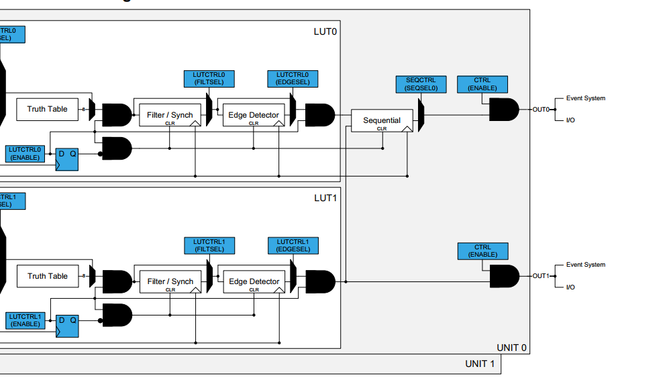
Answer1: CCL IO configurate(out)
Below figure OUT0,OUT1 means LUTx corresponding output pin is OUT[x]?

Slide 14
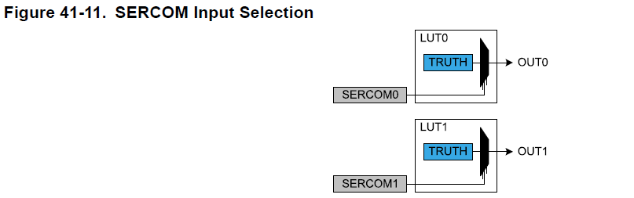
Questions2
How the sercom infect the LUTx?
IN[N][i] = SERCOM[ N % SERCOM_Instance_Number]
With N representing the LUT number and i=0,1,2 representing the LUT input index.
The serial engine transmitter output from Serial Communication Interface (SERCOM TX, TXd for USART, MOSI for SPI) can be used as input sourcw for LUT.
SPI) can be used as input source for the LUT.
Sercom
Txd or MOSI

Slide 15
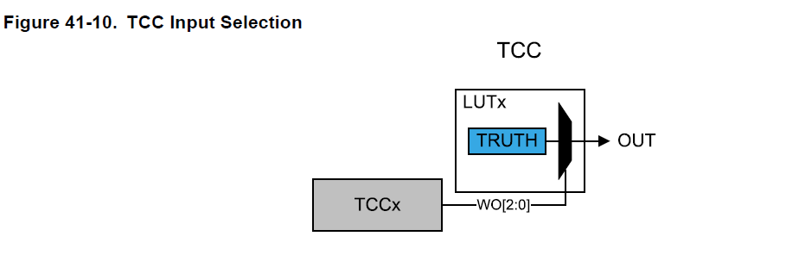
Question3
Base on the Figure, which WO[x] is loaded to IN[x] ? Or LUTCTRLn.INSELx[2:0] corresponding to WO[x] ?
Only WO[2:0] outputs can be selected and routed to the respective LUT input (i.e., IN0 is connected to WO0, IN1 to WO1, and IN2 to WO2), as shown in the figure below.
IN[N][i] = TCC [N % TCC_Instance_Number]
Where N represents the LUT number.

Slide 16
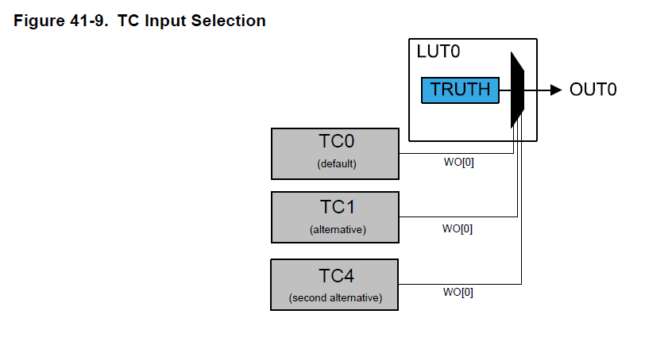
Question4
Base on the Figure, which WO[x] is loaded to IN[x] ? Or LUTCTRLn.INSELx[3:0] corresponding to WO[x] ?
IN [N][i] = DefaultTc[N % TC_Instance_Number]
IN [N][i] = AlternativeTc[(N + 1) % TC_Instance_Number]
Where N represents the LUT number and i represents the LUT input index (i=0,1,2).
IN[N][i] = SecondAlternativeTc [ (N + 4) % TC_Instance_Number ]
Note that for not implemented TC_Instance_Number, the corresponding input is tied to ground.

Slide 17
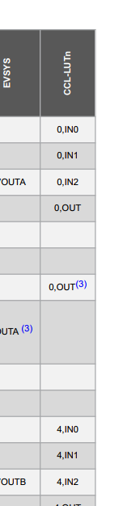
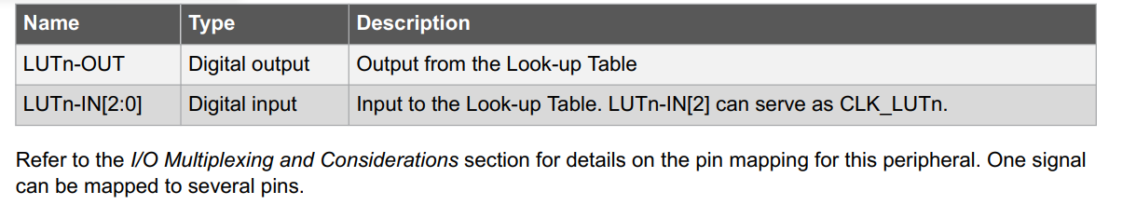
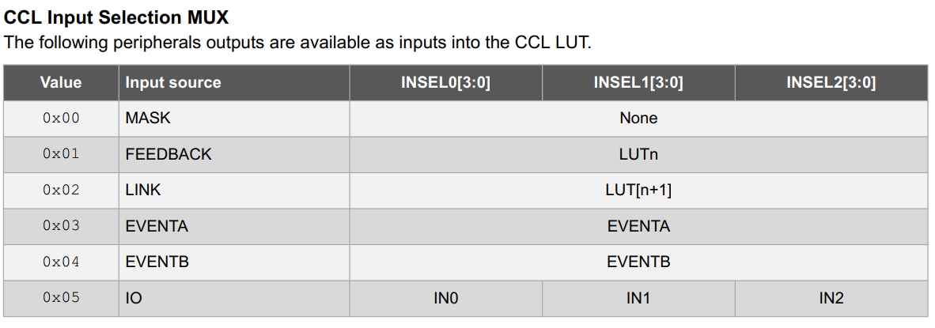
AVR128DA64 CCL

