Slide 1
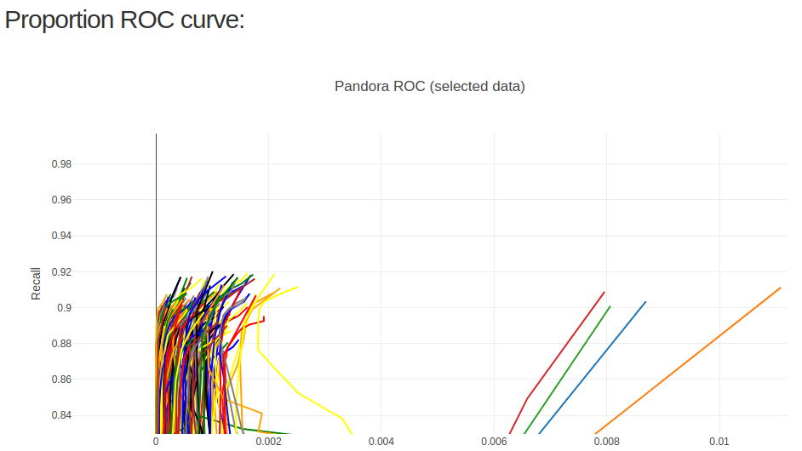
In the following there are several comparisons between the best snippy reference and the 4 truth assemblies, as an orthogonal way of debugging our 4-way evaluation;
To remember, this is our current 4-way: (the 4 on the right are pandora curves, the ones on the left are snippy):

Slide 2
In the following there are several comparisons between the best snippy reference and the 4 truth assemblies, as an orthogonal way of debugging our 4-way evaluation;
By best snippy reference I mean the reference that got the best recall in our 4-way evaluation, with snippy calls applied (which is actually what we evaluate).
Leah pointed out that we should not be including plasmids in our truth assemblies, and she is right. The pandora PRGs do not include plasmids – by including plasmids in the truth assemblies, we might find truth probes coming from plasmids, which pandora will never find, but snippy might find, since the ~250 references snippy uses do include plasmids;
As such, I just removed all plasmids of all fasta files before comparison;

Slide 3
1. Best snippy ref vs the 4 truth assemblies
This snippy ref got 92% recall in our 4-way pipeline, so it could:
1. Be similar all the 4 samples (which supports the idea that our pipeline is correct, but we did not choose the samples wells – they are not divergent enough);
2. Be different from the 4 samples (thus there is a bug in our pipeline);

Slide 4
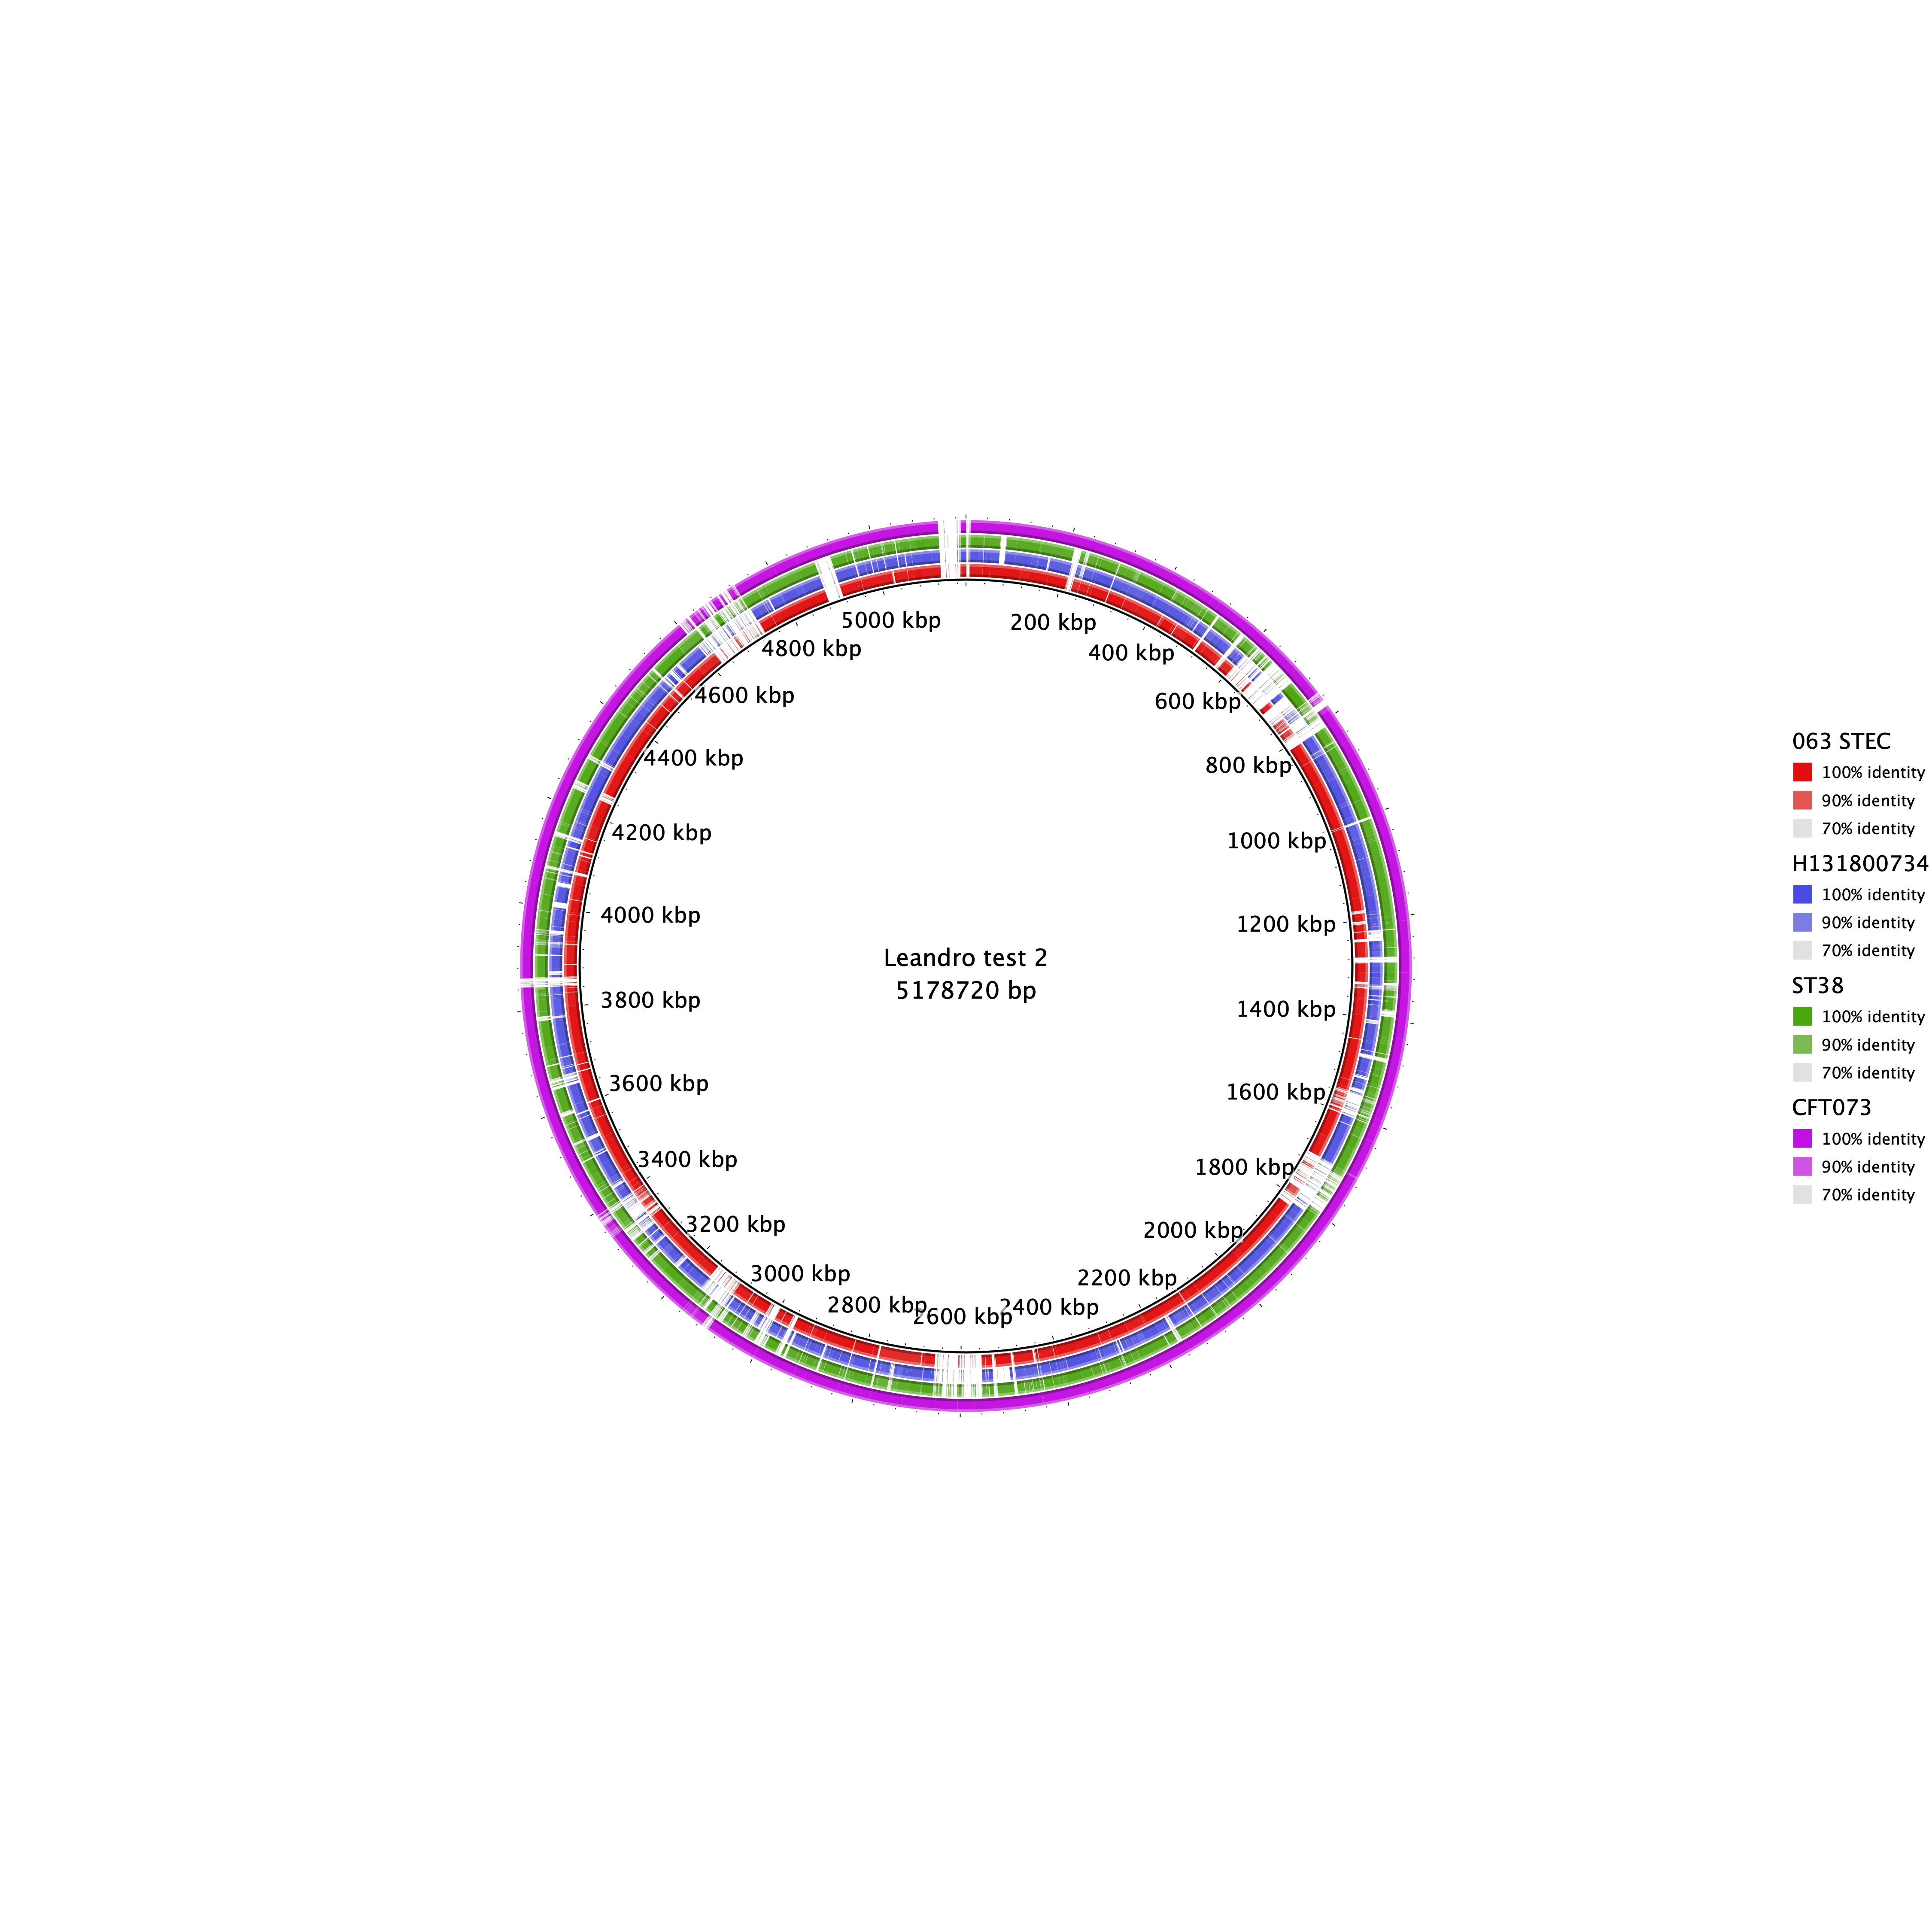
-We start with a circular visualization made by Leah (which also realized that this snippy ref is in the same phylogroup as one of the samples (CFT073));
-Inner black circle is the snippy ref, coloured rings are each sample (the pink ring is almost complete because of being in the same phylogroup)

Slide 5
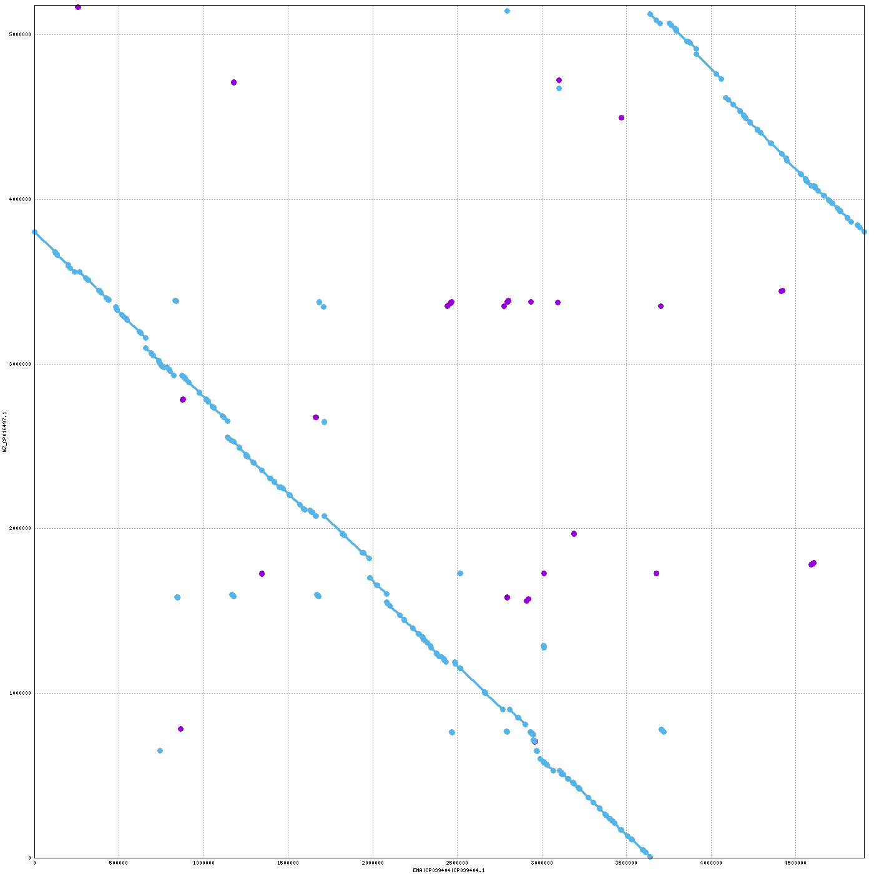
Now we compare this snippy ref
with the 4 samples:
063_STEC

Slide 6
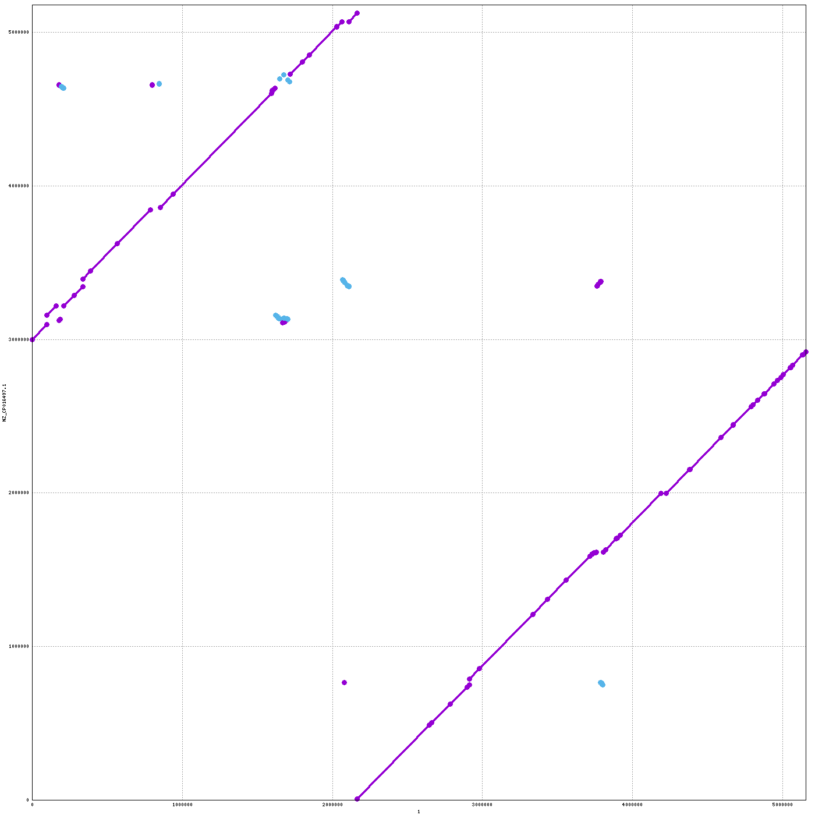
Now we compare this snippy ref
with the 4 samples:
CFT073

Slide 7
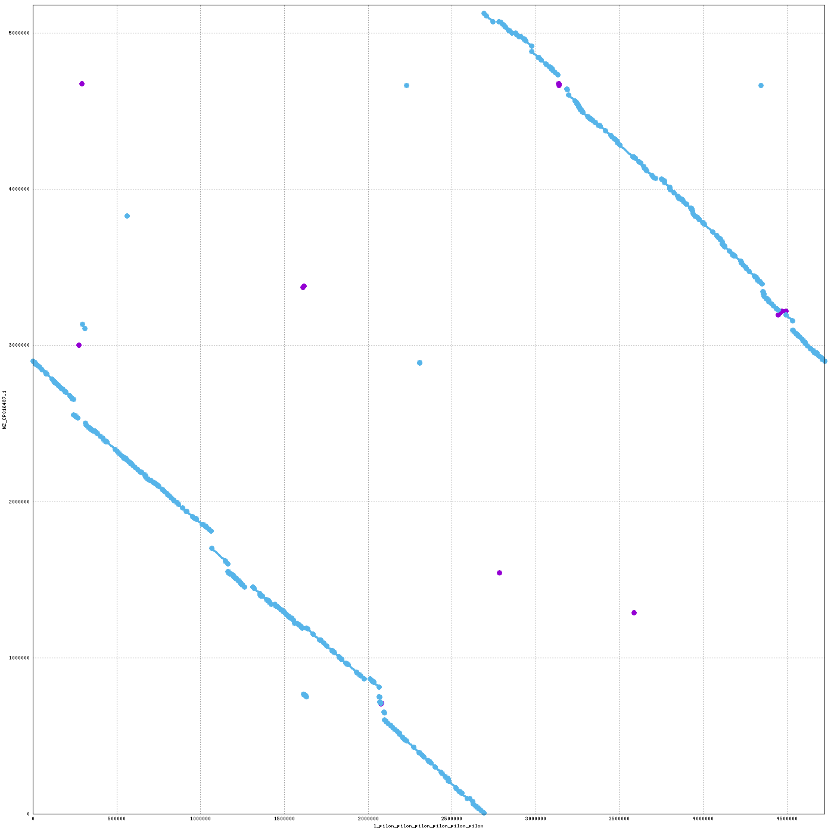
Now we compare this snippy ref
with the 4 samples:
H131800734

Slide 8
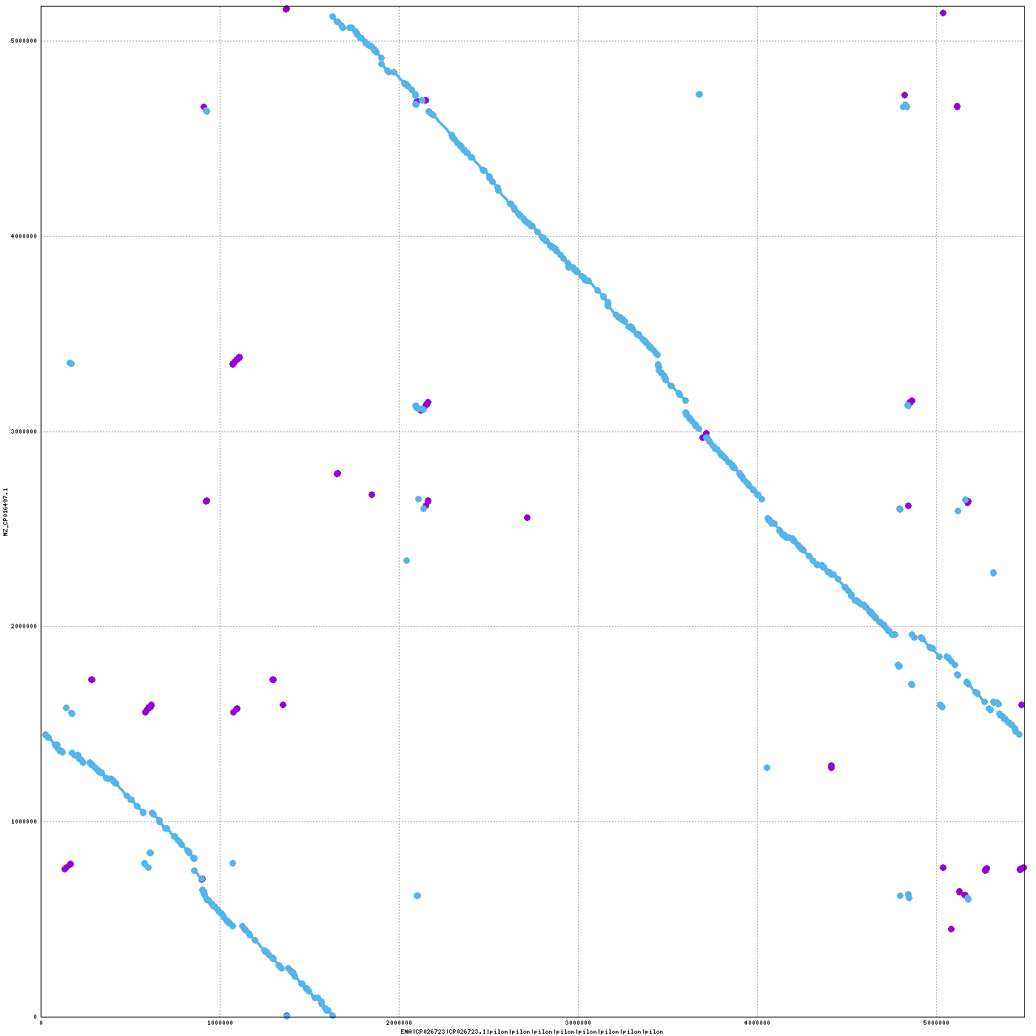
Now we compare this snippy ref
with the 4 samples:
ST38

Slide 9
The snippy ref seems to be way closer to all the assemblies than we expected?

Slide 10
Now we compare sample vs sample

Slide 11
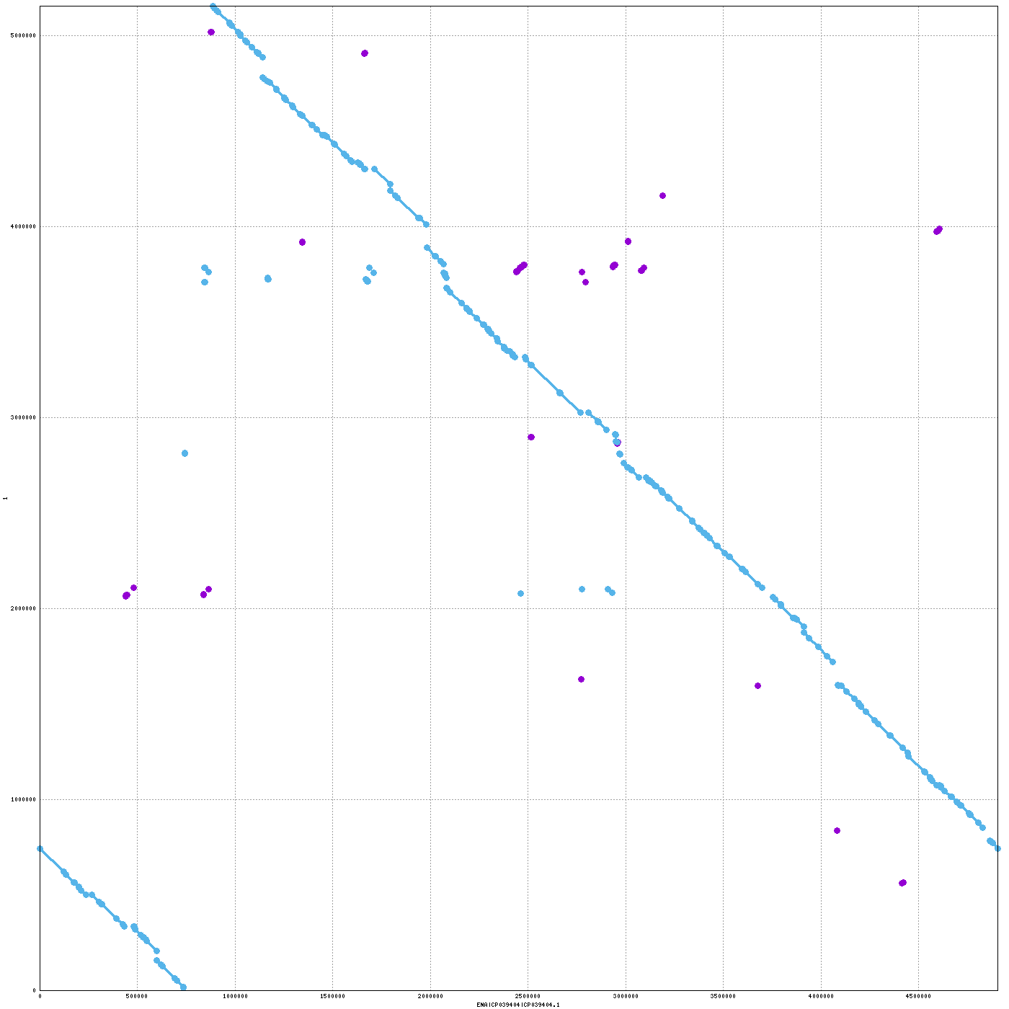
063_STEC vs CFT073

Slide 12
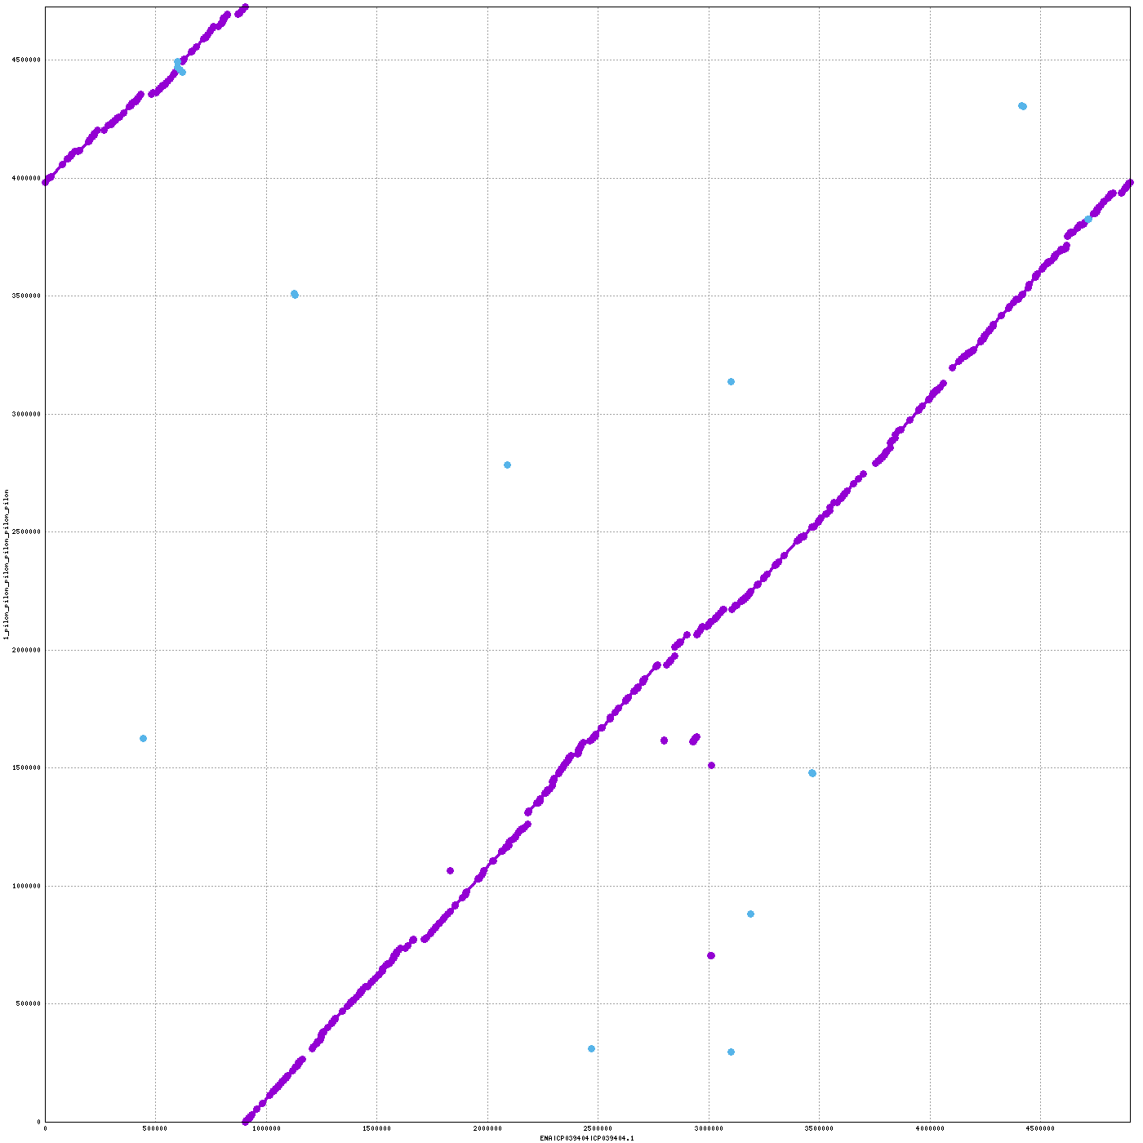
063_STEC vs H131800734

Slide 13
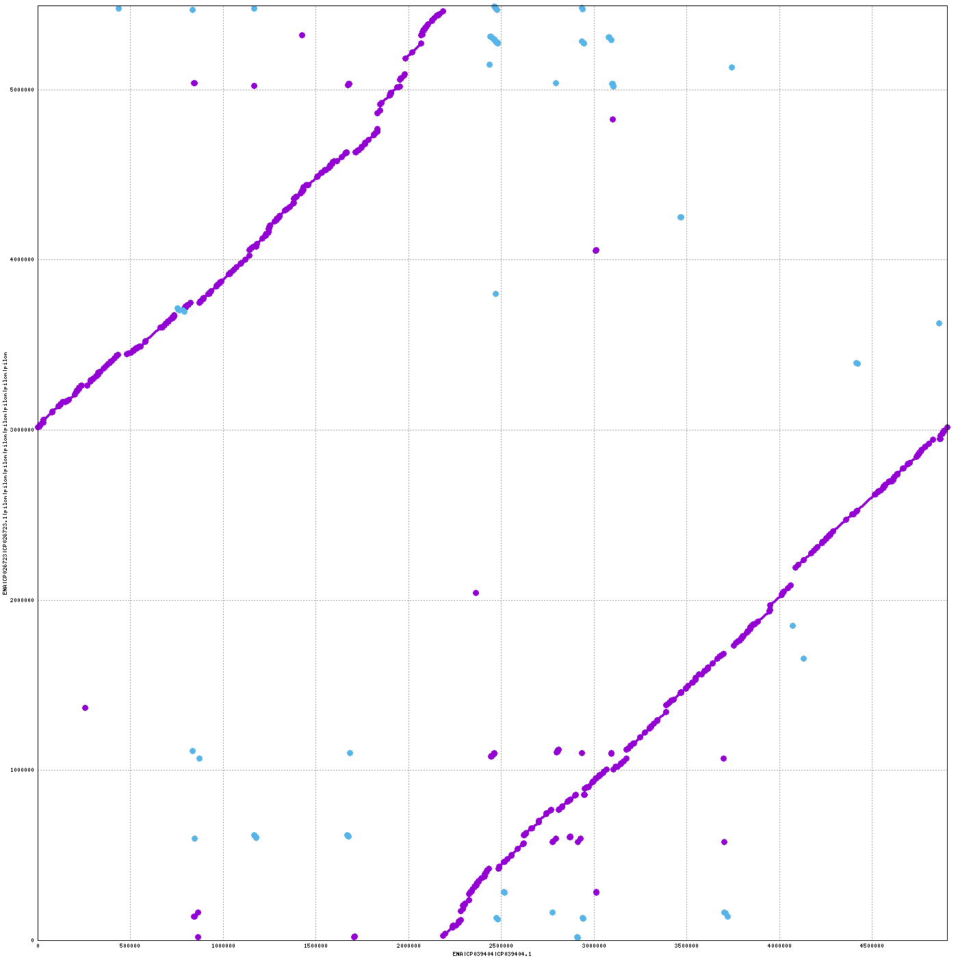
063_STEC vs ST38

Slide 14
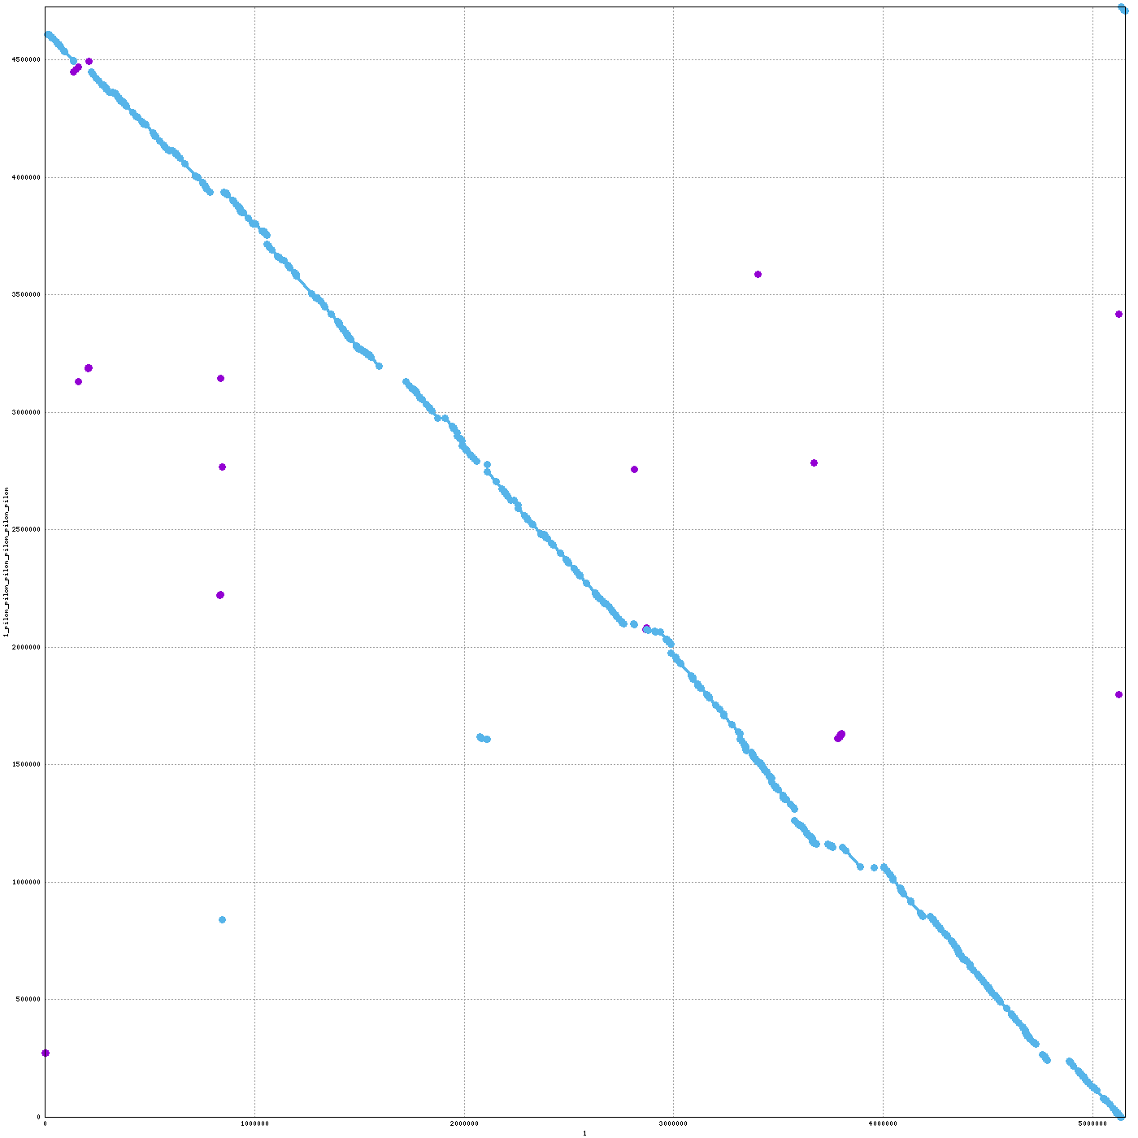
CFT073 vs H131800734

Slide 15
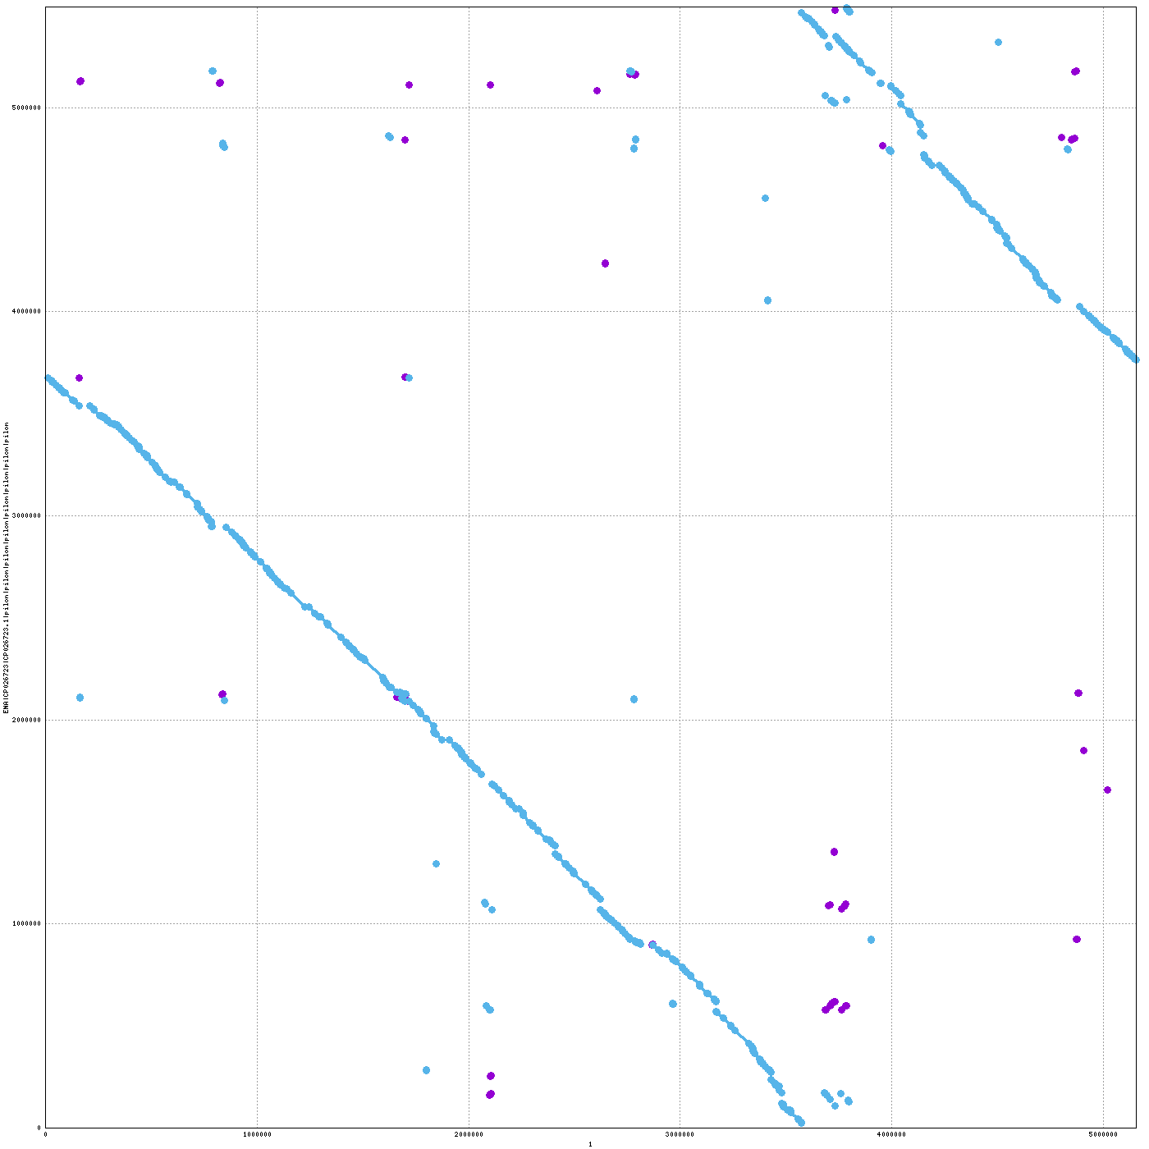
CFT073 vs ST38

Slide 16
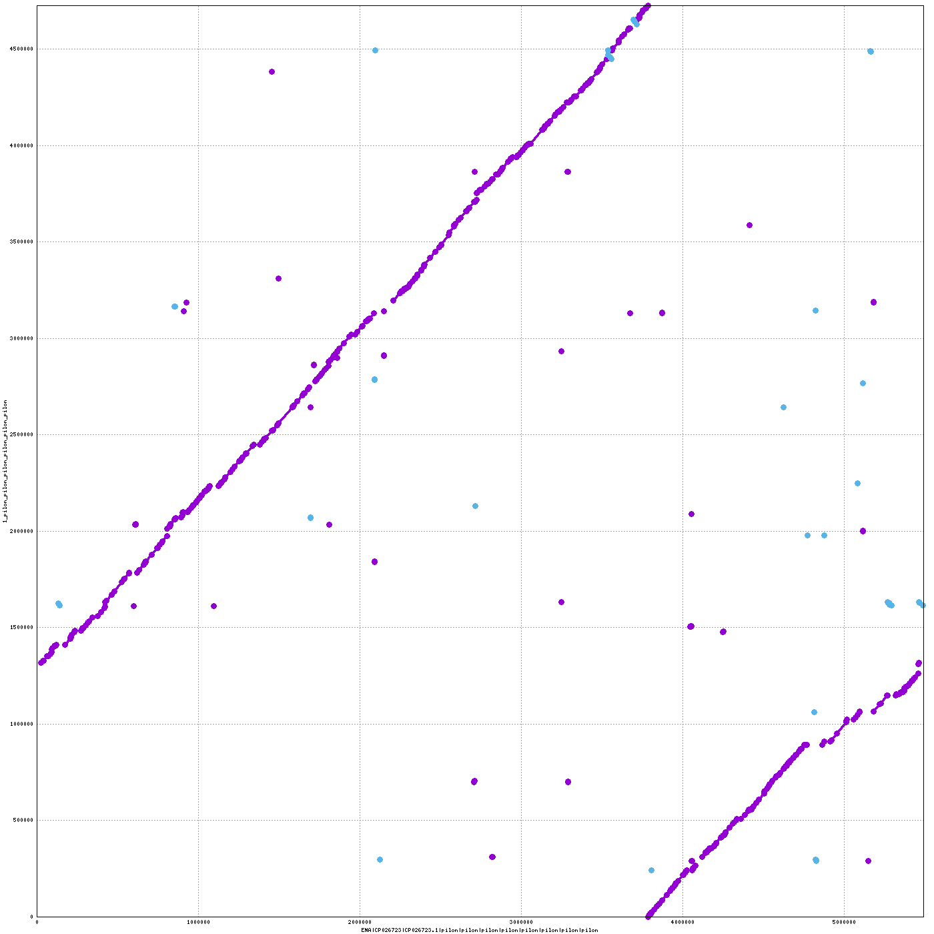
H131800734 vs ST38

Slide 17
A table to summarize the identity between the genomes (% of aligned bases aligned of query (rows) to ref (columns)):
 | Best snippy | 063_STEC | CFT073 | H131800734 | ST38
Best snippy | N/A | 88.3% | 95.1% | 82.2% | 78.4%
063_STEC | 82.8% | N/A | 86.5% | 78.2% | 84.2%
CFT073 | 94.9% | 81.5% | N/A | 74.4% | 83%
H131800734 | 75.3% | 81.4% | 81.9% | N/A | 87.6%
ST38 | 82.6% | 74.9% | 78.4% | 74.8% | N/A
>90% makes sense since best snippy and CFT073 are in the same phylogroup

