Slide 1
database driven image map
Web technology 344 final project

Slide 2
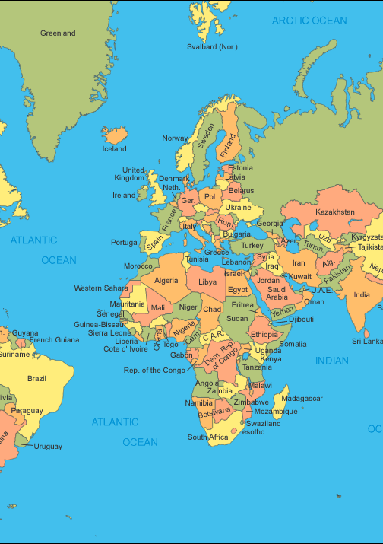
image map allows for graphical representation and selection of related data
Motivation
Situations in which image maps may be useful:
Selecting Geographical Data
Selecting Areas of Interest in Art Work
Highlighting Areas on Interest in Photograph

Slide 3
The app does the following:
Description
Saves, Finds, loads, and displays country info from a remote mongodb database based on a user entered query.
Displays images related to country of query from flickr.
User can go forward and back while viewing flickr images.
Next/previous images are stateful.

Slide 4
Some more information:
Description
The project skeleton was derived from the express-generator module.
The country.html file is the point of entry. The events generated by the country.html file are handled by the country.js file. The country.js file then uses utility methods provided by the other javascript files to process the query events for both image and database. The express server is described by the server.js and www javascript files.
Selecting country info and images can be done three ways:
clicking selectable area in world map.
clicking button with country name.
entering country name into input field.

Slide 5
The app can be launched in two ways:
description
Opening it as a netbeans project and running it .
Running it directly from the command line as a nodejs app by typing the following in in the main project directory:
node bin/www

Slide 6
project technologies
implementation
Database: Mongodb
Server-side: Nodejs, Express, Mongoosejs
Client-side: jQuery, Angularjs, Bootstrap, css, html

