Slide 1


Spring framework
Introduction
Date:
Place:
Trainer:
11.11.2019
Split
Dalibor Starčević, Mladen Banović
Notes:
Achtung, nach dem Importieren eines neuen Motives das Bild in den Hintergrund positionieren. Die mintgrüne Ecke, der mintgrüne Text, sowie das weiße Logo wurden nachträglich auf das Titelchart kopiert.

Slide 2
Topics
Introduction
Spring History
What is Spring ?
Why Spring ?
Spring architecture

Slide 3

Spring History
Introduction
Started 2002/2003 by Rod Johnson and Juergen Holler
Started as a framework developed around Rod Johnson’s book Expert One-on-One J2EE Design and Development
Spring 1.0 Released March 2004
...
Spring 3.0 Released Nov 2009
…
Spring 5.0 Released Sep 2017

Slide 4
What is Spring
Introduction
Spring Framework is an open source light-weight application framework that aims to make J2EE development easier
Spring aims to help develop whole applications in a consistent and productive manner
Used for building Java SE & Java EE applications

Slide 5
What is Spring – Key Features
Introduction
JavaBeans-based configuration management, applying Inversion-of-Control principles, specifically using the Dependency Injection technique.
A core bean factory, which is usable globally
Generic abstraction layer for database transaction management
Built-in generic strategies for JTA and a single JDBC DataSource

Slide 6
What is Spring – Key Features ..
Introduction
Integration with persistence frameworks Hibernate, JDO, iBATIS, JPA
MVC web application framework, built on core Spring functionality, supporting many technologies for generating views, including JSP, FreeMarker, Velocity, Tiles, iText, and POI
Extensive aspect-oriented programming (AOP)

Slide 7
Why Spring
Introduction
Problems with Traditional Approach to J2EE ...
The EJB component model is complex
EJB is designed for distributed, transactional applications. While all non-trivial applications are transactional, distribution should not be built into basic component model
J2EE applications are hard to unit test

Slide 8
Why Spring ..
Introduction
Responses to problems was tool support to catch up with J2EE specifications, e.g code generations tools
Spring aims to take away problems, by simplifying the programming model, rather than concealing complexity behind the complex layer of the tools
The essence of the Spring is in providing enterprise services to Plain Old Java Object (POJOs). This is valuable in a J2EE environment, but application code delivered as POJOs is naturally reusable in variety or runtime environments

Slide 9
Why Spring ..
Introduction
Wiring of components through Dependency Injection
Design to interfaces
Test-Driven Development (TDD)
POJO classes can be tested without being tied up with the framework
Declarative programming through AOP
Integration with other technologies
EJB for J2EE
Hibernate, iBatis, JDBC (for data access)
Velocity (for presentation)
Struts and WebWork (For web)

Slide 10
Overview of the Spring Framework
Introduction
Inversion of Control container
Dependency Injection
Aspect-Oriented Programming(AOP) framework
Data Access abstraction
JDBC simplification
Transaction Management
MVC web framework
Simplification for working with JNDI, JTA
Lightweight remoting
JMS support
Support for testing

Slide 11
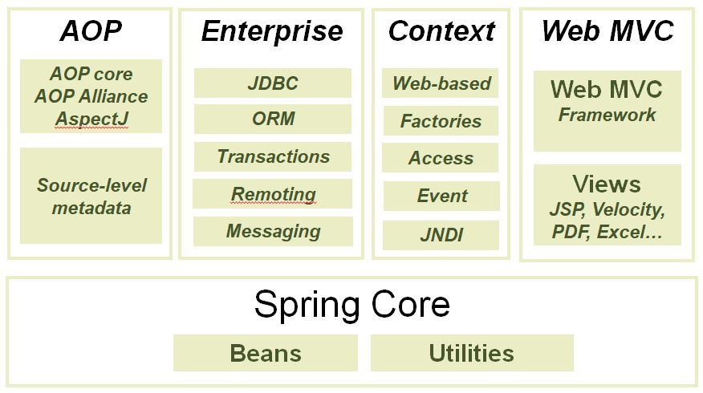
Overview of the Spring Framework
Introduction

Slide 12
Overview of the Spring Framework – Core package
Introduction
Core package is the most fundamental part of the framework and provides the IoC and Dependency Injection features
The basic concept here is the BeanFactory, which provides a sophisticated implementation of the factory pattern which removes the need for programmatic singletons and allows you to decouple the configuration and specification of dependencies from your actual program logic

Slide 13
Overview of the Spring Framework – DAO package
Introduction
The DAO package provides a JDBC-abstraction layer that removes the need to do tedious JDBC coding and parsing of database-vendor specific error codes
The JDBC package provides a way to do programmatic as well as declarative transaction management, not only for classes implementing special interfaces, but for all your POJOs (plain old Java objects)

Slide 14
Overview of the Spring Framework – ORM package
Introduction
The ORM package provides integration layers for popular object-relational mapping APIs, including JPA, JDO, Hibernate, and iBatis.
Using the ORM package you can use all those O/R-mappers in combination with all the other features Spring offers, such as the simple declarative transaction management feature mentioned previously

Slide 15
Overview of the Spring Framework – AOP package
Introduction
Spring's AOP package provides an AOP Alliance-compliant aspect-oriented programming implementation allowing you to define, for example, method-interceptors and pointcuts to cleanly decouple code implementing functionality that should logically speaking be separated
Using source-level metadata functionality you can also incorporate all kinds of behavioral information into your code

Slide 16
Overview of the Spring Framework – MVC package
Introduction
Spring's MVC package provides a Model-View-Controller (MVC) implementation for web applications
Spring's MVC framework is not just any old implementation; it provides a clean separation between domain model code and web forms, and allows you to use all the other features of the Spring Framework.

Slide 17
Thank you.
Dalibor Starčević
Managing director
E-Mail: dalibor.starcevic@maurer-electronics.hr
Telefon: + 385 21 274 131
Mladen Banović
Senior software developer
E-Mail: mladen.banovic@maurer-electronics.hr
Telefon: + 385 21 274 734

