Slide 1


Spring framework
Dependency Injection Advanced
Date:
Place:
Trainer:
09/27/2020
Split
Dalibor Starčević, Mladen Banović
09/27/2020
Spring framework
1
Notes:
Achtung, nach dem Importieren eines neuen Motives das Bild in den Hintergrund positionieren. Die mintgrüne Ecke, der mintgrüne Text, sowie das weiße Logo wurden nachträglich auf das Titelchart kopiert.
<number>

Slide 2

Dependency Injection advanced
Topics
Dependency Injection (DI) Advanced
Bean Life Cycle Management
ApplicationContext
Life-cycle Interfaces
Propagating Events
Events
Internationalization
Resources
ApplicationContext Instance
PropertyPlaceholderConfigurer
Checking for Dependencies
09/27/2020
Spring framework
1

Slide 3
Dependency Injection advanced
Bean Life Cycle Management
Beans can be constructed on a way that they receive notifications at certain points in their life cycles
Enables your beans to perform relevant processing at certain points throughout their lives
Two life cycle events
postinitialization
predestruction
09/27/2020
Spring framework
1

Slide 4
Dependency Injection advanced
Bean Life Cycle Management ..
postinitialization
After setting property values and after finising dependency checks
predestruction
before Spring destroys the bean instance
Works only with singletons
09/27/2020
Spring framework
1

Slide 5
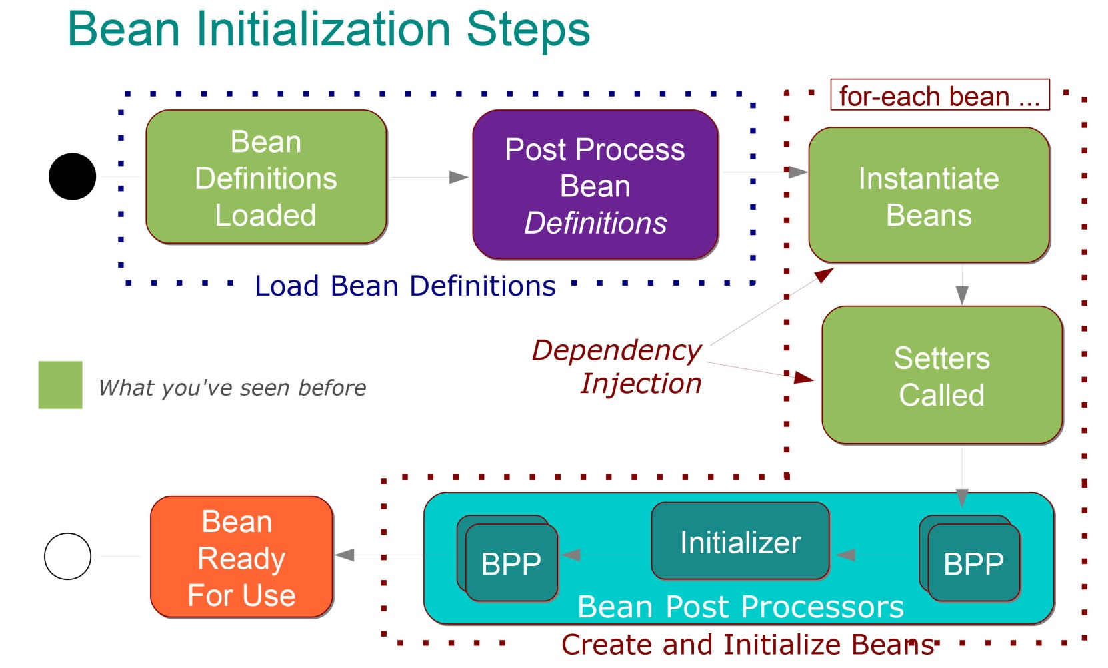
Dependency Injection advanced
Bean Life Cycle Management ..
09/27/2020
Spring framework
1

Slide 6
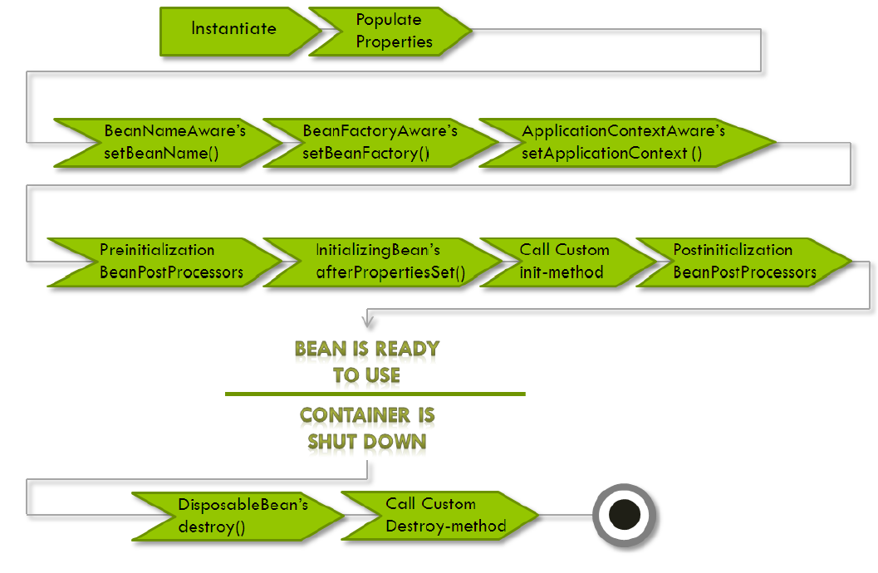
Dependency Injection advanced
Bean Life Cycle Management ..
09/27/2020
Spring framework
1

Slide 7
Dependency Injection advanced
Bean Life Cycle Management ..
Implementing InitializingBean Interface
<bean id="simpleIB1" class="beanlifecycle.SimpleBeanIB" />
public class SimpleBeanIB implements InitializingBean {
...
public void afterPropertiesSet() {...}
...
}
09/27/2020
Spring framework
1

Slide 8
Dependency Injection advanced
Bean Life Cycle Management ..
Executing a Method When a Bean Is Destroyed
<bean id="simple1" class="beanlifecycle.SimpleBean"
destroy-method="destroy” />
09/27/2020
Spring framework
1

Slide 9
Dependency Injection advanced
Bean Life Cycle Management ..
Implementing the DisposableBean Interface
<bean id="simpleIB1" class="beanlifecycle.SimpleBeanIB" />
public class SimpleBeanIB implements DisposableBean {
...
public void destroy() ... {...}
...
}
09/27/2020
Spring framework
1

Slide 10
Dependency Injection advanced
Bean Life Cycle Management ..
Making Your Beans Spring Aware
BeanNameAware
BeanFactoryAware
public class LoggingBean implements BeanNameAware {
public void setBeanName(String name) {...}
}
public class ShutdownHookBean implements BeanFactoryAware {
public void setBeanFactory(BeanFactory) {...}
}
09/27/2020
Spring framework
1

Slide 11
Dependency Injection advanced
Bean Life Cycle Management ..
BeanFactoryPostProcessor
executes after Spring has finished constructing the BeanFactory
before the BeanFactory constructs the beans
public class MyBeanFactoryPostProcessor implements BeanFactoryPostProcessor {
public void postProcessBeanFactory(ConfigurableListableBeanFactory arg0) throws BeansException {
...
}
}
09/27/2020
Spring framework
1

Slide 12
Dependency Injection advanced
Bean Life Cycle Management ..
JavaBean PropertyEditors
converts a property’s value to and from its native type representation into a String
Built-in PropertyEditors
ByteArrayPropertyEditor
ClassEditor
CustomBooleanEditor
...
Custom PropertyEditors
09/27/2020
Spring framework
1

Slide 13
Dependency Injection advanced
Bean Life Cycle Management ..
BeanPostProcessor
need to perform some additional processing immediately before and after Spring instantiates the bean
BeanPostProcessor
postProcessBeforeInitialization
postProcessAfterInitialization
09/27/2020
Spring framework
1

Slide 14
Dependency Injection advanced
ApplicationContext
What is ApplicationContext?
Extension of BeanFactory interface
It provides all the same functionality and more
Supports an infrastructure to enable lots of enterprise-specific features such as transactions and AOP
Used in a more framework-oriented style by using layering and hierarchical contexts providing extra features over BeanFactory
09/27/2020
Spring framework
1

Slide 15
Dependency Injection advanced
ApplicationContext ..
Features of the ApplicationContext?
Add new features over BeanFactory
Additional life-cycle interfaces
Event propagation to beans implementing the ApplicationListener interface
MessageSource, providing access to messages in, i18n-style
Access to resources, such as URLs and files
Loading of multiple (hierarchical) contexts, allowing each to be focused on one particular layer, for example the web layer of an application
09/27/2020
Spring framework
1

Slide 16
Dependency Injection advanced
ApplicationContext ..
When to use ApplicationContext?
Use ApplicationContext over BeanFactory to take advantage of its extended functionality
Except for a few limited situations such as perhaps in an Applet, where memory consumption might be critical
09/27/2020
Spring framework
1

Slide 17
Dependency Injection advanced
ApplicationContext ..
How to use ApplicationContext?
Many users will use ApplicationContext in a completely declarative fashion, not even having to create it manually, but instead relying on support classes such as ContextLoader to automatically start an ApplicationContext as part of the normal startup process of a J2EE webapp
it is still possible to programmatically create an ApplicationContext
09/27/2020
Spring framework
1

Slide 18
Dependency Injection advanced
Life-cycle Interfaces
Life-cycle Interfaces
ApplicationContextAware interface
A bean which implements this interface will be called back on creation of the bean, using the interface's setApplicationContext() method, and provided with a reference to the context, which may be stored for later interaction with the context
09/27/2020
Spring framework
1

Slide 19
Dependency Injection advanced
Life-cycle Interfaces ..
Example: ApplicationContextAware
public class ContextAwareDemo implements ApplicationContextAware {
private ApplicationContext ctx;
public void setApplicationContext(ApplicationContext applicationContext)
throws BeansException {
this.ctx = applicationContext;
}
// Code that uses ApplicationContext
...
}
09/27/2020
Spring framework
1

Slide 20
Dependency Injection advanced
Propagating Events
Propagating Events
Event handling in the ApplicationContext is provided through the ApplicationEvent class and ApplicationListener interface
If a bean which implements the ApplicationListener interface is deployed into the context, every time an ApplicationEvent gets published to the ApplicationContext, that bean will be notified
Essentially, this is the standard Observer design pattern
09/27/2020
Spring framework
1

Slide 21
Dependency Injection advanced
Events
Three Built-in Events
ContextRefreshEvent
ApplicationContext is initialized or refreshed
ContextClosedEvent
ApplicationContext is closed
RequestHandleEvent
A web-specific event telling all beans that a HTTPrequest has been serviced
09/27/2020
Spring framework
1

Slide 22
Dependency Injection advanced
Events ..
Example: Event Handling
<bean id="publisher" class="event.EventPublisherDemo” />
<bean class="event.MessageEventListener” />
09/27/2020
Spring framework
1

Slide 23
Dependency Injection advanced
Events ..
Example: Event Handling
public class EventPublisherDemo implements ApplicationContextAware {
private ApplicationContext ctx;
public void setApplicationContext(ApplicationContext ctx) {
this.ctx = ctx;
}
public void publish(String message) {
MessageEvent evt = new MessegeEvent(message);
ctx.publishEvent(evt);
return;
}
}
09/27/2020
Spring framework
1

Slide 24
Dependency Injection advanced
Events ..
Example: Event Handling
public class MessageEventListener implement ApplicationListener {
public void onApplicationEvent(ApplicationEvent evt) {
...
}
...
}
09/27/2020
Spring framework
1

Slide 25
Dependency Injection advanced
Internationalization
Internationalization: MessageSource
ResourceBundleMessageSource is an implementation of MessageSource interface
The example below assumes you have three resource bundles defined on your classpath called format, exceptions and windows
09/27/2020
Spring framework
1

Slide 26
Dependency Injection advanced
Internationalization ..
Internationalization: MessageSource
<beans>
<bean id="messageSource”
class="org.springframework.context.support.ResourceBundleMessageSource">
<property name="basenames">
<list>
<value>format</value>
<value>exceptions</value>
<value>windows</value>
</list>
</property>
</bean>
</beans>
09/27/2020
Spring framework
1

Slide 27
Dependency Injection advanced
Resources
Getting Resources
Resource x = contextObject.getResource(String location);
Returns a Resource handle for the specified resource
getClass()
getURL()
Supported formats
fully qualified URLs, e.g. "file:C:/test.dat".
classpath pseudo-URLs, e.g. "classpath:test.dat".
relative file paths, e.g. "WEB-INF/test.dat".
09/27/2020
Spring framework
1

Slide 28
Dependency Injection advanced
Resources ..
Example: Getting a Resources
ApplicationContext ctx =
new FileSystemXmlApplicationContext("./events/events.xml");
Resource res1 = ctx.getResource("test.txt");
Resource res2 = ctx.getResource("classpath:log4j.properties");
Resource res3 = ctx.getResource("http://www.google.co.uk");
09/27/2020
Spring framework
1

Slide 29
Dependency Injection advanced
ApplicationContext Instance
ApplicationContext Instance
As opposed to the BeanFactory, which will often be created programmatically, ApplicationContext instances can be created declaratively using for example a ContextLoader
The listener inspects the contextConfigLocation parameter. If it doesn't exist, it'll use /WEB-INF/applicationContext.xml as a default
09/27/2020
Spring framework
1

Slide 30
Dependency Injection advanced
ApplicationContext Instance ..
ApplicationContext Instance
<context-param>
<param-name>contextConfigLocation</param-name>
<param-value>/WEB-INF/daoContext.xml /WEBINF/applicationContext.xml</param-value>
</context-param>
<listener>
<listener-class>org.springframework.web.context.ContextLoaderListener</listenerclass>
</listener>
09/27/2020
Spring framework
1

Slide 31
Dependency Injection advanced
PropertyPlaceholderConfigurer
PropertyPlaceholderConfigurer
Used to externalize property values from a BeanFactory definition, into another separate file in the standard Java Properties format
Useful to allow the person deploying an application to customize enviroment-specific properties (for example database URLs, usernames and passwords), without the complexity or risk of modifying the main XML definition file or files for the container
09/27/2020
Spring framework
1

Slide 32
Dependency Injection advanced
PropertyPlaceholderConfigurer ..
PropertyPlaceholderConfigurer
<!-- Configurer that replaces ${...} placeholders with values from a properties file -->
<!-- (in this case, JDBC-related settings for the dataSource definition below) -->
<bean id="propertyConfigurer"class=
"org.springframework.beans.factory.config.PropertyPlaceholderConfigurer">
<property name="location" value="/WEB-INF/jdbc.properties"/>
</bean>
09/27/2020
Spring framework
1

Slide 33
Dependency Injection advanced
PropertyPlaceholderConfigurer ..
jdbc.properties
jdbc.driverClassName=org.hsqldb.jdbcDriver
jdbc.url=jdbc:hsqldb:hsql://localhost:9001
jdbc.username=sa
jdbc.password=
09/27/2020
Spring framework
1

Slide 34
Dependency Injection advanced
Checking for Dependencies
Checking for Dependencies
Used to check for the existence of unresolved dependencies of a bean deployed into the container
These are JavaBeans properties of the bean, which do not have actual values set for them in the bean definition, or alternately provided automatically by the autowiring feature
This feature is sometimes useful when you want to ensure that all properties (or all properties of a certain type) are set on a bean.
Can also be enabled and disabled per bean
09/27/2020
Spring framework
1

Slide 35
Dependency Injection advanced
Dependency Checking
Dependency Checking Modes
none – no dependency checking
simple – dependency checking is performed for primitive types and collections (everything except collaborators)
object – dependency checking is performed for collaborators only
all – dependency checking is done for collaborators, primitive types and collections
09/27/2020
Spring framework
1

Slide 36
Dalibor Starčević
Managing director
E-Mail: dalibor.starcevic@maurer-electronics.hr
Telefon: + 385 21 274 131
Mladen Banović
Senior software developer
E-Mail: mladen.banovic@maurer-electronics.hr
Telefon: + 385 21 274 734
Thank you.
09/27/2020
Spring framework
1
Notes:
<number>

