Slide 1

Box Office Blockbusters:
Analyzing Top Film Trends for Microsoft's New Movie Studio

Slide 2
Overview
Business Problem: Microsoft wants to create a new movie studio but lacks knowledge of the film industry. They want to explore the current trends and successful movie genres to make informed decisions about what types of films they should create.
The following procedure has been applied in solving the business problem:
Research and analyzing the current movie trends: Research on the current movie trends and successful genres that are performing well at the box office. The research helps identify which genres are popular among audiences and which genres are profitable for the film industry. The use of data analytics has been applied in identifying movie trends, analyzing audience behavior, and predicting movie success.

Slide 3
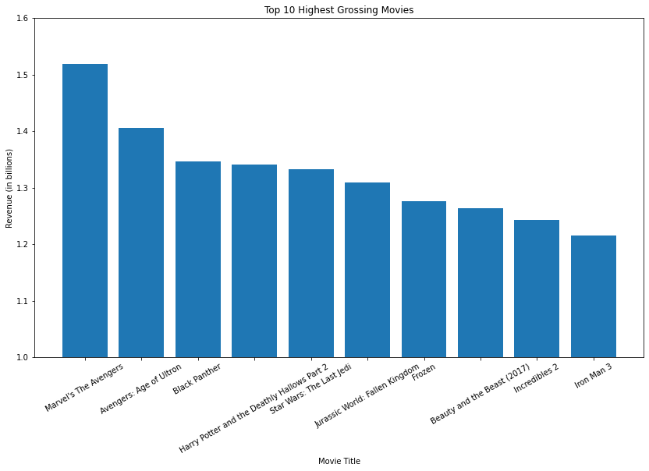
TOP 10 HIGHEST GROSSING MOVIES

Slide 4
Top 10 Highest Grossing Movies and their Genres
Marvel's The Avengers (2012) - Action/Adventure/Sci-Fi
Avengers: Age of Ultron (2015) - Action/Adventure/Sci-Fi
Black Panther (2018) - Action/Adventure/Sci-Fi
Harry Potter and the Deathly Hallows Part 2 (2011) - Fantasy/Adventure
Star Wars: The Last Jedi (2017) - Action/Adventure/Sci-Fi
Jurassic World: Fallen Kingdom (2018) - Action/Adventure/Sci-Fi
Frozen (2013) - Animation/Fantasy/Musical
Beauty and the Beast (2017) - Fantasy/Musical/Romance
Incredibles 2 (2018) - Animation/Action/Adventure
Iron Man 3 (2013) - Action/Sci-Fi
The top selling movies majorly belong in the Action|Adventure|Sci-Fi, Animation|Fantasy genres.

Slide 5
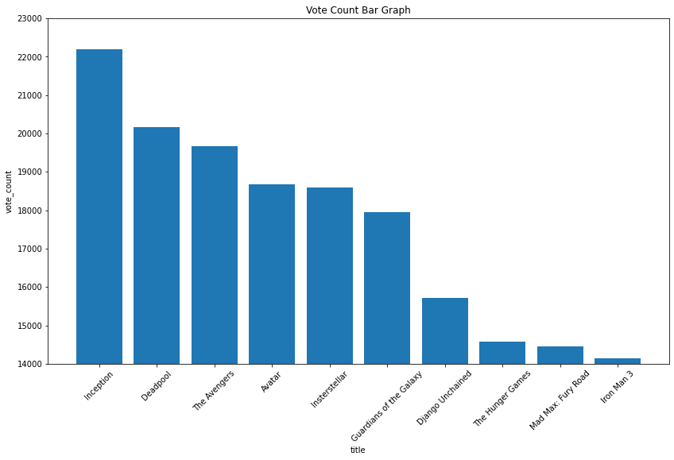
Top 10 Most Popular Movies

Slide 6
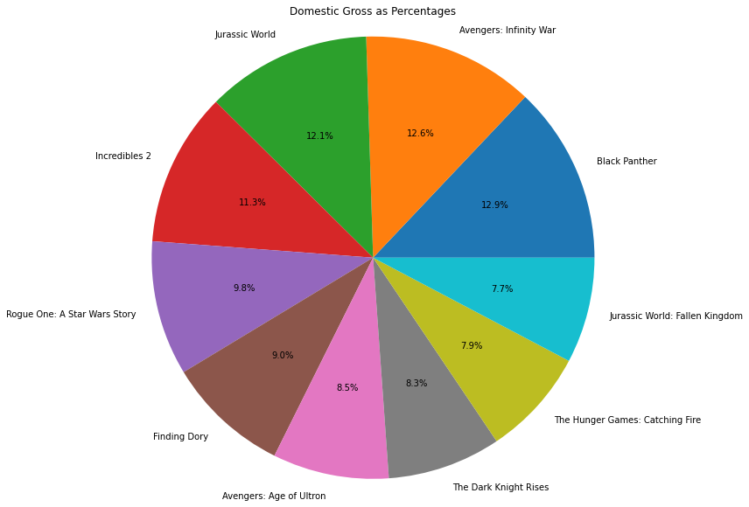
Action|Adventure|Sci-Fi|Animation movies as percentages of the Domestic Gross of the Top 10 movies

Slide 7
Range of runtime minutes for the top selling genres
Genre | Runtime
Action and Adventure|Classics|Drama | 104 minutes
Drama|Science Fiction and Fantasy | 108 minutes
Action and Adventure|Mystery and Suspense | 108 minutes
Action and Adventure|Comedy|Drama | 98 minutes
Action and Adventure | 115 minutes
Action and Adventure|Classics|Drama | 165 minutes
Action and Adventure|Science Fiction and Fantasy | 101 minutes

Slide 8
Recommendations
After Analysis on the datasets from the box office, these are my recommendations:
1. Focus on the following genre of movies:
Action|Adventure|Sc-Fi
Fantasy|Adventure
Animation|Fantasy
Romance
This are the highest grossing genres based on foreign + domestic gross.
They are also the most popular genres based on vote count.
2. Maximize profits by priotizing using Animation in production since they require a low budget and sell more as it’s among the most popular genres.
3. The runtime minutes for the movies should range between 100 – 130 minutes. This is the range for the most popular genres voted for by fans.

Slide 9
Conclusion
The prompt questions emerging from my presentation include:
Are there any emerging trends or niche markets that are ripe for exploration in the film industry?
How can Microsoft differentiate its films from those of established studios to stand out in the marketplace?
What strategies can Microsoft employ to effectively market its films and build buzz around new releases?

Slide 10
Presented by: Leo Kariuki Email : leokariuki98@gmail.com

Slide 11
THANK YOU

