Slide 1
Collaborative Filtering
GROUP 2
Qianli ZhU, Leo lam, ZHONGXING XUE，YIRAN JIANG, Qianhui WAN
Notes:
Hi, everyone!
Today, I am presenting our group's project 4 collaborative filtering algorithm
As we know, collaborative filtering has a significant value for marketing strategy. Since it will recommend some thing you may like, and increase the possibility for user to make a consumption.
Let's see how it works

Slide 2
Memory-based Algorithm | Similarity Weight | Spearman | BOTH
 |  | Vector Similarity | BOTH
 |  | SimRank | MS DATA
 | Variance Weighting | Yes
 |  | No | BOTH
 | Selecting Neighbors | Weight Threshold | BOTH
 |  | Best-n | BOTH
 |  | Combined | BOTH
Model-based Algorithm | Cluster Models |  | MOVIE DATA
Notes:
First, here is the requirement for our algorithm.
.

Slide 3

Memory-based Algorithm
Calculate Similarity Weight
Select Neighbors
Make a prediction
Notes:
Spearman Correlation: calculate the correlation based on the rank
Vector Similarity: treat two rows data as vectors, and calculate the value of cosine, which is geometric measure.
SimRank: is the graph-based algorithm, calculate the similarity between nodes(users/items) based on their common input/output nodes.
Select Neighbor: the meaning of selecting neighbors is trying to find the most efficient similar user for active user’s prediction

Slide 4
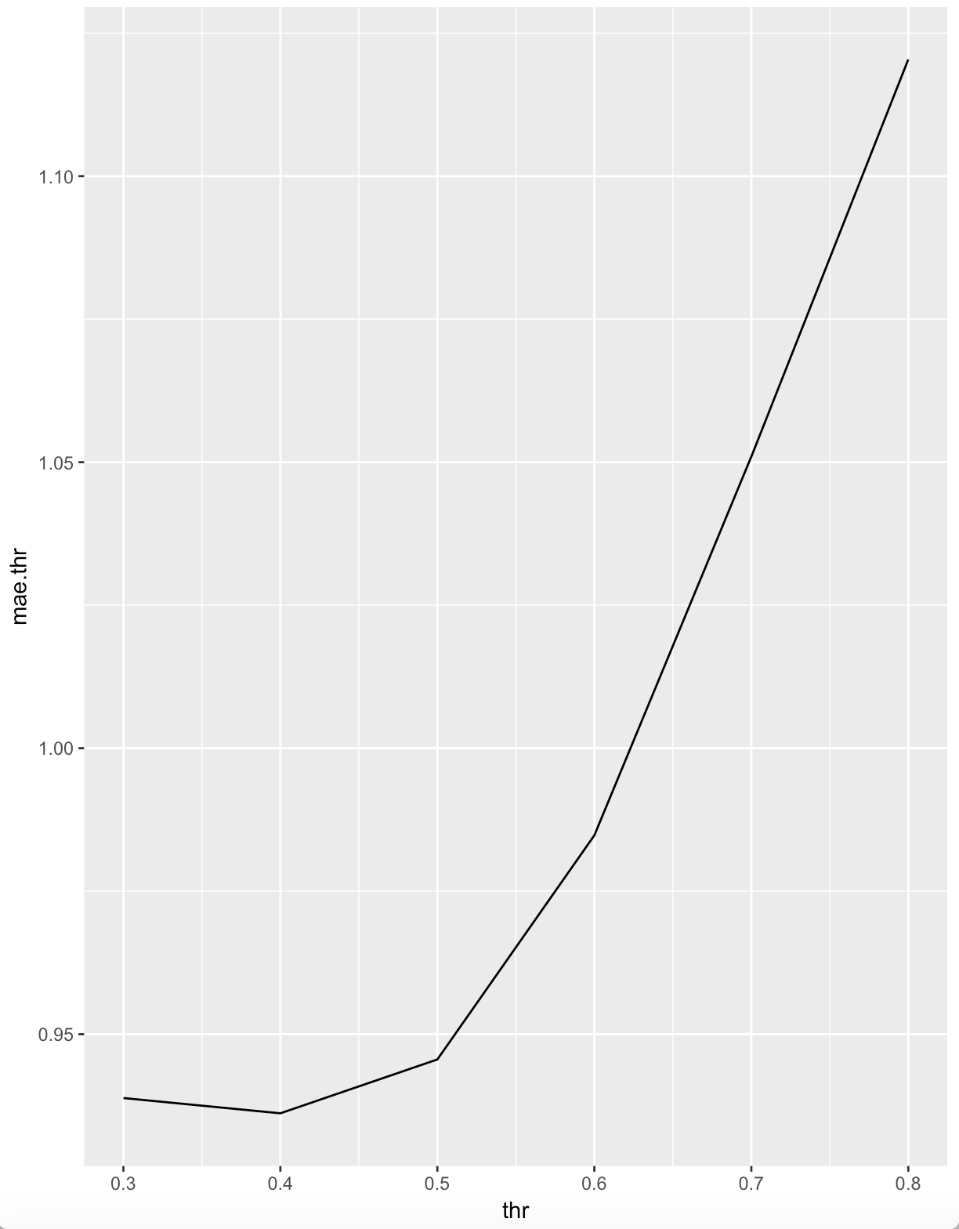
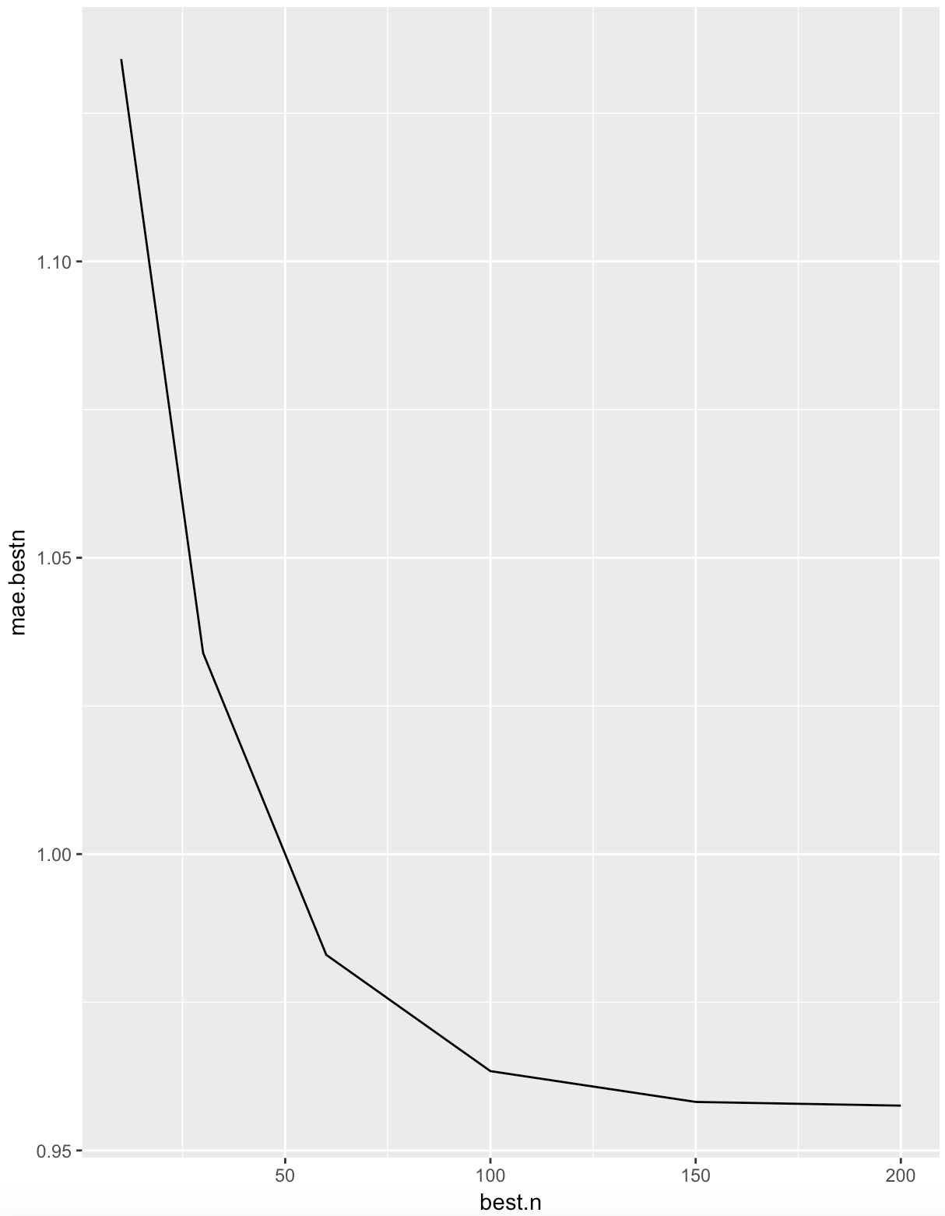
Evaluation: MEMORY-BASED
Movie Data | Method | MAE
Spearman Correlation | Threshold = 0.4 | 0.94
 | Best-n = 100 | 0.96
 | Combine: thres = 0.3, n = 100 | 0.98
Vector Similarity | Threshold = 0.5 | 0.93
 | Best-n = 200 | 0.92
 | Combine thres = 0.3, n = 100 | 0.97

Slide 5
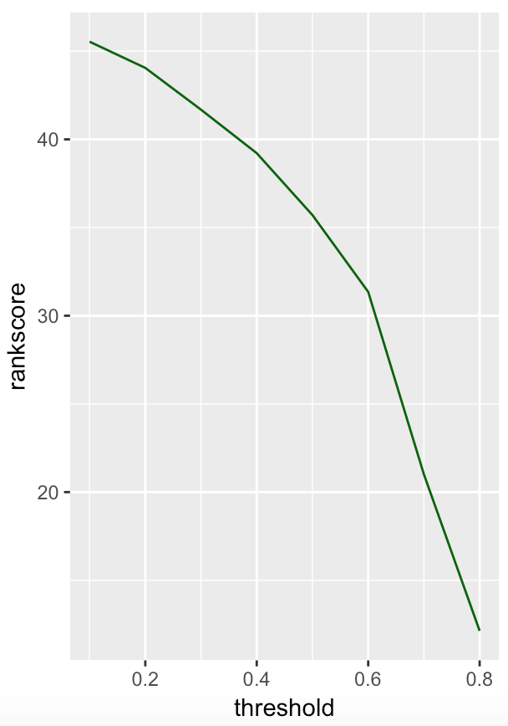
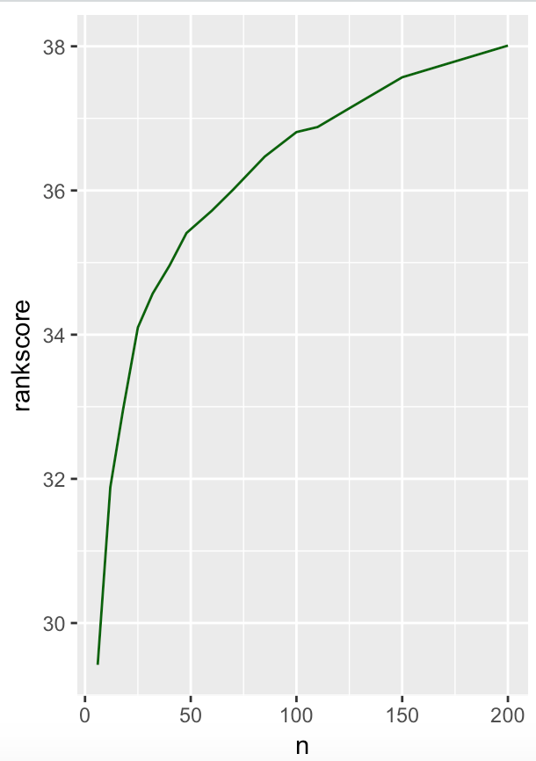
Evaluation: MEMORY-BASED
MS Data | Method | Rank Score
Spearman Correlation | Threshold = 0.1 | 45.53
 | Best-n = 200 | 38.09
 | Combine: thres = 0.1, n = 150 | 44.92
Vector Similarity | Threshold = 0.1 | 45.97
 | Best-n = 180 | 37.96
 | Combine: thres = 0.1, n = 200 | 45.91

Slide 6
Evaluation: MEMORY-BASED
MS DATA | Method | Rank Score
SimRank | Threshold = 0.01 | 45.65
 | Best-n = 150 | 37.37
 | Combine: thres = 0.05, n = 50 | 59.28

Slide 7
Model-based Algorithm
Step 1
Make Cluster Assumption
Step 2
Use EM Algorithm
Step 3
Make a prediction
1. Each cluster has same conditional distribution of score
2. Each cluster is independent
Expectation Step
Maximization Step
Using the MLE we got from step 2 to get expectation of score

Slide 8
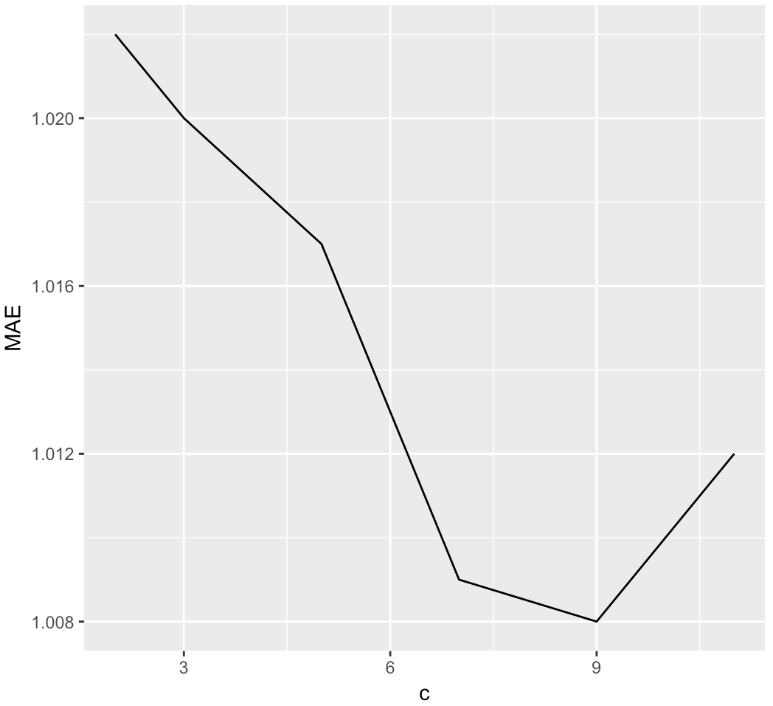
Evaluation: MODEL-BASED
MOVIE DATA
NUMBER OF CLUSTER | MAE
C = 2 | 1.022
C = 3 | 1.020
C = 5 | 1.017
C = 7 | 1.009
C = 9 | 1.008
C = 11 | 1.012
Approximately 90%train, 10%validation
For each C, we uniformly assigned 100 sets of initial parameters which satisfied the condition
In this way, we could find the parameter which is as close as possible to global max
TEST MAE USING C=9 | 1.0069

Slide 9
THANK YOU

