Slide 1
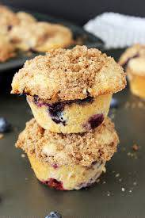
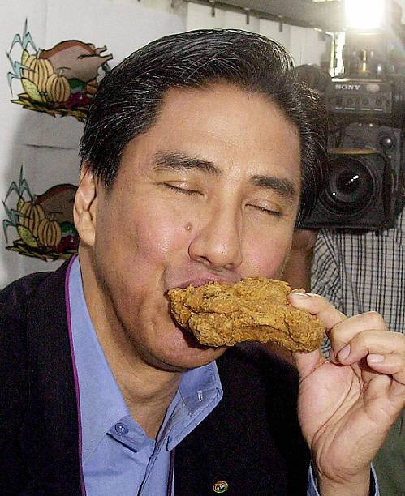
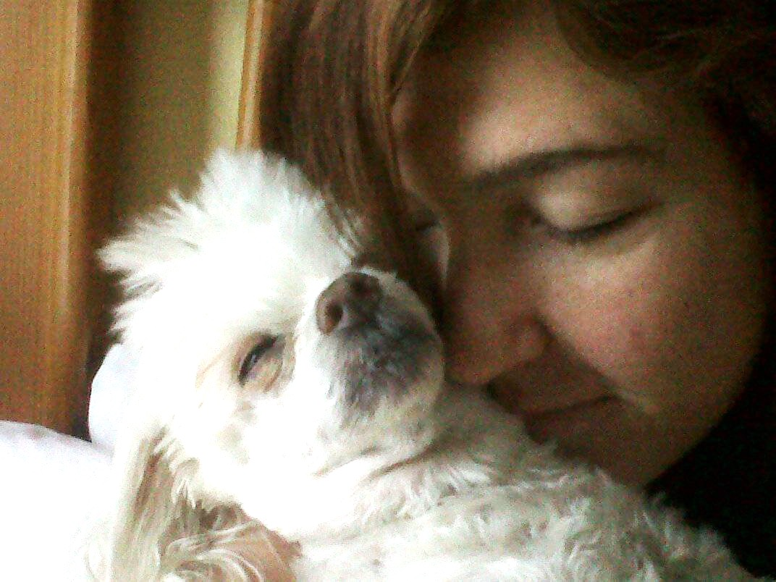
Image analysis: dogs, muffins, fried chicken
Group 5:
Leo Lam
Peifeng Hong
Shiyu Liu
Qianli Zhu
Sitong Chen

Slide 2
Business Goals
Goal:
A model that can be easily implemented and interpreted
Target:
Companies/individual users without strong foundation in machine learning and data science
Implementation:
Low computational cost with high accuracy using commonly used techniques

Slide 3
Classification
CLASSIFICATION
Logistic Regression
KNN
Decision Tree
Random Forest
SVM
GBM
XGBoost
Neural Network
Notes:
a more regularized model formalization that can prevent overfitting

Slide 4
Problem with neural network
Without significant numbers of supporting theories
High computational cost
Time consuming
Require large dataset

Slide 5
Feature extraction
LBP:
- Low computational cost
- Efficient in shape/boundary features
HOG:
- Sensitive to brightness and contrast
- Gradient orientation in localized part of image
RGB:
- Color analysis
SIFT:
- Less sensitive to brightness and contrast
- Detect and describe local features in images

Slide 6
Result
Accuracy | SVM | SVM RBF | RF | GBM | XGBoost | AVG
SIFT | 0.669 | 0.309 | 0.704 | 0.563 | 0.735 | 0.596
RGB | 0.729 | 0.769 | 0.867 | 0.858 | 0.901 | 0.825
LBP | 0.636 | 0.498 | 0.849 | 0.721 | 0.717 | 0.684
HOG | 0.735 | 0.313 | 0.804 | 0842 | 0.840 | 0.707
AVG | 0.692 | 0.472 | 0.806 | 0.746 | 0.798
TIME(S) | SVM | SVM RBF | RF | GBM | XGBoost | AVG
SIFT | 518 | 401 | 2306 | 67 | 248 | 708
RGB | 251 | 107 | 1147 | 76 | 173 | 351
LBP | 231 | 15 | 425 | 27 | 11 | 142
HOG | 212 | 123 | 2717 | 268 | 248 | 714
AVG | 303 | 162 | 1649 | 109 | 170

Slide 7
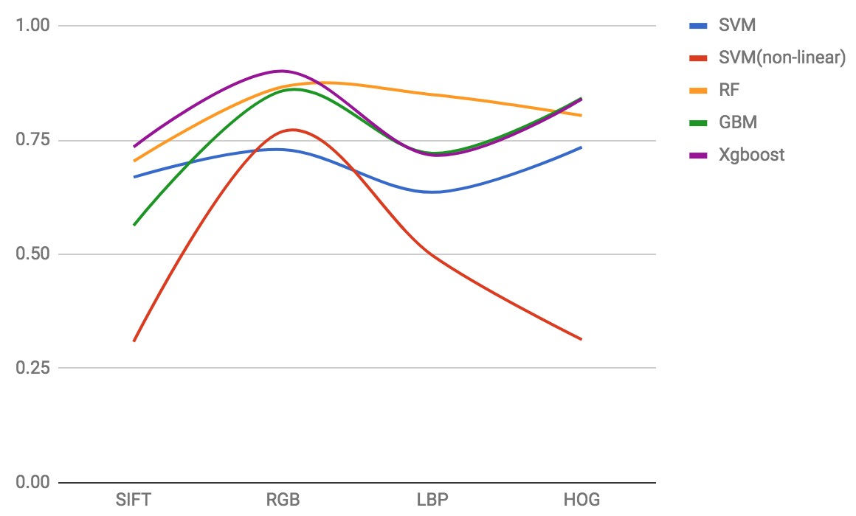
Compare and contrast

Slide 8
Compare and Contrast
 | Base Model | Our Model
Time | 67.43s | 173.11s
Accuracy | 56.3% | 90.1%
SIFT:
time consuming
similar structure / shape(similar feature point)
RGB:
better accuracy
color analysis (color feature)
Notes:
RGB: We analyze the Red, Green and Blue components of the images.
The blue component is a good differentiator between nuggets and dog, while the green component distinguishes muffin from nuggets and dog.
This is a key point for extracting RGB features.

Slide 9
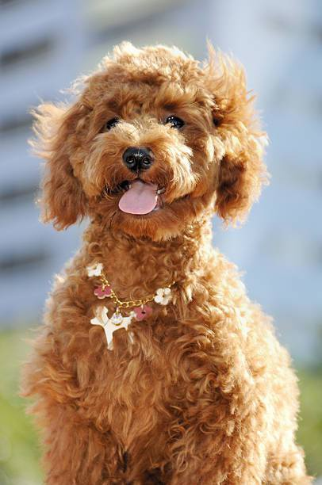
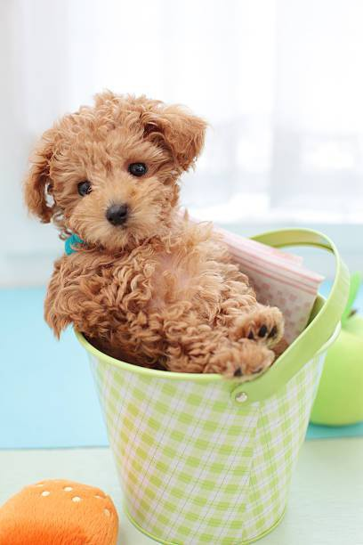
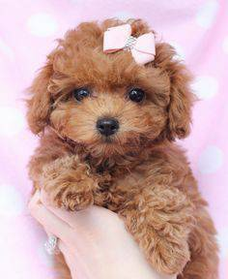
Q & A

