Slide 1

A Variational Approach for Learning from Positive and Unlabeled Data DSA5204 • Project
Group 12:
Liu Boyu (A0177847J)
Liu Yu (A0177906R)
Wang Zihong (A0230339L)
Wu Ruichi (A0177880N)
Zhu Xinji (A0177866H)
Ng Wei Xiang (A0155859L)

Slide 2
Contents
Introduction
VPU and Implementation
Baseline Models: nnPU and Raw NN
Results and Comparison
Limitation and Conclusion

Slide 3
Introduction

Slide 4
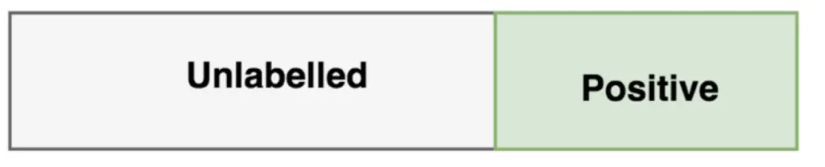
Background of PU learning
Positive - Unlabeled (PU) learning: Build a binary classification model from a number of positive data and plenty of unlabeled data without extra information on the negative data.
Applications examples:
disease gene identification: known disease genes and unknown genes
deceptive review detection
web data mining
…..
Notes:
In many real-life applications, we are facing the task of building a binary classification model from a number of positive data and plenty of unlabeled data without extra information on the
negative data. Such a task is certainly beyond the scope of the standard supervised machine learning, and where we have another method called positive-unlabeled (PU) learning come to deal with such situations.
There are many applications need to apply PU learning, For example, disease gene identification: where we only have known disease genes and unknown genes are available, as of reliable non-disease genes are difficult to obtain. So do some other applications also facing the similar positive-unlabeld situations.

Slide 5
Previous approaches of PU learning
Ranking Pruning (RP)
positive-negative learning problem with noisy labels
Assumption: Data separability
Risk estimator：
πP denotes the class prior, i.e., the proportion of positive data in the unlabeled data.
Classifier can be trained through minimization of the estimated risk when πP is known.
Limitations: easily severe overfitting
Notes:
There are many approaches were proposed by identifying reliable negative data from the unlabeled data, but all have their own limitations.
The rank pruning (RP) aim to solve PU learning as a specific positive-negative learning problem with noisy labels. The data separability is still necessary for the consistent noise estimation of this approach.
The risk estimator in PR promises an effective solution to PU learning, it can achieve an unbiased estimation of the expected misclassification risk
Data separability: positive and negative data are non-overlapping

Slide 6
Previous approaches of PU learning
Positive and Unlabeled learning with Label Disambiguation (PULD)
PU learning is formulated as a maximum margin classification problem for a given πP
Solved by efficient convex optimizers
Limitations: only applicable for linear classifiers in non-trainable feature spaces
Generative Adversarial Networks (GAN)
Generate fake positive and negative samples, and the classifier is trained by using the fake samples.
Improve the PU learning performance when the size of positive labeled data is extremely small
Limitations: The exact value of πP should be available.
Notes:
(PULD): We first regard all the unlabeled examples in PU learning as ambiguously labeled as positive and negative, and then employ the margin-based label disambiguation strategy, which enlarges the margin of classifier response between the most likely label and the less likely one, to find the unique ground-truth label of each unlabeled example. conduct intensive experiments on both benchmark and real-world datasets, and the results clearly demonstrate the superiority of the proposed PULD to the existing PU learning approaches.
GAN: Our generative positive-unlabeled (GenPU) framework incorporates an array of discriminators and generators that are endowed with different roles in simultaneously producing positive and negative realistic samples. We provide theoretical analysis to justify that, at equilibrium, GenPU is capable of recovering both positive and negative data distributions. Moreover, we show GenPU is generalizable and closely related to the semi-supervised classification

Slide 7
Problems of previous approaches
They all make use of class prior πP.
Limitations of class prior:
It cannot be automatically selected as a trainable parameter.
Difficult to adjust πP as a hyper-parameter by cross validation unless some negative data are available in the validation set.
The classification performance could be badly affected by an inaccurate estimate
Notes:
but it cannot be automatically selected as a trainable parameter. (As an example, when trying to minimize the risk defifined in (1) w.r.t. both πP and the classififier, we obtain a trivial
solution with πP = 1 and all data being predicted as positive ones).

Slide 8
A Variational approach for PU learning(VPU)
VPU: an accurate classifier in PU learning without solving class prior estimation problem.
Advantages:
VPU evaluates the difference between a given classifier and the ideal Bayesian classifier in a class prior-free manner by using only distributions of labeled and unlabeled data.
VPU can achieve high classification accuracies in PU learning tasks without the estimation of class prior or the assumption of data separability.
Notes:
VPU allows us to evaluate the difference between a given classififier and the ideal Bayesian classififier in a class prior-free manner by using only distributions of labeled and unlabeled data. As a consequence,
one can effificiently and consistently approximate Bayesian classififiers via variational optimization.

Slide 9
VPU

Slide 10


Assumptions
Assumption 1: features x ∈ R^{d} and class labels y ∈ {−1, +1}
Labeled and unlabeled data are independently drawn as:
Traditional selected completely at random assumption in PU learning.
Assumption 2:
There exists a set A ⊂ Rd satisfying and
Imply that a set of x are almost surely positive
Notes:
Here, Assumption 1 is the traditional selected completely at random (SCAR) assumption in PU learning. Assumption 2 implies that a set of x are almost surely positive, which is roughly satisfied in most practical cases and actually a strong variant of the irreducibility assumption in literature of mixture proportion estimation of PU data

Slide 11
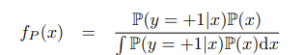


Variational Principle
A parametric model Φ of the Bayesian classifier Φ* is used to estimate the positive data distribution f_{P}
Using Bayes’ rule, f_{P}(x) can be expressed as
where P(y=+1|x) is the posterior probability of positive class given x and P(x) is the marginal probability of x
Approximate using Φ(x), the probability of x belonging to the positive class given by the parametric model Φ, f(x), the marginal distribution of x
f_{Φ}(x) is the density of the positive examples in the unlabeled data with respect to the true data distribution f(x).
Notes:
we introduce the variational principle, which involves approximating the positive data distribution fP using a parametric model.
Specifically, according to bayes rule, we can express fP using the posterior probability of the positive class given x and the marginal probability.
Then without the need for class prior estimation, these probabilities can be approximated using a parametric model.
So this allows us to approximate fP using fΦ(x).

Slide 12
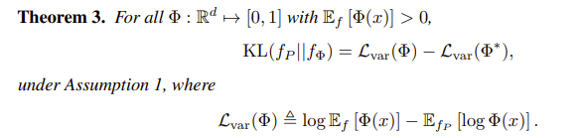
The quality of the approximation can be evaluated by Kullback-Leibler (KL) divergence between fP and fΦ, KL(fP || fΦ).
Notes:
To evaluate the quality of the approximation, we use the Kullback-Leibler (KL) divergence. The variational loss is defined as the difference between the expected log-likelihood of the model and the expected log-likelihood of the positive labeled data.
Theorem 3 of the paper shows that the variational loss Φ provides a variational upper bound of Lvar(Φ*).since KL divergence is nonnegative, By minimizing variational loss, we minimize KL divergence and optimize the parameters of the model Φ.

Slide 13
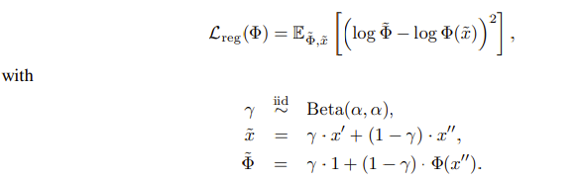
Regularized learning method
To avoid overfitting, a regularization term is incorporated into the loss function.
The loss function used in VPU learning is L(Φ) = Lvar(Φ) + λLreg(Φ), where Lvar(Φ) is the variational loss, and Lreg(Φ) is a MixUp-based consistency regularization term.
Notes:
However, simply minimizing the variational loss with a complex model Φ may suffer from overfitting. To overcome this, we incorporate MixUp-based consistency regularization into the loss function. In this paper, MixUp creates new samples by taking a weighted sum of two randomly selected real samples from labeled and unlabeled data.
MixUp is a data augmentation technique that helps improve the robustness and generalization of the model by creating virtual samples from the existing labeled and unlabeled data.
In this method, a new virtual sample is created by taking a weighted sum of two randomly selected real samples, one from the labeled data and one from the unlabeled data. The weight is drawn from a beta distribution with a fixed parameter alpha, which controls the degree of mixing between the two samples.
Then, a guessed probability of the positive class is constructed for the virtual sample by linearly interpolating between the true label and the predicted probability of the positive class by the model. This guessed probability is used to compute the consistency regularization term in the loss function, which encourages the smoothness of the model and penalizes underestimation of the positive class probability in the virtual samples.

Slide 14
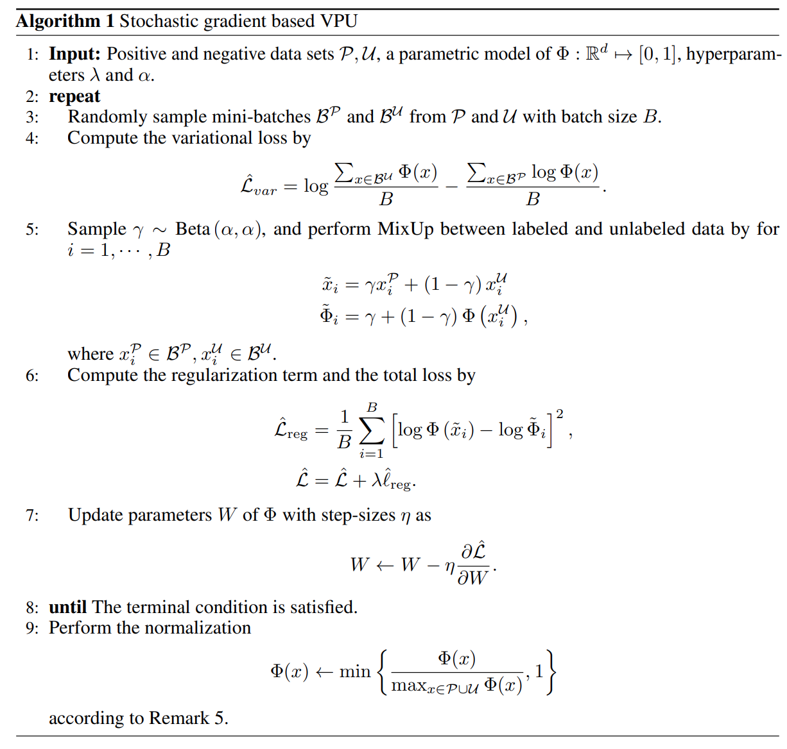

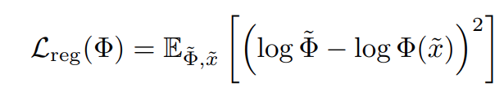
Algorithm Implementation
Sample from positive and unlabeled dataset
Compute variational loss by
Perform mix up
Compute regularization and total loss by

Slide 15
Baseline Models

Slide 16
Dataset
Page Blocks
Benchmark dataset from the UCI Machine Learning Repository
5 labels, part of label 1 is selected as class 1 and the rest are class 2
Very imbalanced labels: ~ 90% of the data are from class 1
Fashion MNIST
Image dataset with 10 labels (denoted by 0-9 respectively)
Part of labels 1, 4, 7 are chosen as class 1 and the rest are class 2
Test 2 times on each
First time class 1 positive and class 2 unlabeled
Second time class 1 unlabeled and class 2 positive

Slide 17
Raw
Page Blocks: MLP
7 fully connected layers
Fashion MNIST: CNN
3 convolutional layers, 2 max pooling layers in between
2 fully connected layers with batch normalization
Both use relu activation after each layer and logsoftmax for output
Replace variational loss with cross entropy loss

Slide 18
Baseline Models Comparison
nnPU (Non-Negative Risk Estimator for PU Learning)
One of the baseline model used in paper
Developed from an unbiased risk estimator
Raw
Standard loss function
Used to set a fundamental baseline

Slide 19
nnPU Theory
In positive - negative learning
Loss can be calculated by:
prob_posi * L(positive, +1) + prob_nega * L(negative, -1)
In positive - unlabeled learning
We don’t have negative data but only unlabeled data
Thus L(negative) is not available
L(unlabeled) - prob_posi * L(positive, -1)
This is called Unbiased PU Learning (uPU)

Slide 20
nnPU Theory
L(unlabeled, -1) - prob_posi * L(positive, -1)
L(unlabeled, -1) is non-negative
L(positive, -1) is non-negative
But L(unlabeled, -1) - prob_posi * L(positive, -1) may be negative
Overfit
Solution:
max(0, L(unlabeled, -1) - prob_posi * L(positive, -1))

Slide 21
Results and Model Comparison

Slide 22
Results - Page Blocks
 | Accuracy | F1-score | Recall | Precision
VPU - Page Blocks¹ | 92.5±0.8 | 95.7±0.6 | 95.4±2.1 | 96.2±1.1
VPU - Page Blocks² | 94.5±1.6 | 75.8±4.9 | 82.9±7.7 | 70.8±7.0
nnPU - Page Blocks¹ | 91.5±5.4 | 58.6±4.0 | 59.2±6.9 | 58.5±2.8
nnPU - Page Blocks² | 85.9±3.9 | 91.8±3.7 | 88.7±5.6 | 95.4±1.3
Raw - Page Blocks¹ | 95.7±1.1 | 80.9±4.0 | 88.7±2.3 | 74.6±6.5
Raw - Page Blocks² | 96.1±0.6 | 97.8±0.3 | 99.0±0.3 | 96.8±0.9
Definitions of labels (’Positive’ vs ’Negative’) are as follows: Page Blocks¹: ’horizontal line , vertical line, picture, graphic’ vs ’text’. Page Blocks²: ’text’ vs ’horizontal line , vertical line, picture, graphic’.

Slide 23
Results - Fashion MNIST
 | Accuracy | F1-score | Recall | Precision
VPU - FMNIST¹ | 92.1±0.5 | 86.1±1.7 | 81.4±3.9 | 91.7±2.7
VPU - FMNIST² | 87.7±2.5 | 90.1±2.1 | 87.0±3.8 | 93.6±1.4
nnPU - FMNIST¹ | 92.3±0.3 | 86.5±0.5 | 83.3±1.5 | 90.0±2.0
nnPU - FMNIST² | 92.0±0.0 | 94.5±0.5 | 94.5±0.5 | 94.5±0.5
Raw - FMNIST¹ | 82.1±2.5 | 58.3±8.0 | 42.5±8.6 | 95.1±0.8
Raw - FMNIST² | 38.7±1.5 | 22.9±3.6 | 13.0±2.4 | 95.7±1.2
Definitions of labels (’Positive’ vs ’Negative’) are as follows: FashionMNIST¹: ’1,4,7’ vs ’0,2,3,5,6,8,9’. FashionMNIST²: ’0,2,3,5,6,8,9’ vs ’1,4,7’.

Slide 24
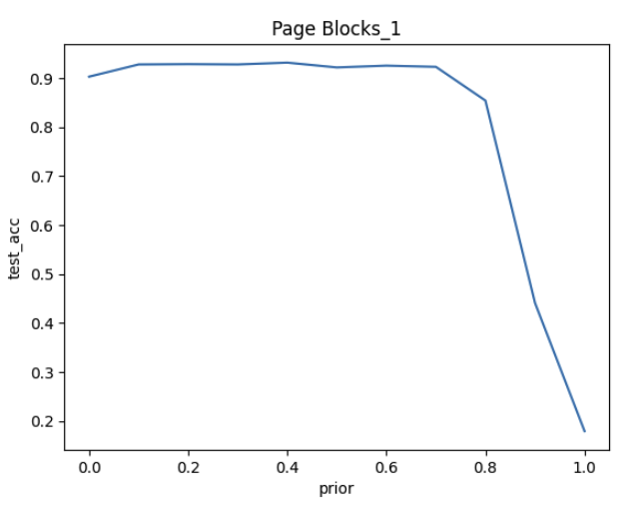
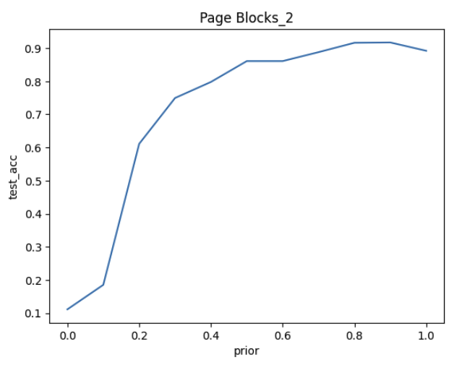
The Impact of Prior on nnPU Performance
The prior has a great impact on the test accuracy of the nnPU model.

Slide 25
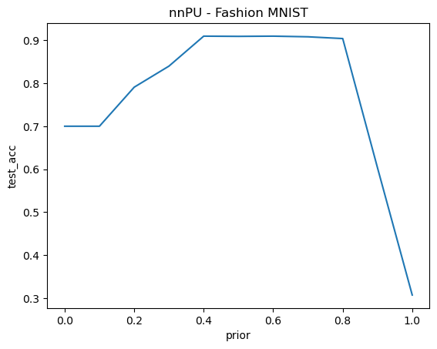
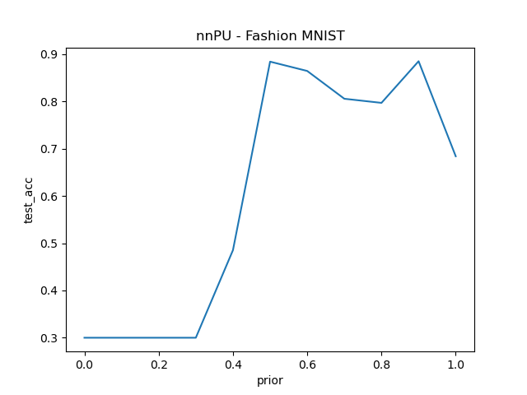
The Impact of Prior on nnPU Performance
The prior has a great impact on the test accuracy of the nnPU model.

Slide 26
Extension and Conclusion

Slide 27
Extension
Other variational principles using different statistical distances
Application on categorical data

Slide 28
Conclusion
VPU can explore the negative pattern in the PU datasets well.
More efficient: Less labels are needed.
More applicable: VPU overcomes some limitations of the baseline models and other state-of-art PU methods.

