Slide 1

Aimag QC
Digital Histopathology Images Quality Control.
A!maginostic Pte. Ltd. All Rights Reserved, 2020.
Aimag QC Version 4.2 Created by Laurent Gole . lgole@aimaginostic.com
Quick Start
Outputs

Slide 2
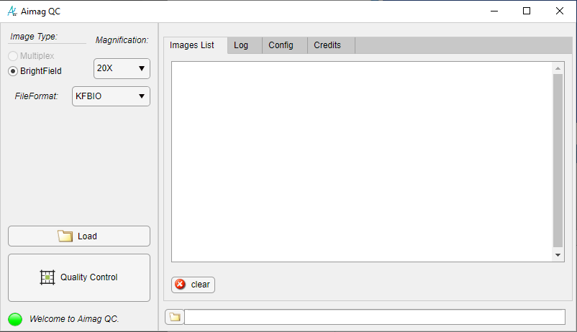
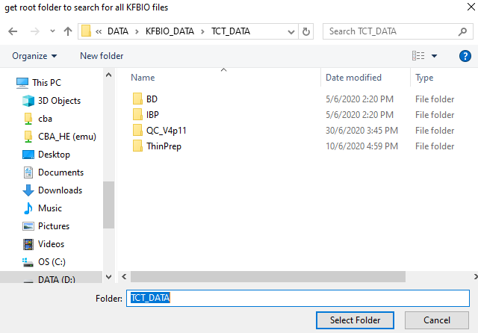
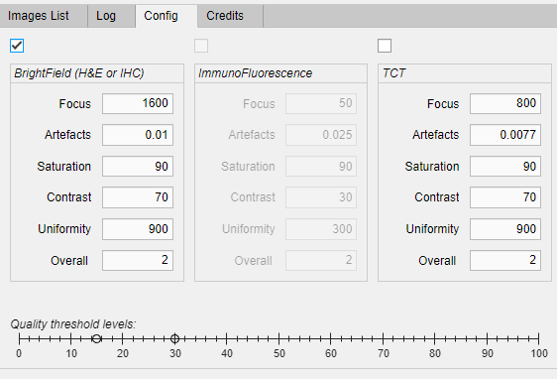
Quick Start
3*
1
2
Press Load and Select a Root Folder Containing a List of Images or a List of Subfolders with Images. ( Detects all “.kfb” files in folder and subfolders.)
Press Quality Control button to Start the Quality Assessment of all Files in Images List Listbox.
Select BrightField or TCT
3

Slide 3
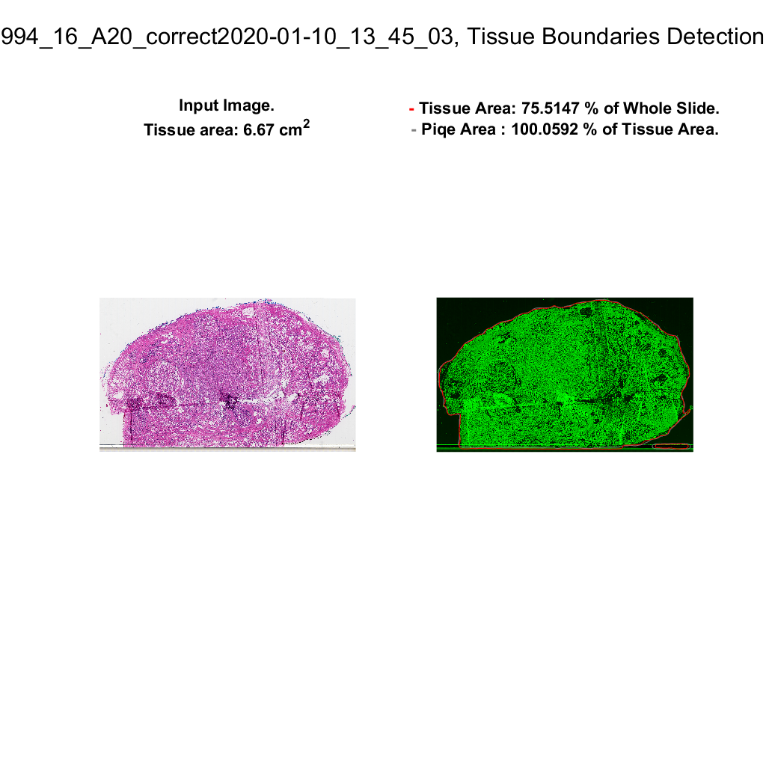
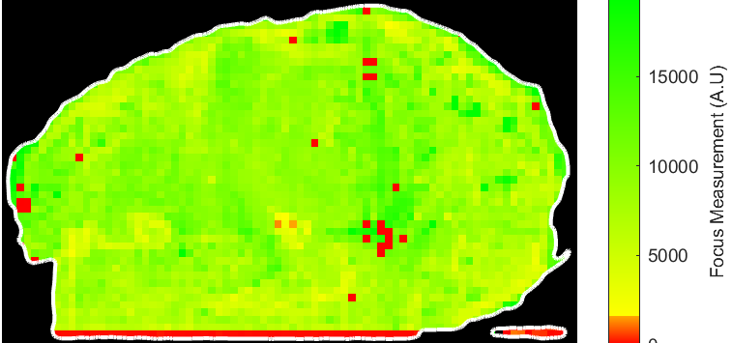
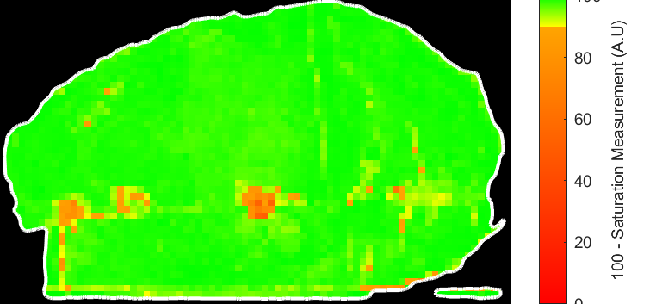
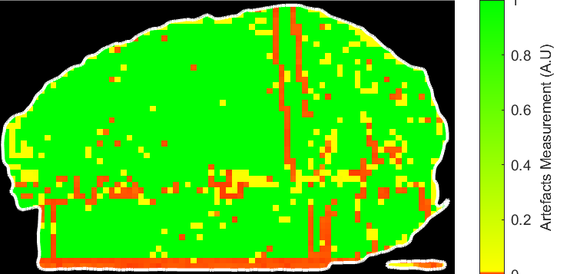
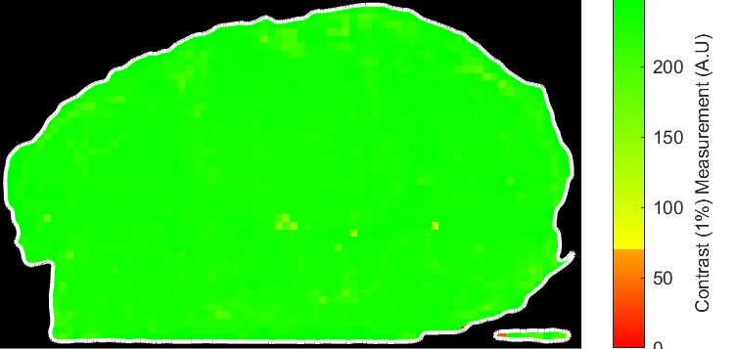
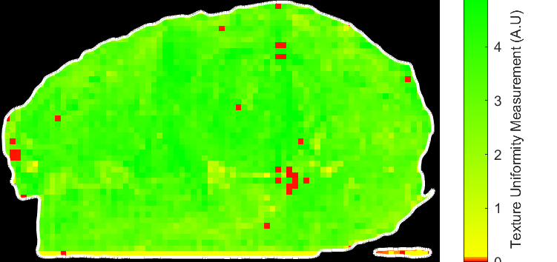

Outputs
Input Image
Tissue ROI
1
2
3
4
5
6
Quality Heat maps
Visual representation of the Quality Assessment of the image Texture , Contrast, Artefacts, Saturation and Focus (2-6).
The QC measurement (1) is a linear combination of the 5 aforementioned image properties.

Slide 4
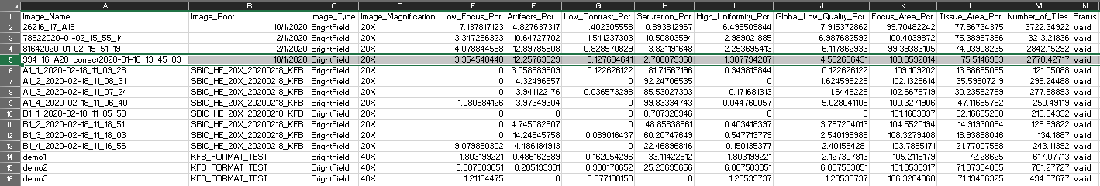
Output
Summary of quality measurements
Low_FocusPct | Artifacts Pct | LowContrast Pct | Saturatio Pct | High Uniformity Pct | Global Low Quality Pct | Tissue_AreaPct | Number of Tiles | Status
3.35 | 12.25 | 0.12 | 2.70 | 1.38 | 4.58 | 75.51 | 2770.42 | Valid
Percentage of “Tiles” ( 256*256 contiguous blocks of the Tissue Region of Interest) Below Quality Threshold.
Low Focus : % of tiles with a low focus
Artifacts : % of tiles with Artefacts ( dust ,folding, cluster, …)
Low Contrast : % of tiles with a low contrast ( faded staining, empty regions, …)
Saturation : % of tiles with saturated colors ( strong stain, clusters, …)
Uniformity : % of tiles with a smooth Texture ( faded stain, slight out of focus, …)
Global Low quality : Linear combination of 5 aforementioned measurements.
Tissue Area : % of Image Area that contains Tissue.
Number of Tiles : Weighted Number of Tiles with in Tissue Area. ( Tiles on Tissue edges have less weights since cropped by Tissue Region boundary.)
Status : Aimag QC estimated image Quality:
Valid: image can be used for diagnosis/ further processing
To Check: image may be used for diagnosis if reviewed by specialist
Rejected: image quality is too low for diagnosis/ further processing

