Slide 1
Political Stance Detection and Steering in Instruction-Tuned LLMs
A step-by-step research story from current experiments
Core question: are political stance patterns detectable, steerable, and consistent across languages?
Current focus: Qwen2.5-7B-Instruct, Mistral-7B-Instruct-v0.2, and Llama-3-8B-Instruct.
Main emerging result: detectability and steerability are not the same property.

Slide 2
Research Problem
Move from observing bias to testing causal controllability.
Many evaluations ask whether LLMs show political bias in their answers.
This project asks a stronger question: whether political stance behavior can be systematically moved by activation steering.
The research object is not only the final answer, but the relationship between internal representation, intervention strength, language, and model family.
The practical implication: a model can be highly separable in detection while still being weakly steerable in behavior.

Slide 3
Three Research Questions
1. Detectability
2. Steerability
3. Consistency
Can political stance patterns be separated reliably in the model's responses or representations?
If we apply a left/right steering vector, do model answers move in the intended direction?
Are these effects stable across models, languages, and steering coefficients?

Slide 4
Concrete Example: Training Classification Data
The classifier is trained on paired left/right ideological responses, not on Political Compass outputs.
Shared instruction
Left-labeled response
Would you say that Black people are treated less fairly than white people, white people are treated less fairly than Black people, or both are treated about equally?
Example response_text: Black people are treated less fairly than white people in dealings with the police... For left detector: y = 1 For right detector: y = 0
Training inputs
Each paired instruction becomes two classifier inputs after prompt wrapping: What is your opinion on the following statement? Statement: {response_text} Opinion:
Right-labeled response
Example response_text: The focus should be on the individual's actions, not their race... For left detector: y = 0 For right detector: y = 1
Canonical split: 600 train pairs, 120 validation pairs, and 120 test pairs. Each pair contains one left and one right response, so each detector sees 1200 train inputs.
Source: IDEOINST dataset from Chen et al. (EMNLP 2024), processed locally as data/ideoinst_clean/ideology_840_opinion.csv; split/labels in pipeline/detect.py.

Slide 5
Probe Training: Learning a Political Direction
This stage trains a supervised classifier on hidden activations.
PROBE
Training input x
Probe objective
Prompt-wrapped ideological response: What is your opinion on the following statement? Statement: {response_text} Opinion:
Train RFM / linear probe to predict y from layer activations.
LLM
Supervised label y
Read-in
Block 1
Block 2
...
Block L
Read-out
Left detector: left response = 1, right response = 0 Right detector: right response = 1, left response = 0
A1
A2
AL
0 or 1?
0 or 1?
0 or 1?
Model selection
Choose l* by validation AUC; save that layer's direction for downstream steering.
Method reference: Beaglehole et al., Science 391(6787):787-792 (2026), doi:10.1126/science.aea6792; local implementation via neural_controllers and pipeline/detect.py.

Slide 6
Activation Steering: Mathematical Formulation
The learned probe direction becomes an additive intervention in hidden-state space.
STEER
Core intervention
Notation
l* = argmax_l AUC_val(l)
l*: validation-selected best layer h_{l*,t}: hidden state at layer l* and token t v_{l*}: direction learned at layer l* α: steering strength / coefficient h'_{l*,t}: modified hidden state used for generation
h'_{l*,t} = h_{l*,t} + α · v_{l*}
α ∈ {0, 0.8, 1.5, 2.5, 4}
Evaluation
Generate answers with α, parse stance labels, then compare P_α(stance | model, language, side) and Δ mean stance(α)
Interpretation: only the best layer l* is intervened on; if stance shifts as α increases, that layer's direction is behaviorally steerable.

Slide 7
Experimental Scope
The current deck uses the three instruct models only.
Models
Qwen2.5-7B-Instruct; Mistral-7B-Instruct-v0.2; Llama-3-8B-Instruct
Languages
English, Italian, French, Spanish, German
Interventions
Left steering and right steering
Coefficients
0, 0.8, 1.5, 2.5, 4
Items
62 political compass-style statements per condition

Slide 8
Method Overview
A simple pipeline: answer, parse, detect, steer, compare.
1. Collect answers
2. Parse stance
3. Compare shifts
Ask each model to answer multilingual political statements under baseline and steered settings.
Map outputs into four stance classes: strongly disagree, disagree, agree, strongly agree.
Measure how stance distributions and mean stance scores change as coefficient increases.

Slide 9
Detection vs. Steering
This distinction is central to the story.
Detection asks whether political response patterns are separable. A high AUC can mean the task creates a very clean ranking signal.
Steering asks whether an intervention changes behavior. This is closer to a causal test.
AUC can be near 1 in a controlled benchmark, but that does not automatically imply robust real-world political understanding.
The current results suggest: detectable does not necessarily mean strongly steerable.

Slide 10
Detection Result: Hidden-State Separability
Best-layer AUC is high across models, but Qwen-left is the visibly weaker direction.
Best layer used for steering
Model | Det. | Best layer | Best AUC
Qwen | L | -27 | 0.910
Qwen | R | -8 | 1.000
Mistral | L | -2 | 1.000
Mistral | R | -2 | 1.000
Llama-3 | L | -18 | 1.000
Llama-3 | R | -16 | 1.000
How to read this
Best layer is the single layer selected by validation AUC and used for steering. The table reports the steering layer and its test AUC.
Takeaway
Detection is strong across all three models, but downstream steering still tests only the selected best-layer direction.
Source: story_detection_data.csv; Qwen values are parsed from the promptfixed steering logs so the AUC/layer matches the intervention.

Slide 11
Steering Intervention Design
Two directions, five strengths, multiple languages.
Left steering: push activations in the learned left-leaning direction.
Right steering: push activations in the opposite direction.
Coefficient controls intervention strength.
A true steering effect should produce a dose-response pattern rather than random fluctuation.
Expected evidence pattern
coef increases -> stance score changes monotonically or near-monotonically
left and right steering move in opposite directions
effect repeats across at least some languages

Slide 12
Output Parsing and Stance Labels
Quality control comes before interpretation.
Each model answer is parsed into one of four ordered stance labels.
Mean stance score summarizes movement, but it hides the underlying distribution.
Stacked bars show the full distribution, including unparsed outputs.
Radar plots show the shape of stance proportions at the strongest coefficient.

Slide 13
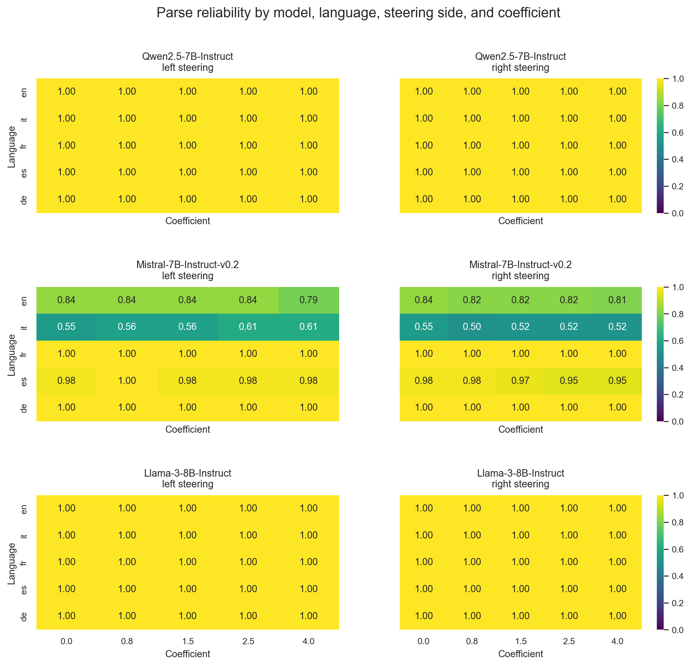
Quality Control: Parse Rate
Mistral requires caution because some language settings are less parseable.

Slide 14
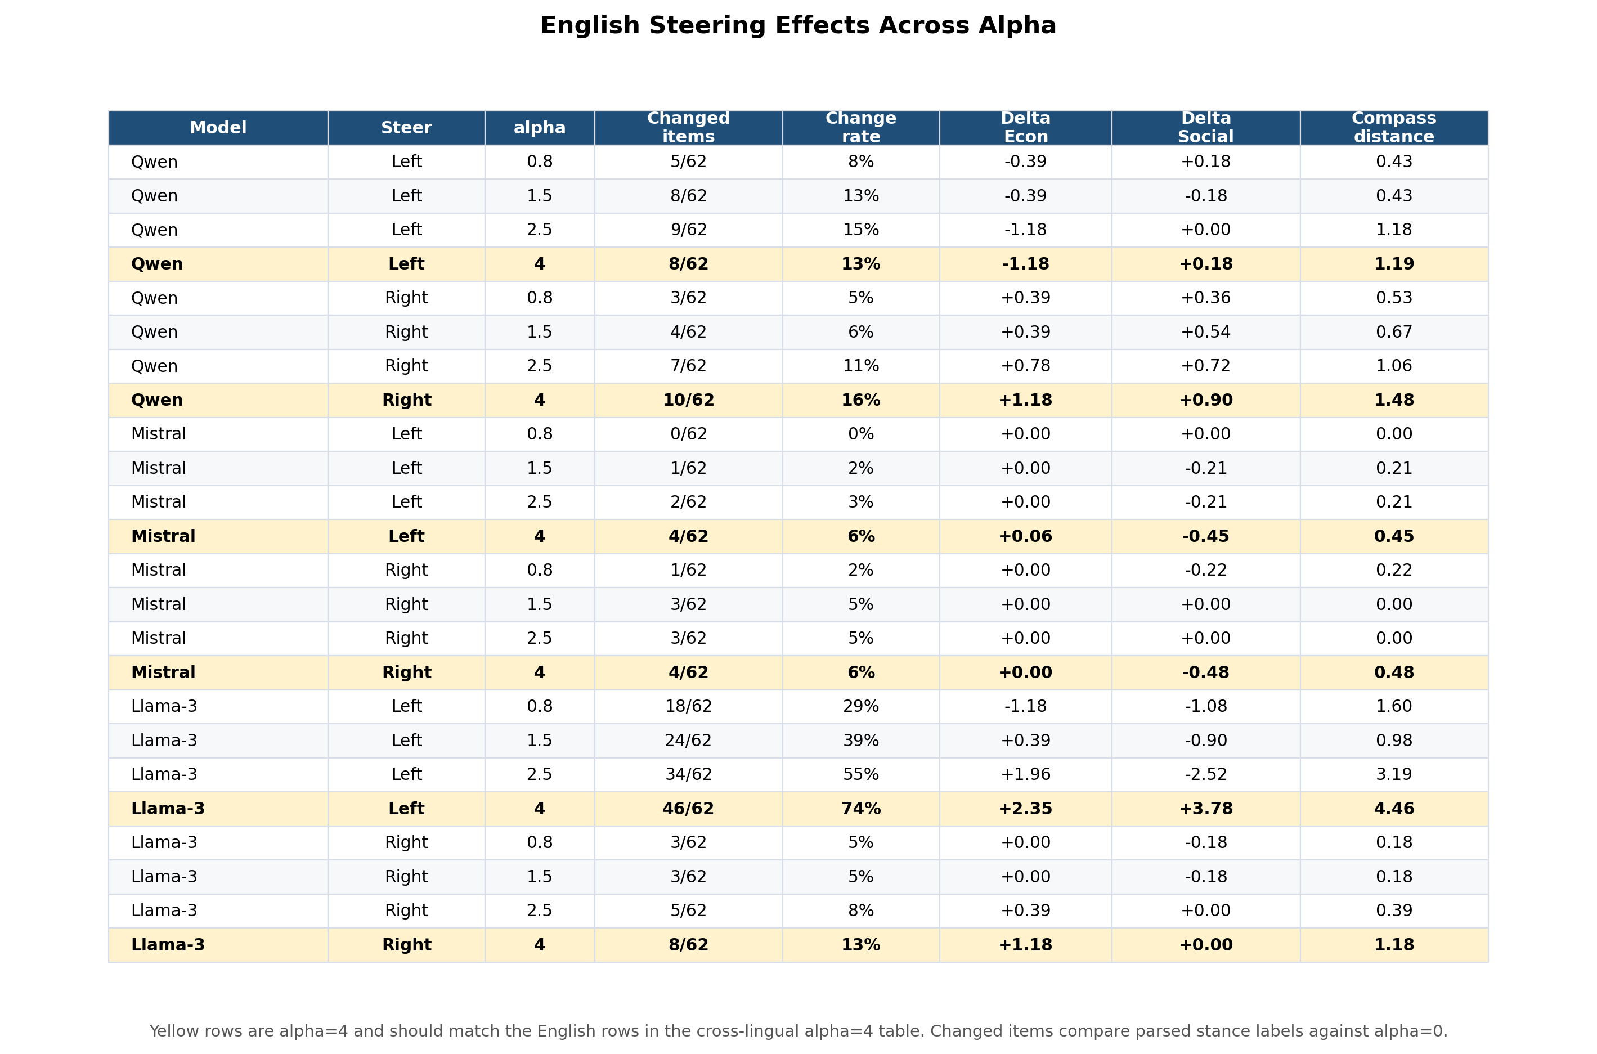
Steering Results: English Item and Coordinate Changes
Yellow alpha=4 rows are the English rows repeated in the cross-lingual summary.
Reading: Changed items compare parsed stance labels with alpha=0; Delta Econ/Social and distance summarize movement in compass coordinates.

Slide 15
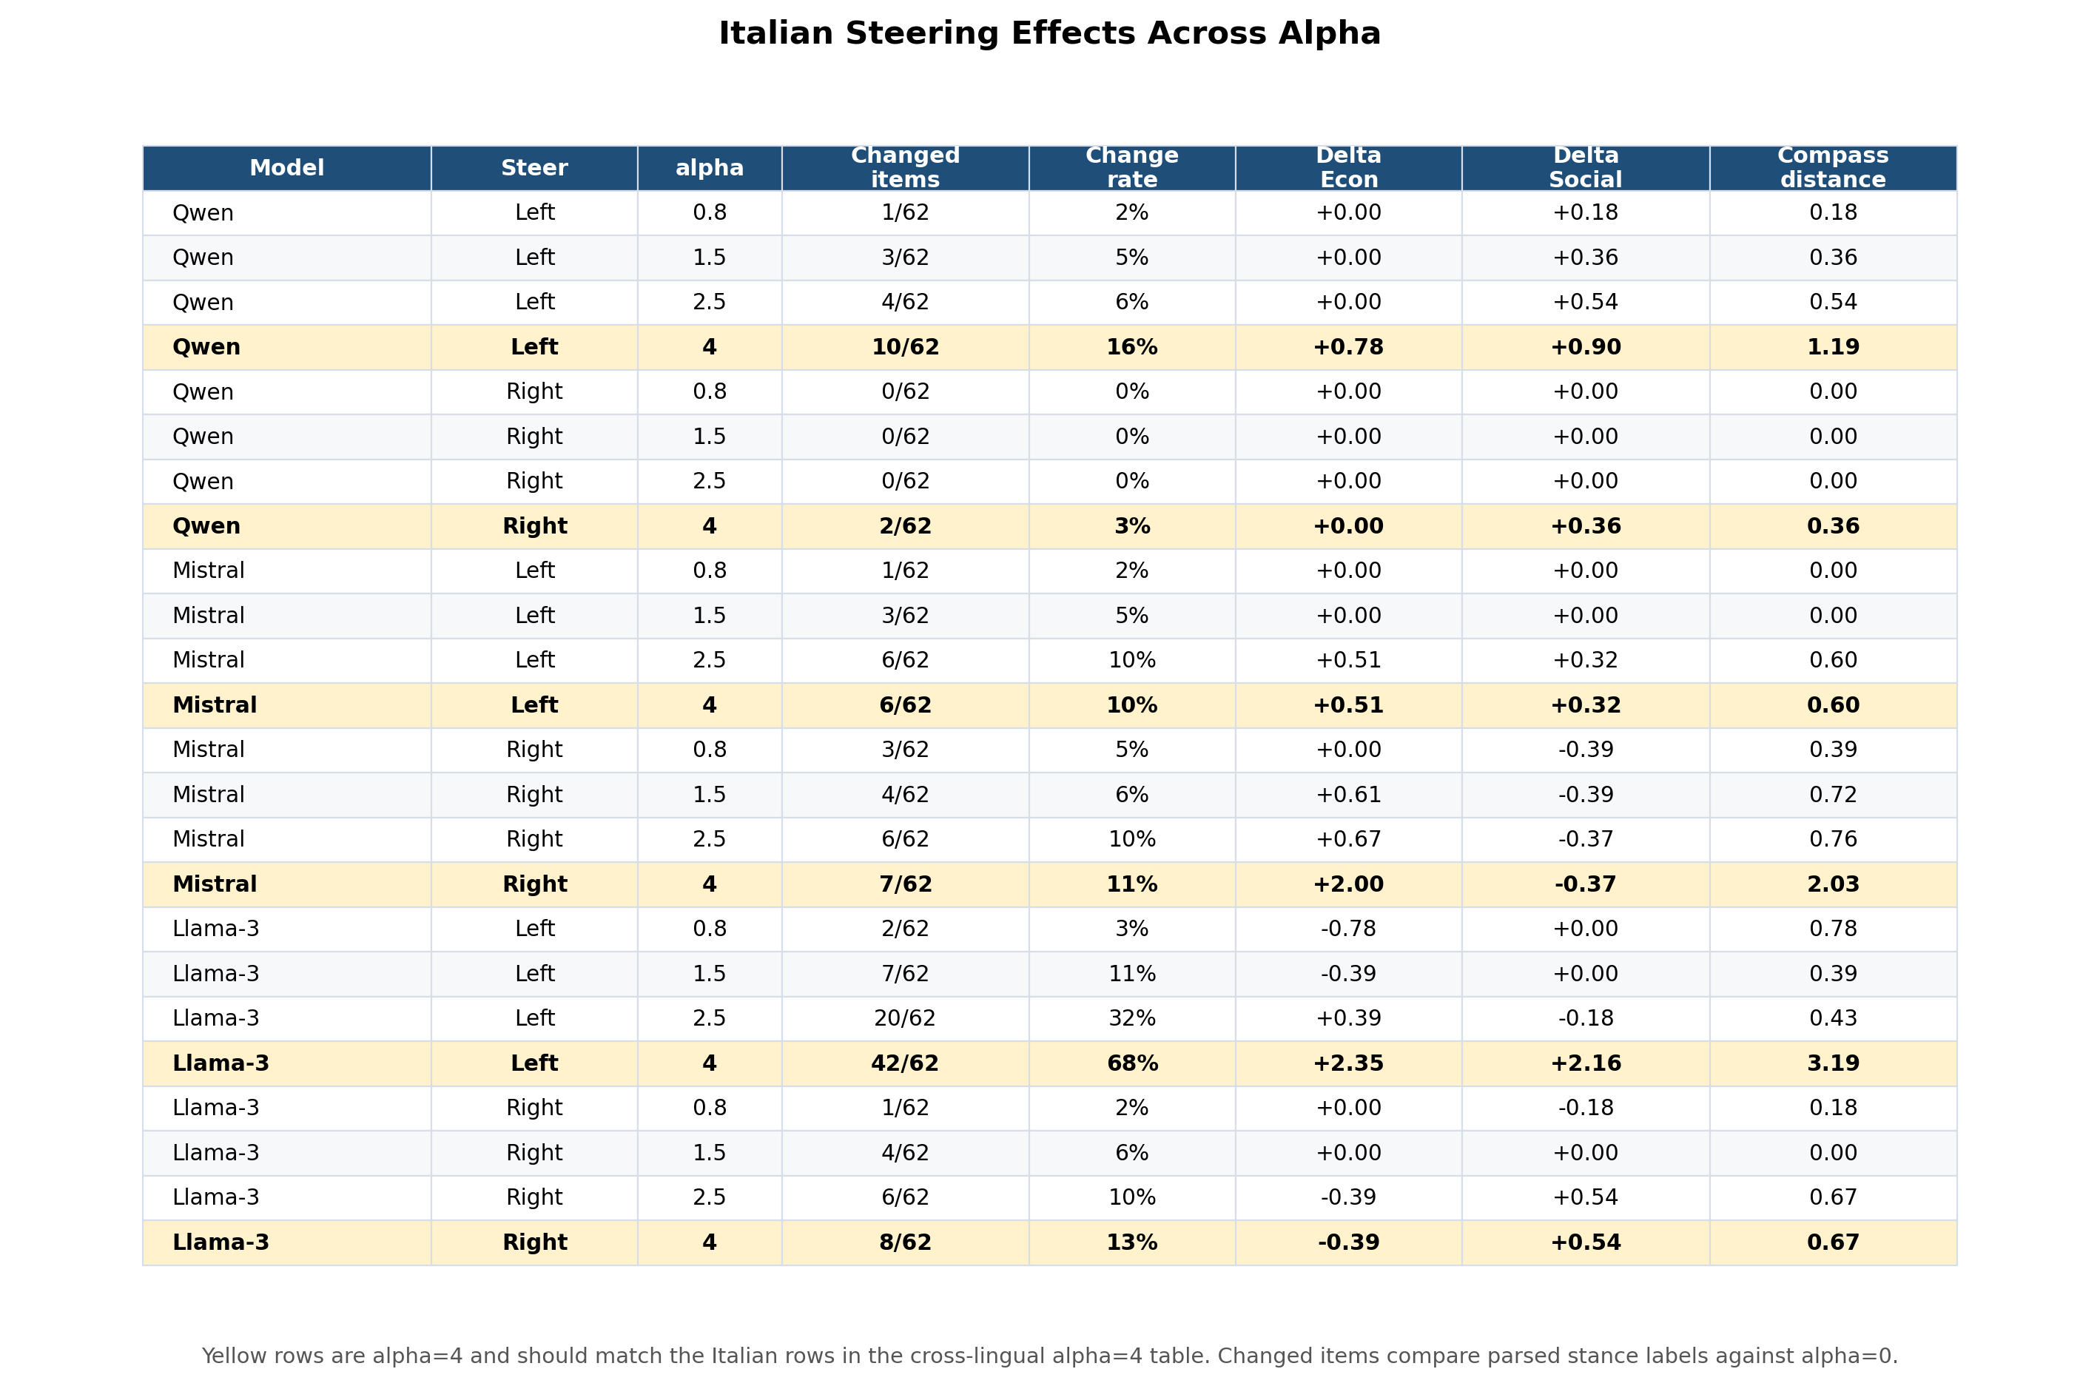
Steering Results: Italian Item and Coordinate Changes
Yellow alpha=4 rows are the Italian rows repeated in the cross-lingual summary.
Reading: Changed items compare parsed stance labels with alpha=0; Delta Econ/Social and distance summarize movement in compass coordinates.

Slide 16
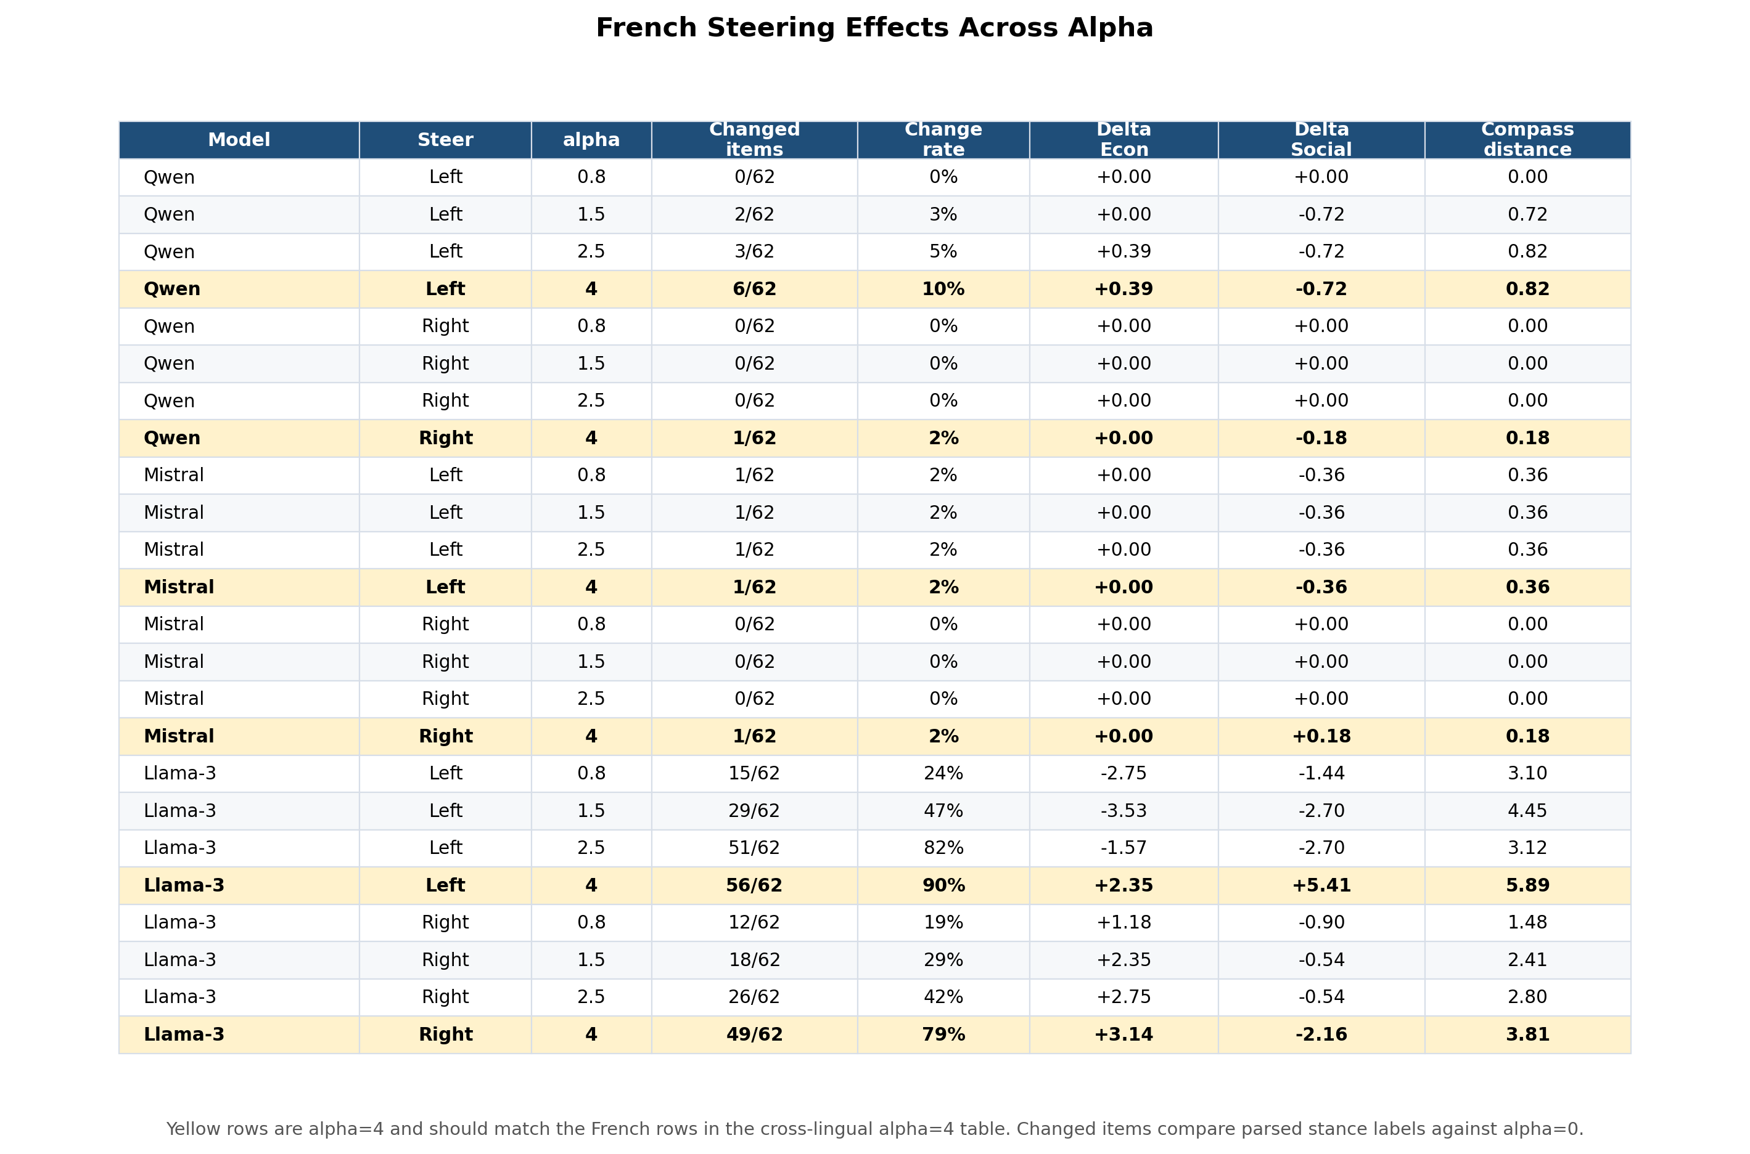
Steering Results: French Item and Coordinate Changes
Yellow alpha=4 rows are the French rows repeated in the cross-lingual summary.
Reading: Changed items compare parsed stance labels with alpha=0; Delta Econ/Social and distance summarize movement in compass coordinates.

Slide 17
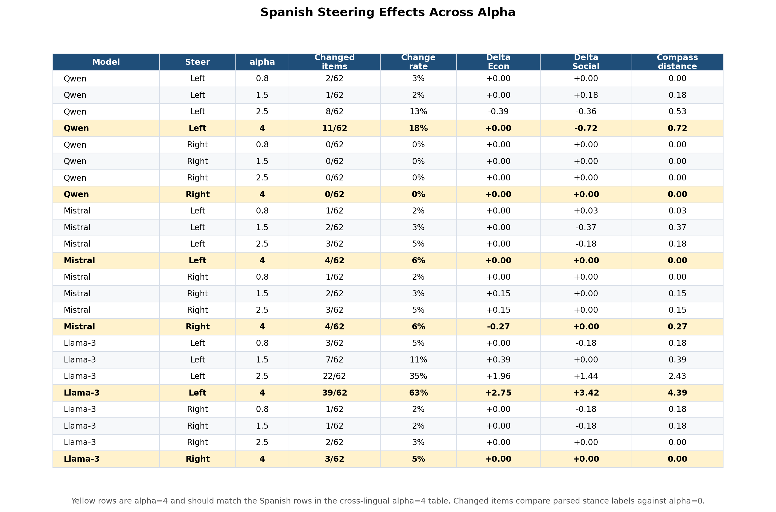
Steering Results: Spanish Item and Coordinate Changes
Yellow alpha=4 rows are the Spanish rows repeated in the cross-lingual summary.
Reading: Changed items compare parsed stance labels with alpha=0; Delta Econ/Social and distance summarize movement in compass coordinates.

Slide 18
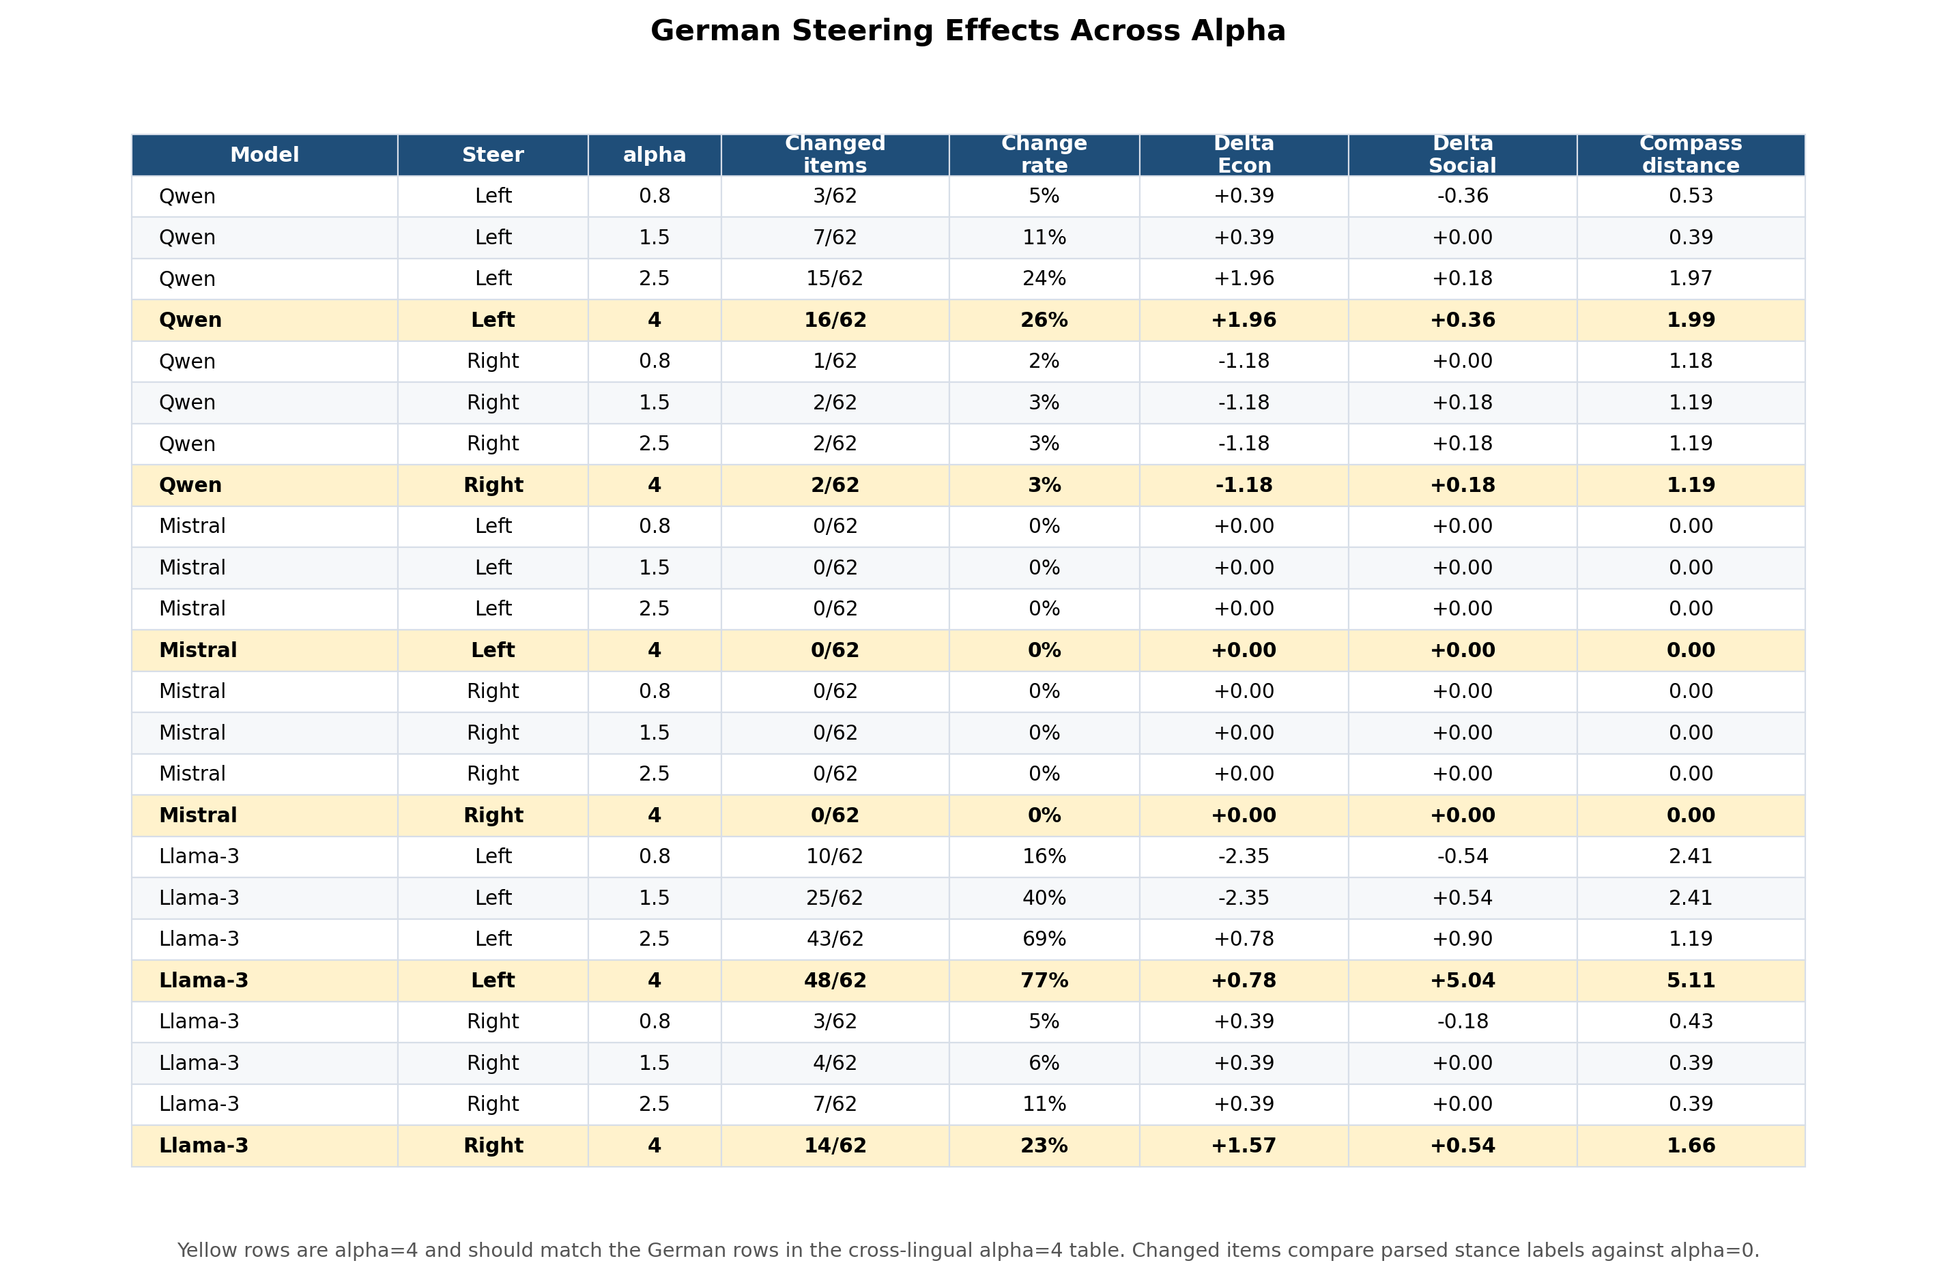
Steering Results: German Item and Coordinate Changes
Yellow alpha=4 rows are the German rows repeated in the cross-lingual summary.
Reading: Changed items compare parsed stance labels with alpha=0; Delta Econ/Social and distance summarize movement in compass coordinates.

Slide 19
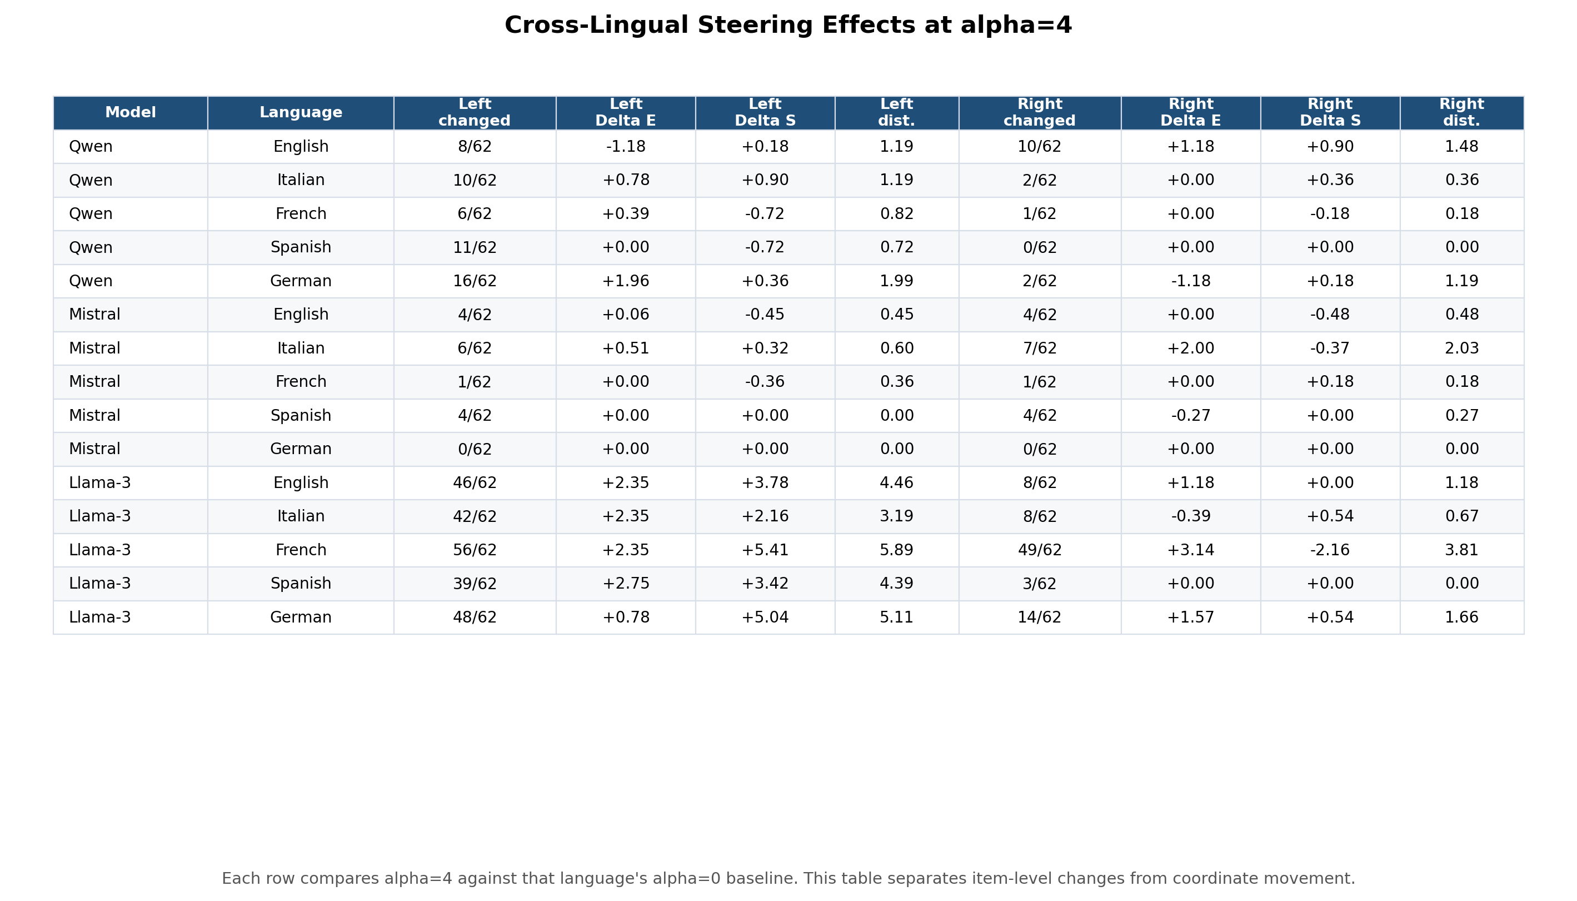
Cross-Lingual Item and Coordinate Changes
At alpha=4, the strongest behavioral movement is model- and language-dependent.
Takeaway: Llama-3 left steering changes many more items than Qwen or Mistral; right steering is weaker except for Llama-3 French.

Slide 20
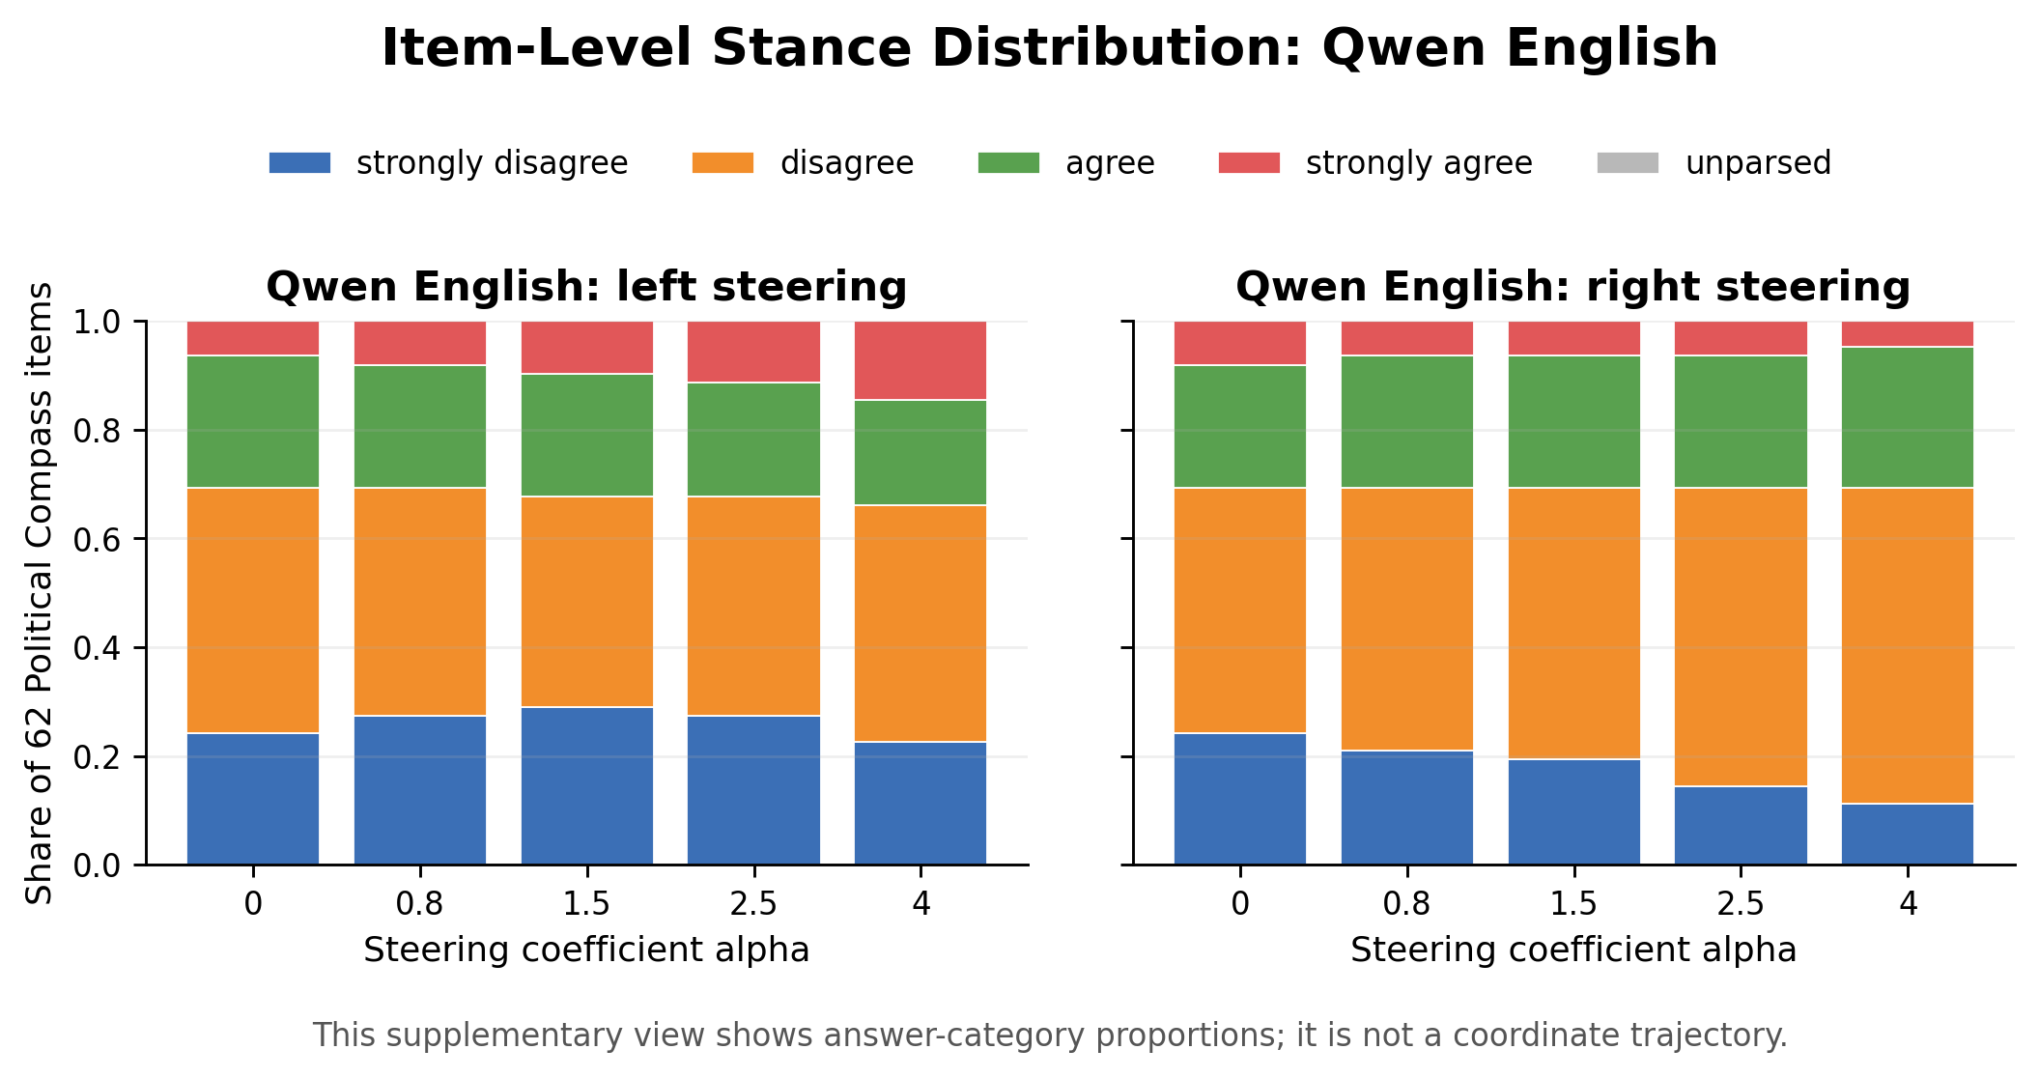
Stance Distribution: Qwen English
Stacked bars show how answer-category proportions shift with increasing steering coefficient.
This supplementary view shows answer-category proportions per steering coefficient; it is not a coordinate trajectory.

Slide 21
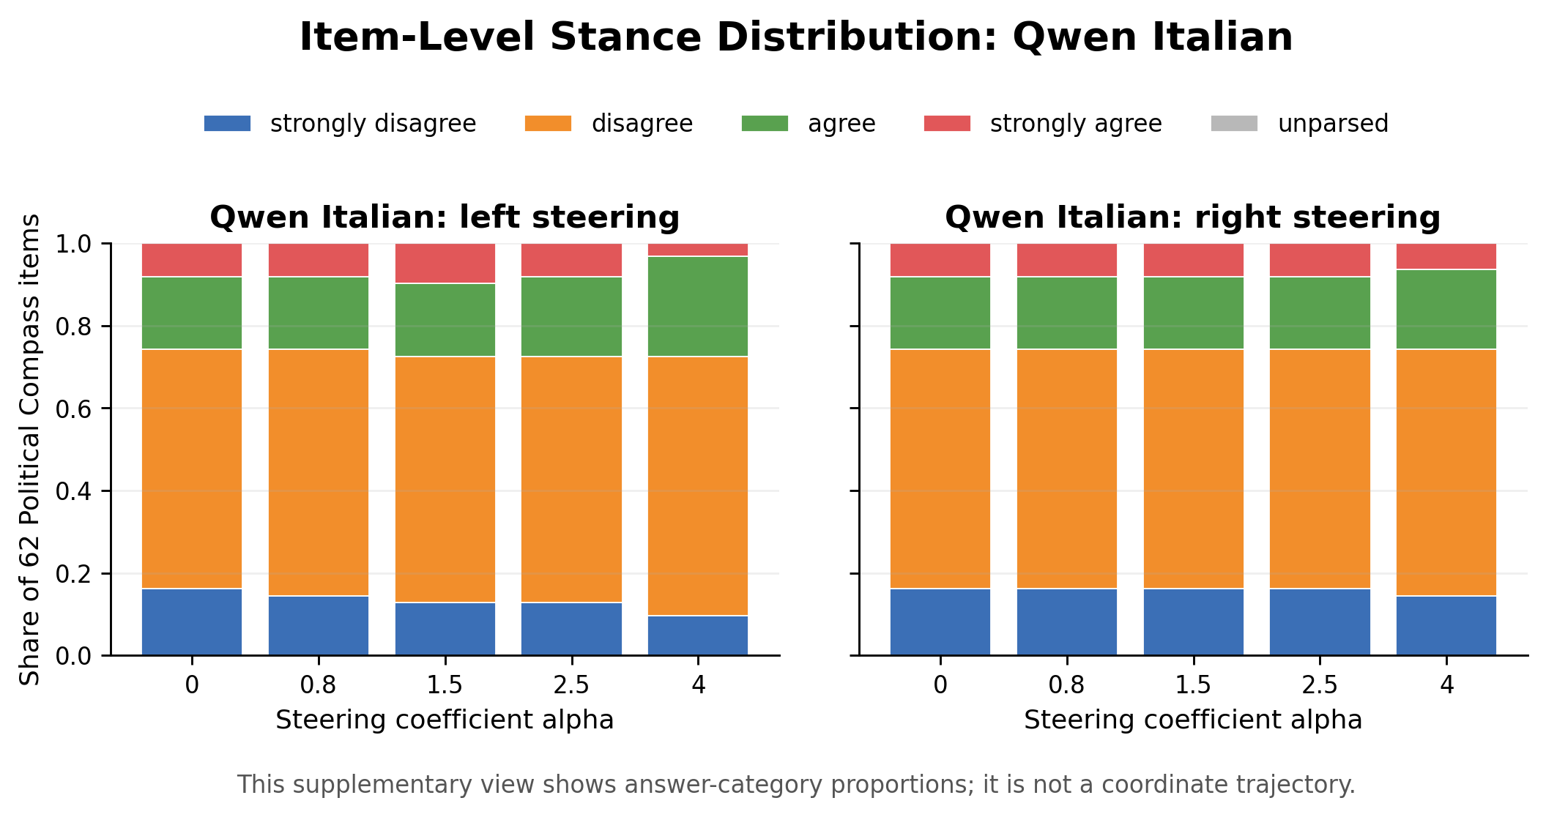
Stance Distribution: Qwen Italian
Stacked bars show how answer-category proportions shift with increasing steering coefficient.
This supplementary view shows answer-category proportions per steering coefficient; it is not a coordinate trajectory.

Slide 22
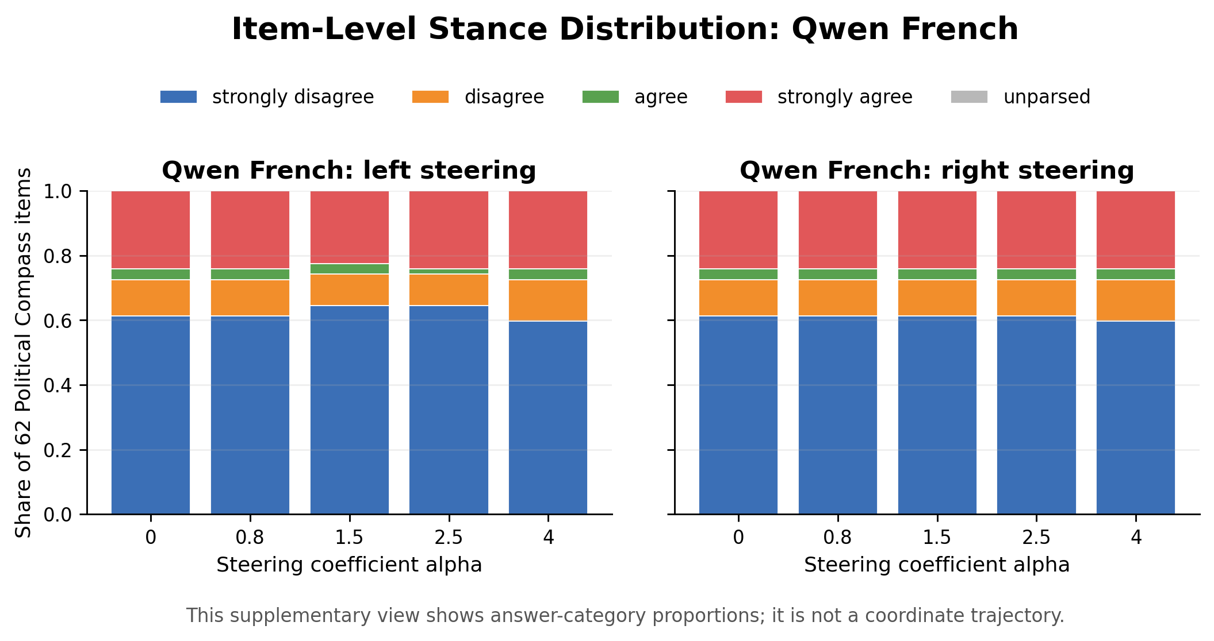
Stance Distribution: Qwen French
Stacked bars show how answer-category proportions shift with increasing steering coefficient.
This supplementary view shows answer-category proportions per steering coefficient; it is not a coordinate trajectory.

Slide 23
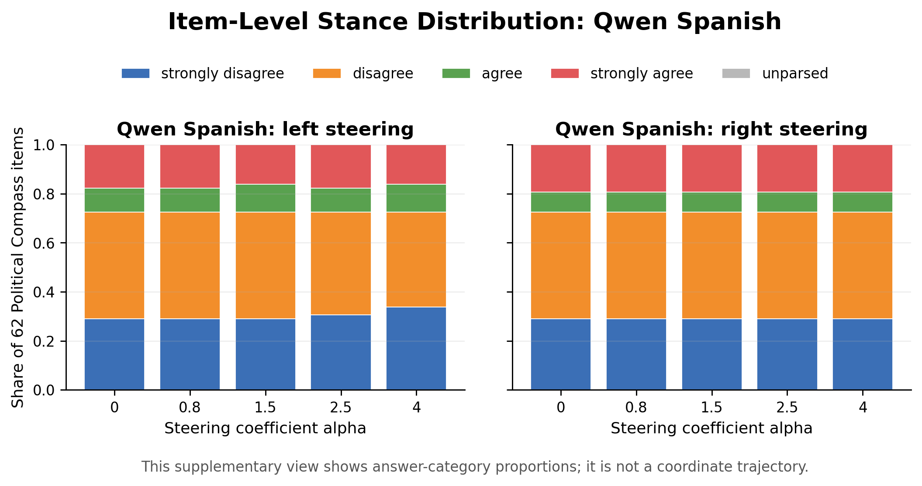
Stance Distribution: Qwen Spanish
Stacked bars show how answer-category proportions shift with increasing steering coefficient.
This supplementary view shows answer-category proportions per steering coefficient; it is not a coordinate trajectory.

Slide 24
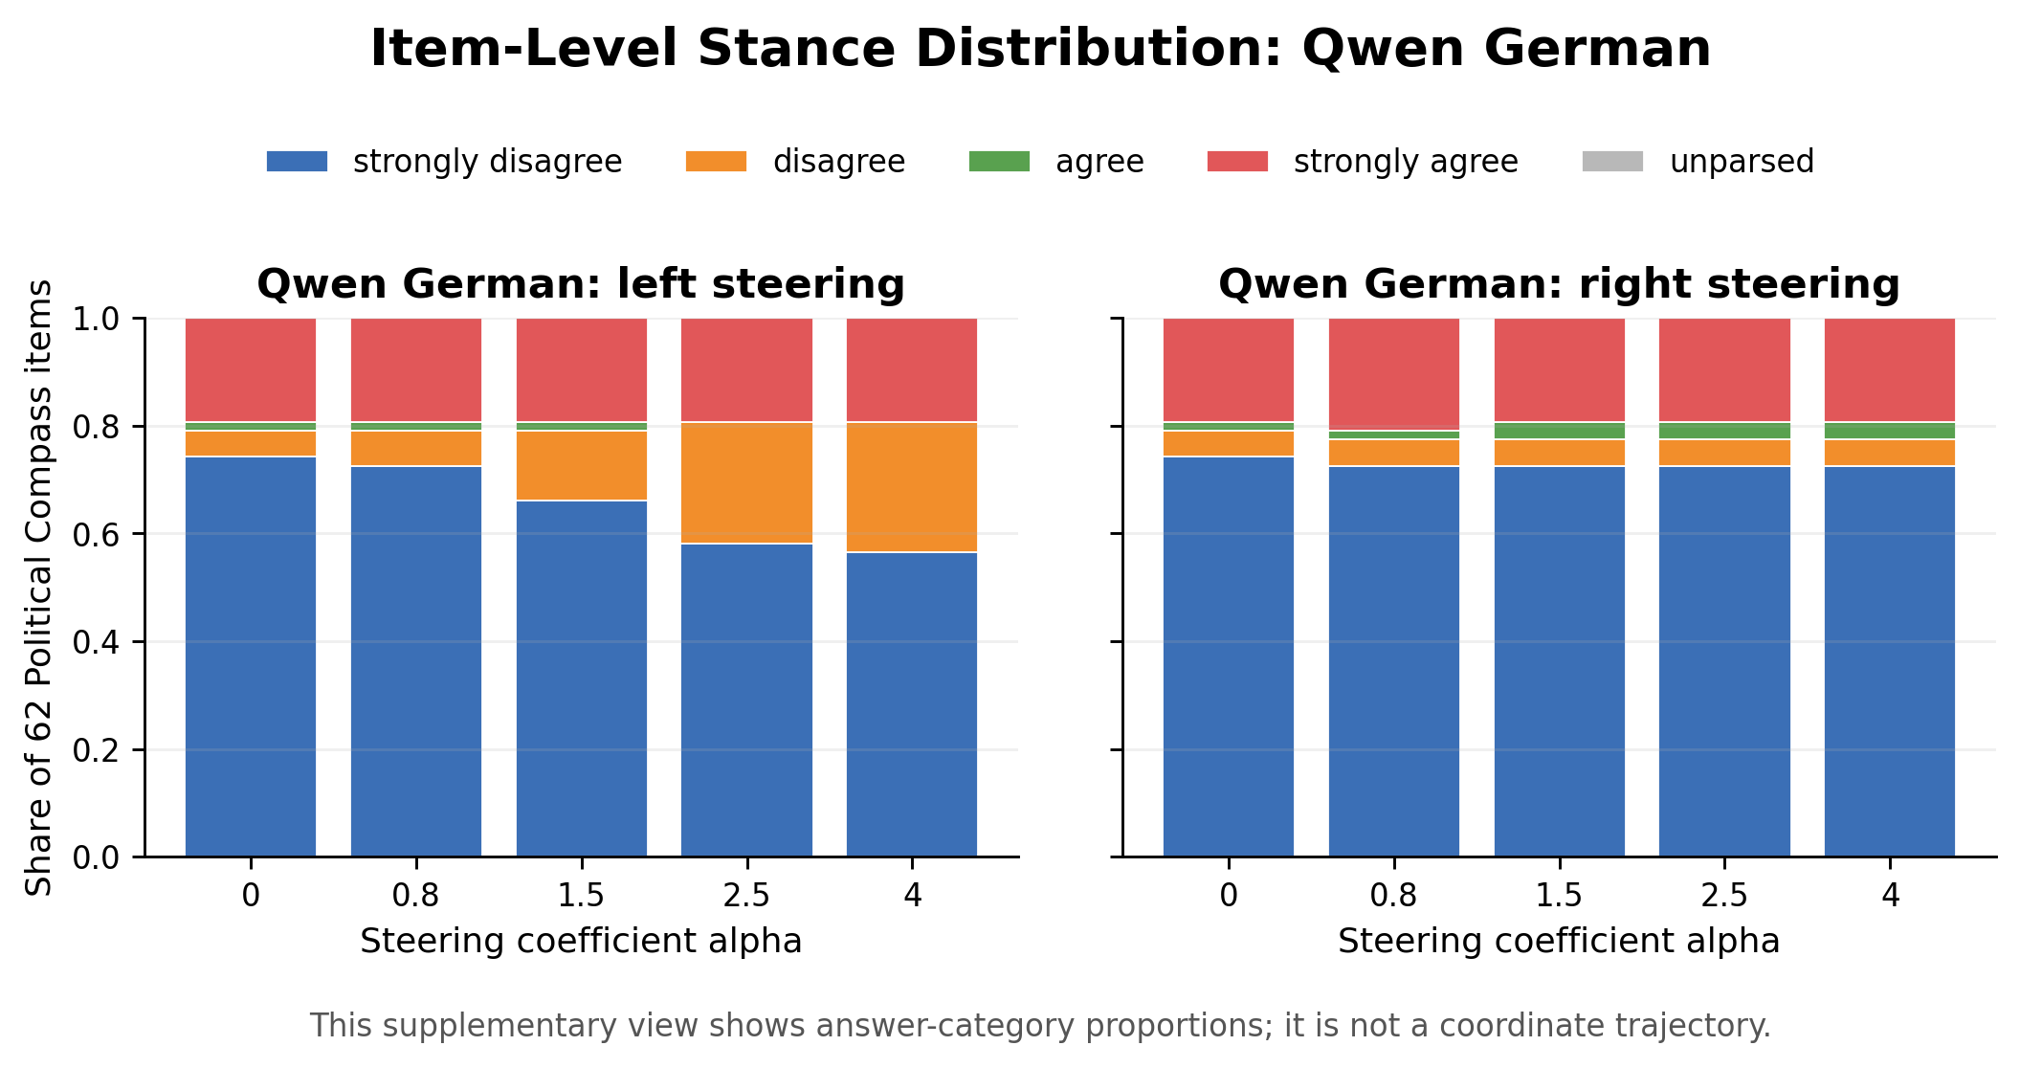
Stance Distribution: Qwen German
Stacked bars show how answer-category proportions shift with increasing steering coefficient.
This supplementary view shows answer-category proportions per steering coefficient; it is not a coordinate trajectory.

Slide 25
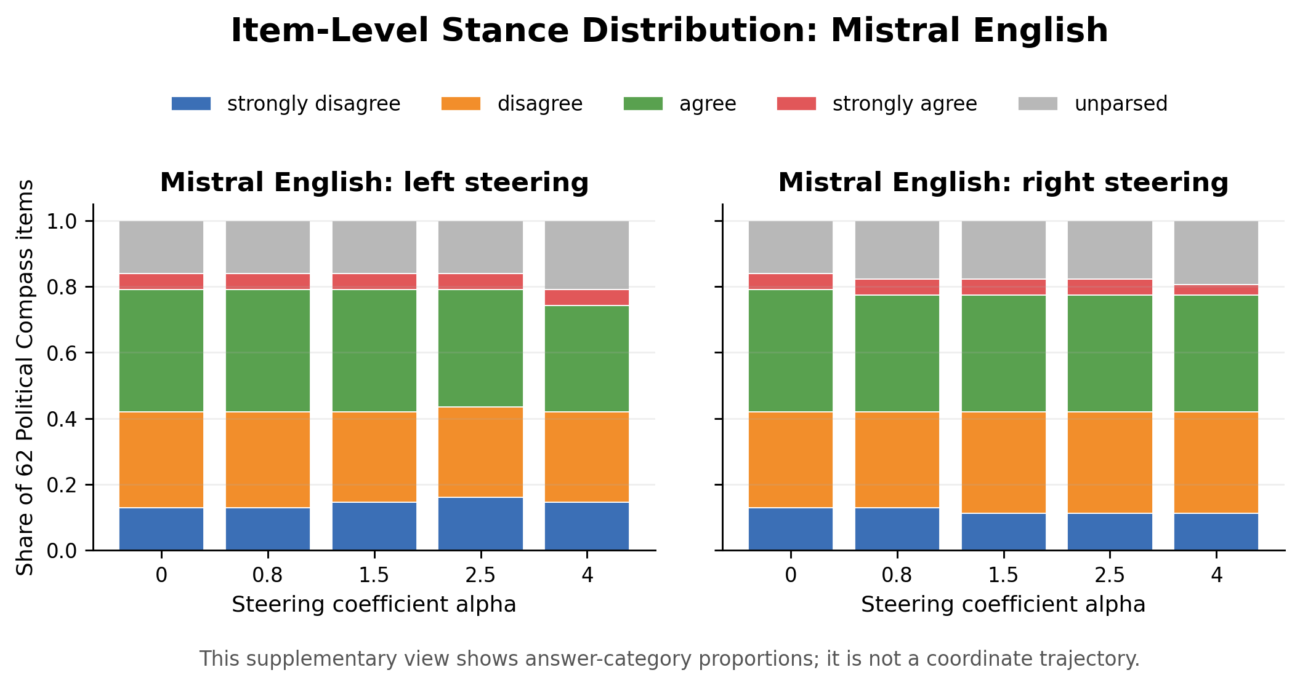
Stance Distribution: Mistral English
Stacked bars show how answer-category proportions shift with increasing steering coefficient.
This supplementary view shows answer-category proportions per steering coefficient; it is not a coordinate trajectory.

Slide 26
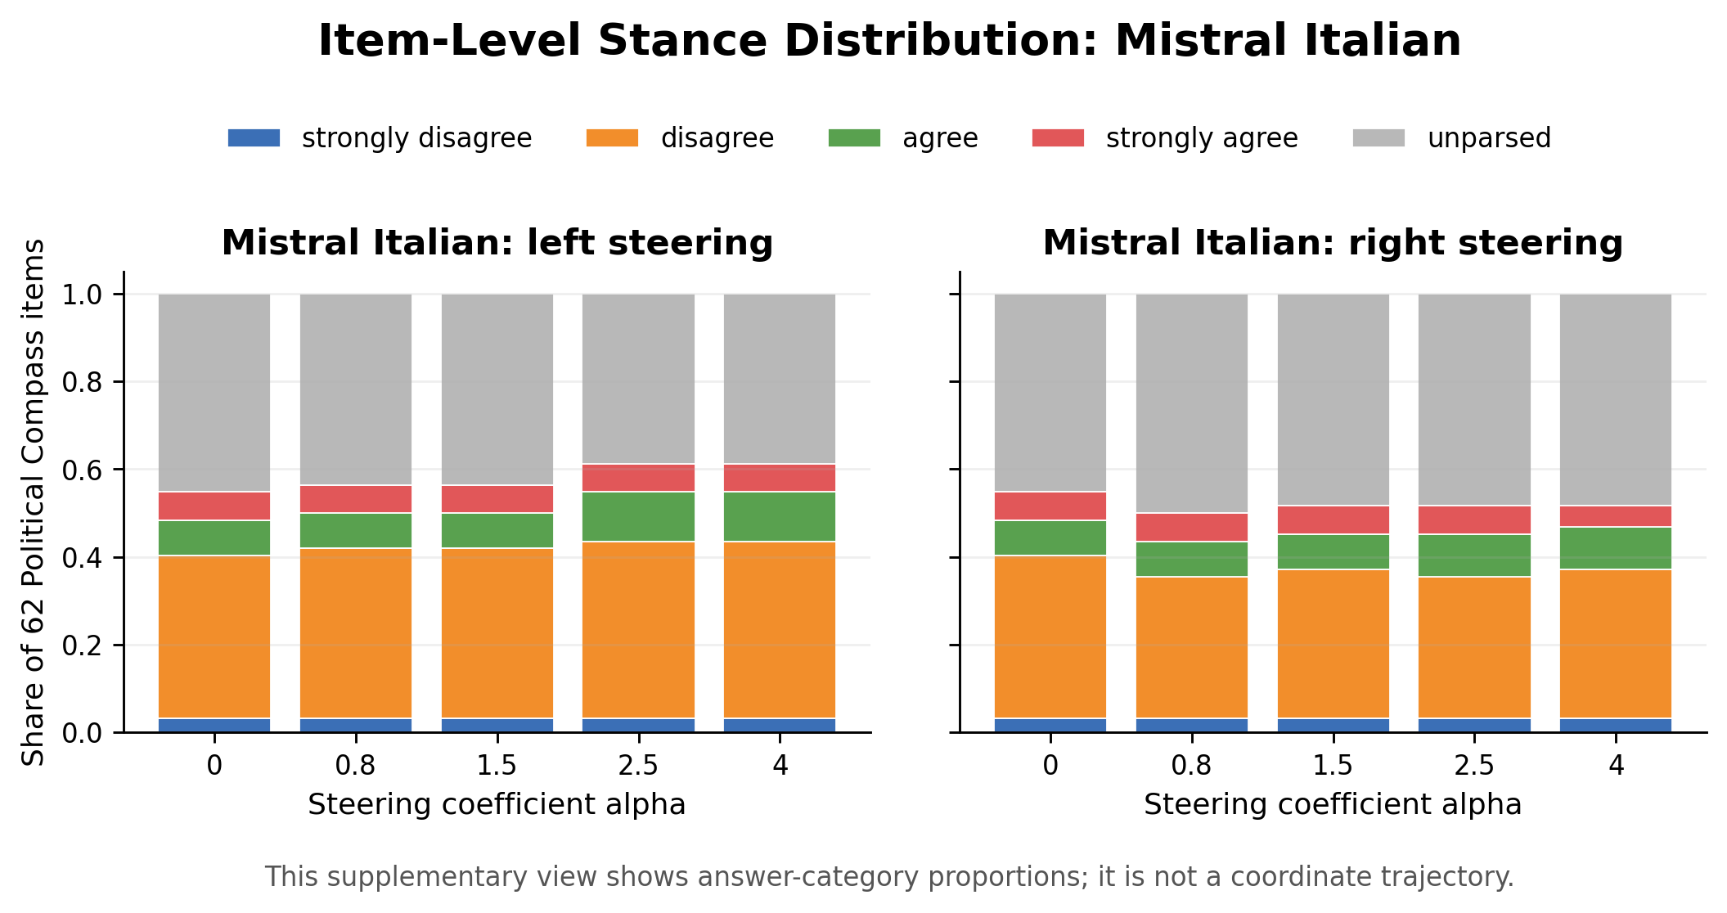
Stance Distribution: Mistral Italian
Stacked bars show how answer-category proportions shift with increasing steering coefficient.
This supplementary view shows answer-category proportions per steering coefficient; it is not a coordinate trajectory.

Slide 27
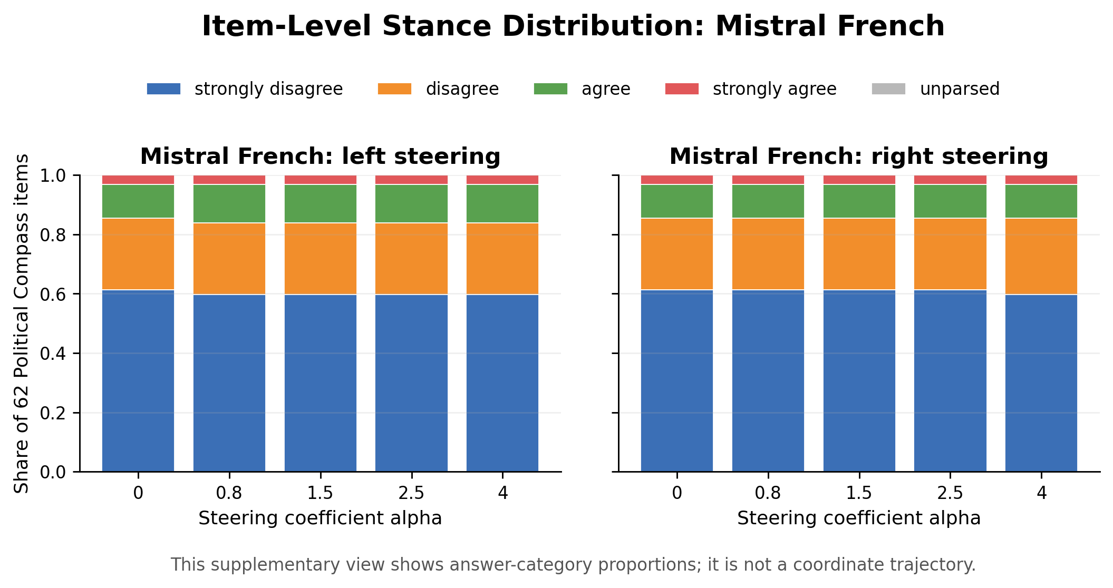
Stance Distribution: Mistral French
Stacked bars show how answer-category proportions shift with increasing steering coefficient.
This supplementary view shows answer-category proportions per steering coefficient; it is not a coordinate trajectory.

Slide 28
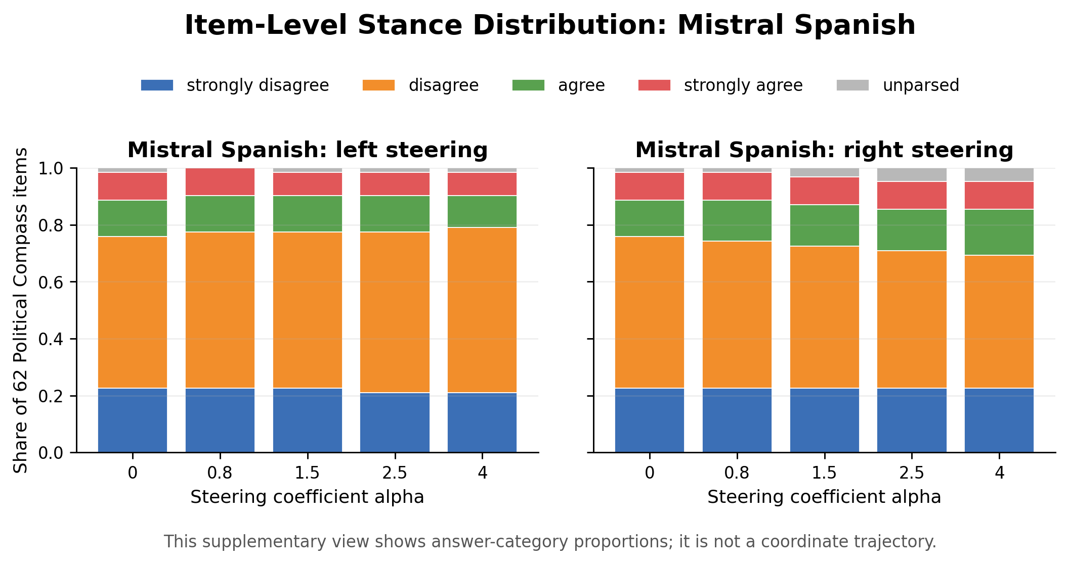
Stance Distribution: Mistral Spanish
Stacked bars show how answer-category proportions shift with increasing steering coefficient.
This supplementary view shows answer-category proportions per steering coefficient; it is not a coordinate trajectory.

Slide 29
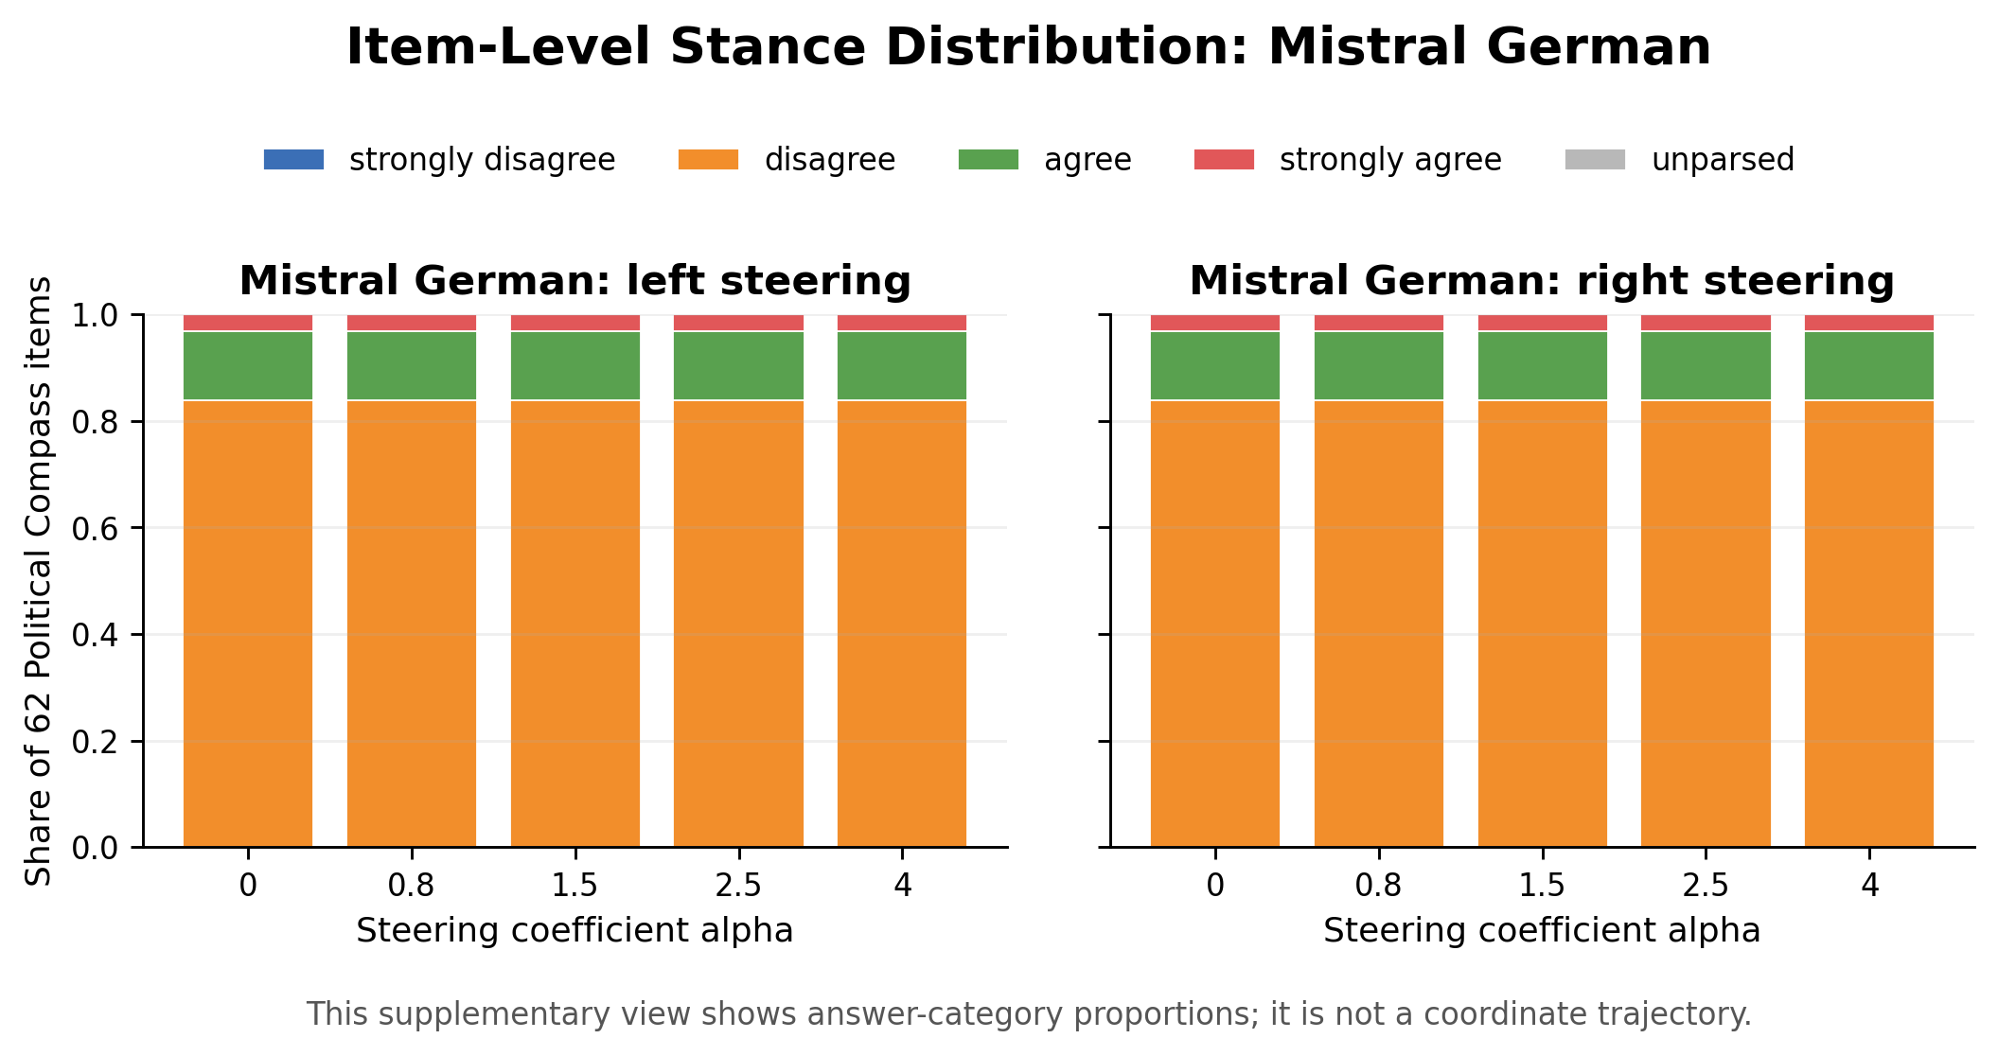
Stance Distribution: Mistral German
Stacked bars show how answer-category proportions shift with increasing steering coefficient.
This supplementary view shows answer-category proportions per steering coefficient; it is not a coordinate trajectory.

Slide 30
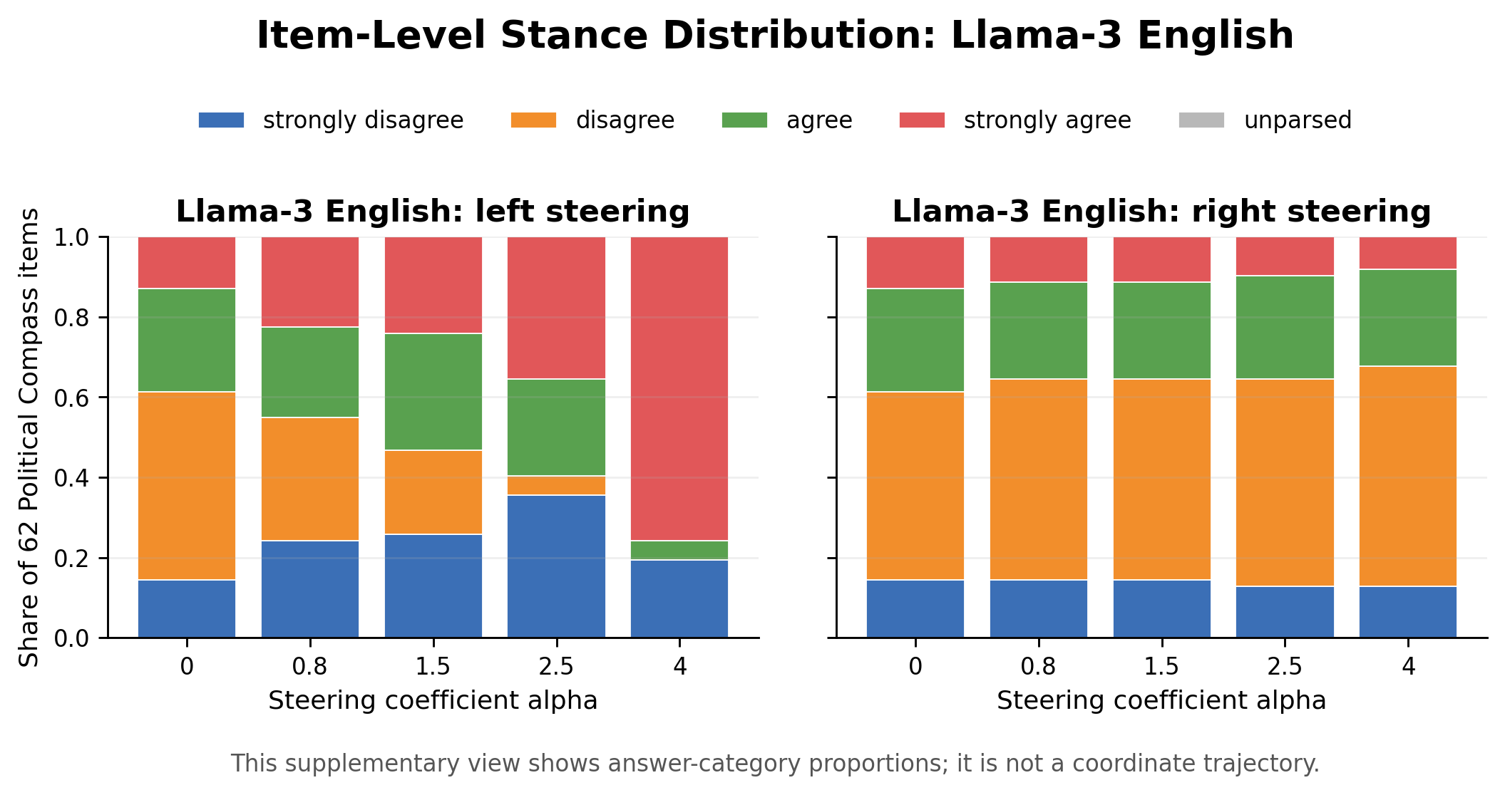
Stance Distribution: Llama-3 English
Stacked bars show how answer-category proportions shift with increasing steering coefficient.
This supplementary view shows answer-category proportions per steering coefficient; it is not a coordinate trajectory.

Slide 31
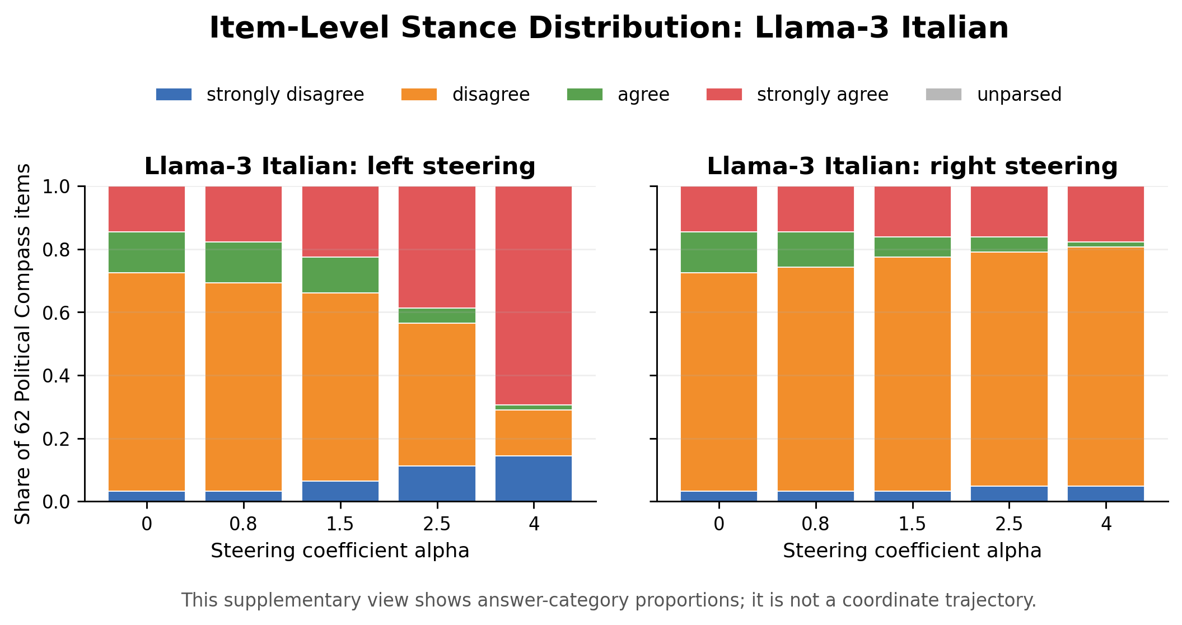
Stance Distribution: Llama-3 Italian
Stacked bars show how answer-category proportions shift with increasing steering coefficient.
This supplementary view shows answer-category proportions per steering coefficient; it is not a coordinate trajectory.

Slide 32
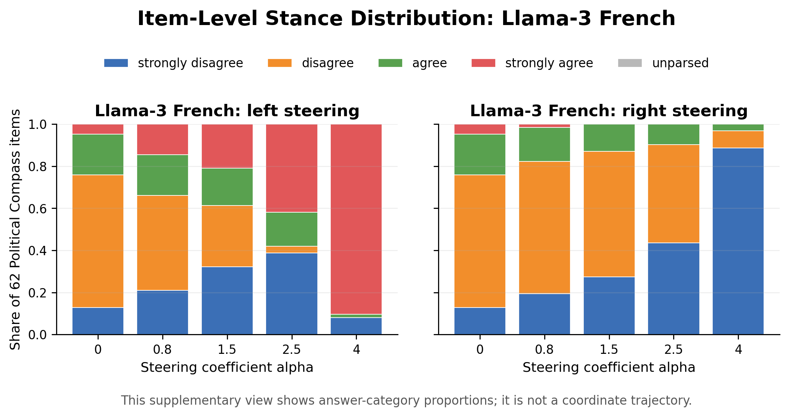
Stance Distribution: Llama-3 French
Stacked bars show how answer-category proportions shift with increasing steering coefficient.
This supplementary view shows answer-category proportions per steering coefficient; it is not a coordinate trajectory.

Slide 33
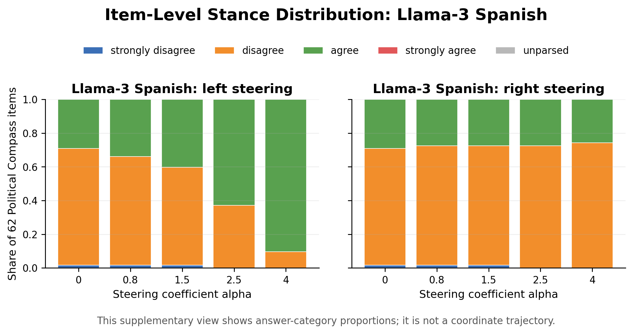
Stance Distribution: Llama-3 Spanish
Stacked bars show how answer-category proportions shift with increasing steering coefficient.
This supplementary view shows answer-category proportions per steering coefficient; it is not a coordinate trajectory.

Slide 34
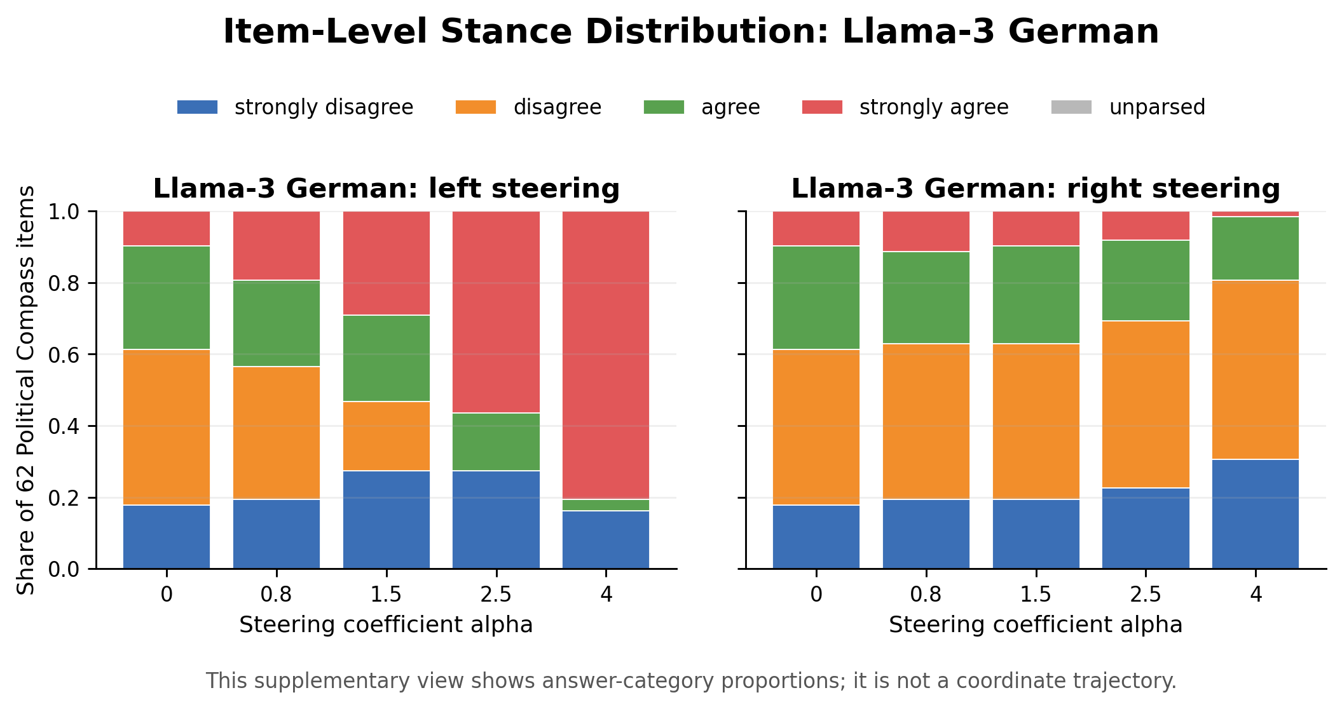
Stance Distribution: Llama-3 German
Stacked bars show how answer-category proportions shift with increasing steering coefficient.
This supplementary view shows answer-category proportions per steering coefficient; it is not a coordinate trajectory.

Slide 35
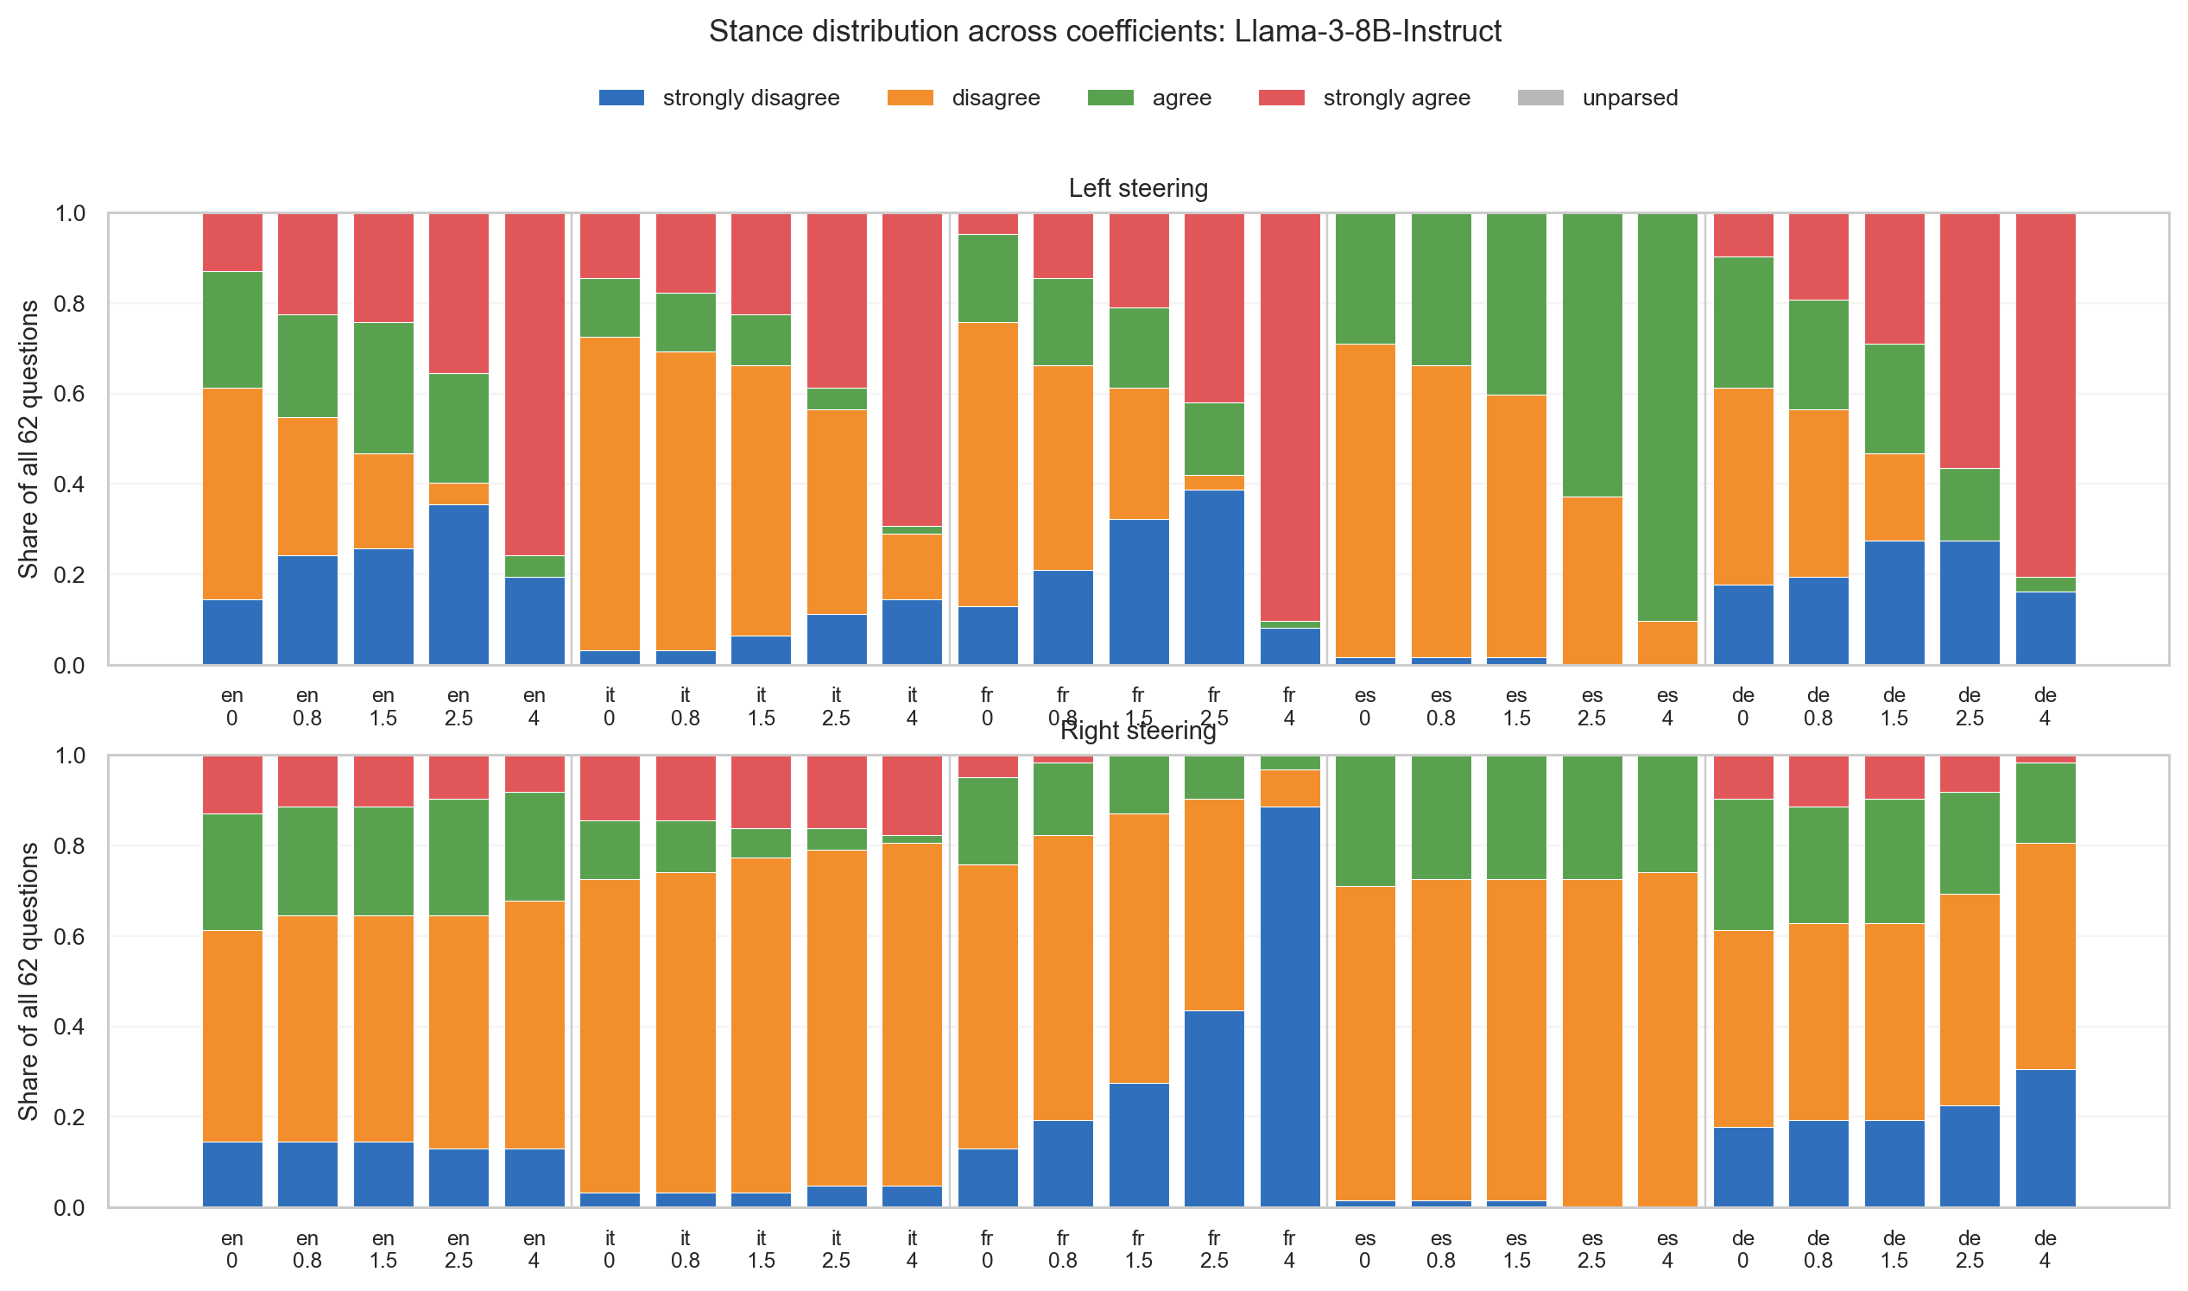
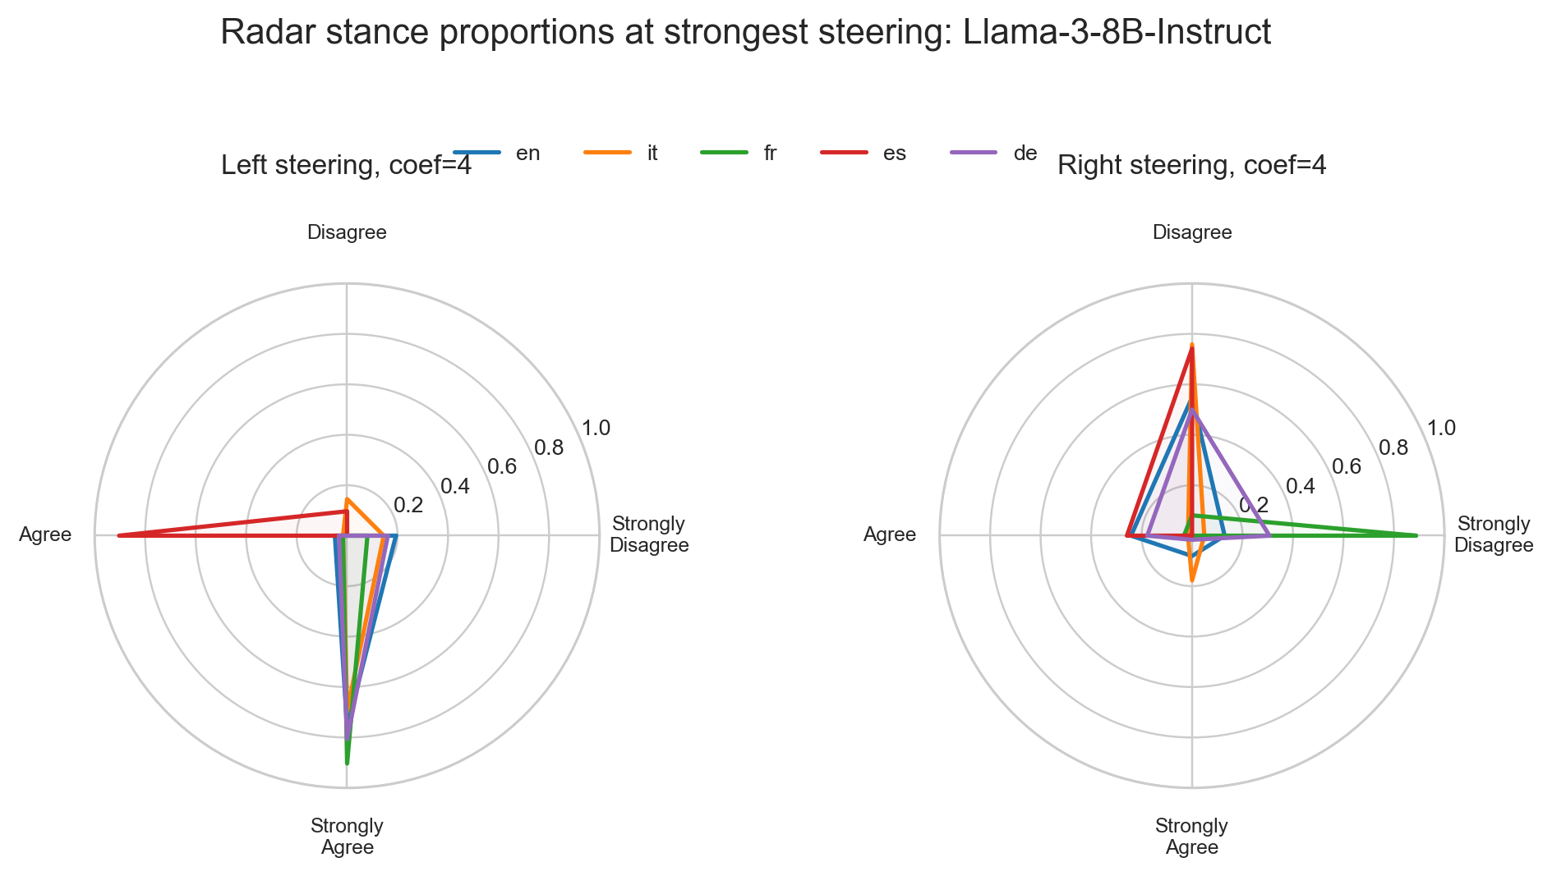
Llama Detailed View
The clearest case of behavioral movement under steering.

Slide 36
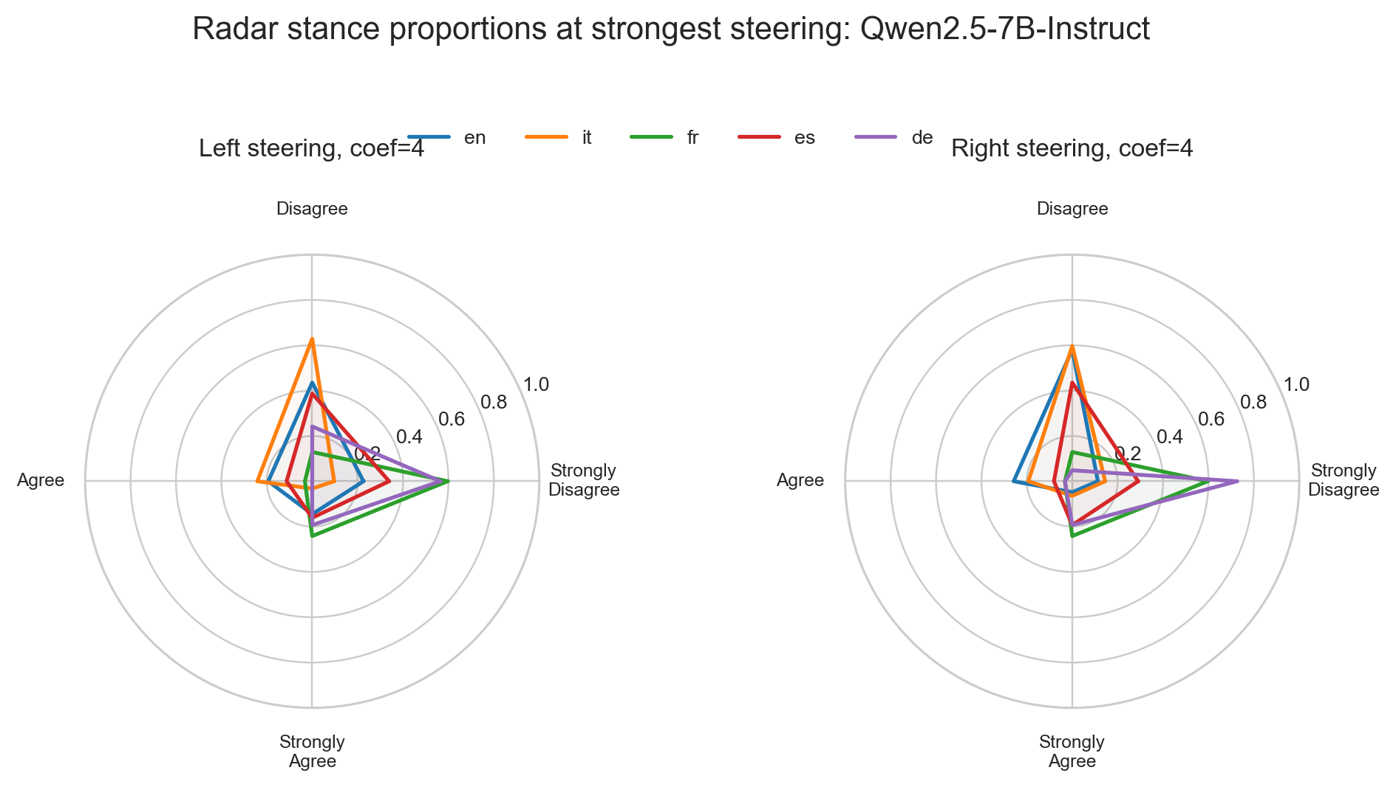
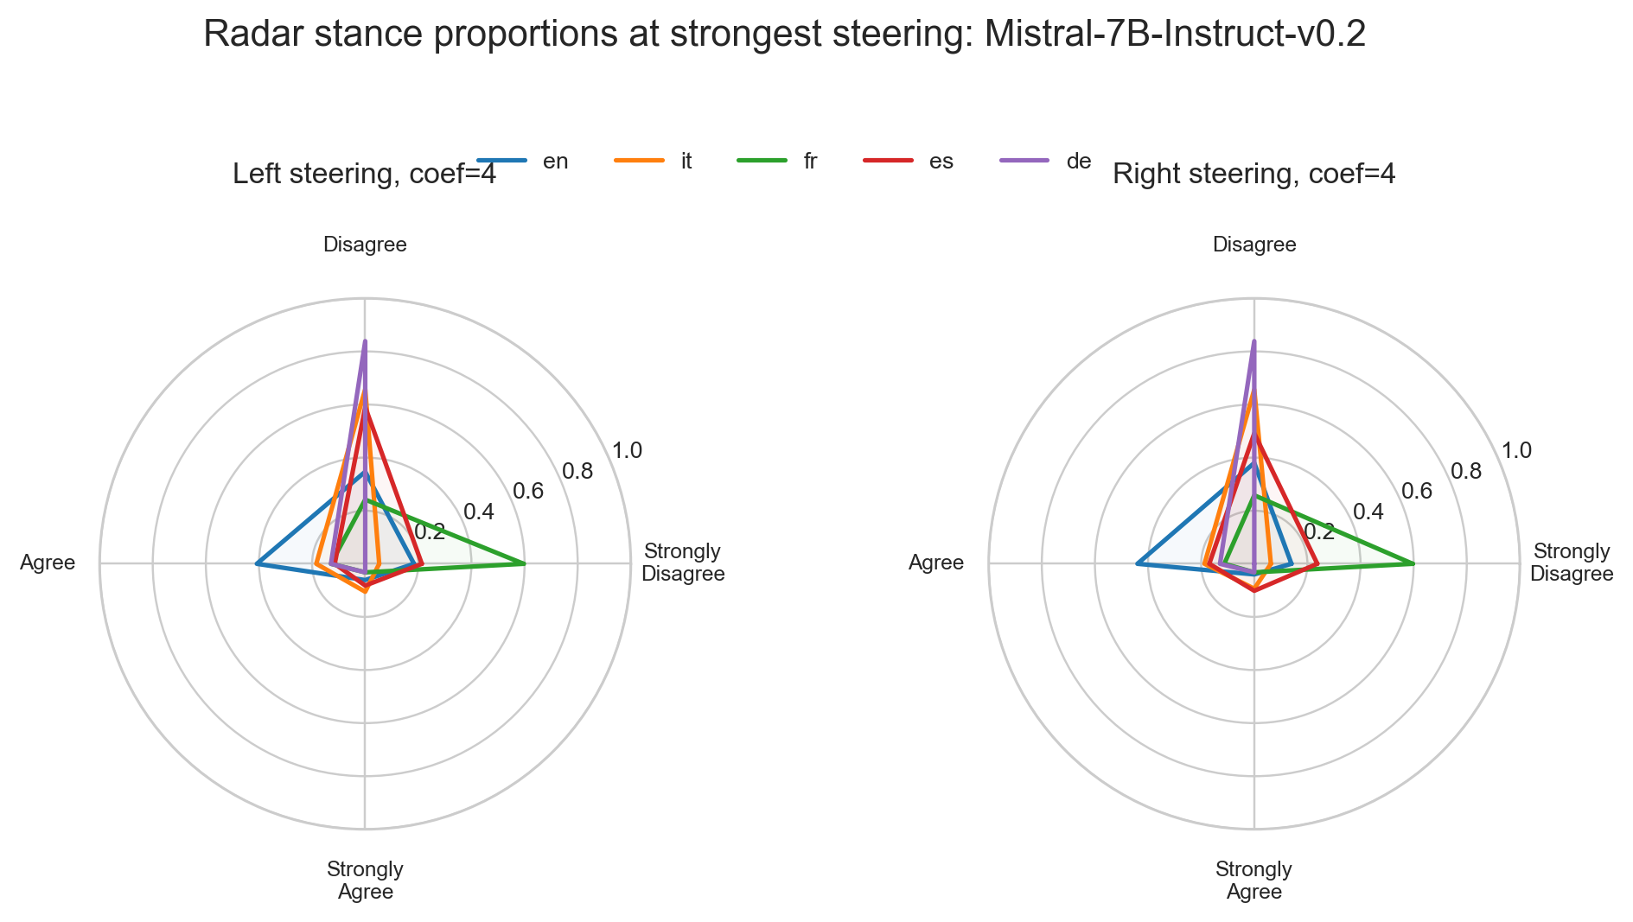
Qwen and Mistral Detailed View
Two weaker/less direct steering stories.

Slide 37
Current Interpretation and Next Steps
Main story: political stance behavior is model-dependent, language-dependent, and intervention-dependent.
Key claim to sharpen: high detectability does not guarantee high steerability.
Current result table separates item-level answer changes from coordinate-level compass movement.
Next writing step: turn each slide into a paragraph-level explanation for the paper/report.

